Slide 1
Build a mini data lake
From messy files to a sales report: one project, six labs
Atul Kahate
Bronze
Silver
Gold
Notes:
Welcome. Today is mostly building, and everyone leaves with a working pipeline on their own laptop.

Slide 2
Today: understand, build, take to production
1
Understand
2
Build
3
Take to production
How a data platform is designed
Six labs, one working pipeline
How it runs in a real company
Why companies need data engineering
Lake, warehouse and lakehouse
ETL and ELT
The six layers of a data lake
Bronze, Silver and Gold
Governance
Lab 1
Keep the raw data safe
Schedulers and streaming
The same pipeline on AWS
The data engineer's job
Quiz and interview practice
What to learn next
Lab 2
Clean it and mask private data
Lab 3
Make queries fast
Lab 4
Answer business questions
Lab 5
Add transactions and undo
Lab 6
Survive failures and reruns
Notes:
This is the shape of the session. First the ideas, so everyone knows why each piece exists. Then six labs, each answering one problem. Finally, how the same design runs in a real company. Point out that the labs build on each other.

Slide 3
Every industry has this problem
Industry | Data it collects | Main use
E-commerce | Orders, clickstream, reviews, images | Customer recommendations
Banking | Card and ATM transactions, loan applications | Fraud detection
Healthcare | Patient records, X-rays, MRI scans | Medical research
Telecom | Call records, network logs | Network monitoring
Manufacturing | Machine sensors, maintenance logs | Predictive maintenance
Our project today: e-commerce
Notes:
Quick icebreaker: ask which of these is closest to their own work, and what data it produces. Don't discuss every row.

Slide 4
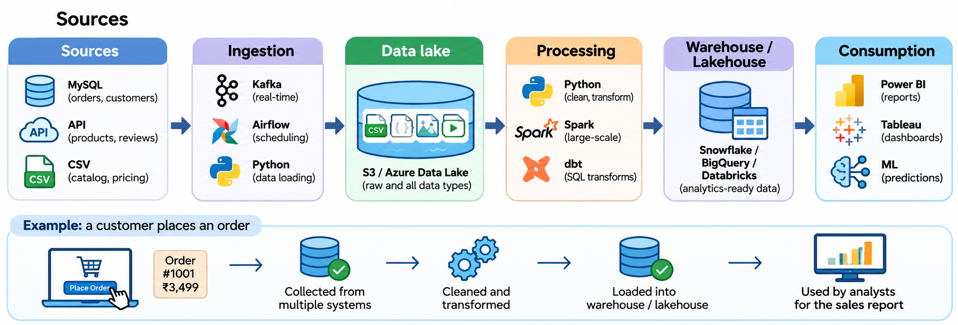
Data Engineering Pipeline

Slide 5
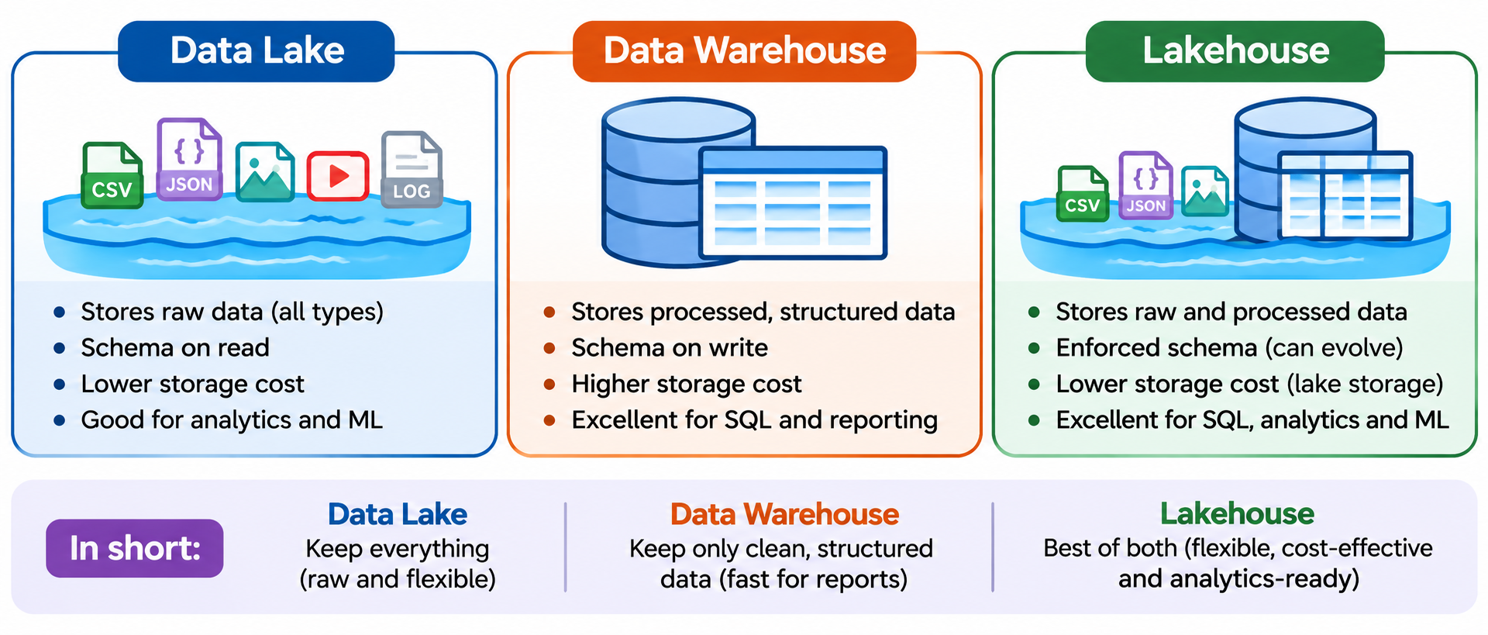
Lake, warehouse or lakehouse?
Notes:
Explain schema on read and on write using the line under the table. Lake: raw and flexible. Warehouse: clean and fast for SQL. Lakehouse: warehouse-style tables on cheap lake storage. Today's project uses all three ideas: Labs 1 to 3 are lake, Lab 4 is warehouse-style tables, and Lab 5 is lakehouse.

Slide 6
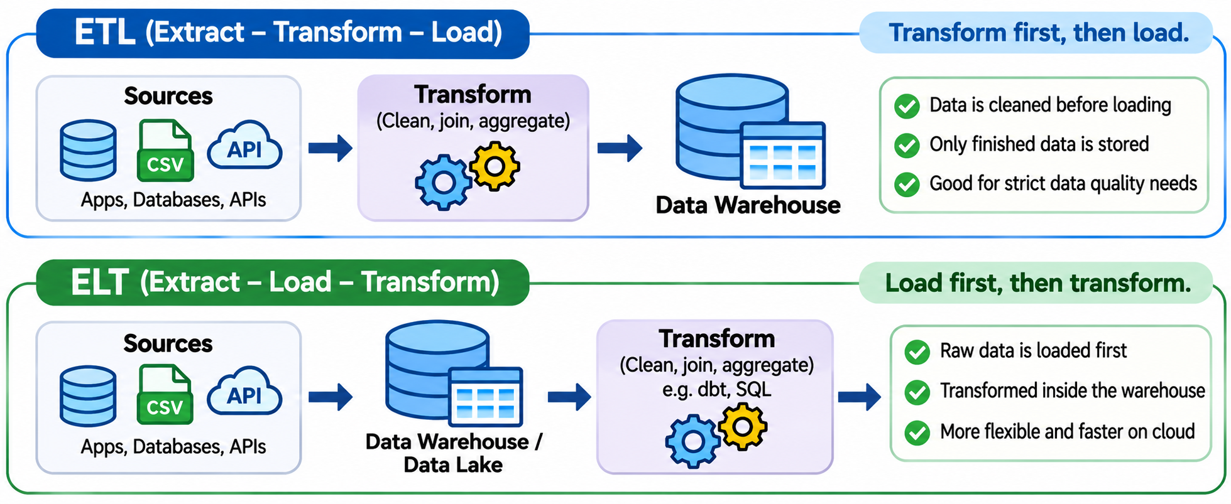
Inside a warehouse: ETL or ELT
Notes:
Keep this short. A warehouse is built as a flow: data lands in staging, is transformed, and is stored in the warehouse. Data marts are focused sets of tables for one team. ETL transforms before loading. ELT loads first and transforms where the data is stored, which suits today's cloud warehouses and lakes. Our labs follow the ELT idea: Bronze keeps the raw data and later steps transform it.

Slide 7
Lakehouse: warehouse features on lake storage
One copy of the data, shared by every team
What the table format adds
BI and SQL
Machine learning
Data engineering
Transactions
Schema enforcement and evolution
Updates to single rows
Time travel and restore
Table format
Delta Lake, Apache Iceberg, Apache Hudi
Object storage: low-cost Parquet files
Amazon S3, Azure Data Lake, Google Cloud Storage
You build this in Lab 5
Notes:
Read the stack from the bottom. Files stay in cheap object storage. A table format adds a transaction log and table rules on top. Everyone then works from the same data instead of keeping a separate copy in a warehouse. Lab 5 builds this on a laptop with Delta Lake.

Slide 8
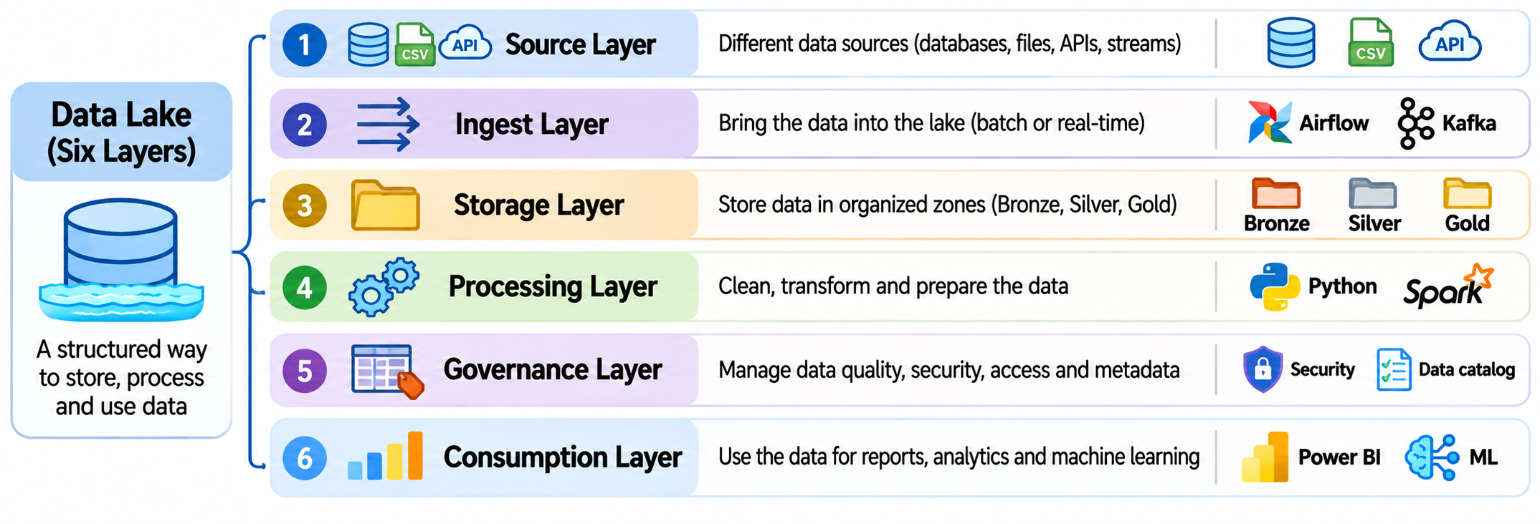
A data lake has six layers
Notes:
Keep this quick; the labs make it concrete. Follow the arrows left to right. Point out that storage holds the three zones, and processing moves data between them. Governance runs across every layer rather than being a step. Ingestion has two paths: today's labs use batch. Lab numbers show where each layer appears today.

Slide 9
Bronze, Silver, Gold
Bronze
Silver
Gold
Raw data
Cleaned data
Business-ready data
Original CSV and JSON
Deduplicated and validated
Summaries and analytics
101 | Rahul | 2000
101 | Rahul | 2000
102 | Amit | 3500
101 | Rahul | 2000
102 | Amit | 3500
Customers | 2
Revenue | 5,500
They are logical layers. In this project, they are just folders.
Notes:
The medallion architecture. These are logical layers, not special storage types: in our project they are just folders. Ask: why keep Bronze at all once Silver exists? Because if a cleaning step has a bug, you can reprocess from the original.

Slide 10
The whole lake, folder by folder
Bronze: raw
Silver: clean
Gold: business
lake/bronze/
orders/
load_date=2026-07-01/
orders.csv
customers/
load_date=2026-07-01/
clicks/
load_date=2026-07-01/
lake/silver/
customers.parquet
orders.parquet
rejected_orders.parquet
clicks.parquet
lake/gold/
daily_sales.parquet
customer_summary.parquet
monthly_revenue.png
Original files, never edited. Written by Lab 1.
Clean Parquet, plus the rejected rows. Written by Lab 2.
Tables shaped for business questions. Written by Lab 4.
On S3 the layout stays the same: s3://ecommerce-data-lake/bronze/orders/
Bronze, Silver and Gold are logical zones, not special storage types.
Notes:
This is the folder structure students will have after Lab 4. Each zone has its own format and purpose. The zones are logical: here they are local folders, and on S3 the same layout becomes prefixes in a bucket. Return to this slide whenever someone asks where a file went.

Slide 11
Governance: avoid the data swamp
Questions a swamp can't answer
How teams prevent it
What data is available?
Where is it stored?
Who owns it?
What does each column mean?
Who can access it?
Catalog: Glue, Unity Catalog
Documented schemas and owners
Tracked data lineage
Access control and encryption
Lifecycle rules for old data
Notes:
Short discussion. A data swamp is a poorly managed lake: disorganized, undocumented, unreliable. Ask: if an analyst needed the customer table in your lake right now, how would they find it? Then look at storage costs: old data can move to cheaper tiers with S3 lifecycle rules.

Slide 12
Why the labs: problems every lake must solve
Problem | What goes wrong | Lab | What you build
Losing the original | A cleaning bug destroys the source data | Lab 1 | Raw copies in Bronze
Bad data | Duplicates and bad values reach reports | Lab 2 | Validation and a reject table
Private data | Anyone can read phone numbers | Lab 2 | Masked columns
Slow queries | Every question scans all the data | Lab 3 | Parquet and partitions
Unclear answers | Teams calculate revenue differently | Lab 4 | Gold tables, one business rule
Changing data | New columns and bad jobs break tables | Lab 5 | A Delta table with history
Pipeline failures | Reruns and bad files give wrong numbers | Lab 6 | Safe reruns, retries, quarantine
Notes:
This is the bridge from theory to practice. Each row is a real problem from data lake projects, and each lab solves one. Ask which of these they have seen at work. Security, governance and cost go much further in production, as we discuss later.

Slide 13
What you will build
Source files
CSV, JSON, logs
Bronze
Raw, untouched
Silver
Clean, Parquet
Gold
Business tables
Report
Answers, chart
Labs 1, 2, 4
Move the data through each layer
Lab 3
Make queries fast
Lab 5
Add transactions and undo
Lab 6
Survive failures and reruns
Tools: Python, DuckDB, Parquet and Delta Lake, on your own laptop
Notes:
This one picture is the whole day. Each lab adds one box. Return to it at the start of each lab. Local folders stand in for cloud storage, so nobody needs an AWS account or a bill.

Slide 14
DuckDB: SQL for files, with no server
What it is
import duckdb
duckdb.sql("SELECT count(*) "
"FROM 'source_data/orders.csv'").show()
A SQL database that runs inside your Python program. There is no server to install or manage.
Server database (MySQL)
DuckDB
Why we use it
Needs a running server
Load data before querying
Built for many small updates
Just pip install duckdb
Query files where they sit
Built for analysis
It runs real SQL directly on CSV, JSON and Parquet files, and it handles millions of rows on a laptop.
In the labs: every lab uses DuckDB for its SQL. In production, tools such as Athena and Spark do this job on far more data.
Notes:
Most students will know a server database such as MySQL. DuckDB is different: it's a library, so it starts when your script starts, and it can query a file without loading it first. It's designed for analysis, not for an application making many small updates. The SQL they learn here carries over to other tools.

Slide 15
Parquet: a file format built for analytics
What it is
CSV: stored row by row
101,2000,completed
102,3500,cancelled
103,1500,completed
An open file format that stores data column by column, with compression and the data types saved inside the file.
Parquet: stored column by column
Why we use it
order_id 101 102 103
amount 2000 3500 1500
status completed cancelled completed
Queries read only the columns they need, and files get smaller. Spark, Athena and Snowflake can all read it.
To add up amount, Parquet can skip the other columns.
In the labs: Lab 2 saves Silver as Parquet, and Lab 3 measures the gain. It's a binary file, so read it with SQL rather than a text editor.
Notes:
Use the picture: the same three orders, stored two ways. CSV keeps each row together, so adding up amount means passing over everything else. Parquet keeps each column together, so it can go straight to amount. Compression works well because similar values sit side by side. Don't give away the Lab 3 numbers: students predict them later. One limitation leads to Lab 5: you can't update a single row in a Parquet file.

Slide 16
Delta Lake: Parquet files plus a change log
What it is
from deltalake import DeltaTable, write_deltalake
write_deltalake("lake/delta/customers", customers)
DeltaTable("lake/delta/customers").restore(2)
An open table format. It keeps your data in Parquet files and adds a transaction log that records every change.
What the table looks like on disk
Why we use it
lake/delta/customers/
_delta_log/
00000.json <- change 0
00001.json <- change 1
part-00000.parquet
part-00001.parquet
It brings warehouse features to cheap file storage: transactions, schema checks, single-row updates and undo.
In the labs: Lab 5 adds a column, updates one row and undoes a bad job. Apache Iceberg and Apache Hudi are similar table formats.
Notes:
Delta Lake is the format, and deltalake is the Python package we install, so we don't need Spark. Point at the folder: the data is still Parquet, and _delta_log holds one numbered file per change. To read the table, a tool checks the log to see which Parquet files are current. That's why a bad overwrite can be undone: the old files are still there. File names here are shortened.

Slide 17
How the labs work
1. Set up once
Missed a lab?
python -m venv .venv
.venv\Scripts\activate
pip install -r requirements.txt
python generate_data.py
Just run it. Every lab is complete code, and it creates everything the next lab needs.
2. Run a lab
python labs/lab2_silver.py
python labs/lab1_bronze.py
Run the labs from the hands_on folder, in order. To start again, delete the lake folder.
Activate .venv in every new terminal. On Mac or Linux: source .venv/bin/activate
3. See what it built
lake/bronze/ lake/silver/ lake/gold/
Notes:
Check that everyone has run setup before moving on, inside their own virtual environment: the prompt should start with (.venv). If PowerShell blocks activation, run: Set-ExecutionPolicy -Scope Process RemoteSigned. The labs are complete code: walk through each file before running it, then compare the output with the Check line on the lab slide. Nobody gets left behind: running a missed lab creates the input for the next one.

Slide 18
Lab 1: Bronze keeps the raw data
Purpose
Keep an untouched copy of every source file, so we can always go back to the original.
What the code does
Copies orders, customers and clicks into lake/bronze/, in a folder dated by load day
Reads the raw files directly with DuckDB SQL
Counts the raw rows
What you learn
Bronze is never edited
Load-date folders show when data arrived
SQL can query files with no database
Run python labs/lab1_bronze.py
Check 202,068 raw orders, more than the 200,000 placed. Why? Duplicates.

Slide 19
Lab 2: Silver cleans the data
Purpose
Raw data has duplicates, missing values, mixed date formats and private data. Make it trustworthy.
What the code does
Counts the problems before fixing anything
Removes duplicates, fixes types and dates, masks phone numbers
Splits orders into clean and rejected tables
Saves the results as Parquet in lake/silver/
What you learn
Measure problems first, then fix them
No row disappears silently: it is kept or rejected
Mask personal data early
Run python labs/lab2_silver.py
Check 202,068 in Bronze, 200,000 after duplicates are removed, 198,188 clean, 1,812 rejected.

Slide 20
Spark demo: same steps, more machines
DuckDB (Lab 2)
PySpark
SELECT DISTINCT
TRY_CAST(amount AS DOUBLE)
AS amount,
status
FROM raw_orders
WHERE amount > 0
clean = (
raw.dropDuplicates()
.withColumn("amount",
F.expr("try_cast(amount AS DOUBLE)"))
.filter("amount > 0")
)
Learn the logic on one laptop. Use Spark when the data no longer fits on one machine.
Notes:
Instructor demo: python demo_spark.py after Lab 1. The logic is the same; Spark spreads the work across a cluster for data too large for one machine. It keeps 198,572 rows, not 198,188, because the demo skips the unknown-customer check. On Windows it reads an exact path, because wildcards need winutils.exe.

Slide 21
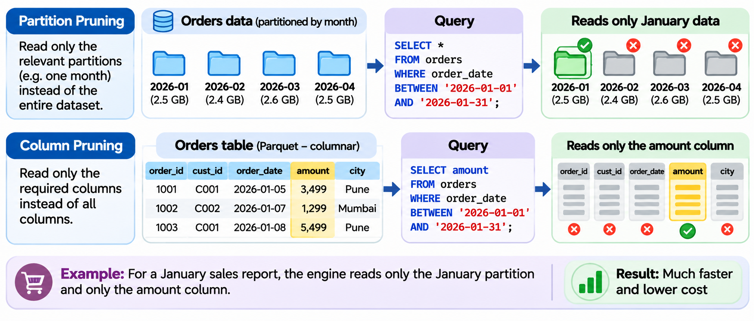
Why Lab 3: slow queries cost time and money
Notes:
Each grid is the orders table: 7 columns, with rows grouped by month. Dark cells are what the query has to read: amount, year and month. This is simplified, but it's the core idea. Students still predict how much faster each layout will be on the next slide.

Slide 22
Lab 3: Make queries fast
Purpose
The same question can take seconds or a fraction of a second, depending on how the data is stored.
What the code does
Builds about 20 million orders
Saves them three ways: CSV, one Parquet file, and Parquet split into year and month folders
Times the same January revenue query on each
What you learn
Parquet reads only the columns it needs
Partitions let a query skip whole folders
Faster is useless unless the answer is the same
Run python labs/lab3_performance.py
Check Both Parquet layouts are much faster and smaller than CSV. Revenue is identical in all three rows.

Slide 23
Lab 4: Gold answers business questions
Purpose
Turn clean order rows into small tables the business can use directly.
What the code does
Builds daily_sales and customer_summary from completed orders
Checks that Gold revenue matches Silver
Finds the top 5 cities and customers, and saves a monthly revenue chart
What you learn
Gold tables are built around questions
One agreed rule: only completed orders count as revenue
Always reconcile Gold with Silver
Run python labs/lab4_gold.py
Check ₹404.8M revenue in both Gold and Silver. Chart: lake/gold/monthly_revenue.png

Slide 24
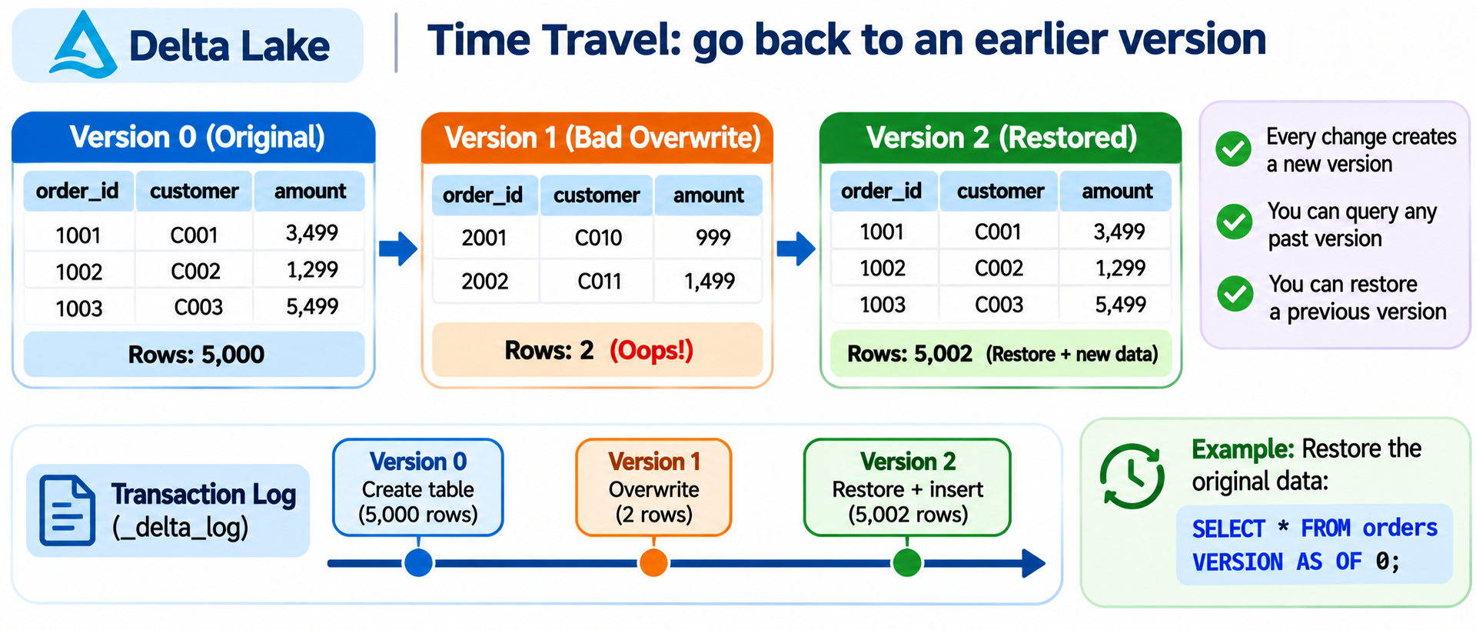
Why Lab 5: plain files are hard to change safely
Notes:
This connects back to the lakehouse slide. The data is still Parquet. The log is what adds schema checks, updates and history. Students open the _delta_log folder at the end of the lab.

Slide 25
Lab 5: Lakehouse adds an undo button
Purpose
Plain Parquet files can't be safely changed or rolled back. Delta Lake adds that.
What the code does
Turns the customers into a Delta table
Adds a new email column
Updates one customer's city in place
A bad job wipes the table, and time travel restores it
What you learn
Delta = Parquet files + a change log
Every change is a new version, so nothing is lost
New columns must be allowed on purpose
Run python labs/lab5_lakehouse.py
Check Rows: 5,000, then 5,002, then 2 after the bad job, then 5,002 after the restore.

Slide 26
Lab 6: Survive failures
Purpose
Pipelines fail: jobs rerun, networks drop, files arrive broken. The worst failures give wrong numbers with no error.
What the code does
Loads one file twice: revenue doubles, with no error
Fixes it: delete that file's rows, then insert, in one transaction
Retries network failures, waiting longer each time
Moves a bad file to quarantine and carries on
What you learn
A load must be safe to rerun
Retry errors that are temporary
One bad file must not stop the pipeline
Run python labs/lab6_failures.py
Check Rerun: 11,000 (wrong), then 5,500 (fixed). Final revenue 7,000, one file quarantined.

Slide 27
In production: schedulers and streams
Airflow runs today's steps on a schedule
Ingest
Clean
Build Gold
Check
Alert on failure
 | Batch (today) | Streaming
When | On a schedule: hourly, daily | Continuously, near real time
Example | Yesterday's orders | Card fraud check during payment
Tools | Python, Airflow, AWS Glue, AWS DMS | Kafka, Amazon Kinesis
Notes:
Talk only. Airflow runs the steps you ran by hand, with retries and alerts built in. All of today's labs were batch. Streaming tools such as Kafka and Kinesis handle data as it arrives, for cases like fraud detection.

Slide 28
You solved the real data lake problems
Challenge | What you did | Where | In production
Data quality | Validated, cleaned and rejected rows | Lab 2 | Great Expectations
Security | Masked phone numbers | Lab 2 | IAM, KMS, Lake Formation
Performance | Parquet and partitions | Lab 3 | Spark, Athena
Schema evolution | Merged a new column | Lab 5 | Delta Lake, Iceberg
Pipeline failures | Idempotent loads, retries, quarantine | Lab 6 | Airflow, CloudWatch
Governance, cost | Discussed only | Talk | Glue Catalog, S3 lifecycle
Notes:
Recap: each common challenge maps to something they did today. Security, governance and cost were covered only partly: masking in Lab 2, and discussion for the rest. Be honest that real platforms add much more there.

Slide 29
The same pipeline on AWS
What you built today | On AWS
source_data/ files | RDS, MySQL, APIs
Copying files (Lab 1) | AWS DMS, Kinesis
lake/ folder | Amazon S3
DuckDB transforms (Labs 2, 4) | AWS Glue, PySpark on EMR
DuckDB queries (Labs 3, 4) | Amazon Athena, Redshift
matplotlib chart (Lab 4) | Power BI, QuickSight
Delta table (Lab 5) | Delta Lake or Iceberg on S3
Logging and retries (Lab 6) | Airflow, CloudWatch
Finding data (discussed, not built) | AWS Glue Data Catalog
Phone masking (Lab 2) | IAM, KMS, Lake Formation
Notes:
Everything they built maps directly to a cloud service. The concepts carry over; only the tools change. The catalog row was only discussed today, and masking is one small part of security. Students can see this table by running the quiz script too.

Slide 30
Follow one order through AWS
1
MySQL
2
AWS DMS
3
S3 Bronze
4
Glue, PySpark
Order is created
Copies it to S3
Stores it raw
Clean the data
8
Power BI
7
Amazon Athena
6
S3 Gold
5
S3 Silver
Shows sales reports
Queries Gold
Holds business tables
Stores clean data
Across every step
Find data: Glue Data Catalog Control access: IAM, KMS, Lake Formation Watch jobs: CloudWatch
Notes:
Walk through the numbers in order, following the arrows. Students have already done steps 3 to 6 on their laptops, and only the tools differ. The band at the bottom is not a step: the catalog, security and monitoring services apply throughout. Stress that this is one common design, not the only one.

Slide 31
What a data engineer does at each layer
Job | What it involves | Today | Typical tools
Ingest | Extract data from databases and APIs | Lab 1 | Python, AWS DMS
Store raw | Load incoming data into Bronze | Lab 1 | Amazon S3
Clean | Remove duplicates, validate, handle gaps | Lab 2 | Python, PySpark
Optimize | Convert to Parquet and partition by date | Lab 3 | Apache Spark
Manage metadata | Register tables and manage schemas | Talk | AWS Glue Data Catalog
Monitor | Detect failed jobs and add retries | Lab 6 | Airflow, CloudWatch
Serve | Give analysts analytics-ready data | Lab 4 | Athena, Power BI
Notes:
This ties the architecture to a real job. Each row is a daily responsibility, and almost all of them were practised today. Metadata was only discussed. Use this slide to link the labs to job descriptions.

Slide 32
Quiz, then interview practice
Answer from what you built
Run the quiz
How do you handle duplicate records?
What are Bronze, Silver and Gold?
How do you optimize queries in a data lake?
What is partitioning, and why is it important?
What is schema evolution?
How do you secure sensitive data in a lake?
What happens when an ingestion pipeline fails?
python
wrapup_quiz.py
4 questions, then the AWS map.
Notes:
Run the quiz: python wrapup_quiz.py. Then pick two or three interview questions and ask for answers based on what people did in the labs, not definitions. Answers for the quiz: Data Swamp; Parquet and partitioning; Schema evolution; Encryption and access control.

Slide 33
What to learn next
S3
Move the lake to the cloud
AWS Glue
Catalog and transforms
PySpark
Scale past one machine
Athena
Query the lake with SQL
Airflow
Schedule the pipeline
Your first step
Take today's project and run it on your own S3 bucket. The logic stays the same, and the main change is the storage paths.
Notes:
Close the day. Everything here builds on what they did today. Suggest repeating the project on a real S3 bucket as the first step, and remind them to check current AWS pricing first.

