Slide 1
MODULE 3
Working with LLMs
Atul Kahate
(https://www.linkedin.com/in/atulkahate)
Basic LLM calls → multimodal → local LLM → document Q&A
Translation → code generation → sampling parameters
Tool calling → cost and latency
1

Slide 2






ROADMAP
What We'll Cover
Twelve runnable demos, building from a single API call up to the ideas behind agentic AI.
Setup
Foundations (Demos 1–5)
Applied Tasks (Demos 6–9)
Python, virtual environment, API keys, and pulling local Ollama models.
One prompt → one response, across OpenAI, Anthropic, Gemini, multimodal input, and a local model.
Summarization, document Q&A, multilingual translation, and code generation.
Controlling Output (Demo 10)
Tools, Cost & Latency (Demos 11–12)
From LLM to Agentic AI
Temperature, top_p, top_k, and max tokens — the same prompt, four different behaviors.
Letting the model call a function, then measuring what a call actually costs and takes.
How the 12 demos form a natural progression toward agents that reason and act in a loop.
2

Slide 3
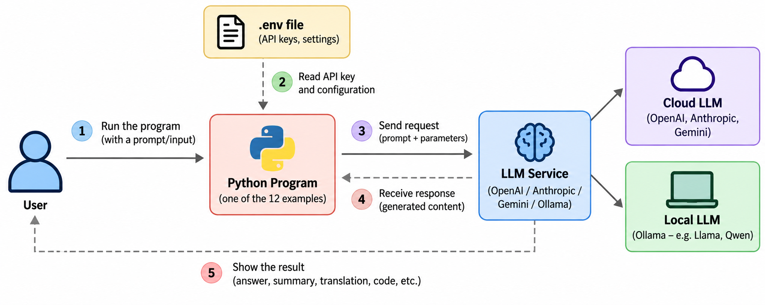
3

Slide 4
Setup
SETUP
Python (3.10 or above)
Virtual environment creation
  mkdir llm-demos
  cd llm-demos
  .\venv\Scripts\Activate.ps1
API keys (OpenAI, Anthropic, Gemini)
  Respective websites
Creation of .env file
Ollama download (https://ollama.com/download)
Models download in Ollama
  ollama pull llama3.2:latest
  ollama pull qwen3:8b
Installing packages in virtual environment
  pip install -r requirements.txt
4

Slide 5
Common setup
Each supplied script includes its own setup instructions
Keep API keys in .env — never put them directly in source code.
Ollama examples run against a local model.
The supplied code uses the model names shown in each script.
For a live class, test every model/API call beforehand.
5

Slide 6
1. Basic example using OpenAI LLM
One prompt → one OpenAI response
Create an OpenAI client.
Choose gpt-4o-mini.
Send system + user messages.
Print the response and token usage.
Based on the supplied Claude Code examples
6

Slide 7
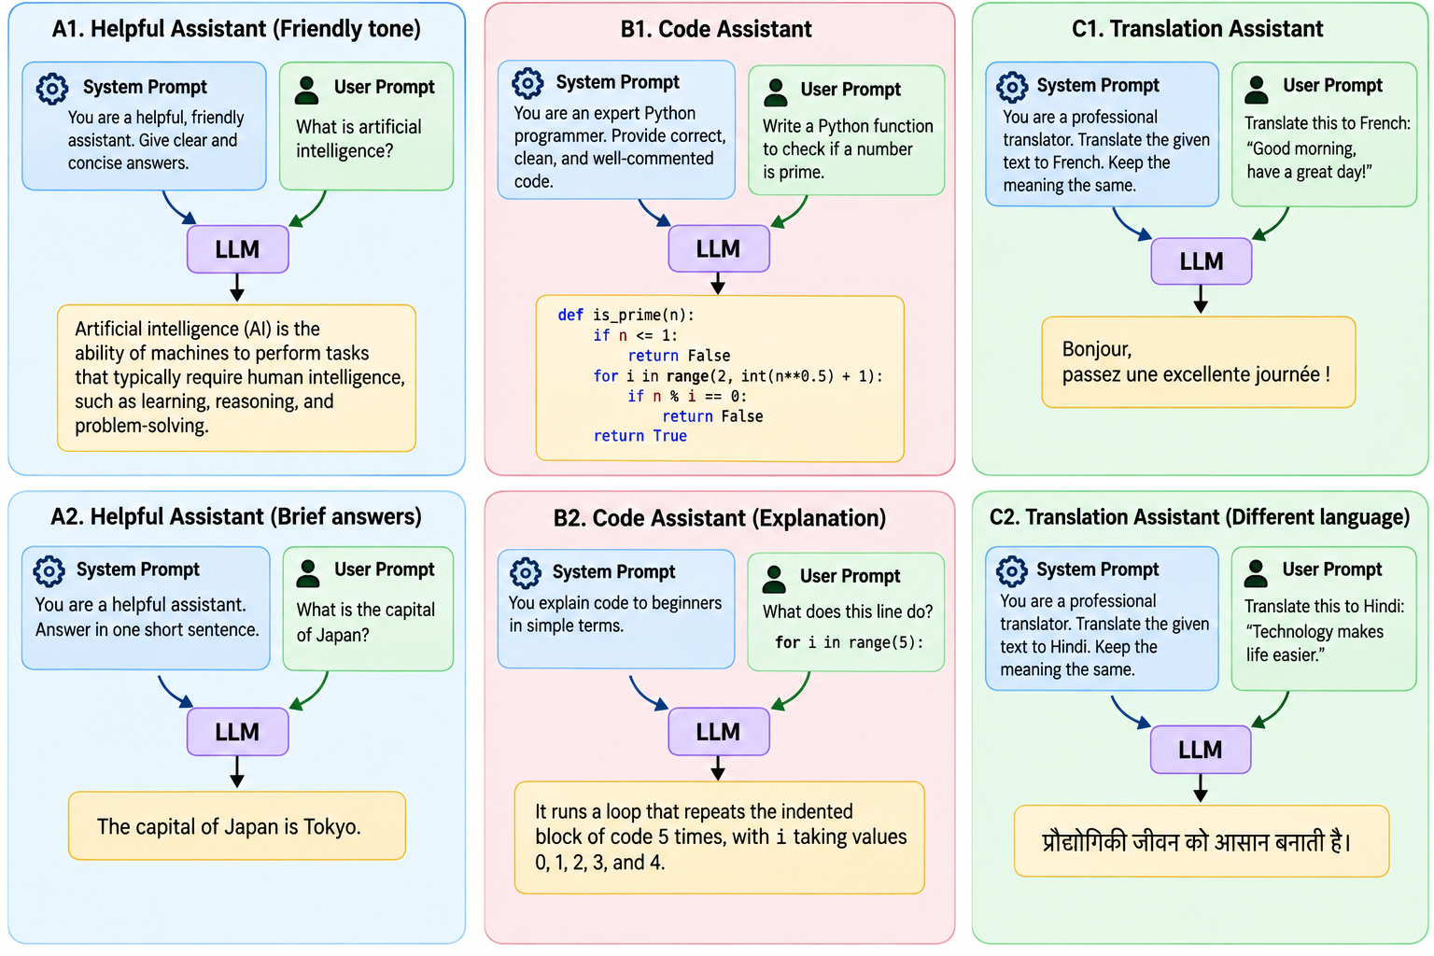
7

Slide 8
2. Basic example using Anthropic LLM
One prompt → one Claude response
Create an Anthropic client.
Choose the model in MODEL.
Use the Messages API.
Print response text and usage.
Based on the supplied Claude Code examples
8

Slide 9
3. Basic example using Gemini LLM
One prompt → one Gemini response
Configure the Google API key.
Create a GenerativeModel.
Call generate_content().
Print response text and usage metadata.
Based on the supplied Claude Code examples
9

Slide 10
4. Multimodal example — image
Text + image → model response
The script creates a small sample image if needed.
The image is encoded as base64.
Text and image are sent together.
The model identifies shapes and colors.
Based on the supplied Claude Code examples
10

Slide 11
5. Basic example using Ollama / Llama
Run an LLM locally — no cloud API key
Install Ollama.
Pull llama3.
Call ollama.chat().
Useful for local experimentation and privacy-sensitive demos.
Based on the supplied Claude Code examples
11

Slide 12
6. Text summarization using OpenAI
Document → short summary
Reads assets/sample_document.txt.
Uses a system instruction for 3–5 bullets.
Uses temperature=0.3.
Shows a useful real-world transformation task.
Based on the supplied Claude Code examples
12

Slide 13
7. Q&A using Ollama / Qwen
Document + question → answer
Loads the supplied sample document.
Asks three questions.
The system instruction says: use ONLY the document.
Important: this is context stuffing, not full RAG.
Larger documents would need chunking + retrieval.
Based on the supplied Claude Code examples
13

Slide 14
8. Multilingual translation using Gemini
One English sentence → several languages
Source text is fixed in SOURCE_TEXT.
Targets: French, Hindi, Japanese and Spanish.
The prompt requests translation only.
Easy demo: change the target-language list.
Based on the supplied Claude Code examples
14

Slide 15
9. Code generation using Anthropic
Natural-language specification → Python code
Claude receives a precise coding task.
It is instructed to return only code.
Generated code is saved to assets/generated_code.py.
Demo the difference between generating and executing code.
Based on the supplied Claude Code examples
15

Slide 16
10. Temperature, top_p, top_k and max tokens
Same prompt + different sampling settings → different outputs
Four configurations are tested.
Low temperature + top_k=1 demonstrates narrow sampling.
Higher temperature/top_k gives more variation.
A small max_output_tokens value can truncate output.
Compare the four results side by side.
Based on the supplied Claude Code examples
16

Slide 17
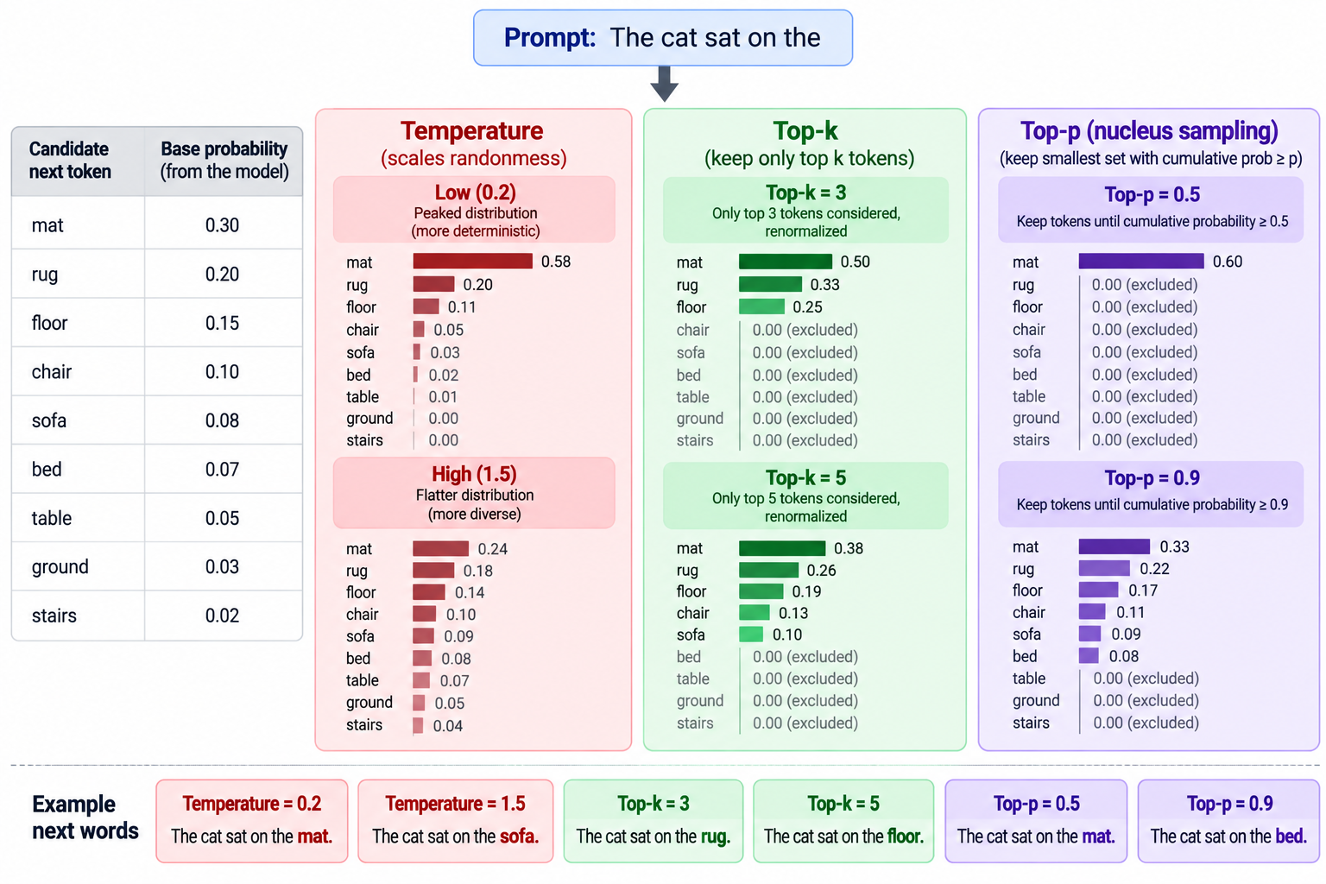
17

Slide 18
11. Tool calling using OpenAI
User request → model requests a tool → Python executes it → model answers
The model is given a get_current_weather tool.
The tool is a local Python function with fake data.
The model decides whether to call it.
Your application executes the function.
The result is sent back for the final answer.
Based on the supplied Claude Code examples
18

Slide 19
12. Cost + latency using OpenAI
Measure one API call instead of guessing
Measures wall-clock latency with time.perf_counter().
Reads prompt/completion token counts from API usage.
Calculates approximate cost from per-1M-token rates.
Also estimates output tokens/sec.
The supplied script explicitly says to verify pricing before real budgeting.
Based on the supplied Claude Code examples
19

Slide 20
The document used for the Q&A demo
assets/sample_document.txt — inspect it before running Demo 7
Project Nimbus – Internal Project Brief
Project Nimbus is a fictional internal software modernization project.
Project lead: Priya Sharma
Approved budget: $250,000
Timeline:
Phase 1 covers requirements gathering and architecture.
Phase 2 covers development and integration.
Phase 3 covers testing, deployment and handover.
The project aims to modernize the company's internal reporting system
and reduce manual reporting work.
20

Slide 21
Demo 11: what tool calling actually does
This is the bridge from LLMs to agentic systems
1
User: What's the weather in Bengaluru?
2
LLM: Requests get_current_weather(city=...)
3
Application: Runs the Python function
4
Tool: Returns weather data
5
LLM: Turns tool result into a natural-language answer
21

Slide 22
Demo 12: understanding cost
Use the numbers returned by the API, then apply the supplied rates
The code's rates are explicitly marked as approximate.
Pricing can change — verify before using for budgeting.
Latency is measured for the actual request.
Latency includes network and service effects; it is not a fixed model property.
22

Slide 23
From LLM to agentic AI
The 12 demos form a natural progression
LLM
Multimodal
Data
Parameters
Tools
Agent
LLM: generate text
Multimodal: understand images + text
Data: answer from supplied documents
Parameters: control generation behavior
Tools: interact with external functions
Agent: reason about what to do and use tools in a loop
23

Slide 24
KEY TAKEAWAYS
Three Things to Remember
Every demo is the same shape
Sampling parameters are a dial, not magic
Tool calling is the bridge to agents
Configure a client, send messages, read the response — cloud or local, text or image, the pattern repeats.
Temperature, top_p, top_k, and max tokens trade determinism for variety — pick settings to match the task.
Once a model can call a function and read the result, the next step is deciding when to call several, in a loop.
24

