Slide 1
MODULE 4
Prompt Engineering
Essentials
Atul Kahate
https://www.linkedin.com/in/atulkahate/

Slide 2

INTRODUCTION
What Is Prompt Engineering?
Prompt engineering is the practice of designing instructions that guide an AI model toward a useful, reliable output. It sits between you and the model — the quality of that instruction shapes the quality of everything the model returns.
A prompt is composable
Reduces ambiguity
A single prompt can combine several building blocks at once:
Precise wording leaves less room for the model to guess what you meant.
Instructions
Supplies relevant context
Context
Background the model needs — audience, purpose, situation — shapes a fitting response.
Examples
Makes the output clear
Stating the expected format up front avoids a second round of edits.
Constraints
Formatting
Prompt Engineering Essentials
2

Slide 3
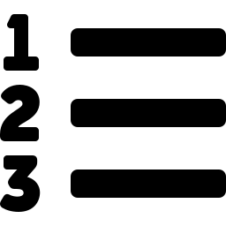



SECTION 1
Core Elements of a Prompt
Every well-formed prompt answers four questions. Missing any one of them is the most common cause of a vague or unusable response.
Instruction
Context
Input Data
Output Indicator
What should the model do?
Background information needed to understand the task.
The actual information the model should work with.
What should the response look like?
“Summarize the following report.”
e.g., audience, purpose, situation.
e.g., text, a table, code, an image.
“Return 5 bullet points.”
Prompt Engineering Essentials
3

Slide 4




SECTION 2
Additional Prompt Elements
Beyond the four core elements, these refinements sharpen a prompt further — most professional prompts use at least one.
Persona
Defines a role or perspective for the model to adopt.
“Act as a Python instructor.”
Examples
Shows the desired pattern directly, rather than describing it.
Useful for one-shot and few-shot prompting.
Tone & Constraints
Sets the voice and the boundaries of the response.
Tone: formal, friendly, concise. Constraints: length, format, audience.
Delimiters & Syntax
Clearly separates instructions from data so the model can't confuse the two.
e.g., XML tags, Markdown, triple quotes.
Prompt Engineering Essentials
4

Slide 5


SECTION 3
Ineffective vs. Effective Prompts
The difference is rarely the topic — it's whether the prompt defines audience, purpose, scope, and format.
Ineffective
Effective
“Tell me about AI.”
“Explain generative AI to first-year engineering students in 150 words.”
Too broad — “AI” covers dozens of subfields
Audience defined: first-year engineering students
No audience specified
Topic scoped: generative AI specifically
No purpose or scope defined
Length set: 150 words
No output format requested
Purpose implied: an explanation, not a debate
Prompt Engineering Essentials
5

Slide 6
SECTION 4
Prompting Techniques
How many examples you show the model changes how reliably it follows the pattern you want.
0
1
N
Zero-shot
One-shot
Few-shot
No example is provided — the model relies only on the instruction.
One example is provided to anchor the expected pattern.
Several examples are provided to demonstrate the pattern.
“Classify this review as positive or negative.”
Example → expected classification → new input.
The examples span different cases of the same task.
Best for simple, well-known tasks.
Best when format matters more than variety.
Best for nuanced or inconsistent tasks.
Prompt Engineering Essentials
6

Slide 7



SECTION 5
Prompt Templates
Templates make prompts reusable and consistent across an application rather than hand-written each time.
String Template
Chat Template
Messages
A reusable text pattern with variables filled in at run time.
Separates conversational roles so the model knows who is speaking.
A structured list of messages, each carrying a role and content.
“Summarize this text: {text}”
System → User → Assistant
Common in API-based applications.
Prompt Engineering Essentials
7

Slide 8


SECTION 6
Prompt Engineering vs. Model Fine-Tuning
Two different levers for improving model behavior — and they're often used together, not as alternatives.
Prompt Engineering
Model Fine-Tuning
Changes the instructions given to the model. Nothing about the model itself is modified.
Changes the model itself by training it further on a task- or domain-specific dataset.
✓ Faster and cheaper to experiment with
✓ No training data or infrastructure needed
✓ Changes take effect immediately
✓ Useful when specialized behavior is needed repeatedly
✓ Can bake in style, format, or domain knowledge
✓ Higher upfront cost in data and compute
In practice: start with prompt engineering to explore what's possible, then layer in fine-tuning once a specific behavior needs to be consistent at scale.
Prompt Engineering Essentials
8

Slide 9





SECTION 7
Prompt Testing & Evaluation
A prompt that works once isn't proven — these five practices build confidence that it works consistently.
Edge Cases
Systematic Evaluation
User Simulation
Comparison Analysis
Test unusual, ambiguous, incomplete, or adversarial inputs.
Use defined criteria and a representative set of test cases.
Simulate realistic users and the interactions they'd actually have.
Compare outputs from different prompts or prompt versions.
Iterative Refinement
Test
→
Identify problems
→
Modify prompt
→
Test again
The cycle that ties the other four together:
Prompt Engineering Essentials
9

Slide 10





SECTION 8
Prompt Testing Methods
Concrete methods that put the evaluation practices from the previous slide into action.
A/B Testing
Stress Testing
Semantic Analysis
User Feedback
Compare Prompt A against Prompt B on the same task.
Push the prompt with difficult or extreme inputs.
Check whether the output preserves the intended meaning.
Collect ratings, comments, and task-success feedback.
Automated Testing
Cross-Model Testing
Scenario-Based Testing
Run a repeatable test set and score outputs automatically.
Test the same prompt across different models.
Create realistic scenarios representing actual use cases.
Prompt Engineering Essentials
10

Slide 11
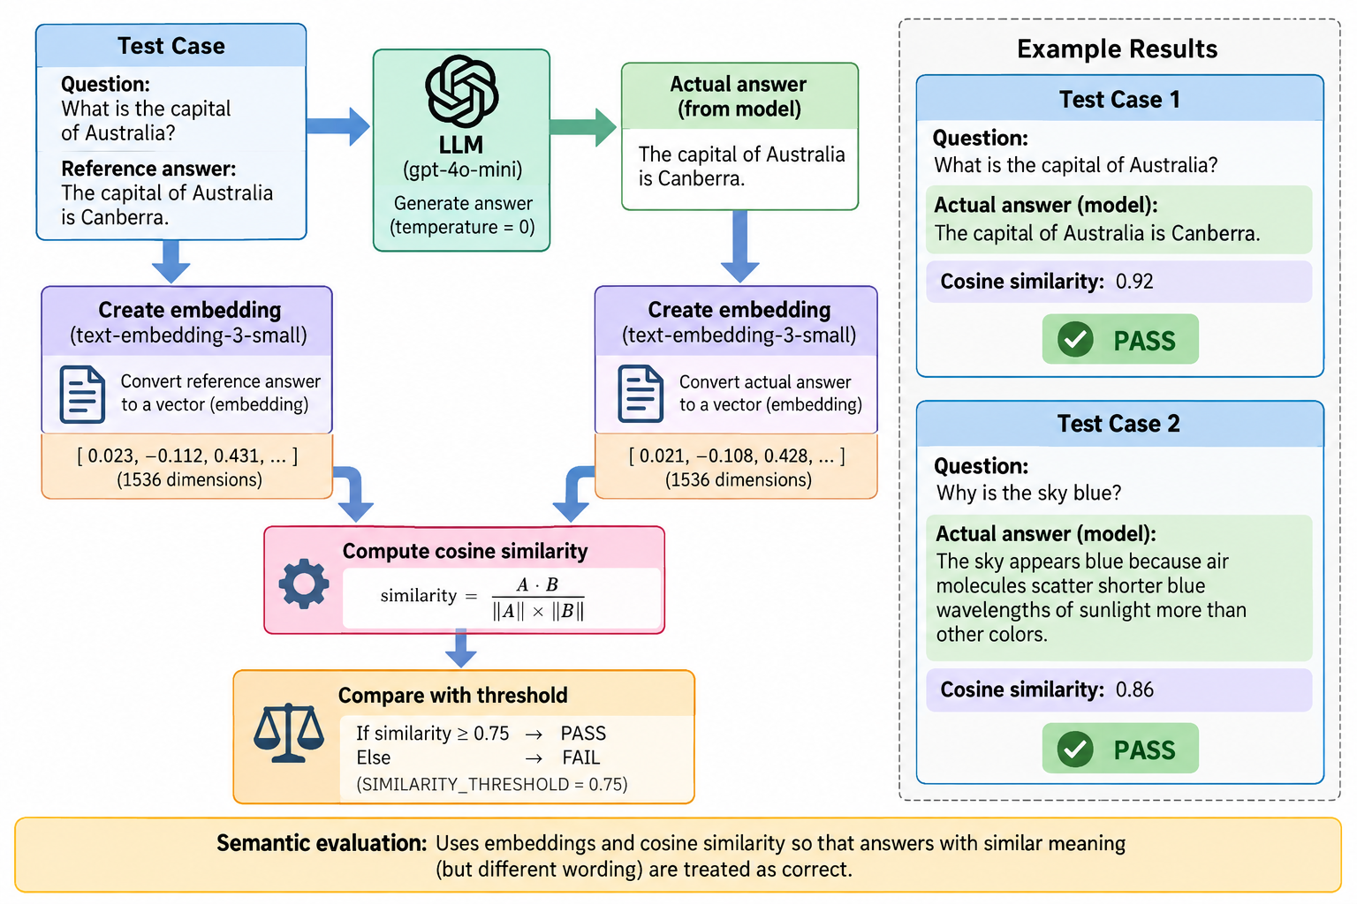
Embedding

Slide 12
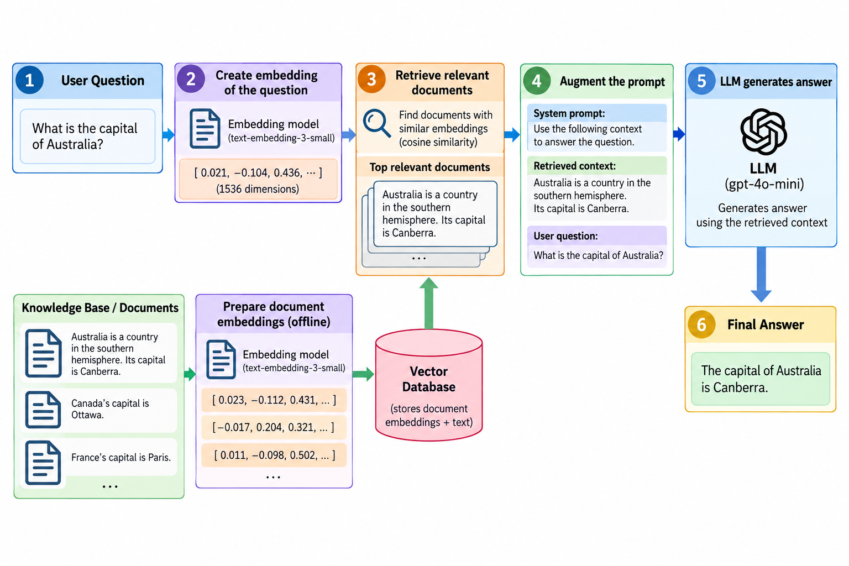
RAG

Slide 13
SUMMARY
Putting It Together
A practical sequence for building a prompt from scratch and hardening it over time.
1
Define the task clearly.
5
Test normal inputs and edge cases.
State exactly what you want the model to do.
Confirm it holds up outside the happy path.
2
Add relevant context and input data.
6
Compare results and refine the prompt.
Give the model what it needs to understand the situation.
Use A/B or comparison analysis to pick a winner.
3
Specify the expected output.
7
Use fine-tuning when prompting alone isn't sufficient.
Format, length, and structure — stated up front.
Reach for training only once prompting hits its ceiling.
4
Add persona, examples, tone, constraints, and delimiters when useful.
Layer in refinements once the basics are solid.
Prompt Engineering Essentials
12

Slide 14

KEY TAKEAWAYS
Three Things to Remember
Structure beats length
Treat prompts as testable code
Prompting and fine-tuning are complementary
A short prompt that defines instruction, context, data, and output format outperforms a long, vague one.
Version them, run them against edge cases, and compare results before shipping.
Start with prompting to explore; reach for fine-tuning only when consistency at scale is required.
Prompt Engineering Essentials
13

