Slide 1
MODULE 6
Context Engineering
Atul Kahate
https://www.linkedin.com/in/atulkahate/

Slide 2




ROADMAP
What We'll Cover
Four themes, moving from the basic constraint to the systems built to work within it.
01
02
1. Context Fundamentals
2. Context & Memory Management
The context window, token costs, and why multi-turn conversations grow the way they do.
Chunking, summarization, windowing, and the three flavors of conversational memory.
03
04
3. Retrieval & Document Chunking
4. Context at Scale
Loading documents, splitting them well, and retrieving only what's relevant as context.
Structuring multi-turn history, resuming across sessions, and measuring token usage precisely.
Context Engineering
2

Slide 3
CONTEXT FUNDAMENTALS · 1 OF 3
The Context Window
The single budget every instruction, message, and retrieved document has to share.
The context window is the maximum number of tokens a model can process in a single call — covering the system prompt, the conversation so far, any retrieved documents, and the response it's about to generate. Content beyond that limit is simply invisible to the model.
CONTEXT WINDOW MATH
What fits in 128K tokens
WHAT COUNTS AGAINST IT
1
The system prompt and instructions.
≈ 300 pages of plain text
≈ 15 average research papers
≈ A multi-hour chat transcript
Once a conversation exceeds the window, older content must be dropped, summarized, or moved into retrieval.
2
The full conversation history sent with the request.
3
Any retrieved documents or tool outputs inserted as context.
4
The model's own response, generated within the same window.
Trade-off: models don't attend to every position equally well — content buried in the middle of a long context is more likely to get missed than content near the start or end.
Key point: the window is shared — instructions, history, retrieved text, and the response all draw from one fixed budget.
Context Engineering
3

Slide 4

CONTEXT FUNDAMENTALS · 2 OF 3
Token Costs: Input, Output, and Total
Every call has two separate bills — and they're usually priced differently.
API pricing is typically metered separately for input tokens (everything sent to the model) and output tokens (what it generates back). Total cost per call is the sum of both, and output tokens are often priced higher than input.
EXAMPLE
Cost of one long-running chat
HOW IT'S CALCULATED
1
Input tokens: system prompt + conversation history + retrieved context.
Turn 1: 500 input tokens, 200 output tokens.
Turn 10: 4,000 input tokens (full history resent), 200 output tokens.
Response length hasn't changed — input cost has grown 8×, because prior turns are still being sent.
2
Output tokens: the model's generated response.
3
Total cost = (input tokens × input rate) + (output tokens × output rate).
Trade-off: a long conversation history re-sent on every turn multiplies input cost even if the new output is short — cost grows with the transcript, not just the request.
Key point: input costs compound across a conversation unless something actively manages what gets resent each turn.
Context Engineering
4

Slide 5

CONTEXT FUNDAMENTALS · 3 OF 3
Multi-Turn Conversations & Context Growth
Left unmanaged, a conversation's context grows every single turn — until it doesn't fit.
In a multi-turn conversation, each new turn is typically appended to everything before it and sent again in full. Without intervention, context grows roughly linearly with turn count until it hits the context window limit.
EXAMPLE
Unmanaged growth
HOW THE GROWTH HAPPENS
1
Turn 1 sends the system prompt and the first user message.
Turn 1: ~300 tokens
Turn 5: ~2,100 tokens
Turn 20: ~9,000 tokens
Same conversation style throughout — the growth comes purely from re-sending history, not longer messages.
2
Turn 2 resends turn 1's exchange, plus the new message.
3
Turn N resends all N−1 prior exchanges, plus the new message.
4
Eventually the transcript exceeds the window and something must give.
Trade-off: this is exactly the problem the next section's strategies — chunking, summarization, windowing, memory — exist to solve.
Key point: context growth is a structural property of naive multi-turn design, not a sign anything has gone wrong.
Context Engineering
5

Slide 6



CONTEXT & MEMORY MANAGEMENT · 1 OF 3
Context Management Strategies
Three complementary ways to keep a growing conversation inside the context window.
Chunking
Summarization
Windowing
Break large content into smaller, independent pieces that can be processed or retrieved on their own, instead of one giant block.
Compress older parts of the conversation into a shorter summary that preserves key points using far fewer tokens.
Keep only the most recent N turns in full (a sliding window), letting the oldest turns drop off or get summarized.
Context Engineering
6

Slide 7

CONTEXT & MEMORY MANAGEMENT · 2 OF 3
Conversational Memory
Different ways to represent what's happened so far in a conversation.
Buffer Memory
Summary Memory
Vector Memory
Stores the raw, verbatim history — simple and faithful, but grows unbounded and eventually exceeds the context window.
Continuously compresses older turns into a running summary, trading some detail for a small, stable token footprint.
Stores past exchanges as embeddings and retrieves only what's relevant to the current turn, rather than everything or a fixed summary.
Context Engineering
7

Slide 8

CONTEXT & MEMORY MANAGEMENT · 3 OF 3
Persisting Conversational Memory
Memory that lives only in RAM disappears the moment the process restarts.
Persisting conversational memory means saving buffer, summary, or vector memory to durable storage — a database, file, or vector store — so it survives restarts, deployments, and crashes, instead of resetting every time the process stops.
EXAMPLE
A simple persistence layer
HOW IT WORKS
1
Choose a store matched to the memory type (database table, vector database).
After each turn:
save(conversation_id, {buffer, summary, timestamp})
On the next request:
memory = load(conversation_id)
→ the assistant resumes with full context, even after a server restart.
2
Write memory updates after each turn, keyed by a conversation or user ID.
3
Load the relevant memory back in at the start of a new request.
Trade-off: persistence adds latency (a read/write per turn) and requires deciding what to keep indefinitely versus prune or expire.
Key point: any application meant to survive restarts or run across multiple servers needs memory outside process memory.
Context Engineering
8

Slide 9
RETRIEVAL & DOCUMENT CHUNKING · 1 OF 6
Retrieval as Context
Instead of stuffing everything into the prompt, fetch only what's relevant, when it's relevant.
Retrieval as context — the core idea behind RAG — fetches relevant passages from an external knowledge source at query time and inserts just those into the prompt, rather than trying to fit an entire knowledge base into the context window up front.
EXAMPLE
Answering from a knowledge base
HOW IT WORKS
1
Store documents as searchable chunks (often as embeddings in a vector store).
Question: “What's our refund policy for digital goods?”
→ Retrieve the 2 most relevant policy-doc chunks → insert them into the prompt → the model answers grounded in the actual policy text.
2
At query time, search for the chunks most relevant to the question.
3
Insert the top-matching chunks into the prompt as context.
4
The model answers using both its own knowledge and the retrieved passages.
Trade-off: retrieval quality is a ceiling on answer quality — if the right passage isn't retrieved, the model can't use it, no matter how good the prompt is.
Best for: knowledge bases too large to fit in context, and answers that need to be grounded in specific source documents.
Context Engineering
9

Slide 10

RETRIEVAL & DOCUMENT CHUNKING · 2 OF 6
LangChain Document Loaders
The first step of any retrieval pipeline: getting content out of its source format.
Document loaders are LangChain components that read content from a source — files, websites, databases, APIs — and convert it into a standard Document object (text plus metadata) the rest of the pipeline can work with.
EXAMPLE
Common loader types
HOW IT WORKS
1
Pick a loader matched to the source (PDF, web page, CSV, Notion, etc.).
PyPDFLoader — PDF files
WebBaseLoader — web pages
CSVLoader — spreadsheets
NotionDBLoader — Notion databases
Each returns a consistent list of Document objects, regardless of source format.
2
The loader reads the raw source and extracts text content.
3
It attaches metadata (source path, page number, timestamps) to each Document.
4
Loaded documents flow into text splitting, then embedding and storage.
Trade-off: loader quality varies by source — scanned PDFs, complex tables, and heavily styled web pages often need extra cleanup after loading.
Key point: loaders standardize different sources into one format so the rest of the pipeline doesn't need to know where content came from.
Context Engineering
10

Slide 11
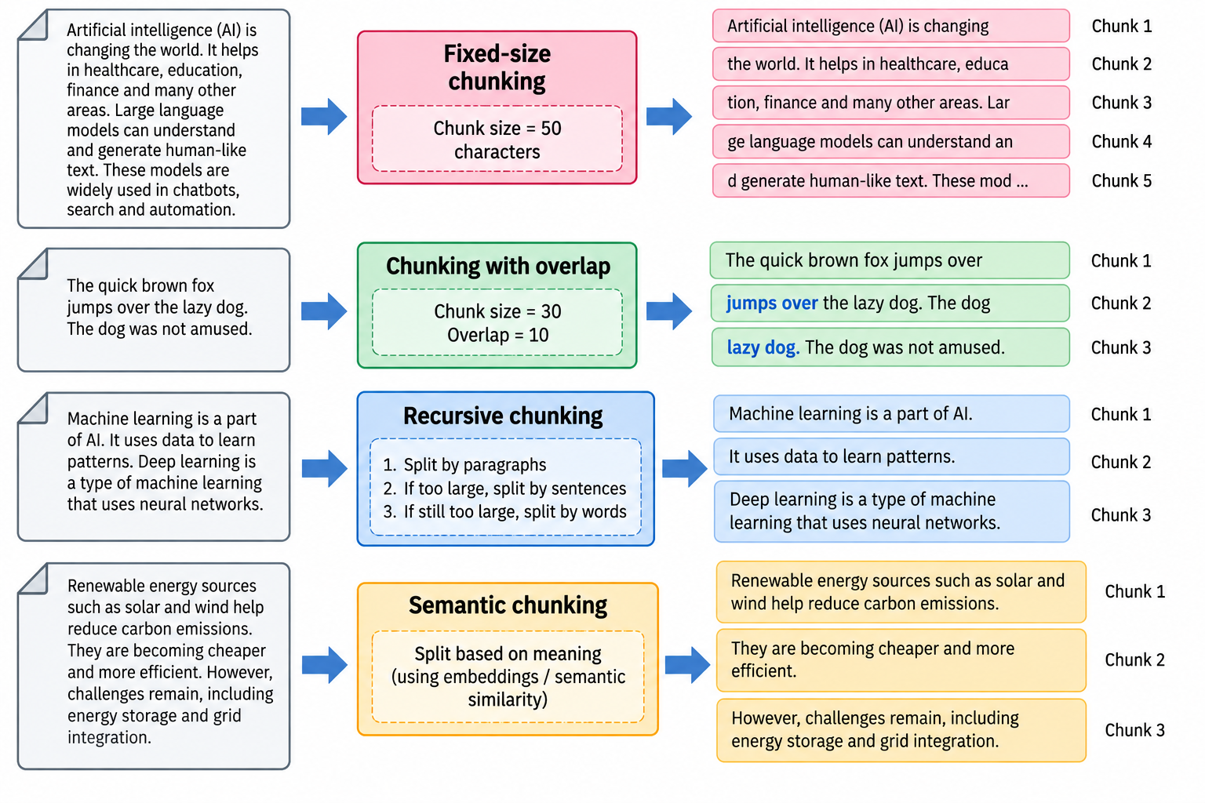
Chunking Strategies

Slide 12
RETRIEVAL & DOCUMENT CHUNKING · 3 OF 6
Text Splitting with Chunk Overlap
Cutting documents into pieces small enough to embed — without severing ideas at the seams.
Text splitting breaks a long document into fixed-size chunks so each piece is small enough to embed and fit in a prompt. Chunk overlap repeats a small amount of text at the boundary between chunks, so context isn't lost at the cut point.
EXAMPLE
500-token chunks, 50-token overlap
HOW IT WORKS
1
Pick a chunk size (e.g., 500 tokens) based on the embedding model and prompt budget.
Chunk 1: tokens 0–500
Chunk 2: tokens 450–950
Chunk 3: tokens 900–1400
The last 50 tokens of each chunk reappear at the start of the next, so no sentence at a cut point is lost.
2
Pick an overlap size (e.g., 50 tokens) to repeat between adjacent chunks.
3
Split the document, sliding forward by (size − overlap) tokens each time.
Trade-off: too little overlap can sever the sentence that answers a question in half; too much wastes storage and retrieval budget on duplicated text.
Best for: any document longer than a single chunk — the default building block underneath most chunking strategies.
Context Engineering
11

Slide 13

RETRIEVAL & DOCUMENT CHUNKING · 4 OF 6
Recursive Chunking
Splitting on the most natural boundary available, and only falling back when it has to.
Recursive chunking splits text using an ordered list of separators — paragraphs first, then sentences, then words, then characters — recursing into smaller separators only where a piece is still too large after the previous one.
EXAMPLE
Separator order in practice
HOW IT WORKS
1
Try splitting on the largest natural boundary first (e.g., paragraphs).
Try, in order:
["\n\n", "\n", ". ", " ", ""]
A report's paragraphs split cleanly. One unusually long paragraph doesn't fit the limit — it alone gets split further on sentence boundaries.
2
If a piece is still over the size limit, split it again on the next separator (sentences).
3
Keep recursing to smaller separators (words, characters) only where still needed.
4
The result respects structure wherever possible, cutting mid-sentence only as a last resort.
Trade-off: still a structural, not meaning-based, cut — two adjacent paragraphs on unrelated ideas can still share a chunk if they fit its size limit together.
Best for: general-purpose chunking of structured text (reports, articles, docs) — the commonly recommended default splitter.
Context Engineering
12

Slide 14

RETRIEVAL & DOCUMENT CHUNKING · 5 OF 6
Semantic Chunking
Cutting where the topic actually changes, not where a fixed size happens to run out.
Semantic chunking splits text based on meaning: it embeds sentences (or small groups), measures similarity between consecutive segments, and places chunk boundaries where similarity drops sharply — i.e., where the topic shifts.
EXAMPLE
Where the boundary lands
HOW IT WORKS
1
Split the text into sentences (or small sentence groups).
A support article covers “how to reset your password,” then shifts to “how to update billing info.”
Semantic chunking places the boundary exactly at that shift — not wherever a 500-token limit happens to land.
2
Embed each sentence or group.
3
Compare similarity between each pair of consecutive segments.
4
Insert a chunk boundary wherever similarity drops sharply.
Trade-off: costs an embedding call per sentence/group during chunking itself, making it more expensive up front than size-based methods.
Best for: documents where topics shift within otherwise-uniform formatting, and coherent chunks matter more than chunking speed or cost.
Context Engineering
13

Slide 15
RETRIEVAL & DOCUMENT CHUNKING · 6 OF 6
Chunking Strategies at a Glance
Each trades setup cost for how well chunk boundaries respect meaning.
STRATEGY
CORE IDEA
BEST FOR
Fixed-Size + Overlap
Split by fixed length; repeat text at boundaries
Simple, uniform documents
Recursive
Try natural separators first, recurse when needed
General-purpose structured text
Semantic
Split where topic similarity drops
Topic-shifting or unstructured text
Context Engineering
14

Slide 16

CONTEXT AT SCALE · 1 OF 3
Managing Multi-Turn Conversation History
Turning a growing transcript into a structured object instead of a wall of text.
In a running application, conversation history is typically stored as a list of role-tagged messages (system, user, assistant) rather than a flat block of text. That structure is what makes it possible to apply memory strategies to it.
EXAMPLE
A structured message list
HOW IT WORKS
1
Append each new message to the history with its role.
[
{role: 'system', content: '...'},
{role: 'user', content: 'Hi'},
{role: 'assistant', content: 'Hello!'},
{role: 'user', content: '...'}
]
This structure is what summarization or windowing actually operates on.
2
Track turn count and token count as the conversation grows.
3
Apply a memory strategy (buffer, summary, or vector) once a threshold is reached.
4
Reconstruct the message list to send on the next request.
Trade-off: the strategy has to run before the request is sent, not after — by the time a call fails on context length, it's too late.
Key point: structure is what turns “manage the context” from a vague goal into an operation you can actually run on data.
Context Engineering
15

Slide 17
CONTEXT AT SCALE · 2 OF 3
Continuing Context Across Sessions
Picking up where a user left off, even days later and on a different device.
Continuing context across sessions means recognizing a returning user or conversation ID and reloading their prior context — a summary, key facts, or recent turns — into a new session, instead of starting from a blank slate every time.
EXAMPLE
Resuming three days later
HOW IT WORKS
1
Identify the returning user or conversation by a stable ID.
Monday: user discusses a trip to Japan; session ends.
Thursday: user returns and asks, “what was that hotel you mentioned?”
→ the assistant loads Monday's saved summary and answers correctly, unprompted.
2
Load their persisted memory (see: Persisting Conversational Memory).
3
Reintroduce enough context — often a summary, not the full history — to resume coherently.
4
Continue appending new turns to that reloaded context going forward.
Trade-off: reloading everything verbatim defeats the purpose — sessions usually resume from a summary, retrieving older detail only if the user asks.
Key point: products where users expect continuity — most assistants, support bots, and long-term collaborative tools.
Context Engineering
16

Slide 18

CONTEXT AT SCALE · 3 OF 3
Token Usage Measurement with Tiktoken
Counting tokens before you send them, instead of finding out the hard way.
Tiktoken is OpenAI's tokenizer library, used to count exactly how many tokens a piece of text will consume for a given model — before it's sent — letting an application estimate cost and check limits ahead of time.
EXAMPLE
Counting tokens in code
HOW IT WORKS
1
Load the encoding that matches the target model (e.g., cl100k_base).
import tiktoken
enc = tiktoken.encoding_for_model("gpt-4")
tokens = enc.encode(
"Hello, how many tokens is this?"
)
len(tokens) → 9
2
Encode a string to get its list of token IDs.
3
Take the length of that list as the token count.
4
Sum counts across the system prompt, history, and new message for the total.
Trade-off: counts are model/encoding-specific — a string tokenized for one model's encoding won't exactly match another model's count.
Best for: pre-flight cost estimation, enforcing context budgets, and deciding when a summarization or windowing strategy needs to kick in.
Context Engineering
17

Slide 19
KEY TAKEAWAYS
Three Things to Remember
Context is a shared, shrinking budget
Chunk and retrieve, don't just append
Memory has to survive restarts and sessions
System prompt, history, retrieved text, and the response all draw from one token limit — spend it deliberately.
Recursive and semantic chunking plus retrieval beat stuffing an entire knowledge base into the prompt.
Persist it outside process memory, and reload it — usually as a summary — when a user returns.
Context Engineering
18

