Slide 1
ML to Agentic AI
Atul Kahate

Slide 2
The Basics
Aspect | AI | ML | DL | GenAI
Full Form | Artificial Intelligence | Machine Learning | Deep Learning | Generative AI
What it does | Mimics human intelligence | Learns patterns from data | Uses neural networks to learn complex patterns | Creates new content
Data dependency | May or may not need data | Needs historical data | Needs large data | Needs massive datasets
Complexity | Broad umbrella | Subset of AI | Subset of ML | Often built on DL
Example | Rule-based chatbot | Spam detection | Face recognition | ChatGPT

Slide 3
Fitment
Level | Fits Inside | Purpose | Example
AI | Top-level umbrella | Intelligent decision-making | Chess engine
ML | Inside AI | Learning from past data | House price prediction
DL | Inside ML | Learning deep patterns | Image recognition
GenAI | Mostly DL-based | Creating new content | AI-generated text / image

Slide 4
Traditional Programming versus ML
Traditional Programming | Machine Learning
Rules + Data → Output | Data + Output → Rules (Model)
Human writes logic | System learns logic
Fixed rules | Adaptive rules
Good for deterministic tasks | Good for prediction

Slide 5
When to Use What
Situation | Best Fit
Rule-based decision system | AI
Predict future outcomes | ML
Image / voice / video analysis | DL
Create text, image, code, PPT | GenAI

Slide 6
Risks and Ethics
Risk | Example
Bias | Unfair hiring decisions
Privacy | Personal data exposure
Hallucination | Wrong generated facts
Deepfake | Fake voice/video
Overdependence | Reduced human judgment

Slide 7
Installation
Install Python: https://www.python.org/ftp/python/3.12.0/python-3.12.0-amd64.exe
Install VS Code: https://code.visualstudio.com/download
Start VS Code and Set Python Interpreter: Ctrl + Shift + P and then type Python
Create a virtual environment: In VS Code, select Terminal -> New Terminal
python -m venv .venv
.venv\Scripts\activate

Slide 8
How does a Machine Learn?
What is the pattern here?
Student | Study Hours | Attendance | Result
A | 2 | 40% | Fail
B | 3 | 50% | Fail
C | 5 | 70% | Pass
D | 6 | 80% | Pass
E | 8 | 90% | Pass
Code:
C:\lectures\Others\Edureka\intralinks
1_hardcoded.py
2_ml.py

Slide 9
Detecting Hidden Layers
Goal: Demonstrate how Deep Learning uses neural networks to learn complex, non-linear patterns that a simple ML model cannot easily untangle
The Narrative: You are building a travel app to map a 7-day itinerary across Japan. You want the app to differentiate between "Typical Tourist Traps" and true "Off-the-Beaten-Path Hidden Gems." The relationship between geographical coordinates, foot traffic, and local reviews is highly complex.
Solution: Build a DL network
Code: 3_dl.py

Slide 10
Detecting Hidden Layers
In the dataset, we gave the model three distinct numbers: Latitude, Longitude, and Tourist Density.
A basic model looks at these as independent columns of numbers.
The Deep Learning model's "hidden layers" act as intermediate filters that combine these numbers to figure out what they actually represent in the real world.
During training, the first hidden layer might figure out that a specific combination of Latitude and Longitude represents an "Urban Area." The second hidden layer might combine that new "Urban Area" concept with the "Tourist Density" score.
It eventually learns the unwritten rule: A density of 85 in an Urban Area means it's a Tourist Trap. But a density of 85 at a remote mountain coordinate means there is a localized event or festival happening, making it a Hidden Gem. It learned to map the geography without us ever feeding it a literal map.

Slide 11
Why is it Difficult for ML?
It comes down to Non-Linearity.
Think about how you would plot these locations on a literal map of Japan. Tourist traps are not grouped together in one massive, neat square on the map. They are scattered in isolated pockets (a pocket in Tokyo, a pocket in Kyoto, a pocket in Osaka).
The ML Limitation (Straight Lines): Simple ML models (like Linear Regression or basic Support Vector Machines) try to draw straight lines or blunt boxes to separate data. You cannot draw one single straight line across a map of Japan that perfectly separates all the tourist traps from the hidden gems.
The DL Advantage (Bending the Space): A neural network doesn't draw straight lines. By using multiple hidden layers, it essentially bends, folds, and warps the mathematical space. It can draw complex, highly irregular boundaries that wrap perfectly around those scattered pockets of data.

Slide 12
Gen AI
Goal: Show exactly how GenAI creates new content and demonstrate the very real production risks of Hallucination and wrong generated facts.
The Narrative: You are drafting a pitch deck for a new AI startup in India that integrates linear optical quantum computing for secure enterprise workflows. You use GenAI to generate the opening statement.
Note: The participants will need to add pip install transformers
Code: 4_gen_ai.py

Slide 13
What is Happening in the Gen AI Case?
While Deep Learning learns to map complex boundaries (like finding hidden gems on a map), Generative AI (specifically Large Language Models like the one in the lab) does something entirely different: it plays a massive, high-speed game of probability.
At its core, an LLM is essentially "autocomplete on steroids." It does not "think," and it does not "know" facts. It only knows the mathematical likelihood of one word following another based on the massive datasets it was trained on.
When we gave the model the prompt: "Our new startup in India will combine Agentic AI and linear optical quantum computing to..." the model paused and assigned a probability score to every single word in the English language.
1. The Strict and Safe Output (Low Temperature = 0.3)
"Temperature" is the dial that controls randomness. When the temperature is low, the model is mathematically conservative. It looks at the probabilities and says, "I will only pick from the top 1% most likely next words."
The Result: It picks highly predictable words (e.g., "...to build...", "...to solve..."). It is factually safe, grammatically perfect, but incredibly boring and repetitive.
2. The Chaotic Output (High Temperature = 2.0)
When we cranked the temperature up, we flattened the math. We told the model, "Ignore the obvious choices. Give those highly unlikely, low-probability words a chance to be picked."
The Result: The model reaches deeper into the vocabulary. Sometimes this results in brilliant "creativity" (pairing concepts a human wouldn't normally pair). But if forced too far, it picks words that mathematically have no business being next to each other.
The Production Risk: This is exactly what a Hallucination is. The model isn't "lying" to you; it was just mathematically forced to pick a low-probability sequence of words that forms a grammatically correct sentence but is entirely false in the real world.

Slide 14
AI/ML Infrastructure
Layer | Description | Key Components
Data Layer | Raw data ingestion and storage | Data lake, DBs, APIs
Processing Layer | Data cleaning and transformation | ETL/ELT pipelines
Feature Layer | Feature creation and storage | Feature engineering, feature store
Training Layer | Model building and experimentation | ML frameworks, GPUs
Deployment Layer | Serving models in production | APIs, batch jobs
Monitoring Layer | Performance and drift tracking | Logging, alerts
Code: 5_ai_ml_end_to_end.py

Slide 15
Data Layer (Ingestion)
Aspect | Details
Purpose | Collect raw data from various sources
Sources | Databases, APIs, sensors, logs, user input
Nature of Data | Unstructured, incomplete, noisy
Key Tasks | Data collection, ingestion, storage
Challenges | Missing values, inconsistent formats, duplicates

Slide 16
Processing Layer (Data Cleaning)
Aspect | Details
Purpose | Prepare data for analysis and modeling
Key Tasks | Cleaning, validation, transformation
Techniques | Imputation, normalization, deduplication
Output | Clean and consistent dataset
Challenges | Handling large-scale messy data reliably

Slide 17
Feature Layer (Feature Engineering)
Aspect | Details
Purpose | Create meaningful inputs for models
Key Tasks | Feature creation, selection, transformation
Types of Features | Derived, aggregated, domain-specific
Benefit | Improves model performance
Challenges | Identifying useful features

Slide 18
Training Layer (Model Building)
Aspect | Details
Purpose | Learn patterns from data
Inputs | Features (X) and labels (Y)
Key Tasks | Model selection, training, evaluation
Techniques | ML algorithms, hyperparameter tuning
Challenges | Overfitting, underfitting, model selection

Slide 19
Deployment Layer (Model Serving)
Aspect | Details
Purpose | Make model available for real-world use
Methods | APIs, batch processing, embedded systems
Key Tasks | Integration, scaling, versioning
Output | Predictions in real-time or batch
Challenges | Latency, scalability, consistency

Slide 20
Monitoring Layer (Maintenance and Drift Detection)
Aspect | Details
Purpose | Ensure model performance over time
Key Tasks | Monitoring, alerting, logging
Focus Areas | Data drift, model accuracy, system health
Actions | Retraining, rollback, updates
Challenges | Detecting drift and maintaining reliability

Slide 21
Data Pipeline
Stage | Purpose | Tools / Tech
Data Sources | Collect raw data | Logs, IoT, DBs, APIs
Ingestion | Move data into system | Kafka, Flume, Airflow
Storage | Persist raw/processed data | S3, HDFS, Data Warehouse
Processing | Clean and transform | Spark, Pandas, dbt
Validation | Ensure quality | Great Expectations
Code: 6_data_pipeline.py
Also run Intralinks_6_data_pipeline in n8n

Slide 22
Exercise
Use the titanic dataset
Find out if the ‘age’ column needs to be cleaned
If yes, perform mean imputation
Add a new feature named ‘adult’ to indicate if the passenger’s age is >= 18 or not
Add a new column to store 0 if the passenger is male, and 1 if female

Slide 23
Feature Engineering Pipeline
Step | Description | Example
Cleaning | Handle missing/outliers | Fill NA, remove noise
Transformation | Convert formats | Log transform, scaling
Encoding | Convert categorical | One-hot, label encoding
Aggregation | Create summary features | Avg purchase per user
Feature Selection | Reduce dimensionality | PCA, correlation filtering
Feature Store | Centralized storage | Online + Offline store
Code: 7_feature_engineering.py
Also run intralinks_7_feature_engineering in n8n

Slide 24
Training Flow
Stage | Description
Data Split | Train / Validation / Test
Model Selection | Choose algorithm
Training | Fit model on data
Hyperparameter Tuning | Optimize performance
Evaluation | Metrics (Accuracy, RMSE, F1)
Experiment Tracking | Log runs and results
KNIME workflow for titanic

Slide 25
Core ML Frameworks
Framework | Type | Best For | Strengths | Limitations
Scikit-learn | Classical ML | Regression, classification | Simple, fast, great for tabular data | Not for deep learning
PyTorch | Deep Learning | Research, custom models | Flexible, dynamic graphs | Slightly less production-ready (earlier)
TensorFlow | Deep Learning | Production ML systems | Scalable, strong ecosystem | Steeper learning curve
Hugging Face | NLP/GenAI | Transformers, LLMs | Pretrained models, easy APIs | Depends on PyTorch/TF backend

Slide 26
Traditional ML: Scikit-Learn
Aspect | Details
Algorithms | Linear Regression, SVM, Random Forest
Data Type | Structured / tabular
Use Cases | Credit scoring, churn prediction
Strength | Easy to learn and fast
Weakness | No deep learning support

Slide 27
PyTorch
Component | Purpose
torch | Core tensor library
torchvision | Image datasets and models
torchaudio | Audio processing
PyTorch Lightning | Simplified training
TorchServe | Model serving

Slide 28
TensorFlow
Component | Purpose
TensorFlow Core | Model building
Keras | High-level API
TensorFlow Lite | Mobile deployment
TensorFlow Serving | Production serving
TensorFlow Extended (TFX) | End-to-end pipelines

Slide 29
Hugging Face
Component | Purpose
Transformers | Pretrained NLP/LLM models
Datasets | Ready-to-use datasets
Tokenizers | Fast preprocessing
Accelerate | Multi-GPU training
Hub | Model sharing

Slide 30
Inference Platforms (Model Serving)
Platform | Type | Use Case | Strength
TorchServe | PyTorch serving | DL models | Easy PyTorch deployment
TensorFlow Serving | TF serving | Production APIs | High performance
FastAPI | Custom API | Lightweight serving | Flexible
BentoML | ML serving | Unified deployment | Multi-framework support
NVIDIA Triton | High-performance inference | GPU serving | Scalable, multi-model

Slide 31
Open Source Models and Model Hubs
Aspect | Description
Definition | Pretrained ML/AI models available publicly
Examples | LLMs, vision models, speech models
Advantage | No need to train from scratch
Use Case | Chatbots, classification, translation
Platform | Purpose | Key Features
Hugging Face Hub | Central model repository | Easy download, APIs
TensorFlow Hub | TF models | Production-ready
PyTorch Hub | PyTorch models | Research-focused
Kaggle Models | Community sharing | Datasets + models
Code: 8_hf_sentiment.py, 9_pytorch_image.py

Slide 32
Model Cards
Field | Description
Model Name | Identifier
Description | What the model does
Training Data | Dataset used
Metrics | Accuracy, F1, etc.
Bias and Limitations | Ethical considerations
Intended Use | Where it should be used

Slide 33
Checkpoints
Concept | Explanation
Definition | Saved state of a model during/after training
Contents | Weights, biases, optimizer state
Format | .pt, .pth, .ckpt, .bin
Purpose | Resume training or reuse model

Slide 34
Tokenizer Basics
Aspect | Description
Definition | Converts text → numbers
Role | Input preprocessing for NLP models
Output | Tokens (IDs)
Input Text | Tokens
"I love AI" | [101, 2003, 2293, 9932]
Type | Description | Example
Word-based | Split by words | "I love AI"
Subword | Break into parts | "play" → "pl", "ay"
Character | Each char | "A", "I"
Byte Pair Encoding (BPE) | Most common in LLMs | GPT models
Text → Tokenizer → Token IDs → Model → Output Code: 10_tokenizing.py

Slide 35
Data Ethics
Aspect | Description
Definition | Moral principles guiding data collection, use, and sharing
Focus | Fairness, privacy, accountability
Scope | Data lifecycle (collection → usage → storage)
Principle | Meaning
Privacy | Protect personal data
Consent | Users agree to data usage
Transparency | Clear data usage policies
Fairness | No discrimination
Accountability | Responsibility for misuse

Slide 36
AI Bias
Aspect | Description
Definition | Systematic unfairness in model outcomes
Cause | Skewed data or flawed assumptions
Impact | Discrimination, inaccurate predictions
Type | Example
Data Bias | Training data not representative
Sampling Bias | Over/under-representation
Algorithmic Bias | Model favors certain groups
Confirmation Bias | Reinforcing existing patterns
Solution Method | Description
Diverse Data | Include varied samples
Reweighting | Balance datasets
Fairness Metrics | Measure bias
Human Review | Add oversight

Slide 37
Hallucinations
Aspect | Description
Definition | Model generates incorrect but confident output
Common In | Large Language Models
Risk | Misinformation, trust issues
Scenario | Issue
Fake citations | Non-existent references
Wrong facts | Incorrect data
Fabricated answers | Made-up explanations
Solution Method | Description
Retrieval-Augmented Generation (RAG) | Use real data sources
Grounding | Restrict to known facts
Prompt Engineering | Clear instructions
Human Validation | Review outputs

Slide 38
Responsible AI
Aspect | Description
Goal | Build AI that is safe, fair, and trustworthy
Scope | Design → development → deployment

Slide 39
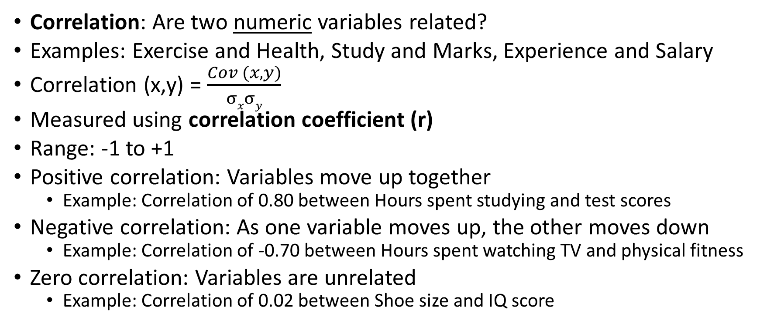
Correlation
Correlation: Are two numeric variables related?
Examples: Exercise and Health, Study and Marks, Experience and Salary
Correlation (x,y) = $\frac{Cov (x, y)}{σxσy}$
Measured using correlation coefficient (r)
Range: -1 to +1
Positive correlation: Variables move up together
Example: Correlation of 0.80 between Hours spent studying and test scores
Negative correlation: As one variable moves up, the other moves down
Example: Correlation of -0.70 between Hours spent watching TV and physical fitness
Zero correlation: Variables are unrelated
Example: Correlation of 0.02 between Shoe size and IQ score

Slide 40
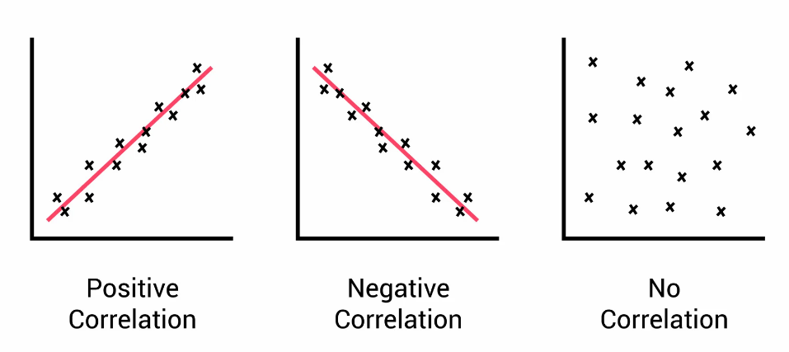
Positive, Negative, No Correlation

Slide 41
Predictive Analytics
Predictive Analytics
Numeric
Categorical
Regression
Classification
Linear Regression
Logistic Regression
Decision Trees
Naïve Bayes’ Classifier

Slide 42
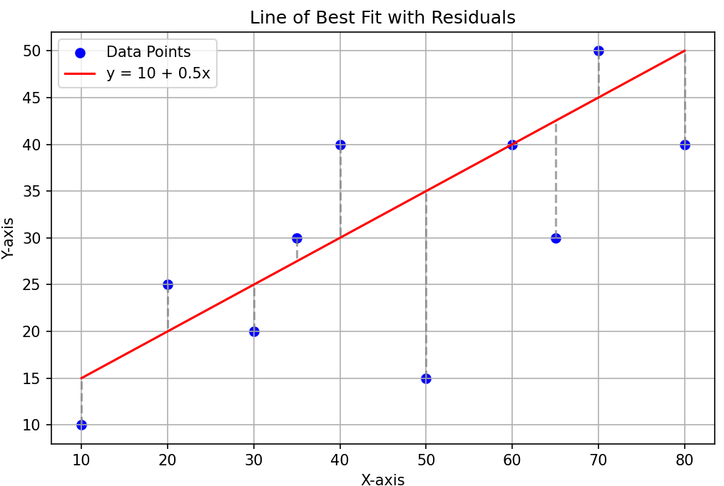
Linear Regression
Linear Regression: Find the best straight line that predicts one variable (Y) using another (X)
Equation: Y = a + bX
a = Intercept (Value of Y when X = 0)
b = Slope (How much Y changes for 1 unit change in X)
Understanding
Imagine plotting our data points (X, Y) on a graph
Draw a line that fits the points as closely as possible
This best fit line shows the trend or relationship between X and Y
Error and Best fit
Each point does not lie exactly on the line
Error/Residual: Vertical distance between a point and the line
Least Squared Error method: Try to minimize the total squared error

Slide 43
Linear Regression Interpretation and Example
If slope b > 0, Y increases as X increases
If slope b < 0, Y decreases as X increases
Suppose we study Hours of study (X) and Marks (Y)
Regression finds the line that best predicts marks for any given study hours
Slope tells us how much marks are expected to increase/decrease as per extra study hours
R² (R-Squared) = Measures proportion of variance in Y explained by X
R = Correlation between X and Y, Range: -1 to +1
R² = (Correlation between X and Y)² -> Squaring R removes its sign, Range: 0 to 1
Example: R = -0.70, R² = 0.49 -> 49% of variance in Y is explained by X

Slide 44
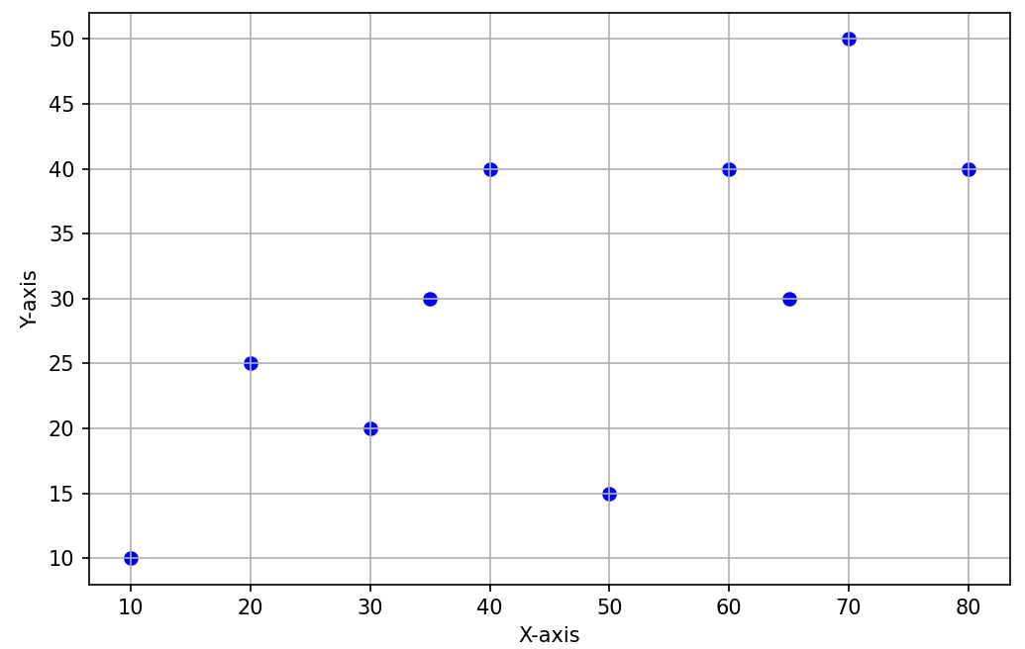
Least Squared Error
Suppose our line satisfies the equation y = 10 + 0.5x
x | y (Actual) | y (Line) | Error | Squared Error
10 | 10 | 15 | 5 | 25
20 | 25 | 20 | -5 | 25
30 | 20 | 25 | 5 | 25
35 | 30 | 27.5 | -2.5 | 6.25
40 | 40 | 30 | -10 | 100
50 | 15 | 35 | 20 | 400
60 | 40 | 40 | 0 | 0
65 | 30 | 42.5 | 12.5 | 156.25
70 | 50 | 45 | -5 | 25
80 | 40 | 50 | 10 | 100
Sum of Squared Error (SSE) |  |  |  | 862.5

Slide 45
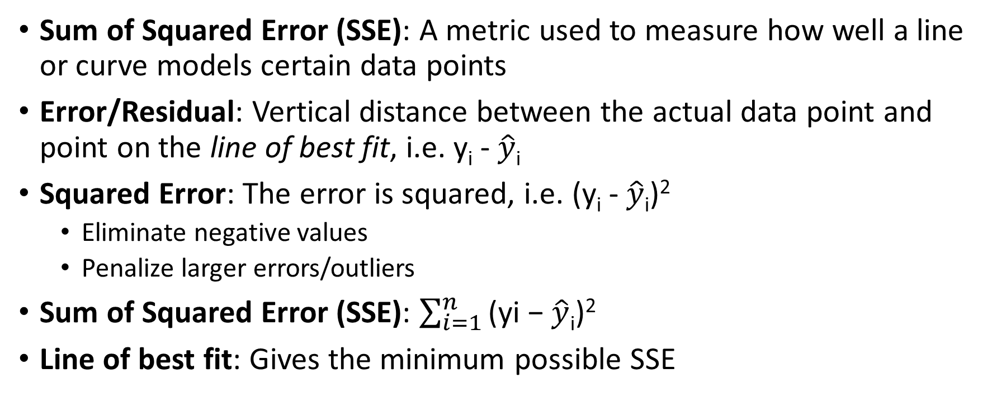
Sum of Squared Error (SSE)
Sum of Squared Error (SSE): A metric used to measure how well a line or curve models certain data points
Error/Residual: Vertical distance between the actual data point and point on the line of best fit, i.e. y_{i} - $\hat{y}\text{i}$
Squared Error: The error is squared, i.e. (y_{i} - $\hat{y}\text{i}$)²
Eliminate negative values
Penalize larger errors/outliers
Sum of Squared Error (SSE): $\sum_{i=1}^{n}{\text{(}\text{yi}\text{ − }\hat{y}\text{i}\text{)}\text{2}}$
Line of best fit: Gives the minimum possible SSE

Slide 46
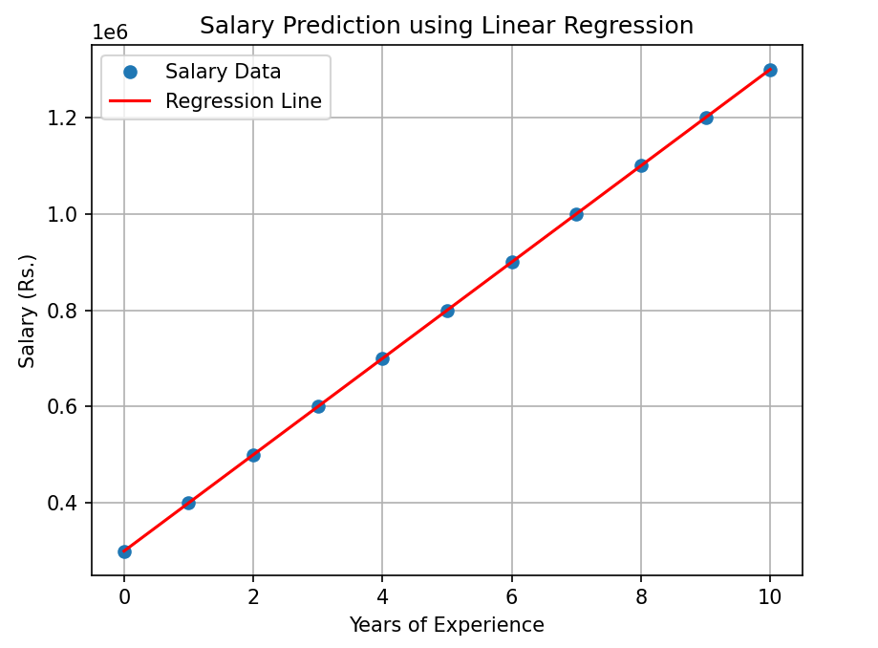
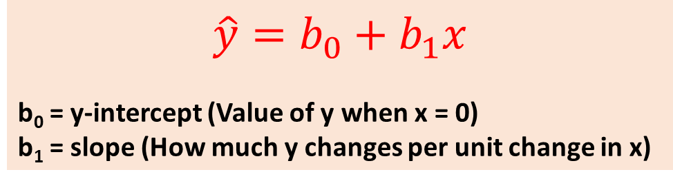
Linear Regression
Example:
Salary (y) = 3,00,000 + 1,00,000x
Here, b₀ = 3,00,000 and b₁ = 1,00,000
Experience (Years) | Salary (Rupees in Lakhs)
0 | 3
1 | 4
2 | 5
3 | 6
4 | 7
5 | 8
6 | 9
7 | 10
8 | 11
9 | 12
10 | 13
$$\hat{y}=b_{0}+b_{1}x$$
b₀ = y-intercept (Value of y when x = 0)
b₁ = slope (How much y changes per unit change in x)

Slide 47
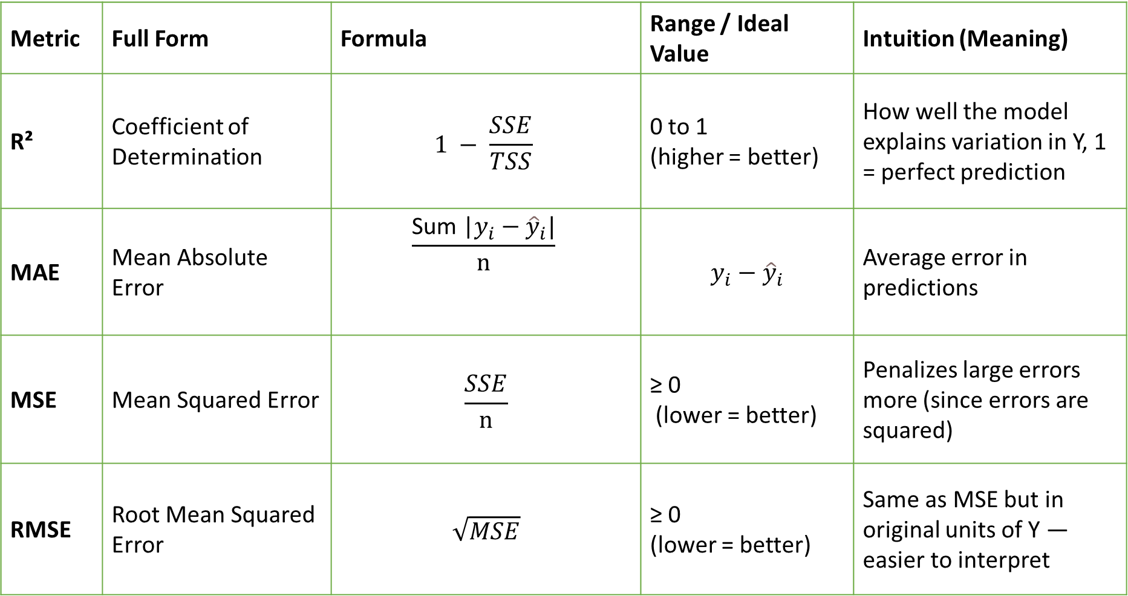
Regression Metrics Evaluation
Metric | Full Form | Formula | Range / Ideal Value | Intuition (Meaning)
R² | Coefficient of Determination | $$1 − \frac{SSE}{TSS}$$ | 0 to 1 (higher = better) | How well the model explains variation in Y, 1 = perfect prediction
MAE | Mean Absolute Error | $$\frac{\text{Sum}\text{ |}y_{i}−{\hat{y}}_{i}\text{|}}{n}$$ | $$y_{i}−{\hat{y}}_{i}$$ | Average error in predictions
MSE | Mean Squared Error | $$\frac{SSE}{n}$$ | ≥ 0 (lower = better) | Penalizes large errors more (since errors are squared)
RMSE | Root Mean Squared Error | $$\sqrt{MSE}$$ | ≥ 0 (lower = better) | Same as MSE but in original units of Y — easier to interpret

Slide 48
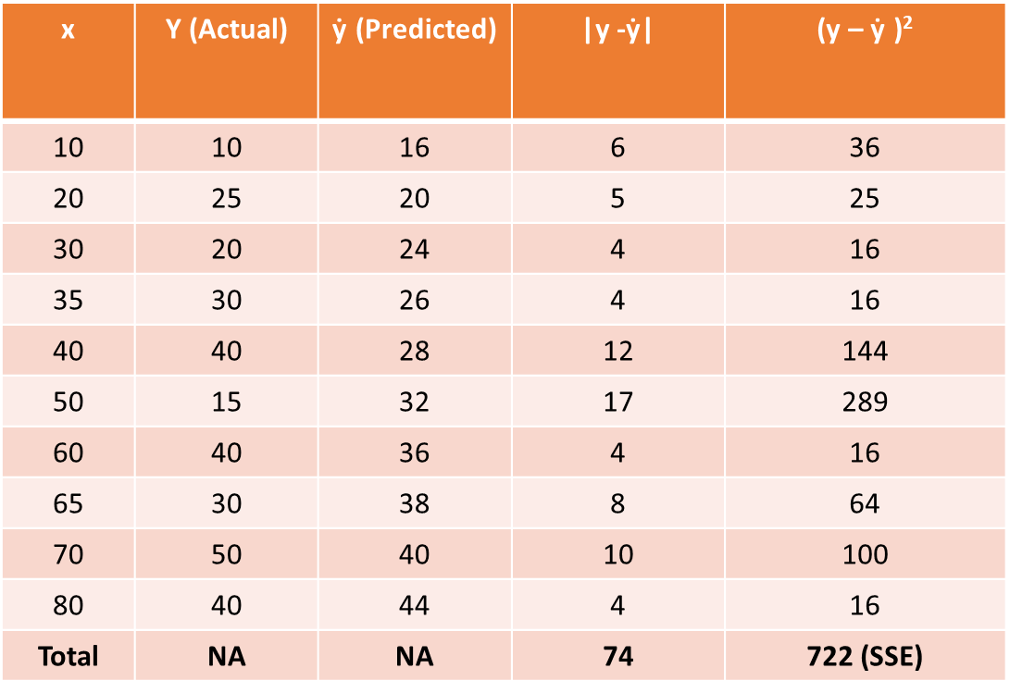

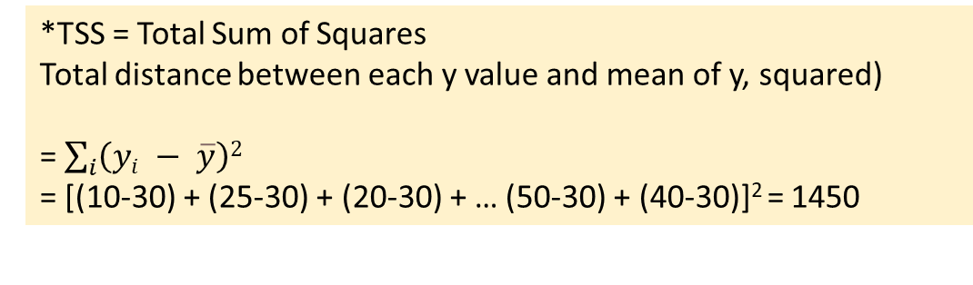
Example
x | Y (Actual) | $\text{ẏ}$ (Predicted) | |y -$\text{ẏ}\text{|}$ | (y – $\text{ẏ}$ )²
10 | 10 | 16 | 6 | 36
20 | 25 | 20 | 5 | 25
30 | 20 | 24 | 4 | 16
35 | 30 | 26 | 4 | 16
40 | 40 | 28 | 12 | 144
50 | 15 | 32 | 17 | 289
60 | 40 | 36 | 4 | 16
65 | 30 | 38 | 8 | 64
70 | 50 | 40 | 10 | 100
80 | 40 | 44 | 4 | 16
Total | NA | NA | 74 | 722 (SSE)
R² = $1 − \frac{SSE}{TSS∗}$
$\text{R}\text{2}\text{ =} 1 − \frac{722}{1450}$ = 0.502
MSE =$\frac{SSE}{n}$ = $\frac{722}{10}$ = 72.2
RMSE = $\sqrt{MSE}$ = $\sqrt{72.2}$ = 8.49
MAE = $\frac{\text{Sum}\text{ (}y_{i}−{\hat{y}}_{i}\text{)}}{n}$ = $\frac{74}{10}$ = 7.4
*TSS = Total Sum of Squares
Total distance between each y value and mean of y, squared)
= $\sum_{i}{\left(yi − \overline{y}\right)2}$
= [(10-30) + (25-30) + (20-30) + … (50-30) + (40-30)]² = 1450

Slide 49
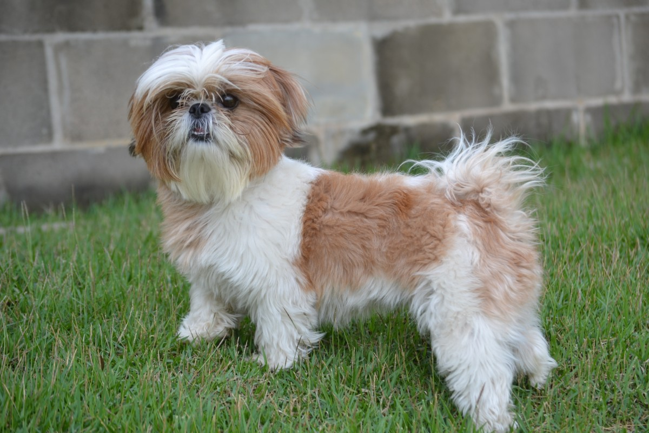
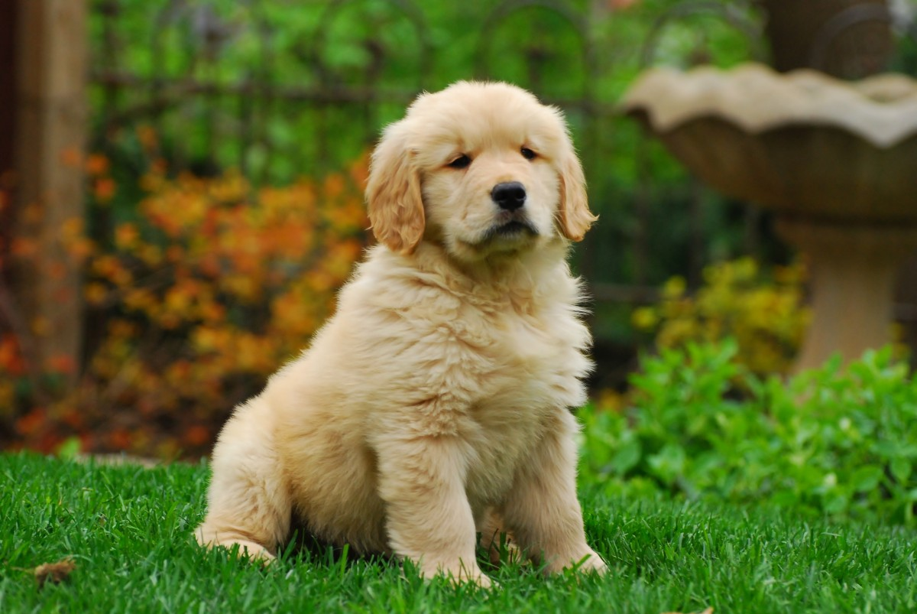
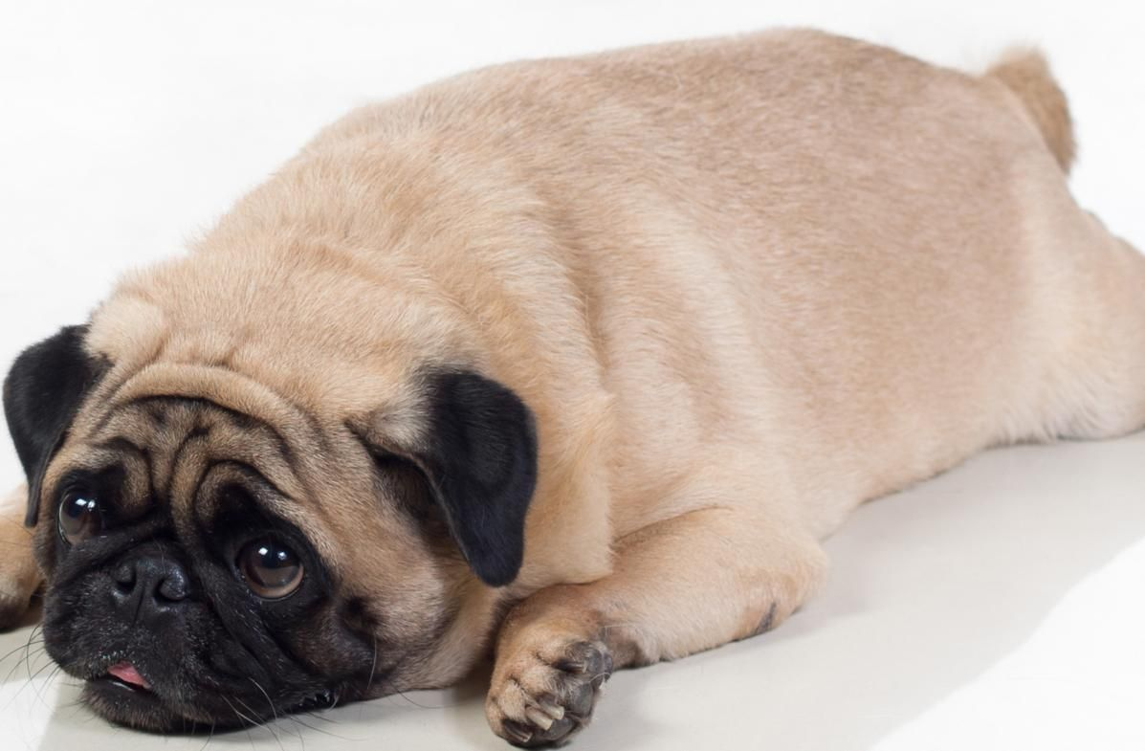
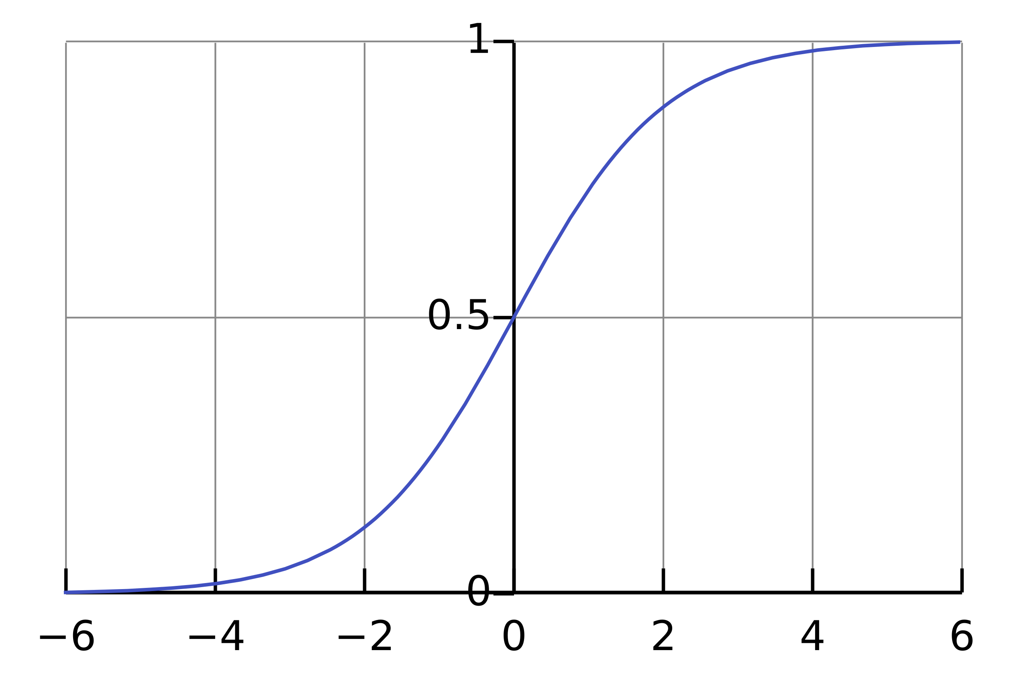
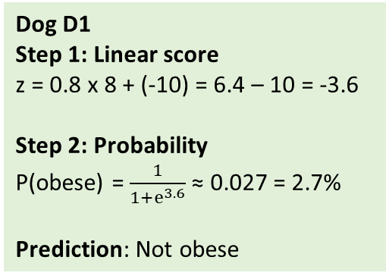
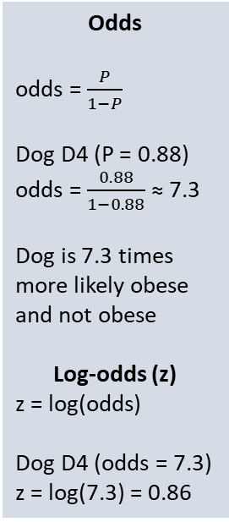
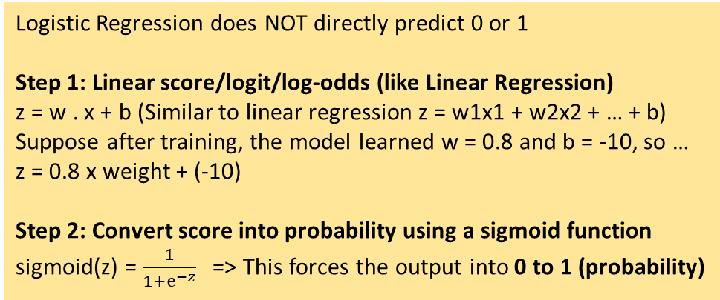
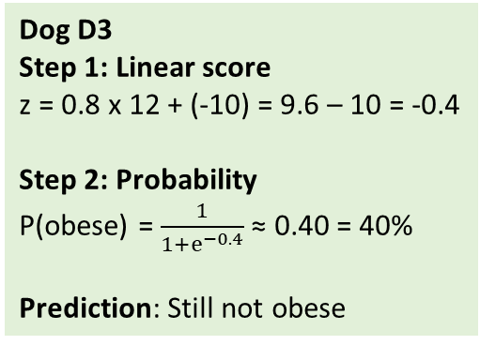
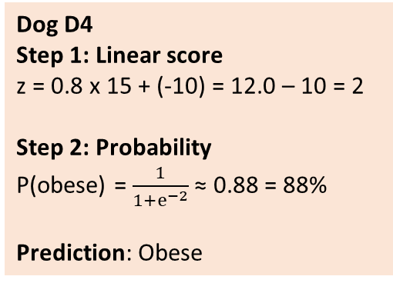
Logistic Regression: Predict Obesity for a Dog
Odds
odds = $\frac{P}{1−P}$
Dog D4 (P = 0.88)
odds = $\frac{0.88}{1−0. 88}$ ≈ 7.3
Dog is 7.3 times more likely obese and not obese
Log-odds (z)
z = log(odds)
Dog D4 (odds = 7.3)
z = log(7.3) = 0.86
Dog | Weight (kg) | Obese (y)
D1 | 8 | 0 (Not obese)
D2 | 10 | 0
D3 | 12 | 0
D4 | 15 | 1 (Obese)
D5 | 18 | 1
D6 | 22 | 1
Logistic Regression does NOT directly predict 0 or 1
Step 1: Linear score/logit/log-odds (like Linear Regression)
z = w . x + b (Similar to linear regression z = w1x1 + w2x2 + … + b)
Suppose after training, the model learned w = 0.8 and b = -10, so …
z = 0.8 x weight + (-10)
Step 2: Convert score into probability using a sigmoid function
sigmoid(z) = $\frac{1}{1+ⅇ^{−z}}$ => This forces the output into 0 to 1 (probability)
Dog D1
Step 1: Linear score
z = 0.8 x 8 + (-10) = 6.4 – 10 = -3.6
Step 2: Probability
P(obese) = $\frac{1}{1+ⅇ^{3.6}}$ ≈ 0.027 = 2.7%
Prediction: Not obese
Dog D3
Step 1: Linear score
z = 0.8 x 12 + (-10) = 9.6 – 10 = -0.4
Step 2: Probability
P(obese) = $\frac{1}{1+ⅇ^{−0.4}}$ ≈ 0.40 = 40%
Prediction: Still not obese
Dog D4
Step 1: Linear score
z = 0.8 x 15 + (-10) = 12.0 – 10 = 2
Step 2: Probability
P(obese) = $\frac{1}{1+ⅇ^{−2}}$ ≈ 0.88 = 88%
Prediction: Obese
z value | Meaning
z = 0 | Obese and not-obese equally likely (50–50)
z > 0 | More likely obese
z < 0 | More likely not obese
Large +z | Almost certainly obese
Large −z | Almost certainly not obese

Slide 50
Confusion Matrix
Confusion matrix: A table that summarizes how well a classification model performs — by comparing actual labels with predicted labels
Tells us where our model is getting confused — i.e. which classes it is mixing up
Symbol | Meaning
H₀ | Null hypothesis — the “default” or “no effect” assumption
H₁ | Alternative hypothesis — the competing claim, suggesting a difference or effect
Hypothesis | Statement
H₀: Email is NOT spam | Default assumption: the email is legitimate (ham)
H₁: Email IS spam | Alternative assumption: the email is spam

Slide 51

Confusion Matrix
Model decision = Hypothesis Test
When the model predicts a probability (say $P\left(\text{Spam}\right)=0.8)$
If $P\left(\text{Spam}\right)≥0.5$→ we reject $H_{0}$(decide email is spam)
If $P\left(\text{Spam}\right)<0.5$→ we fail to reject $H_{0}($decide email is not spam)
Connecting to Confusion Matrix
Actual | Model Decision | What happened (statistically) | Type of Error / Correctness
Not spam (H₀ true) | Predicted not spam | Correctly accepted H₀ | True Negative
Not spam (H₀ true) | Predicted spam | Wrongly rejected H₀ | False Positive (Type I error)
Spam (H₁ true) | Predicted spam | Correctly rejected H₀ | True Positive
Spam (H₁ true) | Predicted not spam | Failed to reject H₀ | False Negative (Type II error)

Slide 52
Metrics Derived From Confusion Matrix
Metric | Formula | Meaning | Example (TN=90, FP=10, FN=20, TP=80) | Value
Accuracy | (TP + TN) / (TP + TN + FP + FN) | Overall correctness | (80+90)/ (80+90+10+20) | 0.85
Precision | TP / (TP + FP) | Of predicted positives, how many were correct | 80/ (80+10) | 0.89
Recall (Sensitivity) | TP / (TP + FN) | Of actual positives, how many were caught | 80/ (80+20) | 0.80
Specificity | TN / (TN + FP) | Of actual negatives, how many were correct | 90/ (90+10) | 0.90
F1 Score | 2 × (Precision × Recall) / (Precision + Recall) | Balance between precision and recall | 2×(0.89×0.80)/ (0.89+0.80) | 0.84

Slide 53
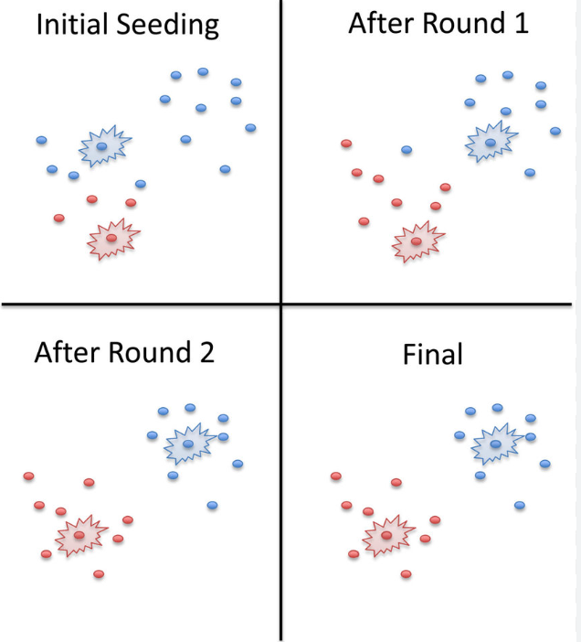
K-Means Clustering
An unsupervised machine learning algorithm used to group similar data points into clusters based on distance
Goal
Divide data into K groups (clusters)
Points in the same cluster are similar
Points in different clusters are dissimilar
Working
Choose K (number of clusters)
Randomly place K centroids
Assign each data point to the nearest centroid
Recompute centroids (mean of points)
Repeat steps 3–4 until centroids stop changing

Slide 54
K-Means Clustering and Elbow Method
Step | Action | Our example
1 | Choose K | Let K = 2
2 | Pick 2 random centers | Center 1 = 35, Center 2 = 75
3 | Assign points to nearest centers | 35, 38, 40 -> Cluster 1 75, 78, 82 -> Cluster 2
4 | Recalculate centers | New Center 1 ≈ 38 New Center 2 ≈ 78
5 | Repeat and stop when clusters do not change | NA
Final result:
Low scores cluster and
High scores cluster
K-Means = Grouping similar data points together
K = Number of groups (clusters)
Means = Center of each group
Used when no labels are available, i.e. Unsupervised learning
Student data: Make 2 clusters
Student | Marks
A | 35
B | 38
C | 40
D | 75
E | 78
F | 82
K = 1, Center = 58
K = 2 (2 groups)
K = 3 (3 groups)
K = 4 (4 groups)
Marks | Far from center?
35 | very far
38 | far
40 | far
75 | far
78 | far
82 | far
Cluster | Marks
1 | 35, 38, 40 (Center = 38)
2 | 75, 78, 82 (Center = 78)
Cluster | Marks
1 | 35, 38 (Center = 36.5)
2 | 40 (Center = 40)
3 | 75, 78, 82 (Center = 78)
Cluster | Marks
1 | 35 (Center = 36.5)
2 | 38, 40 (Center = 39)
3 | 75, 78 (Center = 76.5)
4 | 82 (Center = 82)
Cluster | Are points close to center?
Low marks | YES
High marks | YES
K | Improvement
1 → 2 | BIG improvement
2 → 3 | small improvement
3 → 4 | very tiny improvement
Only a small improvement – Error drops a little
Very bad grouping
Very high error
No real improvement
Huge improvement – Error drops a lot
The point where improvement suddenly slows down = Elbow

Slide 55
Reinforcement Learning
Step 1: Initialize Q-Values (Starting with No Knowledge)
Step 4: Reach Reward State
State = Near food
Action = Right
Reward = +10
Update:
Q(Near Food, Right) = 0 + 0.5[10 + 0 – 0] = 5
Agent learns: Right is good near food
State | Left | Right
Start | 0 | 0
Middle | 0 | 0
Near Food | 0 | 0
Learning formula
Q(s,a) = Q(s,a) + α[r + γmax Q(s′,a′) − Q(s,a)]
α = Learning rate
γ = Discount factor
Learning by Interaction with Environment
A type of Machine Learning
Agent learns by trial and error
Uses rewards and penalties
Goal: maximize cumulative reward
Step 2: Take Action, Observe Reward
Example Episode
State = Start
Action = Right
Reward = 0
Next State = Middle
Example: Robot finding food
Dataset = Experience table – Not fixed!
Step 5: Backpropagate Learning
Q(Middle, Right) = 0 + 0.5[0 + 0.9 x 5 - 0] = 2.25
Q(Start, Right) = 0 + 0.5[0 + 0.9 x 2.25 - 0] = 1.0125
Component | Description
Agent | Learner/decision maker
Environment | Where agent operates
State (S) | Current situation
Action (A) | Choice made by agent
Reward (R) | Feedback signal
Step | State | Action | Reward
1 | Start | Right | 0
2 | Middle | Right | 0
3 | Near Food | Right | +10
4 | Start | Left | -5
Step 3: Update Q-Value (Learning Step)
Q(s,a) = Q(s,a) + α[r + γmax Q(s′,a′) − Q(s,a)]
Assume
α = Lerning rate = 0.5
γ = Discount factor = 0.9
Update:
Q(Start, Right) = 0 + 0.5[0 + 0.9 x 0 – 0] = 0
No reward yet -> No learning
Updated Table and Policy
State | Left | Right
Start | 0 | 1.01
Middle | 0 | 2.25
Near Food | 0 | 5
Unlike ML, data is generated by interaction
RL process
Agent observes state
Takes action
Environment responds
Agent receives reward
Updates policy
Policy
Strategy followed by agent
Mapping: State → Action
Types:
Deterministic
Stochastic
State | Best Action
Start | Right
Middle | Right
Near Food | Right

Slide 56
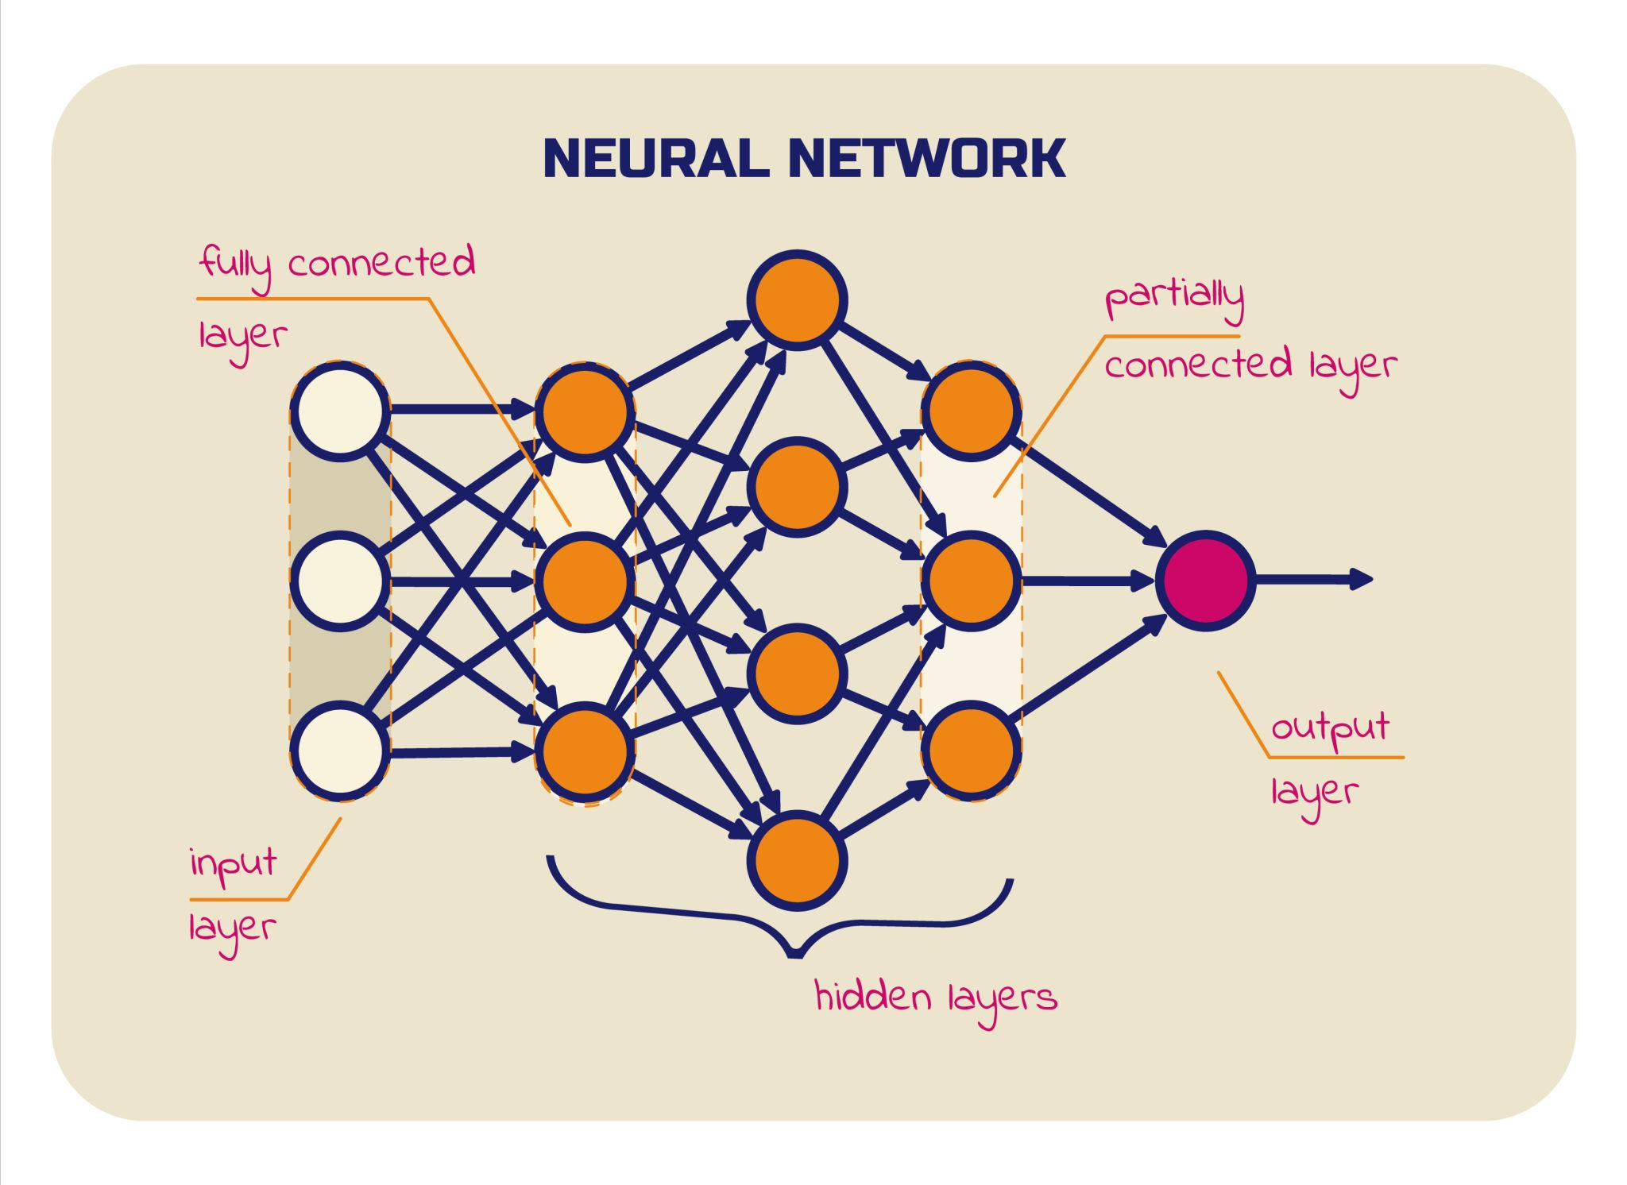
Deep Learning
Subset of Machine Learning
Uses Neural Networks with multiple layers
Learns complex patterns automatically
Inspired by the human brain
Made of neurons (nodes)
Organized in layers
Input Layer
Hidden Layers
Output Layer

Slide 57
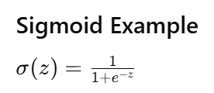
Artificial Neuron and Activation Function
Each neuron computes
Weighted sum of inputs
Adds bias
Applies activation function
Neuron formula: z = w₁x₁ + w₂x₂ + … + b
Activation function adds non-linearity
Common types
Sigmoid
ReLU
Tanh

Slide 58
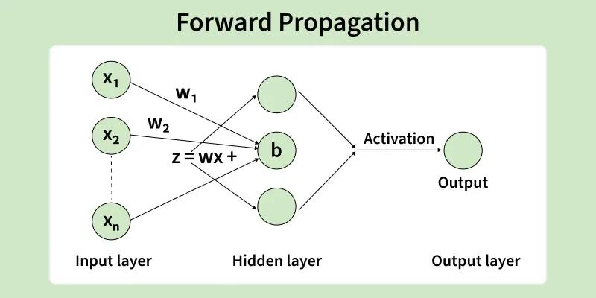
Forward Pass (Prediction Step)
Input features go to network
Each layer computes weighted sum
Activation applied
Final output produced
Example
Input = 2, Weight = 0.5, Bias = 1
Step 1: z = 0.5 x 2 + 1 = 2
Step 2: Output = 𝞼(2) ≈ 0.88
Prediction = 0.88

Slide 59
Loss Function and Backpropagation
Loss function measures error between prediction and actual
Common measures
Mean Square Error (MSE)
Binary Cross Entropy
Backpropagation = Learning step
Adjusts weights to reduce error
Compare prediction vs actual
Calculate error
Send error backward
Update weights
Step | Neural Network
1 | Linear score (z)
2 | Activation (probability)
3 | Compute error
4 | Backprop (gradient)
5 | Update weights
6 | Repeat

Slide 60


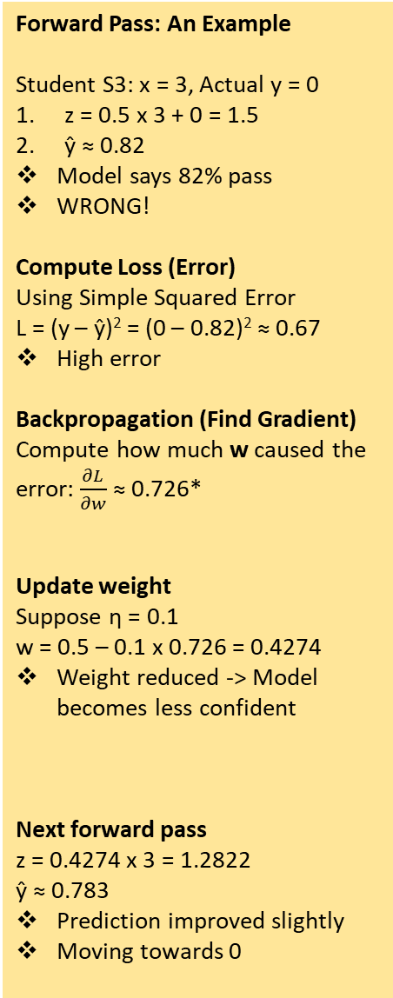
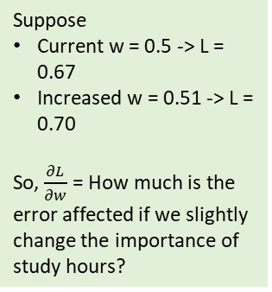
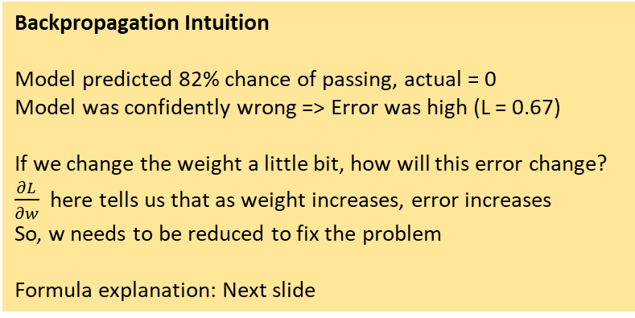
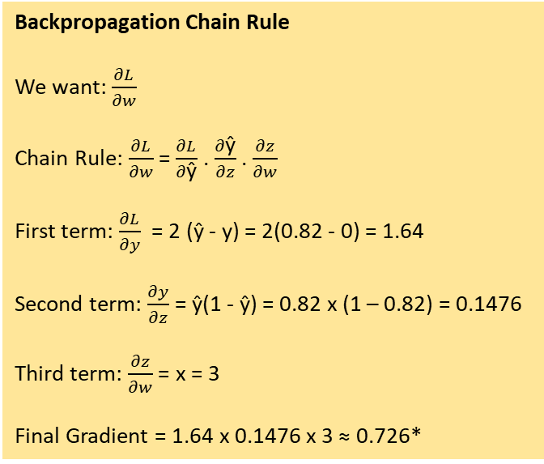
Neural Network Predict Student Pass(1)/Fail(0)
Forward Pass: An Example
Student S3: x = 3, Actual y = 0
z = 0.5 x 3 + 0 = 1.5
ŷ ≈ 0.82
Model says 82% pass
WRONG!
Compute Loss (Error)
Using Simple Squared Error
L = (y – ŷ)² = (0 – 0.82)² ≈ 0.67
High error
Backpropagation (Find Gradient)
Compute how much w caused the error: $\frac{∂L}{∂w}$ ≈ 0.726*
Update weight
Suppose η = 0.1
w = 0.5 – 0.1 x 0.726 = 0.4274
Weight reduced -> Model becomes less confident
Next forward pass
z = 0.4274 x 3 = 1.2822
ŷ ≈ 0.783
Prediction improved slightly
Moving towards 0
Backpropagation Chain Rule
We want: $\frac{∂L}{∂w}$
Chain Rule: $\frac{∂L}{∂w}$ = $\frac{∂L}{∂\text{ŷ}}$ . $\frac{∂\text{ŷ}}{∂z}$ . $\frac{∂z}{∂w}$
First term: $\frac{∂L}{∂y}$ = 2 (ŷ - y) = 2(0.82 - 0) = 1.64
Second term: $\frac{∂y}{∂z}$ = ŷ(1 - ŷ) = 0.82 x (1 – 0.82) = 0.1476
Third term: $\frac{∂z}{∂w}$ = x = 3
Final Gradient = 1.64 x 0.1476 x 3 ≈ 0.726*
Suppose
Current w = 0.5 -> L = 0.67
Increased w = 0.51 -> L = 0.70
So, $\frac{∂L}{∂w}$ = How much is the error affected if we slightly change the importance of study hours?
If I change the weight w a tiny bit, how much will the loss L change?
Student | Study Hours | Actual (y)
S1 | 1 | 0
S2 | 2 | 0
S3 | 3 | 0
S4 | 5 | 1
S5 | 6 | 1
Model
Assume
Weight (w) = 0.5
Bias (b) = 0
Backpropagation Intuition
Model predicted 82% chance of passing, actual = 0
Model was confidently wrong => Error was high (L = 0.67)
If we change the weight a little bit, how will this error change?
$\frac{∂L}{∂w}$ here tells us that as weight increases, error increases
So, w needs to be reduced to fix the problem
Formula explanation: Next slide
Step 1: Forward Pass
z = wx + b
Step 2: Activation Function

Slide 61
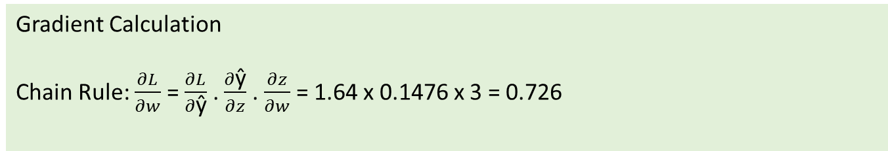
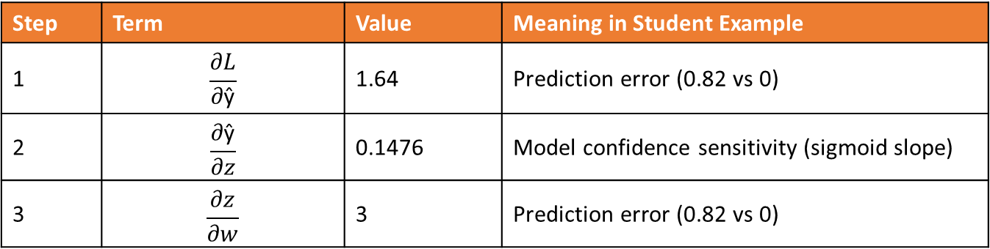
Backpropagation Formula Constituents
Step | Term | Value | Meaning in Student Example
1 | $$\frac{∂L}{∂\text{ŷ}}$$ | 1.64 | Prediction error (0.82 vs 0)
2 | $$\frac{∂\text{ŷ}}{∂z}$$ | 0.1476 | Model confidence sensitivity (sigmoid slope)
3 | $$\frac{∂z}{∂w}$$ | 3 | Prediction error (0.82 vs 0)
Inputs
x = 3 hours
ŷ = 0.82 (Predicted)
y = 0 (Actual)
Factor | What it tells
Error is high (1.64) | Model prediction is very wrong
Sigmoid slope is moderate (0.1476) | Model can still adjust
Input is 3 | Study hours influenced prediction
Gradient Calculation
Chain Rule: $\frac{∂L}{∂w}$ = $\frac{∂L}{∂\text{ŷ}}$ . $\frac{∂\text{ŷ}}{∂z}$ . $\frac{∂z}{∂w}$ = 1.64 x 0.1476 x 3 = 0.726

Slide 62
LLM Architecture
Large Language Model (Examples: GPT, BERT)
Predicts next word/token: Sequence → Probability → Next Token
Trained on massive text data
Concept | What it is | How it works (simple) | Key Point
Tokens | Small units of text converted to numbers | Text → split into tokens → each token gets an ID → converted to vectors | Model understands numbers, not words
Context Window | Maximum number of tokens model can process at once | Model reads only a fixed number of tokens at a time | Older tokens are dropped when limit is exceeded
Attention (Self-Attention) | Mechanism to find relationships between tokens | Each token compares itself with all other tokens and assigns importance (weights) | Helps model understand context and meaning
Transformers | Architecture that processes tokens using attention | All tokens are processed in parallel using attention layers | Enables fast and long-context understanding

Slide 63
Example
Step | Process | What Happens
1 | Input text | “The dog barked loudly”
2 | Tokenization | [The, dog, barked, loudly]
3 | Context Window | All tokens loaded (if within limit)
4 | Attention | Model links “dog” ↔ “barked”
5 | Transformer | Processes all tokens together
6 | Output | Predicts next token (e.g., “at”)

Slide 64
The dog barked loudly
Step 1: Tokens
Step 4: Create Q, K, V
Step 7: Weighted Sum (Final Representation)
Word | Token ID (example)
The | 101
dog | 205
barked | 876
loudly | 432
For simplicity: Q = K = V = Embeddings
So, barked (Q) = [1, 1]
See next slide
Output = Sum (weight . V)
Token | Weight | Value Vector (V) | Weighted Vector (Weight × V)
The | 0.13 | [1, 0] | [0.13, 0]
dog | 0.13 | [0, 1] | [0, 0.13]
barked | 0.37 | [1, 1] | [0.37, 0.37]
loudly | 0.37 | [0, 2] | [0, 0.74]
Step 5: Compute Scores (Dot Product)
Score = Q . K
Model sees: [101, 205, 876, 432]
Word | K | Score with “barked”
The | [1,0] | (1×1 + 1×0) = 1
dog | [0,1] | (1×0 + 1×1) = 1
barked | [1,1] | 2
loudly | [0,2] | 2
Step 2: Convert to Vectors (Embedding)
Token | Vector
The | [1, 0]
dog | [0, 1]
barked | [1, 1]
loudly | [0, 2]
Final Output (Sum of All)
Dimension | Calculation | Result
First | 0.13 + 0 + 0.37 + 0 | 0.50
Second | 0 + 0.13 + 0.37 + 0.74 | 1.24
Step 6: Apply Softmax (Convert to Weights)
Word | Score | Weight
The | 1 | 0.13
dog | 1 | 0.13
barked | 2 | 0.37
loudly | 2 | 0.37
Final Vector [0.50, 1.24]
New representation of barked after attention
For simplicity, we consider 2D vectors here
Step 3: Attention goal
For each word, find which other words are important?
As an example, let us take barked
Sum = 1

Slide 65
Transfer Learning
Applying skills we already have to learn something new faster (e.g. learning to ride a bike, after learning how to ride a bicycle)
AI: Take a model that has already learned something useful and adapt it to a new but related task
Example: Train AI to recognize cats in picture, but in the process, it also learns general things such as edges, shapes, textures, patterns
Result: To train the model to recognize dogs, do not start from scratch; instead just the take the cat-recognition model and retrain the final layers – Since it already knowsabout fur textures, animal shapes, and facial features, it learns to recognize dogs much faster and with fewer examples
Advantages: Saves time, Training data, Starts with good “general knowledge” instead of being completely naïve
Code: C:\code\llm\2_deep_learning\2_2_transfer_learning\2_2_1_transfer_learning.py

Slide 66
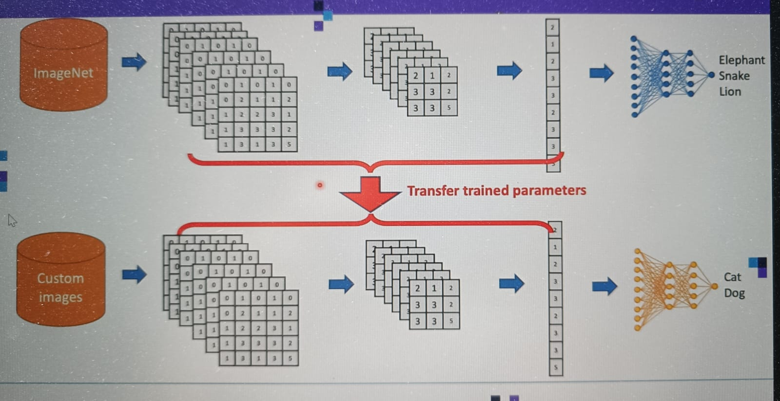
Why Transfer Learning

Slide 67
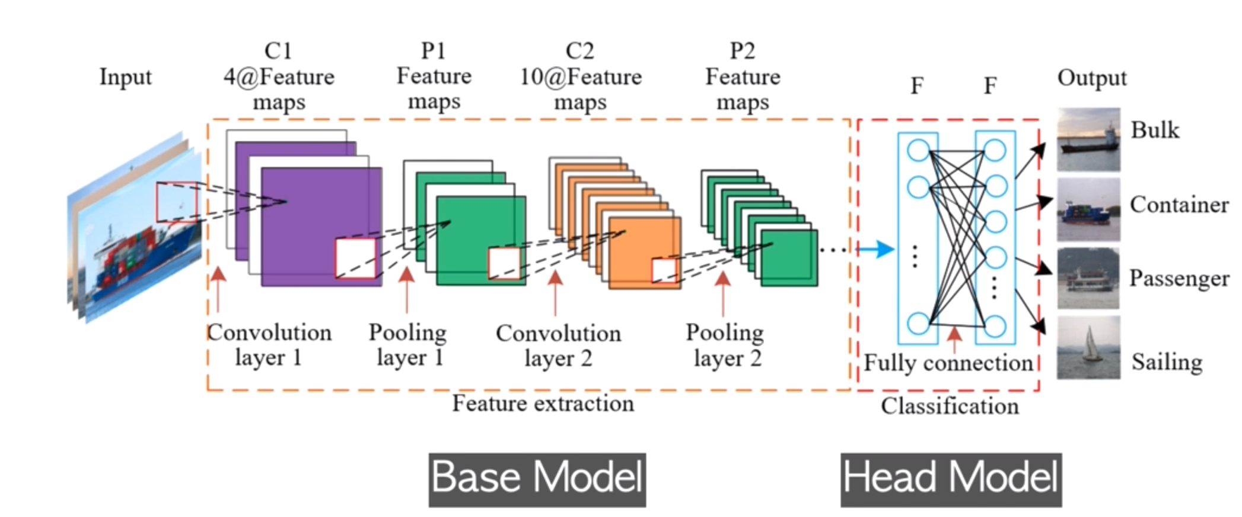
A Typical Convolution Neural Network (CNN)
For transfer learning, we only use the Base Model of a pre-trained model and create our own Head Model

Slide 68
Transfer Learning: Removing the Head Model
baseModel = MobileNetV2(# Load pretrained MobileNet model
weights="imagenet", # Was trained on ImageNet dataset
include_top=False, # Do not use the final classification layer (i.e. Head Model or Top Layer), retain only the feature extraction part (i.e. Base Model)
input_shape=(IMAGE_SIZE, IMAGE_SIZE, 3), # Input image size expected by the model in 3 (RGB) colours
input_tensor=Input(shape=(IMAGE_SIZE, IMAGE_SIZE, 3)) # Connect MobileNet model to a new input layer in our own model, so that our custom model layer gets added to the base model
)

Slide 69
Model Fine-Tuning
C:\code\llm\2_deep_learning\2_2_transfer_learning\2_2_2_finetuning.py
Transfer Learning = User the model as is
Fine-tuning = Allow the model to “adjust a little bit” to our data
How? Slightly retrain the top part of a pretrained model so it learns features specific to our new task
Example: Learn about Homer’s rounder hair, Bart’s spiky hair, …
Approach | Training Time | Requires Big Dataset | Accuracy | Stability
Transfer Learning (base frozen) | Fast | Small dataset OK | Good | Very stable
Fine-Tuning (few layers) | Medium | Small dataset OK | Better | Stable
Full Training (everything unfrozen) | Very slow | Needs massive dataset | Best | Very unstable

Slide 70
Model Fine-Tuning
# | Technical Point | Detailed Explanation
1 | Uses a pretrained model | Instead of starting from random weights we load a model already trained on a massive dataset like ImageNet which already understands edges curves textures and general visual patterns
2 | Replace the final layer | The pretrained model’s last layer was built for its original task like 1000 classes in ImageNet so we remove it and attach a new layer with the number of classes we need such as 2 for Homer and Bart
3 | Freeze early layers | Early layers detect basic universal features like edges and colors so we freeze them meaning we do not update these weights during training and this keeps strong generic features intact
4 | Optionally unfreeze later layers | Deeper layers detect more specific features like shapes and character details and we can unfreeze only these later layers so they learn task specific patterns which is called partial finetuning
5 | Use a lower learning rate | A high learning rate can overwrite useful pretrained knowledge so we use a small learning rate to make gentle updates and preserve what the model has already learned
6 | Requires much less data | Because the model already knows general visual features we need far fewer images to train a new task compared to starting from scratch
7 | Faster training | Since most of the network is already trained and often frozen the model trains much faster and converges quickly
8 | Helps avoid overfitting | Pretrained weights give a solid starting point which prevents the model from memorizing noise especially when our dataset is small
9 | Works best when tasks are similar | Transfer is strongest when the original dataset and our new dataset share visual structure for example ImageNet objects and cartoon characters still include shapes colors and textures
10 | Two main strategies | Feature extraction means freezing most layers and training only the last layer while full finetuning means unfreezing more or all layers for deeper adaptation and both strategies depend on data size and difficulty

Slide 71
LoRA
LoRA = Low-Rank Adaptation
Extra technique, built on top of finetuning, only for large models (LLMs, Stable Diffusion, Vision Transformers, etc)
Not used for traditional networks such as ResNet50, but used only when the base model is extremely large
Reason: Updating all weights is too expensive
LoRA does not rewrite base weights, but instead, adds tiny tracable matrices on the side and trains only those matrices
This drastically reduces parameters
Original weight W → NOT trained
LoRA adds A and B → trained
Final weight = W + A*B
LORA inserts itself inside every layer we want to adapt

Slide 72
Fine-Tuning
Resumption of training a pre-trained model to increase the performance of a specific task using task-specific data
Allows a model to adjust its parameters for improving its ability or to tackle domain-specific issues
Technique | Description | When to Use | Pros | Cons
Standard Fine-Tuning | Updates all model weights using new training data | When we have a large dataset and need deep domain adaptation | Maximum flexibility Highest performance gains | Very expensive Requires large compute Risk of overfitting
LoRA (Low-Rank Adaptation) | Injects small trainable matrices into the model; only these are trained | When we need fast, cheap, parameter-efficient tuning | Very low cost Fast training Can stack multiple adapters | Slightly lower performance than full tuning in complex tasks
SFT (Supervised Fine-Tuning) | Trains model on labeled examples demonstrating correct behavior | For aligning model behavior with specific instructions or tasks | Simple and stable Good for instruction following | Depends on high-quality data Still limited without feedback optimization
RLHF (Reinforcement Learning from Human Feedback) | Model learns via reward signals based on human preference rankings | When behavior alignment, safety, or preferences matter most | Produces safer, more aligned outputs Improves helpfulness and tone | Very costly (needs human labeling + RL system) Hard to train correctly

Slide 73
LoRA (Low-Rank Adaptation)
Aspect | Explanation
What is LoRA? | A parameter-efficient fine-tuning method where small low-rank matrices are added to a frozen model, and only these new matrices are trained.
Why it exists | Full fine-tuning is expensive; LoRA reduces compute and memory needs while maintaining high accuracy.
How it works | Replaces weight update ΔW with BA, where B and A are small low-rank matrices. Base model weights stay frozen.
What gets trained | Only the low-rank adapter matrices (~0.1–1% of total parameters).
Cost efficiency | Very high — up to 90–99% fewer trainable parameters compared to full fine-tuning.
Speed | Much faster training because the base model does not change.
Memory usage | Very low; adapters sit alongside base weights. Easy to load/unload.
Modularity | Multiple LoRA adapters can be swapped for different tasks without retraining the base model.
Common use cases | Chatbots, domain specialization, style tuning, instruction tuning, Q&A, enterprise task customization.
Advantages | Cheap, fast, modular, avoids catastrophic forgetting, works on consumer GPUs.
Disadvantages | Slightly less accurate than full fine-tuning for very deep domain changes.
Popular frameworks | PEFT (HuggingFace), QLoRA, LLaMA-Adapters, DeepSpeed-MoE.

Slide 74
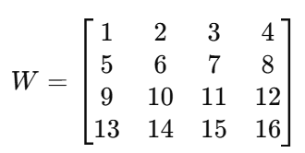
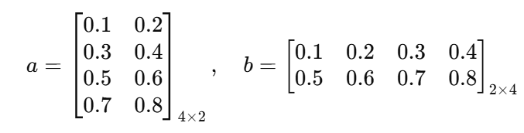

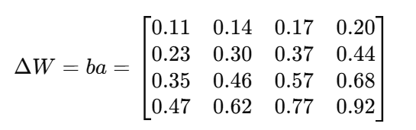
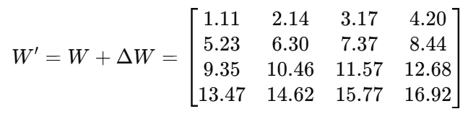
How LoRA Works? An Example
Original weight matrix of a transformer layer
LORA does not update this
This remains frozen
Create two small matrices, rank r = 2
Matrix A: Input -> Rank ➔ 4x2
Matrix B: Output -> Rank ➔ 2x4
Multiply A and B and then compute
Now compute and use
Sample calculations:
(ba)11 =0.1∗0.1 + 0.2∗0.5
= 0.01 + 0.10
= 0.11
(ba)12 = 0.1∗0.2 + 0.2∗0.6
= 0.02 + 0.12
= 0.14

Slide 75
Why LoRA?
Concept | Explanation
Original Weight | The pre-trained model already knows a lot. Think of it as a “chef” who knows how to cook
Problem | Fine-tuning all weights is expensive in memory and compute. Often, only small adjustments are needed for a new task
LoRA Idea | Instead of changing everything, add a small, low-rank adjustment to the weights
Components | Two small matrices: one decides directions to adjust, the other decides strength of adjustment
Update | The original weight is kept mostly frozen - The small matrices are trained to tweak it for the new task
Efficiency | Much fewer parameters to train - Can adapt large models without touching the full weight matrix
Analogy | Giving the chef a few new spices instead of retraining them from scratch
Benefit | Fast, memory-efficient, and modular: multiple tasks can use different small tweaks without changing the original model

Slide 76
QLoRA
Concept | Explanation
What QLoRA Is | A method to fine-tune large language models very cheaply using 4-bit quantization plus LoRA adapters.
Problem It Solves | Full fine-tuning needs huge GPU memory; even LoRA can struggle on very large models.
Core Idea | Compress (quantize) the model weights to 4-bit, but keep a small LoRA adapter in higher precision for training.
Why This Works | The main model becomes very small in memory, but the LoRA adapter still learns high-quality task-specific adjustments.
Benefit | You can fine-tune 30B–70B models on a single GPU.
What Stays Frozen | The compressed (4-bit) backbone model. No training happens here.
What Gets Trained | Only the tiny LoRA adapter (two small matrices).
Memory Savings | Up to 75% less GPU memory compared to full FP16 fine-tuning.
Speed Advantage | Much faster because only the small adapter receives updates.
Quality | Maintains almost the same accuracy as full fine-tuning with far less compute.
Analogy | You store a huge book in a compressed format, but keep a small notepad to write your own notes. The notes change how you “interpret” the book.
Multi-Task | You can keep many task adapters without modifying the original model.
Deployment | During inference, the compressed model + trained adapter work together to produce final outputs.

Slide 77
PEFT
Topic | Explanation
What PEFT Is | A collection of techniques to fine-tune large models using very few trainable parameters.
Why It Exists | Full fine-tuning is expensive; PEFT makes fine-tuning possible on small GPUs or even laptops.
Core Idea | Keep the original large model frozen and train only a tiny number of parameters.
Supported Methods | LoRA, QLoRA, Prefix Tuning, Prompt Tuning, P-Tuning, AdaLoRA.
Memory Benefit | Saves 60–95% GPU memory compared to full fine-tuning.
Speed Benefit | Training is much faster since very few parameters update.
Quality | Often matches or closely approaches full fine-tuning.
Deployment | Merges the small trained adapter with the original model at inference.
Reusability | You can keep multiple adapters for different tasks without retraining the base model.
Libraries | Provided by Hugging Face under the peft package.

Slide 78
Embedding and Vector
Embedding: A technique to represent information (text, image, audio, video) as a list of numbers such that similar items have vectors that are close to each other in high-dimensional space
How? Convert information (text, image, audio, video) into a vector (list of numbers)
Example
Original text: “Cute dog”
Embedding: [0.02134, -0.00312, 0.01579, 0.09821, -0.04412, …]
The entire vector captures semantic meaning in a compressed way, i.e. individual numbers are not interpretable
Distances between embeddings reflect similarity
One Embedding = One Vector

Slide 79
Embedding Models
Model Name | Provider | Key Features (Simple Words) | Typical Dimensions
text-embedding-3-small | OpenAI | Fast, cheap, good for search & clustering | 1536
text-embedding-3-large | OpenAI | Highest accuracy, best semantic understanding | 3072
all-MiniLM-L6-v2 | Hugging Face / Sentence Transformers | Very fast, small, good for local use; widely used | 384
all-mpnet-base-v2 | Hugging Face / Sentence Transformers | High quality semantic search; great balance of speed + accuracy | 768
bge-small-en | Hugging Face (BAAI) | Very fast, optimized for retrieval tasks | 384
bge-base-en | Hugging Face (BAAI) | Strong semantic retrieval; good general-purpose model | 768
bge-large-en | Hugging Face (BAAI) | Very high accuracy; heavier to run | 1024
e5-small-v2 | Hugging Face (Microsoft) | Lightweight; very good for embeddings in search tasks | 384
e5-base-v2 | Hugging Face (Microsoft) | Strong performance for retrieval, question–answering | 768
instructor-xl | Hugging Face (HKU + Meta) | Instruction-based embeddings (you can tell the model what to focus on) | 768 / 1024+
Concept | Meaning | Example
Embedding Model | An AI model that creates these vectors | OpenAI “text-embedding-3-small”
Dimension | How many numbers are in each vector | 1536 numbers, 3072 numbers, etc.
Similarity | How close two vectors are in meaning | “cat” vector ≈ “kitten” vector
Distance | Mathematical gap between two vectors | Small distance → similar meaning
Vector Space | The “map” where all vectors live | Similar ideas group together in space
Use Cases | What embeddings are used for | Search, recommendations, clustering
“Cute dog”
Embedding model
[0.02134, -0.00312, 0.01579, …]

