Slide 1

Agentic AI: Architectures & Design Patterns
Certificate in Agentic AI and Software Solutions — Module 2
Atul Kahate

Slide 2
Learning Objectives
01
02
03
Identify Agent Components
Planning & Decision-Making
Tool Calling
Recognize the major building blocks of an agent architecture
Understand how an agent reasons, plans, and selects actions
Explain tool selection and how agents invoke external capabilities
04
05
Design Patterns
Build a Tool-Using Agent
Compare common agentic architectures and when to apply each
Design a simple architecture and implement it in the lab

Slide 3

Anatomy of an AI Agent
Core Components
Every agent is built from seven fundamental elements that work together in a continuous loop:
Flow: User Goal → Agent → LLM → Decision → Tool / Knowledge / Action → Observation → Agent
Goal
State
LLM
Tools
Memory
Environment
Feedback

Slide 4
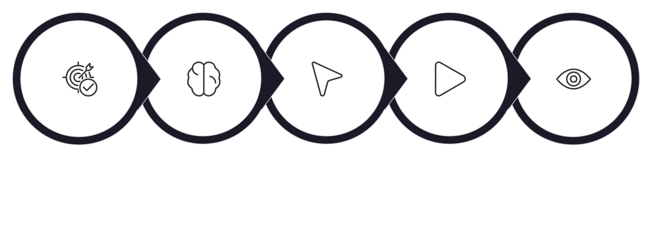
Agent Execution Loop
Understand Goal
Choose Action
Observe Result
Reason
Execute
The agent may cycle through this loop multiple times before a task is fully resolved. Each iteration refines the agent's understanding and brings it closer to completing the goal.

Slide 5
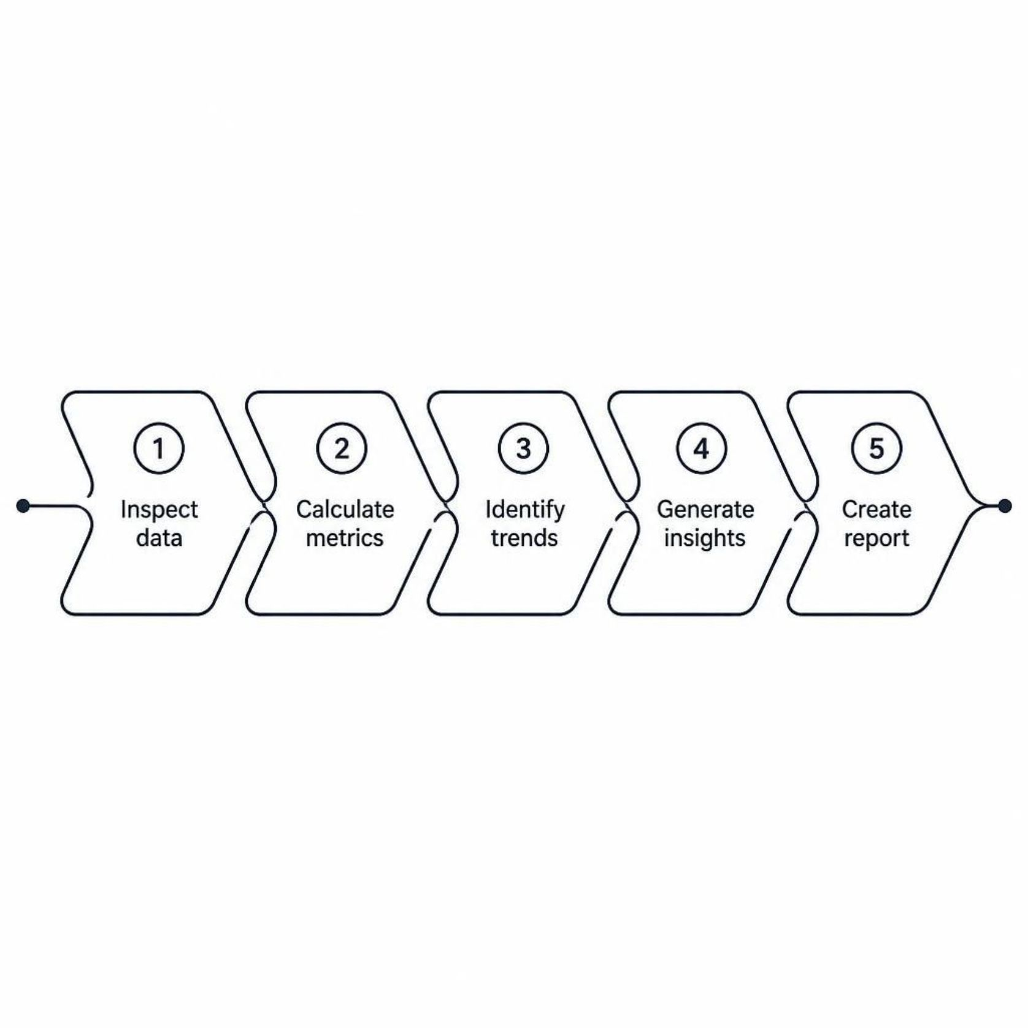
Why Do Agents Need Planning?
The Problem
Some tasks cannot be solved with a single LLM call. Consider: "Analyze a sales dataset and prepare a management report."
No single prompt can accomplish this end-to-end — the work must be broken down.

Slide 6
Planning Strategies
Single-Step
1
One decision, one action — simplest form of planning
Multi-Step
2
A pre-defined sequence of planned actions executed in order
Plan-and-Execute
3
Create the full plan upfront, then execute each step
Re-Planning
4
Adjust the plan dynamically based on new observations
Hierarchical
5
High-level plan broken into nested sub-plans for complex goals

Slide 7
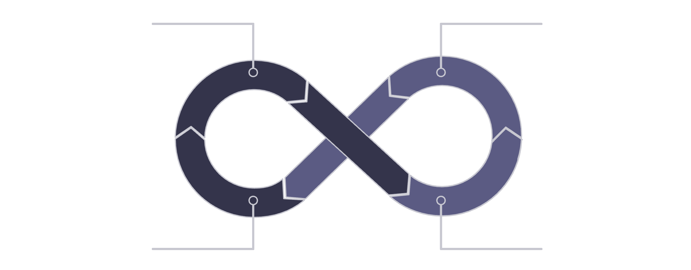
The ReAct Pattern
Reason + Act
Thought
Action
ReAct agents alternate between reasoning about what to do and acting on that reasoning — then observing the result before reasoning again.
Example flow: Determine weather is needed → call weather tool → observe result → answer user
Thought
Observation

Slide 8

The Plan-and-Execute Pattern
Separation of Concerns
When to Use It
This pattern decouples "What should be done?" from "How should it be done?" — the Planner defines all tasks upfront, and the Executor carries them out.
Best suited for complex multi-step tasks where the full plan can be determined before execution begins. Reduces mid-task decision overhead.
Flow: User Goal → Planner → Tasks → Executor → Result

Slide 9

Tool Calling
Extending Agent Capabilities
A tool gives an agent an external capability it couldn't otherwise have. Without tools, an agent can only generate text.
Common Tool Types
Flow: Request → LLM → Select Tool → Arguments → Execute → Result → LLM → Final Response
Web Search
Database
Calculator
REST API
File System
Email / Calendar

Slide 10
Why Tools Matter
Without Tools
With Tools
Generate text only
Limited, static knowledge
No external computation
No direct database access
Retrieve live information
Perform real-world actions
Execute calculations
Query databases directly
Key idea: an LLM can generate, while tools allow the system to do.

Slide 11


Tool Selection & Descriptions
The Selection Problem
An agent may have many tools available — choosing the right one is itself a decision-making challenge.
What the LLM Needs to Know
Good tool descriptions directly improve tool selection accuracy.
What the tool does
When to use it
What arguments it requires
What it returns

Slide 12
Structured Tool Arguments
From Natural Language to Structure
Why Structure Matters
Tools receive structured arguments rather than unstructured text. The LLM translates the user's intent into a precise, machine-readable payload.
Example:
Predictable
Validatable
Consistent format every call
Catch errors before execution
{"percentage": 17.5, "value": 80000}
Safer
Debuggable
Reduced injection risk
Clear audit trail

Slide 13

Agent Architecture: Who Controls What?
🧠 LLM
⚙️ Application / Framework
Understands language, reasons, selects tools, and generates responses
Executes tools, maintains state, controls flow, handles errors, and applies policies
🔧 Tools
Perform the actual operations — computation, retrieval, writing, and external actions

Slide 14
Memory vs. State
State
Memory
Information needed during the current execution
Information retained for future interactions
Current plan
Tool results so far
Current step in the loop
Past conversations
User preferences
Stored domain knowledge
Ephemeral — discarded when the run ends
Persistent — survives across sessions

Slide 15

CHAPTER 2
Agentic Design Patterns
Proven architectural blueprints for structuring agent systems — from simple routing to complex multi-agent collaboration.

Slide 16

Routing Pattern
Direct Requests to the Right Specialist
A Router examines the incoming user request and dispatches it to the most appropriate agent or processing path.
Routing enables specialization without requiring a single agent to do everything.
Sales Question
Technical Issue
Support Issue
→ Sales Agent
→ Technical Agent
→ Support Agent

Slide 17

Sequential Pattern
Extract
Analyze
Summarize
Report
Each agent in the chain depends on the output of the previous step. Tasks execute one after another — ideal for pipelines where order and handoff quality matter. Best used when steps cannot be parallelized.

Slide 18
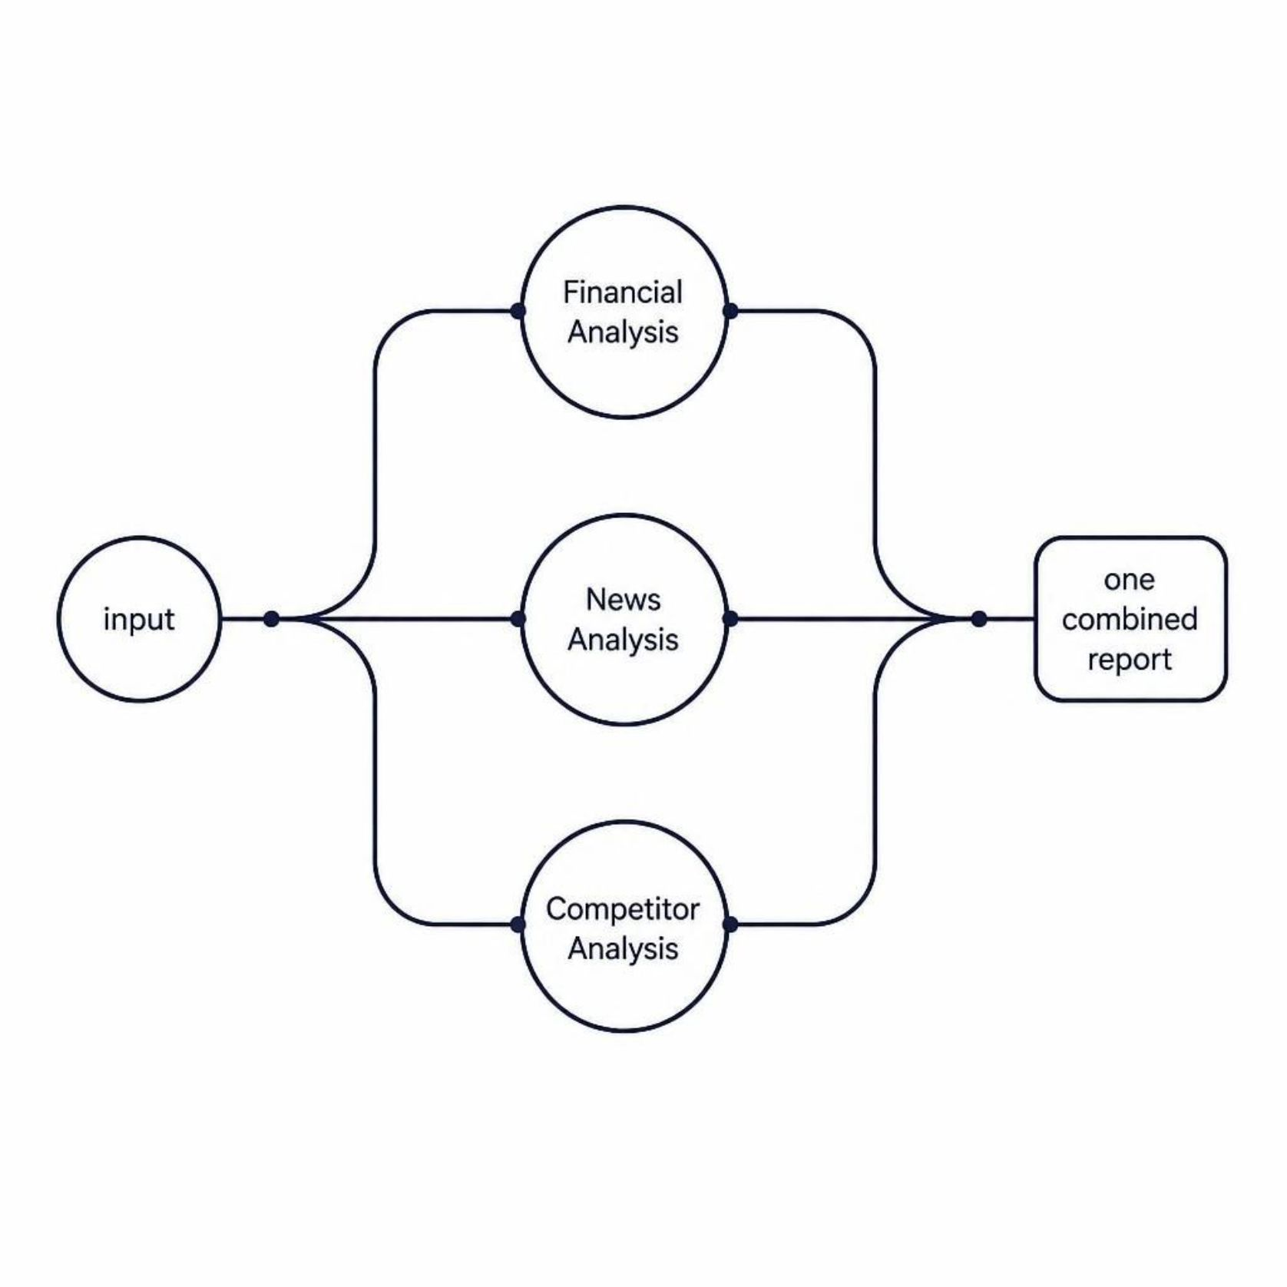
Parallel Pattern
Run Independent Tasks Simultaneously
When subtasks don't depend on each other, they can be dispatched in parallel — dramatically reducing overall execution time.
Example
Financial analysis
News sentiment analysis
Competitor landscape analysis
All three run concurrently, then results are combined into a single report.

Slide 19

Reflection Pattern
Generate → Evaluate → Improve
Trade-offs
The agent critiques its own output and iterates until quality standards are met.
✅ Higher Quality
Errors caught before delivery
Examples
⚠️ More LLM Calls
Generate code → review → improve
Generate report → fact-check → revise
Increased cost per task
⚠️ Higher Latency
Takes longer to complete

Slide 20


Human-in-the-Loop Pattern
When Autonomy Must Pause
Flow: Agent → Proposed Action → Human Review → Approve / Reject → Execute
Some actions are too consequential to execute without human sign-off.
Critical Use Cases
Financial transactions
Production deployments
Deleting data
Important outbound emails
Security-sensitive actions
Autonomy should always be matched to risk.

Slide 21

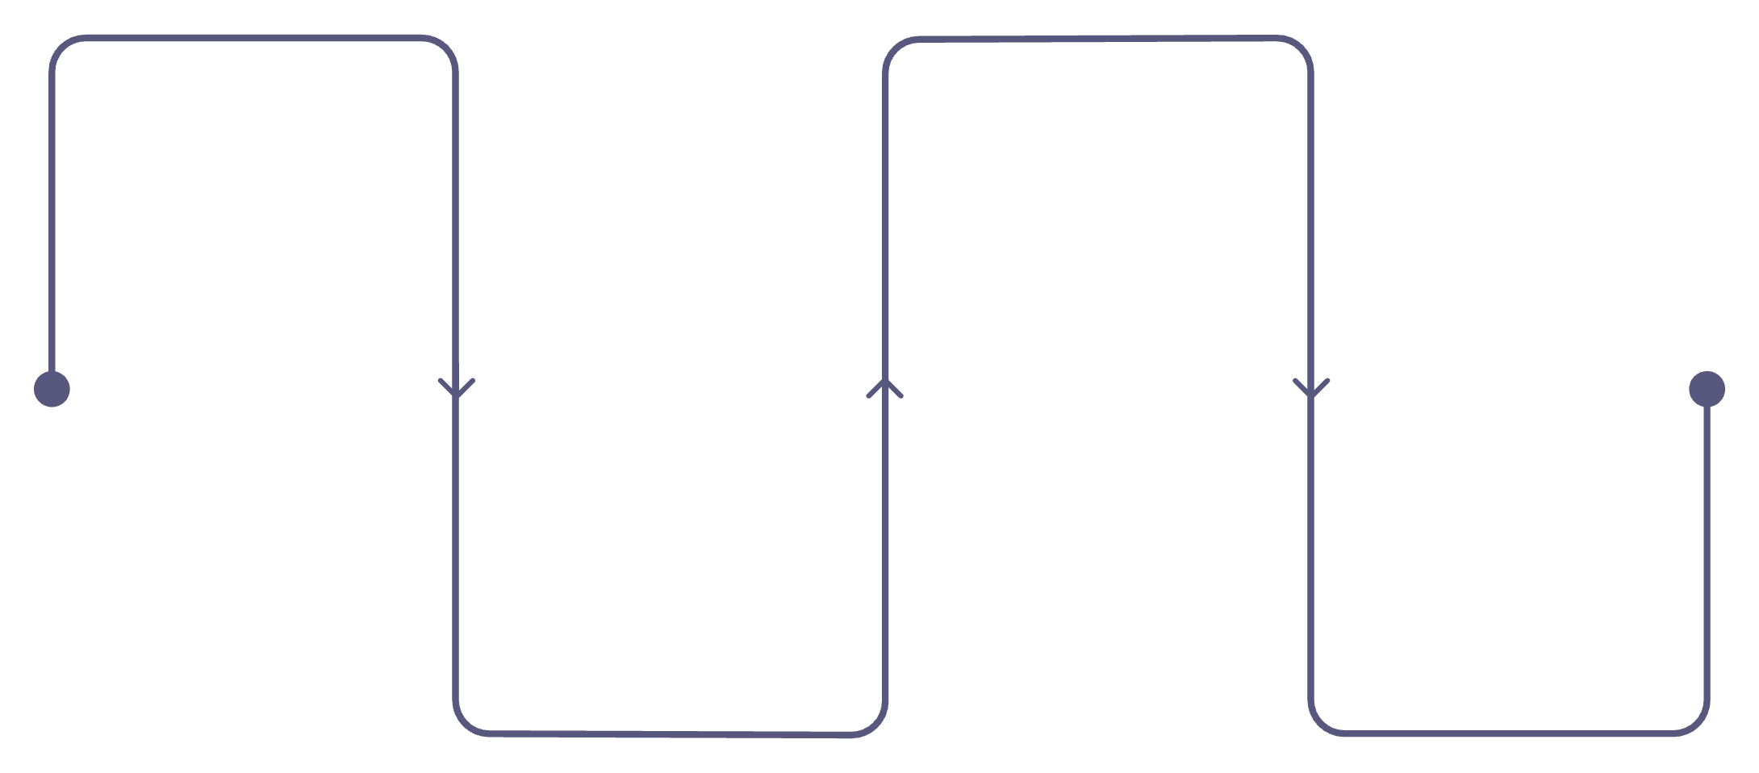
Hierarchical & Multi-Agent Systems
Hierarchical: Supervisor Model
A Supervisor agent delegates tasks to specialized sub-agents and coordinates their results into a coherent output. Specialization makes complex systems easier to design and manage.
Multi-Agent Pipeline Example
Research
Writing
Collect sources and evidence
Draft structured report content
Analysis
Review
Interpret data and findings
Validate, edit, and finalize

Slide 22
Choosing an Architecture
Predictable Task
Dynamic Decisions
→ Workflow
→ Agent
Independent Tasks
Need to Delegate
→ Parallel Execution
→ Supervisor / Hierarchical
Quality Verification
Risky Action
→ Reflection
→ Human-in-the-Loop

Slide 23

Agent Design Checklist
1
Goal
What must the agent accomplish?
2
Tools
What external capabilities does it need?
3
State & Memory
What must it remember now vs. persist across sessions?
4
Output
What should it produce and in what format?
5
Guardrails
What should it never do? Where is human approval required?

Slide 24

CHAPTER 3
Lab: Build a Tool-Using Agent
Apply everything from Theory and Design Patterns — implement a real agent that selects and calls tools to answer user requests.

Slide 25

Lab Architecture
User Request
Agent
LLM
Tool Decision
The agent dynamically decides which tool — if any — is needed based on the user's request. This mirrors real production agent architectures at a learnable scale.

Slide 26
Define the Tools
Three Tools, One Agent
1
2
The lab agent has access to three tools. It must select the right one — or none — for each incoming request.
This forces the agent to reason about what kind of answer the user needs before acting.
calculator(expression)
search_information(query)
Evaluates a mathematical expression and returns a numeric result
Retrieves information from a knowledge source
3
get_current_time()
Returns the current date and time

Slide 27

Agent Decision Examples
"What is 25% of 64,000?"
→ Choose calculator → calculator('64000 * 0.25') → 16,000
Arithmetic request: structured computation required, not text generation
"Explain LangGraph."
→ Choose knowledge tool → retrieve information → generate explanation
Conceptual request: retrieve context first, then synthesize a response

Slide 28

Handling Multiple Tool Calls
Some Requests Require More Than One Tool
Search Tool
Example request: "Find the price of a product and calculate the total cost for 5 units."
This single request requires two sequential tool calls — neither tool alone can complete the task.
Product Price
Calculator
Total Cost

Slide 29
Lab Challenges
Core Scenarios
Failure Cases
Discussion Points
No tool needed
Calculation request
Knowledge question
Multiple tools required
Ambiguous request
Invalid tool argument
Tool unavailable
Unexpected return value
Tool selection logic
Argument generation quality
Failure behavior and recovery

Slide 30


Agent Failure Scenarios
What Can Go Wrong
Wrong Tool Selected
Agent misreads the request type
Incorrect Arguments
Malformed payload causes tool failure
Tool Unavailable
External dependency is down
Goal Misunderstood
LLM reaches an incorrect conclusion
Production agents need: validation, error handling, guardrails, and observability.

Slide 31

Module 2 Summary
What We Covered
Final Principle
Agent architecture & the execution loop
Planning strategies & the ReAct pattern
Tool calling, selection & structured arguments
Routing, sequential, parallel & reflection patterns
Human-in-the-loop & multi-agent systems
Choose the simplest architecture that provides the required level of intelligence, autonomy, and control.
Up Next
Module 3 — Building Production Agentic Systems

