Slide 1
Building AI Agents with LangGraph
Certificate in Agentic AI and Software Solutions | Module 4 | 10-hour module
Module
Duration
Module 4 of the Certificate in Agentic AI and Software Solutions program
10 hours of structured instruction, labs, and applied exercises
Focus
Outcome
Graph-based agent architecture using the LangGraph framework
Build, test, and debug a stateful AI agent with tool use and conditional routing

Slide 2
Learning Objectives
By the end of Module 4, students will be able to:
1
Understand LangGraph and its purpose
Articulate what LangGraph is, why it exists, and how it differs from traditional LLM chaining approaches.
2
Explain graph-based agent architecture
Describe how nodes, edges, and state combine to form a controllable agent execution graph.
3
Define and manage agent state
Design a state schema appropriate to a given agent task and manage state updates across graph execution.
4
Create nodes and edges
Implement processing nodes and connect them with both direct and conditional edges.
5
Implement conditional routing
Write routing logic that directs execution based on the current state of the graph.
6
Integrate tools and build a stateful agent
Connect Python-defined tools to an LLM node and build a complete, testable stateful agent.

Slide 3
What is LangGraph?
LangGraph is a framework for building stateful, multi-step agent applications. Rather than expressing logic as a linear sequence of calls, LangGraph represents application logic as a graph — a structure composed of nodes, edges, and shared state.
Graph Representation
Nodes Perform Work
Application logic is modelled as a directed graph. The graph defines every possible path execution can take, making complex agent behavior explicit and inspectable.
Each node is a discrete function responsible for a specific operation — calling an LLM, executing a tool, validating output, or formatting a response.
Edges Determine Flow
State Carries Information
Edges connect nodes and define what happens next. They can be direct (always go to node B) or conditional (go to B or C depending on state).
A shared state object is passed through the graph. Nodes read from and write to state, providing continuity across every step of execution.

Slide 4
Why LangGraph?
Traditional LLM chains are designed for predictable, linear sequences. Agents, however, require loops, branches, and decisions — capabilities that chains do not naturally support.
The Problem with Linear Chains
What LangGraph Provides
Chains move from step A to step B to step C in a fixed order. When an agent needs to call a tool, evaluate the result, and decide whether to call another tool or finish, a linear chain cannot express that logic cleanly.
Makes branching and looping explicit in the graph structure
Provides fine-grained control over agent execution
Supports state — information persists across steps
Supports persistence — execution can be saved and resumed
Supports human intervention — execution can pause for approval
Supports tool use — tools are first-class citizens in the graph
Agents involve loops and decisions
Traditional chains are often linear
Branching and looping are implicit or impossible

Slide 5
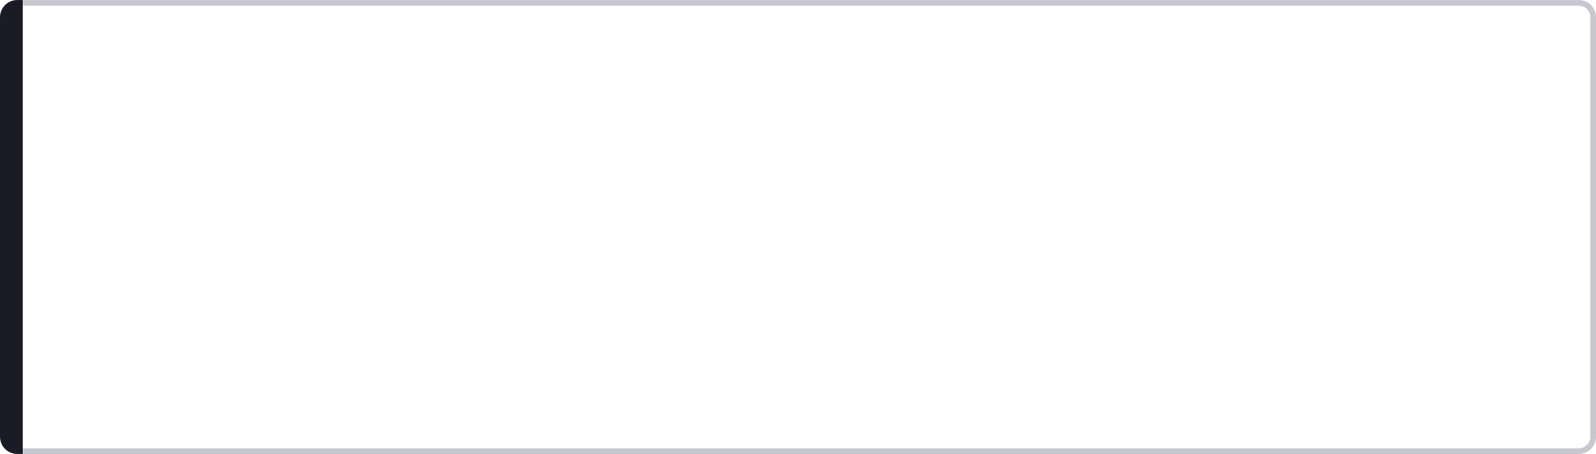
Chain vs Graph
Understanding the distinction between a chain and a graph is foundational to understanding why LangGraph exists and when to use it.
Chain
Graph
Step A → Step B → Step C
A chain is a linear, ordered sequence of operations. Each step executes once, in order. Chains are appropriate for predictable, deterministic workflows where the path never changes based on intermediate results.
Nodes can branch, loop, and return to previous nodes
A graph allows execution to take different paths depending on state. Nodes can be revisited, execution can loop until a condition is met, and multiple branches can exist for different scenarios.
Use Chains For
Use Graphs For
Predictable sequences — document summarization pipelines, structured data extraction, fixed multi-step prompts where the path never varies.
Dynamic agent behavior — tool-calling agents, research agents, multi-step reasoning, retry logic, human-in-the-loop workflows, and any scenario where the next step depends on the current result.

Slide 6
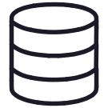
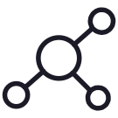
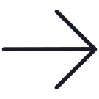




Basic LangGraph Architecture
A LangGraph application is composed of seven core architectural elements. Every agent built with LangGraph is an assembly of these components.
State
Nodes
Edges
The shared data object passed through the graph. Contains all information nodes need to read and write during execution.
Functions that perform discrete operations — LLM calls, tool execution, validation, formatting, or any custom logic.
Connections between nodes that define the default control flow of the graph.
Conditional Edges
Start and End Points
Tools
Routing logic that selects the next node based on the current state — enabling decisions and branching.
Explicit entry and exit points that define where graph execution begins and where it terminates.
Python functions exposed to the LLM, enabling the agent to take actions such as calculation, search, or API calls.
Checkpointing / Persistence
Mechanisms to save graph state at any point, enabling resumption, debugging, and human-in-the-loop workflows.

Slide 7

Understanding State
State is the central concept in LangGraph. It is the shared information object that flows through every node in the graph, providing continuity and context across the entire execution.
What State Contains
How State Works
State can hold any information the graph needs to function. Common contents include:
Nodes read from state to access the information they need, and update state with the results of their operation. State is not global mutable data — each node receives the current state and returns a partial update, which LangGraph merges into the overall state.
The original user request
The full message history (human, AI, and tool messages)
Tool results from previous steps
Intermediate data produced during execution
Decisions made by the LLM or routing logic
The final response to be returned to the user
State provides continuity: without it, each node would operate in isolation with no knowledge of what came before.

Slide 8
Defining State
State must be explicitly defined before a graph can be constructed. The state schema tells LangGraph what information the graph will manage throughout its execution.
01
02
Choose a Schema Format
Define Required Fields
State is typically represented using a TypedDict or a similar schema definition. This provides type safety and makes the state structure explicit and inspectable.
Identify the information the graph needs to carry between nodes. Include message history, task-specific data, intermediate results, and any flags or decisions the routing logic will inspect.
03
04
Keep State Focused
State Provides Continuity
State should contain only what the graph genuinely needs. Avoid storing data that is not used by any node — a focused state schema is easier to reason about and debug.
Once defined, state is initialized with the user's input and updated by each node as execution progresses. The final state contains the complete record of the agent's work and its output.

Slide 9
What is a Node?
A node is a Python function that performs a specific, discrete operation within the graph. Nodes are the units of work in LangGraph — every action the agent takes is implemented as a node.
Call an LLM
Execute a Tool
Validate Output
The most common node type. Passes the current state (typically the message history) to a language model and stores the model's response back into state.
Runs a tool requested by the LLM — a calculator, a search engine, a database query, or any Python function — and returns the result to state.
Inspects the current state to check whether the agent's output meets required criteria before proceeding or looping back.
Retrieve Information
Format Response
Fetches data from an external source — a vector store, an API, or a database — and adds it to state for the LLM to reason over.
Transforms the raw output in state into a structured, user-facing response before the graph reaches its end point.
Nodes receive the current state as input and return a dictionary of state updates. LangGraph merges those updates into the overall state before passing it to the next node.

Slide 10
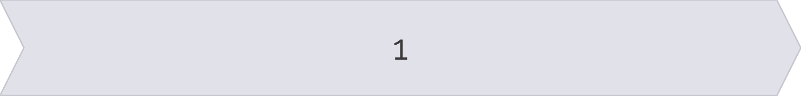
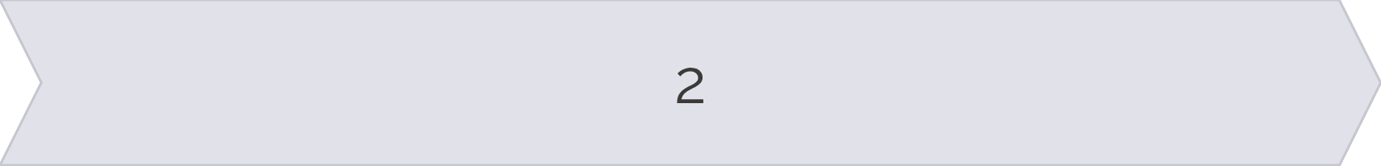
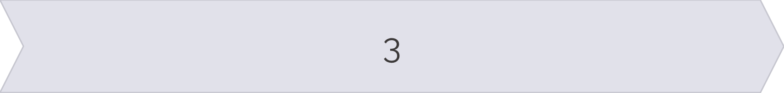

What is an Edge?
An edge is the connection between two nodes. Edges define the control flow of the graph — they determine which node executes after the current one completes.
START
Node A
The entry point of the graph. Execution always begins here, with the initial state provided by the caller.
The first processing node. Receives the initial state, performs its operation, and updates state with its result.
Node B
END
The second processing node. Receives the updated state from Node A and continues the work.
The exit point of the graph. When execution reaches END, the final state is returned to the caller.
In a basic graph, edges are direct — the next node is always the same regardless of state. For dynamic agent behavior, conditional edges are used to select the next node based on the current state.

Slide 11
Conditional Edges
Conditional edges are the mechanism that gives LangGraph agents their decision-making capability. Rather than always routing to the same next node, a conditional edge inspects the current state and selects the appropriate next node based on what it finds.
How Conditional Edges Work
Example: Tool Call Routing
A conditional edge is implemented as a routing function. The function receives the current state, applies logic to it, and returns the name of the next node to execute.
The graph is configured with a mapping from return values to node names, so the routing function's output determines the execution path.
After the LLM node executes, a conditional edge inspects the AI message in state:
If the message contains a tool call → route to the Tool Node
If the message contains no tool call → route to Final Response / END
Conditional routing is essential for agentic behavior. Without it, the graph cannot make decisions — it can only follow a fixed path.

Slide 12
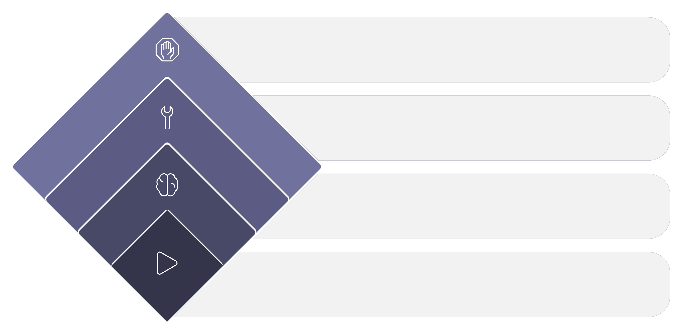
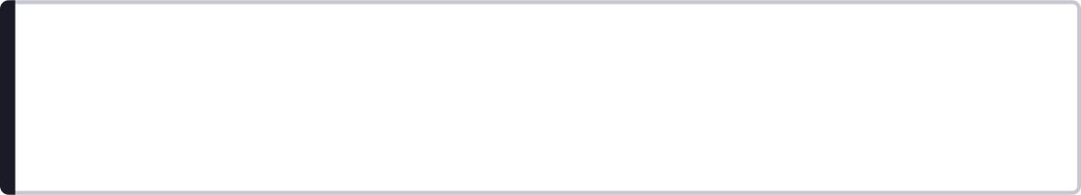
Simple Agent Graph
The simplest complete agent graph combines an LLM node, a tool node, and conditional routing into a loop that continues until the agent has finished its task.
End
Task completed
Tool Node
Run tool if required
LLM Node
Process and decide next
Start
Begin with user request
START → LLM
Tool Required? → Yes → Tool → LLM
Tool Required? → No → END
The user's initial request is placed into state. The LLM node receives the state, reasons over the request, and produces either a direct answer or a tool call.
If the LLM's response contains a tool call, the conditional edge routes to the Tool Node. The tool executes, its result is added to state, and execution returns to the LLM node for further reasoning.
If the LLM's response contains no tool call, the agent has finished. The conditional edge routes to END and the final state — containing the agent's answer — is returned.

Slide 13
The LangGraph Agent Loop
The agent loop is the core execution pattern of a LangGraph agent. It describes the cycle of reasoning, acting, and evaluating that continues until the agent determines it has completed the task.
01
02
User Request
LLM Decides What to Do
The user's input is placed into the initial state as a human message. The graph is invoked with this state.
The LLM node receives the current message history and reasons over it. It either generates a direct response or identifies that a tool is needed and produces a tool call.
03
04
Tool is Called if Required
Tool Result Added to State
If the LLM produced a tool call, the conditional edge routes to the Tool Node. The tool executes the requested operation.
The tool's output is added to state as a tool message, extending the message history with the new information.
05
06
LLM Evaluates the Result
Agent Calls Another Tool or Finishes
Execution returns to the LLM node. The model now has access to the tool result and can reason over it to determine the next action.
The LLM either calls another tool (repeating the loop) or produces a final answer with no tool call, causing the conditional edge to route to END.

Slide 14
Messages as State
In conversational agents, the state is most naturally represented as a list of messages. This message list captures the full interaction history and is the primary input to the LLM at each step of the loop.
Human Messages
AI Messages
Tool Messages
Messages originating from the user. The initial human message contains the user's request. In multi-turn conversations, subsequent human messages continue the dialogue.
Messages produced by the language model. An AI message may contain a direct text response, a tool call request, or both. Tool call requests are structured objects embedded in the AI message.
Messages that carry the result of a tool execution. Each tool message is associated with a specific tool call ID, allowing the LLM to match results to the requests it made.
The message list grows with each step of the agent loop. By passing the full message history to the LLM at each node, the model has complete context — it knows what the user asked, what tools it called, and what those tools returned. This is how messages preserve the interaction history within the graph.

Slide 15







Building a Basic LangGraph
Constructing a LangGraph application follows a consistent seven-step process. Each step builds on the previous, moving from abstract design to a running, testable agent.
1. Define State
Create the state schema using TypedDict. Identify every field the graph will need — messages, task data, flags, and results.
2. Create Nodes
Implement each node as a Python function. Each function accepts the current state and returns a dictionary of updates.
3. Add Nodes to the Graph
Register each node function with the StateGraph instance, giving each node a name that edges will reference.
4. Connect Nodes with Edges
Add direct edges between nodes to define the default control flow. Connect START to the first node and terminal nodes to END.
5. Add Conditional Routing
Add conditional edges with routing functions that inspect state and return the name of the next node to execute.
6. Compile the Graph
Call .compile() on the StateGraph. This validates the graph structure and prepares it for execution.
7. Invoke the Graph
Call .invoke() with the initial state. The graph executes, nodes run in sequence, and the final state is returned.

Slide 16
StateGraph
StateGraph is the primary class in LangGraph used to construct a graph around a defined state schema. It is the container that holds nodes, edges, and routing logic, and it produces the compiled, executable graph.
01
02
Define the State First
Add Processing Nodes
Before creating a StateGraph, define the state schema. The StateGraph is instantiated with the state class as its argument — this binds the graph to that specific state structure.
Use .add_node(name, function) to register each node. The name is a string identifier used when defining edges. The function is the Python callable that implements the node's logic.
03
04
Define Transitions
Compile Before Execution
Use .add_edge() for direct transitions and .add_conditional_edges() for routing logic. Set the entry point with .set_entry_point() to connect START to the first node.
Call .compile() to finalize the graph. Compilation validates the structure — checking for unreachable nodes, missing edges, and other configuration errors — and returns an executable graph object.

Slide 17
Compiling the Graph
Compilation is a required step between graph definition and graph execution. It transforms the declarative graph description into an executable runtime object.
Graph Definition vs Compilation
What Compilation Does
The graph definition phase — adding nodes, edges, and routing logic — describes the architecture of the agent. It specifies what nodes exist and how they connect, but does not execute anything.
Compilation is the step that prepares the graph for execution. It processes the definition and produces a compiled graph object that can be invoked.
Validates the graph structure — checks that all referenced nodes exist, all edges connect valid nodes, and the graph has a reachable END point
Resolves entry and exit points — confirms START and END are correctly configured
Prepares execution machinery — sets up the runtime that will manage state passing, node execution, and edge traversal
Enables optional features — checkpointing and persistence are configured at compile time
The compiled graph can then be invoked with an initial state using .invoke(), .stream(), or .astream().

Slide 18

Invoking a Graph
Once compiled, a graph is executed by invoking it with an initial state. Invocation triggers the full execution cycle — nodes run, state is updated, edges are traversed, and the final state is returned.
Provide Initial State
Graph Executes According to Nodes and Edges
The caller provides a dictionary matching the state schema. At minimum, this includes the user's input — typically as a human message in the messages list. This initial state is passed to the first node via the START edge.
The compiled graph manages execution automatically. It calls each node in turn, passes the current state, collects the state updates returned by the node, and uses the edge configuration to determine which node to call next.
State is Updated as Execution Progresses
Final State Contains the Result
After each node executes, LangGraph merges the node's returned updates into the overall state. The updated state is then passed to the next node. State accumulates information across every step of execution.
When execution reaches END, the graph returns the final state to the caller. The final state contains the complete record of the agent's execution — including the full message history and the agent's final response.

Slide 19
Adding an LLM Node
The LLM node is the reasoning component of the graph. It is responsible for interpreting the current state, deciding what to do next, and producing either a tool call or a final response.
01
02
Create an LLM
Pass Relevant State to the Model
Instantiate a chat model — for example, using LangChain's ChatOpenAI or another supported provider. Configure the model with the appropriate parameters (model name, temperature, etc.).
Inside the node function, extract the relevant information from state — typically the full messages list — and pass it to the model. The model uses this context to reason about the current situation.
03
04
Store the Model Response in State
LLM Node as the Reasoning Component
The model returns an AI message. The node function returns a state update that appends this AI message to the messages list in state. LangGraph merges this update before passing state to the next node.
The LLM node is typically the central node in an agent graph. It is called at the start of each loop iteration, after every tool result, and whenever the agent needs to reason about what to do next.

Slide 20
Adding Tools
Tools extend the agent's capabilities beyond language generation. They allow the agent to take actions — performing calculations, searching the web, querying databases, or calling APIs — and incorporate the results into its reasoning.
1
Define Tools as Python Functions
Each tool is a standard Python function. The function implements the tool's logic — a calculator tool performs arithmetic, a search tool queries an external API, and so on.
2
Provide Tool Names and Descriptions
Tools must be decorated or wrapped so that LangChain can expose them to the LLM. The name and description are critical — the LLM uses them to decide when and how to call each tool.
3
Connect Tools to the LLM
Bind the list of tools to the LLM using .bind_tools(tools). This tells the model what tools are available and enables it to produce structured tool call requests in its output.
4
Add a Tool-Execution Node
Create a node that receives tool call requests from state, executes the appropriate tool function, and returns the results. LangGraph provides a ToolNode utility for this purpose.
5
Return Tool Results to Graph State
The tool node adds tool messages to the messages list in state. These messages carry the tool's output back to the LLM node, which can then reason over the results in the next loop iteration.

Slide 21
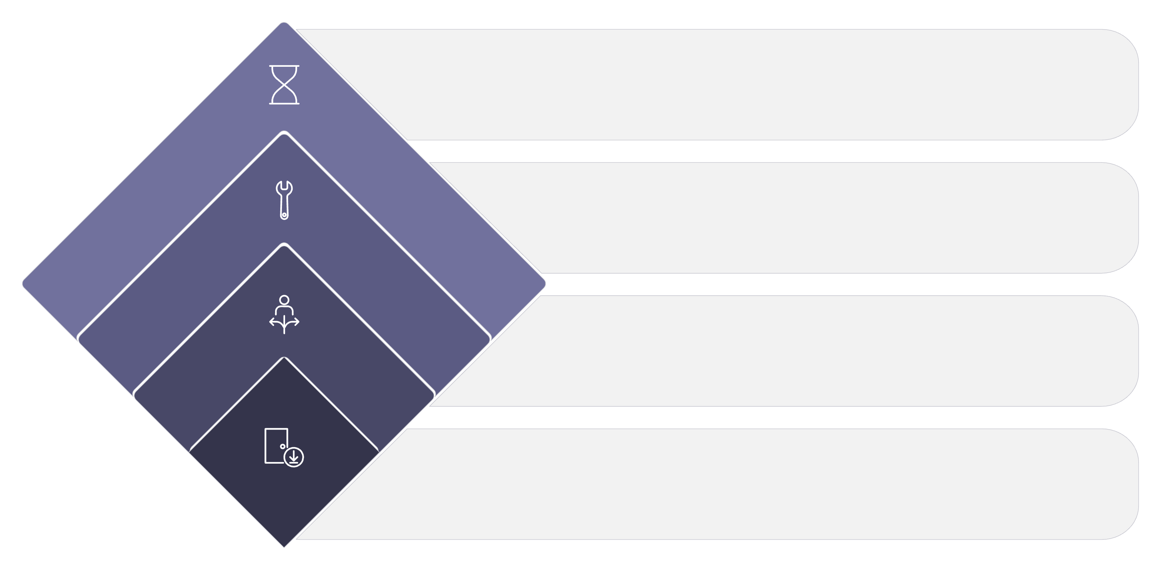
Tool-Calling Graph
The tool-calling graph is the standard pattern for a LangGraph agent that uses tools. It combines the LLM node, the tool node, and conditional routing into a loop that repeats until the agent has no further tool calls to make.
End Loop
No tool call needed — finish
Invoke Tool
Call tool, return result to LLM
Check Tool Need
Conditional: tool call required?
Receive Input
User input enters LLM node
User → LLM Node
No Tool Call → END
The user's request enters state as a human message. The LLM node reasons over the message history and produces a response — either a direct answer or a tool call.
If the LLM's response contains no tool call, the agent has finished. The conditional edge routes to END and the final state is returned to the caller.
Tool Call → Tool Node → LLM Node
Repeat Until Complete
If the LLM's response contains a tool call, the conditional edge routes to the Tool Node. The tool executes, its result is added to state, and execution returns to the LLM Node for further reasoning.
The loop continues — LLM reasons, tool executes, result is added to state — until the LLM produces a response with no tool call, at which point the graph terminates.

Slide 22
Conditional Routing Logic
Conditional routing is implemented as a function that inspects the current state and returns the name of the next node. This function is registered with the graph as a conditional edge.
01
02
Inspect the Latest AI Message
Determine Whether It Contains a Tool Call
The routing function retrieves the most recent message from the messages list in state. This is the AI message produced by the LLM node in the current loop iteration.
The routing function checks whether the AI message contains a tool_calls attribute with one or more tool call objects. If it does, the agent needs to execute a tool. If it does not, the agent is finished.
03
04
Route to the Appropriate Node
Continue Until No Additional Tool Call is Required
Based on the inspection result, the routing function returns a string: the name of the tool node (if a tool call was found) or "__end__" / END (if no tool call was found). LangGraph uses this return value to select the next node.
The routing function is called after every LLM node execution. The loop continues as long as the LLM keeps producing tool calls. When the LLM produces a response with no tool call, the routing function returns END and the graph terminates.

Slide 23
Example: Calculator Agent
The calculator agent is a concrete illustration of the tool-calling loop. It demonstrates how an LLM identifies the need for a tool, delegates the computation, and incorporates the result into a final response.
The Task
Execution Trace
User: "What is 18% of ₹75,000?"
This is a straightforward arithmetic question. While an LLM could attempt to answer directly, a well-designed agent recognizes that precise calculation should be delegated to a tool rather than relying on the model's arithmetic.
LLM identifies that calculation is required — the model inspects the user's question and determines that a calculator tool should be called rather than generating a direct answer.
Calculator tool is called — the LLM produces a tool call with the appropriate arguments (0.18 × 75000). The tool node executes the calculation.
Result is returned — the calculator returns 13,500. This result is added to state as a tool message.
LLM generates the final answer — the LLM node receives the updated state, reads the tool result, and produces a natural language response: "18% of ₹75,000 is ₹13,500."

Slide 24
Example: Research Agent
The research agent demonstrates a more complex tool-calling scenario where the agent must retrieve external information before it can answer the user's question.
01
02
User Asks a Knowledge Question
LLM Decides Whether Information Retrieval is Needed
The user submits a question that requires up-to-date or domain-specific information — something the LLM may not have in its training data or may not be able to answer reliably from memory alone.
The LLM node reasons over the question and determines whether it can answer directly or whether it needs to call a search or retrieval tool to obtain relevant information.
03
04
Search / Retrieval Tool is Called
Result is Added to State
If retrieval is needed, the LLM produces a tool call. The tool node executes the search — querying a web search API, a vector store, or another retrieval system — and returns the results.
The retrieved information is added to state as a tool message, extending the message history with the new context the LLM will use for its next reasoning step.
05
06
LLM Evaluates the Information
Final Response is Generated
The LLM node receives the updated state and reasons over the retrieved information. It determines whether the information is sufficient to answer the question or whether additional retrieval is needed.
Once the LLM has sufficient information, it produces a final response with no tool call. The conditional edge routes to END and the answer is returned to the user.

Slide 25
Loops in LangGraph
Loops are a first-class feature of LangGraph. A graph can return to a previous node — including the LLM node — as many times as needed before reaching END. This is what enables agents to handle complex, multi-step tasks.
Tool Calling
Retry Logic
Validation
The most common loop pattern. After a tool executes and its result is added to state, execution returns to the LLM node for further reasoning. The loop continues until the LLM produces a response with no tool call.
If a tool fails or returns an unexpected result, the graph can loop back to retry the operation — either immediately or after applying corrective logic to the state.
A validation node can inspect the LLM's output and route back to the LLM node if the output does not meet required criteria, prompting the model to try again with additional guidance.
Reflection
Iterative Processing
The agent can be designed to reflect on its own output — evaluating the quality of its response and looping back to improve it before returning a final answer.
For tasks that require processing multiple items — documents, data records, sub-questions — the graph can loop over each item, accumulating results in state before producing a final synthesis.
Loops allow agents to continue until a condition is satisfied — making them far more capable than linear chains for open-ended, multi-step tasks.

Slide 26

Error Handling
Production agents must handle failures gracefully. LangGraph graphs should be designed with explicit error handling — not just the happy path — to ensure robust, reliable behavior in real-world conditions.
Categories of Failure
Handling Failures in the Graph
Tool failure — a tool raises an exception or returns an error response
Invalid input — the user's request is malformed, ambiguous, or outside the agent's scope
Model failure — the LLM returns an unexpected format, refuses to answer, or produces a malformed tool call
Unexpected output — a node receives state that does not match its expectations
API errors — network failures, rate limits, or authentication errors from external services
The graph should handle failures explicitly where appropriate. Strategies include:
Retry — loop back and attempt the failed operation again, optionally with modified parameters or a delay
Error-handling node — route to a dedicated node that logs the error, updates state with an error message, and either retries or routes to END with an informative failure response
Graceful degradation — if a tool is unavailable, route to an alternative approach or inform the user that the operation could not be completed
Never allow unhandled exceptions to propagate silently through the graph. Always design explicit failure paths for critical operations.

Slide 27
Human-in-the-Loop
Human-in-the-loop (HITL) is a pattern where graph execution pauses at a designated point to allow a human to review, approve, or modify the agent's proposed action before execution continues.
01
02
03
Graph Execution Pauses Before a Sensitive Action
Human Reviews the Proposed Action
Human Approves or Rejects
The reviewer makes a decision. They may approve the action as proposed, reject it entirely, or modify the state before allowing execution to continue — for example, correcting a parameter in the tool call.
The graph is configured to interrupt at a specific node — typically before an action with significant consequences, such as sending an email, modifying a database, or making a financial transaction.
The current state — including the agent's proposed action — is presented to a human reviewer. The reviewer can inspect the full context: what the user asked, what the agent reasoned, and what action it intends to take.
04
05
Graph Continues Based on the Decision
Useful for High-Risk Operations
If approved, execution resumes from the interruption point. If rejected, the graph may route to an alternative path — informing the user, requesting clarification, or terminating the task.
HITL is essential for any agent operating in a domain where mistakes are costly or irreversible. It provides a safety layer between the agent's reasoning and its real-world actions.

Slide 28
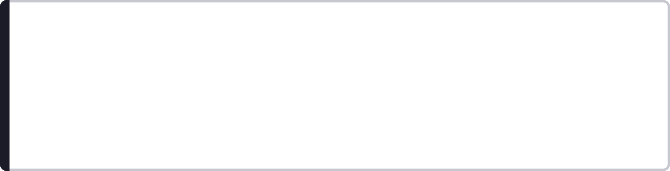
Persistence and Checkpointing
LangGraph supports persistence — the ability to save graph state at any point during execution and restore it later. This is implemented through a checkpointing mechanism.
Graph Execution Can Be Persisted
Checkpoints Capture Graph State
By configuring a checkpointer at compile time, LangGraph automatically saves the graph state after each node execution. The state is stored in a backend — in-memory, a database, or another persistence layer.
Each checkpoint is a snapshot of the complete state at a specific point in execution. Checkpoints are identified by a thread ID and a checkpoint ID, allowing specific execution states to be retrieved and restored.
Long-Running Tasks
Resuming Interrupted Execution
Human Approval
Agents working on extended tasks can save progress incrementally, preventing loss of work if execution is interrupted.
A graph that was interrupted — by a failure, a timeout, or a human-in-the-loop pause — can be resumed from the last checkpoint rather than restarting from scratch.
The graph pauses, saves state, and waits for human input. Once the human responds, the graph resumes from the saved checkpoint.
Debugging
Conversation Continuity
Checkpoints allow developers to inspect the exact state at any point in a past execution, making it possible to reproduce and diagnose issues.
Multi-turn conversations can be persisted across sessions, allowing the agent to remember previous interactions when the user returns.

Slide 29

LangGraph vs LangChain
LangGraph and LangChain are complementary frameworks. LangChain provides the foundational building blocks for working with language models; LangGraph provides the orchestration layer for assembling those building blocks into stateful, controllable agent workflows.
LangChain
LangGraph
Models — integrations with LLM providers (OpenAI, Anthropic, Google, etc.)
Prompts — prompt templates, few-shot examples, and prompt management
Tools — tool definitions, tool wrappers, and tool utilities
Structured output — output parsers and structured response schemas
Chains / components — composable building blocks for linear workflows
State — shared information schema passed through the graph
Nodes — discrete processing functions registered in the graph
Edges — direct and conditional connections between nodes
Loops — explicit support for cyclic execution patterns
Conditional routing — state-dependent execution path selection
Stateful agent workflows — complete, controllable agent orchestration
LangGraph builds on the broader LangChain ecosystem. LangChain components — models, tools, output parsers — are used inside LangGraph nodes. The two frameworks are designed to work together.

Slide 30


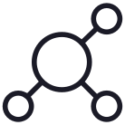



Designing a LangGraph Agent
Before writing any code, a well-designed LangGraph agent begins with a structured design process. Answering these questions up front produces a clearer architecture and avoids costly redesigns during implementation.
What is the goal?
What information belongs in state?
Define the agent's purpose precisely. What task is it solving? What does a successful outcome look like? A clear goal drives every subsequent design decision.
Identify every piece of information the graph needs to carry between nodes. Design the state schema to include all required fields and nothing more.
What nodes are required?
Which decisions require conditional edges?
List every discrete operation the agent must perform. Each operation becomes a node. Common nodes: LLM reasoning, tool execution, validation, formatting.
Identify every point where the next step depends on the current state. Each such point requires a conditional edge with a routing function.
What tools are needed?
Where can the graph loop, stop, validate, or require approval?
List the tools the agent will use. Define their names, descriptions, and input/output schemas. Ensure descriptions are clear enough for the LLM to use them correctly.
Identify loop points, termination conditions, validation checkpoints, and any operations that require human-in-the-loop approval before execution.

Slide 31
Lab: Build a Stateful LangGraph Agent
This lab is the practical culmination of Module 4. Students will implement a complete, working LangGraph agent from scratch, applying every concept covered in the module.
Lab Objectives
Lab Structure
By completing this lab, students will have hands-on experience with every core component of a LangGraph agent:
The lab is structured as five sequential implementation steps, each building on the previous:
Build an agent using LangGraph
Define state using a typed schema
Add an LLM node for reasoning
Add a tool node for action execution
Add conditional routing between nodes
Create an agent loop that repeats until complete
Test different user requests against the agent
Step 1 — Define State
Step 2 — Create the Agent Node
Step 3 — Create the Tool Node
Step 4 — Add Conditional Routing
Step 5 — Compile and Invoke
After implementation, students run a structured test suite to observe the agent's behavior across a range of scenarios — from simple questions to multi-step tool-calling tasks.

Slide 32

Lab Architecture
The lab agent implements the standard tool-calling graph pattern. The architecture is intentionally simple — a single LLM node, a single tool node, and conditional routing — so that students can focus on understanding each component clearly.
Tool Node
Perform tool task then return
Tool Required?
If yes invoke tool, no end
Agent / LLM Node
Generate action or call tool
Start
Begin agent flow
START → Agent / LLM
Tool Required? → No → END
The user's input enters state as a human message. The Agent/LLM node is the first node to execute. It receives the initial state and begins reasoning.
If the LLM produces a response with no tool call, the conditional edge routes directly to END. The final state — containing the agent's answer — is returned to the caller.
Tool Required? → Yes → Tool Node → Agent / LLM
Continue Until Complete
If the LLM produces a tool call, the conditional edge routes to the Tool Node. The tool executes, its result is added to state, and execution returns to the Agent/LLM node.
The loop repeats — LLM reasons, tool executes if needed, result is added to state — until the agent produces a final response with no tool call.

Slide 33
Lab Step 1: Define State
The first step in building the lab agent is defining the state schema. The state schema determines what information the graph will carry and manage throughout its execution.
01
02
Create a State Schema
Include Messages
Define a class using TypedDict (from Python's typing module) or LangGraph's MessagesState base class. The schema declares the fields that will exist in the state dictionary throughout graph execution.
The messages field is the core of the state for a conversational agent. It holds the full message history — human messages, AI messages, and tool messages — and grows with each step of the agent loop. Use LangGraph's add_messages reducer to ensure messages are appended rather than overwritten.
03
04
Define Any Additional Information Needed by the Agent
Initialize the Graph with User Input
If the agent requires task-specific data beyond the message history — for example, a user ID, a session context, or a configuration flag — add those fields to the state schema at this stage.
When invoking the graph, provide the initial state as a dictionary. At minimum, include the user's request as a human message in the messages list: {"messages": [HumanMessage(content="...")]}.

Slide 34
Lab Step 2: Create the Agent Node
The agent node is the reasoning core of the lab agent. It receives the current state, passes the message history to the LLM, and stores the model's response back into state.
01
02
Create the Chat Model
Pass the Current Messages to the Model
Instantiate a chat model using LangChain — for example, ChatOpenAI(model="gpt-4o"). Configure the model with the appropriate provider credentials and parameters. This model will serve as the agent's reasoning engine.
Inside the agent node function, extract the messages list from state and pass it to the model using model.invoke(state["messages"]). The model receives the full conversation history and uses it to reason about the next action.
03
04
Store the AI Response in State
Allow the Model to Generate Tool Calls
The model returns an AI message object. The agent node function returns a state update: {"messages": [ai_message]}. LangGraph's add_messages reducer appends this AI message to the existing messages list in state.
Bind the available tools to the model using model.bind_tools(tools) before using it in the node. This enables the model to produce structured tool call requests in its AI messages when it determines that a tool is needed.

Slide 35
Lab Step 3: Create the Tool Node
The tool node is responsible for executing the tool calls requested by the LLM and returning the results to state. It is the action-taking component of the agent.
01
02
Define a Calculator or Search Tool
Register the Tool
Implement the tool as a Python function. For the calculator tool, the function accepts numeric arguments and returns the computed result. Decorate the function with @tool from LangChain to make it a recognized tool object with a name and description.
Collect the tool(s) into a list: tools = [calculator_tool]. This list is used both to bind tools to the LLM (in the agent node) and to configure the tool node for execution.
03
04
Execute Requested Tool Calls
Add Tool Results to the Message State
Use LangGraph's ToolNode(tools) utility to create the tool node automatically. ToolNode inspects the latest AI message in state, identifies any tool calls, executes the corresponding tool functions with the provided arguments, and collects the results.
ToolNode automatically formats each tool result as a ToolMessage and returns a state update that appends these messages to the messages list. The LLM node will receive these tool messages in the next iteration of the agent loop.

Slide 36
Lab Step 4: Add Conditional Routing
Conditional routing is what transforms the graph from a linear sequence into an agent loop. This step adds the routing logic that decides whether to call a tool or terminate execution after each LLM response.
01
02
Inspect the Latest Model Response
If a Tool Call Exists → Route to the Tool Node
Write a routing function that receives the current state and retrieves the most recent message from the messages list. This message is the AI message produced by the agent node in the current iteration.
Check whether the AI message has a non-empty tool_calls attribute. If it does, the LLM has requested a tool. The routing function returns the name of the tool node, directing execution there.
03
04
If No Tool Call Exists → Route to END
This Creates the Agent Loop
If the AI message has no tool calls, the agent has produced its final response. The routing function returns END, directing execution to the graph's exit point. The final state is returned to the caller.
Register the routing function with the graph using .add_conditional_edges("agent", routing_function, {"tools": "tools", END: END}). Combined with the direct edge from the tool node back to the agent node, this creates the complete agent loop.

Slide 37
Lab Step 5: Compile and Invoke
The final implementation step assembles the complete graph, compiles it for execution, and invokes it with a test input to verify that the agent works correctly end-to-end.
01
02
03
Connect START and END
Compile the Graph
Provide Initial State
Add the entry point edge connecting START to the agent node: graph.set_entry_point("agent") or graph.add_edge(START, "agent"). Ensure that all terminal paths in the graph lead to END — either directly via the conditional routing function or via explicit edges.
Call app = graph.compile(). LangGraph validates the complete graph structure — checking that all nodes are reachable, all edges connect valid nodes, and the graph has a valid END point. If validation passes, the compiled graph object is returned.
Construct the initial state dictionary with the user's test input: initial_state = {"messages": [HumanMessage(content="What is 18% of ₹75,000?")]}. This state will be passed to the first node when the graph is invoked.
04
05
Invoke the Graph
Inspect the Final Response
Call result = app.invoke(initial_state). The graph executes — the agent node reasons, the conditional edge routes, the tool node executes if needed, and the loop continues until END is reached.
Examine the returned state. The final AI message in result["messages"] contains the agent's answer. Review the full message history to trace the agent's reasoning, tool calls, and tool results across the execution.

Slide 38
Lab Testing
After implementing the agent, a structured test suite validates its behavior across a range of scenarios — from simple questions to complex multi-step tasks and failure conditions.
Test Scenarios
What to Observe
No tool required — a question the LLM can answer directly without calling any tool
Single tool call — a calculation requiring the calculator tool
Multiple tool calls — a task requiring the tool to be called more than once in a single execution
Invalid input — a malformed or out-of-scope request
Tool failure — a scenario where the tool raises an exception or returns an error
Multi-step reasoning — a question requiring several reasoning steps before a final answer
For each test scenario, observe and record:
State changes — how the messages list grows with each step
Node execution — which nodes execute and in what order
Tool calls — the tool call arguments produced by the LLM
Conditional routing — which path the routing function selects at each decision point
Final response — the quality and correctness of the agent's answer
Observing state changes across test scenarios is the most effective way to build an intuitive understanding of how LangGraph agents work.

Slide 39
Visualize and Debug the Graph
Debugging a LangGraph agent requires visibility into the graph structure, the execution sequence, and the state at each step. LangGraph provides several mechanisms to support this.
Inspect the Graph Structure
Trace Node Execution
Use app.get_graph().print_ascii() or app.get_graph().draw_mermaid() to visualize the compiled graph. This confirms that nodes and edges are connected as intended and helps identify structural errors before running the agent.
Use app.stream() instead of app.invoke() to receive a stream of events as the graph executes. Each event identifies which node produced it, allowing you to trace the exact execution sequence step by step.
Inspect Messages and State
Identify Incorrect Routing
After each test run, print the full messages list from the final state. Examine each message in sequence — human, AI, tool, AI — to verify that the agent reasoned correctly, called the right tools with the right arguments, and produced an appropriate final response.
If the agent terminates too early or loops indefinitely, the routing function is the first place to investigate. Add print statements or logging inside the routing function to observe what it receives and what it returns at each decision point.
Identify Failed Tool Calls
Use Logging / Tracing During Development
If a tool call fails, inspect the tool message in state for the error details. Check that the tool function handles edge cases correctly and that the LLM is providing arguments in the expected format.
Add structured logging to node functions and the routing function during development. LangSmith — LangChain's observability platform — provides a visual trace of every LangGraph execution, showing node inputs, outputs, and state at each step.

Slide 40
Module 4 Summary
Module 4 has covered the complete conceptual and practical foundation for building stateful AI agents with LangGraph. The following are the core principles to carry forward.
Graph Represents Logic
State Carries Information
LangGraph represents agent logic as a directed graph — making branching, looping, and conditional behavior explicit and inspectable.
A shared state object flows through every node, providing continuity and context across the entire execution of the agent.
Nodes Perform Operations
Edges Control Execution
Each node is a discrete Python function — LLM call, tool execution, validation, or formatting — that reads from and writes to state.
Direct edges define the default control flow. Conditional edges enable state-dependent routing — the foundation of agentic decision-making.
Loops Enable Iteration
Tools Extend Capabilities
Graphs can return to previous nodes, enabling tool-calling loops, retry logic, validation cycles, and iterative processing.
Python functions exposed as tools allow the agent to take real-world actions — calculation, search, API calls — beyond language generation alone.
Key Takeaway: LangChain provides the building blocks — models, prompts, tools, structured output. LangGraph lets us orchestrate those building blocks into stateful, controllable agent workflows. Together, they form the complete stack for production-grade agentic AI applications.

