Slide 1

Automated Testing with Generative AI
Certificate in Agentic AI and Software Solutions · Module 3 · 10-hour module · Beginner-friendly

Slide 2
Learning Objectives
1
Understand the purpose of automated testing
2
Identify common types of software tests
3
Use AI to generate test cases and test code
4
Use AI to improve test coverage
5
Review and validate AI-generated tests

Slide 3

What is Software Testing?
Testing checks whether software behaves as expected
Tests compare actual behavior with expected behavior
Testing helps find defects before deployment
Automated tests can be executed repeatedly

Slide 4
Why Automate Testing?
Faster Feedback
Repeatable Testing
Catch issues instantly as code changes
Run the same tests every time, without variation
Reduced Manual Effort
Detect Regressions
Free up developers from tedious manual checks
Useful during development and after code changes

Slide 5


Types of Automated Tests
Unit Tests
1
Test individual functions or components in isolation
Integration Tests
2
Test components working together as a group
End-to-End Tests
3
Test complete user workflows from start to finish
This module focuses on simple, practical examples across all three types.

Slide 6
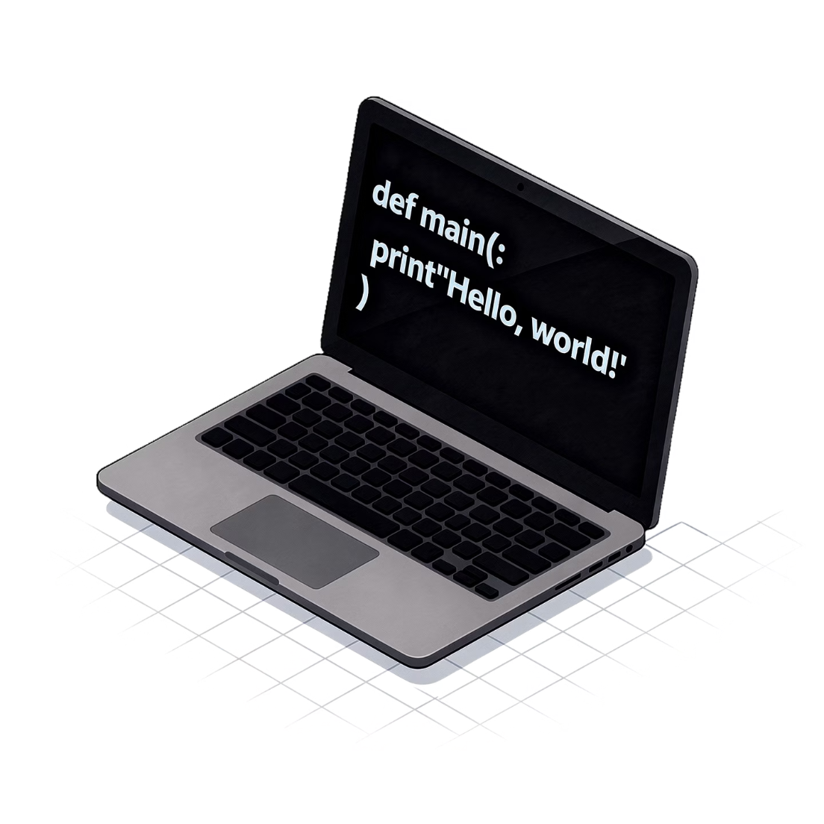
Unit Testing Basics
A unit test checks a small piece of code
Usually tests one function or method
Tests should be focused and repeatable
Python example: pytest

Slide 7



Anatomy of a Test
Arrange
Act
Assert
Prepare inputs and test data before running
Call the function or component under test
Check the expected result against actual output
Keep each test focused on a specific behavior.

Slide 8
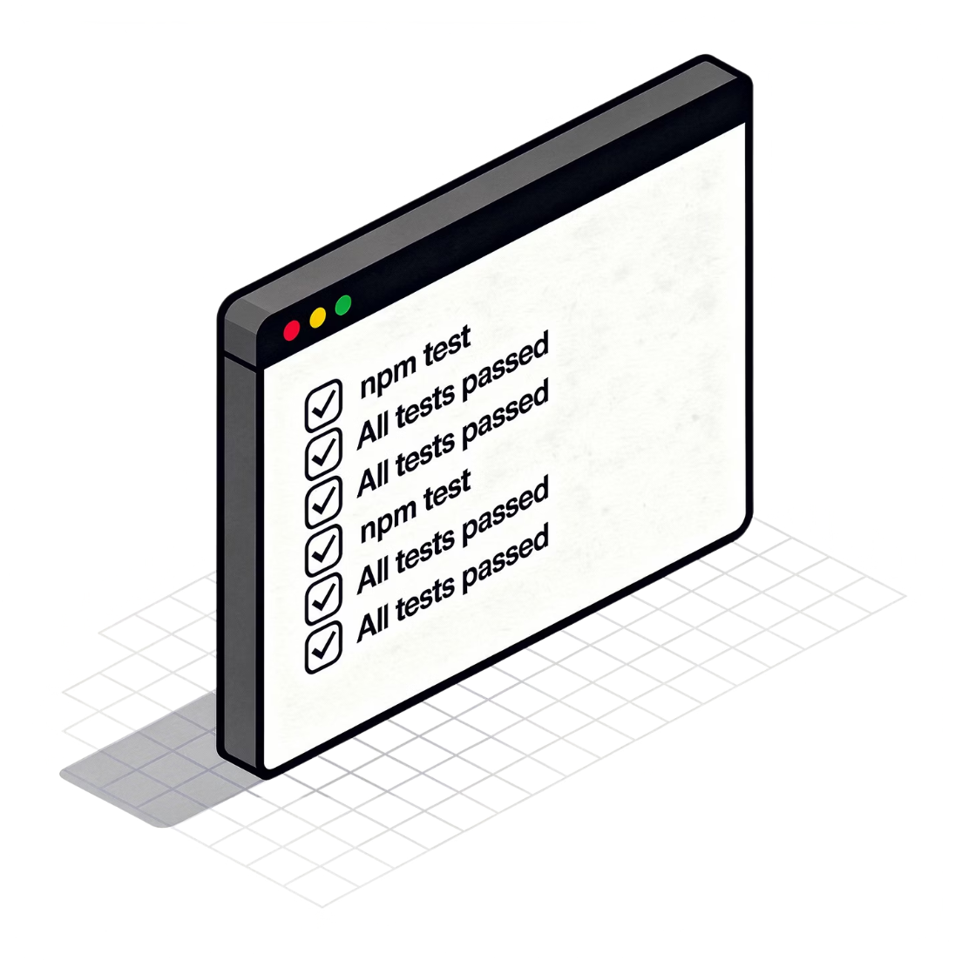
Example Unit Test
Function: calculate_discount(price, percentage)
Test normal discount calculation
Test zero discount
Test invalid input
Use assertions to verify expected results

Slide 9





Where Generative AI Helps
Generate Initial Tests
Quickly scaffold test cases from function signatures
Suggest Edge Cases
Identify boundary and invalid input scenarios
Explain Existing Tests
Clarify what a test does and why it matters
Identify Missing Scenarios
Improve readability and test completeness

Slide 10

Prompting AI to Generate Tests
Specify Requirements
State framework and case types
Provide the function or component
Describe expected behavior
Specify the testing framework
Ask for normal, boundary, and invalid cases
Ask for readable test names
Request Output
Provide Context
Ask for readable names and explanations
Share function and expected behavior

Slide 11

Example Test Prompt
Start with the request
Include the function code
"Generate pytest unit tests for this function"
Paste the full implementation so AI has complete context
Specify case types
Request explanations
Ask for positive cases, edge cases, and invalid inputs
Ask for a short explanation of each test generated

Slide 12

AI-Generated Tests: Review First
Incorrect Assumptions
Syntactically Correct ≠ Logically Right
Generated tests may assume behavior that doesn't match the real requirement
A test can run without errors but still verify the wrong thing
More Tests ≠ Better Testing
Check whether expected results actually match requirements

Slide 13

Test Cases vs Test Code
A test case describes what should be tested
Test code implements the test in a framework
AI can help with both
Start by identifying scenarios before generating large amounts of test code

Slide 14





Edge Cases
Boundary Values
Empty & Missing Input
Minimum and maximum limits of valid input ranges
Null, empty string, or absent required fields
Unexpected Data Types
Extreme Values
Strings where numbers are expected and vice versa
Very large, very small, or invalid input values
Ask AI to identify relevant edge cases for your specific application.

Slide 15


Testing Existing Code with AI
Provide Code
Identify Behaviors
Generate Tests
Run Tests
Review Failures

Slide 16

Integration Testing
Checks whether multiple components work together
Examples: service + database, API + service, module + external component
AI can help generate test scenarios and setup code
Keep integration tests focused and practical

Slide 17
API Testing with AI
01
02
Describe the API endpoint
Specify request and expected response
Share the route, method, and parameters with AI
Define what a valid request looks like and what response is expected
03
04
Generate basic test cases
Validate status codes and response data
Ask AI to cover success and failure scenarios
Test both happy path and error responses thoroughly

Slide 18

Test Data Generation
AI can generate sample test inputs
Useful for normal and edge cases
Avoid using real confidential or sensitive data
Keep generated data representative of realistic inputs

Slide 19
Mocking and Test Doubles
The Problem
The Solution
AI's Role
External services can make tests slow or unreliable when called in every test run
Mocks replace external dependencies during testing with controlled substitutes
AI can suggest simple mocking approaches when the real dependency is unnecessary

Slide 20

AI-Assisted Test Debugging
Provide the failing test and error output
Ask AI to explain the failure
Check whether the test or application is wrong
Apply the smallest appropriate change
Run the test again

Slide 21

Improving Test Coverage
What Coverage Measures
How AI Helps
AI can suggest untested branches or conditions you may have overlooked
Coverage indicates which code is exercised by tests — lines, branches, and conditions
What Coverage Doesn't Tell You
A high percentage alone does not guarantee quality — focus on meaningful behaviors

Slide 22

Regression Testing
A regression occurs when a change breaks previously working behavior
Automated tests help detect regressions quickly
Add a test when fixing an important bug
Run the test suite after significant changes

Slide 23
AI-Assisted Test Review
Check Clarity
Ask AI to review tests for readability and clear naming
Verify Assertions
Check whether assertions are meaningful and actually catch bugs
Eliminate Duplication
Look for tests that overlap or repeat the same verification
Find Gaps
Look for missing edge cases and uncovered scenarios
Ensure Independence
Tests should be independent of each other and maintainable over time

Slide 24

Common Problems with AI-Generated Tests
Incorrect Assumptions
Weak Assertions
Duplicate Tests
Tests may encode assumptions about behavior that don't reflect real requirements
Assertions that are too loose may not catch real bugs when they occur
AI may generate tests that overlap or repeat the same check
Mismatched Mocks
Implementation Coupling
Generated mocks may not accurately reflect the real external system
Tests can become too tightly coupled to implementation details, breaking on refactors

Slide 25

Best Practices
Understand the requirement before generating tests
Generate tests incrementally
Use clear test names
Check assertions carefully
Run tests regularly
Keep tests simple and maintainable

Slide 26


Lab: Generate Unit Tests
HANDS-ON LAB
1
2
3
Select a Module
Identify Scenarios
Generate Tests
Choose a small Python module to work with
Ask AI to identify test scenarios for the module
Generate pytest tests using AI assistance
4
5
Run & Fix
Add Edge Cases
Run the tests and fix any incorrect ones
Identify and add any missing edge case tests

Slide 27

Lab: Test and Debug
HANDS-ON LAB
Introduce or identify a small bug
Run the generated tests
Inspect the failure
Ask AI to explain the problem
Fix the code
Run the tests again

Slide 28
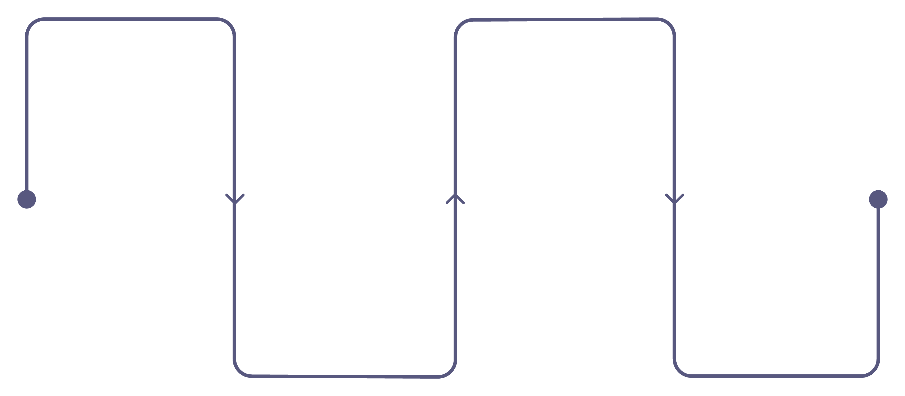
Lab: Generate API / Integration Tests
HANDS-ON LAB
Select API
Generate Tests
Pick a simple or multi-component example
Use AI to create basic integration tests
Define Behavior
Run & Review
Describe expected inputs and outcomes
Execute tests and inspect generated scenarios

Slide 29

Lab: Test Review and Coverage
HANDS-ON LAB
Review the complete test suite
Identify missing scenarios
Ask AI for additional test ideas
Check basic coverage
Remove unnecessary or duplicate tests

Slide 30


Module Summary
Accelerate Test Creation
Generative AI can rapidly scaffold test cases and test code
Better Prompts = Better Tests
Good prompts produce more relevant and useful test scenarios
AI Does More Than Generate
AI can also explain, debug, and review your tests
Always Validate
Automated tests provide fast, repeatable feedback — but always validate against actual requirements
Key takeaway: AI helps create tests, but developers must decide what correct behavior means.

