Slide 1

AI-Assisted Documentation & Project Management
Certificate in Agentic AI and Software Solutions
30-Slide Outline | 10-hour module | Beginner-friendly

Slide 2

AI-Assisted Documentation & Project Management
Documentation
Using generative AI to create and maintain software documentation
Project Management
Using AI for planning, tracking, and project communication
Artifacts
Generating requirements, user stories, and project artifacts
Lab
Create documentation and a simple project plan with AI

Slide 3
Learning Objectives
1
Documentation in Context
Understand the role of documentation in software projects
2
Generate & Improve
Use AI to generate and improve technical documentation
3
Project Artifacts
Use AI to create project management artifacts
4
User Stories & Tasks
Generate user stories, tasks, and acceptance criteria
5
Review & Validate
Review AI-generated project and documentation content

Slide 4


Why Documentation Matters
Documents communicate how a system works
Good documentation helps developers, testers, and users
Documentation reduces dependency on individual team members
It should be accurate, clear, and easy to maintain
Well-maintained documentation is the foundation of a sustainable software project.

Slide 5






Types of Software Documentation
Requirements Documentation
API Documentation
Captures what the system must do and the constraints it operates under
Describes endpoints, parameters, responses, and error codes
Technical / Design Docs
README & Setup Guides
Explains system design, components, and key decisions
Helps new developers get started quickly
User Documentation
Release Notes & Change Logs
Guides end-users on how to use the software
Tracks what changed between software versions

Slide 6
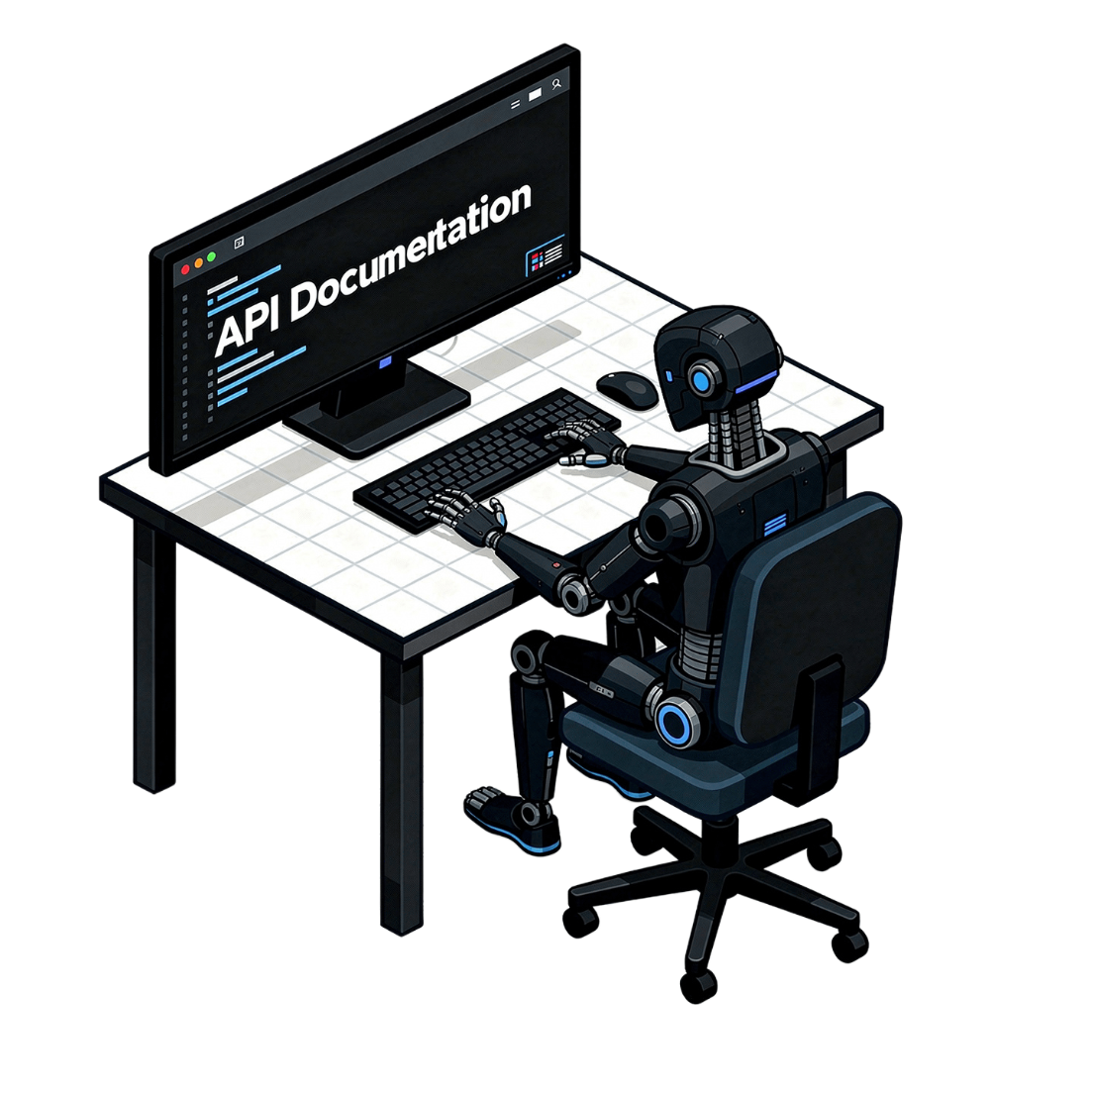
How AI Helps with Documentation
Generate first drafts
Summarize existing code
Explain technical concepts
Convert notes into structured documents
Improve clarity and consistency
Update documentation after code changes

Slide 7
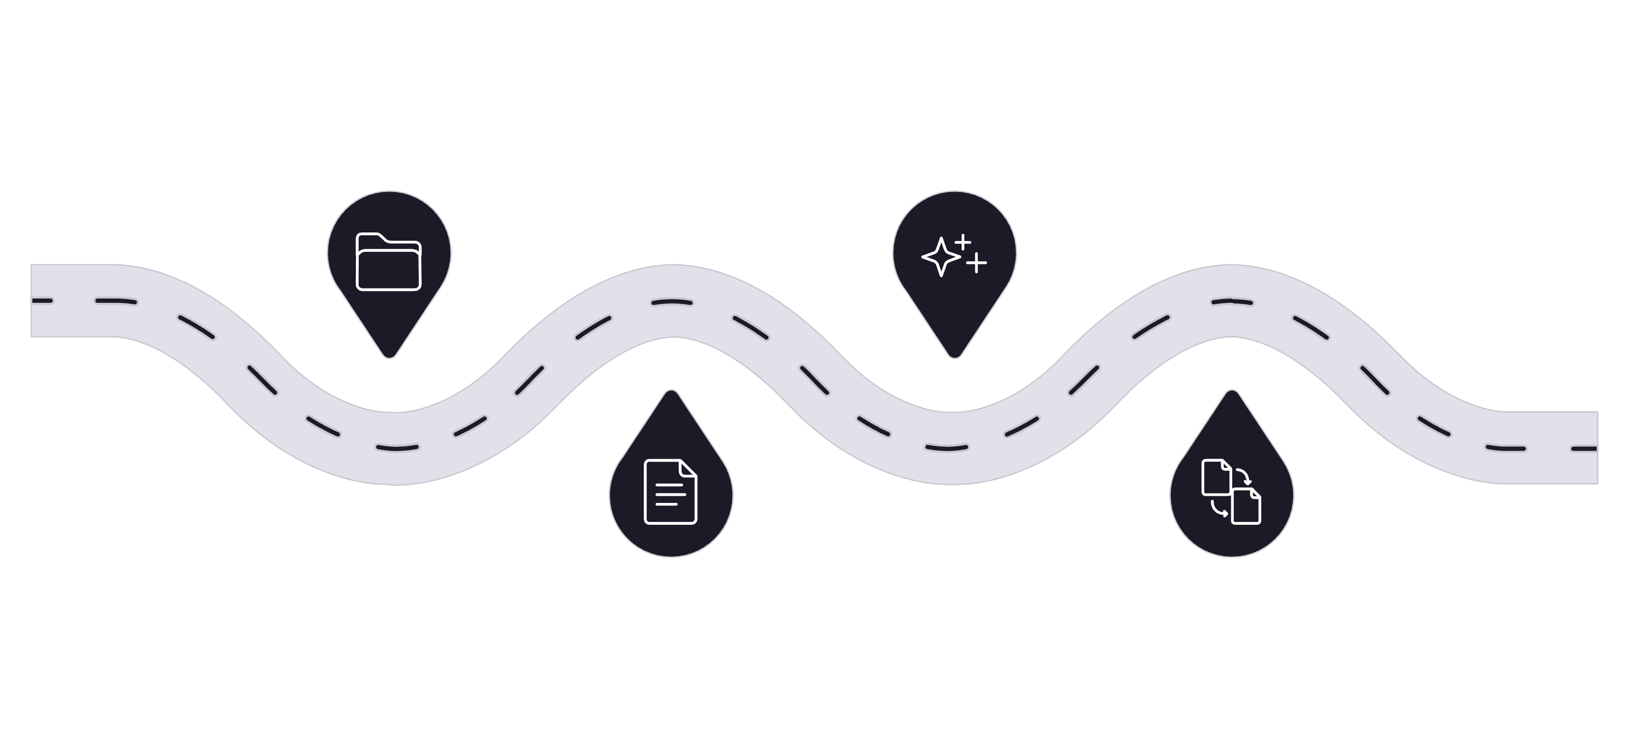
AI Documentation Workflow
Collect Sources
Generate Draft
Gather repos, specs, and notes
Create initial AI-written content
Provide Context
Review & Sync
Share relevant code and constraints
Validate accuracy and keep updated
Following this workflow ensures AI-generated documentation stays accurate and aligned with the actual codebase.

Slide 8
Generating a README
A well-structured README is often the first document developers encounter. AI can generate a complete README covering all essential sections:
Project Overview
Features
Prerequisites
Installation
Configuration
Usage Examples
Troubleshooting

Slide 9
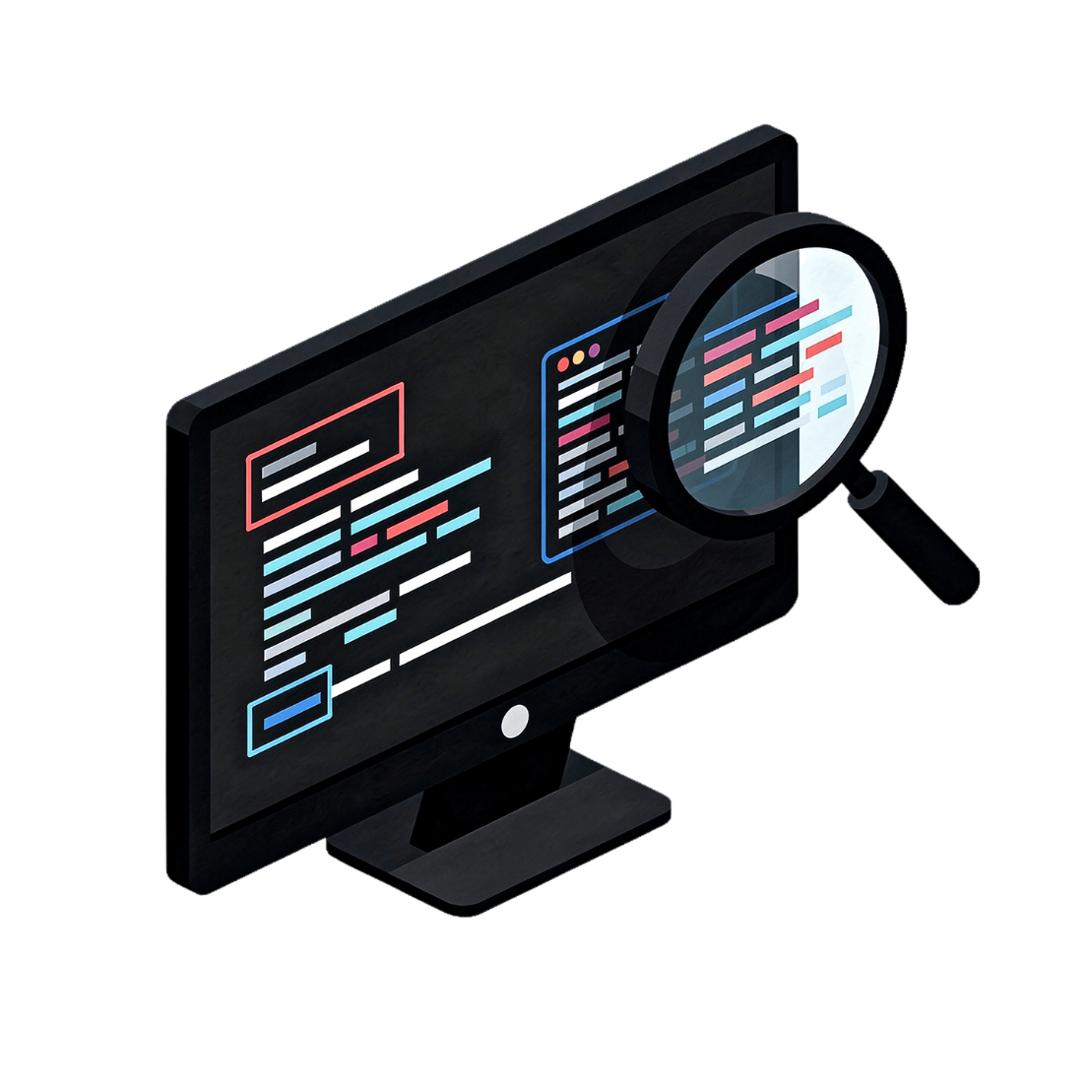

Documenting Existing Code
Give AI the relevant source code
Ask it to explain purpose, inputs, outputs, and dependencies
Generate function or class documentation
Review the explanation against the actual implementation
Always verify AI-generated code explanations — the model may misinterpret complex or ambiguous logic.

Slide 10



API Documentation with AI
Endpoints & Purpose
Request Parameters
Response Formats
Describe each endpoint and what it does
Document required and optional parameters with types
Describe the structure and fields of each response
Example Requests & Responses
Common Errors
Document error codes and how to handle them
Include realistic examples to help developers integrate quickly
Verify all examples against the actual API before publishing.

Slide 11
Creating Technical Documentation
System Overview
Main Components
Data Flow
High-level description of the system and its purpose
Key modules, services, and how they relate
How data moves through the system
Dependencies & Config
Design Decisions
External libraries, services, and configuration options
Important architectural choices and the rationale behind them
Use diagrams or structured descriptions where useful to make complex systems easier to understand.

Slide 12
AI for Documentation Updates
Documentation Quality Checks
Provide the old documentation and changed code
Ask AI to identify outdated sections
Generate updated sections
Review the changes
Keep documentation changes together with code changes
Is the information accurate?
Is the language clear?
Are examples correct?
Are important steps missing?
Are there contradictions?
Can a new developer follow the instructions?

Slide 13
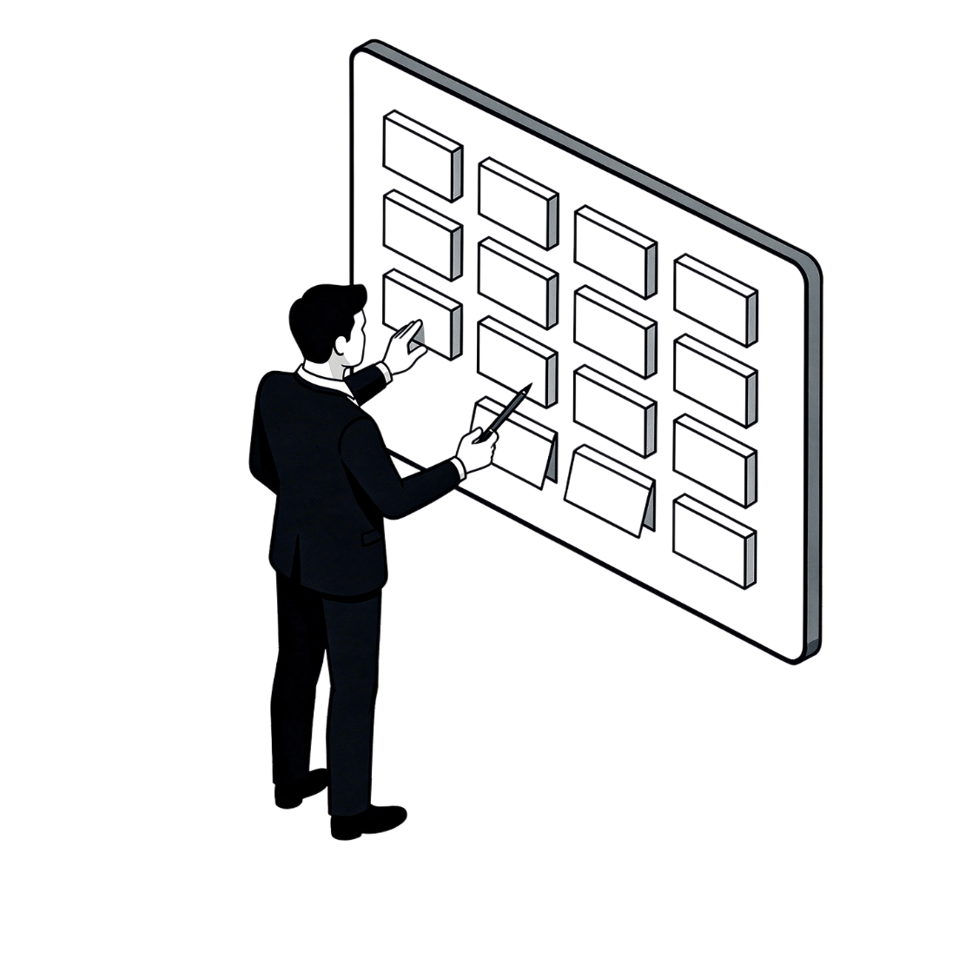
PART 2
What is Project Management?
Planning and coordinating work to deliver a software product
Includes requirements, tasks, timelines, resources, risks, and communication
AI can assist with many planning and administrative activities
AI is a powerful co-pilot for project management — but humans remain the decision-makers.

Slide 14

AI in the Software Project Lifecycle
Requirements
Planning
Development
Testing
AI can assist with artifacts and communication throughout the lifecycle. Human decisions remain important for priorities and trade-offs.

Slide 15
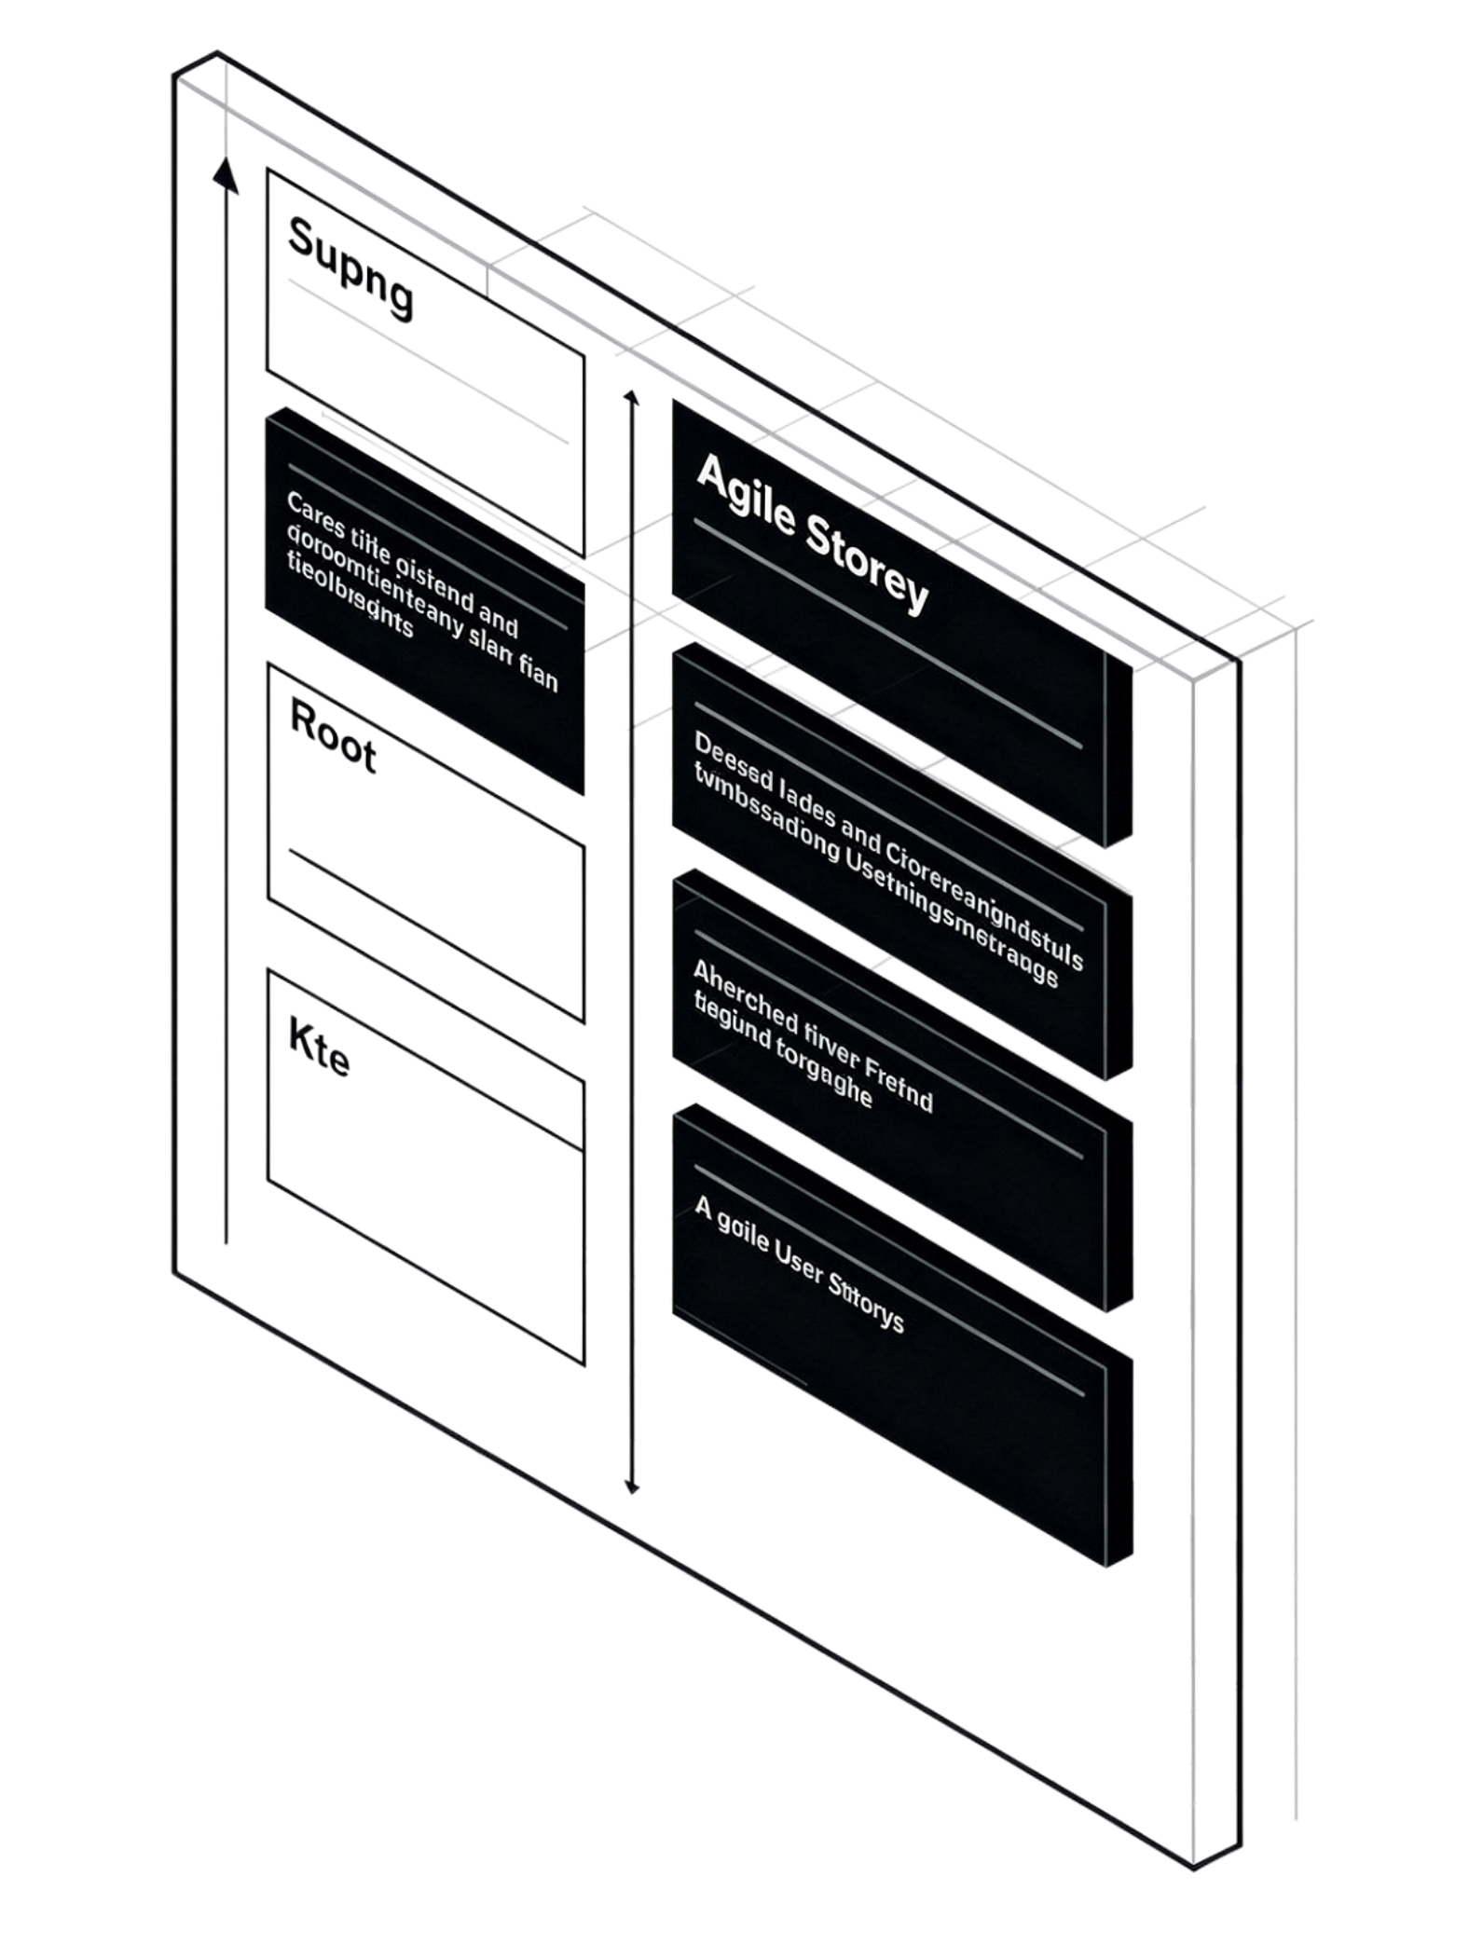
Generating User Stories
User stories describe requirements from a user's perspective
Common format: As a [user], I want [goal], so that [benefit]
AI can convert business requirements into draft user stories
Review stories with stakeholders before implementation
AI-generated user stories are a starting point — always validate them with your team and stakeholders.

Slide 16
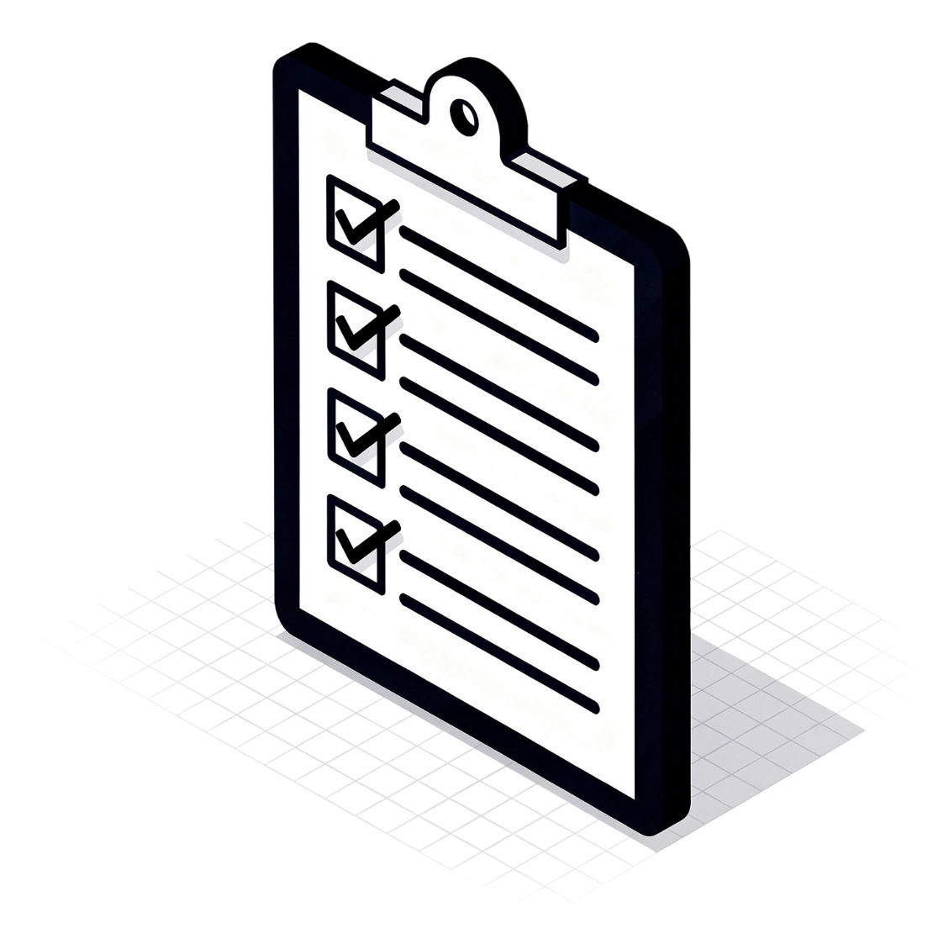
Acceptance Criteria
Acceptance criteria define when a requirement is considered complete.
AI can suggest testable conditions
Good criteria should be clear and measurable
Example conditions for a login feature:
Successful login with valid credentials
Error message for invalid password
Account locked after repeated failures

Slide 17



Breaking Requirements into Tasks
Large Requirement
AI Decomposition
Review & Scope
Start with a high-level user story or feature
AI suggests development, testing, documentation, and deployment tasks
Review the task list for completeness and realistic scope

Slide 18
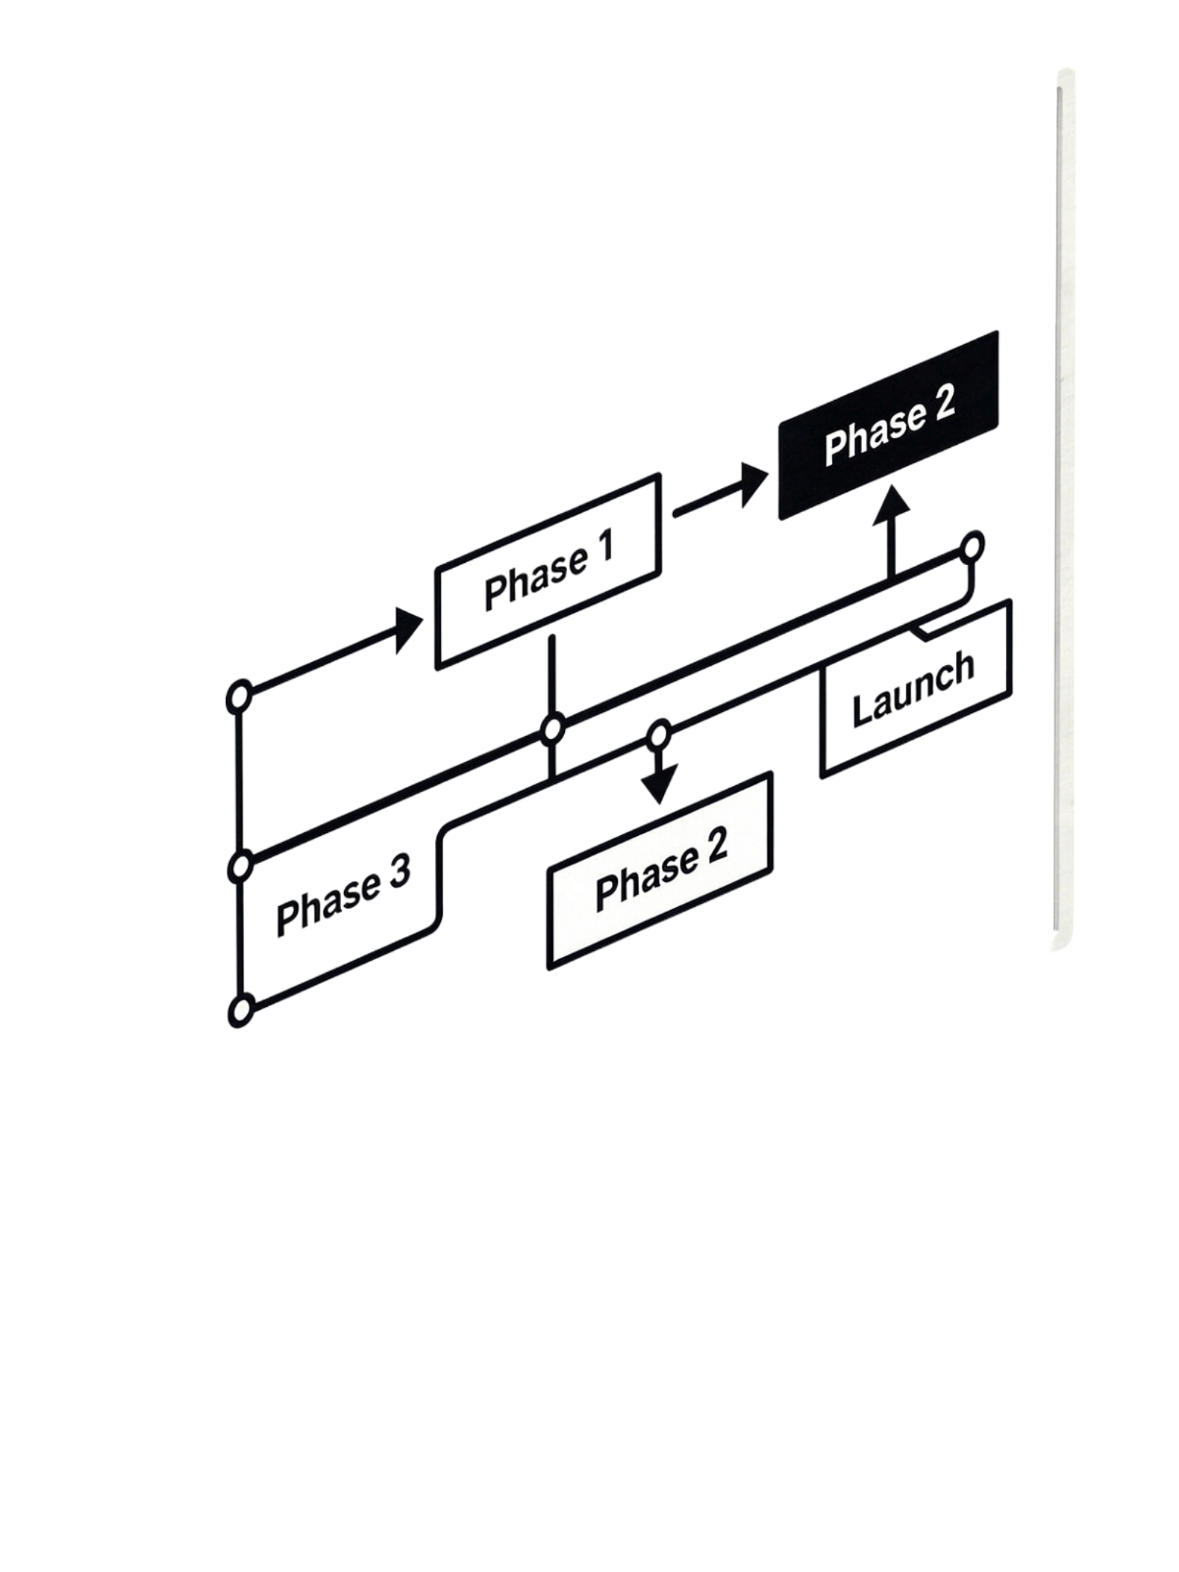
Creating a Project Plan
Project Goal
Clear statement of what the project aims to achieve
Deliverables & Tasks
Major outputs broken into tasks with dependencies
Milestones
Key checkpoints and target dates
Effort & Risks
Estimated effort, risks, and assumptions
AI can generate a first draft project plan directly from a project description.

Slide 19
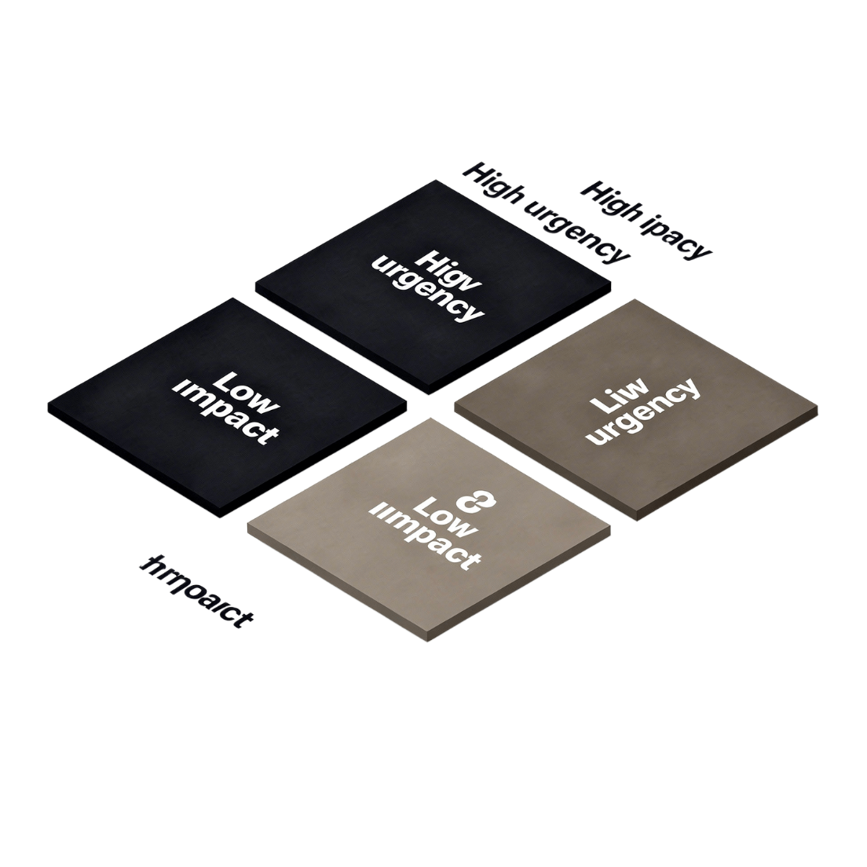
AI-Assisted Task Prioritization
Identify urgent and important work
Group tasks by feature or workstream
Identify dependencies
Suggest a possible implementation order
Final priorities should be decided by the project team
AI can propose an order — but only the team knows the real constraints.

Slide 20





Project Status Reports
Completed Work
Summarize what has been finished since the last report
Current Activities
List what the team is actively working on right now
Blockers
Highlight issues preventing progress
Upcoming Work
Identify what is planned for the next period
Risks & Decisions
Summarize outstanding risks and key decisions made
AI can convert meeting notes or task updates into a polished status report.

Slide 21

Meeting Notes with AI
Summarize discussions
Extract decisions
Identify action items
Assign owners when explicitly known
Identify unresolved questions
Review AI-generated notes before sharing

Slide 22





Risk Identification
Technical Risks
Schedule Risks
Dependency Risks
Unknown technologies, integration challenges, or performance issues
Delays in deliverables or unrealistic timelines
External systems or teams that may not deliver on time
Resource Risks
Security & Quality Risks
Staff availability, skill gaps, or budget constraints
Vulnerabilities or gaps in testing coverage
AI can suggest potential risks from project information, but teams must validate them.

Slide 23
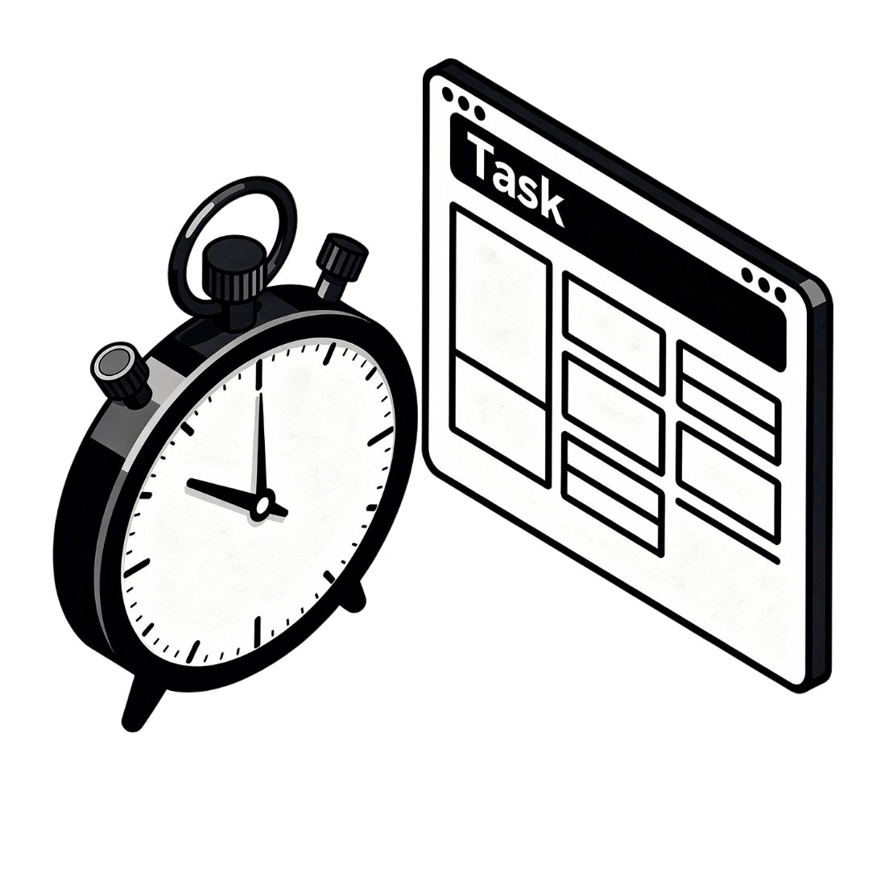
AI-Assisted Estimation
AI can help break work into smaller pieces
It can suggest rough effort ranges
Estimates depend on team experience and project context
Treat AI estimates as starting points, not commitments
Never treat AI-generated estimates as fixed commitments — context and team expertise always matter more.

Slide 24


Common Problems with AI-Generated Project Artifacts
Unrealistic Timelines
Missing Dependencies
AI may suggest schedules that ignore real-world constraints
Critical task relationships may be overlooked
Incorrect Assumptions
Overly Generic Requirements
AI fills gaps with plausible but unverified details
Stories may lack the specificity needed for implementation
Poorly Scoped Tasks
Confident but Unsupported Estimates
Tasks that are too large or too small to be actionable
Numbers presented with false precision

Slide 25
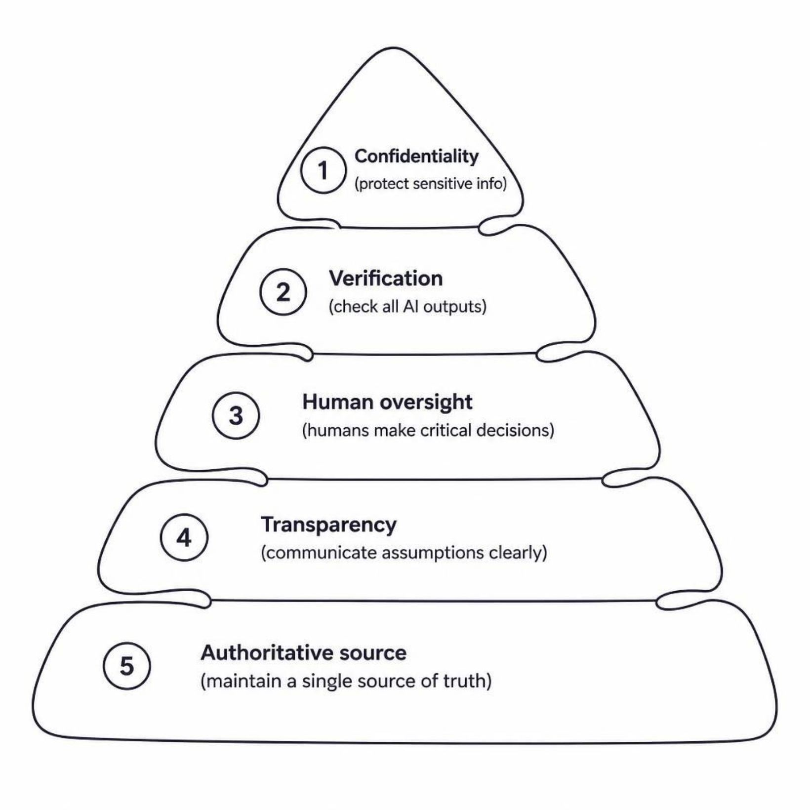
Responsible Use of AI in Projects
Do not share confidential project information unnecessarily
Verify requirements and technical details
Do not let AI make critical project decisions without human review
Clearly communicate assumptions
Keep an authoritative source for project decisions

Slide 26
LAB EXERCISE 1
Lab: Generate Project Requirements
01
02
03
Choose a Project
Write a Business Description
Generate User Stories
Select a simple software project to use as your example
Provide a short description of what the project should do
Ask AI to produce user stories from your description
04
05
Generate Acceptance Criteria
Review & Refine
Ask AI to define testable conditions for each story
Validate the requirements and improve them with your own knowledge

Slide 27
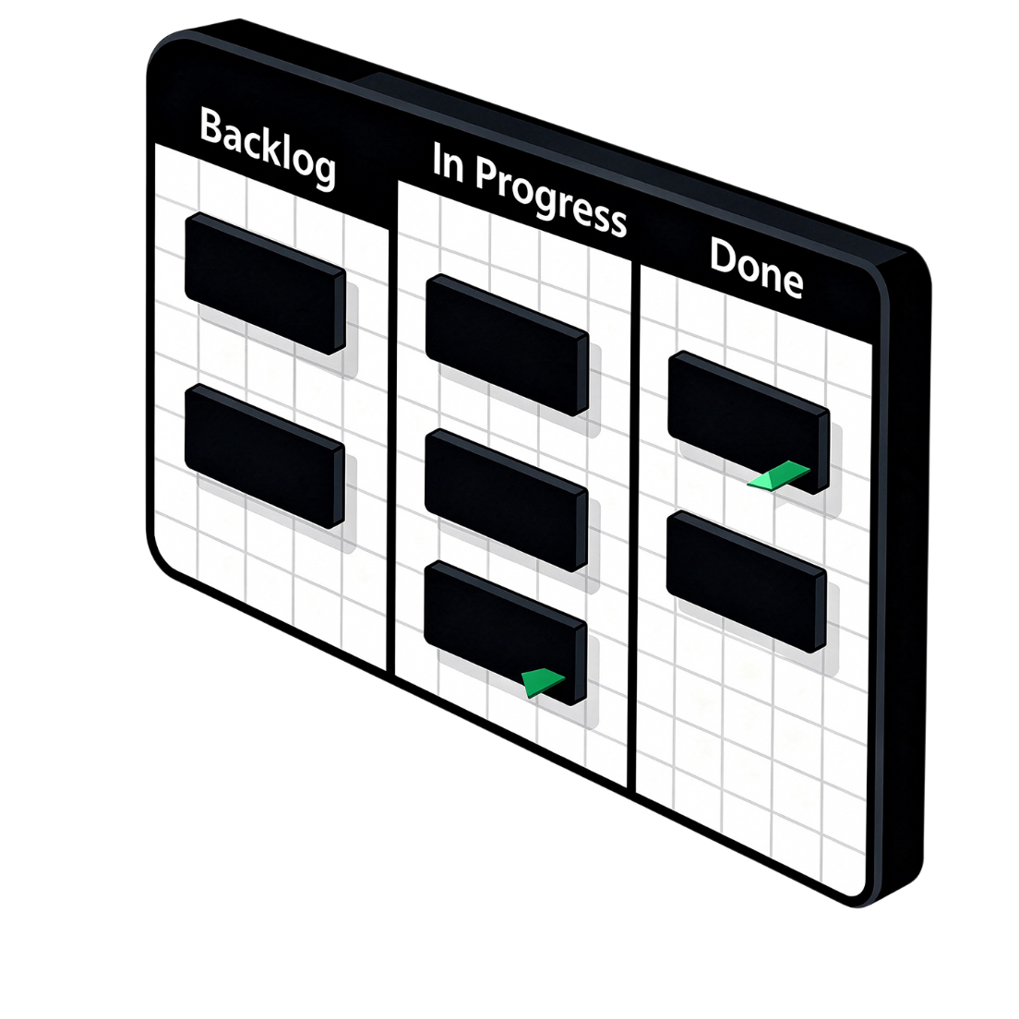
LAB EXERCISE 2
Lab: Create Project Tasks
Break the user stories into development tasks
Add testing and documentation tasks
Identify dependencies between tasks
Group tasks into logical phases
Create a simple project backlog
A well-structured backlog makes it much easier to track progress and plan sprints.

Slide 28


LAB EXERCISE 3
Lab: Create Documentation
1
2
3
README
Component Docs
API / Module Docs
Generate a README for the project
Document the main components and their responsibilities
Create basic API or module documentation
4
5
Setup Guide
Review
Generate setup and usage instructions
Review all documents for accuracy and completeness

Slide 29
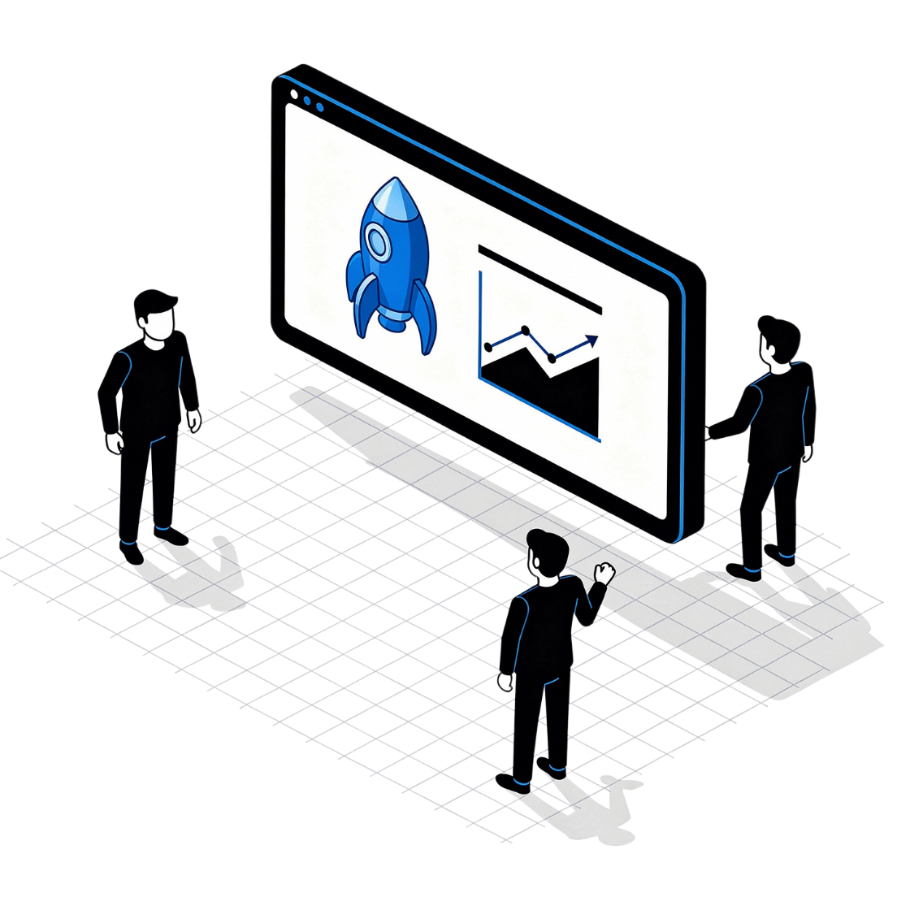
LAB EXERCISE 4
Lab: Project Status & Review
Create sample progress updates
Ask AI to generate a project status report
Identify blockers and risks
Generate a short action-item list
Review the output and correct unsupported assumptions

Slide 30
Module Summary
Documentation Creation
Requirements to Artifacts
Summaries & Reports
AI can accelerate documentation creation and maintenance
AI can turn requirements into user stories, tasks, and project artifacts
AI can summarize meetings and project status efficiently
Human Review Required
Accuracy & Ownership
AI-generated plans and estimates always require human review
Accuracy, confidentiality, and clear ownership remain important
Key takeaway: Use AI to reduce project administration while keeping humans responsible for decisions.

Slide 31
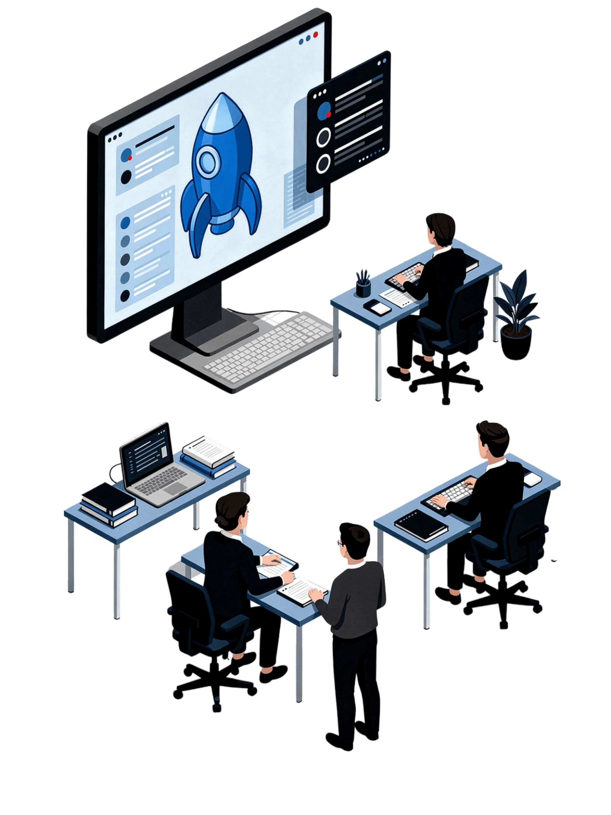

What's Next?
You've completed Module 4 of the Certificate in Agentic AI and Software Solutions. You are now equipped to use AI as a practical tool for both documentation and project management.
Practice the Labs
Apply what you learned by completing all four lab exercises with a real or sample project
Experiment & Iterate
Try different prompts and compare AI outputs — refine until they meet your standards
Continue the Certificate
Move on to the next module and keep building your Agentic AI skill set

