Slide 1

Agentic AI: Memory, RAG & Multi-Agent Concepts
Certificate in Agentic AI and Software Solutions — Module 5

Slide 2
Learning Objectives
1
2
3
Agent Memory
RAG Architecture
ChromaDB
Explain the role of memory in agents
Understand the basic RAG architecture
Use ChromaDB for simple document retrieval
4
5
Tool Calling
Multi-Agent
Combine retrieval with tool calling
Understand basic multi-agent concepts

Slide 3

Why Do Agents Need Memory?
Agents often work across multiple steps
Memory helps maintain useful context
Can retain conversation history, preferences, and previous results
Memory should be designed according to the application's needs

Slide 4
State vs Memory
State
Short-Term Memory
Information needed during the current execution — transient and task-scoped
Information maintained during a conversation or task — persists across steps
Long-Term Memory
Example
Information retained for future interactions — survives session boundaries
Current task state vs stored user preferences

Slide 5

Why LLM Knowledge Is Not Enough
Private Information
LLMs may not know private organizational information
Outdated Knowledge
Knowledge can become outdated after the training cutoff
Domain Specificity
Applications often need domain-specific information not in training data
RAG to the Rescue
RAG provides a way to retrieve relevant information when needed

Slide 6
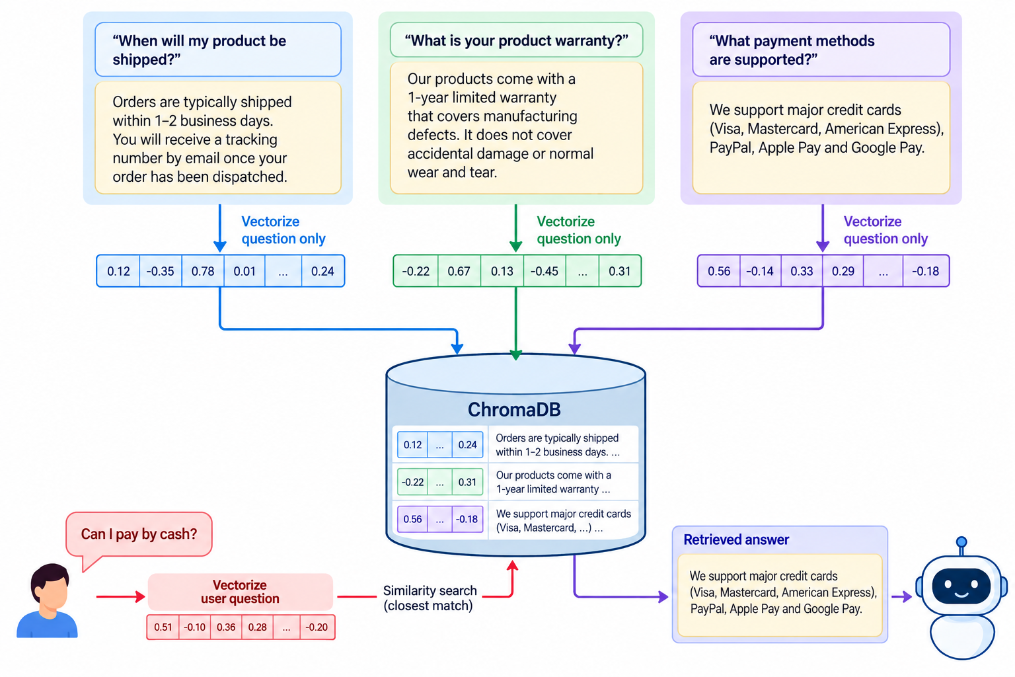
What is RAG?
Retrieval-Augmented Generation
RAG is a technique that combines the power of information retrieval with language model generation — grounding answers in real, retrieved content.
Retrieve relevant information first
Provide retrieved information to the LLM
Generate an answer grounded in the retrieved context
RAG combines retrieval with generation

Slide 7

Basic RAG Architecture
Indexing
Embed & Store
Query Retrieval
LLM Answer
The indexing phase prepares your knowledge base; the retrieval phase uses it at query time to ground the LLM's response in relevant content.

Slide 8

Embeddings and Vector Databases
What Are Embeddings?
Embeddings represent text as numerical vectors — capturing semantic meaning in a high-dimensional space
Semantic Similarity
Similar meanings tend to have similar vector representations, enabling meaning-based search
Vector Databases
Store embeddings and associated content for fast similarity lookup — examples: ChromaDB, FAISS, Pinecone
This Module
We use simple local ChromaDB — no cloud setup required

Slide 9


Why ChromaDB?
Simple to install and use
Runs locally — no cloud dependency
Suitable for demonstrations and small projects
Easy to combine with LangChain
No separate database server is required for the basic lab
ChromaDB is the ideal starting point: minimal setup, maximum learning focus.

Slide 10
RAG Document Pipeline
Load Documents
1
Ingest source files from disk or other sources
Split into Chunks
2
Divide documents into manageable, meaningful pieces
Generate Embeddings
3
Convert each chunk into a numerical vector representation
Store in ChromaDB
4
Persist chunks and embeddings in the local vector store
Retrieve Chunks
5
Find the most relevant chunks for a given query
Pass to LLM
6
Provide retrieved context to the language model for generation

Slide 11
Document Chunking
Why Chunk?
Meaningful Content
Too Small
Large documents are divided into smaller pieces so embeddings capture focused meaning
Chunks should contain meaningful information — avoid splitting mid-sentence or mid-concept
Very small chunks may lose context and reduce answer quality
Too Large
Start Simple
Very large chunks may reduce retrieval precision — too much noise per chunk
Begin with recursive or fixed-size splitting and iterate from there

Slide 12
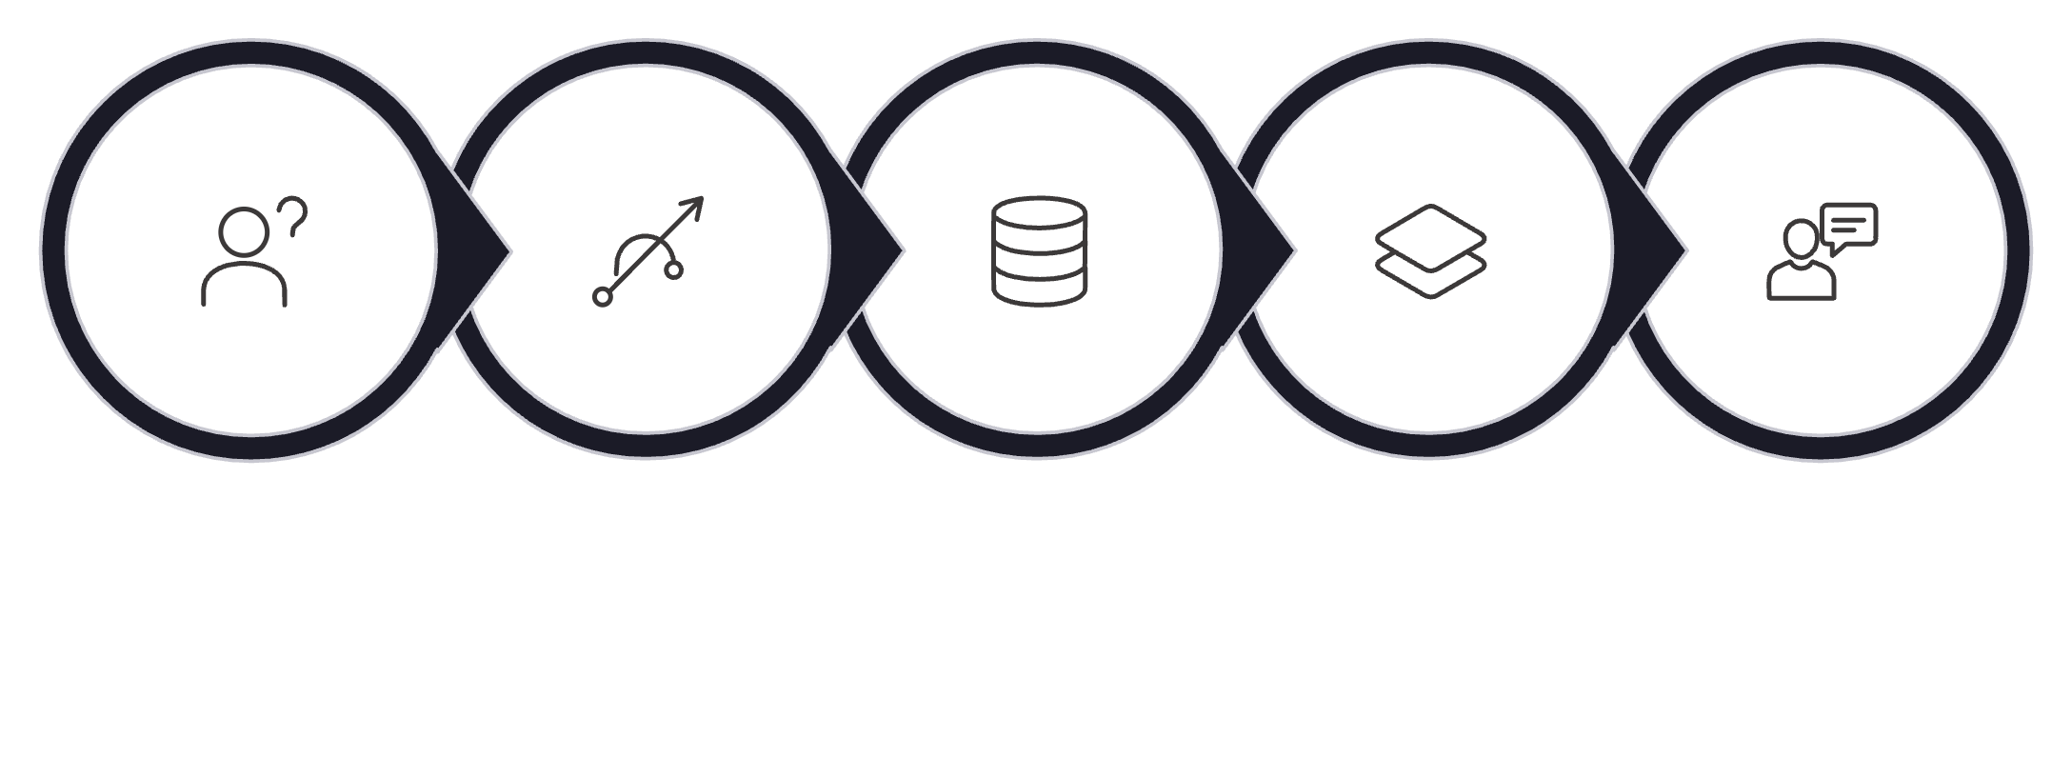
Simple RAG Retrieval
How It Works
User asks a question
Question is converted into an embedding
ChromaDB finds similar document chunks
Top relevant chunks are returned
Retrieved context is provided to the LLM
User Question
To Embedding
ChromaDB Search
Top Chunks
Provide Context

Slide 13

RAG Prompting
Effective RAG prompts guide the LLM to use retrieved content faithfully and avoid hallucination.
Tell the LLM that retrieved context is the information source
Ask it to answer using the provided context
Tell it not to invent information when the context is insufficient
Keep the prompt simple and explicit

Slide 14




RAG Example
The Documents
The Question
The Retrieval
The Answer
Documents contain an organization's leave policy
User asks about annual leave entitlements
Retriever finds the relevant policy section from ChromaDB
LLM answers using the retrieved content — private domain knowledge applied

Slide 15

RAG Limitations
Garbage In, Garbage Out
Poor documents produce poor answers — quality of source material matters enormously
Chunking Errors
Incorrect chunking can hurt retrieval — splitting at the wrong boundaries loses meaning
Retrieval Gaps
Relevant information may not be retrieved; retrieved context can be incomplete
No Factual Guarantee
RAG does not automatically guarantee factual correctness — always validate outputs

Slide 16
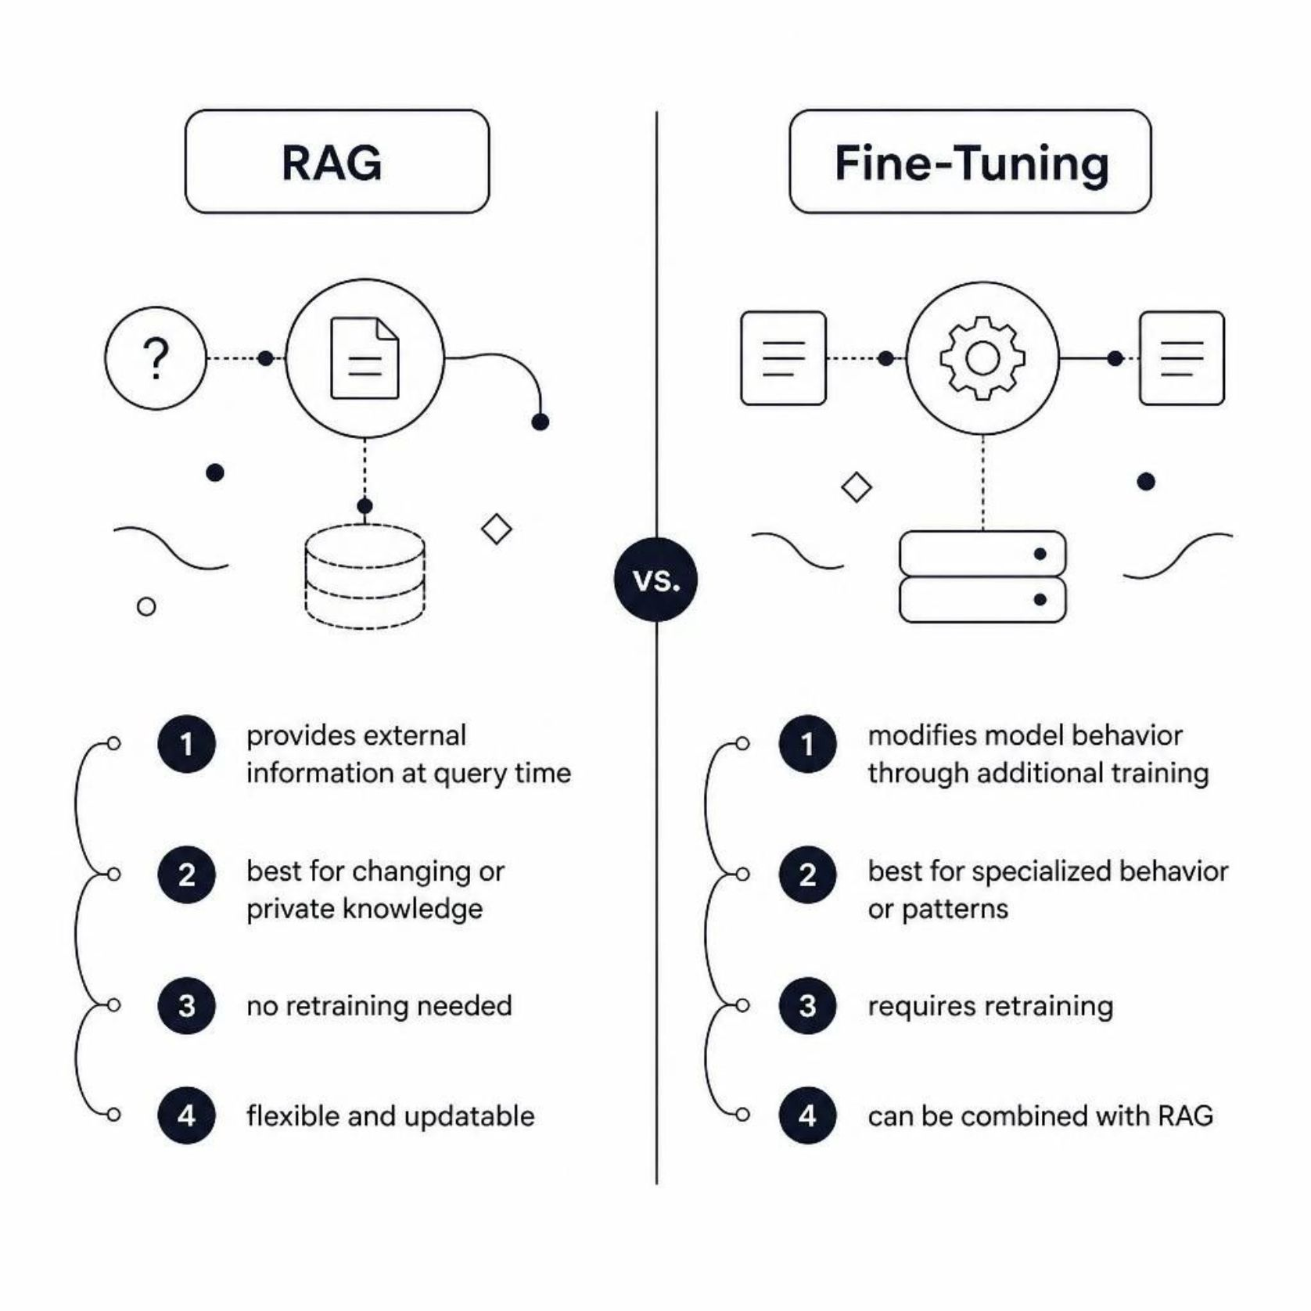
RAG vs Fine-Tuning
Choosing the Right Approach
RAG provides external information at query time
Fine-tuning modifies model behavior through additional training
Use RAG for changing or private knowledge
Use fine-tuning for specialized behavior or patterns
They can also be combined for maximum effect

Slide 17

Bringing RAG into an Agent
Traditional RAG
Question → Retrieve → Answer
Retrieval always happens — no decision-making involved
Agentic RAG
Question → Agent decides → Retrieve → Evaluate → Answer
The agent decides when retrieval is useful — smarter, more efficient
Agentic RAG adds a reasoning layer: the agent evaluates whether retrieval is necessary before invoking it.

Slide 18

Agent + RAG + Tools
Document Retrieval
RAG-powered access to private knowledge bases
Calculator
Precise numerical computation when needed
Web Search
Real-time information from the internet
Other Tools
Any application-specific capability the agent may need
The LLM decides which capability is appropriate for each step of the task.

Slide 19

Example: Document + Calculator Agent
How the Agent Combines Tools
User asks for a policy-based discount and final price
Retrieve the relevant policy
Determine the allowed discount
Use calculator for the final amount
Generate the answer using both results
User Request
Retrieve Policy
Determine Discount
Calculate Final
Generate Answer

Slide 20

Memory + RAG
Memory
RAG
Together
Information about the user, interaction, or previous tasks — who you are talking to and what has happened
Information retrieved from external documents — what the knowledge base contains
Memory and RAG solve different problems — both can be used together in a single agent for richer, more personalized responses
Memory and RAG are complementary, not competing — combine them when your application needs both personalization and knowledge retrieval.

Slide 21

What is a Multi-Agent System?
Specialized Agents
A system containing multiple AI agents, each with a specific responsibility
Collaboration
Agents can collaborate, delegate tasks, or pass results to one another
Example
Research Agent + Analysis Agent + Writing Agent working in concert

Slide 22


Why Use Multiple Agents?
Specialization — each agent excels at its role
Separation of responsibilities
Different tools or knowledge sources per agent
Easier organization of complex tasks
Multi-agent systems add complexity and cost — use them only when the benefit is clear.

Slide 23
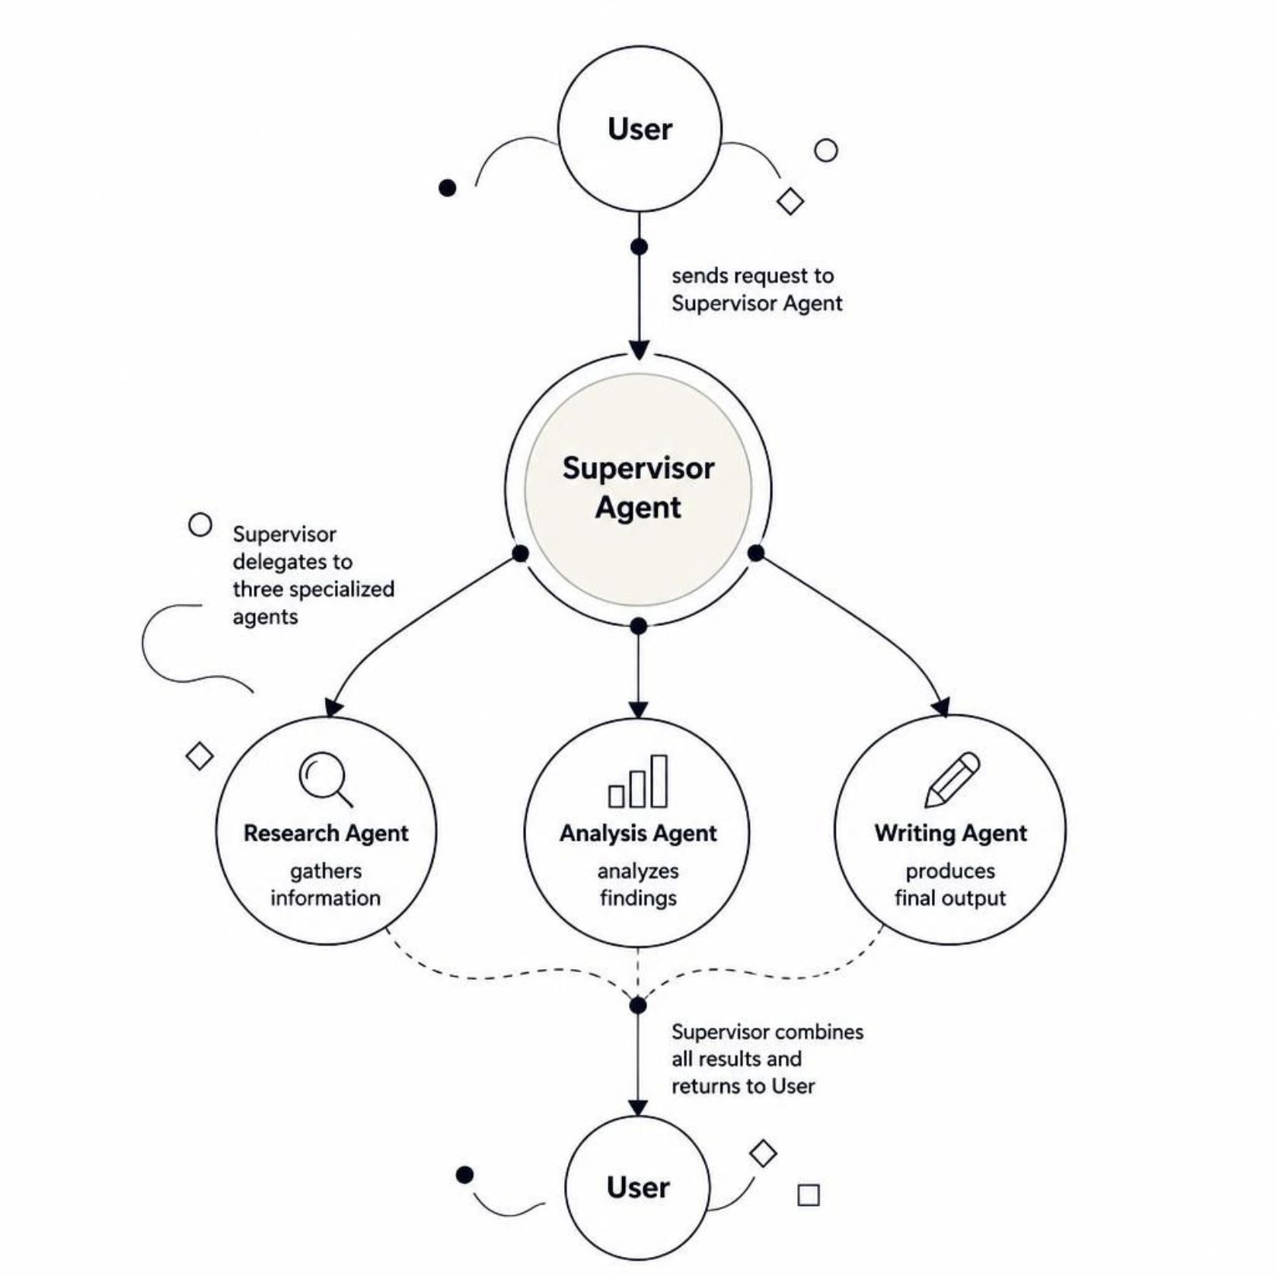
Simple Multi-Agent Architecture
How It Works
User → Supervisor Agent — entry point for all requests
Research Agent → gathers information
Analysis Agent → analyzes findings
Writing Agent → produces final output
Supervisor combines the results and responds

Slide 24

When NOT to Use Multiple Agents
Simple Tasks
Simple tasks usually do not need multiple agents — a single well-designed agent is often sufficient
Coordination Overhead
Multi-agent systems add coordination overhead — more moving parts, more failure points
Cost
More agents can mean more LLM calls and significantly higher operational cost
Start Simple
Start with one agent and add specialization only when it provides a clear, measurable benefit

Slide 25

Lab Overview
What You Will Build
A simple document-aware agent that combines retrieval and calculation capabilities.
Use a small set of local documents
Create a ChromaDB vector store
Expose retrieval as a tool
Add a simple calculator tool
Allow the agent to use retrieval and calculation together

Slide 26

Lab Architecture
LLM Final Answer
User Question
Initial input to the agent
Combines context and results
Calculation Result
Lab Agent Architecture
RAG Retriever
Queries ChromaDB for context
Numeric output from tool
Document Context
Calculator Tool
Performs numeric computations
Relevant passages returned
The agent orchestrates two tools — a RAG retriever backed by ChromaDB and a calculator — combining their outputs through the LLM to produce a grounded final answer.

Slide 27
Lab Steps
Prepare Documents
Prepare a small folder of sample documents
Load and Split
Load and split the documents into chunks
Build ChromaDB
Generate embeddings and create the ChromaDB vector store
Test Retrieval
Test retrieval independently before connecting to the agent
Connect Tools
Expose the retriever and calculator as tools, then connect to the agent

Slide 28

Lab Testing
Systematically test each capability and combination to understand agent behaviour.
Test a question requiring only document retrieval
Test a question requiring only calculation
Test a question requiring both retrieval and calculation
Test a question that cannot be answered from the documents
Observe which tools the agent selects
Check whether retrieved information is correctly used

Slide 29
Debugging and Improving the Agent
Check Retrieved Chunks
Improve Tool Descriptions
Inspect what the retriever returns and improve chunking or retrieval queries
Clear tool descriptions help the LLM select the right tool at the right time
Validate Tool Arguments
Add Logging
Validate inputs and handle tool failures gracefully to prevent cascading errors
Add simple logging and include source information in responses where appropriate

Slide 30

Module 5 Summary
Memory
RAG
Retain useful information across steps and sessions
Retrieve relevant external knowledge at query time
ChromaDB
Tools
Simple local vector storage for embeddings and chunks
Provide capabilities and actions beyond language generation
Agent
Multi-Agent
Decide what capability to use and when to use it
Coordinate specialized agents for complex tasks
Key takeaway: Start simple, then add memory, RAG, tools, or additional agents only when they solve a real problem.

