Slide 1

Agentic AI Fundamentals
Certificate in Agentic AI and Software Solutions — Module 1
Atul Kahate

Slide 2

Learning Objectives
01
Generative AI & LLMs
Explain the foundations of generative AI and large language models
02
System Types
Distinguish between an LLM application, workflow, and AI agent
03
Agent Mechanics
Understand reasoning, planning, tools, memory, and actions
04
Use Cases & Practice
Identify suitable use cases and build a simple LLM-powered application

Slide 3



From Traditional Software to Agentic AI
Traditional Software
Generative AI
Agentic AI
Input → Program Logic → Output
Follows programmed rules exactly
Prompt → LLM → Generated Output
Creates and transforms information
Goal → Reason → Plan → Act → Observe → Adapt
Decides what actions are required

Slide 4

What is Generative AI?
AI systems that create new content based on learned patterns from vast training data.
Output types: text, code, images, audio, video, and structured data
Common tasks:
Answer, summarize, generate
Extract, classify, transform

Slide 5

What is an LLM?
Large Language Model
Trained on vast amounts of text and code — understands natural-language instructions and generates text, code, summaries, and reasoning
Key Distinction
LLM = reasoning & generation capability
Agent = LLM + ability to decide and act

Slide 6

A Basic LLM Application
User
Sends a question or request
Application
Crafts prompt + context
LLM
Generates a response
Output
Chatbot, summarizer, translator, code generator, document Q&A
The application controls what to ask the LLM and how to use the response.

Slide 7


What is an AI Workflow?
Input Document
A predefined sequence of AI and software operations — defined entirely by the developer in advance.
Key difference from an agent: the sequence is fixed, not dynamically determined.
Extract Text
Summarize & Classify
Generate Report
The developer defines the path. The system follows it.

Slide 8
LLM Application vs. Workflow vs. Agent
LLM Application
AI Workflow
AI Agent
One or few LLM calls, simple logic
e.g. chatbot, summarizer
Multiple steps, explicit orchestration, fixed sequence
e.g. document processing pipeline
Dynamic decisions, tools, planning, and autonomous action toward a goal

Slide 9

What is an AI Agent?
A software system that uses an AI model to pursue a goal by deciding what actions to take.
Instead of following a fixed sequence:
"What should I do next?"
The agent continuously evaluates its situation and selects its own next step — making it fundamentally different from a workflow.

Slide 10

The Agentic Loop
Set Goal
Form Plan
Adapt & Reason
Act & Observe
The loop repeats until the goal is achieved or human intervention is needed. Core concept: the agent acts, observes the result, and decides what to do next.

Slide 11

Core Components of an AI Agent
LLM
Interprets goals, reasons, plans, and selects actions
Tools
Web search, APIs, databases, file access — real-world capabilities
Memory & State
Retains context within and across interactions
Environment
Where actions occur; observations feed back to the agent

Slide 12

Tools: Giving Agents the Ability to Act
A tool is a function or external capability the agent can invoke to interact with the world.
Examples: web search, database query, file reading, email, API calls, Python execution, calendar
Without Tools
With Tools
Think + Generate
Think + Act + Observe

Slide 13
Planning: Static vs. Dynamic
Static Workflow
Developer defines A → B → C → D in advance. The path is fixed before execution begins.
The developer determines the path.
Dynamic Agent
Goal → determine what's needed → select tool → observe → decide next action
The system can determine parts of the path at runtime.

Slide 14

Memory and State
State
Information needed during the current task — user request, plan, tool results, current step
Memory
Information retained beyond the immediate interaction — past conversations, user preferences, stored knowledge

Slide 15
Agent + RAG
RAG (Retrieval-Augmented Generation) provides external knowledge via a vector database. Agentic behavior adds dynamic decision-making and action on top of retrieval.
Agent
Determine Need
Agent determines what information is needed
Retriever fetches relevant documents
Documents become context for the LLM
LLM generates a grounded, accurate answer
Retriever
Documents

Slide 16

Levels of AI Systems
1
Level 1 — LLM
Generate
2
Level 2 — LLM Application
Prompt + Context
3
Level 3 — AI Workflow
Multiple predefined steps
4
Level 4 — AI Agent
Dynamic decisions + Tools + State
5
Level 5 — Multi-Agent System
Multiple collaborating agents
Higher level does not automatically mean better — use the simplest architecture that solves the problem.

Slide 17

When NOT to Use an Agent
Agents introduce complexity, more LLM calls, latency, cost, and harder debugging.
Use a Simple LLM App
Use a Workflow
Use an Agent
When one prompt is enough
When steps are predictable
When decisions and actions need to be dynamic

Slide 18

Where Agents Are Useful
Software Development
Code analysis, testing, debugging, documentation
Business Operations
Customer support, research, reporting, workflow automation
IT Operations
Incident investigation, log analysis, monitoring
Knowledge Work
Research assistants, document analysis, information retrieval

Slide 19
Example: Customer Support at Each Level
1
LLM Application
2
AI Workflow
3
AI Agent
Customer question → LLM → Answer
Classify issue → Retrieve FAQ → Generate response → Send
Determine what's needed → Search knowledge base → Check account/order → Decide response or escalate

Slide 20
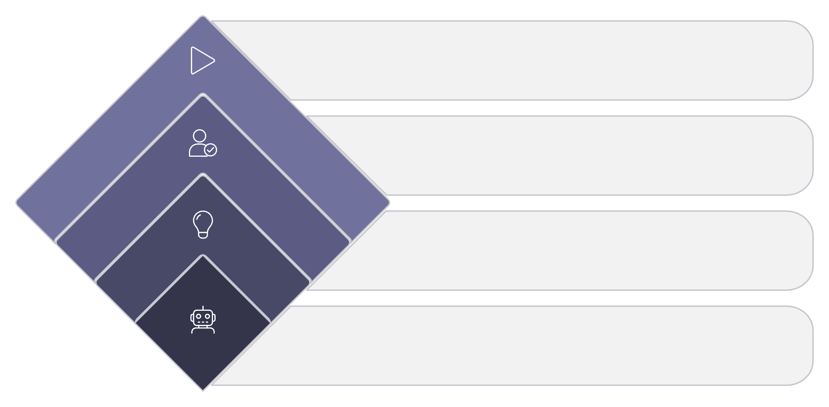
Agentic AI ≠ Fully Autonomous AI
Execute Action
Perform approved change
Human Approval
Agents do not necessarily mean completely independent systems. Autonomy should be matched to risk.
Critical for human oversight:
Review and authorize
Propose Action
Generate recommended step
Financial transactions
Production deployments
Security operations
External communications
Agent Detects Task
Identify required action

Slide 21

Agent Reliability & Production Readiness
Possible Failure Modes
Production Requirements
Incorrect reasoning or misunderstood goal
Wrong tool selected or bad data returned
API failures or infinite loops
Guardrails & validation
Logging & observability
Evaluation frameworks
Human approval where stakes are high
Production agents require more than a working prototype — reliability engineering is essential.

Slide 22

CHAPTER 2
Lab: Build a Simple LLM Application
Hands-on Python practice — from prompt to response

Slide 23

Lab Objective
Build a simple Python LLM application that connects to the OpenAI API and returns a real response.
User Input
Python App
OpenAI API
LLM Response

Slide 24
Lab Setup
1
2
3
Create Virtual Environment
Install OpenAI SDK
Configure API Key
python -m venv .venv
pip install openai
Set your OpenAI API key as an environment variable — never hard-code keys in source code

Slide 25
Your First LLM Application
What's Happening
from openai import OpenAI
client = OpenAI()
response = client.responses.create(
model="YOUR_MODEL",
input="Explain agentic AI in simple terms."
)
print(response.output_text)
client — authenticated connection to OpenAI
request — your prompt is sent to the model
model — generates a response
response — printed to your console

Slide 26



Experiment with Prompts
"Explain agentic AI to a beginner."
"Explain agentic AI to a Python developer who has never worked with AI."
"Explain agentic AI using a real-world restaurant example."
Discuss: What changed? The model stayed the same — only the instructions changed.

Slide 27
Add System-Level Instructions
"You are an AI instructor. Explain technical concepts in simple language, using practical examples, avoiding jargon, and using short sections."
A system prompt shapes how the entire application behaves — before the user ever asks a question.
Then ask: "What is an AI agent?"
Observe how system instructions shape the tone, depth, and style of every response.

Slide 28


From LLM Application to Agent
Current
With a Tool
Question → LLM → Answer
Question → LLM → Decide if tool needed → Tool → Result → LLM → Answer
This is the transition from a simple LLM application toward a tool-using agent — the foundation for everything in Module 2.

Slide 29

Lab Extension: Think Like an Agent
Before adding tools, reason through the agent's perspective:
Knowledge Boundaries
What does the LLM already know? What does it not know?
Tool Requirements
What external capability would it need — and what tool could provide it?
Failure Handling
What happens if the tool returns an unexpected result?

Slide 30

Module 1 Summary
Progression
Core Loop
Generative AI → LLM → LLM Application → AI Workflow → AI Agent → Multi-Agent System
Generate → Process → Decide → Act → Observe → Adapt
Next Up
Module 2 — Agentic AI Architectures & Design Patterns

