Slide 1

Module 3 — Working with LangChain
Certificate in Agentic AI and Software Solutions · 10-Hour Module

Slide 2

What You'll Learn in This Module
01
Understand LangChain
Why it exists and when to reach for it
02
Prompts, Models & Messages
Work with chat models and message types
03
Pipelines & Structured Output
Build chains with LCEL and validate model responses
04
Tools & Tool Calling
Define tools and build a basic tool-calling application

Slide 3
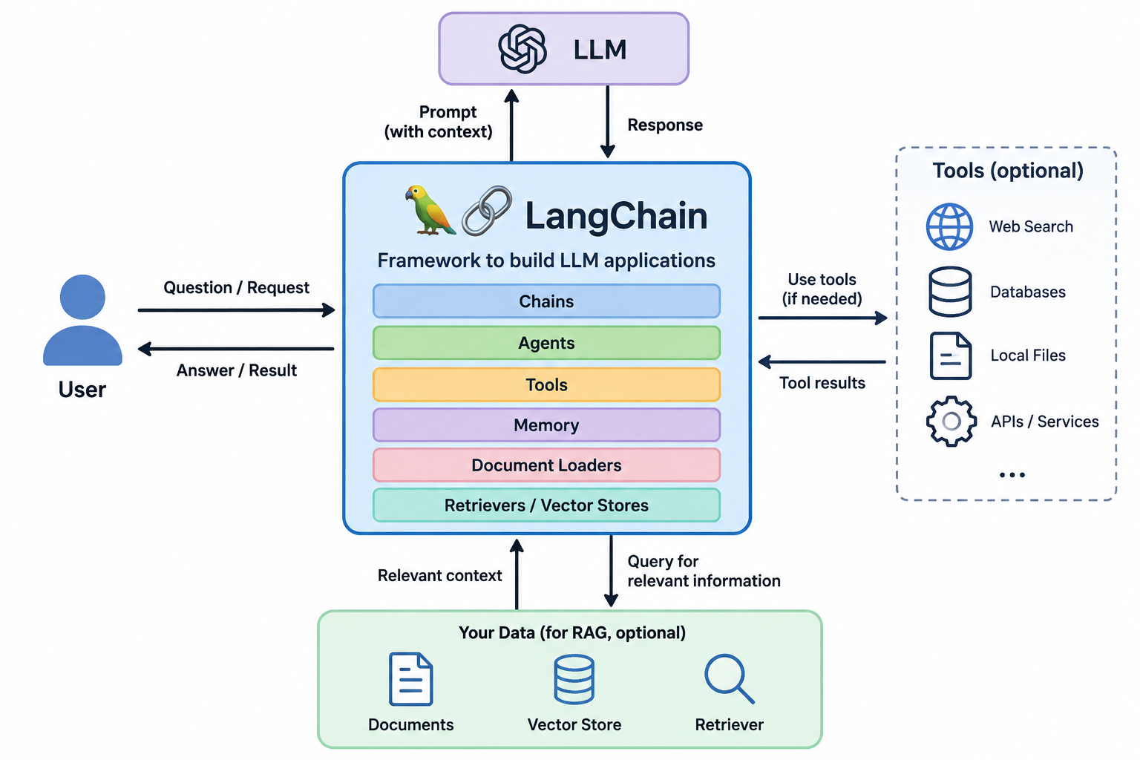

What is LangChain?
LangChain is an open-source framework for building LLM-powered applications. It provides reusable abstractions — models, prompts, tools, messages, and structured output — that connect LLMs with application logic and external capabilities.
Key distinction: LangChain is not an LLM — it is an application development framework that sits on top of any supported model.

Slide 4
Why Use LangChain?
Eliminates Boilerplate
Standardized Interface
No more repetitive integration code every time you connect to an LLM
Interact with different models through a single, consistent API
External Connectivity
Scales to Agents
Connect LLMs to tools, APIs, databases, and external systems
Building blocks that grow naturally into LangGraph agent frameworks

Slide 5

LangChain Application Architecture
At its core, every LangChain application follows a clean, composable flow from user input to final output.
Prompt Template
Chat Model
Apply templates, formatters, and parsers.
Invoke model with tools, retrievers, logic.
User Input
Parsed Output
Collect queries and context from users.
Produce structured, validated final results.
LangChain composes these stages into a coherent, maintainable application — abstracting away the complexity of each integration point.

Slide 6

CHAPTER 1
Core Building Blocks
The essential components that power every LangChain application

Slide 7
The 8 Core LangChain Components
Chat Models
Prompts
Accept messages as input and return structured responses
Reusable templates for instructing models consistently
Messages
Structured Output
Structured conversation units — System, Human, AI, Tool
Parse and validate model responses against a defined schema
Tools
Runnables / Chains
Callable functions the model can invoke at runtime
Compose components into end-to-end processing pipelines

Slide 8
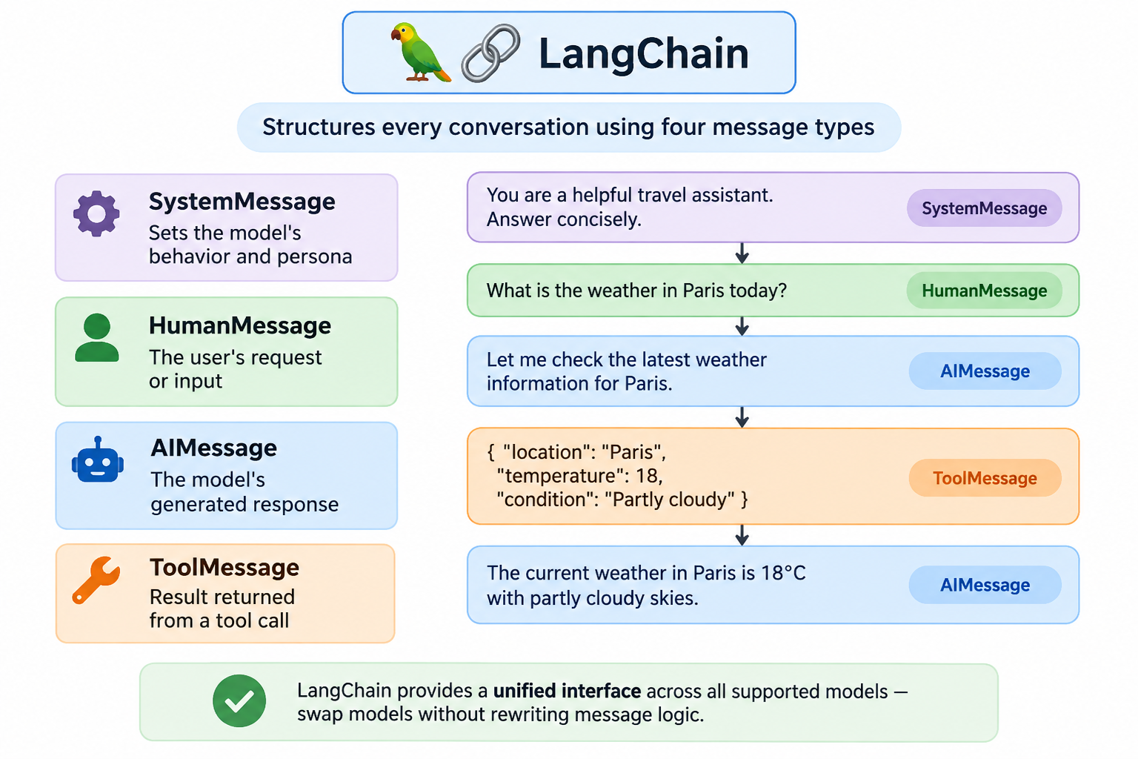
Chat Models & Messages
LangChain structures every conversation using four distinct message types. Together, they give the model the context it needs to behave correctly and respond accurately.
SystemMessage — sets the model's behavior and persona
HumanMessage — the user's request or input
AIMessage — the model's generated response
ToolMessage — result returned from a tool call
LangChain provides a unified interface across all supported models — swap models without rewriting message logic.

Slide 9
Prompt Templates
Separate Instructions from Data
PromptTemplate
Use variables to inject runtime values: 'Explain {topic} for a {audience}' — the template stays constant while inputs change.
For simple, text-based prompts. Best suited for single-turn completions where a full chat history isn't needed.
ChatPromptTemplate
Why It Matters
For message-based chat interactions. Combines System, Human, and AI message slots into a single reusable structure.
Reusable, consistent, and easy to maintain — templates eliminate ad-hoc string formatting across your codebase.

Slide 10

CHAPTER 2
Chains, LCEL & Structured Output
Composing components into clean, maintainable pipelines

Slide 11
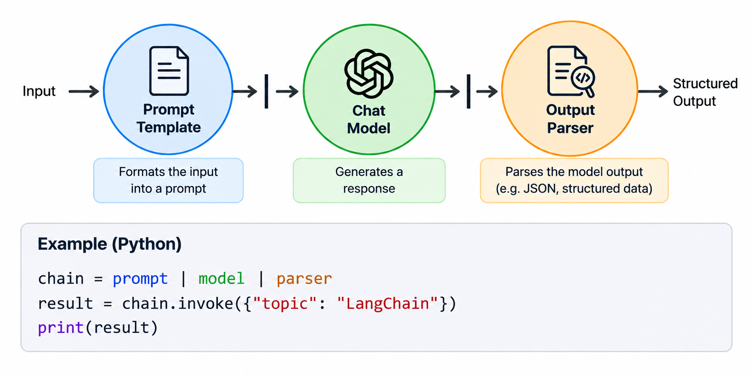
LCEL: Composing Components
LangChain Expression Language (LCEL) is the glue that connects components into sequences. Its pipe-based syntax is both readable and powerful:
prompt | model | parser
Input flows from one component to the next automatically
No boilerplate wiring — just declare the sequence
Supports complex pipelines with parsing and transformation steps
Works with any LangChain-compatible runnable component

Slide 12

Chains vs. Agents
⛓ Chain
A predefined sequence: Input → Prompt → Model → Parser. The execution path is fixed and known in advance. Ideal when your workflow doesn't require dynamic decisions.
🤖 Agent
Uses repeated decision-making and tool use to pursue a goal. The path emerges at runtime based on the model's reasoning.
Tool calling is the foundation that bridges chains and agents — mastering it here unlocks more advanced agent patterns later.

Slide 13
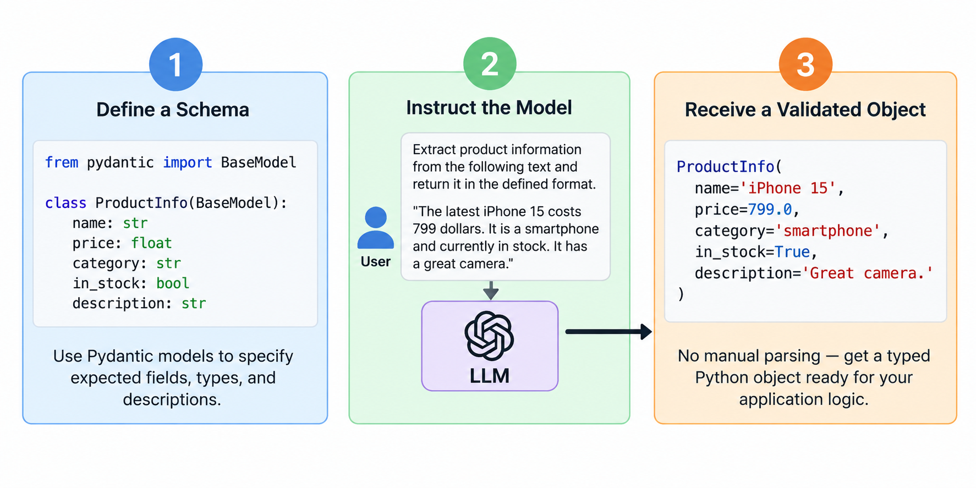



Structured Output
Define a Schema
Use Pydantic models to specify expected fields, types, and descriptions
Instruct the Model
Ask the LLM to return data that matches your schema exactly
Receive a Validated Object
No manual parsing — get a typed Python object ready for your application logic

Slide 14
Example: Structured Customer Request
"My payment failed twice and I need help immediately."
Field
Extracted Value
Category
Payment
Free-form user text like this is hard to route or process programmatically. With structured output, the model extracts exactly what your application needs — no regex, no parsing logic.
Priority
High
Summary
Payment failure — occurred twice
Urgency Signal
"immediately" detected
The validated Pydantic object flows directly into your application code — routing, ticketing, or escalation logic.

Slide 15

CHAPTER 3
Tools & Tool Calling
Extending LLM capabilities beyond text generation

Slide 16
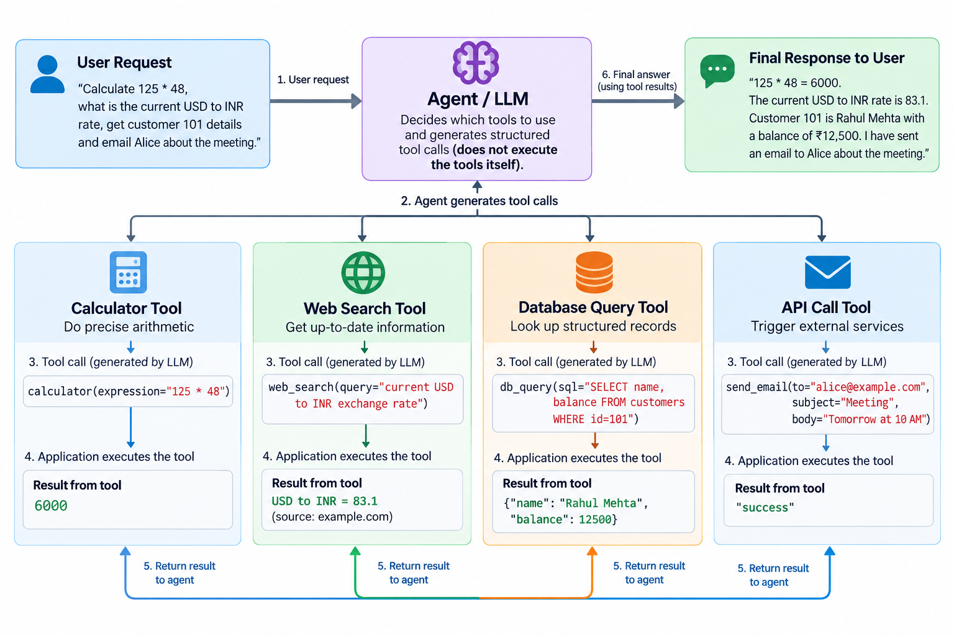

Slide 17
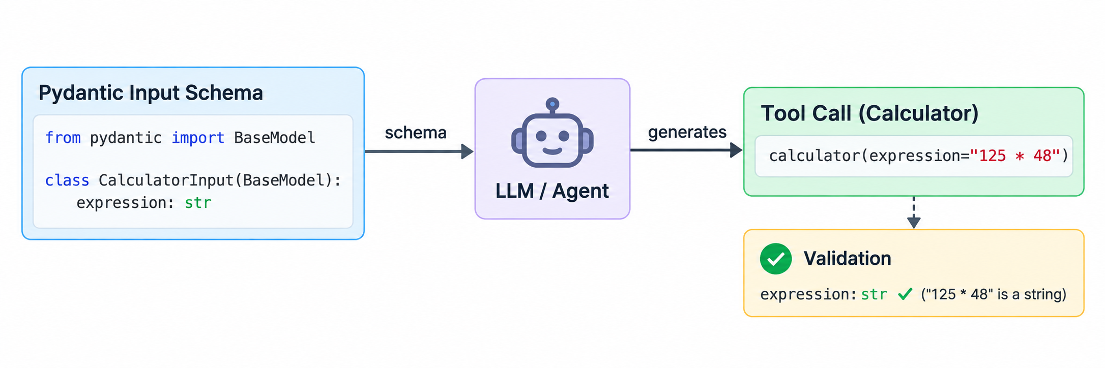

Tool Input Schemas
Well-typed tool arguments are essential for reliability. Pydantic models define input schemas so the model knows exactly what to pass — and your application can validate what it receives.
Tool arguments should be structured and well-typed
Example: calculator(expression: str)
Structured inputs improve validation, reliability, and debugging
Clear field descriptions guide the model's argument generation
Think of the schema as a contract between the LLM and your tool — precision here prevents runtime errors downstream.

Slide 18
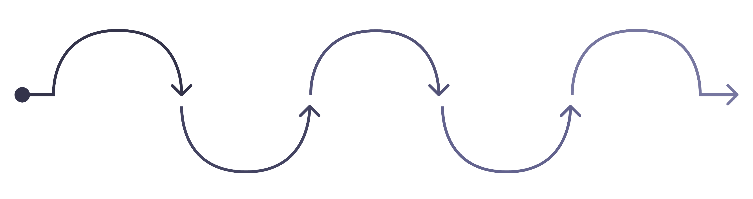
Tool Calling Flow
LLM Reasoning
Argument Generation
User Request
Tool Selection
Tool Execution
Initial user question or command
Model evaluates need for a tool
Choose the appropriate tool
Prepare inputs for the tool
Application runs the selected tool
The model decides when a tool is appropriate and supplies the arguments. The application executes the tool and returns the result — the model then uses it to generate a grounded final response.

Slide 19

Example: LangChain Research Assistant
A practical end-to-end scenario showing tool calling in action:
1
User asks a research question
2
Model decides a tool is needed
The model receives the natural-language query
Determines external information is required to answer accurately
3
Search tool is called
4
Grounded answer generated
Result is returned to the model as a ToolMessage
Model uses the retrieved result to produce an accurate, cited response

Slide 20
Error Handling & Reliability
Know the Failure Points
Validate Early
Invalid arguments, tool execution errors, and unexpected output formats are the most common culprits
Use Pydantic schemas to catch bad inputs before they reach your tool's logic
Log Intermediate Outputs
Handle Errors Gracefully
Inspect prompts, tool calls, and results during development — don't debug blind
Never pass raw error messages blindly to the user — transform exceptions into meaningful responses

Slide 21

CHAPTER 4
Lab: Build a LangChain Application
Four hands-on exercises — from a simple prompt chain to a complete tool-calling cycle

Slide 22
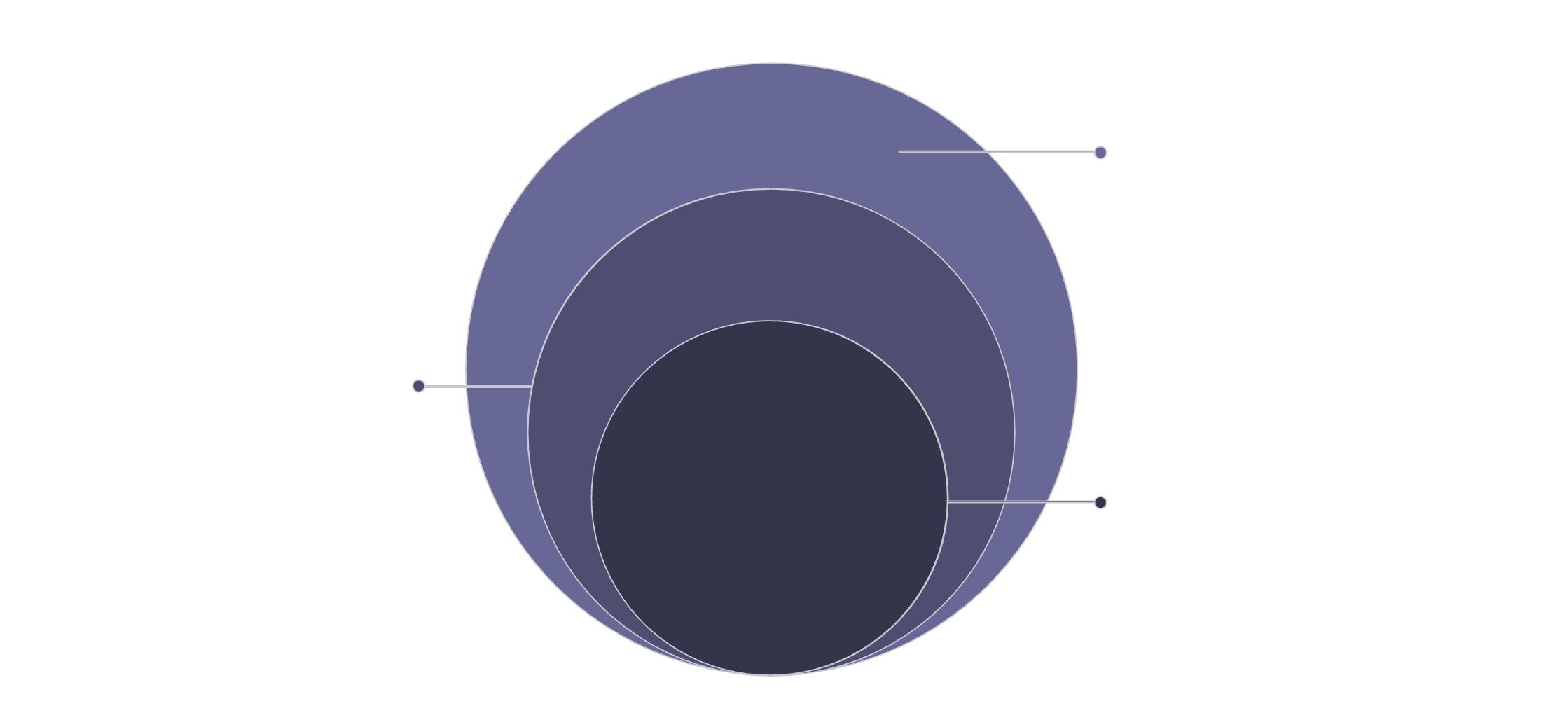
Lab Architecture Overview
Structured Output & Tools
Top layer: parsers, tool calls, and actions
Each exercise builds on the previous one, progressively assembling a fully functional LangChain application. By the end of the lab, you'll have implemented every layer of the stack.
Chat Model
Core processing: conversational LLM handling
ChatPromptTemplate
Base layer: structured prompts and templates
1
🔧 Exercise 1
Prompt + Chat Model
2
📋 Exercise 2
Structured Output
3
🛠 Exercise 3
Add a Tool
4
🔄 Exercise 4
Full Tool-Calling Cycle

Slide 23


EXERCISE 1
Prompt + LLM
Your first LangChain pipeline: wire a prompt template to a chat model and generate a response from user input.
Create a ChatPromptTemplate with a system instruction
Connect it to a chat model using LCEL pipe syntax
Pass user input and display the model's response
Experiment with different system instructions — observe how behavior changes
Try changing the system role from "helpful assistant" to "Socratic tutor" — notice how the model's style shifts immediately.

Slide 24



EXERCISE 2
Structured Output
Define the Model
Connect & Prompt
Inspect & Validate
Create a Pydantic output model with typed fields — e.g. category: str, priority: int, summary: str
Attach the schema to your chat model and ask the LLM to classify or extract information from unstructured input
Receive the structured object — inspect individual fields and confirm they match expectations before wiring to application logic

Slide 25

EXERCISE 3
Add a Tool
Extend your application by defining and binding a tool — then test when the model decides to use it.
Define a simple calculator or search tool with a clear name and description
Provide a Pydantic input schema for the tool's arguments
Bind the tool to the chat model using .bind_tools()
Test requests that do and do not require the tool — observe the model's decision

Slide 26
EXERCISE 4
Full Tool-Calling Cycle
Model Selects Tool
App Executes Tool
Model reasons and chooses tool with arguments.
Application runs the tool and returns results.
User Request
Model Final Answer
User asks a question or provides a task.
Model integrates tool output into final response.
Observe the complete cycle end-to-end: the model reasons about the request, selects a tool, your application executes it, and the model weaves the result into a final, grounded answer.

Slide 27

Debugging Your LangChain App
When something goes wrong, systematic inspection is faster than guessing. Build debugging habits from the start.
Inspect prompts — is the system instruction correct? Are variables injected properly?
Inspect model responses and tool call arguments before execution
Check structured-output validation errors — Pydantic messages tell you exactly what failed
Log intermediate outputs at every stage during development

Slide 28
LangChain Design Principles
Single Responsibility
Reuse & Consistency
Keep each component focused on one job — prompt templates prompt, tools execute, parsers parse
Use reusable prompt templates and structured data wherever possible — avoid ad-hoc string formatting
Clear Tool Contracts
Validate Everything
Give tools descriptive names, clear descriptions, and well-typed schemas — the model's decisions depend on it
Validate external inputs and tool results — keep architecture simple and guard every boundary

Slide 29

Module Summary & What's Next
Building Blocks Mastered
Prompts, chat models, messages, chains, structured output, and tools — you now have the full LangChain toolkit
LCEL Pipelines
Compose components into clean, readable, and maintainable pipelines using the pipe operator
Tool Calling Foundation
The complete tool-calling cycle is the gateway to advanced agent behavior — you've built it from scratch
Next: Building AI Agents with LangGraph
Take these primitives further — build multi-step, decision-making agents that reason and act autonomously

