Slide 1



The Cub
Way
SOCIAL MEDIA INTERN ONBOARDING
How we look, sound and feel
on social media.
Notes:
Welcome the intern. 'The Cub Way' is our short guide to how The Cub looks, sounds and feels online. Everything here comes from our brand guide and our own Instagram posts. Use it as a reference while you create content. Walk-through order: who we are, our voice, how we write, our language, colours and fonts, design style, visuals and reels, do's and don'ts, examples.

Slide 2


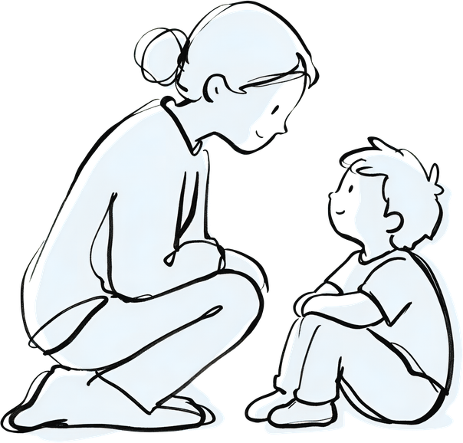





We see the child
before the label.
ABOUT THE CUB
WHO WE ARE
WHO WE TALK TO
A multidisciplinary centre for children and adolescents.
Parents & caregivers
Experts, together
They want clear, kind answers. We help them feel understood and confident.
Psychology, speech & language, OT and special education.
The whole child
Communication, learning, emotions and daily life.
Clinicians & professionals
Parents are partners
Families know their child best. We help them feel confident.
SLPs, OTs, paediatricians. They want practical, clinical detail.
Restraint over labels
A diagnosis is a last resort, used only when it truly helps.
Notes:
We are a multidisciplinary centre for children and adolescents. Our big idea: look at the whole child before reaching for a label. Two audiences. Parents and caregivers: they want clear, kind answers and often feel judged. Clinicians and professionals: they want practical detail (see our OSIT workshop posts). Ask the intern: who is this post for? That answer decides the words you choose.

Slide 3




Warm. Clear.
Never judging.
VOICE & TONE
Warm
Clear
Respectful
Expert
We lead with care, never with fear.
Simple words. One idea at a time.
We never blame a child or a parent.
We know the science and explain it simply.
SOUNDS LIKE
SOUNDS LIKE
SOUNDS LIKE
SOUNDS LIKE
“A little understanding can go a long way.”
“Give clear, simple instructions.”
“Struggling doesn’t mean not trying.”
“Look beyond the presenting concern.”
Sound like a kind expert, not a textbook.
Notes:
Four words to remember: warm, clear, respectful, expert. Each quote on the cards is taken or adapted from our own posts. The test: would a worried parent feel judged by this line? If yes, rewrite it. Would a clinician trust it? It should still be accurate and evidence-informed.

Slide 4

Challenge the label.
Then offer help.
HOOKS · HEADLINES · CAPTIONS
Hooks
Headlines
Captions
Open with a myth or a question.
Two lines: setup, then payoff.
Short, kind, one next step.
QUESTION A LABEL
1
Hook
“Struggling Doesn’t Mean Not Trying.”
Understanding Comes
Before Labelling.
One line that names the myth or feeling.
2
Explain
WIDEN THE VIEW
Two or three short lines, plain words.
“ADHD is more than just being ‘Hyper’”
Reassure
3
Charcoal setup, orange payoff
End with hope: “Every child deserves to be understood.”
ASK SIMPLY
2–5 words a line
“What can help?”
4
Next step
Playfair Display Bold
One action, e.g. thecub.co.in.
Notes:
Hooks and headlines follow one pattern in our posts: question the label, then offer help. Examples are real: 'Struggling Doesn't Mean Not Trying.', 'ADHD is more than just being Hyper', 'What can help?'. Headline recipe: line one sets up (charcoal), line two pays off (orange). Caption recipe is based on how our ADHD and Learning Disability carousels flow: hook, explain, reassure, one next step.

Slide 5
Short sentences.
Soft, simple words.
LANGUAGE & SENTENCES
How our sentences sound
Words we use
Short and plain
understand
support
strengths
1
“Give clear, simple instructions.”
every child
“What would help them?”
2
Soft, not absolute (use may and can)
“…may sometimes reflect difficulties with attention.”
About needs, not faults
Words we only quote
3
“What they often need is the right kind of support.”
“lazy”
“careless”
“not trying”
“hyper”
4
Lists of 4–6 short points
“Attention · Impulse control · Organisation”
Only to challenge them, never to describe a child.
British spelling: organisation, labelling
Dates and prices: 5th & 6th Dec. 2026 · ₹17,499
Web: thecub.co.in
Notes:
Short sentences, simple words. Notice how often our posts say 'may' and 'can': 'may sometimes reflect', 'may struggle with'. We never state things as absolute facts about a child. Words like lazy, careless and not trying only appear inside quote marks, to challenge them. Spelling is British (organisation, labelling, individualised, paediatricians). Dates and prices follow the workshop posts. Parent posts explain terms simply; clinician posts can use clinical terms.

Slide 6
Warm orange.
Calm charcoal.
COLOURS & FONTS
Playfair Display · Headlines
Understanding Comes
Glacial Indifference · Body text and lists
Give clear, simple instructions.
The Cub Orange
Charcoal
Cream
White
#F0853E
#2B2B2B
#FDF6EE
#FFFFFF
Accents, labels, icons, CTAs
Headlines, backgrounds, wordmark
Backgrounds, cards, panels
Cards, digital UI, breathing space
Lexend · Labels and tags
AWARENESS SERIES
Orange leads. Charcoal is for text. Cream and white give space.
Notes:
Four colours: The Cub Orange (#F0853E) for accents, labels, icons and calls to action; Charcoal (#2B2B2B) for headlines, backgrounds and the wordmark; Cream (#FDF6EE) for backgrounds, cards and panels; White for cards, digital UI and breathing space. Three fonts: Playfair Display for headlines, Glacial Indifference for body text, Lexend for small labels and tags. Do not add other colours or fonts.

Slide 7
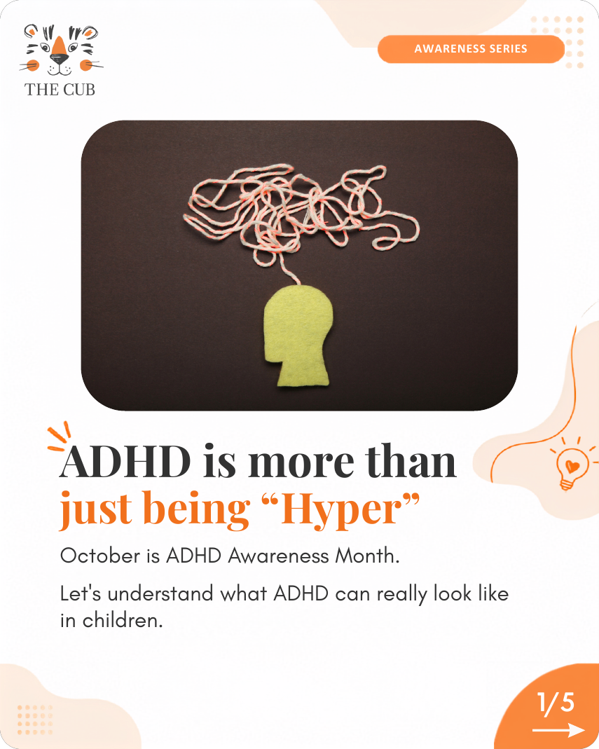
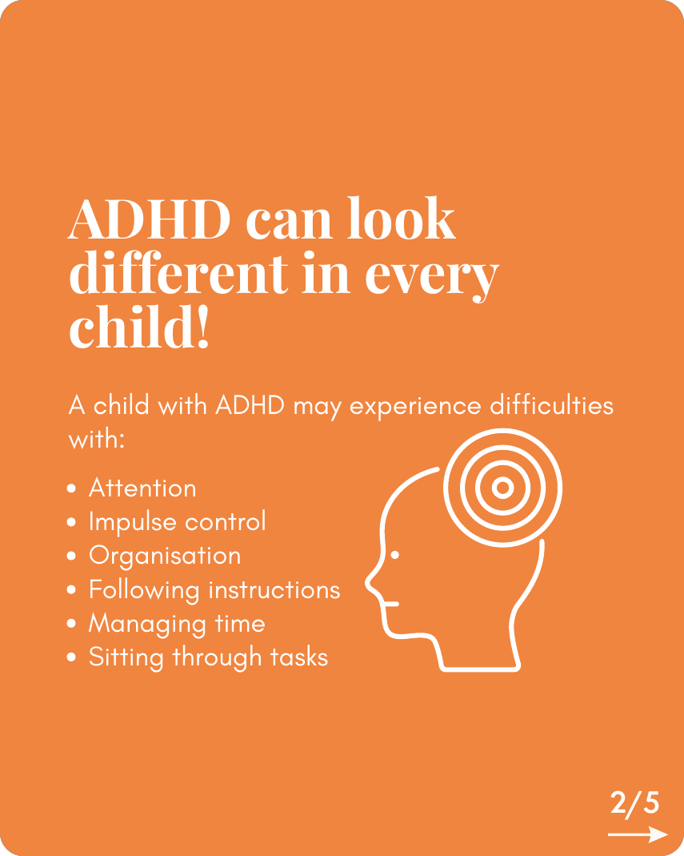
Every post
looks like us.
DESIGN STYLE
1
Logo
1
Top-left on cover slides, on white.
2
2
Tag pill
Names the series, e.g. Awareness Series.
3
3
Rounded photo
Soft corners. One calm picture.
5
4
Two-tone headline
Playfair Bold. Charcoal setup, orange payoff.
4
5
Warm extras
Blobs, dots and sparks. Keep them light.
6
Page counter
6
Orange corner and arrow on every slide.
Cover slide: white
Content slide: orange
Notes:
Anatomy of a Cub post, using our ADHD Awareness carousel. Walk through the six numbered parts. Rhythm: a white cover slide, then alternate between white and orange slides so the swipe feels lively. Every slide has the page counter in the bottom-right corner. Special days (like Learning Disability Month) use a textured paper background, big numbers and hand-drawn doodles, but the same colours, fonts and voice.

Slide 8
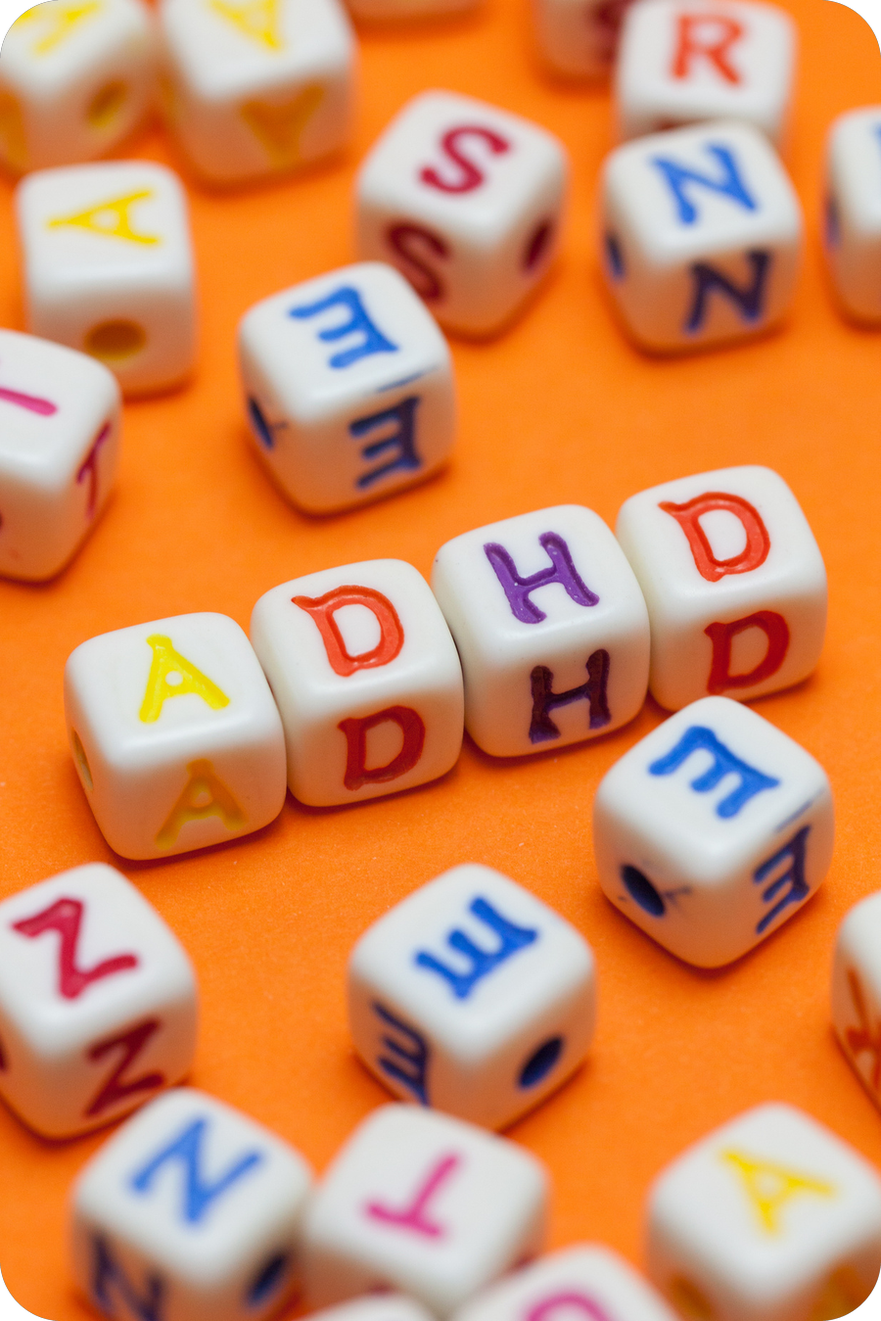

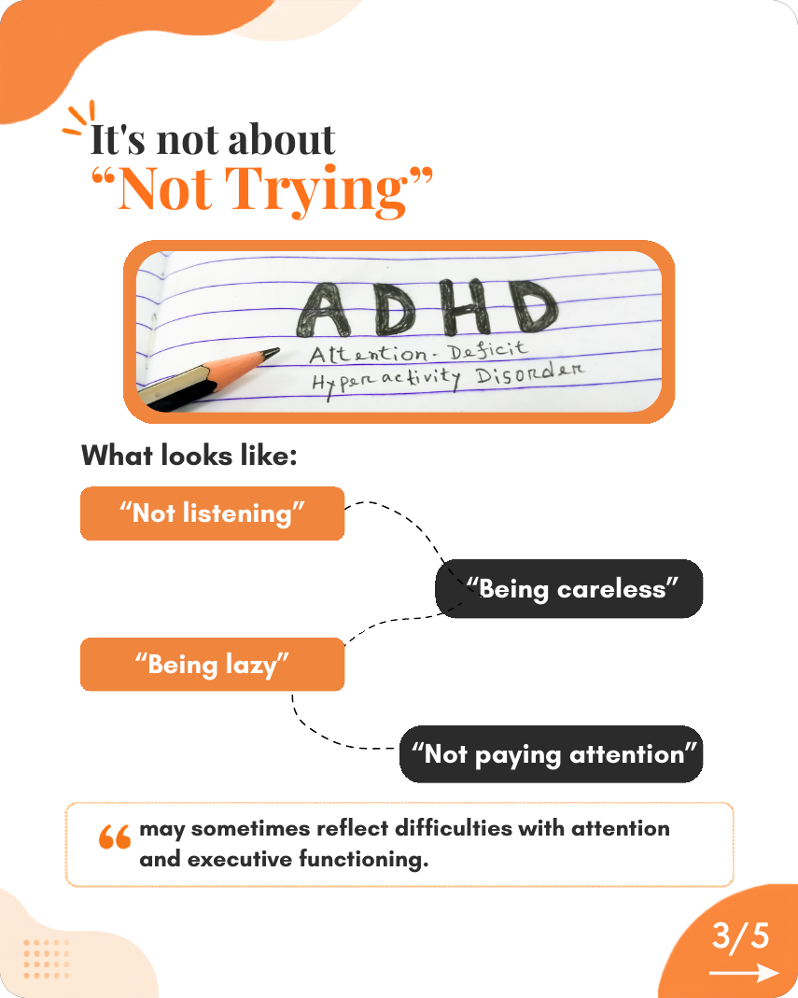

Same look.
Every format.
VISUALS · REELS · MORE
Photos and drawings
Carousels
Reels and video
Calm photos in rounded frames. Hand-drawn doodles for tender topics. White line icons on orange.
5–6 slides, one idea each. Alternate white and orange. Counter and arrow on every slide.
Same colours, fonts and calm voice. Logo on white. End with thecub.co.in.
Event posts:
Price tags in charcoal pills
QR code to register
Partner logos on a white plate
Notes:
Photos: soft rounded frames, calm and simple; hand-drawn doodles for sensitive topics; white line icons on orange. Carousels are our main format: five or six slides, one idea each, alternating white and orange. Our references do not include a reel, so apply the same system in motion: same colours and fonts, same calm voice, logo on white, finish with thecub.co.in. Check new reel ideas with the team lead until we have a reel template. Event posts add charcoal price pills with orange labels, a QR code to register, and partner logos on a white plate (as in the OSIT workshop posts).

Slide 9

What to do,
what to avoid.
DO'S & DON'TS
Do
Don’t
Open with a myth or a question
Blame a child or a parent
Use short, plain sentences
Label or diagnose in a post
Say “may” and “can”
Use scary hooks: “5 signs you can’t ignore!”
End with reassurance and thecub.co.in
Use jargon in parent posts
Use our colours, fonts and the real logo
Add new colours, fonts or a redrawn logo
Proofread every slide before posting
Crowd a slide or copy old text across
Notes:
The quick reference. Do: open with a myth or question, short plain sentences, may and can, end with reassurance and our website, use the brand colours, fonts and the real logo, proofread. Don't: blame, label or diagnose, use scary or clickbait hooks, use jargon in parent posts, add new colours or fonts or redraw the logo, crowd slides or copy old text across posts. Always proofread: reused text from an old post is easy to miss, and overlapping elements show up only when you look at the finished slide.

Slide 10
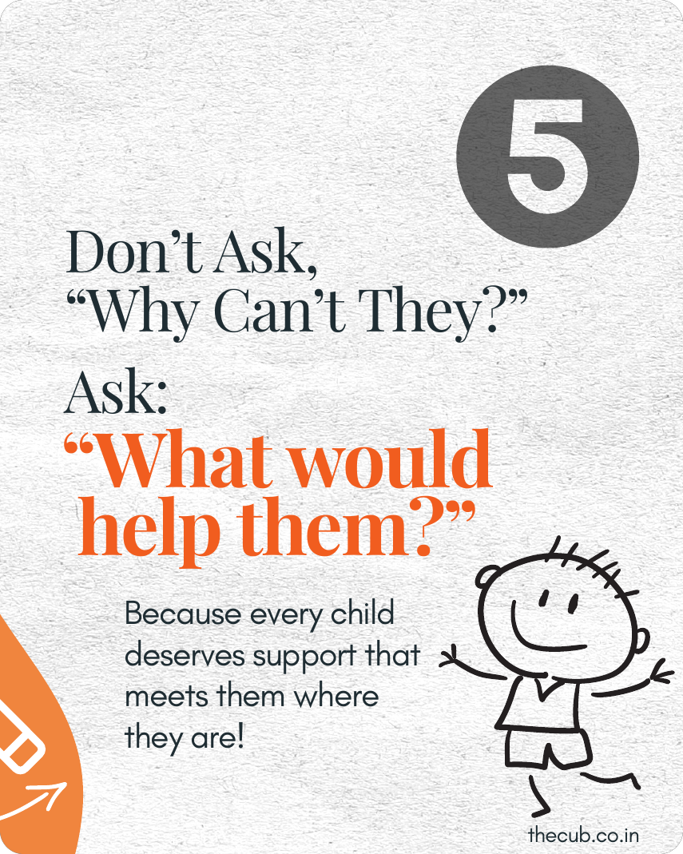
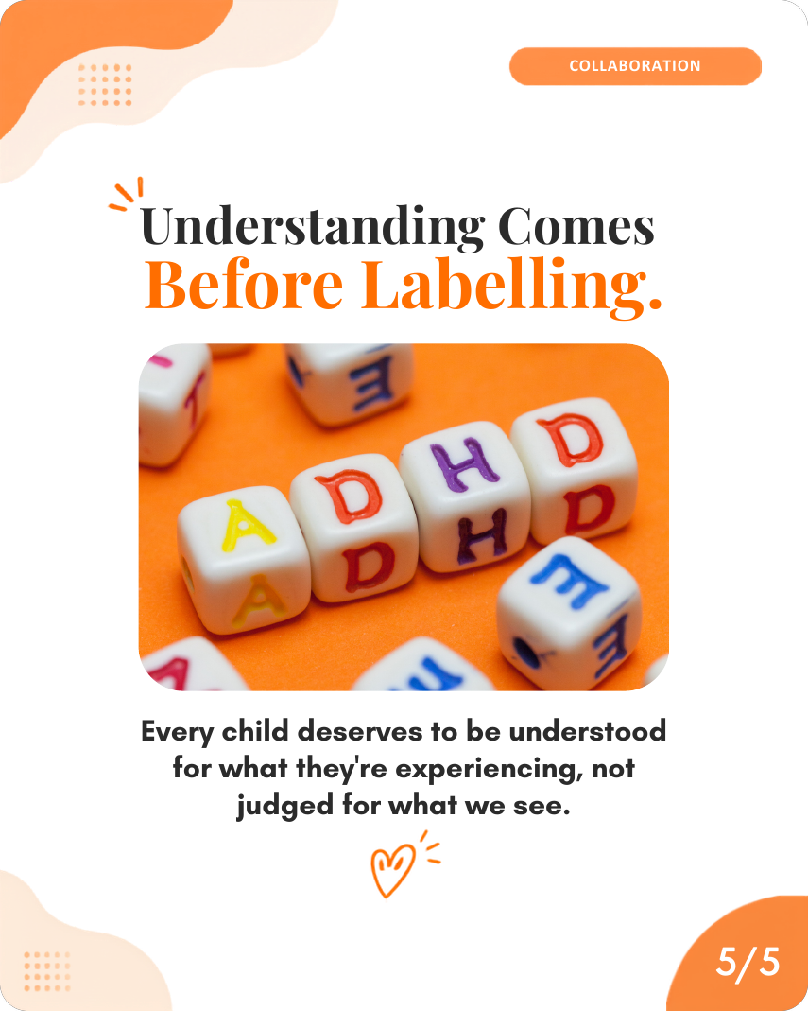
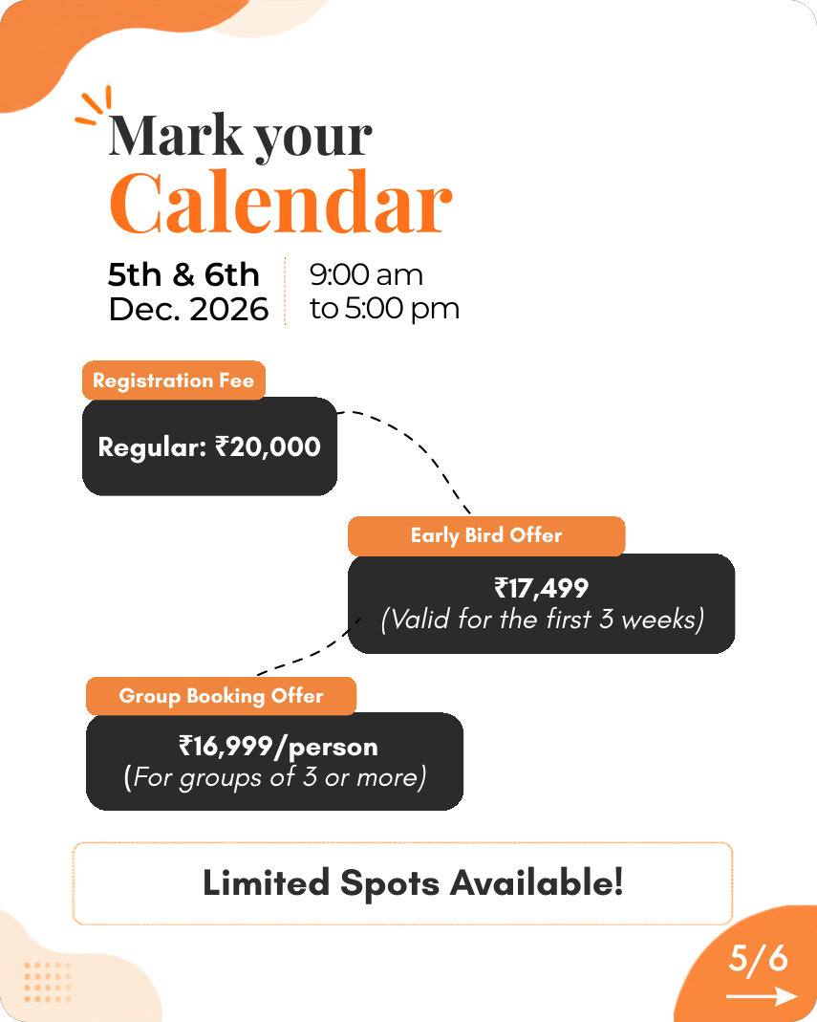
Content that
feels like us.
EXAMPLES
Not us → The Cub way
Is your child lazy? 5 signs you can’t ignore!
“Struggling Doesn’t Mean Not Trying.”
Why can’t they just focus?!
“What would help them?”
Flips the question. Kind and hopeful.
Two-tone headline. Warm close.
Event details, easy to scan.
BOOK NOW!!! Hurry, seats going fast!!!
“Limited Spots Available!”
Before you post:
Kind?
Clear?
Sounds like us?
Looks like us?
Proofread?
Notes:
Three real posts from our feed and why they feel like us: the Learning Disability Month post flips a blaming question into a helpful one; the ADHD carousel closes with a two-tone headline and warm line; the OSIT workshop post makes event details easy to scan. On the right, the 'Not us' lines are examples of what we would never publish; the orange lines are how we say the same thing. Close with the five-question check before every post: kind, clear, sounds like us, looks like us, proofread.

