Slide 1

LIBRARY BOOKS VISUALIZATION
This presentation analyzes a library book dataset of 7,405 records, detailing titles, authors, genres, publishers, shelf locations, and availability. Derived from a library management system, the analysis uses charts and visualizations to enhance understanding and optimize library operations.
ATUL KUMAR
REG NO – 12313543
ROLL NO - 13
SECTION – K23SK

Slide 2

OBJECTIVE 1
Books Published by Each Publisher Across Different Genres
Objective: Determine the number of books published by each publisher across different genres.
Method
Results
Extracted data from "Genre" and "Publisher" columns. Used Excel’s PivotTable to group data by genre and count books published by each publisher.
NCERT published the most books (1,258), excelling in Biology and Social Science. Oxford led in Maths. Validated results with summary tables.

Slide 3
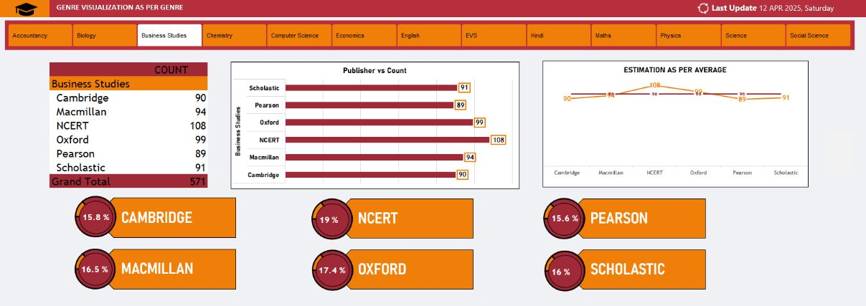

Slide 4

OBJECTIVE -2
Detailed Book Information Search Using Book ID
Objective: Search for detailed information of a specific book using its ID.
Search Mechanism
Implemented a search mechanism simulating Excel’s VLOOKUP function. Filtered dataset by Book ID (e.g., BK126) to extract all details.
Information Extracted
Retrieved Title, Author, Genre, ISBN, Publisher, Publication Year, Edition, Pages, Shelf Code, Availability Status, Cost, Category, Book Condition, and Number of Reviews.

Slide 5
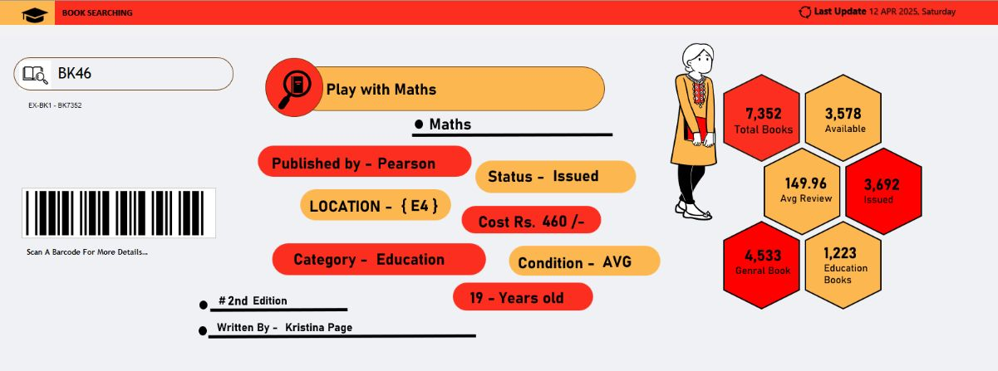

Slide 6
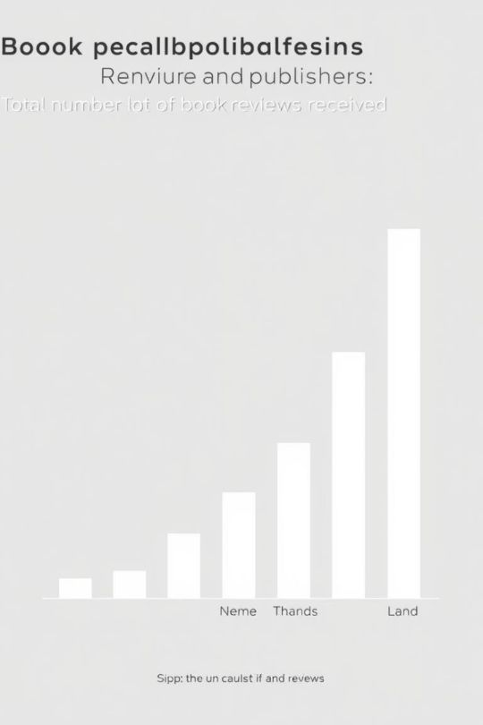
OBJECTIVE-3
Ranking Publishers Based on Total Number of Reviews
Objective: Rank publishers based on the total number of reviews their books received.
Calculation
Summed the "Number of Reviews" column for each publisher using Excel’s PivotTable. Ranked publishers in descending order based on total reviews.
Top Publisher
NCERT had the highest number of reviews (23,545), followed by Oxford, Macmillan, Pearson, Scholastic, and Cambridge.

Slide 7
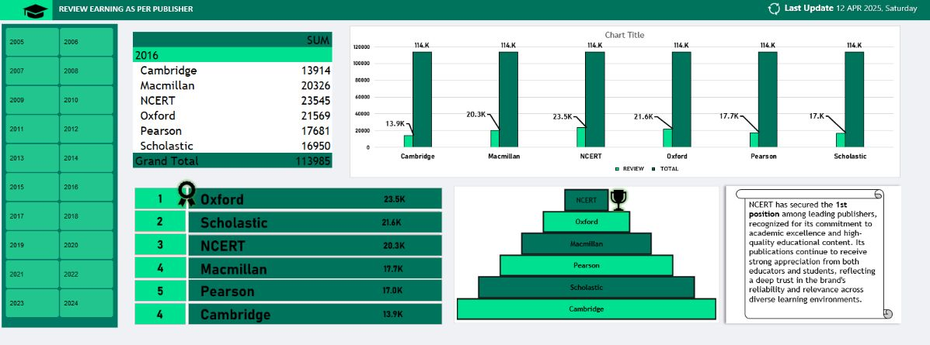

Slide 8
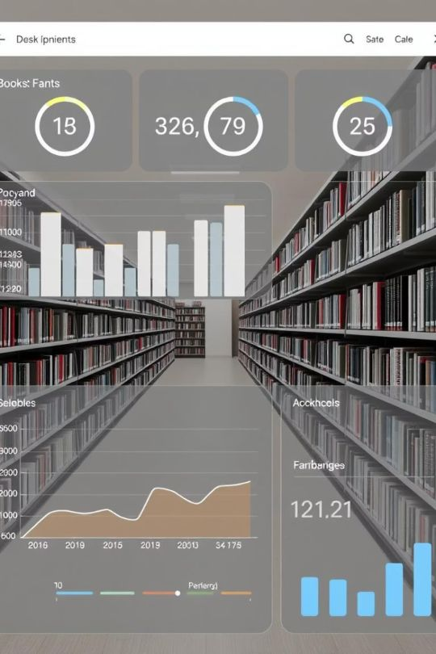



OBJECTIVE-4
Visualizing Books by Shelf Location Using Slicers
Objective: Visualize books by shelf location (A1 to E4) using slicers.
Shelf Analysis
Interactive Filters
Usage Patterns
Analyzed "Shelf Code" and "Availability Status" using Excel’s PivotTable and Slicer tools.
Added interactive slicers for dynamic filtering, enabling users to explore specific shelves.
Visualizations like stacked bar charts or heatmaps to illustrate usage patterns and storage efficiency.

Slide 9
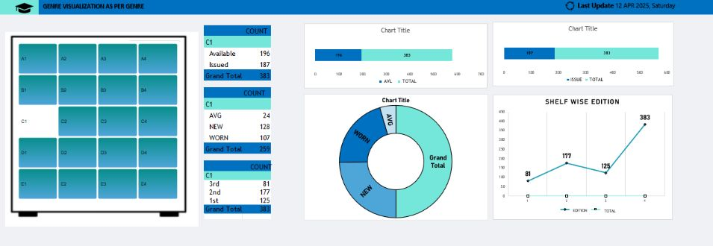

Slide 10
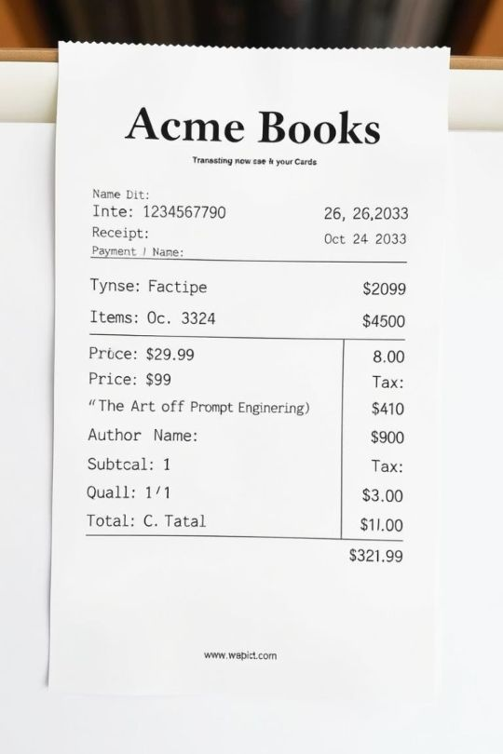
OBJECTIVE-5
Generating a Formatted Receipt for Book Transactions
Objective: Generate a formatted receipt for book transactions.
Template Design
Designed a template in Excel and PowerPoint incorporating key book and transaction details.
Data Extraction
Extracted Book ID, Title, Author, Cost, and Availability Status, along with customer information.
Professional Layout
Created a professional receipt layout with clear, printable format, enhancing operational efficiency.

Slide 11
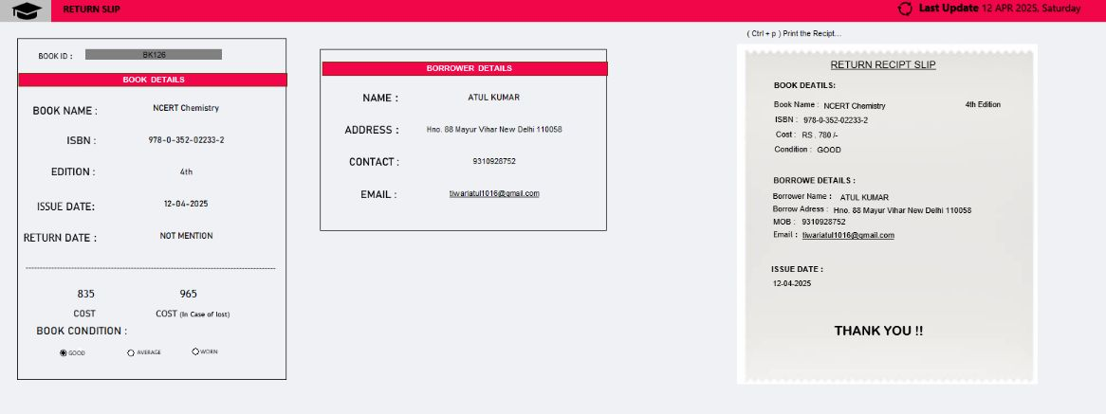

Slide 12
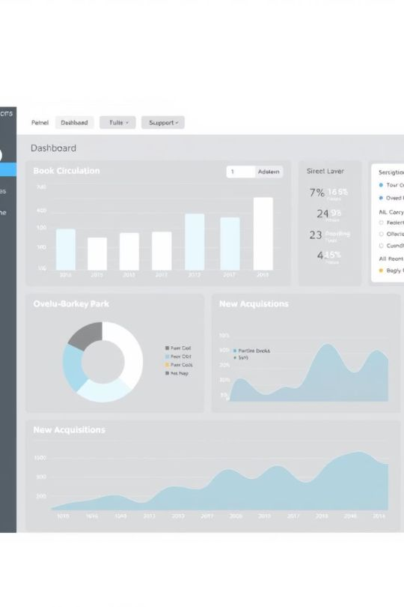




Final Dashboard Overview
The final dashboard integrates all objectives, providing a comprehensive view of library operations. It allows for detailed analysis and efficient management of library resources.
Publisher Analysis
Number of books published by each publisher across different genres.
Book Search
Detailed information retrieval using Book ID.
Review Ranking
Ranking of publishers based on total reviews.
Shelf Visualization
Distribution of books by shelf location.

Slide 13
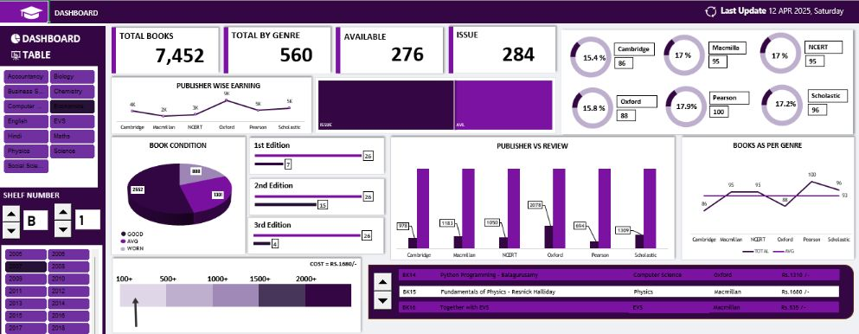

Slide 14



Dashboard Table Details
Clicking on a table name in the dashboard reveals a detailed description of the tables, providing deeper insights into the data structure and content.
1
Data Structure
2
Content Overview
3
Detailed Insights
This feature enhances user understanding and facilitates more informed decision-making.

Slide 15
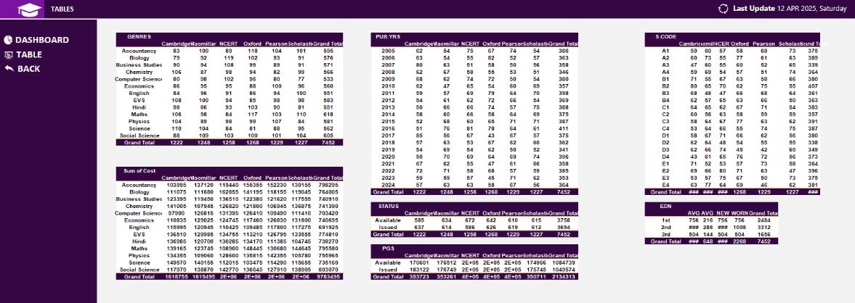

Slide 16

Key Takeaways and Next Steps
This presentation highlighted the power of data visualization in optimizing library operations. Key takeaways include the importance of publisher analysis, efficient book search mechanisms, and interactive shelf management.
Gather Feedback
Train Staff
Collect feedback for continuous improvement.
Implement Dashboard
Provide training to library staff on using the dashboard.
Integrate the dashboard into daily library operations.

