Slide 1

GoodCabs - Performance Analysis
By – Atul Kumar

Slide 2

Categories
Problem Statement
Objective
Analysis
key insights
Recommendations

Slide 3
Problem Statement
GoodCabs, a cab service company with a strong presence in tier-2 cities, is committed to enhancing its services and achieving ambitious growth targets for 2024. The company’s strategy focuses on improving passenger satisfaction, ensuring seamless experiences for users, and empowering local drivers. To drive these objectives, GoodCabs has identified the need to analyze its performance across critical metrics, including trip volume, passenger satisfaction, repeat passenger rate, trip distribution, and the balance between new and returning passengers. By gaining insights into these areas, the company aims to refine operations, better understand passenger behavior, and ensure sustainable growth in a competitive market.

Slide 4
Objective
The objective is to conduct a comprehensive analysis of GoodCabs' key performance metrics to support the company’s strategic goals for 2024. These metrics include trip volume, which helps assess operational efficiency and demand; passenger satisfaction, which measures the quality of services provided; repeat passenger rate, indicating customer loyalty and retention; trip distribution, which provides insights into service coverage and utilization; and the balance between new and returning passengers, reflecting the company’s ability to attract and retain customers. By leveraging these insights, GoodCabs aims to optimize its operations, enhance passenger experiences, and achieve sustainable growth in its target tier-2 city markets.

Slide 5
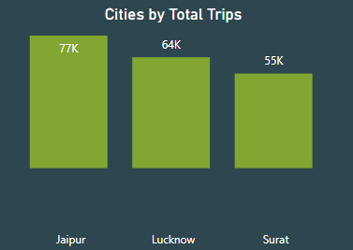
Problem 1: Identify the top 3 and bottom 3 cities by total trips over the entire analysis Period.
Top 3 Cities by Total Trips
Jaipur: The top city with 77K trips, contributing 40% of trips among the top 3 and 18% overall.
Lucknow: Second with 64K trips, accounting for 33% of top 3 trips and 15% overall.
Surat: Third with 55K trips, making up 27% of top 3 trips and 13% overall.

Slide 6
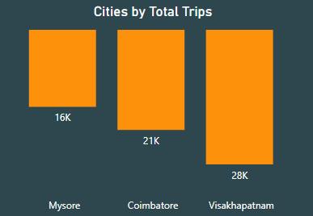
Bottom 3 Cities by Total Trips
Visakhapatnam: The leading bottom city with 28K trips, contributing 42% of trips among the bottom 3 and 7% overall.
Coimbatore: Second with 21K trips, accounting for 32% of bottom 3 trips and 5% overall.
Mysore: Third with 16K trips, making up 26% of bottom 3 trips and 4% overall.

Slide 7
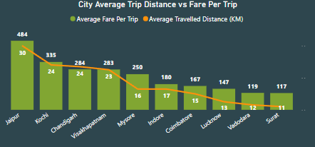
Problem 2: Calculate the average fare per trip for each city and compare it with the city’s average trip distance. Identify the cities with the highest and lowest average fare per trip to assess pricing efficiency across locations.
Tourism Cities (Jaipur, Kochi, Visakhapatnam, Mysore): Fares are 108.9% higher, and distances are 77.2% longer than business cities.
Business Cities (Indore, Coimbatore, Vadodara, Surat): Lower fares and shorter distances reflect cost-focused, localized travel.
Tourism drives premium pricing, while business hubs prioritize efficiency.

Slide 8
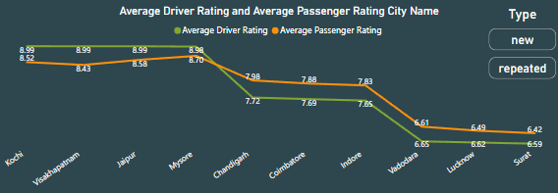
Problem 3: Calculate the average passenger and driver ratings for each city, segmented by passenger type (new vs. repeat). Identify cities with the highest and lowest average ratings.
Jaipur and Kochi lead with the highest new and repeat ratings (8.99 driver, 8.99 passenger).
Surat records the lowest new driver rating (6.99) and Vadodara the lowest repeat passenger rating (5.98).
Enhancing services in Surat and Vadodara can improve satisfaction.
Benchmarking Jaipur and Kochi ensures service consistency.

Slide 9
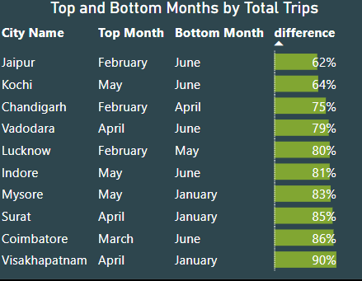
Problem 4: For each city, identify the month with the highest total trips (peak demand)and the month with the lowest total trips (low demand). This analysis will help Goodcabs understand seasonal patterns and adjust resources accordingly.
Peak demand varies by city, with April , February and May being the most common high-demand months.
Low demand is concentrated in June and January across most cities.
Seasonal variation is highest in Visakhapatnam (90%) and Coimbatore (86%), indicating significant fluctuations.
Jaipur (62%) and Kochi (64%) have relatively lower seasonal differences.

Slide 10
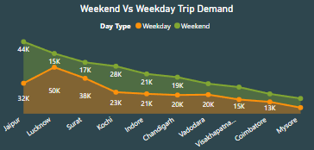
Problem 5: Compare the total trips taken on weekdays versus weekends for each city over the six-month period. Identify cities with a strong preference for either weekend or weekday trips to understand demand variations.
Lucknow: Weekday demand is 77% higher than weekends.
Jaipur: Weekend demand is 37% higher than weekdays.
Mysore: Weekend trips are 53% higher than weekdays.
Trend: Most cities show 10–50% higher weekday demand.
Exception: Jaipur and Surat favor weekends (30–40% higher).

Slide 11
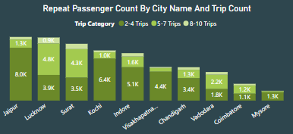
Problem 6: Analyze the frequency of trips taken by repeat passengers in each city(e.g., % of repeat passengers taking 2 trips, 3 trips, etc.). Identify which cities contribute most to higher trip frequencies among repeat passengers and examine if there are distinguishable patterns between tourism-focused and business-focused cities.
Tourism Cities: Jaipur (29.9%), Kochi (23.8%), Mysore (4.7%), and Visakhapatnam (16.5%) focus on attracting short-term, repeat travelers.
Business Cities: Lucknow (17.8%), Surat (16.1%), Indore (19.0%), Chandigarh (12.7%), Vadodara (6.6%), and Coimbatore (3.9%) show frequent, long-term travel with higher trip frequencies.

Slide 12
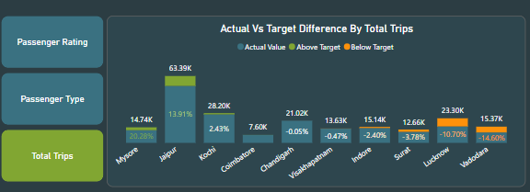
Problem 7: Foreach city, evaluate monthly performance against targets for total trips, new passengers, and average passenger ratings from targets_db. Determine if each metric met, exceeded, or missed the target, and calculate the percentage difference. Identify any consistent patterns in target achievement, particularly across tourism versus business-focused cities.
Exceeded Targets: Tourism-focused cities (Mysore, Jaipur, Kochi, Coimbatore) outperformed with a 20.28% to 0.50% increase.
Missed Targets: Business-centric cities (Chandigarh, Surat, Lucknow, Vadodara) underperformed, missing targets by up to 14.60%.
Tourism-focused cities exceeded targets, while business-focused cities struggled.

Slide 13
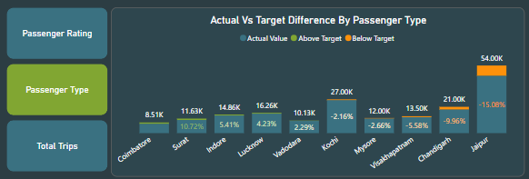
Passenger Analysis
Exceeded Targets: Coimbatore (13.52%), Surat (10.72%), Indore (5.41%), Lucknow (4.23%), Vadodara (2.29%) indicate strong demand.
Missed Targets: Kochi (-2.16%), Mysore (-2.66%), Visakhapatnam (-5.58%), Chandigarh (-9.96%), Jaipur (-15.08%) need focus.
Tourism cities underperformed compared to business-centric cities.

Slide 14
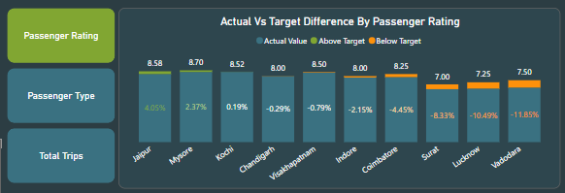
Passenger Rating
Exceeded Targets: Jaipur (4.05%), Mysore (2.37%), Kochi (0.19%) showed high satisfaction.
Missed Targets: Chandigarh (-0.29%), Visakhapatnam (-0.79%) had minor deviations.
Tourism-driven cities (Jaipur, Mysore) excel, while business hubs (Surat, Vadodara) significantly underperformed, requiring improvements.

Slide 15
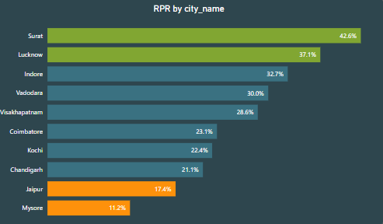
Problem 8(A): Analyze the Repeat Passenger Rate (RPR%) for each city across the six-month period. Identify the top 2 and bottom 2 cities based on their RPR% to determine which locations have the strongest and weakest rates.
Top Performers: Surat (42.6%) and Lucknow (37.1%) excel in RPR, indicating strong passenger loyalty.
Bottom Performers: Mysore (11.2%) and Jaipur (17.4%) struggle with retention.
Replicate strategies from top cities and address customer satisfaction issues in underperforming locations.

Slide 16
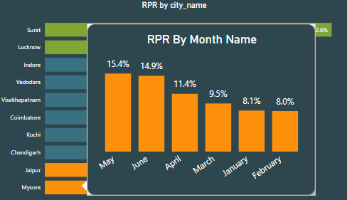
Problem 8(B): Similarly, analyze the RPR% by month across all cities and identify the months with the highest and lowest repeat passenger rates. This will help top in point any seasonal patterns or months with higher repeat passenger loyalty.
Peak Months: May (15.4%) and June (14.9%) show the highest RPR%, indicating strong passenger loyalty.
Low Months: February (8.0%) and January (8.1%) have the lowest RPR%.
Address low retention in early months by introducing promotions and replicate successful strategies from May-June.

Slide 17
Key Insights
Top and Bottom Cities: Jaipur, Lucknow, and Surat dominate with the highest trips, while Visakhapatnam, Coimbatore, and Mysore lag behind.
Pricing & Distance: Tourism cities (e.g., Jaipur) show higher fares and longer distances compared to cost-efficient business hubs like Surat.
Passenger & Driver Ratings: Jaipur and Kochi lead with top ratings (8.99), while Surat and Vadodara require improvements.
Seasonal Trends: High demand in April, February, and May; low in January and June. Seasonal variability is highest in Visakhapatnam.
Weekday vs. Weekend Demand: Most cities prefer weekdays; Jaipur and Surat favor weekends.
Repeat Passenger Rates (RPR): Surat excels at 42.6%, while Mysore trails at 11.2%.
Target Performance: Tourism cities outperform targets; business hubs underperform.

Slide 18
Secondary Analysis and Recommendations
What factors might contribute to higher or lower repeat passenger rates indifferent cities? Are there correlations with socioeconomic or lifestyle patterns in these cities?
Quality of Service: High standards in punctuality, vehicle cleanliness, and driver professionalism lead to higher customer satisfaction and repeat rates.
Competitive Pricing: Cities with price-sensitive populations may have higher repeat rates if affordable, transparent pricing is offered. Dynamic pricing can affect loyalty in diverse income groups.
Socioeconomic & Demographic Patterns: Areas with higher disposable income or tech-savvy populations may see more frequent use of ride services. Local lifestyle preferences, such as reliance on public transport or private vehicles, also influence repeat customer behavior.

Slide 19
How do tourism seasons or local events impact Goodcabs' demand patterns? Would tailoring marketing efforts to these events increase trip volume in tourism-oriented cities?
Tourism-Focused Cities (Jaipur, Lucknow):
Demand peaks in February due to festivals and tourist activities.
Marketing strategies: Promote sightseeing tours and festival-related offers to boost trip volume.
Business-Focused Cities (Indore, Surat, Chandigarh):
Demand increases in April, aligning with the financial year-end.
Marketing strategies: Offer reliable airport transfers, timely pickups, and corporate discounts for business travelers.
Overall Strategy:
Align marketing with seasonal trends and local events.
Optimize demand and attract more customers in tourism and business hubs.

Slide 20
What emerging trends, like electric vehicles and green energy, are impacting the cab market in Tier-2 cities? Should Goodcabs adopt EVs and eco-friendly initiatives to stay competitive?
EV Adoption: EVs are gaining traction in Tier-2 cities due to affordability, government incentives, and lower operational costs.
Eco-Conscious Demand: Consumers increasingly prefer sustainable travel options, favoring companies with green initiatives.
Government Push: Subsidies and improved charging infrastructure make EV adoption viable.
Goodcabs Strategy: Adopting EVs and eco-friendly measures can reduce costs, attract eco-conscious customers, and align with sustainability trends.

Slide 21
Can Goodcabs partner with local businesses (hotels, malls, event venues) to boost
demand and customer loyalty, especially in tourism-heavy or high-footfall areas?
Hotel & Event Venue Partnerships:
Provide airport transfers and exclusive rides for hotel guests.
Offer discounted rides for event attendees and VIP services for large events.
Boosting Customer Loyalty:
Create joint loyalty programs with local businesses to encourage repeat customers.
Offer cross-promotions like free rides after shopping or attending events.
Tourism Area Collaboration:
Partner with tour operators to provide rides to popular attractions.
Offer exclusive ride packages combining transport with sightseeing for tourists.

Slide 22
Can Goodcabs partner with local businesses (hotels, malls, event venues) to boost
demand and customer loyalty, especially in tourism-heavy or high-footfall areas?
Customer Behavior: Track ride frequency, preferences, and feedback to identify satisfaction levels and usage patterns.
Operational Efficiency: Monitor ride duration, route optimization, and vehicle utilization to enhance efficiency and reduce delays.
Driver Performance: Collect data on driver ratings, response times, and trip completion rates for performance improvements.
Market Trends: Analyze customer demographics, competitor pricing, and seasonal trends to stay competitive and adapt services.
Customer Loyalty: Track repeat usage, loyalty program engagement, and referral data to boost retention and customer satisfaction.

Slide 23
Thank You

