Slide 1
QUIZ GAME
By: Atullya Maharjan

Slide 2
Quiz Game
A quiz game is an engaging and educational activity where participants answer a series of questions to test their knowledge on a specific topic or a range of subjects.
Participants answer questions, and their responses are evaluated to determine a winner based on the quiz's rules. The game is quick, easy to learn, and does not require any special equipment.

Slide 3
Objectives
To develop an interactive quiz game in C that matches Data Structures and Algorithms (DSA) logic, utilizing array and linked list structures.
To Create a user-friendly interface for interaction between players and the quiz game.
To Utilize array and linked list structures for efficient management of quiz questions.

Slide 4
Key Feature of the game are as follows:
1. Input: The quiz game prompts users with a variety of questions related to different topics, utilizing the Data Structures and Algorithms (DSA) logic.
2. Logic and Evaluation: The game uses DSA-based logic to evaluate and score user responses to each question.
3. Informative Output: After answering questions, the quiz game provides users with their overall score and possibly explanations for correct answers.

Slide 5
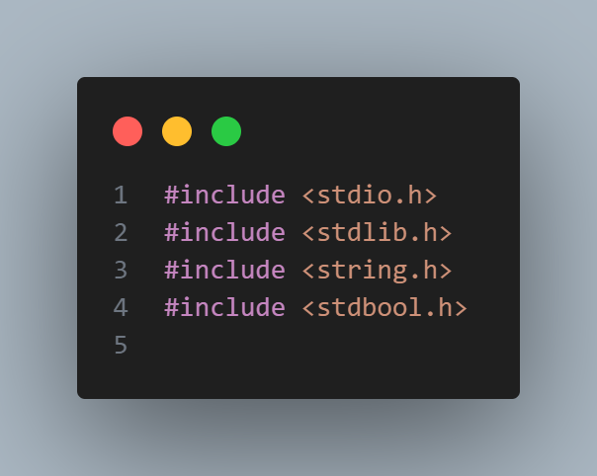
To implement the features of the quiz game in C, the header files <stdio.h>, <stdlib.h>, <string.h>, and <stdbool.h> were included. These files provide essential functions for input and output, string manipulation, standard library functions, and boolean data type support.

Slide 6
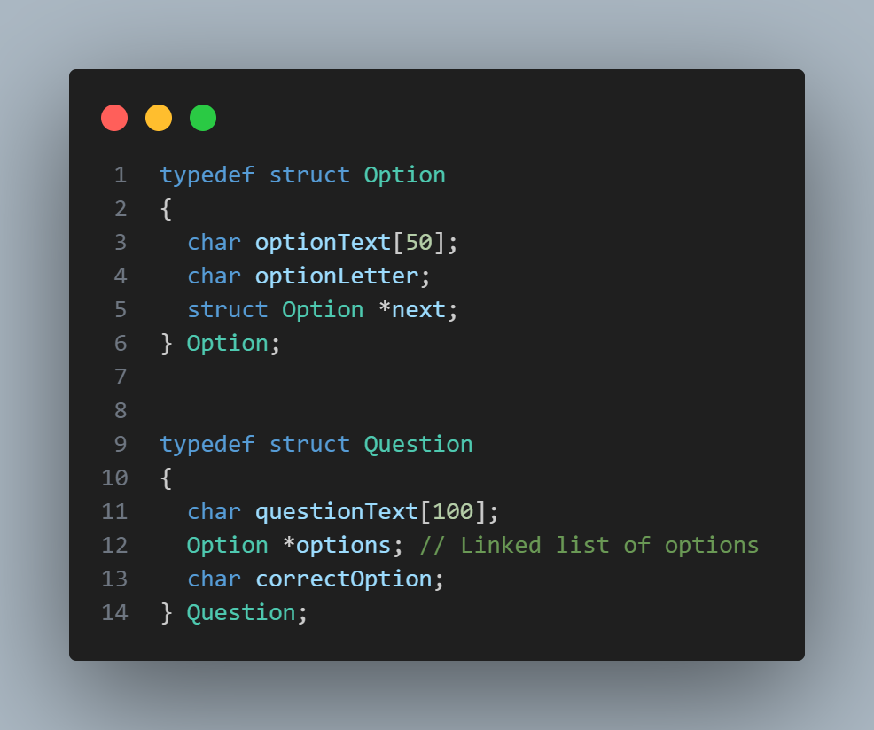
Structured the quiz game using two custom data structures: "Option" for answer choices, storing text and letters, and "Question" for quiz questions, containing the question text, a linked list of options, and the correct answer. This design simplifies data organization and supports efficient quiz management.

Slide 7
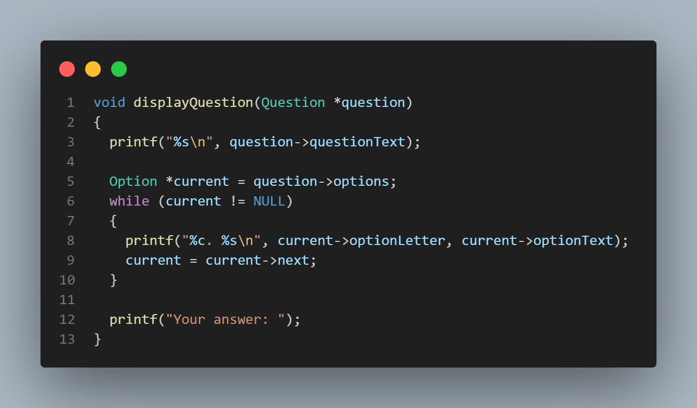
Defined a function, displayQuestion, that prints the question text and the list of options for a given quiz question. It prompts the user to input their answer by displaying "Your answer:".

Slide 8
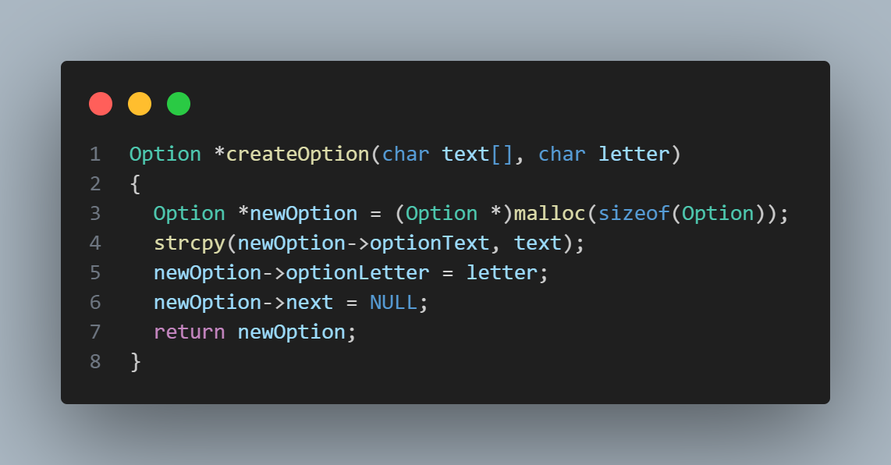
Defined a function, createOption, which dynamically allocates memory for an "Option" structure, initializes its text and letter fields with provided values, sets the next pointer to NULL, and returns the newly created option.

Slide 9
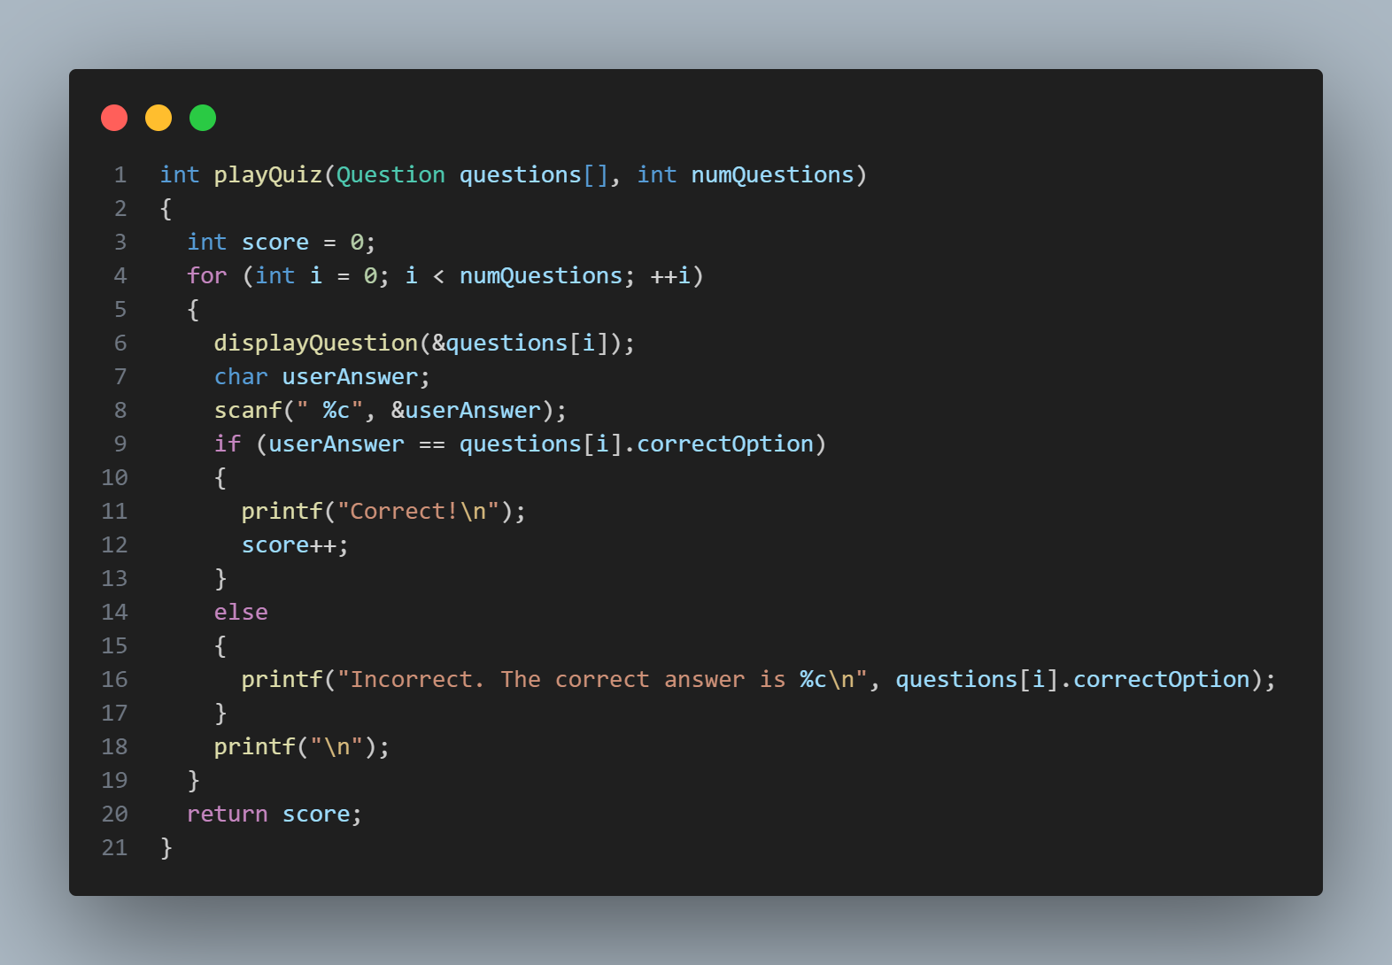
This function facilitates the quiz gameplay by iterating through each question, displaying it along with options, receiving the user's answer, and updating the score based on correctness.

