Slide 1
Honeypot Security
Presented By: Atullya Maharjan

Slide 2
Introduction
One who makes an attempt to get access to a working computer is known as an invader.
Popular terms for this persona include hacker, black hat and cracker.
Over the past 3 decades, a lot of research has been done in the area of network intrusion detection.
Intrusion detection is becoming more difficult as networks become faster and personal and business importance of internet grows.
The number of computers connected to a network and the Internet is increasing with every day. When combined with the increase in networking speed has made intrusion detection a challenging process.

Slide 3
A computer called a “honeypot” was created to assist in learning the goals, and methods used by the hacker community.
A honeypot is a security mechanism that creates a virtual trap to lure attacker.
Honeypots are a type of deception technology that helps to understand attacker behavior pattern.
A honeypot is a system designed to interact with cyber attackers and learn about their tactics and intentions.
It is a tool that helps to understand existing threats to business and spot the detect the appearance of new threats.

Slide 4
What is Honeypot?
A program, device or system placed on a network as bait for attackers is known as a Honeypot.
The goal of honeypot is to fool the attacker by giving the honeypot the appearance of a trustworthy system.
In most cases, honeypots are virtual computers that imitate real machines by pretending to have open ports and operating service.
Honeypot can be classified as deception systems
By definition a honeypot is “ a security resource whose value lies in being probed, attacked or compromised”
Honeypots can be used to collect data that can then be used to secure and strengthen existing attacks or network firewalls.

Slide 5
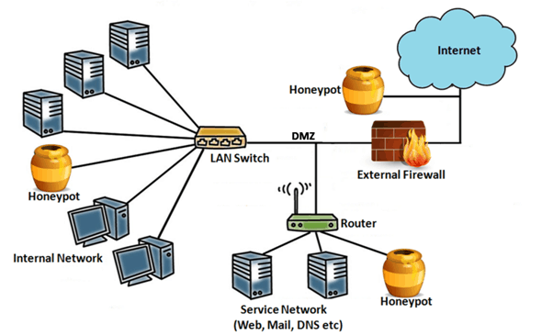

Slide 6
Role of Honeypots in Network Security
Honeypots are one element in comprehensive cyber security strategy and is one of the newest network security techniques currently accessible. .
Organizations can utilize honeypots, just like cybercriminals can.
Cybercriminals or bad hackers may flood the honeypot with attacks to divert attention away from actual attacks on the legitimate system if they realize the honeypot is a ruse.
Hackers may purposefully give the honeypot false information.

Slide 7
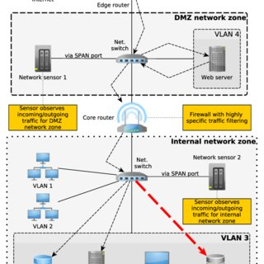
Approaches for Preventing Honeypot Detection and Compromise

Slide 8
How Honeypots work
The honeypot fools hackers into thinking it’s a legitimate target by having the appearance of a real computer system, complete with apps and data.
For example, a honeypot could try to copy a company's customer billing system, which is a popular target for criminals looking for credit card numbers.
Once the hackers have gained access, their behavior can be monitored for clues on how to make the real network more secure.
Honeypots are made attractive to attackers by including intentional security problems.

Slide 9
Benefits of Using Honeypots
Using honeypot is an excellent approach to find weakness in important systems.
A honeypot, for example, can demonstrate the high level of threat faced by IoT device attacks.
It can also suggest ways to improve security.
A honeypot, should never receive valid traffic, so any activity recorded is almost certainly a sample or attack attempt.
Honeypots provide reliable intelligence on how threats are evolving.

Slide 10
Dangers of Honeypots
A well-configured honeypot will trick attackers into thinking they have gained access to the real system.
However, if an attacker manages to identify it as a honeypot, they can proceed to attack other systems leaving the honeypot untouched.
Once a honeypot has been 'fingerprinted,' an attacker can create spammers attacks to divert attention away from a real attackers targeting production systems.
They can also provide false information to the honeypot.
A skilled attacker could use a honeypot to gain access to systems.

Slide 11
As a result, honeypots should never be used in place security controls such as firewalls and intrusion detection systems.
The honeypot must be constantly supervised at regular intervals.
Honeypots don’t guarantee every attack will be detected it can only detect attacks from traffic directed at them.
So a smart hacker who detects a honeypot in a network will avoid sending any traffic to the honeypot.

Slide 12
Thank You

