Slide 1
EduQuiz-Student Teacher Portal with MCQ Generator
By: Atullya Maharjan
TU Symbol Number: 28863/078
NCCS

Slide 2
Table Of Content
Introduction
Problem Statement
Objectives
Development Methodology
Algorithm Details
Result Analysis
ER-Diagram
Use Case Diagram
DFD Diagram
Result
Conclusion
References
1

Slide 3
Introduction
EduQuiz is a web-based educational platform.
Integrates admin, teacher, and student roles
Automates MCQ generation using NLP (TF-IDF & cosine similarity and T5 transformer)
Simplifies class, assignment, and quiz management
Enhances teaching, learning, and assessment
2

Slide 4
Problem Statement
Teachers spend too much time creating quizzes and assignments manually
No unified system to manage classes, students, and assessments
Limited use of automation and NLP in existing educational tools
3

Slide 5
Objectives
To build a platform that helps admins and teachers manage users, classes, and assignments easily
Automatically generate MCQ questions from text or PDF using smart algorithms like TF-IDF, cosine similarity, rule-based algorithm and T5 Transformer
4

Slide 6
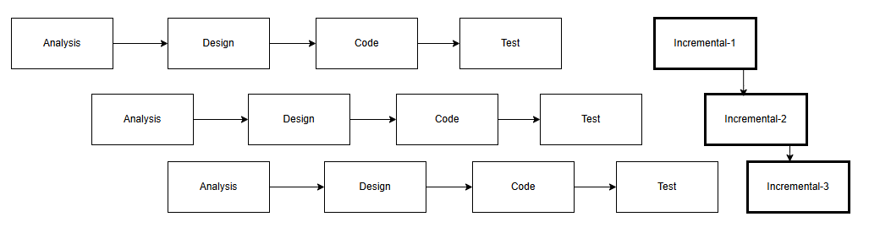
Development Methodology
Fig: Incremental Delivery
Incremental delivery allows step-by-step development and early testing of modules for faster and safer implementation.
5

Slide 7
Algorithm Details
TF-IDF (Term Frequency – Inverse Document Frequency)
Cosine Similarity
Rule-Based Algorithm
T5-Transformer
6

Slide 8
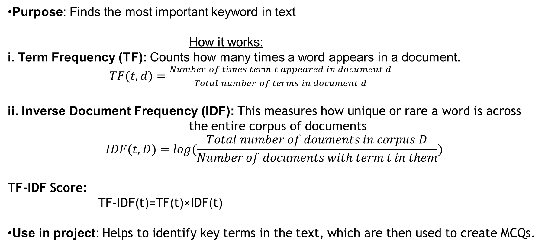
1. TF-IDF (Term Frequency – Inverse Document Frequency)
Purpose: Finds the most important keyword in text
How it works:
i. Term Frequency (TF): Counts how many times a word appears in a document.
$TF(t,d)=\frac{Number of times term t appeared in document d}{Total number of terms in document d}$
ii. Inverse Document Frequency (IDF): This measures how unique or rare a word is across
the entire corpus of documents
$$IDF(t,D)=log(\frac{Total number of douments in corpus D}{Number of documents with term t in them})$$
TF-IDF Score:
TF-IDF(t)=TF(t)×IDF(t)
Use in project: Helps to identify key terms in the text, which are then used to create MCQs.
7

Slide 9
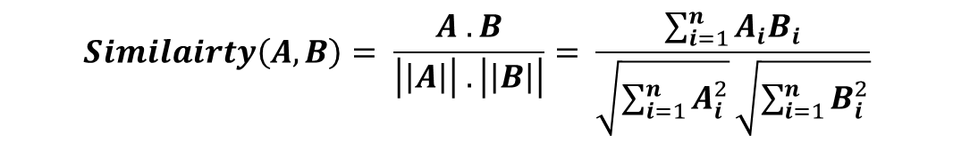
2. Cosine Similarity
Purpose: Measures how similar two words or sentences are.
How it works:
Convert words or sentences into numerical vectors.
Compute the cosine of the angle between vectors:
$$Similairty\left(A, B\right)= \frac{A . B}{\left|\left|A\right|\right| . \left|\left|B\right|\right|}= \frac{\sum_{i=1}^{n}{A_{i}B_{i}}}{\sqrt{\sum_{i=1}^{n}{A_{i}^{2}}}\sqrt{\sum_{i=1}^{n}{B_{i}^{2}}}}$$
Use in project
Identify terms or sentences that are similar.
Generate distractors for MCQ by selecting words related to the answer but not identical.
Avoid irrelevant or random words in MCQ options.
8

Slide 10
3. Rule Based Algorithm
Purpose: Create simple MCQs using predefined rule
How it works
Identify keywords or phrases in the text.
Apply rules/templates to form questions, e.g.:
If sentence contains “is”, create “What is …?”
Use in project
Provides backup MCQs if the T5 model or NER does not generate enough questions.
Makes MCQ generation faster for simple facts.
9

Slide 11
4.T5 Transformer
The T5 (Text-to-Text Transfer Transformer) is a deep learning and it treats every task as text-to-text problem, where both the input and output are always text.
Example: Question Answering
Input:
Context: “Albert Einstein was a theoretical physicist who developed the theory of relativity.”
Output: “Who developed the theory of relativity?”
Use in project:
Converts text automatically into human-like MCQs.
Works with PDF or plain text input for automatic quiz generation.
10

Slide 12
Result Analysis
Metrics Used:
ROUGE Score: Measures overlap between generated questions and reference questions.
BLEU Score :Measures how close the generated question is to reference questions (n-gram match).
F1 Score : Measures accuracy of predicted answers vs correct answers in MCQs.
ROUGE-L: 0.58
BLEU:0.62
F1-Score: 0.73
11

Slide 13
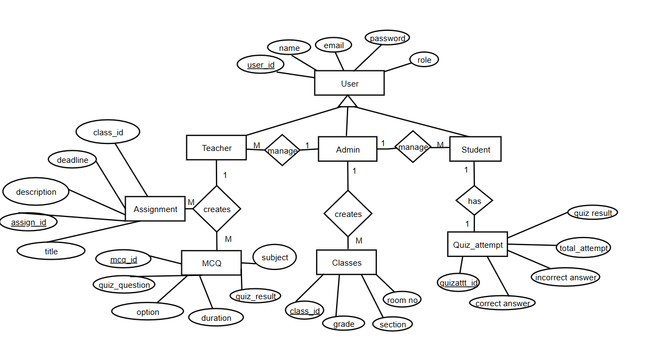
ER Diagram
12

Slide 14
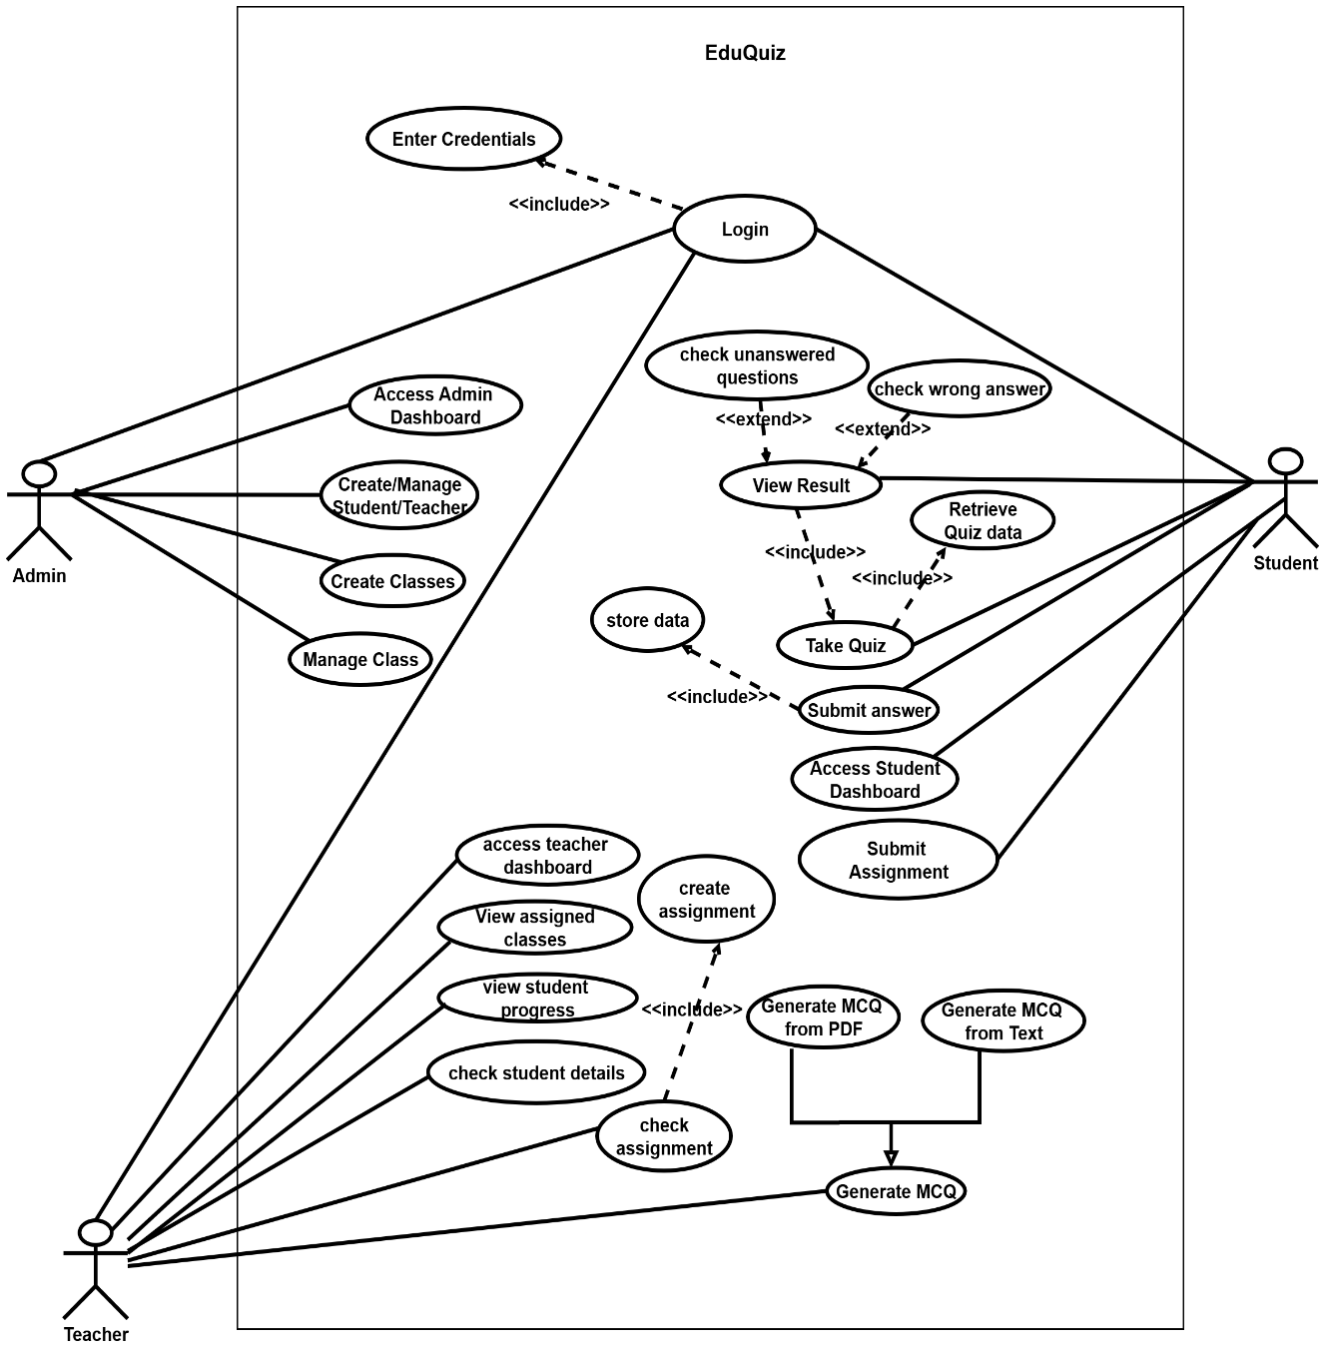
Use Case
Diagram
13

Slide 15
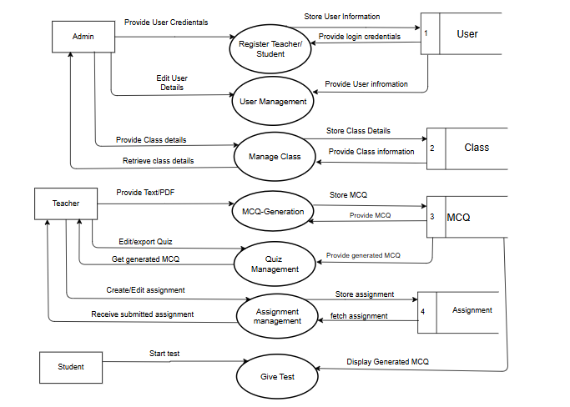
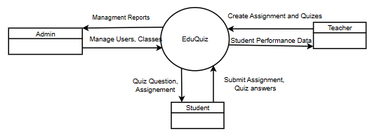
DFD Diagram
Level 0 DFD
Level 1 DFD
14

Slide 16
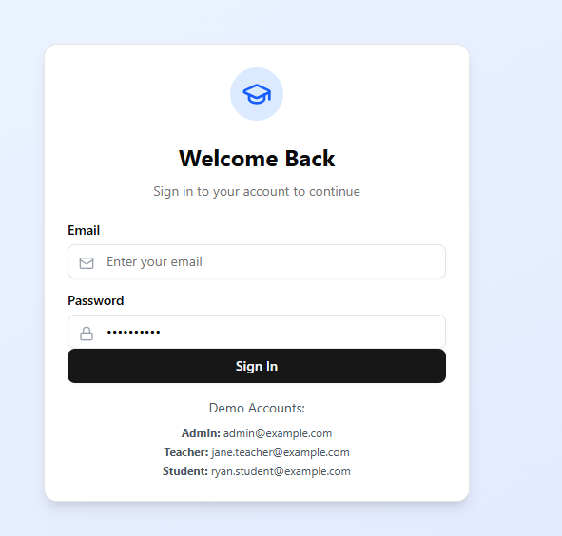
Result
15

Slide 17

16

Slide 18
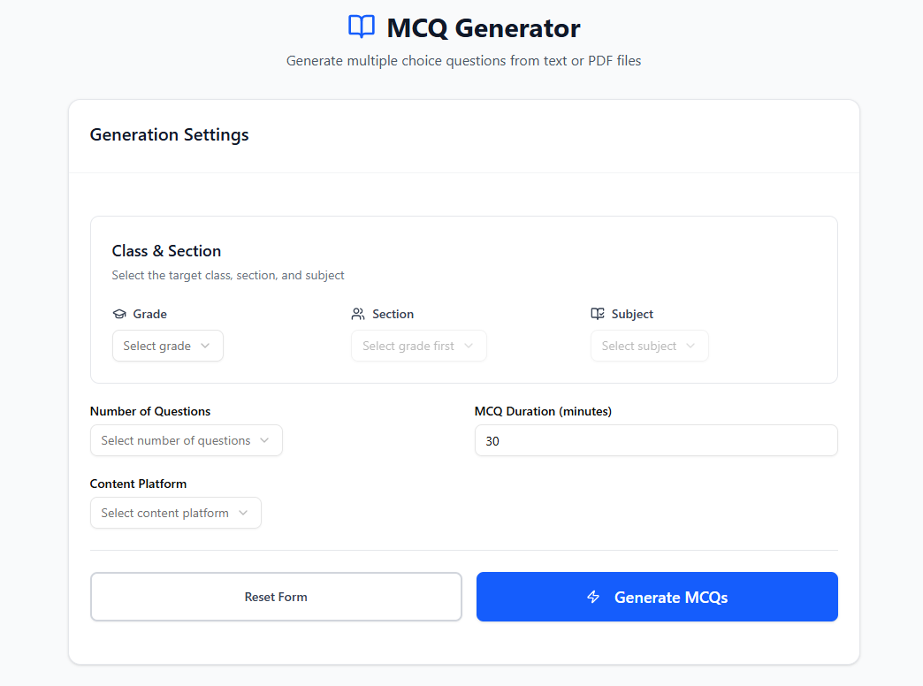
17

Slide 19
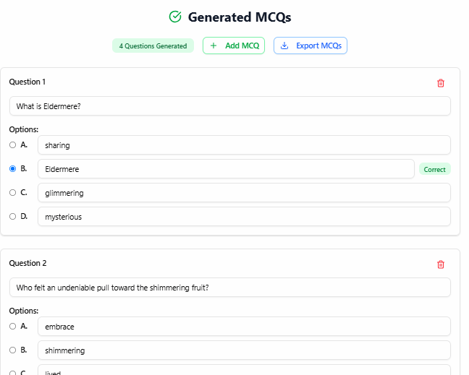

18

Slide 20

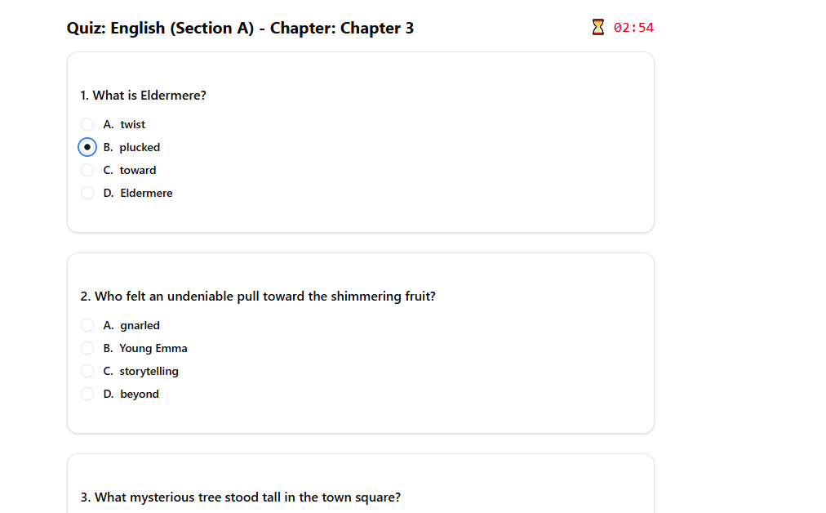
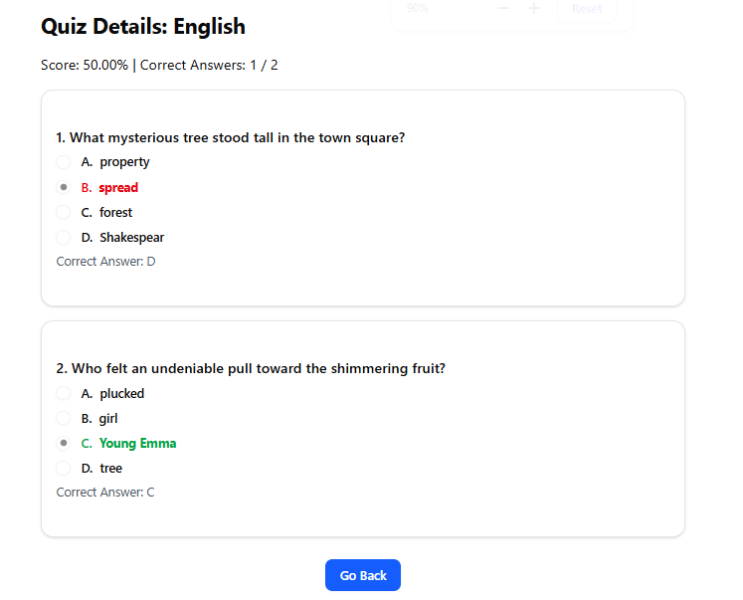
19

Slide 21
Conclusion
The EduQuiz project provides a simple and effective web-based platform that improves interaction between admins, teachers, and students. With automated question generation and easy access to assignments, it makes learning and assessment more efficient and user-friendly.
20

Slide 22
References
https://www.geeksforgeeks.org/quizzes/natural-language-processing-quiz/
https://www.remoterocketship.com/advice/guide/python-engineer/natural-language-processing-nltk-interview-questions-and-answers
https://nevonprojects.com/student-portal-project/
21

