Slide 1

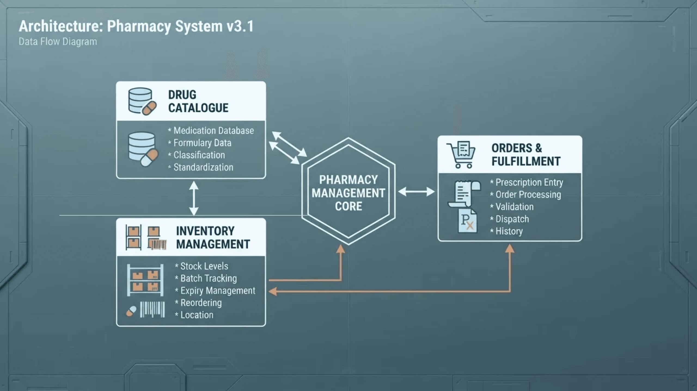
PHARMA-G7
Smart Online Pharmacy Management System
S.Y. BCA Academic Project Prototype
Digital Healthcare Operations Study
PHARMA-G7
1

Slide 2

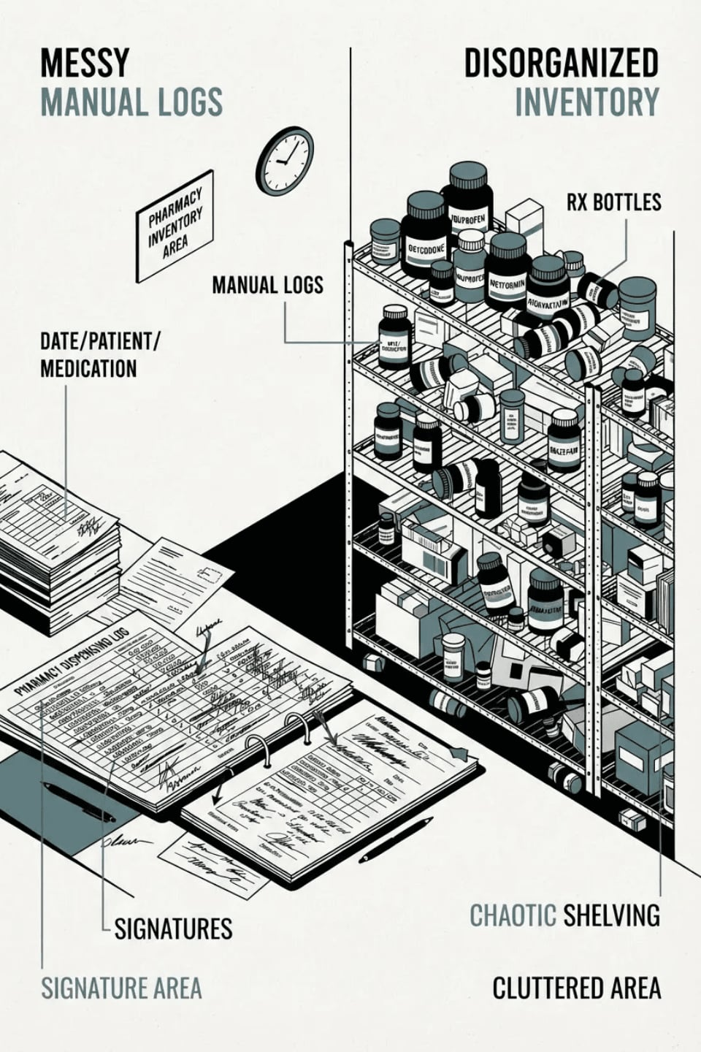
The Problem We Address
Fragmented Manual Records
Traditional pharmacies rely on disconnected logs for stock, sales, and billing, leading to critical data entry errors.
Inventory Inefficiency
Difficulty in monitoring expiry dates and low-stock levels in real-time results in waste or medicine unavailability.
Prescription Management Risks
Lack of a structured digital bridge between customer uploads and pharmacist review creates safety and compliance bottlenecks.
PHARMA-G7
2

Slide 3

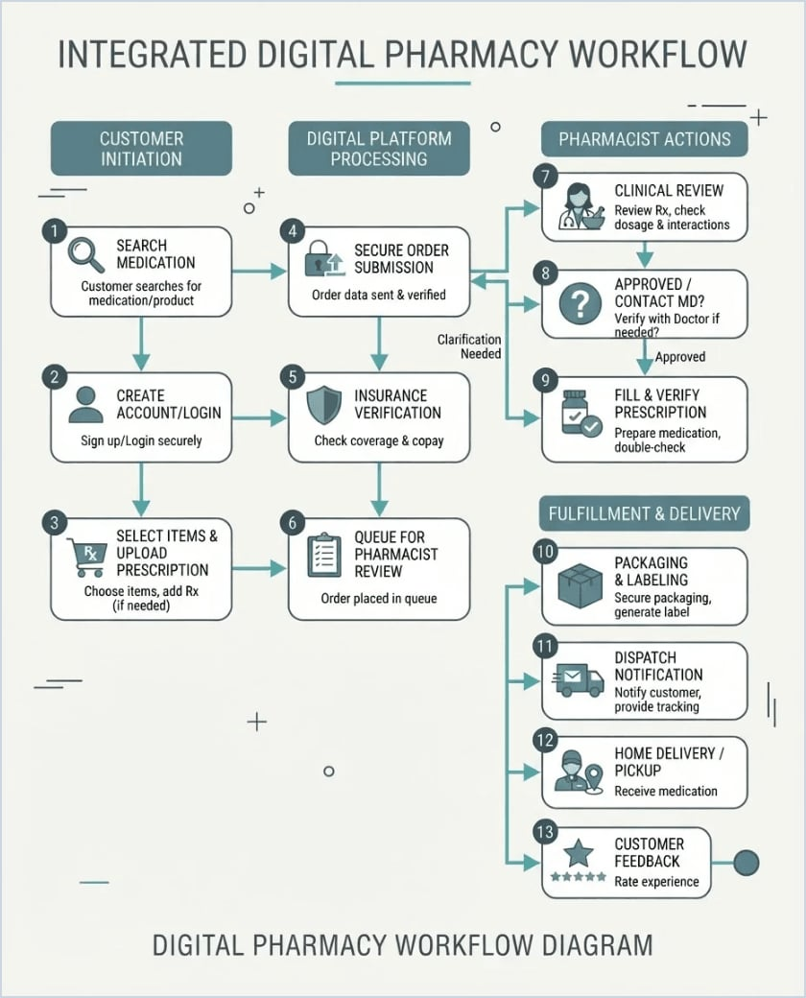
A Clearer Digital Workflow
Integrated System Concept
PHARMA-G7 unifies the medicine catalogue, customer ordering, and backend pharmacy operations into a single, cohesive digital prototype.
The system ensures that every order is inventory-aware and every prescription-only medicine triggers a mandatory pharmacist review queue.
PHARMA-G7
3

Slide 4
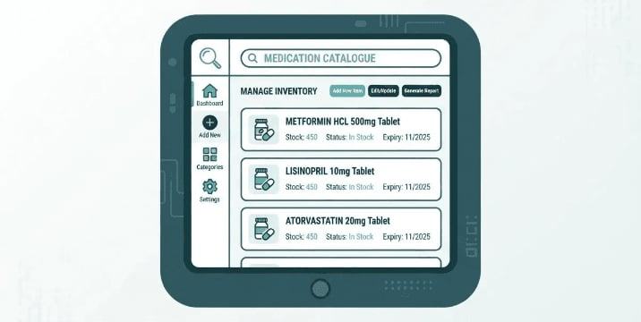
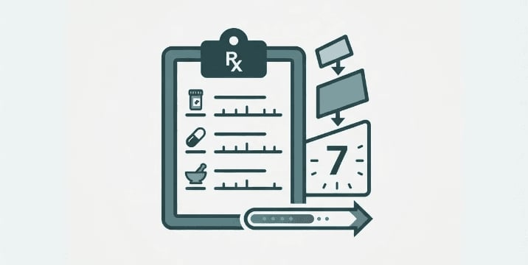
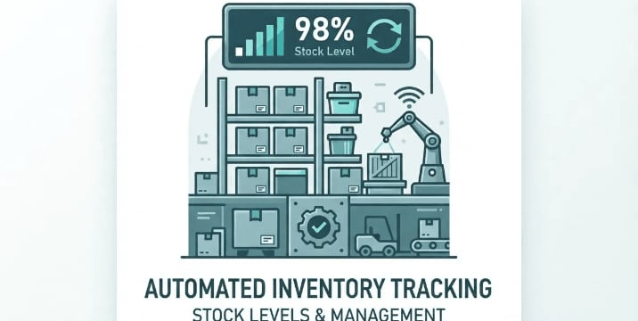
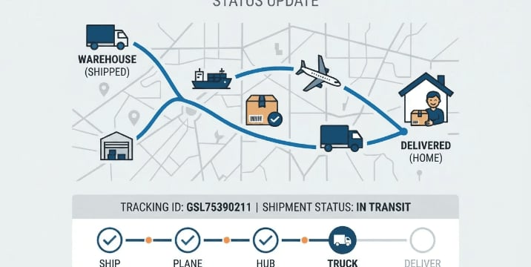
Core System Features
A comprehensive suite of modules designed for both the healthcare customer and the pharmacy administrator.
Medicine Catalogue
Prescription Hub
Smart search and category browsing with
Secure upload simulation and mandatory
detailed metadata.
pharmacist review queue.
Inventory Control
Order Tracking
Automated stock health monitoring and reorder
End-to-end status visibility from cart to final
alerts.
delivery.
PHARMA-G7
4

Slide 5
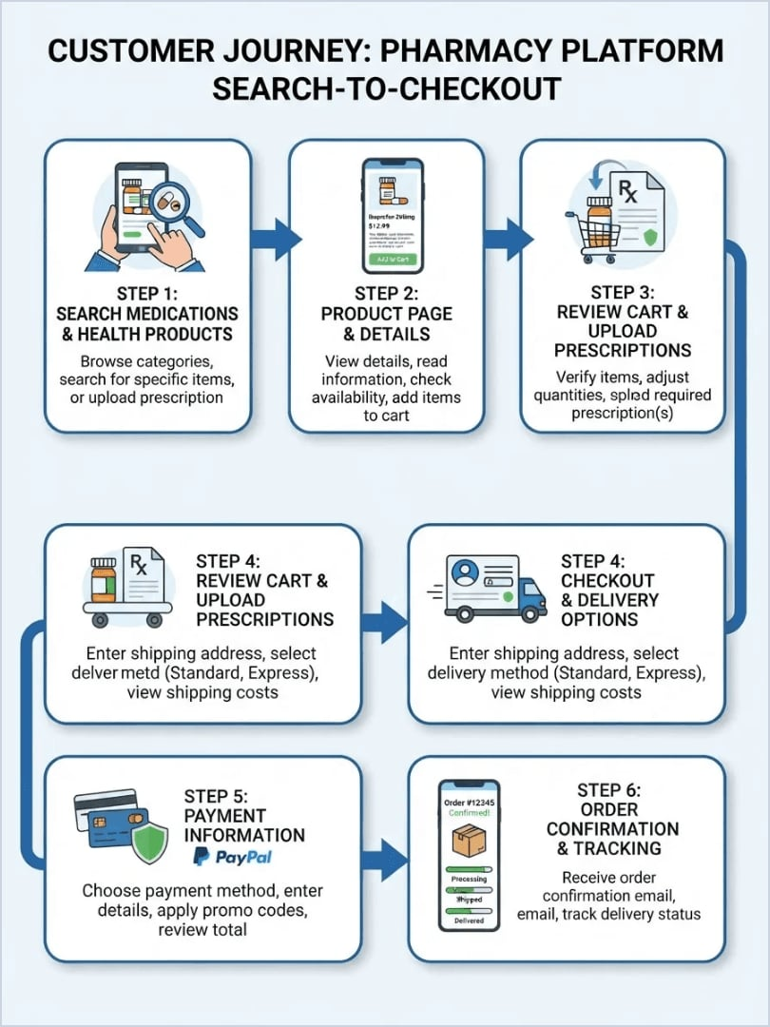
Customer Experience
01
Browse & Search
Seamlessly discover medicines using filters or instant search.
02
Inspect Details
Amazon-style modals showing form, stock, and dosage info.
03
Prescription Upload
Mandatory gateway for Rx items to ensure safety.
04
Buy Now / Cart
Rapid checkout flow with demo order tracking.
PHARMA-G7
5

Slide 6
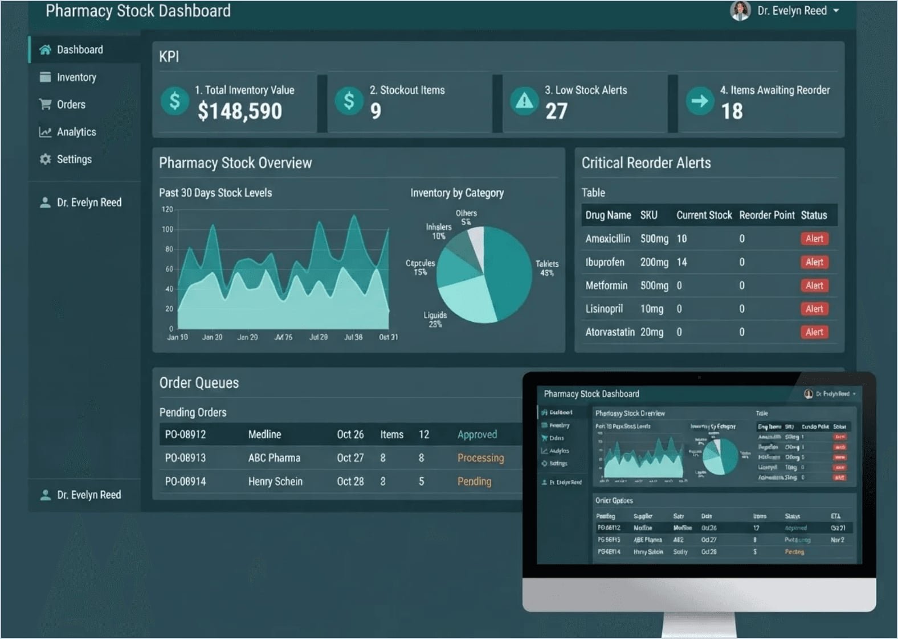
Pharmacy Operations
Data-Driven Oversight
A centralized dashboard for pharmacists to manage inventory health, monitor expiry risks, and process the pending review queue efficiently.
PHARMA-G7
6

Slide 7
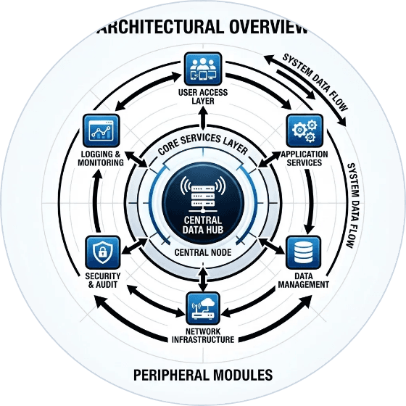
Technology & Architecture
Frontend
Static Serving
Modular HTML, CSS, and Vanilla JS for high performance.
Node.js micro-server for reliable prototype delivery.
State Management
Demo Data Layer
Reactive UI updates for cart and search interactions.
In-memory JSON structure for realistic operations.
Route Manifest
Extensibility
Structured JSON navigation for system indexing.
Defined hooks for future DB and Auth integration.
PHARMA-G7
7

Slide 8

Responsible by Default
Academic Prototype Boundaries
PHARMA-G7 is a demonstration tool for system logic, not a diagnostic or clinical application.
Mandatory Pharmacist Review
Prescription-only items cannot be auto-supplied; they trigger a human-led review queue.
Information Guardrails
Clear disclaimers ensure convenience never replaces qualified medical advice.
PHARMA-G7
8

Slide 9

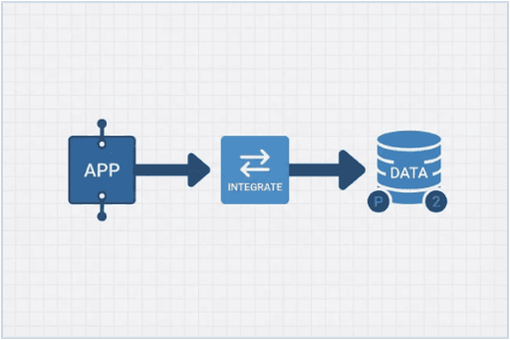


Future Development Roadmap
PHASE 01
PHASE 02
PHASE 03
PHASE 04
System Hardening
Data Persistence
Secure Transfers
Compliance
Implementation of role-based auth and secure sessions.
Migration from demo data to MySQL production database.
File storage for Rx docs and payment gateway integration.
Notifications, audit logs, and healthcare regulatory hardening.
PHARMA-G7
9

Slide 10

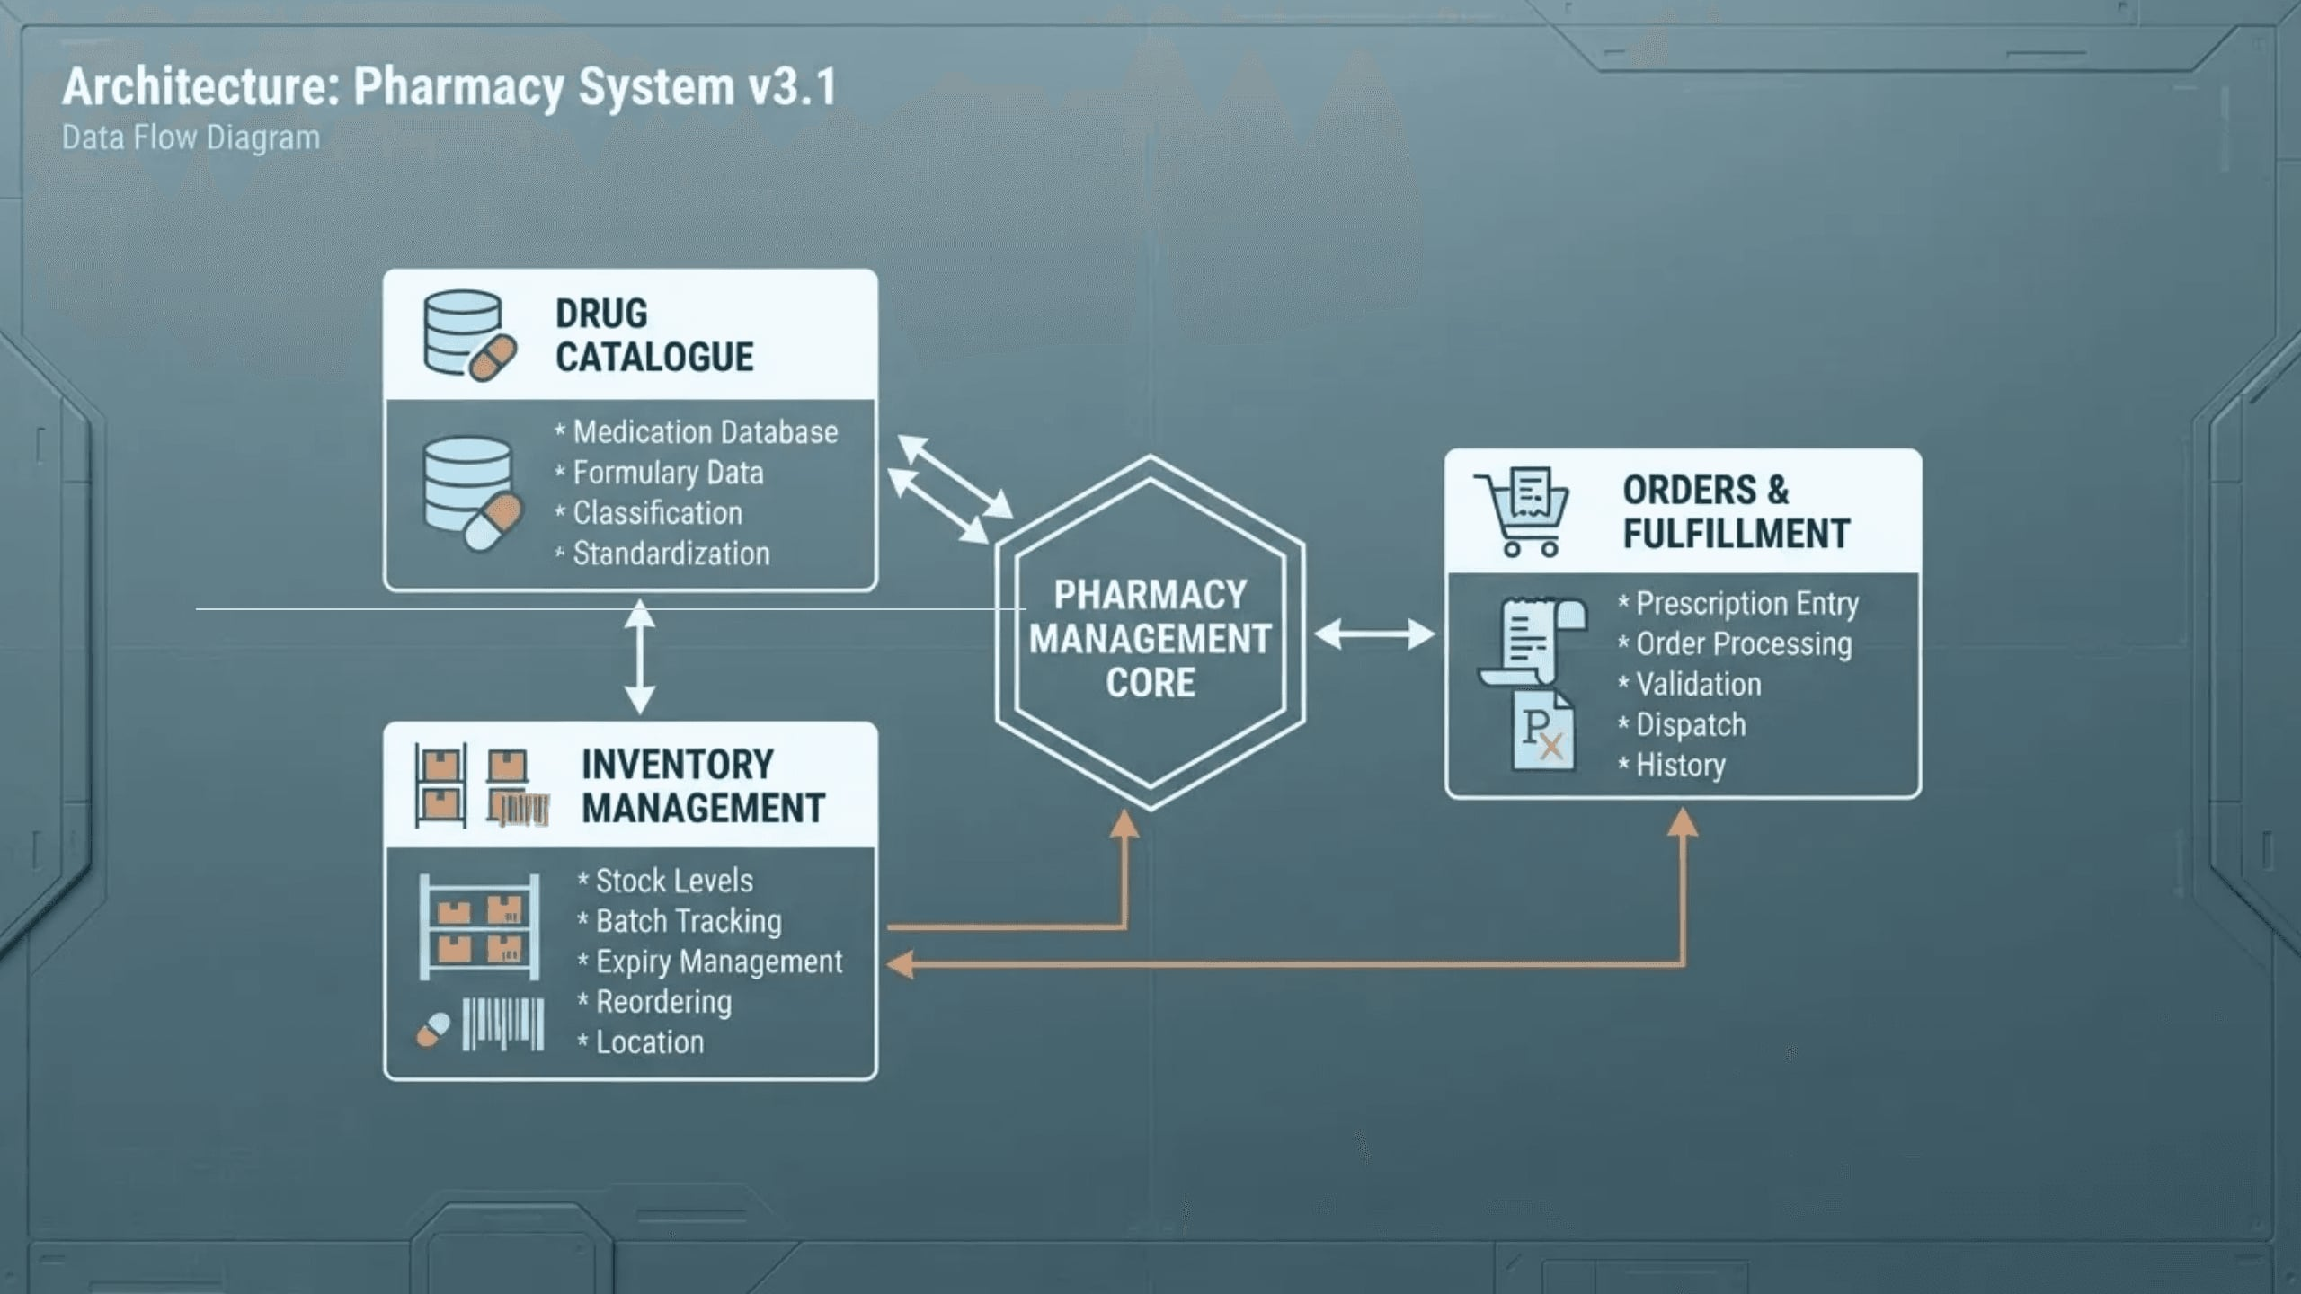
Thank You
Questions & Discussion
PHARMA-G7 Project Demonstration
Academic Prototype · S.Y. BCA
PHARMA-G7
10

