Slide 1

Crop Recommendation System Using Machine Learning
MCA 2nd year 4th semester
2023-24
Under the guidance of :
Dr. Manik Chandra
Mr. Sandeep Yadav
Group Members :
Kartikey : 2200520140025
Arpan Gupta : 2200520140010
Harsh Jaiswal : 2200520140018

Slide 2
Table of Contents
Abstract
Introduction
Existing System
Advantages
Disadvantages
Proposed System
Data Flow Diagram
Methodology
Conclusion
References

Slide 3
Abstract
The current contribution of agriculture to India’s GDP is around 18-19%.
Agriculture is the field which plays an important role in improving our countries economy.
Selecting of every crop is very important in the agriculture planning. The selection of crops will depend upon the different parameters like humidity, temperature, minerals in soil etc.
We can improve agriculture by using machine learning techniques which are applied easily on farming sector.
This improves our Indian economy by maximizing the yield rate of crop production.

Slide 4
Introduction
Crop analysis and prediction is a rapidly growing field which is vital in optimizing agricultural practices.
Crop recommendation is pivotal in agriculture, empowering farmers to make informed decisions about the most suitable crops for their land and climate conditions.
Traditionally, this process heavily relied on expert knowledge, which proved time-consuming and labor-intensive.
Moreover, considering the projected global population of 9.7 billion by 2050, the need to produce more food sustainably becomes imperative.
Machine learning technique scan play a crucial role in effectively automating crop recommendations and detecting pests and diseases to enable farmers to optimize their yield from the land while simultaneously maintaining soil fertility and replenishing essential nutrients.

Slide 5
Existing System
The existing systems only predict yield based on input of total area of farm land in hectares but this systems doesn’t predict best suitable and profitable crop ,doesn’t suggest fertilizers and doesn’t calculate the total value of the crop.
These systems are built on predefined rules and guidelines. Experts determine the rules based on their knowledge and experience. For example, if the soil pH is X, and the temperature is Y, recommend crop Z.
These systems rely on a database of agricultural knowledge. They use this knowledge to make recommendations. However, they lack the ability to adapt and learn from new data.

Slide 6
Advantages
Existing systems are often straightforward to understand and implement.
These systems typically do not require powerful computational resources.
The recommendations generated by existing systems are usually easy to interpret because they are based on explicit rules or knowledge.
Existing systems often incorporate knowledge and expertise from agricultural scientists and agronomists

Slide 7
Disadvantages
Existing systems lack adaptability to changing conditions or new data. They are unable to learn from experience or adjust recommendations based on evolving circumstances.
Compared to machine learning-based systems, existing systems are generally less accurate.
The fixed nature of existing systems means they cannot account for nuanced or complex situations. They may overlook unique conditions or factors specific to certain regions or farms.

Slide 8
Proposed System
We have considered some machine learning models which are Logistic Regression, Support Vector Machine, Random Forest, Naive Bayes method and K- Nearest Neighbor. Using these methods we can predict which crops to be selected for our land. In this application we can make prediction of the suitable crop by giving input as humidity, temperature, pH, rainfall, and some minerals in soil like potassium, phosphorus and Nitrogen.
We can process large datasets and extract complex relationship between variables.
Machine learning algorithm often provide more accurate recommendations compared to rule-based systems, and can learn from past successes and failures.

Slide 9
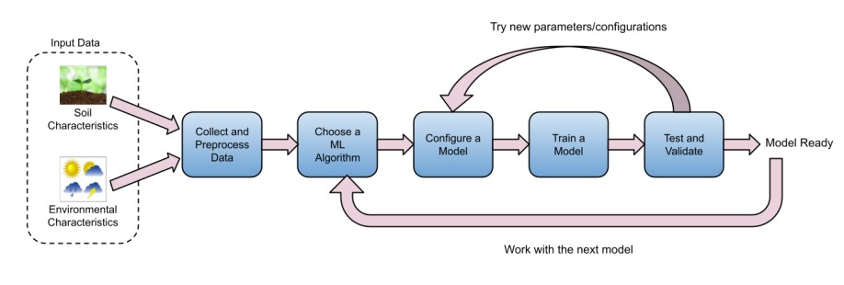
Data Flow Diagram

Slide 10
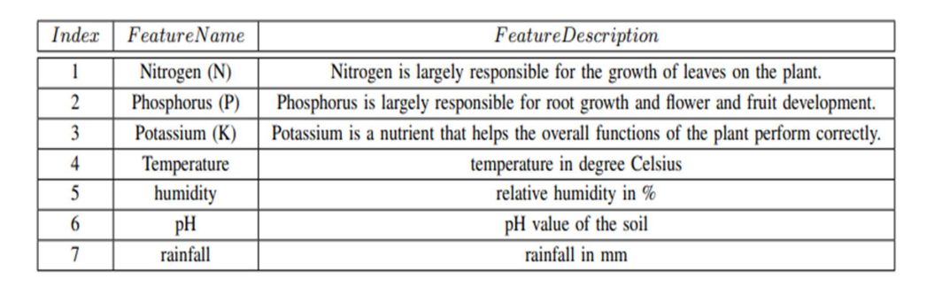
Methodology
This section presents an overview of the methodology, we have used to train various models. First, we iterated all the following steps with all the selected machine learning algorithms listed previously:
1)Input Data: Because the quality and quantity of the data significantly impact a model’s accuracy, we ensured the data was clean and well-labeled.The input to the system is a combination of soil and environmental characteristics.

Slide 11
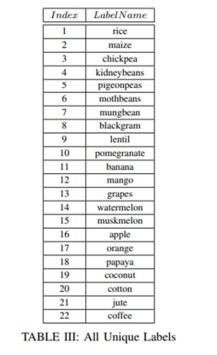

Slide 12
2) Preprocessing: We cleaned the data, removed outliers, and transformed the data into a format that your machine learning algorithm could understand. We primarily removed all null and duplicate records, segregated features from the label column, creating new features from existing features (also called feature engineering), and described & plotted all the data to ensure no outliers.
3) Choose a machine learning algorithm: In each iteration, we chose one of the six algorithms we had decided to use. For every selected algorithm, we iterated steps from preprocessing to testing or validating the model to tune the model.
1) Logistic Regression.
2) Decision Tree.
3) Random Forest.
4) K-Nearest Neighbors.
5) Naive Bayes.
6) SVM.

Slide 13
4) Model Configurations: To achieve higher test and cross validation accuracy, we used various configurations such as activation function, epoch, decision tree depth, and a number of nearest neighbors. Figure V shows some other important configurations. Note that we have to keep in mind the performance of the model also; for example, increasing the decision tree’s depth could cause to degrade the performance of the mode; Similarly, increasing the value of the number of time data should be fed to the neural network model will also highly impact the performance of the model.
5) Training Models: This is where the machine learning algorithm learns from the data prepared in the "Preprocessing" step.
6) Testing Accuracy of the Model: We evaluate the accuracy of the created model against the test data. In addition, we measured the cross-validation accuracy of the model. If the accuracy is unsatisfactory, we iterate the process by returning to the "Model Configuration" step. In some instances, we experimented with the feature engineering approach. Suppose the model’s accuracy and performance are good at this step. In that case, we return to choosing a new algorithm step to repeat the same procedure with another advanced machine learning algorithm.

Slide 14
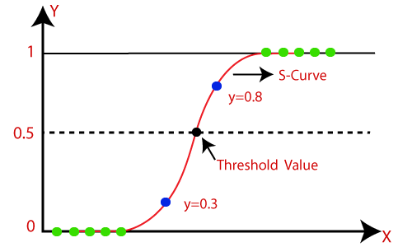
Machine Learning Algorithms
Logistic Regression
Logistic regression is used for binary classification where we use sigmoid function, that takes input as independent variables and produces a probability value between 0 and 1.
For example, we have two classes Class 0 and Class 1 if the value of the logistic function for an input is greater than 0.5 (threshold value) then it belongs to Class 1 otherwise it belongs to Class 0. It’s referred to as regression because it is the extension of linear regression but is mainly used for classification problems.

Slide 15
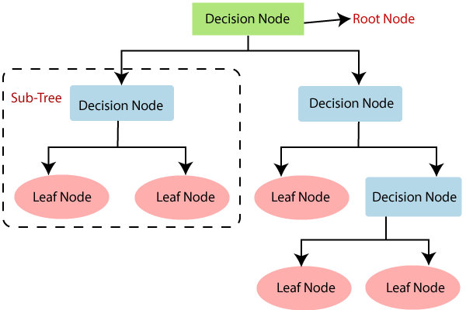
Decision Tree
Decision Tree is a Supervised learning technique that can be used for both classification and Regression problems, but mostly it is preferred for solving Classification problems. It is a tree-structured classifier, where internal nodes represent the features of a dataset, branches represent the decision rules and each leaf node represents the outcome.
In a Decision tree, there are two nodes, which are the Decision Node and Leaf Node.

Slide 16
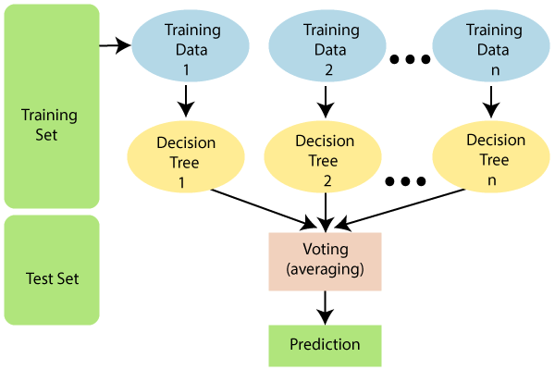
Random Forest:
Random Forest is a popular machine learning algorithm that belongs to the supervised learning technique. It can be used for both Classification and Regression problems in ML. It is based on the concept of ensemble learning, which is a process of combining multiple classifiers to solve a complex problem and to improve the performance of the model.

Slide 17
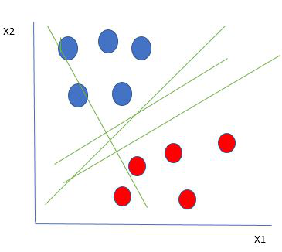
Support Vector Machine
Support Vector Machine (SVM) is a supervised machine learning algorithm used for both classification and regression. Though we say regression problems as well it’s best suited for classification. The main objective of the SVM algorithm is to find the optimal hyperplane in an N-dimensional space that can separate the data points in different classes in the feature space. The hyperplane tries that the margin between the closest points of different classes should be as maximum as possible. The dimension of the hyperplane depends upon the number of features.

Slide 18
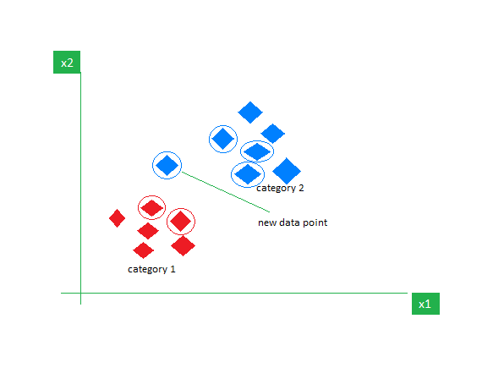
K-Nearest Neighbor(KNN)
KNN is one of the most basic yet essential classification algorithms in machine learning. It belongs to the supervised learning domain and finds intense application in pattern recognition, data mining, and intrusion detection.
It is widely disposable in real-life scenarios since it is non-parametric, meaning it does not make any underlying assumptions about the distribution of data (as opposed to other algorithms such as GMM, which assume a Gaussian distribution of the given data). We are given some prior data (also called training data), which classifies coordinates into groups identified by an attribute

Slide 19
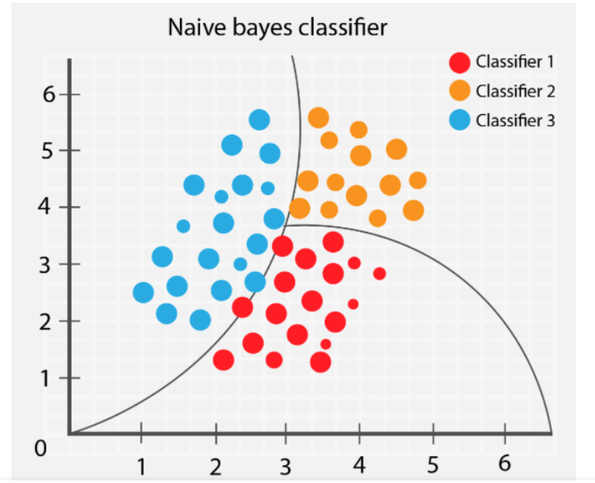
Naive Bayes Classifiers
Naive Bayes classifiers are a collection of classification algorithms based on Bayes’ Theorem. It is not a single algorithm but a family of algorithms where all of them share a common principle, i.e. every pair of features being classified is independent of each other.
One of the most simple and effective classification algorithms, the Naïve Bayes classifier aids in the rapid development of machine learning models with rapid prediction capabilities.

Slide 20
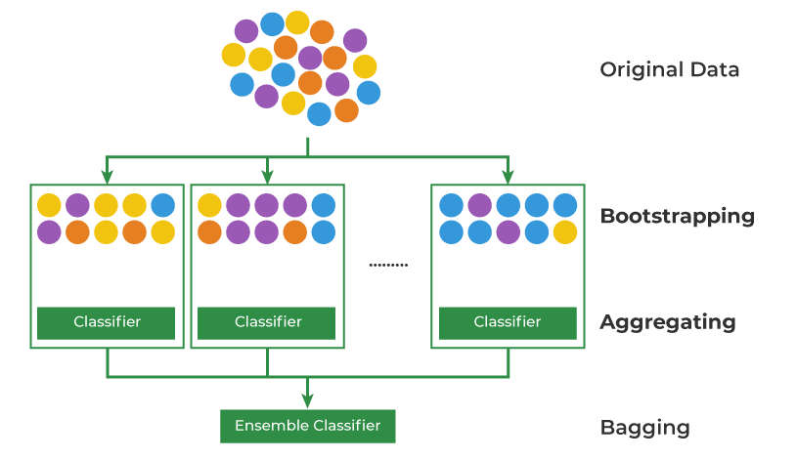
Bagging Classifier
A Bagging classifier is an ensemble meta-estimator that fits base classifiers each on random subsets of the original dataset and then aggregate their individual predictions (either by voting or by averaging) to form a final prediction. Such a meta-estimator can typically be used as a way to reduce the variance of a black-box estimator (e.g., a decision tree), by introducing randomization into its construction procedure and then making an ensemble out of it.

Slide 21
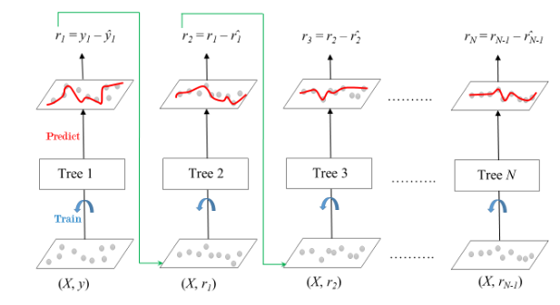
Gradient Boosting
Gradient Boosting is a powerful boosting algorithm that combines several weak learners into strong learners, in which each new model is trained to minimize the loss function such as mean squared error or cross-entropy of the previous model using gradient descent. In each iteration, the algorithm computes the gradient of the loss function with respect to the predictions of the current ensemble and then trains a new weak model to minimize this gradient. The predictions of the new model are then added to the ensemble, and the process is repeated until a stopping criterion is met.

Slide 22
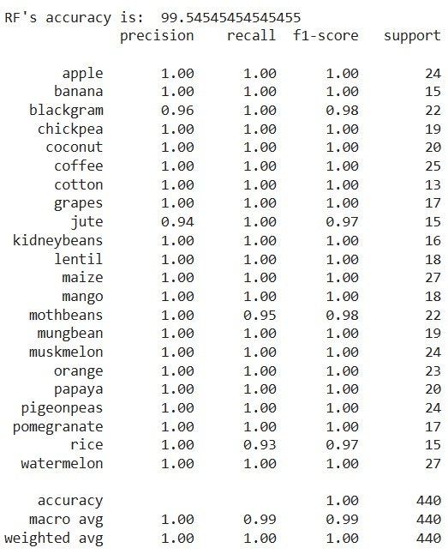
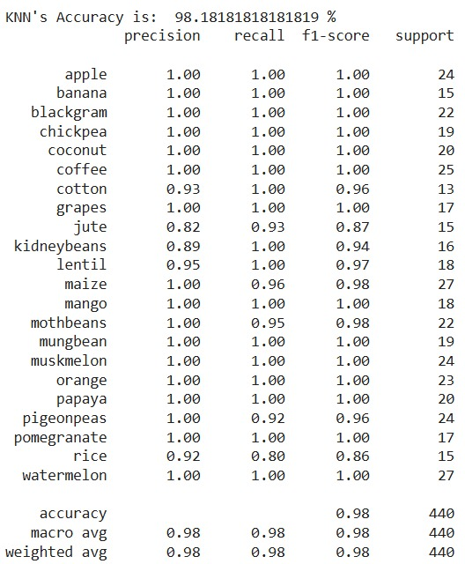
Accuracy of Different Models

Slide 23
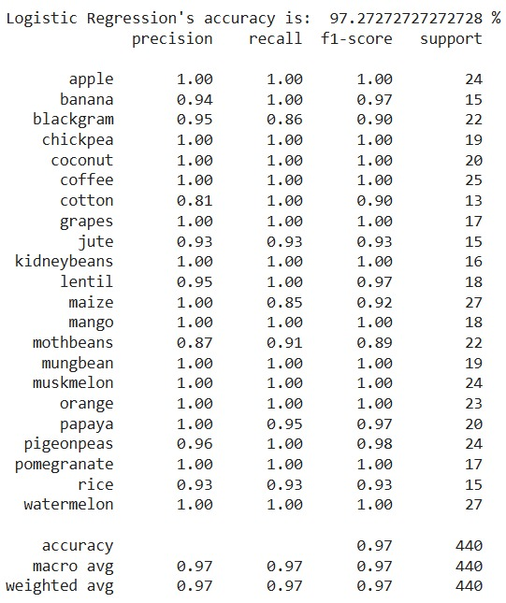
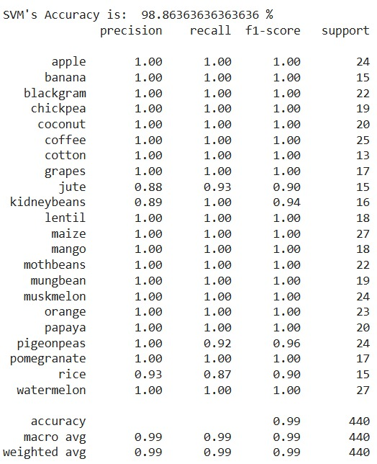

Slide 24
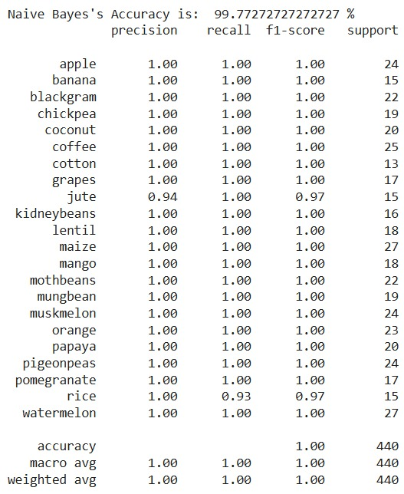

Slide 25
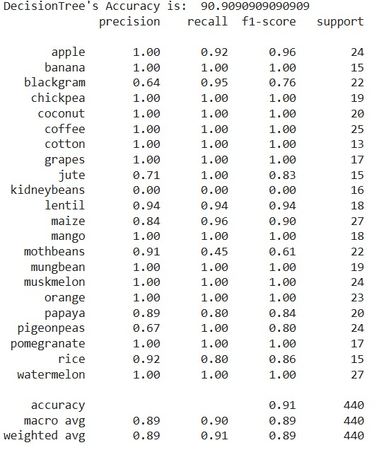
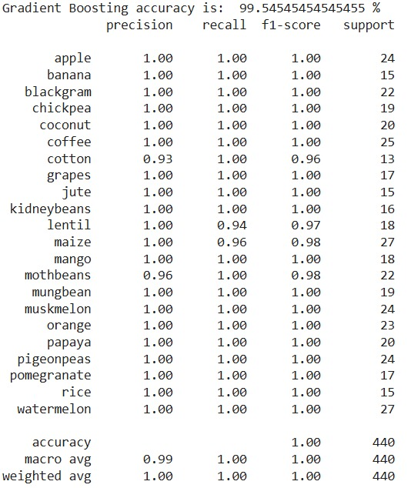

Slide 26
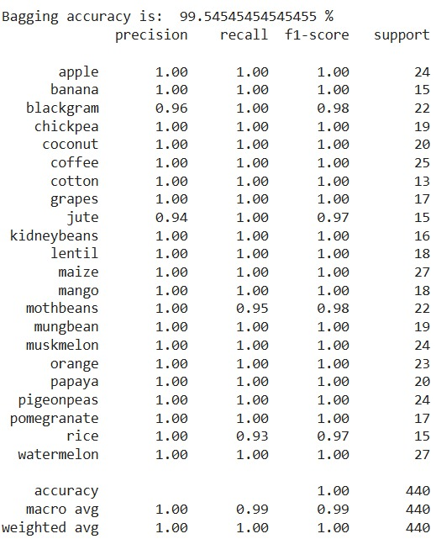

Slide 27
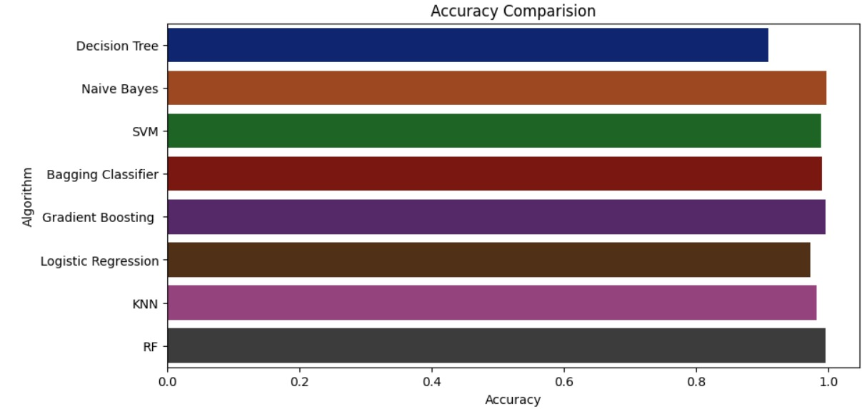
Result and Evaluation

Slide 28
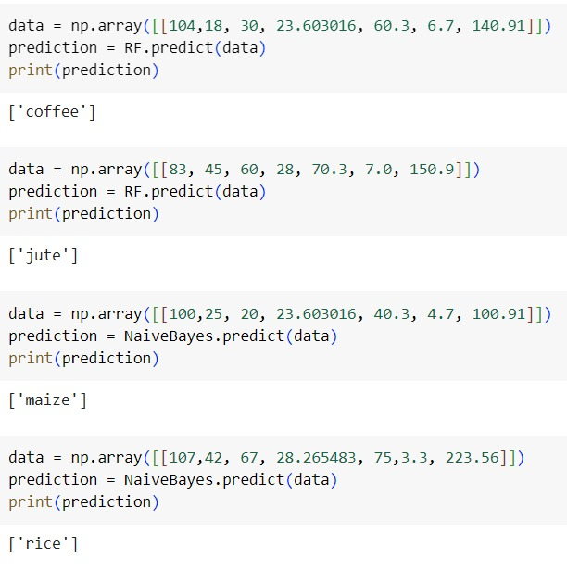
Sample Output:

Slide 29
Conclusion
In conclusion, this project has presented crop recommendation models to predict the best crops to grow using multiple advanced machine learning algorithms.
The technique is scalable and easily adapted to new data and regions or countries.
The results of this study have several positive implications for the agricultural industry. First, the technique can be used by farmers to make more informed decisions about what crops to grow.
Second, the method can be used by governments to develop policies that support the agricultural sector.
Third, the method can be used by businesses to create new products and services that support the agricultural industry.
Fourth, it will help keep the agricultural goods prices stable. Next, we thoroughly presented agricultural challenges and some interesting future ideas to venture into.
Overall, this project has made a significant contribution to the field of agriculture. The technique is scalable, accurate, and easy to use, making it a valuable tool for farmers, governments, and businesses.

Slide 30
References
[1] A. L. Samuel, “Some studies in machine learning using the game of checkers,” IBM Journal of Research and Development, vol. 3, no. 3, pp. 210–229, 1959.
[2] H. Wang, Z. Lei, X. Zhang, B. Zhou, and J. Peng, “Machine learning basics,” Deep learning, pp. 98–164, 2016.
[3] G. Bonaccorso, Machine learning algorithms. Packt Publishing Ltd, 2017.
[4] A. Calzadilla, T. Zhu, K. Rehdanz, R. S. Tol, and C. Ringler, “Climate change and agriculture: Impacts and adaptation options in south africa,” Water Resources and Economics, vol. 5, pp. 24–48, 2014.
[5] T. Partap, “Hill agriculture: challenges and opportunities,” Indian Jour nal of Agricultural Economics, vol. 66, no. 902-2016-67891, 2011.
[6] T. O. Ayodele, “Types of machine learning algorithms,” New advances in machine learning, vol. 3, pp. 19–48, 2010.
[7] D. W. Hosmer Jr, S. Lemeshow, and R. X. Sturdivant, Applied logistic regression. John Wiley & Sons, 2013, vol. 398.
[8] R. E. Wright, “Logistic regression.” 1995.
[9] B. Charbuty and A. Abdulazeez, “Classification based on decision tree algorithm for machine learning,” Journal of Applied Science and Technology Trends, vol. 2, no. 01, pp. 20–28, 2021.
[10] M. R. Segal, “Machine learning benchmarks and random forest regression,” 2004.

Slide 31
[11] K. Taunk, S. De, S. Verma, and A. Swetapadma, “A brief review of nearest neighbor algorithm for learning and classification,” in 2019 International Conference on Intelligent Computing and Control Systems (ICCS). IEEE, 2019, pp. 1255–1260.
[12] S. Chen, G. I. Webb, L. Liu, and X. Ma, “A novel selective naïve bayes algorithm,” Knowledge-Based Systems, vol. 192, p. 105361, 2020.
[13] M. A. Hearst, S. T. Dumais, E. Osuna, J. Platt, and B. Scholkopf, “Support vector machines,” IEEE Intelligent Systems and their applications, vol. 13, no. 4, pp. 18–28, 1998.
[14] I. Steinwart and A. Christmann, Support vector machines. Springer Science & Business Media, 2008.
[15] K. Gurney, An introduction to neural networks. CRC press, 1997.
[16] S. Albawi, T. A. Mohammed, and S. Al-Zawi, “Understanding of a convolutional neural network,” in 2017 International Conference on Engineering and Technology (ICET), 2017, pp. 1–6.
[17] S. Sharma, S. Sharma, and A. Athaiya, “Activation functions in neural networks,” Towards Data Sci, vol. 6, no. 12, pp. 310–316, 2017.
[18] J. Dean and S. Ghemawat, “Mapreduce: Simplified data processing on large clusters,” in OSDI’04: Sixth Symposium on Operating System Design and Implementation, San Francisco, CA, 2004, pp. 137–150.

