Slide 1
MEDIPREDICT
DISEASE PREDICTION SYSTEM
Presented By Abacus UCP Coders:-
ATUL PATANAYAK
HIMANI PANIGRAHY
KANHU CHARAN SETHI
MANAS RANJAN SAHU
BEDA PRAKASH PADHI
A Machine Learning Web Application | Python • Flask • scikit-learn • Random Forest | 2026

Slide 2

INTRODUCTION & OBJECTIVES
Project Overview
MediPredict leverages machine learning to predict diseases from user-reported symptoms. This educational project demonstrates seamless Flask and ML integration.
Key Objectives:
• Predict diseases accurately from symptom inputs
• Build an interactive, user-friendly web application
• Integrate Flask backend with Random Forest ML model
• Provide actionable health suggestions to users

Slide 3
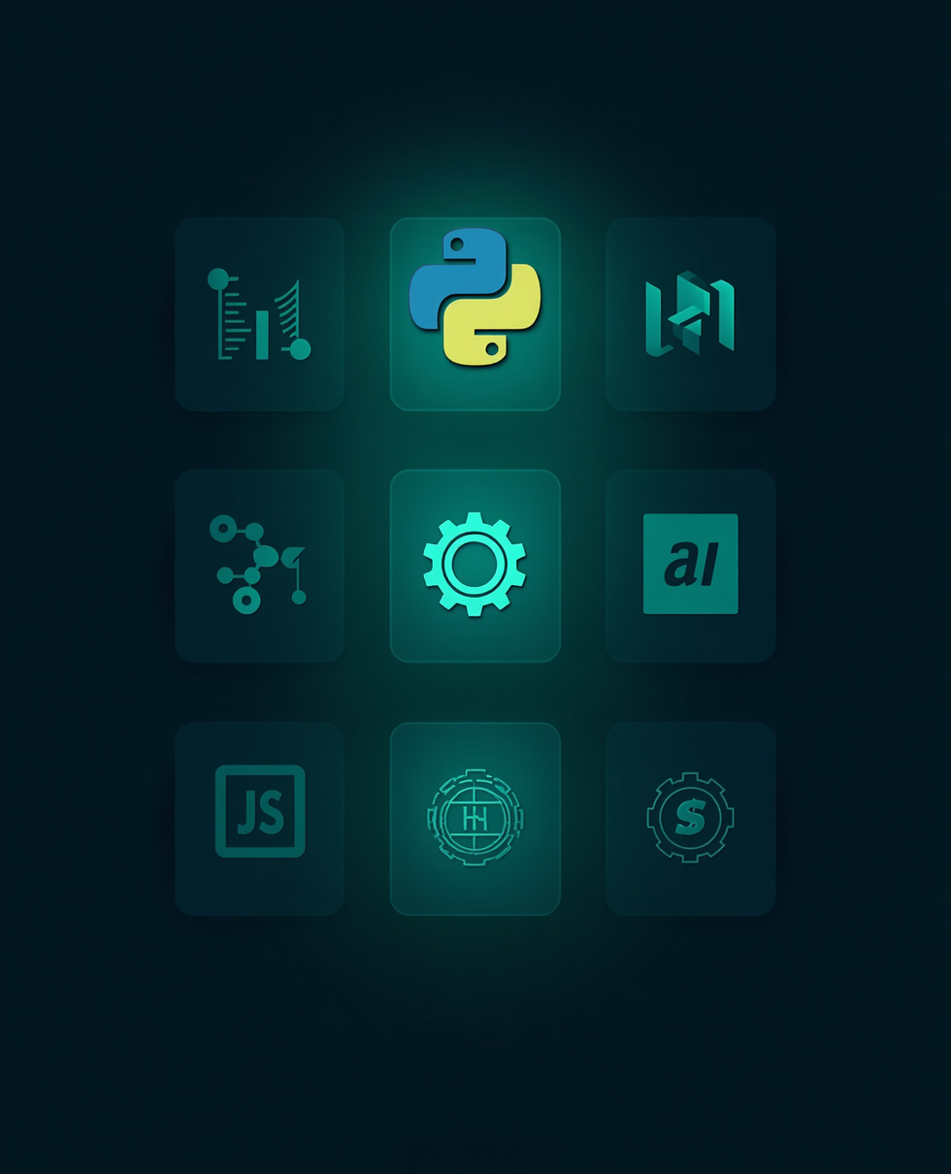
TECHNOLOGIES USED
Backend & Frontend Stack
Backend: Python, Flask, scikit-learn, pandas, NumPy
Frontend: HTML, CSS, JavaScript, Jinja2
Modern tools powering intelligent disease prediction.

Slide 4
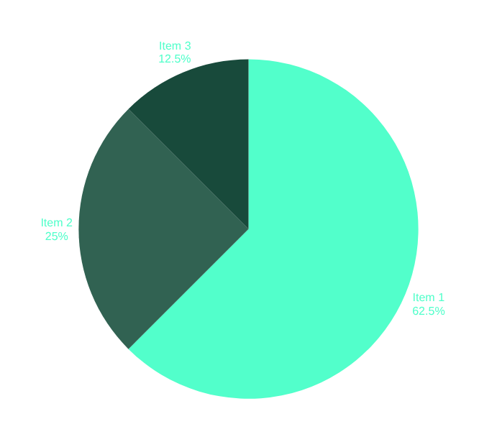
DATASET & MACHINE LEARNING MODEL
Random Forest Classifier Architecture
Dataset Overview
• Synthetic dataset with 8 training records
• 5 input symptoms: Fever, Cough, Headache, Fatigue, Body Pain
• 5 target diseases: COVID-19, Flu, Migraine, Cold, Healthy
ML Model Configuration
• Random Forest Classifier with 100 estimators
• Ensemble learning combining multiple decision trees
• Improves prediction reliability and reduces overfitting

Slide 5
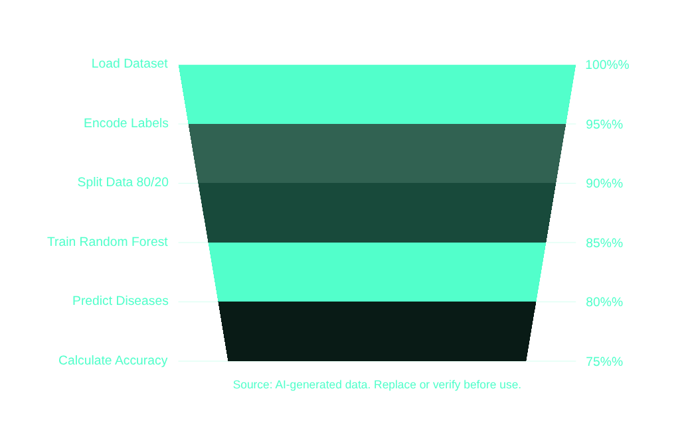
MODEL TRAINING PROCESS
From Data to Prediction
Load Dataset → 2. Encode Labels → 3. Split Data (80% train, 20% test) → 4. Train Random Forest (n_estimators=100) → 5. Predict Diseases → 6. Calculate Accuracy
Parameters: test_size=0.2, random_state=42

Slide 6
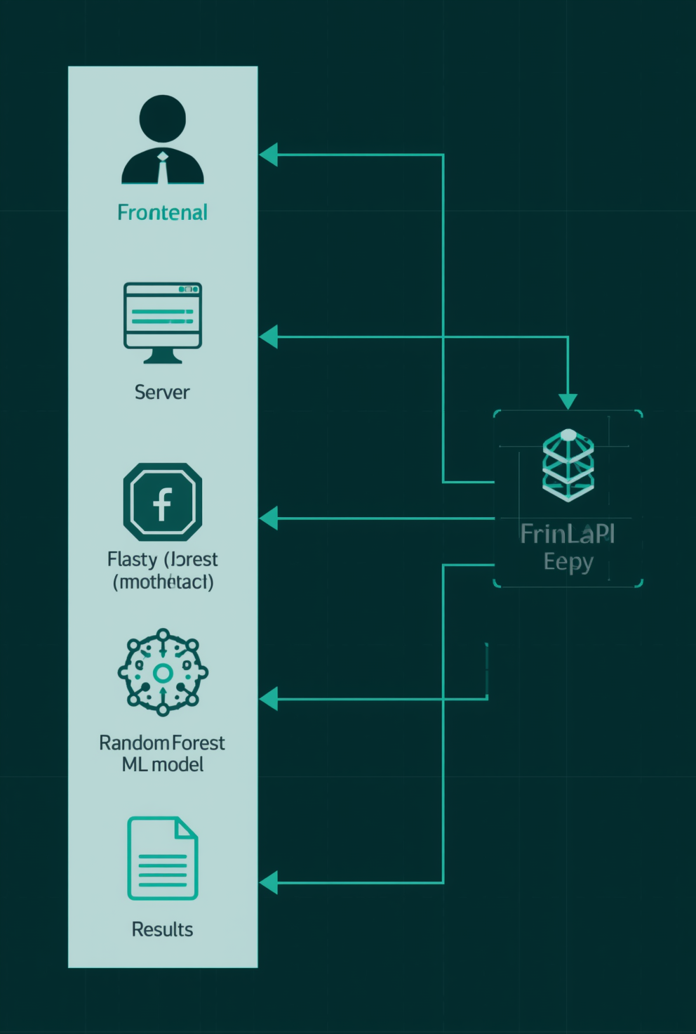
SYSTEM ARCHITECTURE
Application Data Flow
User → Frontend Website → Flask Backend API → Random Forest Model → Prediction Result
The system follows a clean request-response architecture:
• User selects symptoms via the web interface
• Frontend sends JSON request to Flask API
• Backend processes input through ML model
• Random Forest classifier returns prediction
• Result displayed with health suggestions
JSON communication enables seamless frontend-backend integration.

Slide 7
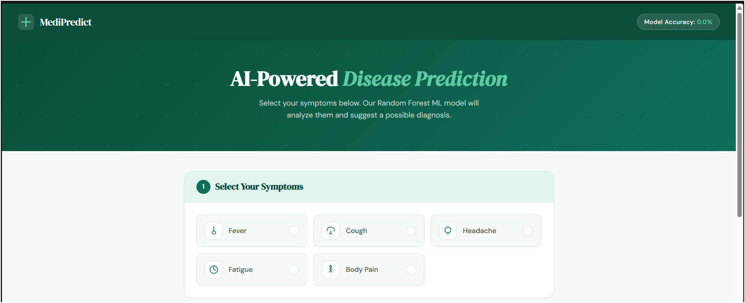
FRONTEND WEBSITE
User Interface Screenshots
Homepage – Symptom Selection Interface
Users can easily select their symptoms through an intuitive checkbox interface. The clean, minimal design ensures a seamless experience for entering health data.
Diagnosis Section – Prediction Interface
After symptom submission, the system displays the predicted disease along with relevant health suggestions, powered by the Random Forest ML model.

Slide 8
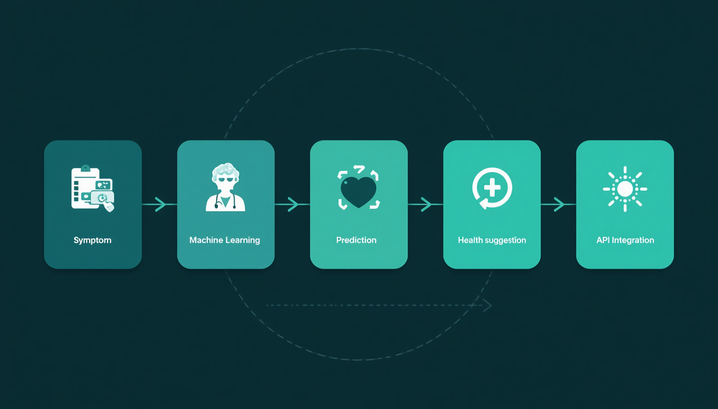
FEATURES & WORKING
Key Capabilities & System Flow
• Symptom selection interface for user input
• Disease prediction powered by ML model
• Health suggestions provided with results
• Interactive, responsive user interface
• Flask API integration for backend ML calls
Working Flow: User selects symptoms → JSON sent to Flask → ML model predicts → Result displayed with suggestions

Slide 9
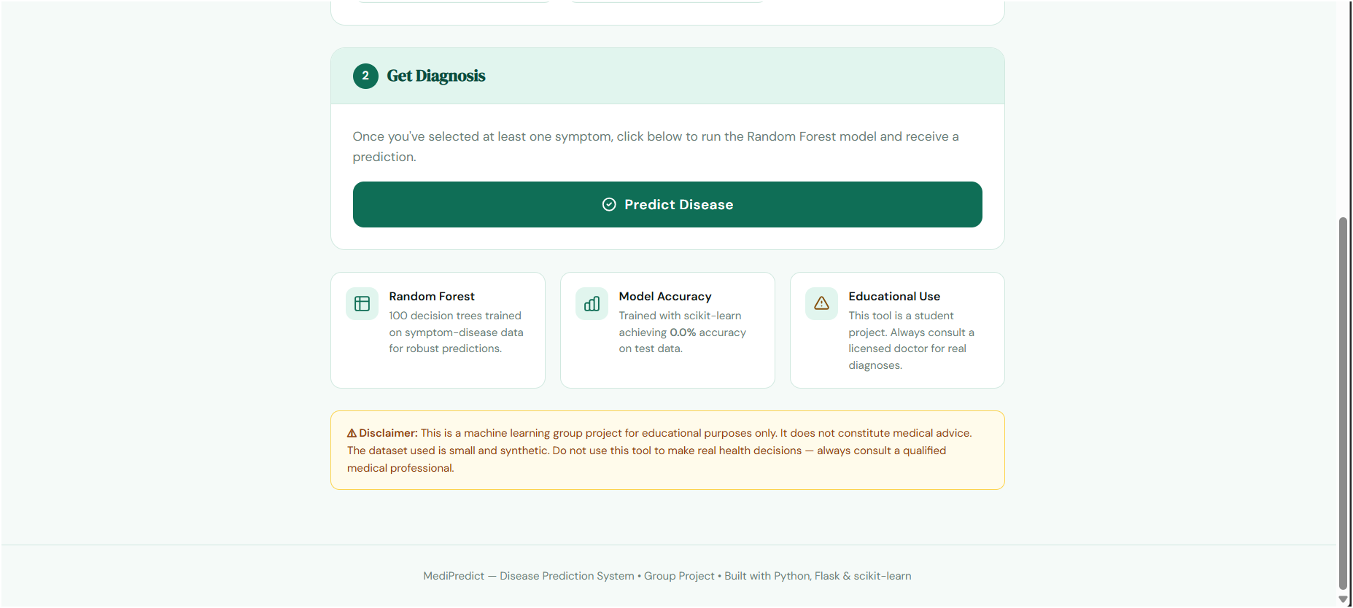
Current Limitations
LIMITATIONS & FUTURE IMPROVEMENTS
• Small synthetic dataset (8 records only)
• Limited to 5 diseases and 5 symptoms
• No database integration
• No input validation implemented
• Model retrained on every server start
• Debug mode enabled (educational use only)

Slide 10
THANK YOU
10/10
MediPredict – Disease Prediction System

