Slide 1
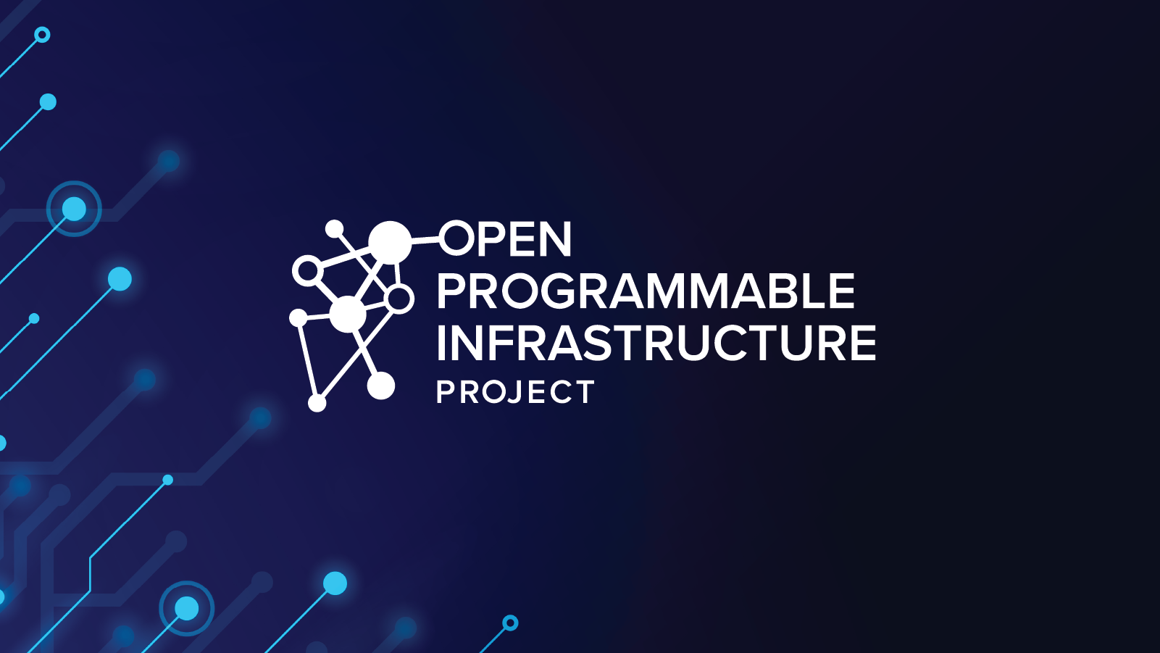
OPI-EVPN-BR Architecture
EVPN-GW offload to xPUs (Intel/Ericsson PoC)
Dimitrios Markou (Ericsson)
Feb 2024

Slide 2
Agenda
Intel-Ericsson IPU PoC Overview
Network Architecture
K8s Tenant Networking and EVPN GW Design
EVPN GW API (Already merged to OPI)
Target Architecture
OPI-EVPN-Bridge Architecture
Sequence Diagrams
References

Slide 3
Intel-Ericsson IPU POC Overview
Overview of the Intel-Ericsson IPU PoC
Working together on several IPU-based use cases :
Telco edge networking for K8s
remote manageability
NW Security
Focus of the Networking use case
Supporting K8s primary and accelerated secondary networking – latter is critical for Telco use cases
An Integrated edge router (‘EVPN GW’) and managed underlay on the IPU
Building on open-source control planes on the IPU
Open architecture based on standard interfaces with goal to contribute vendor-agnostic code to the OPI community

Slide 4
Network Architecture

Slide 5
EVPN – Overlay and Network Separation
EVPN
L3/L2 VPN overlay
Telco Edge or enterprise site
fabric
PE
PE
Server with EVPN GW functionality on the xPU
servers
Datacenter
EVPN: Service Provider VPN technology standardized by the IETF ”BGP Enabled Services” working group (https://tools.ietf.org/wg/bess/)

Slide 6
K8s Tenant Networking & EVPN GW Design

Slide 7
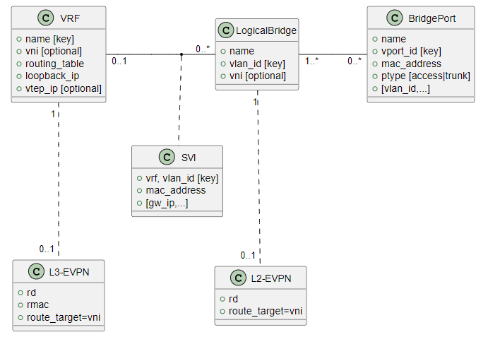
EVPN Network Provisioning API
Lean API for EVPN orchestration
Focus on essential entities and attributes for common use cases
LogicalBridge:
Local L2 broadcast domain
Optionally part of an L2-EVPN identified by L2 VNI
BridgePort:
Attaches a VF to one or more LogicalBridges
Access or VLAN trunk port
VRF:
Local routing instance of an L3-EVPN identified by L3 VNI
SVI (Switched Virtual Interface):
Connects a LogicalBridge to a VRF for L3 VPN connectivity
automatically managed by xPU Infra Manager and FRR

Slide 8
Tenant Networking & EVPN GW offload – Target Architecture
Host
K8s Control Plane
K8s pod
K8s pod
Network Provisioning CLI (godpu)
Kubelet
KubeProxy
eth0
Secondary access VF
Secondary trunk VF
EVPN GW CNI
Primary CNI
Linux routing iptables
Vendor Agnostic
Upstream Target
Primary VF
EVPN GW gRPC API
Vendor Specific
xPU
ARM Cores
Programmable HW pipeline
Existing Open Source
OPI-EVPN-BR
Vendor Plugin
VLAN-aware L2 Bridge
Linux Bridging & Routing CP and slow path
VRF routing
VXLAN encap/decap
Control plane interface
EVPN Gateway CP (FRR)
Underlay routing
Data plane fast path
Plugin
IPSec CP
(strongSwan)
Vendor SDK
IPSec encryption/decryption
Data plane slow path

Slide 9
OPI-EVPN-Bridge Architecture

Slide 10
CLI
DB
Set ()
Get()
List()
….
EVPN-GW API
opi-evpn-bridge core
Vendor provided
Vendor choice
Storage Library
gRPC Server
InfraDB
Object Store
Translation
Task Manager
Subscriber Framework
notify
SlowPath
Subscribe
Offload
General Linux Mod
Vendor Linux Mod
FRR Mod
Netlink Watcher
notify
Vendor Mod
ApplyConf
FRR
PollConf
Linux (SlowPath)
FastPath

Slide 11
Flexible modular design
IPU
xPU
CI
Linux General Module
Linux IPU Module
FRR Module
Netlink Watcher
IPU Offload Module
Linux General Module
Linux xPU Module
FRR Module
Netlink Watcher
xPU Offload Module
Linux General Module
Linux CI Module
FRR Module

Slide 12
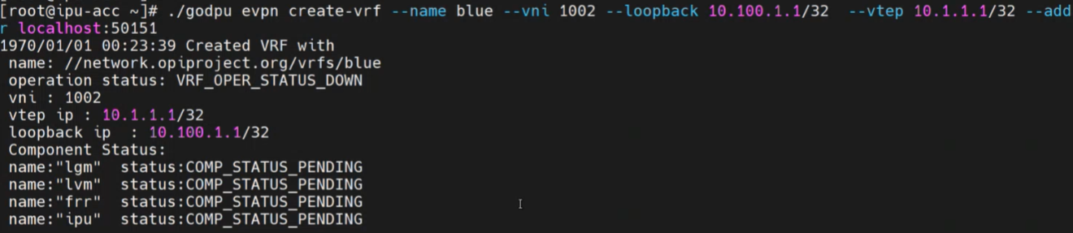
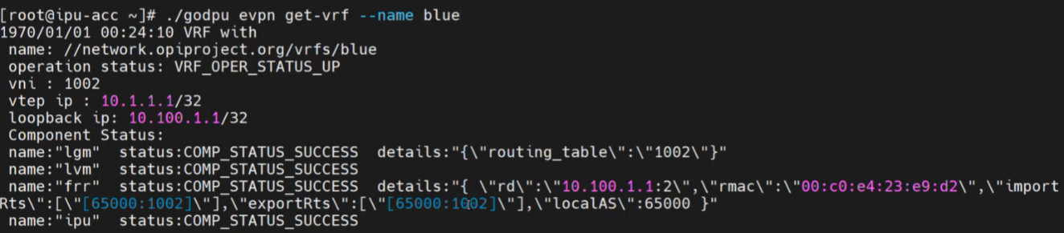

Slide 13
Sequence Diagrams
Create VRF example
Netlink Module (VRF example)
Requeue Failed Task
Resiliency

Slide 14
References
OPI-EVPN-BR
EVPN-GW-API
GoDPU
EVPN-GW-CNI

Slide 15
THANK YOU!

Slide 16
Backup

Slide 17
EVPN Control and Data Plane
EVPN implementation
BGP session
VXLAN/IPSec tunnel
Telco Edge or enterprise site
fabric
PE
PE
VXLAN/IPSec tunnel
Server with EVPN GW functionality on the xPU
servers
Datacenter
BGP session
EVPN uses BGP in the control plane and VXLAN in the data plane. We use additional IPSec encapsulation for security.

Slide 18
Network scenario
Telco Edge or enterprise site
Arbitrary IP transport
Server with EVPN GW functionality on the xPU
Arbitrary IP transport
Telco Edge or enterprise site
fabric
PE
Arbitrary IP transport
Arbitrary IP transport
PE
Server with EVPN GW functionality on the xPU
servers
Telco Edge or enterprise site
Datacenter
Arbitrary IP transport
Server with EVPN GW functionality on the xPU
EVPN GW functionality = Edge router with integrated routing and bridging
Goal: Optimize stand-alone server (and small cluster) deployments on telco edge and enterprise edge sites: Avoid CAPEX for dedicated site network equipment and remove dependencies on transport infrastructure

Slide 19
EVPN routing
Host
Host
K8s pod
K8s pod
K8s pod
K8s pod
K8s pod
K8s pod
K8s pod
K8s pod
xPU
xPU
Tenant network bridge
BGP EVPN
Tenant network bridge
VPN
VPN
VPN
…
VPN
VPN
VPN
VPN
…
VPN
VRF
VRF
VRF
VRF
VRF
VRF
VRF
VRF
Underlay routing
VPN routes
Underlay routing
GRD
GRD routes
GRD
IPSec
IPSec
Transport network
Site 1
Site N

