Slide 1






RECOGNITION OF ALPHABETS IN NEPALI SIGN LANGUAGE (NSL)
8th Semester Project:
Project Group
Supervisor Asst. Prof. Ankit Bhattarai
Atul Pokharel
(170308)
Nabin Raj Dhungel
(170322)
Nabin Joshi
(170323)
Rakshya Bhetwal
(170334)
18th September, 2022

Slide 2
OUTLINE
Background
Objective(s)
Significance of the Project
Literature Review
Methodology
Results, Analysis, and Contributions
Conclusions and Future Works
References
Appendix

Slide 3
BACKGROUND
Speech and hearing impairments re disability of individual to communicate using speech and hearing.
There remains a challenge for non-sign language communicators to interact with sign language speakers and it’s been researched for many years on how to facilitate communication between those people with hearing impairment.
In order to improve communication between signers and non-signers, we developed a model that can detect sign language and assist non-signers in understanding it.
The model consists of image of the sign to be recognized as an input and as an output, it will be able to return the meaning of the sign contained in the image.

Slide 4
OBJECTIVE(S)
The Objective(s) of this project are:
To build a system that will be able to correctly identify alphabets that corresponds to the hand gestures of Nepali Sign Language.
To aid those who wish to learn and communicate in sign language.

Slide 5
SIGNIFICANCE OF THE PROJECT
Our project proposes an intelligent system for recognizing sign languages without restricting movement, and Nepali sign language recognition appears to be a less researched topic.
The model addresses the difficulties that signers face when attempting to express themselves effectively without the use of interpreters or wired technology and proposes a suitable solution.
The model will also benefit the non-signers wishing to learn sign language or communicate with the signers.

Slide 6
LITERATURE REVIEW
Jhuma Sunuwar and Ratika Pradhan (2015), proposed use of object descriptor representing boundary information of hand to make classification easy and simple by transforming the gesture to shape number.
Drish Mali, Rubash Mali, Sushila Sipai and Sanjeeb Prasad Pandey (2018), proposed a system to translate NSL using red glove detection.
Abdulwahab A. Abdulhussein and Firas A. Raheem (2020), put forward a model based on Gesture recognition of static ASL using Deep Learning.

Slide 7
Literature Review Contd…
Mujahid, A., Awan, M. J., Yasin, A., Mohammed, M. A., Damasevicius, R., Maskeliunas, R. and Abdulkareem, K. H. (2021), proposed a lightweight model based on YOLO (You Only Look Once) v3 and DarkNet-53 for gesture recognition.
Rasha Amer Kadhim and Muntadher Khamees (2020), built a real-time ASL recognition system for 26 alphabets.

Slide 8
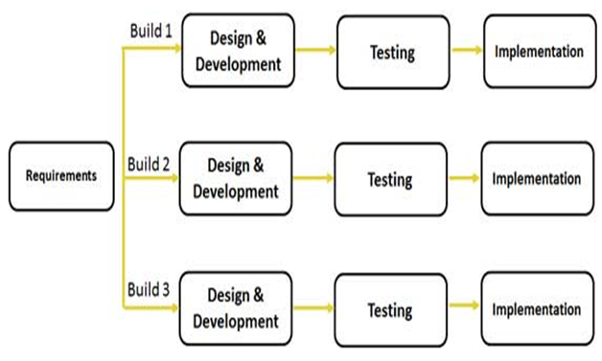
METHODOLOGY
Software Process Model (Incremental Model)

Slide 9
Methodology Contd…
Tools and Environment:
Software Tools:
Jupyter Notebook: It is an open-source web application that allows us to create and share documents that contain live code, equations, visualizations, etc.
Libraries:
Tensorflow: It is an open source software library for numerical computation widely used in Machine Learning.
Keras: It is a high-level neural networks library written in python that works as a wrapper to TensorFlow.
OpenCV: Open Source Computer Vision (OpenCV) is an open source library of programming functions used for real-time computer-vision.

Slide 10
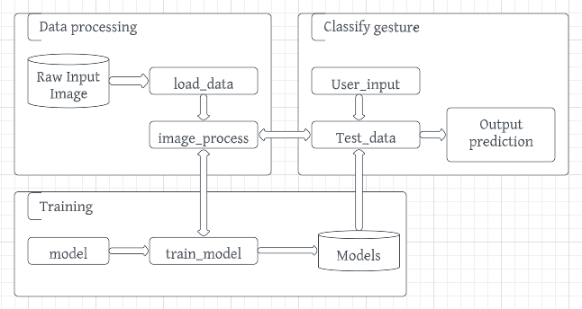
Methodology Contd…
Overall System Architecture

Slide 11
Methodology Contd…
Dataset:
OpenCV library was used to capture images through web-cam.
At first labels for each of the alphabets were defined and path for each class folders in which the respective images were going to be stored were defined.
The image path was set inside a folder named ’collectedimages’ in our local computer.
The input image was of 640*480 dimension with file size 27.4 KB of each image with it’s horizontal and vertical resolution both being 120 dpi.
The bit depth of the original image was 124.
Then RGB normalization of the images was performed.

Slide 12
Methodology Contd…
CNN as an Algorithm:
CNN takes input as images, assigns weights or biases to various aspects of image which helps in distinguishing the images from one another..
They are automatic feature extractors.
We have used max pooling to reduce size of image without compromising with image quality.
CNN provides usage of convolutions, which act as feature emphasizer.

Slide 13
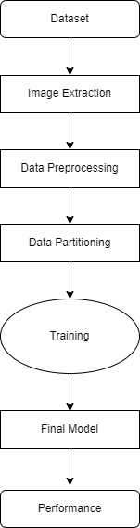
Methodology Contd…
Workflow Diagram

Slide 14
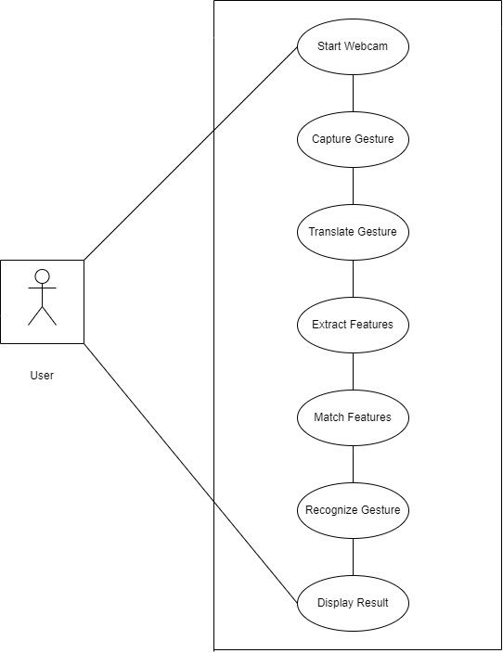
Methodology Contd…
Use Case Diagram

Slide 15
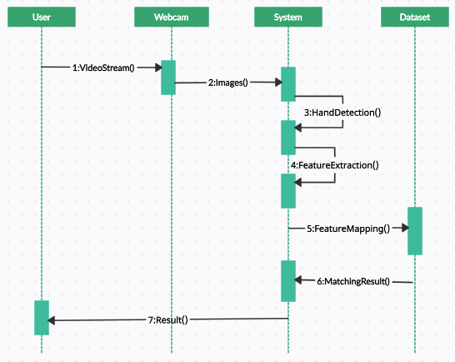
Methodology Contd…
Sequence Diagram

Slide 16
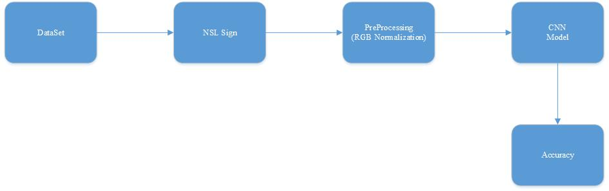
Methdology Contd…
Model Implementation

Slide 17

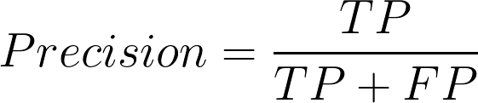
Methodology Contd..
Validation Criteria
Confusion Matrix: Confusion Matrix is the visual representation of actual vs predicted value and it help to measure the performance of our Machine Learning mode
Accuracy: It is the measure of how often the classifier makes the correct prediction. It is the ratio between the number of correct predictions and the total number of predictions
Precision: Precision checks how many outcomes are actually positive outcomes out of the total positively predicted outcomes.
Notes:
Soft max (e^ln/mod|e^l)--→0 or 1

Slide 18
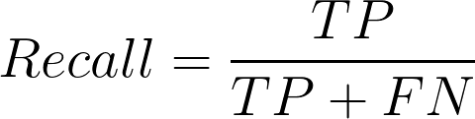
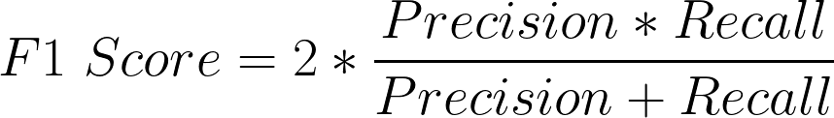
Methodology Contd…
Validation Criteria Cont.…
Recall: It is a measure of actual observations which are predicted correctly. It simply evaluates how many positive classes are actually predicted positively.
F1 Score: F1 score is a number between 0 and 1 and is the harmonic mean of precision and recall.F1 score maintains the balance between Precision and Recall.
Notes:
H(P, Q) = – sum x in X P(x) * log(Q(x))
Crossentropy
Y=g(sum(i=1)to m (xiwi))
Y=g(w0+sum(i=1)to m (xiwi))

Slide 19
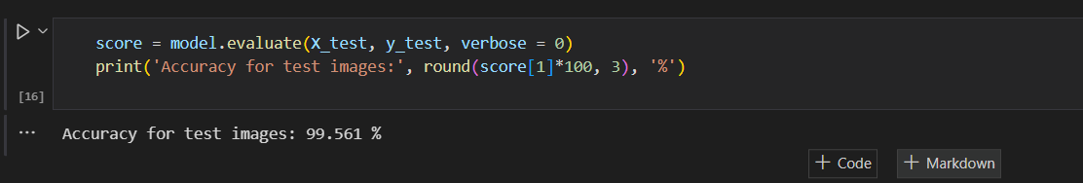
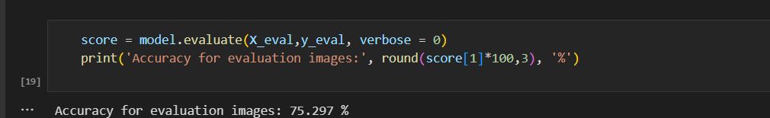
Results, Analysis, and Contributions
We have an evaluation accuracy of 75.297% and a testing accuracy of 99.561% in this project. Because of the similarity of the gesture, the testing accuracy appears to be high.

Slide 20
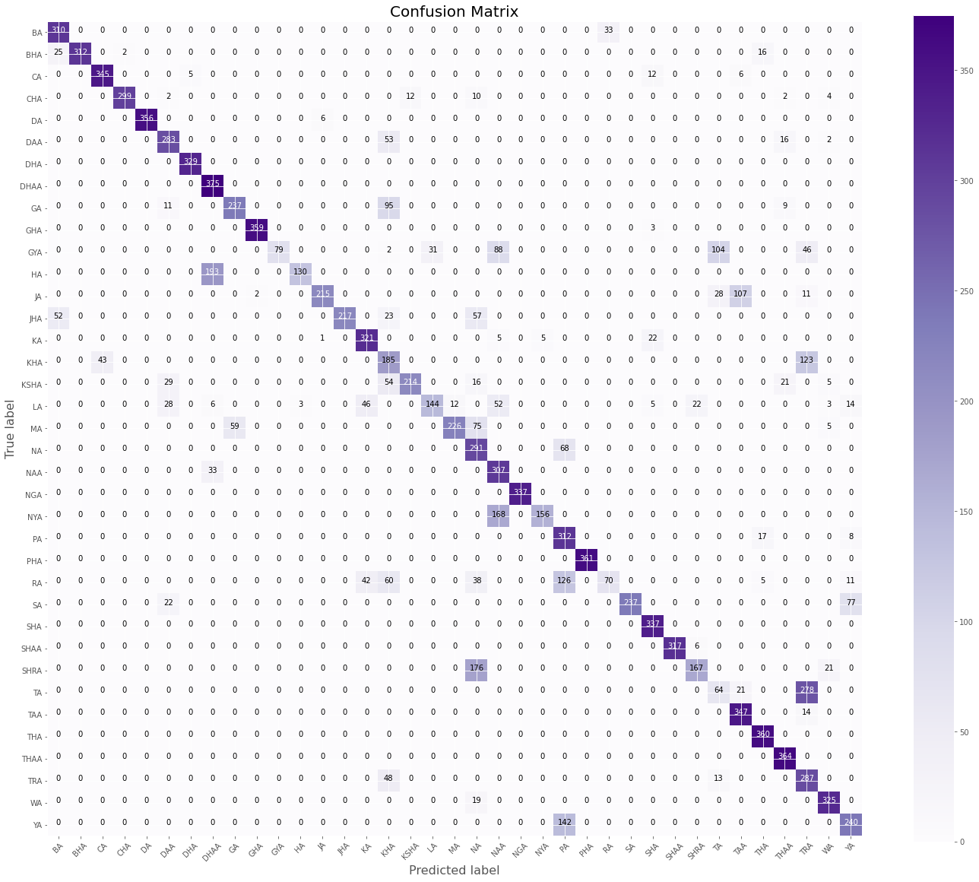
Results and Analysis Contd…

Slide 21
Results and Analysis Contd…
From the confusion matrix ,we are getting the anomalies in some classes: SA , SHA, NYA, GYA, GA, SHRA, TA, THA, RA, WA, TRA, YA these classes were predicted wrongly.
Performance Metrics
Accuracy | Precision | Recall | F1 Score
Macro avg | 82% | 76% | 75%
Weighted avg | 81% | 76% | 75%

Slide 22
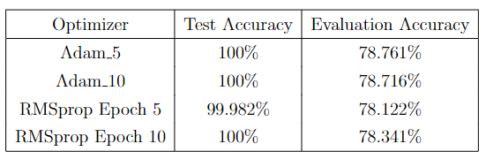
Results and Analysis Contd…
Experiment with Optimizers

Slide 23
Results and Analysis Contd…
Discussion
The model appears to have a 75% evaluation accuracy and 99% testing accuracy, which could be due to the 64x64 resolution and the use of the same hand gesture for multiple alphabets.
The earlier issue of this project is the model incorrectly predicts the majority of the alphabets in this project, which is addressed by generating a large dataset of 77700 with a static background.
In real time prediction due the dynamic background of the image extracting the gesture from that image some how applies the expected output but not like anticipated.

Slide 24
Result and Analysis Contd…
In spite of getting some alphabets wrong we still accomplish to predict majority of alphabets correct.
Since there haven't been many initiatives to recognize Nepali Sign Language up to now, we were able to achieve some results that are marginally superior than the earlier ones.

Slide 25
Result and Analysis Contd…
Limitation:
Does not work well with some alphabets, like SA , SHA, NYA, GYA, GA, SHRA, TA, THA, RA, WA, TRA, YA .
Because of the dynamic background, the accuracy in the live demo is low.

Slide 26
Conclusion
In this project We learned that how sometimes basic approaches work better than complicated approaches. Despite trying to use a complex approach we simply use the normal CNN to classify images and achieved 75% accuracy.
We also noticed the time constraints and difficulties of creating a dataset from scratch, but still end up creating the dataset of 77000 which aids in the achievement of good results.

Slide 27
Future Works
Use of more pixelated images in the future 128*128 size of the input image
Reconstruction of dataset using red-glove approach for testing the system.
The CNN model that we are using has huge parameters, which cam be optimized that aid to better processing and achieving greater accuracy.
In real time prediction in live the image we capture has the random background and the hand gesture may not be right place which will affect the accuracy, hence segmentation of the image can be done to extract the required gesture to predict correctly.

Slide 28
Acknowledgment
We would like to express our sincere gratitude to our supervisor Asst. Prof. Ankit Bhattarai for his guidance and support throughout the work. Our deepest appreciation to our external supervisor Dr. Aman Shakya, the entire team of Cosmos College of Management and Technology, for granting us this valuable opportunity and helping us reach our milestone by giving valuable feedbacks and suggestions.

Slide 29
REFERENCES
[1] Jhuma Sunuwar and Ratika Pradhan. Hand gesture recognition for nepali sign lan- guage using shape information. 3, 2015.
[2] Mujahid Abdullah, Awan Mazhar Javed, Yasin Awais, Mohammed Mazin Abed, Robertas Damaˇseviˇcius, Rytis Maskeli ̄unas, and Karrar Hameed Abdulkareem. Real- time hand gesture recognition based on deep learning yolov3 model. Applied Sciences, 11(9):4164, 2021.
[3] Rasha Amer Kadhim and Muntadher Khamees. A real-time american sign language recognition system using convolutional neural network for real datasets, volume 9. UIKTEN-Association for Information Communication Technology Education and . . 2020.
[4] Abdulwahab A Abdulhussein and Firas A Raheem. Hand gesture recognition of static letters american sign language (asl) using deep learning. Engineering and Technology Journal, 38(6):926–937, 2020.

Slide 30
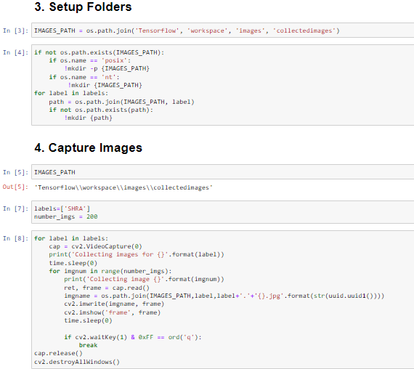
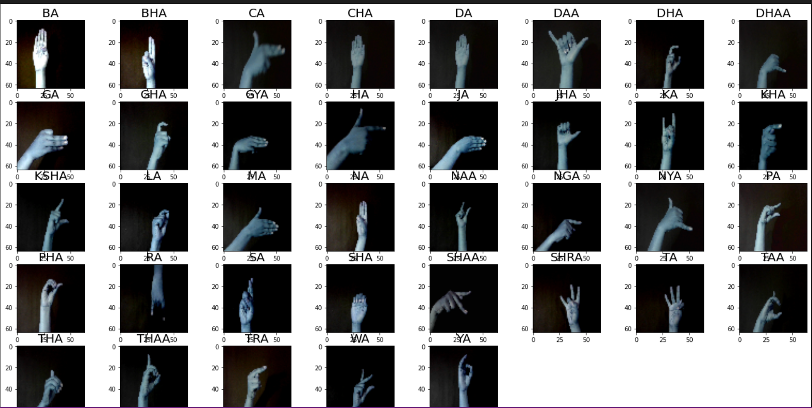
APPENDIX (work snapshots)
Image Collection Process

Slide 31
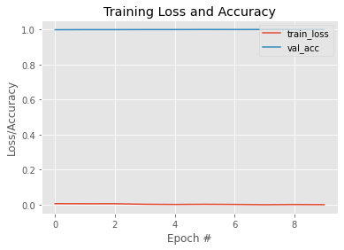
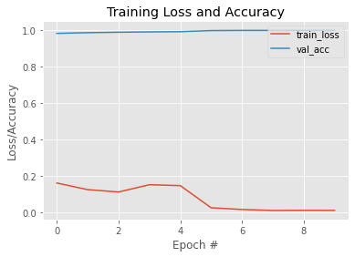
Appendix contd…
Training Loss and Accuracy Plot
Fig: Adam Optimiser
Fig: RMSprop Optimiser

Slide 32
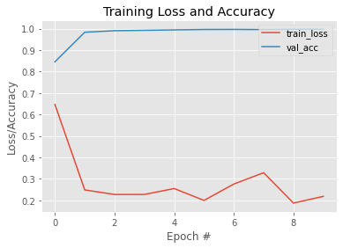
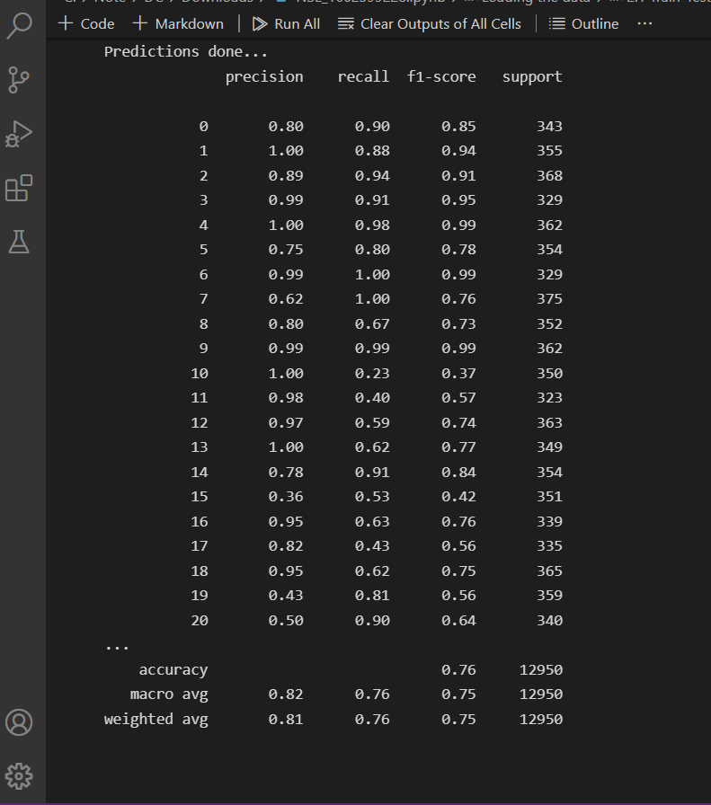
Appendix contd…
fig : Training loss and accuracy curve for evaluation data
Fig: Performance Matrix

Slide 33
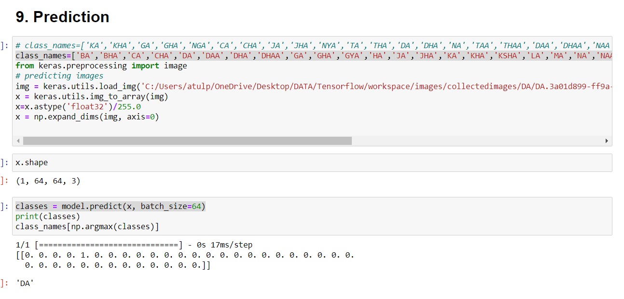
Appendix contd…
Prediction in Real Time

Slide 34



Queries/Comments/Feedback?
THANK YOU!!
Project Group
Project Group
Atul Pokharel
(170308)
Nabin Raj Dhungel
(170322)
Nabin Joshi
(170323)
Rakshya Bhetwal
(170334)

