Slide 1
UNIX ELF File Format
By Atul R. Raut

Slide 2
Elf File Format
The a.out format served the Unix community well for over 10 years.
However, to better support cross-compilation, dynamic linking, initializer/finalizer (e.g., the constructor and destructor in C++) and other advanced system features, a.out has been replaced by the elf file format.
Elf stands for “Executable and Linking Format.”
Elf has been adopted by FreeBSD and Linux as the current standard.
We better learn it.

Slide 3
Elf File Types
Elf defines the format of executable binary files. There are four different types:
Relocatable
Created by compilers or assemblers. Need to be processed by the linker before running.
Executable
Have all relocation done and all symbol resolved except perhaps shared library symbols that must be resolved at run time.
Shared object
Shared library containing both symbol information for the linker and directly runnable code for run time.
Core file
A core dump file.

Slide 4
ELF Structure
Elf files have a dual nature:
Compilers, assemblers, and linkers treat the file as a set of logical sections described by a section header table.
The system loader treats the file as a set of segments described by a program header table.

Slide 5
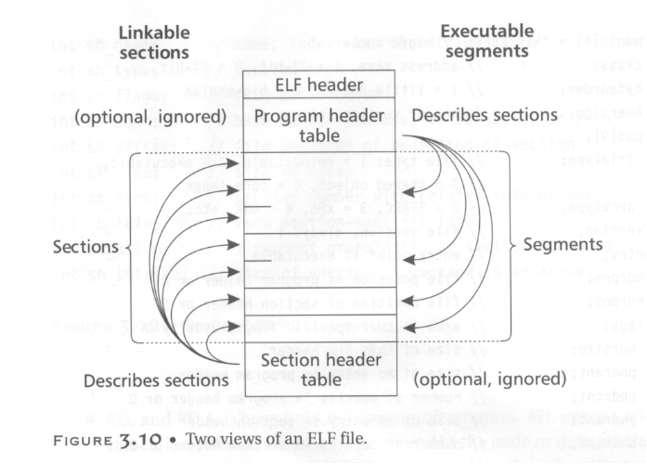

ELF Structure
segments

Slide 6
ELF Structure
A single segment usually consist of several sections. E.g., a loadable read-only segment could contain sections for executable code, read-only data, and symbols for the dynamic linker.
Relocatable files have section header tables. Executable files have program header tables. Shared object files have both.
Sections are intended for further processing by a linker, while the segments are intended to be mapped into memory.

Slide 7
ELF Header
The Elf header is always at offset zero of the file.
The program header table and the section header table’s offset in the file are defined in the ELF header.
The header is decodable even on machines with a different byte order from the file’s target architecture.
After reading class and byteorder fields, the rest fields in the elf header can be decoded.
The elf format can support two different address sizes:
32 bits
64 bits

Slide 8
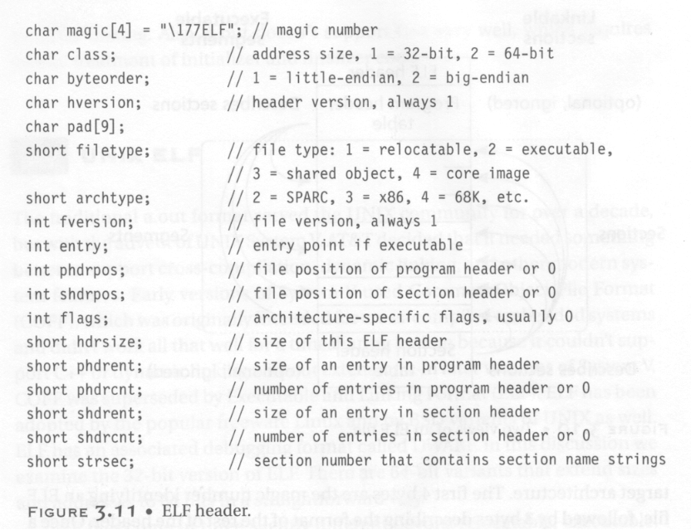

Slide 9
Relocatable Files
A relocatable or shared object file is a collection of sections.
Each section contains a single type of information, such as program code, read-only data,or read/write data, relocation entries,or symbols.
Every symbol’s address is defined relative to a section.
Therefore, a procedure’s entry point is relative to the program code section that contains that procedure’s code.

Slide 10
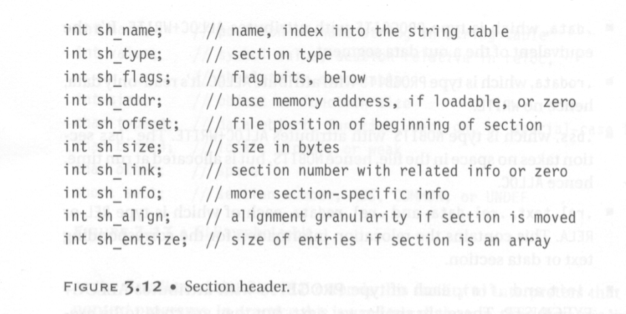
Section Header

Slide 11
Types in Section Header
PROGBITS: This holds program contents including code, data, and debugger information.
NOBITS: Like PROGBITS. However, it occupies no space.
SYMTAB and DYNSYM: These hold symbol table.
STRTAB: This is a string table, like the one used in a.out.
REL and RELA: These hold relocation information.
DYNAMIC and HASH: This holds information related to dynamic linking.

Slide 12
Flags in Section Header
WRITE: This section contains data that is writable during process execution.
ALLOC: This section occupies memory during process execution.
EXECINSTR: This section contains executable machine instructions.

Slide 13
Various Sections
.text:
This section holds executable instructions of a program.
Type: PROGBITS
Flags: ALLOC + EXECINSTR
.data:
This section holds initialized data that contributes to the program’s image.
Type: PROGBITS
Flags: ALLOC + WRITE

Slide 14
Various Sections
.rodata:
This section holds read-only data.
Type: PROGBITS
Flags: ALLOC
.bss :
This section holds uninitialized data that contributed to the program’s image. By definition, the system will initialize the data with zero when the program begins to run.
Type: NOBITS
Flags: ALLOC + WRITE

Slide 15
Various Sections
.rel.text, .rel.data, and .rel.rodata:
These contain the relocation information for the corresponding text or data sections.
Type: REL
Flags: ALLOC is turned on if the file has a loadable segment that includes relocation.
.symtab:
This section hold a symbol table.
.strtab:
This section holds strings.

Slide 16
Various Sections
.init:
This section holds executable instructions that contribute to the process initialization code.
Type: PROGBITS
Flags: ALLOC + EXECINSTR
.fini:
This section hold executable instructions that contribute to the process termination code.
Type: PROGBITS
Flags: ALLOC + EXECINSTR
C does not need these two sections. However, C++ needs them.

Slide 17
Various Sections
.interp:
This section holds the pathname of a program interpreter.
Type: ALLOC
Flags: PROGBITS
If this section is present, rather than running the program directly, the system runs the interpreter and passes it the elf file as an argument.
For many years (used in a.out), UNIX has had self-running interpreted text files, using
#! /bin/csh as the first line of the file.
Elf extends this facility to interpreters that run nontext programs.
In practice, this is used to run the run-time dynamic linker to load the program and to link in any required shared libraries.

Slide 18
Various Sections
.debug:
This section holds symbolic debugging information.
Type: PROGBIT
.line:
This section holds line number information for symbolic debugging, which describes the correspondence between the program source and the machine code (ever used gdb?)
Type: PROGBIT
.comment
This section may store extra information.

Slide 19
Various Sections
.got:
This section holds the global offset table.
We will explain got when we present shared library.
Type: PROGBIT
.plt:
This section holds the procedure linkage table.
Type: PROGBIT
.note:
This section contains some extra information.

Slide 20
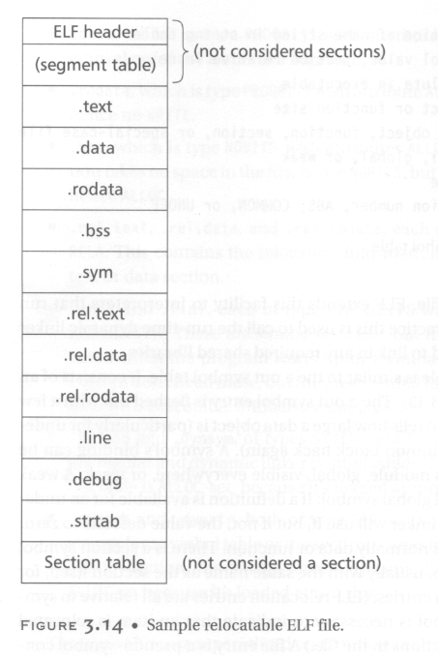
A typical relocatable file.

Slide 21
String Table
Like the format used in a.out.
String table sections hold null-terminated character sequences, commonly called strings.
The object file uses these strings to represent symbol and section names.
We use an index into the string table section to reference a string.
The reason why we separate symbol names from symbol tables is that in C or C++, there is no limitation on the length of a symbol.

Slide 22
Symbol Table
An object file’s symbol table holds information needed to locate and relocate a program’s symbolic definition and references.
A symbol table index is a subscript into this array.

Slide 23
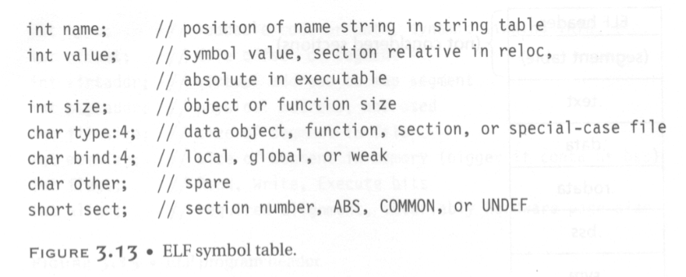

Symbol Table
e.g., int, double
If a definition is available
for an undefined weak
symbol, the linker will use
it. Otherwise, the value
defaults to 0.
The section relative to which the symbol
is defined. (e.g., the function entry points
are defined relative to .text)

Slide 24
Relocation Table
Relocation is the process of connecting symbolic references with symbolic definitions.
Relocatable files must have information that describes how to modify their section contents.
A relocation table consists on many relocation structures.

Slide 25
Relocation Structure
Struct {
R_offset;
This field gives the location at which to apply the relocation.
For a relocatable file, the value is the byte offset from the beginning of the section to the storage unit affect by the relocation.
For an executable file and shared object, the value is the virtual address of the storage unit affected by the relocation.

Slide 26
Relocation Structure
R_info;
This field gives both the symbol table index with respect to which the relocation must be made and the type of relocation to apply.
R_addend;
This field specifies a constant addend used to compute the value to be stored into the relocation field.
}

Slide 27
Executable Files
An executable file usually has only a few segments. E.g.,
A read-only one for the code.
A read-only one for read-only data.
A read/write one for read/write data.
All of the loadable sections are packed into the appropriate segments so that the system can map the file with just one or two operations.
E.g., If there is a .init and .fini sections, those sections will be put into the read-only text segment.

Slide 28
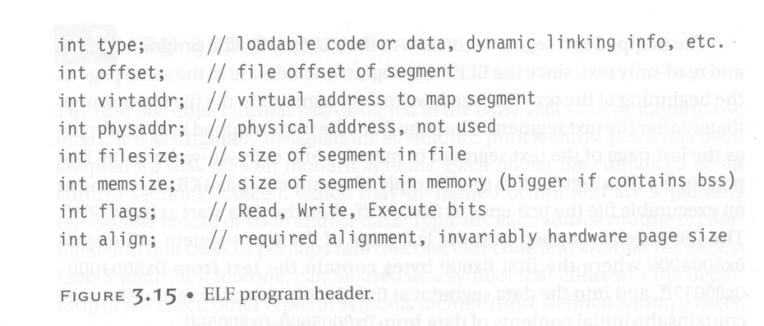
Program Header

Slide 29
The Types in Program Header
This field tells what kind of segment this array element describes:
PT_LOAD: This segment is a loadable segment.
PT_DYNAMIC: This array element specifies dynamic linking information.
PT_INTERP: This element specified the location and size of a null-terminated path name to invoke as an interpreter.

Slide 30
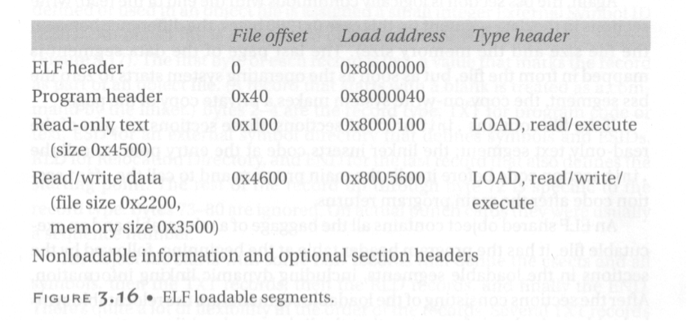

Executable File Example

Slide 31
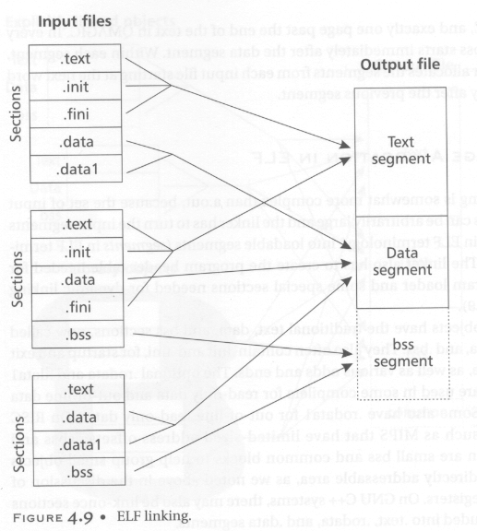
Elf Linking

Slide 32
Elf File Trace (We can use the objdump or nm command)

Slide 33
An Example C Program
int xx, yy;
main()
{
xx = 1;
yy = 2;
printf ("xx %d yy %d\n", xx, yy);
}

Slide 34
ELF Header Information
shieyuan3# objdump -f a.out
a.out: file format elf32-i386
architecture: i386, flags 0x00000112:
EXEC_P, HAS_SYMS, D_PAGED
start address 0x080483dc

Slide 35
Program Header
Program Header:
PHDR off 0x00000034 vaddr 0x08048034 paddr 0x08048034 align 2**2
filesz 0x000000c0 memsz 0x000000c0 flags r-x
INTERP off 0x000000f4 vaddr 0x080480f4 paddr 0x080480f4 align 2**0
filesz 0x00000019 memsz 0x00000019 flags r--
LOAD off 0x00000000 vaddr 0x08048000 paddr 0x08048000 align 2**12
filesz 0x00000564 memsz 0x00000564 flags r-x
LOAD off 0x00000564 vaddr 0x08049564 paddr 0x08049564 align 2**12
filesz 0x000000a8 memsz 0x000000cc flags rw-
DYNAMIC off 0x0000059c vaddr 0x0804959c paddr 0x0804959c align 2**2
filesz 0x00000070 memsz 0x00000070 flags rw-
NOTE off 0x00000110 vaddr 0x08048110 paddr 0x08048110 align 2**2
filesz 0x00000018 memsz 0x00000018 flags r--

Slide 36

Dynamic Section
Dynamic Section:
NEEDED libc.so.4
INIT 0x8048390
FINI 0x8048550
HASH 0x8048128
STRTAB 0x80482c8
SYMTAB 0x80481b8
STRSZ 0xad
SYMENT 0x10
DEBUG 0x0
PLTGOT 0x8049584
PLTRELSZ 0x18
PLTREL 0x11
JMPREL 0x8048378
Need to link this shared library
for printf()

Slide 37
Section Header
Sections:
Idx Name Size VMA LMA File off Algn
0 .interp 00000019 080480f4 080480f4 000000f4 2**0
CONTENTS, ALLOC, LOAD, READONLY, DATA
1 .note.ABI-tag 00000018 08048110 08048110 00000110 2**2
CONTENTS, ALLOC, LOAD, READONLY, DATA
2 .hash 00000090 08048128 08048128 00000128 2**2
CONTENTS, ALLOC, LOAD, READONLY, DATA
3 .dynsym 00000110 080481b8 080481b8 000001b8 2**2
CONTENTS, ALLOC, LOAD, READONLY, DATA
4 .dynstr 000000ad 080482c8 080482c8 000002c8 2**0
CONTENTS, ALLOC, LOAD, READONLY, DATA
5 .rel.plt 00000018 08048378 08048378 00000378 2**2
CONTENTS, ALLOC, LOAD, READONLY, DATA
6 .init 0000000b 08048390 08048390 00000390 2**2
CONTENTS, ALLOC, LOAD, READONLY, CODE
7 .plt 00000040 0804839c 0804839c 0000039c 2**2
CONTENTS, ALLOC, LOAD, READONLY, CODE
8 .text 00000174 080483dc 080483dc 000003dc 2**2 CONTENTS, ALLOC, LOAD, READONLY, CODE

Slide 38
Section Header (cont’d)
9 .fini 00000006 08048550 08048550 00000550 2**2
CONTENTS, ALLOC, LOAD, READONLY, CODE
10 .rodata 0000000e 08048556 08048556 00000556 2**0
CONTENTS, ALLOC, LOAD, READONLY, DATA
11 .data 0000000c 08049564 08049564 00000564 2**2
CONTENTS, ALLOC, LOAD, DATA
12 .eh_frame 00000004 08049570 08049570 00000570 2**2
CONTENTS, ALLOC, LOAD, DATA
13 .ctors 00000008 08049574 08049574 00000574 2**2
CONTENTS, ALLOC, LOAD, DATA
14 .dtors 00000008 0804957c 0804957c 0000057c 2**2
CONTENTS, ALLOC, LOAD, DATA
15 .got 00000018 08049584 08049584 00000584 2**2
CONTENTS, ALLOC, LOAD, DATA
16 .dynamic 00000070 0804959c 0804959c 0000059c 2**2
CONTENTS, ALLOC, LOAD, DATA
17 .bss 00000024 0804960c 0804960c 0000060c 2**2
ALLOC
18 .stab 000001bc 00000000 00000000 0000060c 2**2
CONTENTS, READONLY, DEBUGGING
19 .stabstr 00000388 00000000 00000000 000007c8 2**0
CONTENTS, READONLY, DEBUGGING
20 .comment 000000c8 00000000 00000000 00000b50 2**0

Slide 39
Symbol Table
SYMBOL TABLE:
080480f4 l d .interp 00000000
08048110 l d .note.ABI-tag 00000000
08048128 l d .hash 00000000
080481b8 l d .dynsym 00000000
080482c8 l d .dynstr 00000000
08048378 l d .rel.plt 00000000
08048390 l d .init 00000000
0804839c l d .plt 00000000
080483dc l d .text 00000000
08048550 l d .fini 00000000
08048556 l d .rodata 00000000
08049564 l d .data 00000000
08049570 l d .eh_frame 00000000
08049574 l d .ctors 00000000
0804957c l d .dtors 00000000
08049584 l d .got 00000000
0804959c l d .dynamic 00000000

Slide 40
Symbol Table (cont’d)
0804960c l d .bss 00000000
00000000 l d .stab 00000000
00000000 l d .stabstr 00000000
00000000 l d .comment 00000000
00000000 l d .note 00000000
00000000 l d *ABS* 00000000
00000000 l d *ABS* 00000000
00000000 l d *ABS* 00000000
00000000 l df *ABS* 00000000 crtstuff.c
08048460 l .text 00000000 gcc2_compiled.
08049568 l O .data 00000000 p.3
0804957c l O .dtors 00000000 __DTOR_LIST__
0804956c l O .data 00000000 completed.4
08048460 l F .text 00000000 __do_global_dtors_aux
08049570 l O .eh_frame 00000000 __EH_FRAME_BEGIN__

Slide 41
Symbol Table (cont’d)
080484b4 l F .text 00000000 fini_dummy
0804960c l O .bss 00000018 object.11
080484bc l F .text 00000000 frame_dummy
080484e0 l F .text 00000000 init_dummy
08049570 l O .data 00000000 force_to_data
08049574 l O .ctors 00000000 __CTOR_LIST__
00000000 l df *ABS* 00000000 crtstuff.c
08048520 l .text 00000000 gcc2_compiled.
08048520 l F .text 00000000 __do_global_ctors_aux
08049578 l O .ctors 00000000 __CTOR_END__
08048548 l F .text 00000000 init_dummy
08049570 l O .data 00000000 force_to_data
08049580 l O .dtors 00000000 __DTOR_END__
08049570 l O .eh_frame 00000000 __FRAME_END__
00000000 l df *ABS* 00000000 p10.c
080483ac F *UND* 00000031 printf
0804959c g O *ABS* 00000000 _DYNAMIC
08048550 g O *ABS* 00000000 _etext
08048390 g F .init 00000000 _init
08049624 g O .bss 00000004 environ
00000000 w *UND* 00000000 __deregister_frame_info
08049630 g O *ABS* 00000000 end
08049628 g O .bss 00000004 xx

Slide 42
Symbol Table (cont’d)
08049564 g O .data 00000004 __progname
080483dc g F .text 00000083 _start
0804960c g O *ABS* 00000000 __bss_start
080484e8 g F .text 00000038 main
08048550 g F .fini 00000000 _fini
0804962c g O .bss 00000004 yy
080483bc F *UND* 00000070 atexit
0804960c g O *ABS* 00000000 _edata
08049584 g O *ABS* 00000000 _GLOBAL_OFFSET_TABLE_
08049630 g O *ABS* 00000000 _end
080483cc F *UND* 0000005b exit
00000000 w *UND* 00000000 __register_frame_info

Slide 43
Dynamic Symbol Table
DYNAMIC SYMBOL TABLE:
080483ac DF *UND* 00000031 printf
0804959c g DO *ABS* 00000000 _DYNAMIC
08048550 g DO *ABS* 00000000 _etext
08048390 g DF .init 00000000 _init
08049624 g DO .bss 00000004 environ
00000000 w D *UND* 00000000 __deregister_frame_info
08049630 g DO *ABS* 00000000 end
08049564 g DO .data 00000004 __progname
0804960c g DO *ABS* 00000000 __bss_start
08048550 g DF .fini 00000000 _fini
080483bc DF *UND* 00000070 atexit
0804960c g DO *ABS* 00000000 _edata
08049584 g DO *ABS* 00000000 _GLOBAL_OFFSET_TABLE_
08049630 g DO *ABS* 00000000 _end
080483cc DF *UND* 0000005b exit
00000000 w D *UND* 00000000 __register_frame_info

Slide 44
Debugging Information
int main ()
{ /* 0x80484e8 */
} /* 0x80484e8 */
int main ()
{ /* 0x80484e8 */
/* file /usr/home/shieyuan/test/p10.c line 3 addr 0x80484ee */
/* file /usr/home/shieyuan/test/p10.c line 5 addr 0x80484ee */
/* file /usr/home/shieyuan/test/p10.c line 6 addr 0x80484f8 */
/* file /usr/home/shieyuan/test/p10.c line 7 addr 0x8048502 */
/* file /usr/home/shieyuan/test/p10.c line 8 addr 0x804851e */
/* file /usr/home/shieyuan/test/p10.c line 8 addr 0x804851e */
} /* 0x8048520 */
int xx /* 0x8049628 */;
int yy /* 0x804962c */;

Slide 45
Dynamic Relocation Table
DYNAMIC RELOCATION RECORDS
OFFSET TYPE VALUE
08049590 R_386_JUMP_SLOT printf
08049594 R_386_JUMP_SLOT atexit
08049598 R_386_JUMP_SLOT exit

