Slide 1


SMART INDIA HACKATHON 2025
TITLE PAGE
Problem Statement ID – SIH25267
Problem Statement Title:- Developing more efficient jute Ribboner Machine to extract fibre for enhancing in-situ retting technology
Theme- Agriculture & Rural Development
PS Category- Hardware
Team ID- 83032
Team Name- Kisan Sarthi

Slide 2
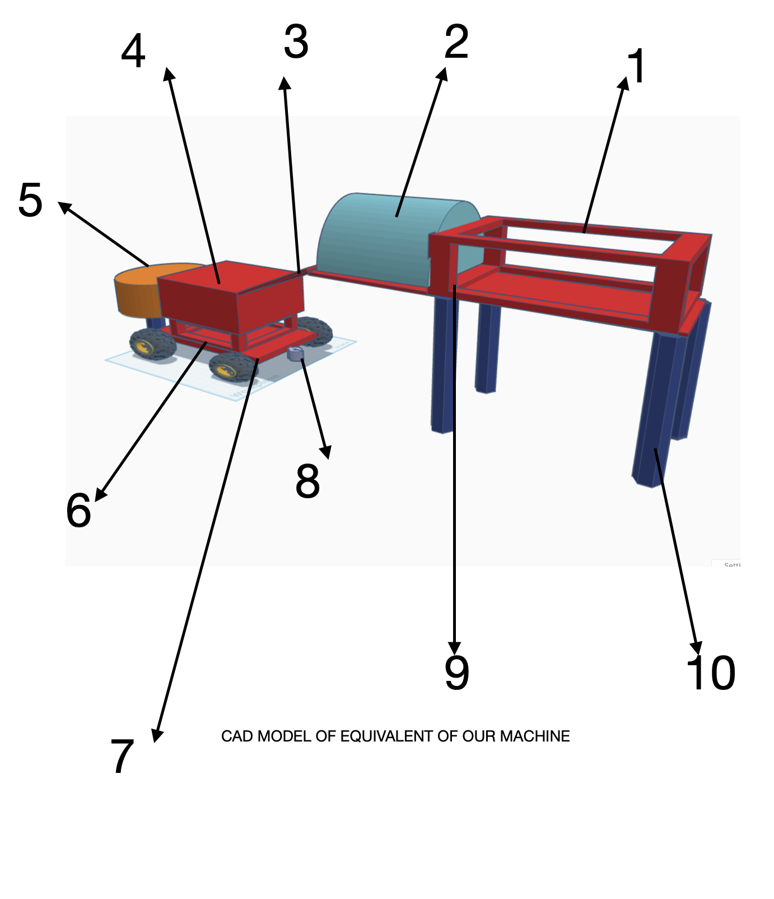
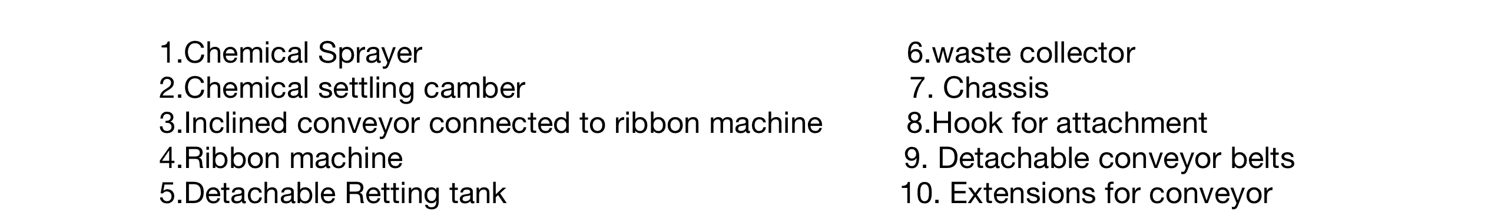
IDEA TITLE
Kisan Sarthi
Proposed Solution:
Pre-treatment of the Jute Barks:
The bark of the jute plant is pre-treated with ICAR-recommended chemicals to ease ribboning. A detachable spraying unit applies an ammonium oxalate and sodium sulphate solution to soften the bark without causing any damage.
Made more efficient and effective Ribbon cutter:
After the pre-treatment, the bark is allowed to rest briefly to ensure proper softening for ribboning. The cutting gears are designed with sharp edges to precisely separate about 15% of the bark containing the outer fibre layers. A dedicated chamber is provided at the bottom of the machine for efficient waste bark collection. The power distribution system is optimized to ensure effective energy utilization during ribbon cutting. Additionally, a separating chamber is integrated to guide the extracted ribbons directly to the retting tank.
Adjustable Conveyer belts :
All the conveyer belts that we have used including the chemical sprayer can be removed and attached again as per the need , minimizing the space and making transportation easy.
Hybrid power systems:
The system is equipped with an MCU(Micro-Controller based unit) capable of handling multiple operations. It includes signal detection chambers linked to power units, allowing the MCU to identify whether an electric or diesel source is connected. This ensures optimized workflow and provides warnings in case of incorrect or multiple power connections..
Attachable Retting tank with suitable measures:
We made a small retting tank at the end of the machine so which is also removable, and new tanks of similar sizes can be placed which helps in proper utilization of water . These tanks are treated by the chemicals suggested by ICAR and other research teams like Ammonium oxalate and Sodium sulphate making retting easy.
Easy Transportation:
This whole machine is fit on wheels which can be easily transported by the hook that can be attached to a tractor and can be easily navigated to different places.

Slide 3
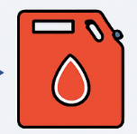






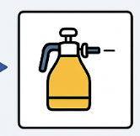





TECHNICAL APPROACH
Kisan Sarthi
Technologies Required:
Flow of work:
1. Core Hardware Components
•Microcontroller Unit (MCU) — Raspberry Pi
•Motor Driver Modules — L298N, BTS7960, or DRV8833 (depending on motor size).
•Sensors (for feedback and monitoring):
Load sensors / strain gauges (to detect overloading)
Vibration or damping sensors
Temperature sensors (To check temperature and for arrangement of heatsinks )
RPM sensors / Hall effect sensors (for motor inspection)
•Input Buttons / Keypad — for manual operation and control.
•LCD Display / TFT Display — 16x2 LCD, 20x4 LCD, or 2.4” TFT touch display.
•Conveyor Belt Motor System — with motor and belt assembly.
•Chemical Sprayer Unit — solenoid-controlled or pump-driven system.
2. Embedded System Technologies
• C / C++ / MicroPython Programming
• Real-Time Operating System (RTOS)
• Sensor Calibration Algorithms — for precise overload/damping detection.
• Signal Conditioning Circuits — operational amplifiers, filters for sensor signals.
• PWM (Pulse Width Modulation) — for motor control and power regulation.
3. Power & Control Systems
• Power Signal Detection Circuits — to differentiate diesel and electric sources.
• Voltage Regulators (LM7805, LM317) — for stable MCU power.
• Battery Management System (BMS) — if battery operation is needed.
• Isolation Techniques — optocouplers or isolation amplifiers for signal safety.
4. Communication and Connectivity
• Serial Communication (UART / SPI / I²C) — between MCU and peripherals.
5. Software and Simulation Tools
•MPLAB X IDE — for coding and flashing MCU.
•MATLAB Simulink — for circuit simulation and validation.
•EAGLE / KiCad / Altium Designer — for PCB design (if making a custom board).
6. Mechanical & Auxiliary Systems
• Conveyor System Assembly — rollers, motor mount, frame.
• Engine Coupling Mechanism — to connect MCU control to engine systems.
• Sprayer Mechanism — with pump, nozzles, and pressure regulation.
7. Safety and Protection
• Fuses and Circuit Breakers
• Overcurrent and Overload Protection Circuits
• Emergency Stop Switch
MCU
(Microcontroller)
Power unit signal detection
Diesel as power
Electric energy as power
Motor driver
Conveyor Belts
Control of Engine in the Ribbon Machine Core
Signals for the chemical sprayer
Input Buttons for operation
Signals need to be taken from sensors to indicate operation for user at different stages to get rid of over loading and over damping.
LCD Screen for display of working of engine and the supplied power
Technologies used:

Slide 4




FEASIBILITY AND VIABILITY
Kisan Sarthi
Technical :
•Feasibility: Proven tech—Raspberry-Pi is efficient enough to handle the tasks along with good signal processing units.
•Risks: Errors caused in the signals from sensors and signal processing units and delays in DSP units.
•Solutions: Designing efficient filters.
Financial :
•Feasibility: Viable—ROI through yield gains + policy support.
•Risks: A bit high maintenance costs
•Solutions: Regular maintenance checks and inspection
Operational :
•Feasibility: Practical with phased deployment + personalized
engagement.
•Risks: May to new for farmers to adapt.
•Solutions: Giving elementary training regarding the operation of machine to the farmers.
Legal / Regulatory :
Legally sound—aligns with govt. digital agriculture goals.
Supports National Mission on Natural Fibre Technologies and related agricultural policies.

Slide 5








IMPACT AND BENEFITS
Kisan Sarthi
Increased Fibre Yield & Farmer Income
Water Conservation & Faster Retting
Portability & Power Flexibility
Improved Fibre Quality
Enhanced ribbon extraction efficiency (up to 90%) and reduced fibre breakage directly increase total fibre yield and farmer profitability.
Ribbon retting saves up to 70% water and cuts retting time by 4–5 days, promoting sustainable jute farming in dry months.
Compact, lightweight design attachable to tractors or power tillers; supports electric, diesel, or PTO operation for field mobility.
Uniform extraction with optimized roller control ensures better fibre strength, colour, and lustre — boosting export market value.
Cost-Effective & Scalable Solution
Eco-Friendly & Sustainable Mechanization
Reduced Labour & Manual Effort
Empowering Rural Entrepreneurship
Affordable modular design suited for small farmers. Scalable models for cooperatives and agro-based industries.
Reduces stagnant water retting and methane emissions, promotes climate-resilient jute production aligned with green farming goals.
Automated/semi-automated feeding minimizes manual work, improves safety, and allows faster continuous processing of jute bundles.
Supports creation of local ribboning units and SHGs, generating rural employment and sustainable income opportunities.

Slide 6
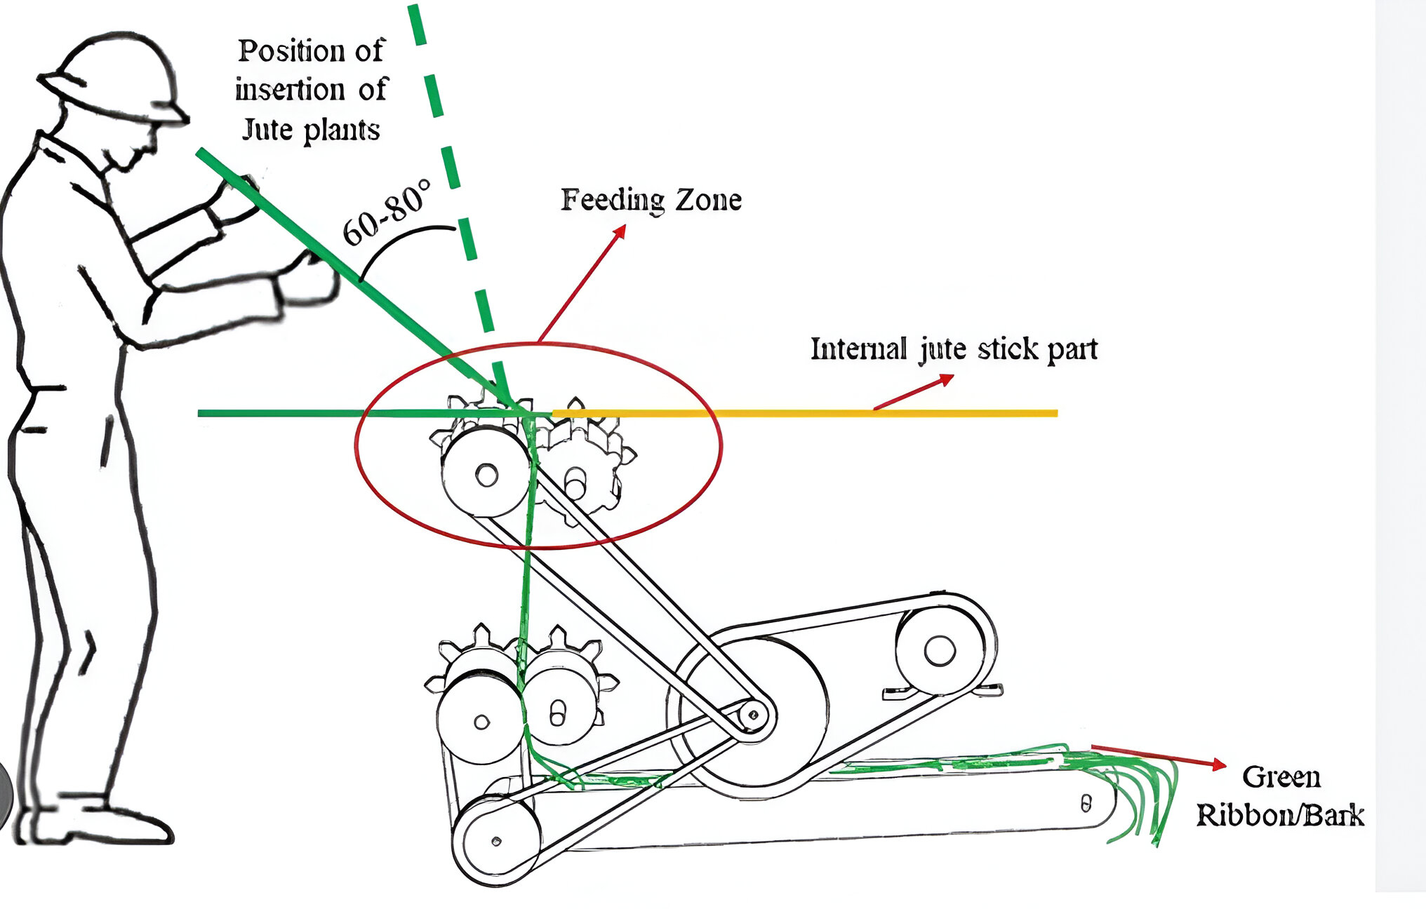
RESEARCH AND REFERENCES
Kisan Sarthi
References & Supporting Research
Mechanical and Biochemical Methods for Bast Fibre Extraction — ICRISAT
Power-Operated Jute Ribboning Machine — QuickCompany
ICAR Research on Mechanized Jute Fibre Extraction — JAEM Journal
Core and Interior Structure of the Machine

