Slide 1

B.Tech 6th Semester Minor project Presentation
“TripSmart: Smart Trip Planning Application”
Presented by:
Prakhar Bansal
(2303051051227)
Sathvik Merugu
(23030512040308)
Rudrax Rana
(2303051240187)
Atul Singh
(230305105
Supervisors:
Mr. Janmejay Kumar Vishwakarma Sir
PARUL INSTITUTE OF TECHNOLOGY, PARUL UNIVERSITY
NAME OF THE INSTITUTE, PARUL UNIVERSITY

Slide 2
Content of Presentation
Abstract
Introduction
Problem Statement
Literature Review (if any)
Proposed Methodology
Project Module
Use case diagram/ER diagram/Flow diagram
Hardware and software Requirement
Excepted Outcome of the Project
Limitation
Conclusion and Future Work
References
NAME OF THE INSTITUTE, PARUL UNIVERSITY
NAME OF THE INSTITUTE, PARUL UNIVERSITY

Slide 3
Key Points:
Integrates real Indian Railways data (2,533+ trains) with actual timings and routes
Searches 9,234+ hotels across major Indian cities
Uses Priority-based Backtracking Algorithm with dynamic budget allocation
Generates budget-optimized plans across three tiers: Budget, Comfort, and Premium
Achieves efficient search (~450 combinations) enabling real-time trip optimization
Provides complete day-by-day itineraries including transport, accommodation, meals, and activities
Abstract
NAME OF THE INSTITUTE, PARUL UNIVERSITY
NAME OF THE INSTITUTE, PARUL UNIVERSITY

Slide 4
Introduction
Frontend Technology Stack:
React 18 - Modern JavaScript library for building user interfaces
TypeScript - Type-safe JavaScript for robust code
Vite - Next-generation frontend build tool
Tailwind CSS - Utility-first CSS framework
shadcn/ui - High-quality UI component library
Lucide React - Icon library
Backend Technology Stack:
Node.js - JavaScript runtime environment
Express.js - Fast, minimal web framework
MongoDB - NoSQL database for user data
JSON Data Files - For trains and hotels data
RESTful API - API architecture pattern
NAME OF THE INSTITUTE, PARUL UNIVERSITY
NAME OF THE INSTITUTE, PARUL UNIVERSITY

Slide 5
Introduction
Aim and Objectives
Aim:
To develop an intelligent trip planning system that automatically generates cost-effective and personalized travel itineraries for users traveling within India.
Objectives:
Automate Trip Planning - Eliminate manual research for transport, hotels, and activities
Budget Optimization - Generate plans that maximize value within user's budget
Real Data Integration - Use actual Indian Railways data with accurate timings
Multi-tier Options - Provide Budget, Comfort, and Premium plan alternatives
Time Efficiency - Generate comprehensive plans in under 20 milliseconds
User Experience - Deliver intuitive interface with visual itinerary presentation
Constraint Handling - Respect timeline feasibility (hotel check-in/out, transport schedules)
NAME OF THE INSTITUTE, PARUL UNIVERSITY
NAME OF THE INSTITUTE, PARUL UNIVERSITY

Slide 6
Problem Statement
Problem Statement
Current Challenges in Trip Planning:
Time-Consuming Research
  Users spend hours comparing flights, trains, hotels, and activities separately
  No unified platform for complete trip planning
Budget Management Difficulty
  Hard to track total costs across multiple bookings
  Often exceeds planned budget due to hidden costs
Lack of Optimization
  Existing platforms don't optimize for best value
  No intelligent suggestion based on preferences
Scattered Information
  Train schedules, hotel availability, and attractions on different websites
  No consolidated view of complete trip
Timeline Conflicts
  Manual coordination between transport arrival and hotel check-in times
  Risk of infeasible itineraries
Our Solution:
An AI-powered system that solves all these problems by generating optimized, feasible trip plans within budget constraints.
NAME OF THE INSTITUTE, PARUL UNIVERSITY
NAME OF THE INSTITUTE, PARUL UNIVERSITY

Slide 7
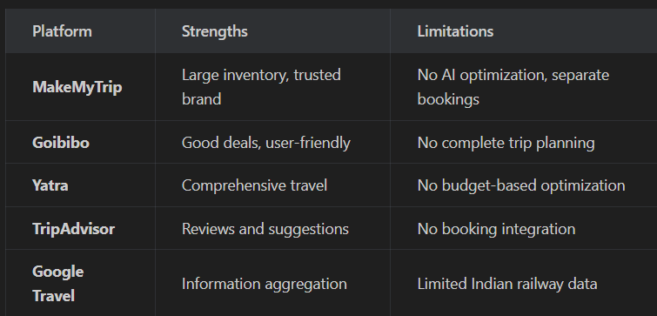
Literature Review
Existing Systems Analysis:
Research Gap:
No existing platform combines AI-based optimization with real Indian Railways data
Existing solutions lack constraint satisfaction for timeline feasibility
No system provides tiered budget options with automatic optimization
Technologies Studied:Priority-based Backtracking for budget optimization
Dynamic Budget Allocation across transport, accommodation, meals, activities
React ecosystem for modern web applications
Pareto-optimal selection for diverse results
React ecosystem for modern web applications
NAME OF THE INSTITUTE, PARUL UNIVERSITY
NAME OF THE INSTITUTE, PARUL UNIVERSITY

Slide 8
Proposed Methodology
Proposed Methodology
Algorithm: Priority based backtracking algorithm – checks all the combinations requested by the user
Step 1: Data Collection
Load 2,533 trains from EXP-TRAINS.json
Load 9,234 hotels from hotel_details.csv
Fetch city attractions and activities
Step 2: Pre-Filtering (Constraint Propagation)
Allocate budget: ~40% transport, ~30% accommodation, ~15% meals, ~15% activities
Filter options within allocated budget per category
Prune infeasible combinations through backtracking
Step 3: Priority-based Scoring
Score plans based on category weights
Backtrack from lowest priority (activities) to highest (transport) when over budget
Maximize budget utilization within constraints
NAME OF THE INSTITUTE, PARUL UNIVERSITY
NAME OF THE INSTITUTE, PARUL UNIVERSITY

Slide 9
Proposed Methodology
Step 4: Backtracking Search
Start with highest priority options in each category
Backtrack from activities → meals → accommodation → transport when over budget
Step 5: Combination Generation
Generate feasible combinations (transport × hotel × meal × activity)
Approximately 450 combinations for typical search
Step 6: Budget Validation
Calculate total cost for each combination
Filter combinations within user's budget
Step 7: Plan Scoring & Selection
Score plans by category weights (Transport 40%, Accommodation 30%, etc.)
Select top plans across Budget, Comfort, and Premium tiers
NAME OF THE INSTITUTE, PARUL UNIVERSITY
NAME OF THE INSTITUTE, PARUL UNIVERSITY

Slide 10
Project Modules
Module 1: User Authentication
User registration and login
JWT-based session management
Password encryption with bcrypt
Module 2: City & Transport Search
Search trains using station codes and city names
Flight search with multiple class options
Real-time availability checking
Module 3: Hotel Search
Filter by star rating (1-5 stars)
Sort by price, rating, location
Room availability for travelers
NAME OF THE INSTITUTE, PARUL UNIVERSITY
NAME OF THE INSTITUTE, PARUL UNIVERSITY

Slide 11
Project Modules
Module 4: Trip Planning Engine
Priority-based Backtracking algorithm
Multi-tier plan generation
Budget allocation across categories
Module 5: Itinerary Generator
Day-by-day activity scheduling
Meal recommendations
Local transport suggestions
Module 6: Results Display
Interactive plan comparison
Expandable cost breakdowns
Plan selection and details view
NAME OF THE INSTITUTE, PARUL UNIVERSITY
NAME OF THE INSTITUTE, PARUL UNIVERSITY

Slide 12
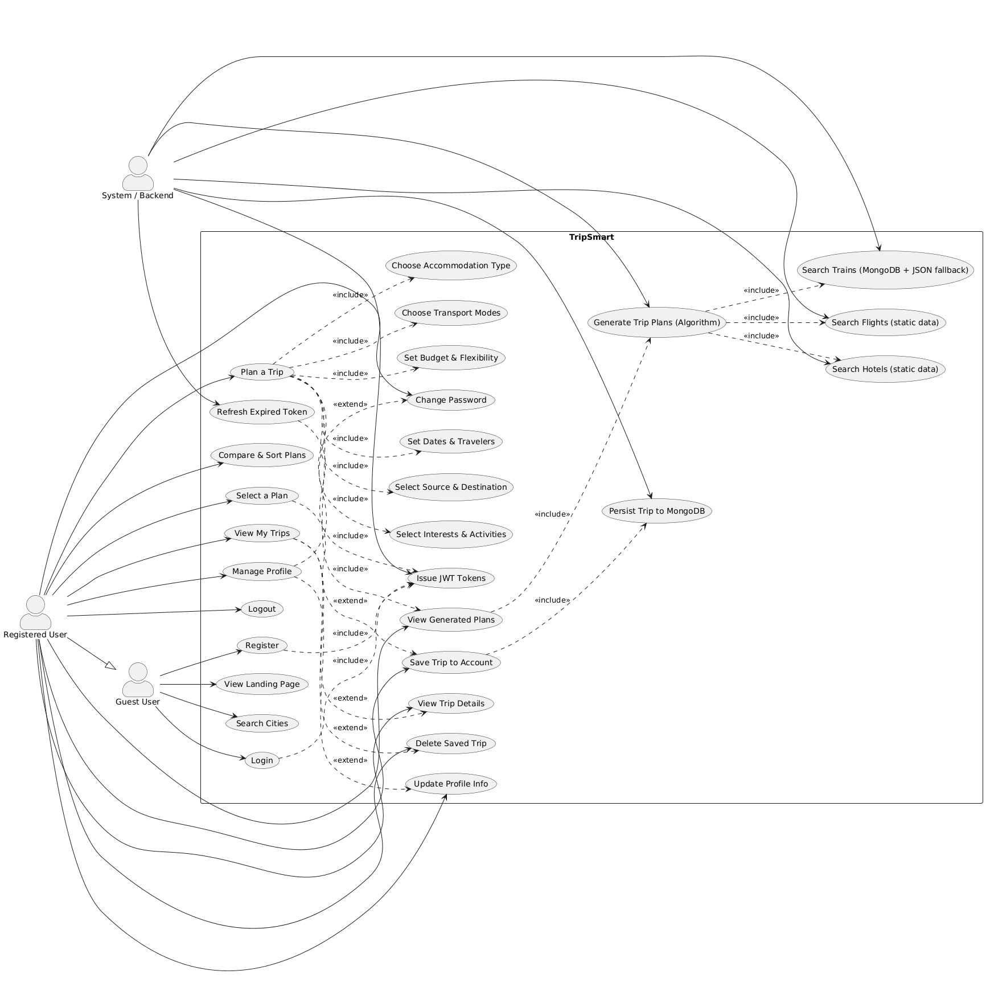
Use Case Diagram
NAME OF THE INSTITUTE, PARUL UNIVERSITY
NAME OF THE INSTITUTE, PARUL UNIVERSITY

Slide 13
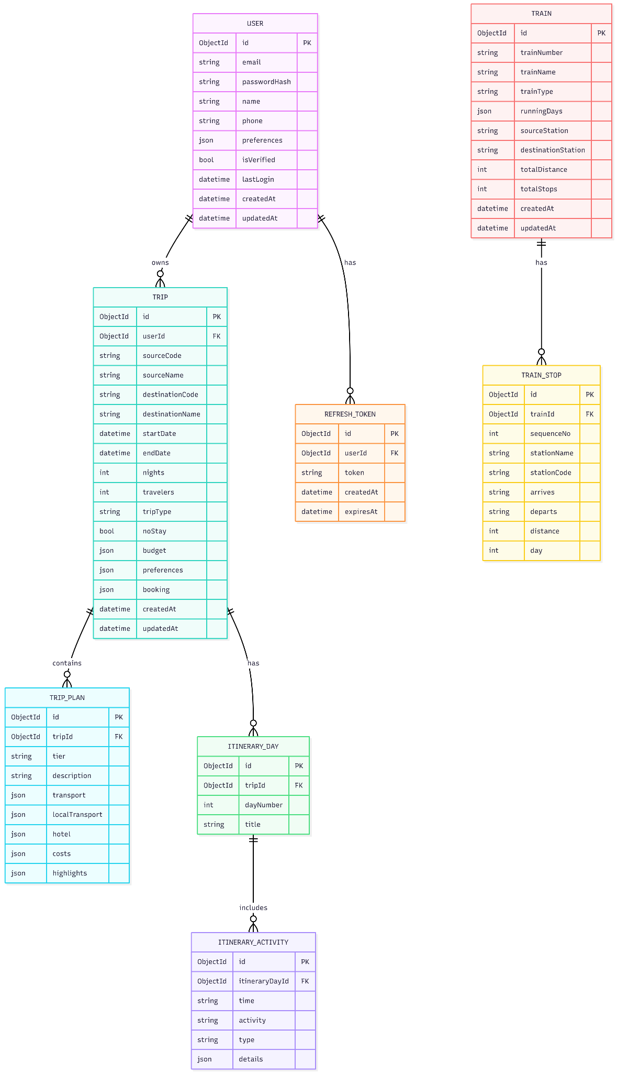
ER Diagram / Data Model
NAME OF THE INSTITUTE, PARUL UNIVERSITY
NAME OF THE INSTITUTE, PARUL UNIVERSITY

Slide 14
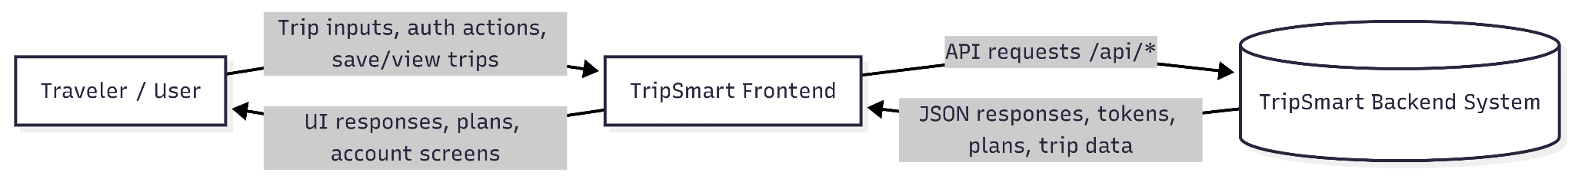
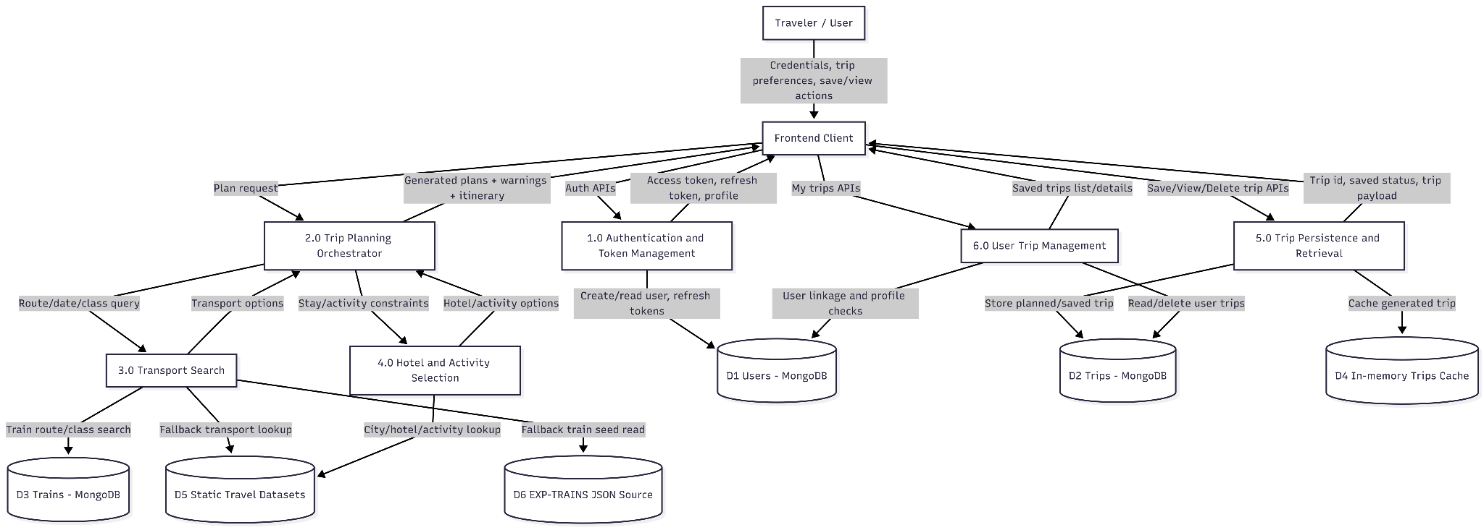
System Architecture / Flow Diagram
Level - 0
Level - 1
NAME OF THE INSTITUTE, PARUL UNIVERSITY
NAME OF THE INSTITUTE, PARUL UNIVERSITY

Slide 15
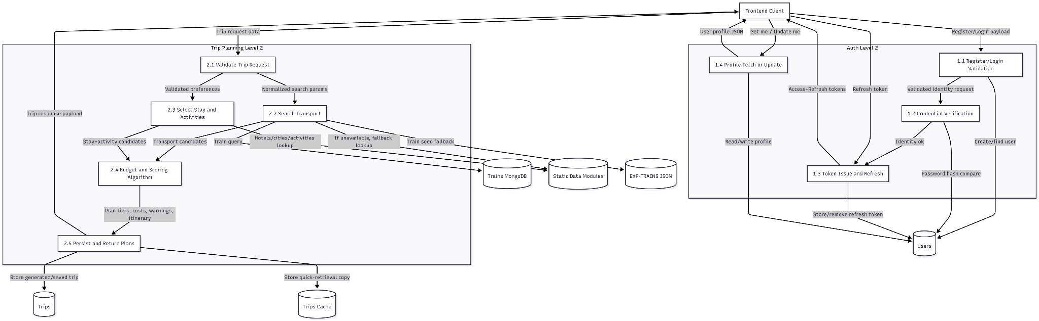
System Architecture / Flow Diagram
Level - 2

Slide 16
Hardware and Software Requirements
Hardware Requirements:
Component | Minimum | Recommended
Processor | Intel i3 / AMD Ryzen 3 | Intel i5 / AMD Ryzen 5
RAM | 4 GB | 8 GB
Storage | 500 MB free space | 1 GB free space
Internet | 1 Mbps | 10 Mbps
Display | 1366 x 768 | 1920 x 1080
Software Requirements:
Software | Version
Node.js | 18.x or higher
npm | 9.x or higher
MongoDB | 6.0 or higher
Git | 2.x
VS Code | Latest
NAME OF THE INSTITUTE, PARUL UNIVERSITY
NAME OF THE INSTITUTE, PARUL UNIVERSITY

Slide 17
Expected Outcome
Expected Outcome of the Project
Functional Outcomes:
Complete Trip Plans in Seconds
  Generate 3-5 optimized plans real-time – Generates trips for all the travel options
  Cover transport, hotels, meals, and activities
Budget Optimization
  Plans stay within user's specified budget (±10%)
  Clear cost breakdown by category
Diverse Options
  Budget Saver: Lowest cost option
  Comfort Plan: Best value for money
  Premium Plan: Highest quality experience
Accurate Train Data
  Real Indian Railways schedules
  Correct departure/arrival times
  Available class information
User-Friendly Interface
  Intuitive trip planning form
  Visual comparison of plans
NAME OF THE INSTITUTE, PARUL UNIVERSITY
NAME OF THE INSTITUTE, PARUL UNIVERSITY

Slide 18
Limitations
Current Limitations:
Geographic Scope
  Currently limited to domestic travel within India only
  International destinations not supported
Real-time Availability
  Train/hotel availability is simulated, not real-time
  Actual booking requires third-party integration
Payment Integration
  No direct booking or payment functionality
  Users must book through respective platforms
Dynamic Pricing
  Prices are based on static data
  Pricing doesn’t integrate with live market rates
Limited Transport Modes
  Transport schedules are static from static datasets
  No live seat/room availability
Offline Functionality
  Requires internet connection
  No offline mode available
NAME OF THE INSTITUTE, PARUL UNIVERSITY
NAME OF THE INSTITUTE, PARUL UNIVERSITY

Slide 19
Conclusion and Future Work
Conclusion:
TripSmart successfully demonstrates an AI-powered approach to trip planning that:
Reduces planning time from hours to seconds
Optimizes budgets using priority-based backtracking
Integrates real data from Indian Railways
Provides diverse options for different travel preferences
Ensures feasibility through constraint validation
The application proves that intelligent algorithms can significantly improve travel planning experience while maintaining computational efficiency.
Future Work:
Real-time Integration
  Live train/flight availability via IRCTC API
  Real-time hotel booking integration
Machine Learning
  Personalized recommendations based on user history
  Price prediction for optimal booking time
Extended Coverage
  International destinations
  Bus and car rental options
NAME OF THE INSTITUTE, PARUL UNIVERSITY
NAME OF THE INSTITUTE, PARUL UNIVERSITY

Slide 20
References
Academic References:
Russell, S., & Norvig, P. (2020). Artificial Intelligence: A Modern Approach (4th ed.). Pearson. (Chapter 6: Backtracking Search for CSPs) Technical Documentation:
React Documentation - https://react.dev/
Node.js Documentation - https://nodejs.org/docs/
MongoDB Documentation - https://docs.mongodb.com/
Express.js Documentation - https://expressjs.com/
TypeScript Documentation - https://www.typescriptlang.org/docs/
Tailwind CSS Documentation - https://tailwindcss.com/docs
Data Sources:
Indian Railways Data - IRCTC Open Data
Hotel Data - Aggregated from public sources
City Attractions - Wikipedia and Tourism Board data
Tools Used:
Visual Studio Code - https://code.visualstudio.com/
Git & GitHub - https://github.com/
Vite Build Tool - https://vitejs.dev/
NAME OF THE INSTITUTE, PARUL UNIVERSITY
NAME OF THE INSTITUTE, PARUL UNIVERSITY

