Slide 1
Multi objective neuro-evolution with back propagation assisted local search
Mini Project (Semester V)

Slide 2
Introduction
The advent of artificial neural networks and importance of evolutionary algorithms
Notes:
Davis, 1988 merged these two. Genetic algorithm can be used to evolve a neural network by achieving optimal value of hyper-parameters in very less time.

Slide 3
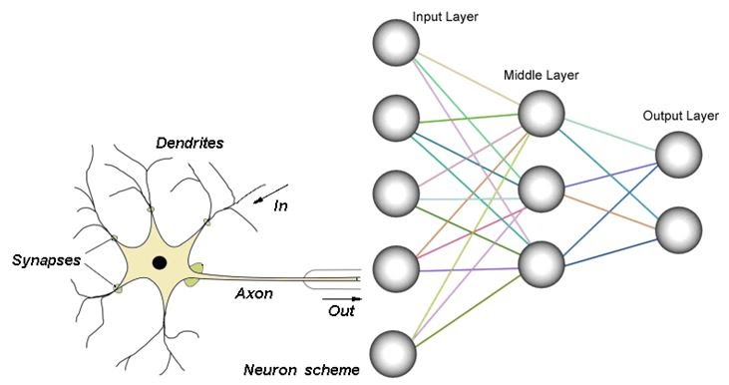
Artificial Neural networks
Modelling human brain with feed-forward and back-propagation

Slide 4
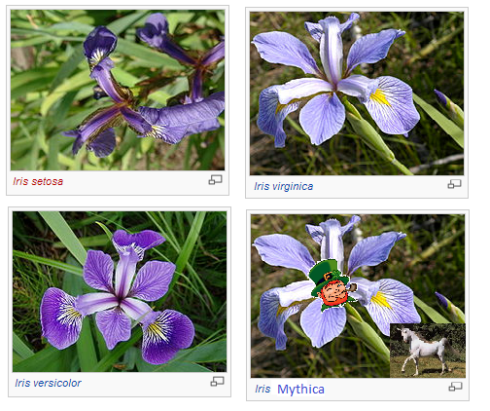
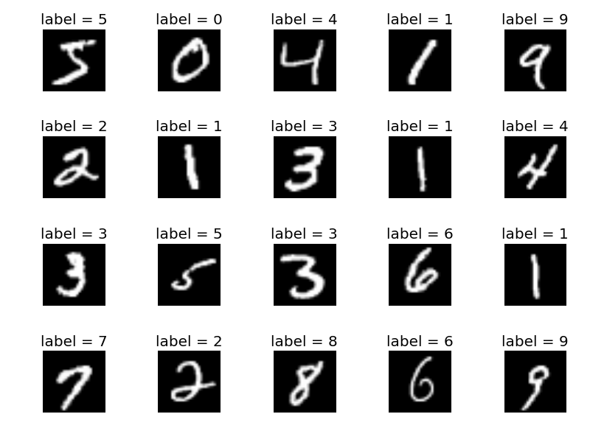

datasets
Iris
Cards
MNIST
PIMA

Slide 5
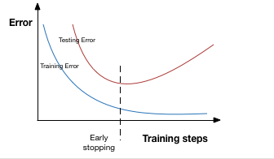
Coping with overfitting - regularization

Slide 6
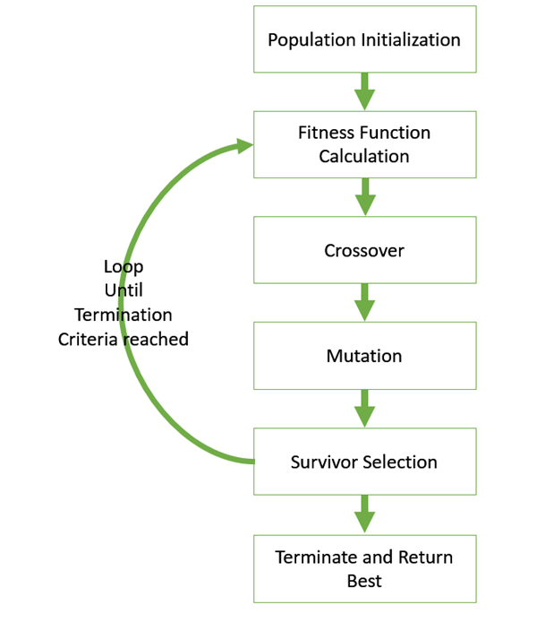
Genetic Algorithms
Optimization using Influence of the principles of nature

Slide 7
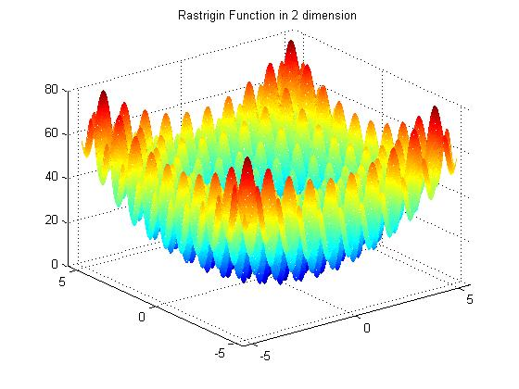
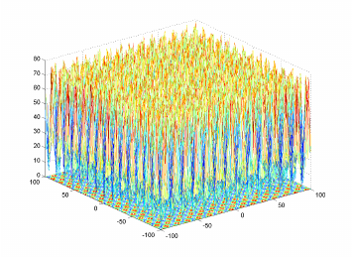
Genetic algorithms – Real Valued Chromosomes
Rastrigin Function
Katsuura Function

Slide 8
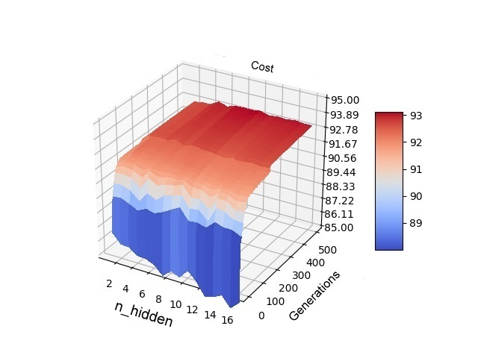
Genetic algorithms – variable length chromosomes
Variation of no. of hidden nodes on PIMA dataset

Slide 9
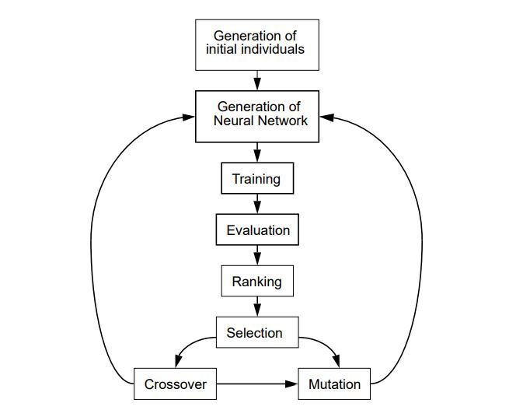
Combining NN and GA

Slide 10
Initial results
Implementing hybrid gives much better results

Slide 11
Initial results
Back Propagation Only
Hybrid Algorithm (On < 20 Hidden Units)
Hidden Units | Testing Accuracy |  |  | Validation
 | Average | Best | Standard Deviation | Best
20 | 66.99% | 75.20% | 6.7% | 68.10%
60 | 72.20% | 76.33% | 4.2% | 71.20%
Testing Accuracy |  |  | Validation Accuracy
Average | Best | Standard Deviation | Best
74.74% | 79.45% | 2.0% | 77.32%

Slide 12
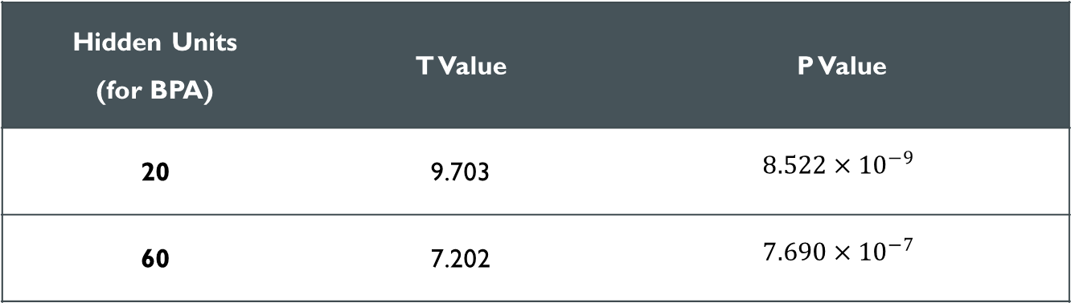
Initial results – pairwise t-test
Hidden Units (for BPA) | T Value | P Value
20 | 9.703 | $$8.522×{10}^{−9}$$
60 | 7.202 | $$7.690×{10}^{−7}$$

Slide 13
Conclusion and Future work
Structural Mutation
Clustering Algorithm
Multi-Objective Optimization
Multi-threaded Architecture
Evolutionary Algorithms - Genetic Programming, Evolutionary Robotics, etc.

