Slide 1
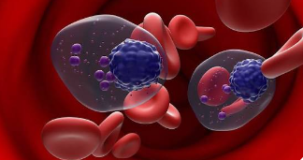

BMS CELMoD Advisory Board Meeting
UAE
Virtual Advisory Board Meeting
27 June 2026

Slide 2

Meeting agenda
Meeting agenda
Meeting introduction and objectives
Faculty introduction
MM disease burden/unmet medical needs and current treatment landscape
Discussion 1
Break
CELMoDs:
overview and recent data
Discussion 2
Wrap up
and conclusions
Local perspective, practice, and challenges
Perspectives on CELMoDs

Slide 3
Advisors
Advisors | Affiliation | Country
Asma Olama | Dubai Hospital, Dubai | UAE
Arif Alam | Tawam Hospital, Al Ain | UAE
Hani Yousif Osman | Tawam Hospital, Al Ain | UAE
Faraz Khan | American Hospital, Dubai | UAE
Kourosh Lotfi | Sheikh Shakhbout Medical City, Abu Dhabi | UAE
Hasan Al Yaseen | Dubai Hospital, Dubai | UAE
Emmanouil Nikolousis | Yas Clinic, Abu Dhabi | UAE
Panayotis Kaloyannidis | Burjeel Cancer Institute, Abu Dhabi | UAE

Slide 4
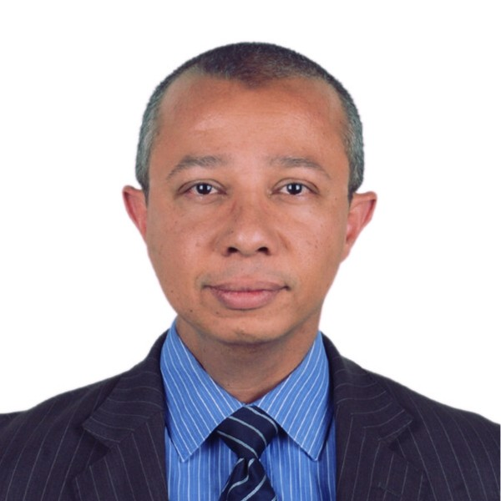
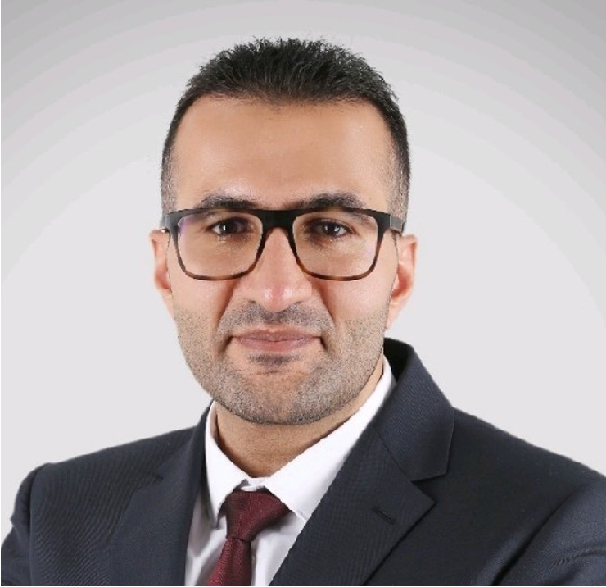
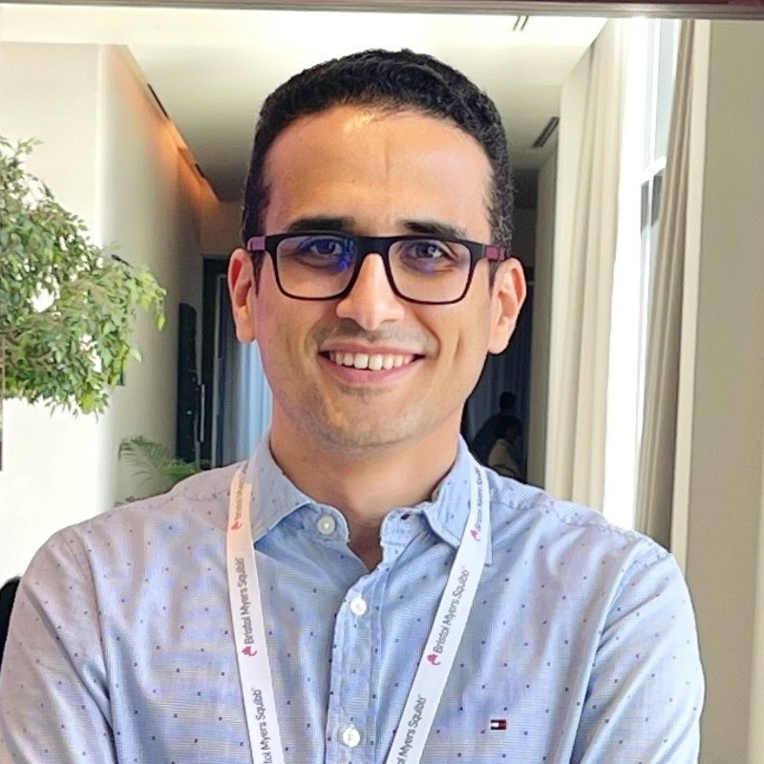
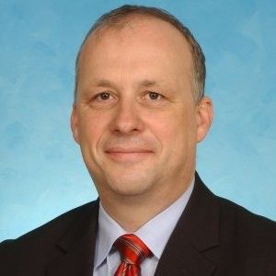


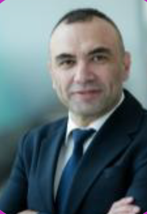
BMS Attendees
Mina Nagib
Senior Scientific Advisor, MEA
Ahmed Belal
Senior Product Manager, Gulf countries
Mayada Al Ahmad General Manager, GCC
Mohamed El-Halfawi Oncology & Hematology Franchise lead,
Gulf Countries

Slide 5
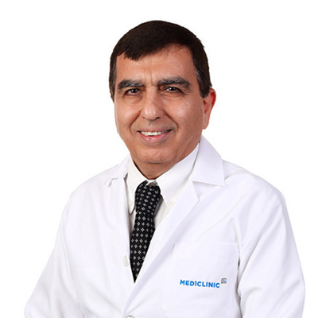
Meeting Introduction: Moderator
Prof. Dr. Mahmoud Marashi
Head, Academic Department of Medicine at Dubai Medical College/Dubai Health Authority.
Dr Marashi is a Consultant Hematologist at Mediclinic City Hospital, Dubai, with over 30 years of experience in clinical hematology.
He is recognized as one of the pioneers of hematology services in the UAE, having established the clinical hematology service within Dubai Health Authority. His clinical expertise covers both benign and malignant blood disorders, including leukaemia, myeloma, and thrombosis-related conditions.
He has also been actively involved in medical education for more than 20 years. He is a Professor of Medicine and Haematology and serves as the Head of the Academic Department of Medicine at Dubai Medical College/Dubai Health Authority.
5

Slide 6
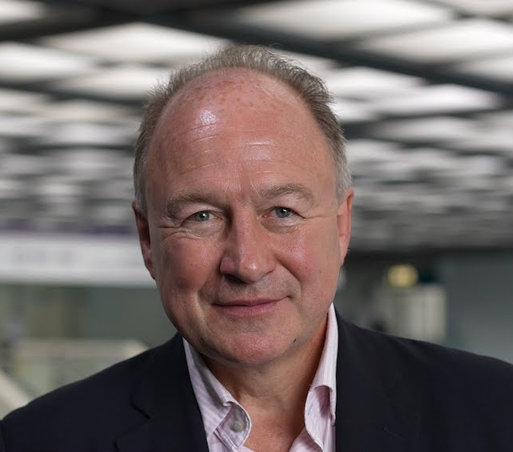
Meeting Introduction: Speaker
Prof. Paul Richardson
RJ Corman Professor of Medicine at Harvard Medical School, USA.
He is currently the RJ Corman Professor of Medicine at Harvard Medical School, as well as Clinical Programme Leader and Director of Clinical Research at the Dana-Farber Cancer Institute (DFCI).
His leadership in landmark Phase III trials has directly shaped global standards of care. These include the VISTA trial, DETERMINATION (IFM/DFCI) study, OPTIMISMM trial, ICARIA trial, and GRIFFIN study.
He has led the clinical development of many of today’s foundational myeloma therapies, including thalidomide, lenalidomide, bortezomib, pomalidomide, daratumumab, elotuzumab, isatuximab and panobinostat, as well as the more recent oral cereblon E3 ligase modulator (CelMoD), mezigdomide.
Dr. Richardson has authored or co-authored 490+ original articles and 430+ reviews and editorials in peer-reviewed journals and is consistently ranked among the top 1% of most-cited scientists globally.
6

Slide 7

Advisory Board Objectives
Assess the burden of multiple myeloma and identify key unmet medical needs in the region
1
Explore the potential role and clinical value of Iberdomide and Mezigdomide within the evolving multiple myeloma treatment landscape
Gather expert insights on the CELMoDs mechanism of action and clinical development program
2
3
7

Slide 8
Session 1: MM disease burden/unmet medical needs and current treatment landscape

Slide 9
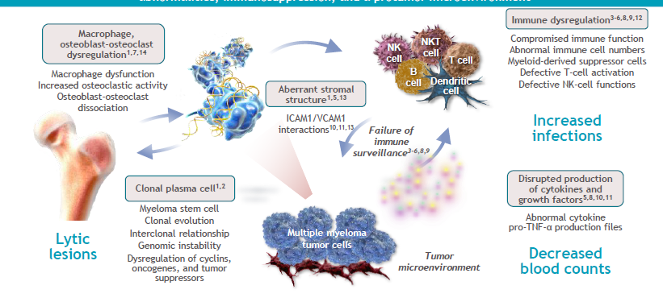
MM is characterized is not driven solely by genetic abnormalities within the myeloma cell, but also by the surrounding pro-tumor microenvironment.
Understanding inflammasome biology is important because inflammation actively drives disease progression, immune dysfunction and treatment response. The Duffy-null phenotype may be particularly relevant in Middle Eastern populations and could be considered during patient assessment where clinically appropriate.
ICAM1: intercellular adhesion molecule 1; MM: multiple myeloma; NK: natural killer; NKT: natural killer T; TNF-α: tumor necrosis factor alpha; VCAM1: vascular cell adhesion molecule 1.
1. Raab MS, et al. Lancet 2009;374:324–339; 2. Morgan GJ, et al. Nat Rev Cancer 2012;12:335–348; 3. Katodritou E, et al. Am J Hematol 2011;86:967–973; 4. Braga WMT, et al. Clin Dev Immunol 2012;2012:293479; 5. Pratt G, et al. Br J Haematol 2007;138:563–579; 6. Rosenblatt J, et al. J Immunother 2011;34:409–418; 7. Kyle RA, Rajkumar SV. N Engl J Med 2004;351:1860–1873; 8. Cook G, Campbell JD. Blood Rev 1999;13:151–162; 9. Bernal M, et al. Hum Immunol 2009;70:854–857;
10. Gupta D, et al. Leukemia 2001;15:1950–1961; 11. Jourdan M, et al. Eur Cytokine Netw 1999;10:65–70; 12. Favaloro J, et al. Leuk Lymphoma 2014;55:2893–2900; 13. Damiano JS, et al. Blood 1999;93:1658–1667; 14. Oranger A, et al. Clin Dev Immunol 2013;2013:289458.
9

Slide 10
Current treatment landscape
MRD-driven strategies may support more selective or deferred use of transplant in patients achieving deep responses.
ADCs, CAR T-cell therapies, bispecific antibodies and GPRC5D-targeted therapies are expanding later-line options.
Quadruplet regimens remain a key frontline approach, while ASCT continues to be standard for transplant-eligible patients.
ADCs: antibody–drug conjugates; ASCT: autologous stem cell transplantation; CAR T: chimeric antigen receptor T-cell; GPRC5D: G protein-coupled receptor class C group 5 member D; MRD: minimal residual disease.
10

Slide 11
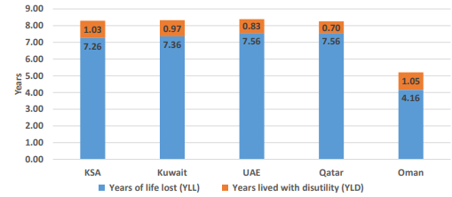
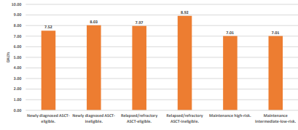
MM remains incurable in ~40% of patients (potentially up to ~60% for long-term disease control)
DALYs per patient with MM¹
Average DALYs per patient per classification¹
MM imposes a significant burden on the Gulf region, especially the economic burden. The relapsed/refractory ASCT-ineligible group recorded the highest DALYs across all groups while the relapsed/refractory ASCT-eligible group incurred the highest direct medical costs¹
ASCT: autologous stem cell transplantation; DALY: disability-adjusted life year; KSA: Kingdom of Saudi Arabia; MM: multiple myeloma; UAE: United Arab Emirates; YLD: years lived with disability; YLL: years of life lost.
1. Farghaly M, et al. ISPOR Europe. Poster EE178.
11

Slide 12
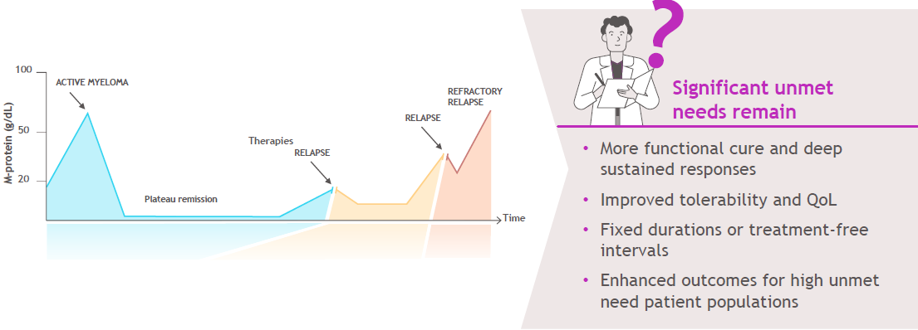
Unmet needs persist despite advances with IMiDs, PIs, anti-CD38 antibodies and BCMA-targeted therapies
BCMA: B-cell maturation antigen; EMD: extramedullary disease; IMiDs: immunomodulatory drugs; MM: multiple myeloma; PIs: proteasome inhibitors; QoL: quality of life; RRMM: relapsed/refractory multiple myeloma.
1. Hajek R. Strategies for the treatment of multiple myeloma in 2013: Moving toward the cure. InTech eBooks. Published online April 10, 2013. https://doi.org/10.5772/55366.
12

Slide 13
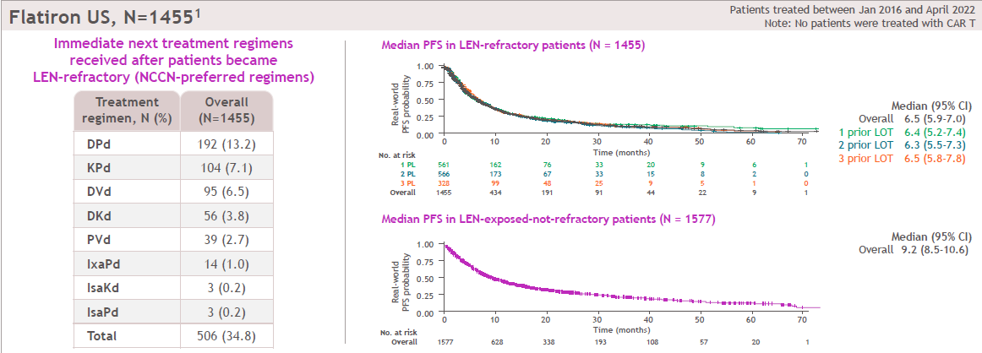
Real-world patients with lenalidomide-refractory MM and 1 to 3 prior LOT progress rapidly through therapies
Outcomes remain suboptimal in lenalidomide-refractory MM, with median PFS of approximately 6.3 to 6.5 months regardless of prior treatment lines.
Lenalidomide-exposed but non-refractory patients had a longer, although still modest, median PFS of 9.2 months.
CAR T: chimeric antigen receptor T-cell therapy; CI: confidence interval; DKd: daratumumab, carfilzomib, and dexamethasone; DPd: daratumumab, pomalidomide, and dexamethasone; DVd: daratumumab, bortezomib, and dexamethasone; IsaKd: isatuximab, carfilzomib, and dexamethasone; IsaPd: isatuximab, pomalidomide, and dexamethasone; IxaPd: ixazomib, pomalidomide, and dexamethasone; KPd: carfilzomib, pomalidomide, and dexamethasone; LEN: lenalidomide; LOT: line of therapy; MM: multiple myeloma; N: number of patients; NCCN: National Comprehensive Cancer Network; PFS: progression-free survival; PL: prior line of therapy; PVd: pomalidomide, bortezomib, and dexamethasone; RWE: real-world evidence.
1. Dhakal, B, et al. Blood Adv. 2024;8(19):5062
13

Slide 14
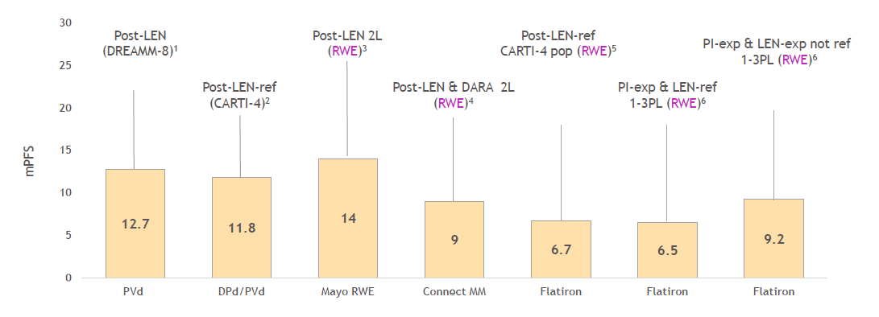
Median PFS remains modest at 6.5 to 14 Months in lenalidomide-exposed or lenalidomide-refractory populations
2L: second-line therapy; DARA: daratumumab; DPd: daratumumab, pomalidomide, and dexamethasone; exp: exposed; LEN: lenalidomide; MM: multiple myeloma; mPFS: median progression-free survival; PI: proteasome inhibitor; PL: prior line of therapy; pop: population; PVd: pomalidomide, bortezomib, and dexamethasone; ref: refractory; RWE: real-world evidence.
1. Dimopoulos, M, et al. NEJM2024; 2. San Miguel, J, et al. NEJM2023; 3. Goel, U. et al. Blood Cancer J. 2024;14(1):55; 4. Cowan, AJ, et al. IMS 2023; 5. Touzeau C, et al. EHA 2024; Poster P967; 6. Dhakal, B, et al. Blood Adv. 2024;8(19):5062.
14

Slide 15
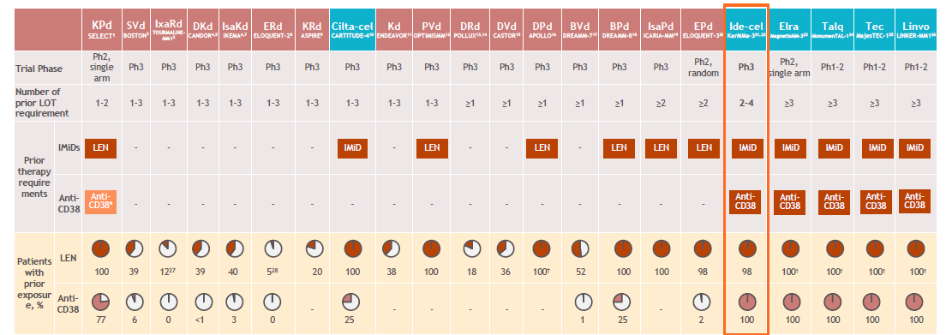
KarMMa-3 is the only prospective, randomized phase 3 study in which nearly all patients had prior lenalidomide exposure, and all had prior anti-CD38 exposure
Prior therapy exposure across relapsed or refractory MM trials
No treatments were studied in 2L patients with required prior LEN and an anti-CD38 antibody exposure
*At study initiation, included patients must have completed at least two consecutive cycles of daratumumab; this criterion was removed in March 2021, approximately 8 months before the last patient enrolled. †IMiD exposure.
See speaker notes for abbreviations and reference.
15
Notes:
2L: second-line therapy; anti-CD38 Ab: anti-cluster of differentiation 38 antibody; BPd: belantamab mafodotin, pomalidomide and dexamethasone; BVd: belantamab mafodotin, bortezomib and dexamethasone; Cilta-cel: ciltacabtagene autoleucel; DKd: daratumumab, carfilzomib and dexamethasone; DPd: daratumumab, pomalidomide and dexamethasone; DRd: daratumumab, lenalidomide and dexamethasone; DVd: daratumumab, bortezomib and dexamethasone; Elra: elranatamab; EPd: elotuzumab, pomalidomide and dexamethasone; ERd: elotuzumab, lenalidomide and dexamethasone; Ide-cel: idecabtagene vicleucel; IMiD: immunomodulatory drug; IsaKd: isatuximab, carfilzomib and dexamethasone; IsaPd: isatuximab, pomalidomide and dexamethasone; IxaRd: ixazomib, lenalidomide and dexamethasone; Kd: carfilzomib and dexamethasone; KPd: carfilzomib, pomalidomide and dexamethasone; KRd: carfilzomib, lenalidomide and dexamethasone; LEN: lenalidomide; Linvo: linvoseltamab; LOT: line of therapy; MM: multiple myeloma; Ph: phase; PI: proteasome inhibitor; PVd: pomalidomide, bortezomib and dexamethasone; SVd: selinexor, bortezomib and dexamethasone; Talq: talquetamab; Tec: teclistamab.
Rodriguez-Otero et al. N Engl J Med. 2023;388:1002-1014

Slide 16
Need for CELMoDs
Integration of CELMoDS in MM treatment landscape
Immune exhaustion and treatment failure across IMiDs, PIs, anti-CD38 antibodies, and BCMA-targeted therapies highlight persistent unmet needs.
Lenalidomide- and anti-CD38-exposed or refractory populations remain a key treatment challenge.
Outcomes are particularly poor in older, frailer patients and those exposed or refractory to both lenalidomide and anti-CD38 therapy, with anti-CD38 retreatment yielding a PFS of only 4 to 5 months.
Differentiated therapies are needed to overcome resistance and restore immune function.
CELMoDs (iberdomide and mezigdomide) offer direct anti-myeloma activity together with immune activation.
Durable, safe and convenient oral therapies are needed, particularly for older patients and those with EMD or triple-class refractory MM.
Unmet needs
Clinical needs
Disease understanding & scientific innovation
CELMoDs
Iberdomide
Mezigdomide
anti-CD38: anti-cluster of differentiation 38 monoclonal antibodies; BCMA: B-cell maturation antigen; CELMoDs: cereblon E3 ligase modulators; EMD: extramedullary disease; IMiDs: immunomodulatory drugs; MM: multiple myeloma; PFS: progression-free survival; PIs: proteasome inhibitors.
16

Slide 17
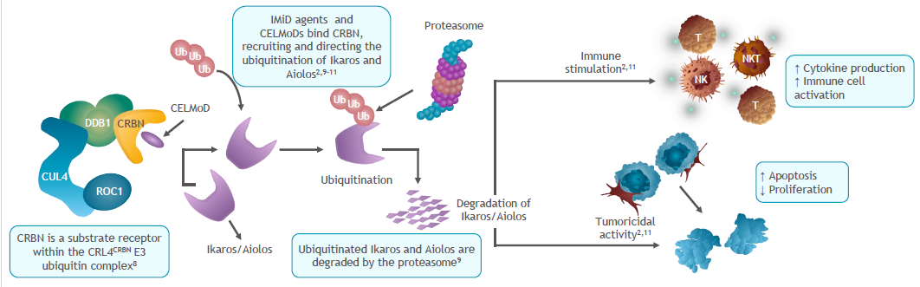
CELMoDs: Mechanism of action
CELMoDs (iberdomide, mezigdomide) are oral CRBN E3 ligase modulators that degrade Ikaros/Aiolos, resulting in antitumor and immunostimulatory effects; mezigdomide shows the highest CRBN engagement (~100%) and the most potent immune activation.¹⁻⁷
CRBN: cereblon; CELMoDs: cereblon E3 ligase modulators; CRL4CRBN: CUL4-ROC1-DDB1-CRBN; CUL4: cullin-4; DDB1: DNA damage-binding protein 1; IMiD: immunomodulatory drug; NK: natural killer; NKT: natural killer T; ROC1: regulator of cullins 1; T: T-cell; Ub: ubiquitin.
Matyskiela ME et al. J Med Chem. 2018;61(2):535-542; 2. Bjorklund CC et al. Leukemia. 2020;34(4):1197-1201; 3. Carrancio S et al. Blood. 2021;138(suppl 1):1200; 4.Lopez-Girona A et al. Poster presentation at ICML 2021 [abstract 232];
5. Carrancio S et al. Poster presentation at ASH 2021 [abstract 1200]; 6. Richardson PG et al. Blood. 2021;138(suppl 1):2731; 7. Wong L, et al. Oral presentation at ASCO 2020 [abstract 8531]; 8. Fischer ES et al. Nature. 2014;512:49–53; 9. Krönke J et al. Science. 2014;343:301–305; 10. Gandhi AK, et al. Br J Haematol. 2014;164(6):811–821; 11. Hansen JD et al. J Med Chem. 2020;63(13):6648–6676.
17

Slide 18
Discussion 1:
Epidemiology and local practice

Slide 19
What is the number of new multiple myeloma cases you see in your center annually?

Slide 20
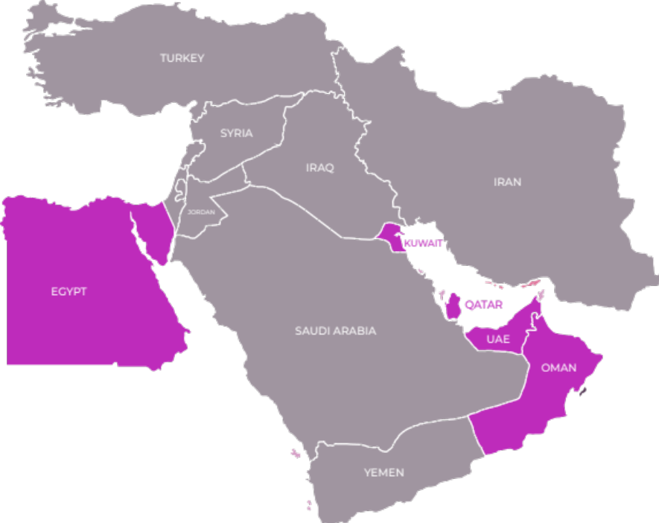
Regional clinical experience shared by experts
UAE
~10–20 new MM cases annually at each centre
BAHRAIN
Case volumes vary by practice setting, with around 6–8 new patients per year in a single private practice
Estimated national incidence was approximately 50–60 new MM cases per year
MM: multiple myeloma; UAE: United Arab Emirates.
20

Slide 21
What is your current treatment approach for patients with multiple myeloma?

Slide 22

Regional clinical experience shared by experts
Daratumumab-based quadruplet therapy, particularly DVRd, is the preferred frontline approach for most fit patients, followed by consolidation and daratumumab plus lenalidomide maintenance.
In transplant-ineligible patients, treatment is tailored according to frailty: fitter patients may receive quadruplet therapy, whereas frailer patients are generally treated with reduced-intensity triplets such as DRd or DVd.
Autologous transplant remains standard for eligible patients, although MRD status is increasingly influencing transplant timing and decision-making.
Bortezomib remains the preferred frontline PI, while carfilzomib is generally reserved for later lines or selected younger, high-risk patients because of cardiovascular toxicity concerns.
Treatment sequencing is increasingly guided by risk profile, tolerability, MRD response and access to therapy, with emerging combinations expected to further refine the role of PIs.
DRd: daratumumab, lenalidomide, and dexamethasone; DVRd: daratumumab, bortezomib, lenalidomide, and dexamethasone; DVd: daratumumab, bortezomib, and dexamethasone; MRD: minimal residual disease; Pls: proteasome inhibitors.
22

Slide 23
What are the preferred treatment options for patients with multiple myeloma in the second- and third-line settings?

Slide 24
Preferred second- and third-line treatment approaches
Treatment selection is guided by duration of prior response, previous drug exposure, patient fitness, and access to advanced therapies
In the second-line setting, carfilzomib-based combinations are commonly used after frontline DVRd, while rechallenge with prior therapy may be considered following a prolonged remission.
Belantamab-based ADC combinations are increasingly used in relapsed disease because of their activity, manageable safety profile, and potential for combination with mezigdomide.
In the third-line setting and beyond, options include BPd, BVd, bispecific antibodies, and CAR T-cell therapy, although careful patient selection is required because of infection, neurological, and treatment-related risks.
Selinexor remains an underused option and may be effective at low weekly doses, particularly in combination with mezigdomide, with proactive management of cytopenias using G-CSF or romiplostim.
Mezigdomide was viewed as a flexible backbone across multiple treatment lines, with dose optimization and supportive care considered essential.
ADC: antibody–drug conjugate; BPd: bortezomib, pomalidomide, and dexamethasone; BVd: bortezomib, and dexamethasone; CAR T-cell: chimeric antigen receptor T-cell therapy; DVRd: daratumumab, bortezomib, lenalidomide, and dexamethasone; G-CSF: granulocyte colony-stimulating factor.
24

Slide 25
Guideline use in clinical practice
  NCCN and regional Gulf guidelines are commonly used to guide treatment decisions.
  Some centres also refer to mSMART recommendations.
  Guideline implementation is influenced by drug availability, insurance coverage, and local practice constraints.
  Advisors highlighted the importance of maintaining and publishing updated region-specific guidelines that reflect real-world clinical practice.
mSMART: Mayo stratification for myeloma and risk-adapted therapy; NCCN: National Comprehensive Cancer Network.
25

Slide 26
Role of high-dose melphalan
High-dose melphalan should be used selectively, particularly in very young patients, because of its potential genetic toxicity and risk of secondary malignancies.
In standard-risk, MRD-negative younger patients, stem-cell collection with deferred transplant may be considered instead of immediate transplantation.
Long-term lenalidomide may also increase MDS risk; however, available evidence suggests a higher incidence of secondary malignancies with high-dose melphalan than with lenalidomide alone.
MDS: myelodysplastic syndrome; MRD: minimal residual disease.
26

Slide 27

Key takeaways
MM case volume varies across centres, with some advisors reporting around 10–20 new cases annually.
DVRd was commonly identified as the preferred first-line approach for most fit patients followed by consolidation and daratumumab-lenalidomide maintenance.
In transplant-ineligible patients, treatment is tailored by frailty, with triplets for frailer patients and quadruplets for fitter patients.
The role of transplant is evolving. While BMT remains standard practice in some centres, MRD assessment is increasingly influencing decisions.
PIs remain an important backbone with bortezomib continues to be widely used, with weekly dosing, supportive care and dose escalation helping to reduce neuropathy.
Carfilzomib was favored in younger or ultra-high-risk patients, but its use remains cautious due to cardiovascular toxicity and is often reserved for later lines.
BMT: bone marrow transplantation; DVRd: daratumumab, bortezomib, lenalidomide, and dexamethasone; MM: multiple myeloma; MRD: minimal residual disease; Pls: proteasome inhibitors.
27

Slide 28
Key takeaways (Contd.)
In relapsed/refractory settings, treatment decisions remain highly individualized and depend on prior therapy, DoR, patient fitness, access, toxicity and reimbursement.
Belantamab combinations were viewed positively with advisors sharing growing clinical experience and interest in future mezigdomide and belantamab combination.
Bispecifics and CAR T were recognised as highly effective options, but concerns remain around infections, CNS events, ICANS, opportunistic infections and real-world safety.
Selinexor was considered underutilised but valuable when used carefully, with a “go low and go slow” approach and attention to cytopenia management.
Regional guidelines, NCCN guidelines, Gulf recommendations, insurance coverage and drug availability all strongly influence real-world treatment decisions.
ADCs: antibody–drug conjugates; CAR T-cell: chimeric antigen receptor T-cell therapy; CELMoDs: cereblon E3 ligase modulators; EMD: extramedullary disease; RRMM: relapsed/refractory multiple myeloma.
28

Slide 29
Session 2: CELMoDs (Overview and recent data)

Slide 30
CELMoDs development program in MM
  Broad clinical development strategy: CELMoD trials span the MM treatment continuum, from post-transplant maintenance to heavily pretreated RRMM.
  Key trials:
    EXCALIBER: Iberdomide vs lenalidomide in post-ASCT maintenance; iberdomide-based RRMM cohort with daratumumab + dexamethasone.
    SUCCESSOR-1: Mezigdomide + bortezomib/dexamethasone vs PVd in lenalidomide-exposed RRMM.
    SUCCESSOR-2: Mezigdomide + carfilzomib/dexamethasone vs carfilzomib/dexamethasone in lenalidomide- and CD38-exposed RRMM.
  Expanding evidence base: ~40 CELMoD trials are evaluating combinations across diverse patient populations, including with T-cell redirecting therapies.
ASCT: autologous stem cell transplantation; CD38: cluster of differentiation 38; CELMoDs: cereblon E3 ligase modulators; MM: multiple myeloma; PVd: pomalidomide, bortezomib, and dexamethasone; RRMM: relapsed/refractory multiple myeloma; T-cell: thymus-derived lymphocyte.
Lonial S et al. Future Oncol. 2025;21(14):1761-1769; Richardson PG et al. J Clin Oncol. 2026;44(17_suppl).
30

Slide 31
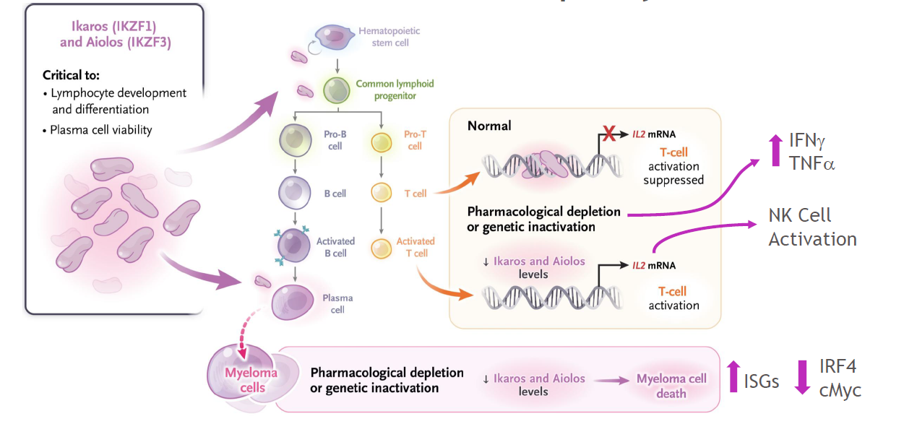
Role of Aiolos and Ikaros in MM
CELMoDs target IKZF1 (Ikaros) and IKZF3 (Aiolos) to enhance anti-myeloma activity and immune modulation
cMyc: cellular myelocytomatosis oncogene; CELMoDs: cereblon E3 ligase modulators; IFNγ: interferon gamma; IKZF1: ikaros family zinc finger protein 1 (ikaros); IKZF3: ikaros family zinc finger protein 3 (aiolos); IL-2: interleukin-2; IRF4: interferon regulatory factor 4; ISGs: interferon-stimulated genes; MM: multiple myeloma; mRNA: messenger ribonucleic acid; NK: natural killer; TNFα: tumor necrosis factor alpha.
31

Slide 32
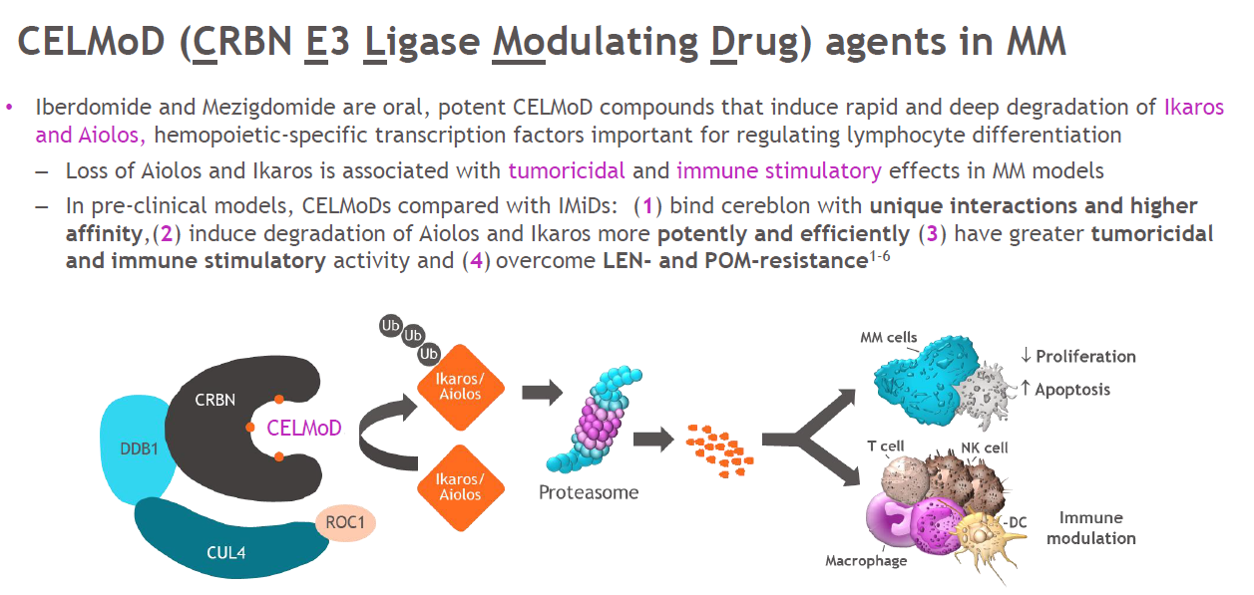
CELMoD agents in MM
Iberdomide and Mezigdomide are oral, potent CELMoD compounds that induce rapid and deep degradation of Ikaros and Aiolos, hemopoietic-specific transcription factors important for regulating lymphocyte differentiation
Loss of Aiolos and Ikaros is associated with tumoricidal and immune stimulatory effects in MM models.
In pre-clinical models, CELMoDs compared with IMiDs: (1) bind cereblon with unique interactions and higher affinity, (2) induce degradation of Aiolos and Ikaros more potently and efficiently (3) have greater tumoricidal and immune stimulatory activity and (4) overcome LEN- and POM-resistance.
CELMoD: cereblon E3 ligase modulator; CRBN: cereblon; CUL4: cullin 4; DC: dendritic cell; DDB1: DNA damage-binding protein 1; E3: ubiquitin protein ligase; IBER: iberdomide; LEN: lenalidomide; MM: multiple myeloma; NK: natural killer; POM: pomalidomide; ROC1: regulator of cullins-1; Ub: ubiquitin.
van de Donk NWCJ et al. Onco Targets Ther. 2025;18:921-933.
32

Slide 33
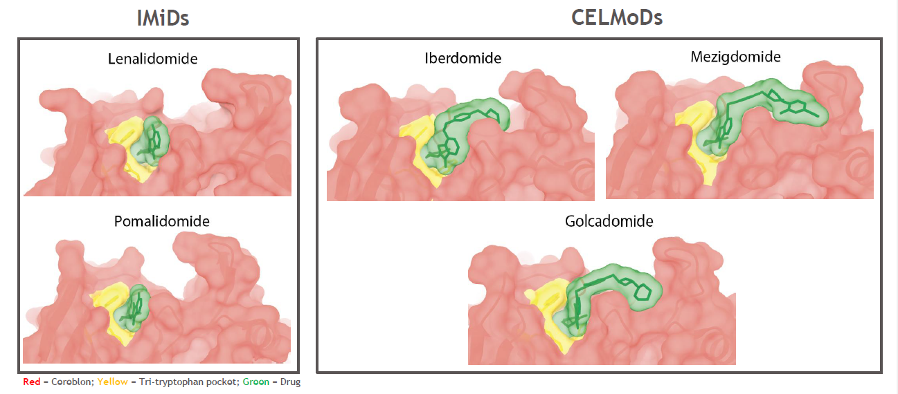
CELMoDs: Enhanced mechanism over IMiDs
Lenalidomide and pomalidomide achieve only partial complex closure (~20–25%)
Iberdomide achieves greater engagement (~50%)
Mezigdomide achieves near-complete closure approaching (~100%)
CELMoDs bind CRBN uniquely outside of tri-tryp pocket
CELMoDs: cereblon E3 ligase modulator; CRBN: cereblon; IMiDs: Immunomodulatory drugs.
33

Slide 34
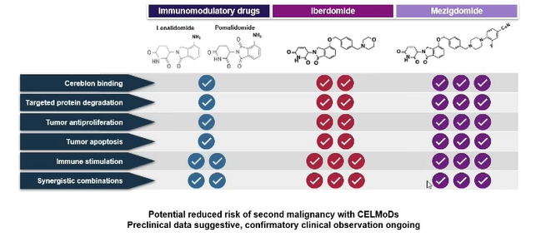
Molecular advantages of CELMoDs over IMiDs
  CELMoDs (iberdomide and mezigdomide) exhibit superior CRBN binding and activation through single S-isomer design, enabling enhanced Ikaros/Aiolos degradation compared with IMiDs.
  Greater CRBN conformational activation drives faster and deeper protein degradation, translating into stronger anti-myeloma activity and efficacy in IMiD-resistant models.
  Mezigdomide demonstrated the broadest preclinical activity profile, including tumour cell killing, immune stimulation, and combination potential, supporting its clinical development in RRMM.
CRBN: cereblon; CELMoDs: Cereblon E3 ligase modulators; IMiDs: immunomodulatory drugs; RRMM: relapsed/refractory multiple myeloma.
Hartley-Brown MA et al. Cancers (Basel). 2024;16(6):1166.
34

Slide 35
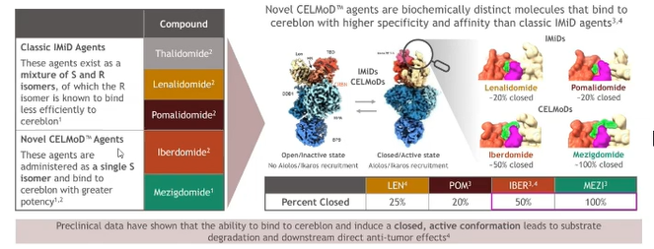
CELMoDs are a distinct class of protein Degraders, not simply next-generation IMiDs
Aiolos: ikaros family zinc finger protein 3 (IKZF3); CRBN: cereblon; CELMoDs: cereblon E3 ligase modulators; IMiDs: immunomodulatory drugs; IBER: iberdomide; LEN: lenalidomide; POM: pomalidomide; ; POM: pomalidomide; MEZI: mezigdomide.
35

Slide 36
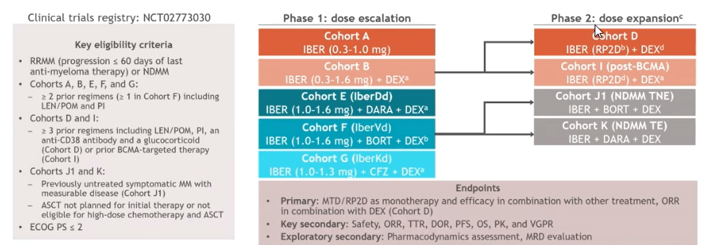
CC-220-MM-001 (Phase 1b/2a): Study design
aDEX given at a dose of 40 mg (20 mg in patients aged > 75 years) on days 1, 8, 15, and 22 of each 28-day cycle; bIBER was given at 1.0, 1.3, or 1.6 mg on D1–14 in C1–8, and D1–21 in C ≥ 9, BORT was started at starting at 1.3 mg/m2 on D1, 4, 8, and 11 in C1–8, and DEX was given at a dose of 20 mg on D1, 2, 4, 5, 8, 9, 11, and 12 in C1–8 (10 mg in patients > 75 years of age), and 40 mg weekly in C ≥ 9 (20 mg in patients > 75 years); cCohort C (IBER monotherapy expansion) was planned, but not opened; d1.6 mg once a day.
ASCT: autologous stem cell transplant; BCMA: B-cell maturation agent; BORT: bortezomib; C, cycle; CFZ: carfilzomib; D, day; DARA: daratumumab; DEX: dexamethasone; DOR: duration of response; ECOG PS: Eastern Cooperative Oncology Group performance status; IBER: iberdomide; IberDd: iberdomide, daratumumab, and dexamethasone; IberKd: iberdomide, carfilzomib, and dexamethasone; IberVd: iberdomide, bortezomib, and dexamethasone; LEN: lenalidomide; MM: multiple myeloma; MRD: minimal residual disease; MTD: maximum tolerated dose; NDMM: newly diagnosed multiple myeloma; ORR: overall response rate; OS: overall survival; PFS: progression-free survival; PI: proteasome inhibitor; PK: pharmacokinetics; POM: pomalidomide; PS: performance status; RP2D: recommended phase 2 dose; RRMM: relapsed/refractory multiple myeloma; TE: transplant eligible; TNE: transplant non-eligible; TTR: time to response; VGPR: very good partial response.
ClinicalTrials.gov. https://ClinicalTrials.gov/ct2/show/NCT02773030. Accessed February 11, 2026; CC-220-MM-001 Study Protocol. Celgene Corporation. 2020.
36

Slide 37
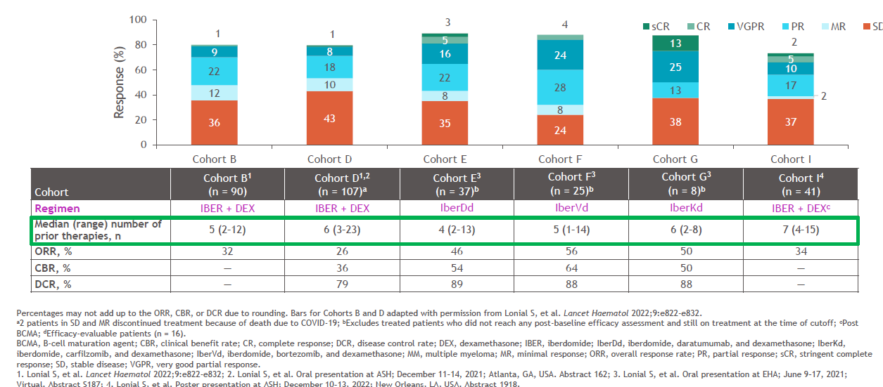
Clinical outcomes with iberdomide in RRMM
Iberdomide demonstrated activity in a highly refractory population (median 4–7 prior lines; high triple-class and IMiD-refractory rates), with ORR 26–56% and disease control rates up to 88–89%.
Iberdomide + daratumumab (IberDd) showed promising efficacy in late-line RRMM, with ORR 45.9%, clinical benefit rate 54.1%, and disease control rate 89.2%.
Responses were durable, with 63% ongoing at 12 months and 37% at 24 months; mezigdomide retained activity against CRBN A365D mutant clones associated with pomalidomide resistance.
A365D: alanine to aspartic acid substitution at amino acid 365 (CRBN A365D mutation); CBR: clinical benefit rate; CR: complete response; CRBN: cereblon; DCR: disease control rate; DEX: dexamethasone; IBER: iberdomide; IberDd: iberdomide, daratumumab, and dexamethasone; IberKd: iberdomide, carfilzomib, and dexamethasone; IberVd: iberdomide, bortezomib, and dexamethasone; IMiD: immunomodulatory drug; MR: minimal response; ORR: overall response rate; PR: partial response; RRMM: relapsed/refractory multiple myeloma; sCR: stringent complete response; SD: stable disease; VGPR: very good partial response.
37

Slide 38
IberDd Efficacy and Safety
  IberDd (iberdomide 1.0, 1.3, or 1.6 mg + daratumumab + dexamethasone) achieved a sustained ORR of 94.7%, with ≥CR increasing from 22.7% to 44.0%, 57.3%, and 68.0% across 7, 11, 14, and 22 months of follow-up; MRD negativity (10⁻⁵) reached 64.0%, including 56.0% MRD-negative CR.
  Compared with DRd (MAIA) and IsaRd (BENEFIT), IberDd achieved the highest ORR with ≥CR (94.7%; ≥CR 68.0%) and highest MRD negativity (64.0%), with lower rates of grade 3/4 fatigue, diarrhoea, and grade 3/4 rash (1.3% vs 7% with IsaRd).
  Hematologic toxicities included neutropenia (82.7%; grade 4: 44.0%), anaemia (38.7%), and thrombocytopenia (21.3%); nonhematologic TEAEs were generally low grade with no grade 3/4 diarrhoea, supporting advancement into EXCALIBER-RRMM.
CR: complete response; DRd: daratumumab, lenalidomide, and dexamethasone; IsaRd: isatuximab, lenalidomide, and dexamethasone; MRD: minimal residual disease; ORR: overall response rate; RRMM: relapsed/refractory multiple myeloma; TEAEs: treatment-emergent adverse events.
38

Slide 39
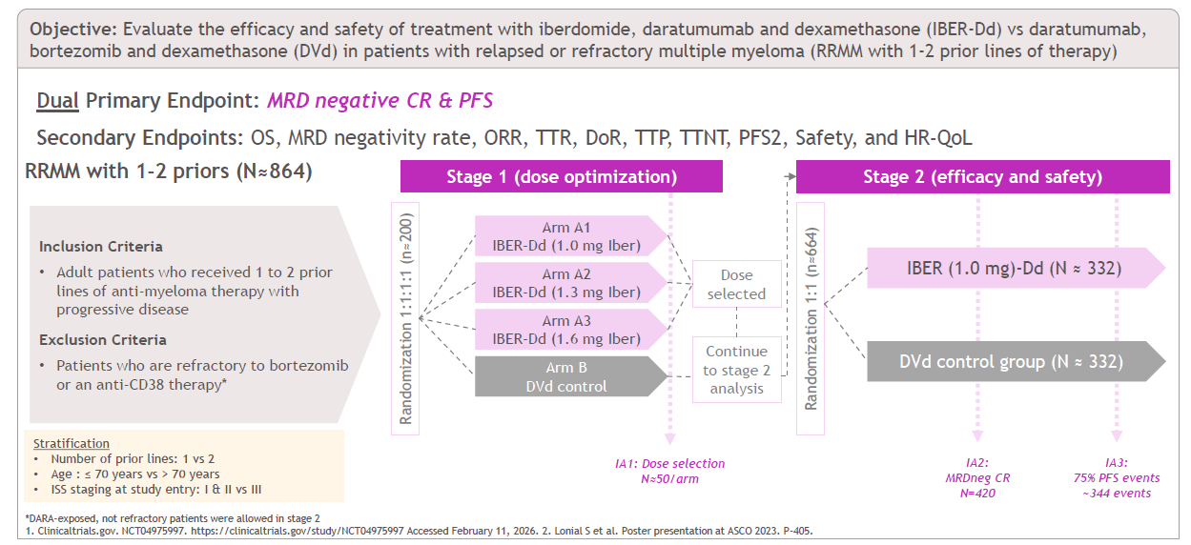
EXCALIBER-RRMM (CC-220-MM-002): IBER-Dd vs DVd
Iberdomide has been shown to have synergy with dexamethasone and daratumumab in vitro.
In a phase I/II trial, IberDd was well tolerated and demonstrated promising preliminary efficacy in patients with heavily pretreated RRMM, including patients refractory to IMiD agents, daratumumab, and PIs.
Outcomes of EXCALIBER-RRMM may establish IberDd as a transformative treatment in early-line RRMM and potentially broaden its role in combination regimens across the disease spectrum.
CC-220-MM-002: clinical trial protocol code for the EXCALIBER-RRMM study; CD38: cluster of differentiation 38; CR: complete response; DARA: daratumumab; Dd: daratumumab and dexamethasone; DoR: duration of response; DVd: daratumumab, bortezomib, and dexamethasone; EXCALIBER-RRMM: exploratory clinical trial of iberdomide in relapsed/refractory multiple myeloma (trial name); HR-QoL: health-related quality of life; IA1: interim analysis 1; IA2: interim analysis 2; IA3: interim analysis 3; IBER: iberdomide; IberDd: iberdomide, daratumumab, and dexamethasone; IMiD: immunomodulatory drug; ISS: international staging system; MRD: minimal residual disease; ORR: overall response rate; OS: overall survival; PFS: progression-free survival; PFS2: second progression-free survival; PI: proteasome inhibitor; RRMM: relapsed/refractory multiple myeloma; TTP: time to progression; TTNT: time to next treatment; TTR: time to response.
Lonial S et al. Future Oncol. 2025;21(14):1761-1769.
39

Slide 40
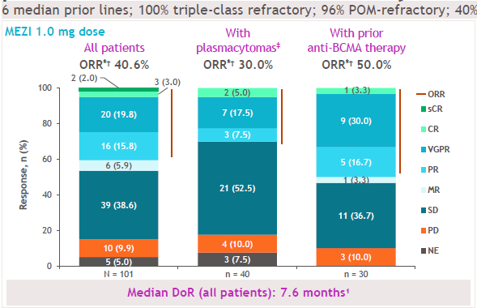
CC-92480-MM-001 dose-expansion cohort: MEZI + DEX oral doublet demonstrated efficacy in RRMM patients with multi-class refractory disease
  CC-92480-MM-001: Mezigdomide 1 mg (Days 1–21) + dexamethasone evaluated in heavily pretreated triple-class refractory RRMM (median 6 prior lines).
Mezigdomide is not currently approved in any market and has not been evaluated by any regulatory agency as safe or effective for multiple myeloma.
*Data cutoff: 16 September 2022. †PR or betterI. ‡ncluding extramedullary soft tissue only disease as well as soft tissue bone-related plasmacytomas.
BCMA: B cell maturation antigen; CR: complete response; DEX: dexamethasone; DoR: duration of response; EMD: extramedullary disease; IMiD: immunomodulatory drug; MEZI: mezigdomide; MR: minimal response; NE: not evaluable; ORR: overall response rate; PD: progressive disease; PET: positron emission tomography ; PR: partial response; RRMM: relapsed/refractory multiple myeloma; sCR: stringent complete response; SD: stable disease; VGPR: very good partial response.
1. Richardson PG et al. Oral presentation at ASH 2022. Abstract 568; 2. Richardson PG et al. Oral presentation at ASCO 2020. Abstract 8500; 3. Data on file. Princeton, NJ: Bristol-Myers Squibb Company.
40

Slide 41
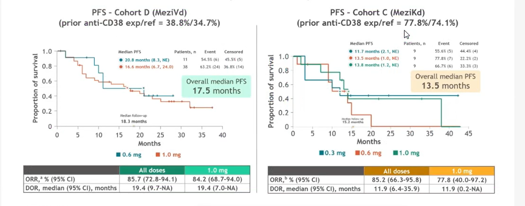
MeziVd and MeziKd efficacy summary
Data cutoff: June 28, 2024.aORR refractory to LEN and anti-CD38 mAbs (data cutoff: May 9, 2024): cohort D = 75.0%. bMedian number of prior therapies = 2. eORR refractory to LEN and anti-CD38 mAbs (data cutoff: May 9, 2024): cohort C = 82.4%.
CD: clusters of differentiation; DOR: duration of response; EHA: European Hematology Association; LEN: lenalidomide; mAb: monoclonal antibody; Mezi: mezigdomide; NE: not evaluable; ORR: overall response rate; PFS: progression-free survival; MeziKd: mezigdomidea, carfilzomib, and dexamethasone; MeziVd: mezigdomide, bortezomib, and dexamethasone; RRMM: relapsed/refractory multiple myeloma.
1.Sandhu I et al. Presented at EHA Annual Meeting 2025. Abstract PF723.
41

Slide 42
SUCCESSOR-1 and SUCCESSOR-2 trial overview
SUCCESSOR-1* compares MeziVd vs PVd in early RRMM (1–3 prior lines), enrolling lenalidomide-exposed, pomalidomide-naïve, and bortezomib-non-refractory patients; PFS is the primary endpoint (OS key secondary endpoint).
SUCCESSOR-2 (CA057-008) evaluates MeziKd vs Kd in RRMM after ≥1 prior line, enrolling ~606 patients with prior lenalidomide and anti-CD38 exposure (excluding prior mezigdomide/carfilzomib); PFS is the primary endpoint and OS the key secondary endpoint.
In SUCCESSOR-2, patients had a median of 2 prior lines across 26 countries; 52.4% remained on MeziKd versus 31.4% on Kd, with lower discontinuation due to disease progression (29.5% vs 48.7%) and comparable median follow-up (10.5–10.8 months).
*Results are expected to read out in 2027
Anti-CD38: anti-CD38 monoclonal antibody; Kd: carfilzomib and dexamethasone; MeziKd: mezigdomide, carfilzomib, and dexamethasone; MeziVd: mezigdomide, bortezomib, and dexamethasone; OS: overall survival; PFS: progression-free survival; PVd: pomalidomide, bortezomib, and dexamethasone; RRMM: relapsed/refractory multiple myeloma.
Richardson PG et al. J Clin Oncol. 2026;44(17_suppl).
42

Slide 43
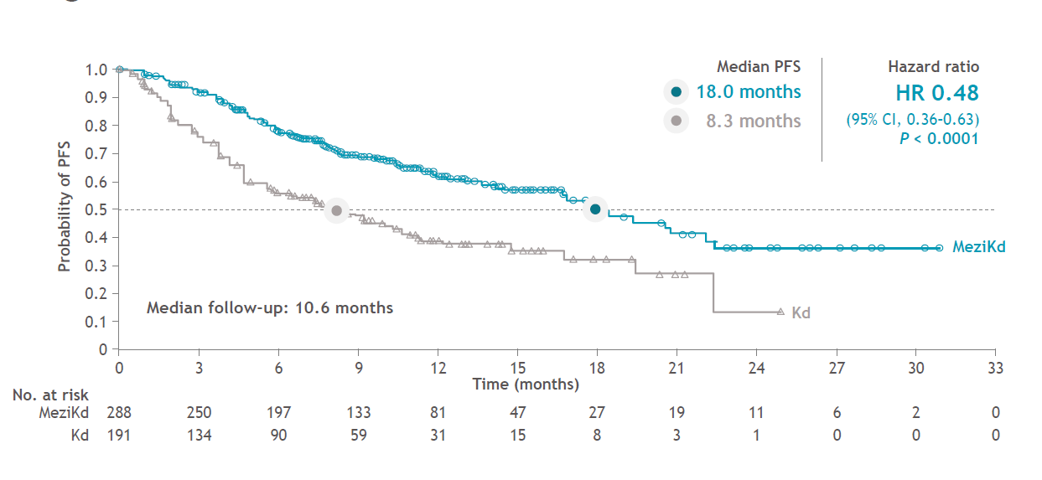
SUCCESSOR-2: Progression-free survival (MeziKd vs Kd)
CI: confidence interval; HR: hazard ratio; Kd: carfilzomib and dexamethasone; MeziKd: mezigdomide, carfilzomib and dexamethasone; PFS: progression-free survival.
Richardson PG et al. J Clin Oncol. 2026;44(17_suppl).
43

Slide 44
SUCCESSOR-2: MeziKd efficacy and safety
  MeziKd more than doubled median PFS versus Kd, with benefit observed across key subgroups, including patients ≥75 years (HR 0.52), lenalidomide-/anti-CD38-refractory disease (HR 0.47), and extraosseous EMD (HR 0.33)
PFS2 was 23.6 vs 13.0 months (HR 0.53); fewer patients received subsequent antimyeloma therapy (24.0% vs 49.7%), including BsAbs (10.4% vs 44.2%) and pomalidomide (5.6% vs 36.8%)
ORR was 80.2% with MeziKd vs 53.4% with Kd; OS showed HR 0.79 at a median follow-up of 10.6 months
Grade 3/4 AEs were more frequent with MeziKd (83.7% vs 56.5%), mainly neutropenia (61.1% vs 9.1%), thrombocytopenia (39.2% vs 22.6%), and anemia (26.0% vs 15.1%)
AEs: Adverse events; Anti-CD38: anti-CD38 monoclonal antibody; BsAbs: bispecific antibodies; CI: confidence interval; EMD: extramedullary disease; HR: hazard ratio; Kd: Carfilzomib and dexamethasone; MeziKd: Mezigdomide, carfilzomib, and dexamethasone; ORR: overall response rate; OS: overall survival; PFS: progression-free survival; PFS2: progression-free survival after next line of therapy.
Richardson PG et al. J Clin Oncol. 2026;44(17_suppl).
44

Slide 45
Discussion 2:
Perspectives on CELMoDs

Slide 46
How should the efficacy and safety of IberDd be interpreted compared with currently available second- and third-line treatment options?

Slide 47
Views on efficacy and safety of IberDd
Demonstrate manageable hematological toxicity with favorable neurological and gastrointestinal tolerability
Dosing generally ranges from 0.75 to 1.3 mg, depending on the regimen and tolerability
Follow-up and comparative data are needed to define its positioning versus belantamab-based therapies
Neutropenia can be managed with G-CSF and dose modification
G-CSF: granulocyte colony-stimulating factor; IberDd: iberdomide, daratumumab, and dexamethasone.

Slide 48
How do CELMoDs differ from traditional IMiDs?

Slide 49
CELMoDs vs IMiDs
CELMoDs are a distinct therapeutic class, not simply next-generation IMiDs, and may remain effective in lenalidomide- or pomalidomide-refractory patients.
Oral iberdomide combined with monthly subcutaneous daratumumab could offer a convenient, fixed treatment schedule.
Anti-CD38 maintenance remains important, although iberdomide-based combinations may influence its future duration and role.
Iberdomide may offer improved tolerability, lower secondary malignancy risk, and greater efficacy, including in high-risk disease.
Anti-CD38: anti-cluster of differentiation 38; CELMoDs: cereblon E3 ligase modulators; CD38: cluster of differentiation 38; IMiDs: immunomodulatory drugs.
49

Slide 50
How should the efficacy, safety and clinical positioning of mezigdomide be interpreted?

Slide 51
Views of efficacy and safety of mezigdomide
Mezigdomide demonstrated encouraging efficacy and a manageable safety profile, although longer follow-up and broader clinical experience are needed.
Neutropenia and infection risk appear manageable with proactive supportive care, including G-CSF, PCP prophylaxis, close monitoring and early intervention.
Regional differences in infection rates may reflect variations in BMI, pharmacokinetics, supportive care and healthcare practices, requiring further investigation.
CELMoDs may provide a practical option where TCEs or CAR T-cell therapy are inaccessible, with mezigdomide–ADC combinations viewed as a promising future strategy.
ADC: antibody-drug conjugate; BMI: body mass index; CAR T-cell: chimeric antigen receptor T-cell; CELMoDs: cereblon E3 ligase modulators; G-CSF: granulocyte colony-stimulating factor; PCP: Pneumocystis jirovecii pneumonia; TCEs: T-cell engagers.
51

Slide 52
Which patient profiles are most suitable for IberDd or mezigdomide-based combinations, and how should CELMoDs be sequenced relative to ADCs and T-cell–engaging therapies?

Slide 53
Patient selection and sequencing of CELMoD-based therapy
IberDd may be suitable after frontline triplet therapy, while mezigdomide-based regimens may be preferred following quadruplet exposure.
CELMoDs could be positioned in the second- or third-line setting, particularly before bispecific antibodies or CAR T-cell therapy because of their more manageable safety profile and practical delivery.
ADC–CELMoD combinations were viewed as a promising early-relapse strategy, especially in daratumumab- or lenalidomide-refractory patients.
CELMoDs may be particularly valuable where access to CAR T-cell therapy or bispecific antibodies is limited.
Cytopenias are generally manageable with supportive care, and IVIG requirements appear lower than with T-cell–directed therapies.
CAR T: chimeric antigen receptor T-cell therapy; CELMoDs: Cereblon E3 Ligase Modulators; IberDd: iberdomide, daratumumab, and dexamethasone; IVIG: intravenous immunoglobulin.
53

Slide 54
Could CELMoDs eventually replace current treatment standards in multiple myeloma?

Slide 55
CELMoDs for all seasons
Iberdomide may move into frontline therapy, potentially replacing lenalidomide because of improved tolerability, lower secondary malignancy risk and activity in high-risk disease.
Mezigdomide is expected to be positioned strategically in relapse and may move earlier as further combination data emerge.
ADCs may remain preferred initially because of greater clinical experience, while CELMoDs could be sequenced before TCEs, BsAbs, and CAR T-cell therapy.
Infection risk appears manageable with proactive monitoring and PCP prophylaxis, with further evidence awaited from ongoing mezigdomide combination studies.
ADCs: antibody–drug conjugates; BsAbs: bispecific antibodies; CAR T-cell therapy: chimeric antigen receptor T-cell therapy; CELMoDs: cereblon E3 ligase modulators; PCP: Pneumocystis jirovecii pneumonia; TCEs: T-cell engagers.
55

Slide 56
Key takeaways
Iberdomide was viewed as a distinct CELMoD rather than simply a next-generation IMiD, with potential use in lenalidomide or pomalidomide refractory patients.
The safety profile of iberdomide was considered favourable with limited neurological toxicity and good GI tolerability.
Neutropenia with iberdomide was considered manageable with dose adjustment and G-CSF support, while stem cell or T-cell collection is not expected to be affected.
IberDd was considered a convenient option with oral iberdomide and monthly SC daratumumab, offering a more patient-friendly schedule.
Mezigdomide data were considered encouraging, although longer follow-up and broader experience are needed to better define safety and infection risk.
Infection risk with mezigdomide was viewed as manageable with proactive monitoring, G-CSF, PCP prophylaxis and early intervention.
CELMoD: cereblon E3 ligase modulator; G-CSF: granulocyte colony-stimulating factor; GI: gastrointestinal; IberDd: iberdomide, daratumumab, and dexamethasone; IMiD: immunomodulatory drug; PCP: Pneumocystis jirovecii pneumonia.
56

Slide 57
Key takeaways (Contd.)
Advisors felt CELMoDs could be positioned before BsAbs and CAR T, given concerns around infections, toxicity, access and practicality with T-cell-directed therapies.
ADC–CELMoD combinations, particularly belantamab plus mezigdomide, were viewed as highly promising future strategies, especially in early relapse.
Overall, iberdomide was seen as likely to move earlier, potentially into frontline therapy, while mezigdomide may play a major role in relapse.
ADCs: antibody–drug conjugates; BsAbs: bispecific antibodies; CAR T: chimeric antigen receptor T-cell therapy; CELMoDs: cereblon E3 ligase modulators.
57

Slide 58
Thank You

