Slide 1
8 Weeks at Animoto: Learnings, Musings, Experiences
Atul Tiwary
Notes:
----- Meeting Notes (7/29/13 14:56) -----
Thank you for coming
Have learned a lot, am here to showcase that knowledge as a data engineering intern for the past 8 weeks

Slide 2
Overview
Previous Background (Java, C)
Learning Ruby, R, JavaScript, Git
Databases and Queries (SQL, Mongo)
Projects
Refactoring the Analytics Dashboard
SQL Queries and their insights
Statty2 Bugs
Amazon Web Services EC2 Project
Demonstration
Questions
Notes:
----- Meeting Notes (7/29/13 14:56) -----
To Give a
----- Meeting Notes (7/29/13 15:18) -----
Give a brief overview of what I will talk about today

Slide 3

Previous Experience
Primarily Java
Good Bit of C
Very Little in High-Level Languages
No Database Experience
Notes:
----- Meeting Notes (7/29/13 15:18) -----
From studies, know plenty of Java, fair bit of C
Never really looked at or studied high level languages (Ruby, R, etc)
Knew what databases where, but never "used" one or wrote queries or performed analytics through them

Slide 4




Languages Learned Here
Ruby
R
JavaScript
Git (not a language, but still relates to programming!)
Notes:
----- Meeting Notes (7/29/13 15:18) -----
Quickly Picked Up Ruby and R, learned a little JavaScript here and there
Learned how to use Git well (not a language, but very important to know for programming)

Slide 5

Learning Ruby and JavaScript
Great Website: Ruby The Hard Way (Also StackOverflow)
For the Technical Details: The Ruby Programming Language
JavaScript: All Over The Internet, But Primarily StackOverflow!
Notes:
----- Meeting Notes (7/29/13 15:18) -----
Learned basic syntax and ruby ideas from Ruby The Hard Way
Technical Details About the Language: Ruby Programming Language Book
JavaScript: Bits and pieces from the internet, some semblance to Java
Of Course, can't forget about StackOverflow (immensely useful for little issues)
Comparison: I think high-level languages are great to get stuff done fast, at the expense of concreteness and speed (Ruby: different syntax styles across people, sometime unclear functions, lack of strong typing can cause confusion across large applications, very slow)
Lower level languages aren't perfect either (Java: very verbose, strong typing can get kind of annoying, lack of some cool built-in functions)

Slide 6


Learning SQL and Mongo
SQL:
Official Reference Manual
Basic Concepts from w3schools
Mongo:
Official Website
SQL to Mongo Translation
Notes:
----- Meeting Notes (7/29/13 15:18) -----
Learned basic concept of database querying from w3schools, and picked up on more advanced functions/features from official reference manual. ed also gave some very good practice problems, intro to schema, advice.
Mongo: learned how to translate SQL ideas into Mongo/JS style, realized that Mongo is much more flexible than SQL.
Comparison: Mongo is more powerful in terms of functionality (cursors, data structures, functions, programmatic-ness) but has a much steeper learning curve (strange syntax at first, WAY too many brackets and symbols)

Slide 7
Projects I Worked On
Database Queries For Different Departments
Improved Analytics Dashboard Performance
Statty2–Fixing Bugs, Building New Metrics
Notes:
----- Meeting Notes (7/29/13 15:18) -----
With These skills, would like to discuss the main projects that I did when I was here
Reworked architechture to speed up analytics dashboard
Data pulls for different departments/people
Fixing bug in Statty2 that was bothering many people (rollup)
Worked to analyze AWS EC2 usage (statty2 report, autolaunch from mongodb)

Slide 8

Database Queries For Different Teams
Learnings and Insights
Notes:
----- Meeting Notes (7/29/13 15:18) -----
Discuss Some of The More Insightful Database Queries

Slide 9
CTA Usage
What Percentage of Users and Videos (broken down by user type) Use CTAs in Their Videos?
Challenges:
Combining Data From Multiple Databases
Using Slightly Unclear Data
For Tom Clifton to Evaluate the Feature

Slide 10
CTA Usage
Approach to Challenges:
Use R (+rmysql) to query and reuse results across databases
Learn Regex to Deduce User Type From Multiple Columns
Results:
Conclusions: Surprisingly High Number of Photographers and Businesses Use The Feature, Should Investigate How To Repackage It
User Type | % of Users | % of Videos
Personal | 1 | 0.67
Business | 5.2 | 6.91
Photography | 8.1 | 9.95
For Tom Clifton to Evaluate the Feature

Slide 11
Character Usage in Videos
How Often Does Each Character Appear Across All The Text In Videos?
Challenges:
Lack of Library Support to Parse CSV Files Encoded in UTF-8
Forcing Java (MacRoman) to Interpret Input and Write Output as UTF-8
Dealing With Right-to-Left Characters
Results: English Characters Vast Majority, but wide variety of Japanese, Korean, and Chinese Characters Also Need to be Considered When Choosing Fonts
For the Motion Design Team to Evaluate Rendering Quality of Fonts Over Different Character Planes
Notes:
----- Meeting Notes (7/29/13 15:35) -----
For Motion Design Team: Analyzed Character Frequencies in Videos so that they could decide what types of characters to analyze when deciding upon fonts in videos
As expected, the vast majority of the characters were in English, but there was a very wide variety of East Asian characters that had low frequencies each, but collectively a statistically significant chunk of the characters in use

Slide 12
Character Usage in Videos
Approach to Challenges:
Build UTF-8 CSV Parser From Scratch in Java
Modify System-Level Input and Internal Representation in Java to UTF-8
Perform Double Lateral Inversions to Ensure All Characters Print Left to Right
Results: Latin Characters Vast Majority, but Wide Variety of East Asian Characters Also Need to be Considered When Choosing Fonts
For the Motion Design Team to Evaluate Rendering Quality of Fonts Over Different Character Planes

Slide 13
Autolaunch Usage Data
How Long Does Each Box in AWS EC2 Stay Running in a Given Time Period?
Challenges:
Learning MongoDB
Performing Significant Map-Reductions Within A Mongo Query
For Analyzing Our EC2 Usage

Slide 14
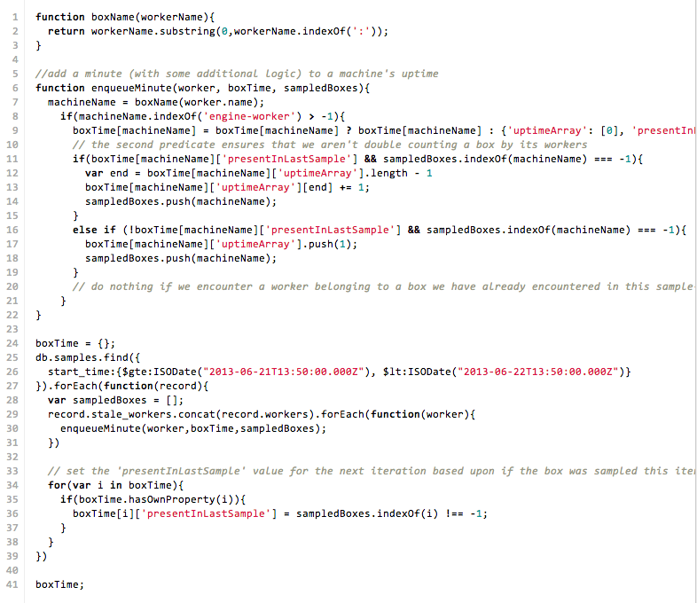
Autolaunch Usage Data
For Analyzing Our EC2 Usage
Notes:
----- Meeting Notes (7/29/13 15:51) -----
Also analyzed record samples from autolaunch mongo database
Developed a map-reduce mongo query that boiled samples down into summaries of how long we had each instance on
These two things should be helpful in the ongoing analysis over our EC2 usage and efficiency questions

Slide 15
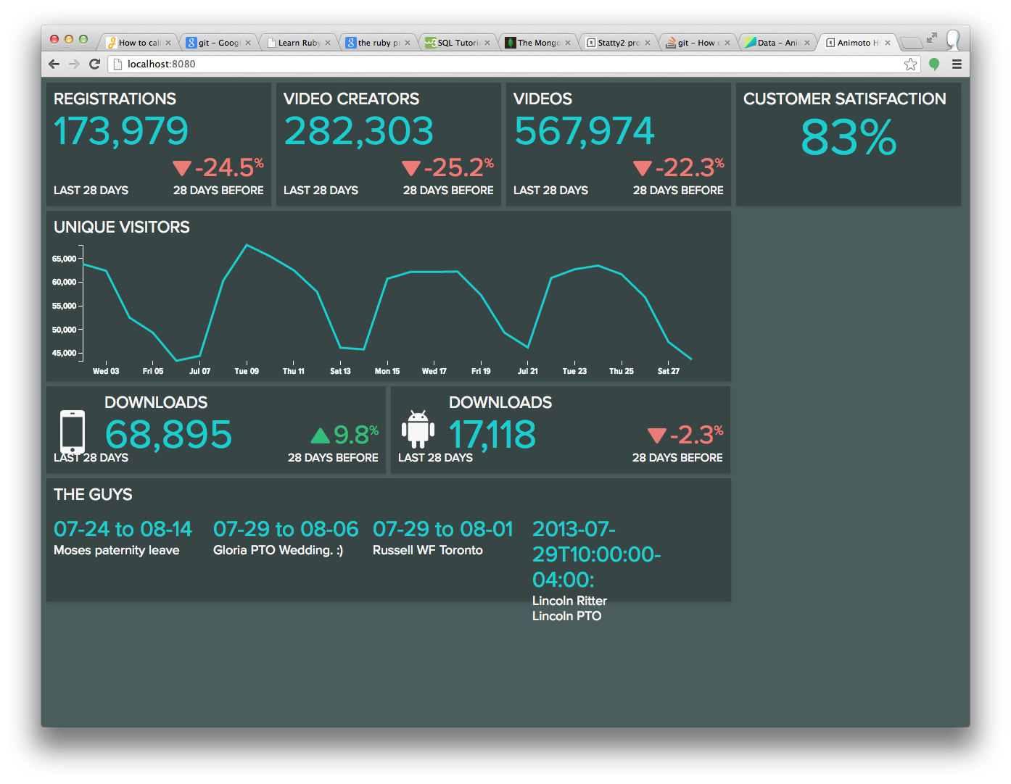
Improving Analytics Dashboard Performance
From Scripting Style to Object-Oriented Style – Significant Performance Gain
Notes:
----- Meeting Notes (7/29/13 15:18) -----
Discuss speeding up the dash

Slide 16
Structure–Before
User Requests Page
Display and Chart in Browser Window
Transform Data (JavaScript)
RJMetrics API Call
Distimo API Call
Extract Relevant Google Data
Google Authentication/API Calls
Client
Intermediate
Server
Notes:
----- Meeting Notes (7/29/13 15:18) -----
What the old structure was like

Slide 17
Structure–After
Automatically Done Every 15 Minutes on The Server
User Requests Page
Display Data and Charts Using NVD3 (coming soon)
Unpack Pre-Parsed JSON
Extract Relevant Google Data
Google Authentication/API Calls
Client
Intermediate
Server
Erase All Stored Data
RJMetrics/Distimo API Calls
Store Raw Data
Melt Raw Data From Multiple Sources Into Standard Format
One Script to Roll Up and Aggregate Molten Data Into Desired Statistics
Write Desired Statistics as JSON File on Server
Notes:
----- Meeting Notes (7/29/13 15:18) -----
New structure (explain the cyclic caching part)

Slide 18
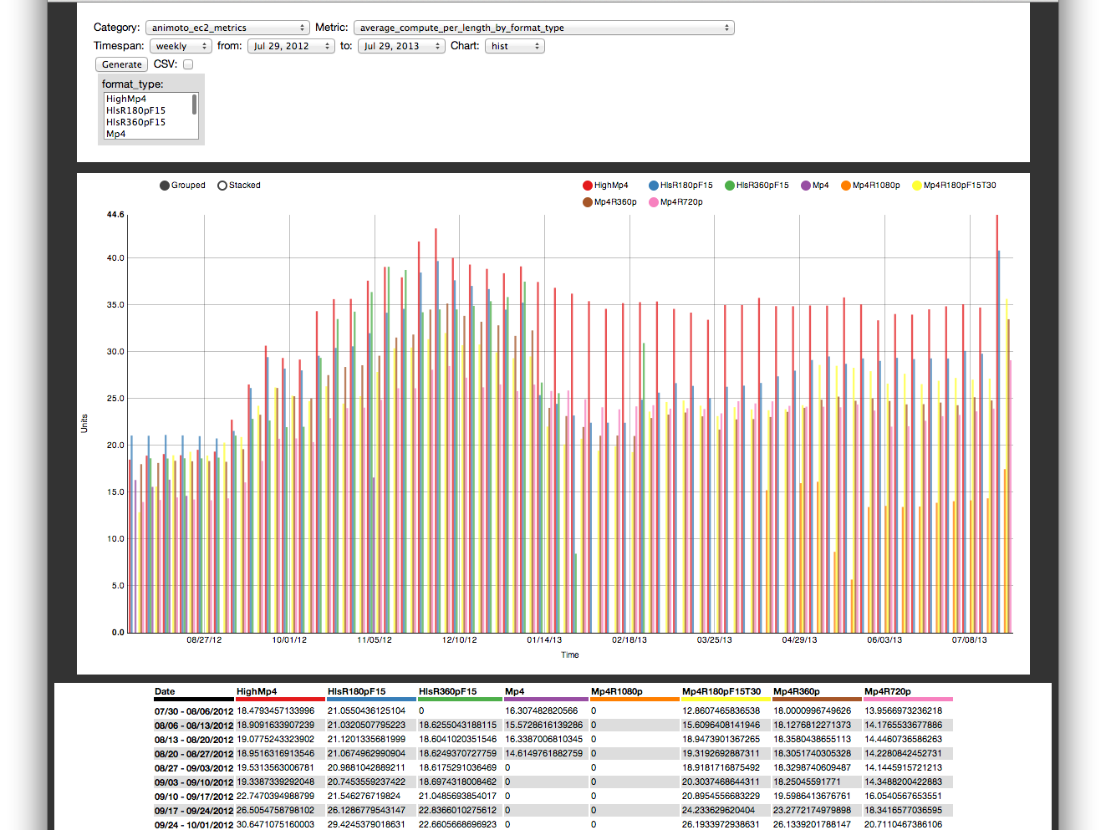
Revising Statty2
Bugs and Other Stuff
Notes:
----- Meeting Notes (7/29/13 15:42) -----
Would like to bring attention to a subtle, but useful bug fix in statty2

Slide 19
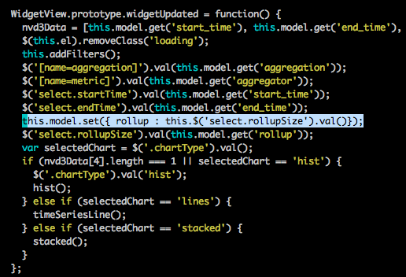
Preventing Rollup Reset
Notes:
----- Meeting Notes (7/29/13 15:42) -----
Fixed the Bug where statty2 would reset the rollup (weekly, hourly, etc) upon changing and refreshing a different parameter.
----- Meeting Notes (7/29/13 15:44) -----
Was only a one-line fix, but took considerable time to track it down across the whole application

Slide 20


Result: More Convenience
Original Query
After Changing a Date
Notes:
----- Meeting Notes (7/29/13 15:45) -----
Now, that bug is fixed, should be a much better user experience for most

Slide 21

Amazon EC2 Analysis
Looking at Amazon EC2 Usage in Multiple Ways
Notes:
----- Meeting Notes (7/29/13 15:51) -----
As part of an ongoing project, I did some work on analyzing our Amazon EC2 (cloud compute) usage in different ways

Slide 22
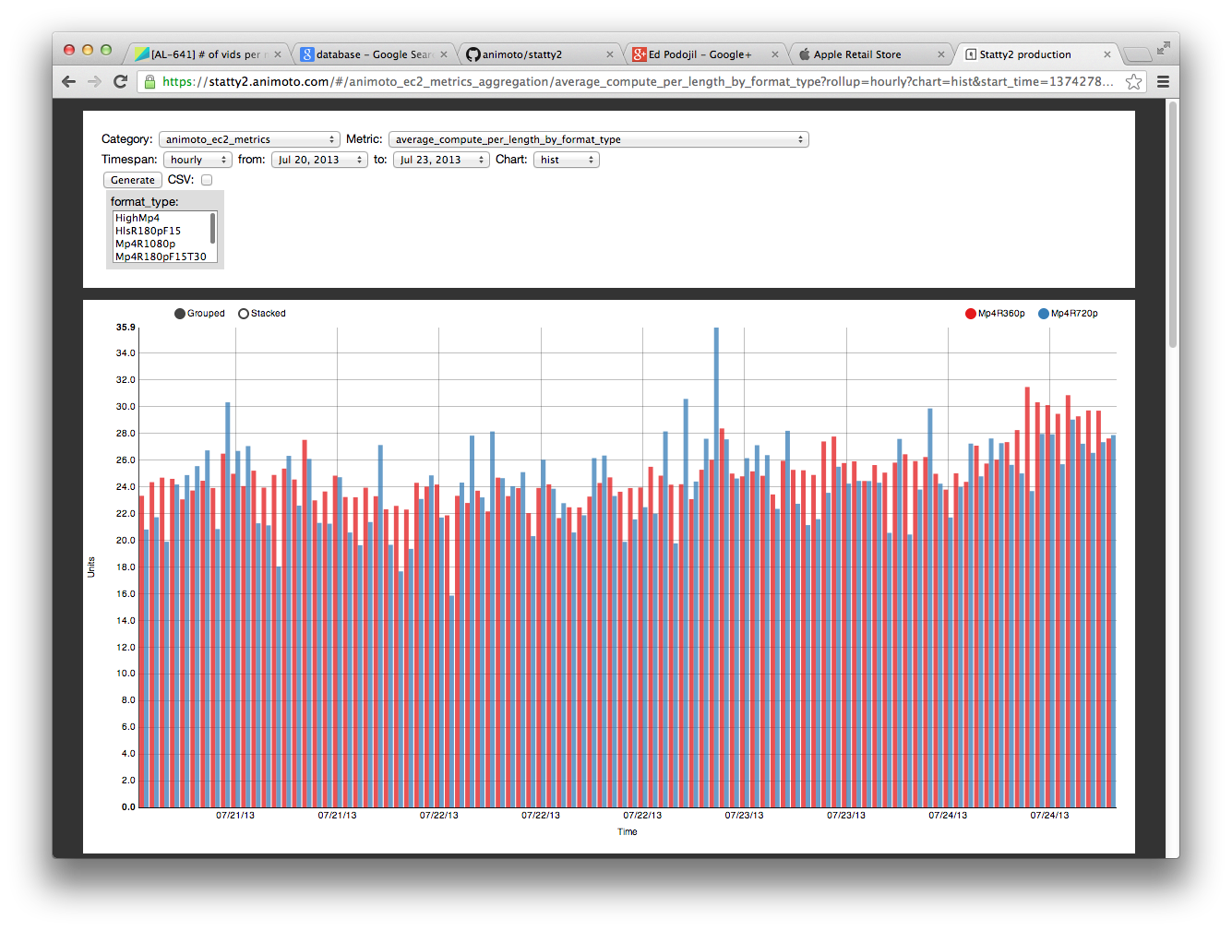
A New Report In Statty2
Compute Time Per Video Length and Total Time Spent Rendering Are Now Available on Demand in Statty2
Notes:
----- Meeting Notes (7/29/13 15:51) -----
Part of It–new report in statty2
displays two new metrics (compute time per video length, and total render time)
displays it for chosen time periods, can be broken down by any combination of style, format, subscription type, or nothing

Slide 23

That’s It!
Questions?
Notes:
----- Meeting Notes (7/29/13 15:51) -----
That brings me to the conclusion of my presentation. Does anyone have questions?

