Slide 1
8 Weeks at Animoto: Learnings, Musings, Experiences
Atul Tiwary
Notes:
----- Meeting Notes (7/29/13 14:56) -----
Thank you for coming
Have learned a lot, am here to showcase that knowledge as a data engineering intern for the past 8 weeks

Slide 2
Overview
Previous Background (Java, C)
Learning Ruby, R, JavaScript, Git
Databases and Queries (SQL, Mongo)
Projects
Analytics Dashboard
SQL Queries and their insights
Statty2 Bugs
Amazon Web Services EC2 Project
Demonstration
Questions
Notes:
----- Meeting Notes (7/29/13 14:56) -----
To Give a
----- Meeting Notes (7/29/13 15:18) -----
Give a brief overview of what I will talk about today

Slide 3

Previous Experience
Primarily Java
Good Bit of C
Very Little in High-Level Languages
No Database Experience
Notes:
----- Meeting Notes (7/29/13 15:18) -----
From studies, know plenty of Java, fair bit of C
Never really looked at or studied high level languages (Ruby, R, etc)
Knew what databases where, but never "used" one or wrote queries or performed analytics through them

Slide 4




Languages Learned Here
Ruby
R
JavaScript
Git (not a language, but still relates to programming!)
Notes:
----- Meeting Notes (7/29/13 15:18) -----
Quickly Picked Up Ruby and R, learned a little JavaScript here and there
Learned how to use Git well (not a language, but very important to know for programming)

Slide 5

Learning Ruby and JavaScript
Great Website: Ruby The Hard Way
(Also StackOverflow)
For the Technical Details: The Ruby Programming Language
JavaScript: All Over The Internet, But Primarily StackOverflow!
Notes:
----- Meeting Notes (7/29/13 15:18) -----
Learned basic syntax and ruby ideas from Ruby The Hard Way
Technical Details About the Language: Ruby Programming Language Book
JavaScript: Bits and pieces from the internet, some semblance to Java
Of Course, can't forget about StackOverflow (immensely useful for little issues)
Comparison: I think high-level languages are great to get stuff done fast, at the expense of concreteness and speed (Ruby: different syntax styles across people, sometime unclear functions, lack of strong typing can cause confusion across large applications, very slow)
Lower level languages aren't perfect either (Java: very verbose, strong typing can get kind of annoying, lack of some cool built-in functions)

Slide 6


Learning SQL and Mongo
SQL: Official Reference Manual and Basic Concepts from w3schools
Mongo: Official Website
Notes:
----- Meeting Notes (7/29/13 15:18) -----
Learned basic concept of database querying from w3schools, and picked up on more advanced functions/features from official reference manual. ed also gave some very good practice problems, intro to schema, advice.
Mongo: learned how to translate SQL ideas into Mongo/JS style, realized that Mongo is much more flexible than SQL.
Comparison: Mongo is more powerful in terms of functionality (cursors, data structures, functions, programmatic-ness) but has a much steeper learning curve (strange syntax at first, WAY too many brackets and symbols)

Slide 7
Projects I Worked On
Speeding Up the Analytics Dashboard
SQL Queries Across Different Departments–CTA Usage, Character Usage in Title Cards, iOS video creation before/after Creation Flow
Statty2–Fixing Widget so rollup field doesn’t reset
Amazon EC2 Metrics–Integrating new report into Statty2, Autolaunch data from MongoDB
Notes:
----- Meeting Notes (7/29/13 15:18) -----
With These skills, would like to discuss the main projects that I did when I was here
Reworked architechture to speed up analytics dashboard
Data pulls for different departments/people
Fixing bug in Statty2 that was bothering many people (rollup)
Worked to analyze AWS EC2 usage (statty2 report, autolaunch from mongodb)

Slide 8
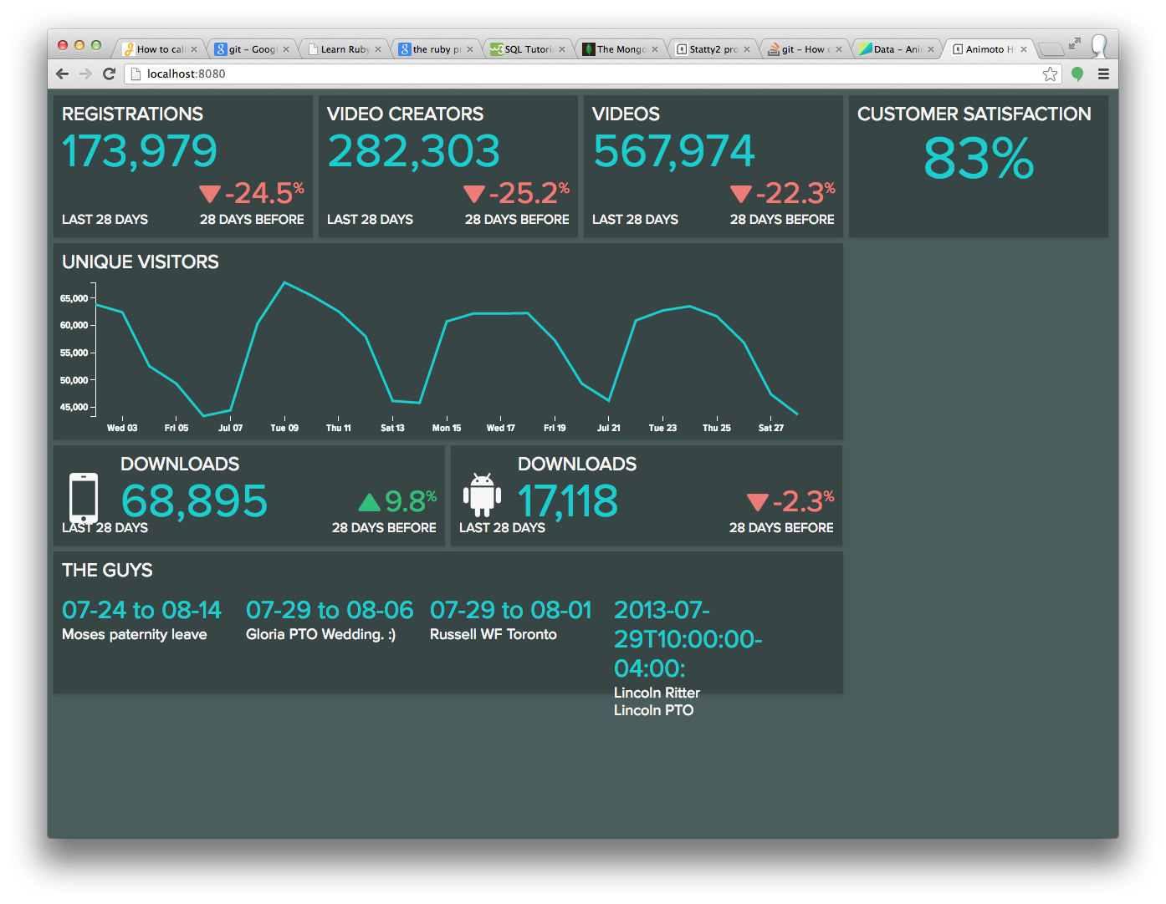
Speeding Up the Analytics Dashboard
From Scripting Style to Object-Oriented Style–Significant Performance Upgrade
Notes:
----- Meeting Notes (7/29/13 15:18) -----
Discuss speeding up the dash

Slide 9
Before and After: Overview
Obtained All Data From API every time page was refreshed
Performed Data Transforms in Every Instance
Large Monolithic Scripts For Obtaining and Transforming From Each Data Source
Uses d3 library for charting
Very Slow Upon Start Up
Caches Data Periodically on the server
Performs Data Transforms on Server and Stores it Periodically
Hierarchical Structure With Standard Interfaces Across Levels for Data Exchange
Will use NVD3 (in the future) for charting–nicer looking and easier to scale with new data
Much Faster Upon Start Up
Notes:
----- Meeting Notes (7/29/13 15:18) -----
Beginning: when user visited the site, the application would pull the data from API calls at that moment, perform data transforms in the browser in javascript, and use the d3 library for charting. Was Very slow.
Wasn't very scalable because of the large individual scripts used for each data source and the specificity of the JS file for each input source
After: Stores required data on server periodically. Has more scalable, hierarchical structure for data exchange and integration, will migrate to NVD3 (better-looking charts and effects) for future charting

Slide 10
Structure–Before
Display and Chart in Browser Window
Transform Data (JavaScript)
RJMetrics API Call
Distimo API Call
Extract Relevant Google Data
Google Authentication/API Calls
Front End
Intermediate
Back End
Notes:
----- Meeting Notes (7/29/13 15:18) -----
What the old structure was like

Slide 11
Structure–After
Automatically Done Every 15 Minutes on The Server
Display Data and Charts Using NVD3 (coming soon)
Unpack JSON Into Local Storage
Extract Relevant Google Data
Google Authentication/API Calls
Front End
Intermediate
Back End
Erase All Stored Data
RJMetrics/Distimo API Calls
Store Raw Data
Melt Raw Data From Multiple Sources Into Standard Format
One Script to Roll Up and Aggregate Molten Data Into Desired Statistics
Write Desired Statistics as JSON File on Server
Notes:
----- Meeting Notes (7/29/13 15:18) -----
New structure (explain the cyclic caching part)

Slide 12

Database Queries For Different People
Learnings and Insights
Notes:
----- Meeting Notes (7/29/13 15:18) -----
Discuss Some of The More Insightful Database Queries

Slide 13
Character Usage in Videos
Analyzed Appearance Frequencies of Unicode (UTF-8) Characters in Title Cards
Challenges: Forcing Java (MacRoman) to Interpret Input and Write Output as UTF-8, Dealing With Right-to-Left Characters
Results: English Characters Vast Majority, but wide variety of Japanese, Korean, and Chinese Characters Also Need to be Considered When Choosing Fonts
For the Motion Design Team to Analyze Rendering Quality of Fonts Over Different Character Planes
Notes:
----- Meeting Notes (7/29/13 15:35) -----
For Motion Design Team: Analyzed Character Frequencies in Videos so that they could decide what types of characters to analyze when deciding upon fonts in videos
As expected, the vast majority of the characters were in English, but there was a very wide variety of East Asian characters that had low frequencies each, but collectively a statistically significant chunk of the characters in use

Slide 14
iOS Creates Before and After Creation Flow
Extracted Data: The Number of Users Who Registered on iOS in the Two Weeks Before and After the Introduction of Creation Flow and Number of Videos Created By These Users
Results:
Before Creation Flow:
107,002 Regs; 131,931 Creates
After Creation Flow:
85,411 Regs; 100,169 Creates
Conclusion: Each User Created Fewer Videos After the Introduction of Creation Flow
For Chris Barnes to Evaluate the Efficacy of Creation Flow in the Mobile App
Notes:
----- Meeting Notes (7/29/13 15:35) -----
Evaluation of Efficacy of Creation Flow Release (iOS)
----- Meeting Notes (7/29/13 15:38) -----
These were the numbers we looked at for before and after the release of creation flow.
In fact, creates per user went slightly down after the release of creation flow
----- Meeting Notes (7/29/13 15:42) -----
Still might be too early to draw conclusions however

Slide 15
CTA Usage
Analyzed the Proportion of Users and Videos (broken down by user type) that used CTAs at least once in their videos
Results:
Photography: 8.1% of users, 9.95% of videos
Business: 5.2% of users, 6.91% of videos
Personal: 1% of users, 0.67% of videos
Conclusions: Significant Number of People (especially photographers) are using this, should evaluate how to better package the feature
For the Product Team to Decide on the Feature’s Future
Notes:
----- Meeting Notes (7/29/13 15:27) -----
Since Photograhers Use this feature more than expected, we can add print-ordering functionality (or however they seem to link their page) directly from the videos instead of through a normal page.
Might be useful to analyze how businesses use this feature to link to different product pages, maybe use multiple CTAs for different demographics of user…?

Slide 16
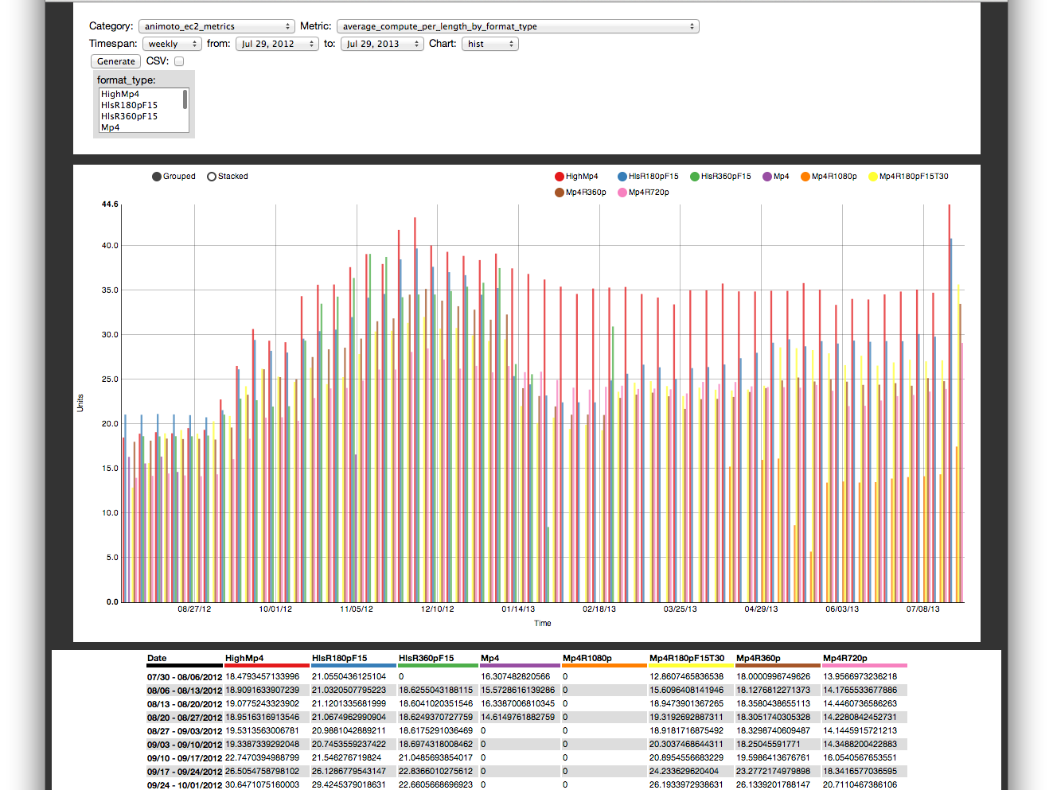
Revising Statty2
Bugs and Other Stuff
Notes:
----- Meeting Notes (7/29/13 15:42) -----
Would like to bring attention to a subtle, but useful bug fix in statty2

Slide 17
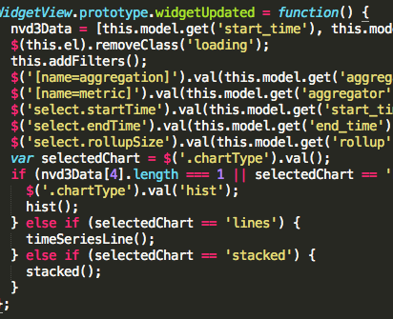
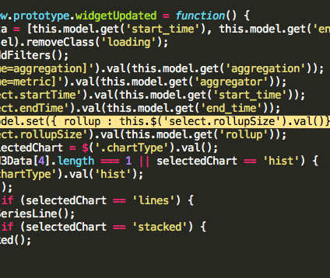
Preventing Rollup Reset
Before
After
Notes:
----- Meeting Notes (7/29/13 15:42) -----
Fixed the Bug where statty2 would reset the rollup (weekly, hourly, etc) upon changing and refreshing a different parameter.
----- Meeting Notes (7/29/13 15:44) -----
Was only a one-line fix, but took considerable time to track it down across the whole application

Slide 18


Result: More Convenience
Original Query
After Changing a Date
Notes:
----- Meeting Notes (7/29/13 15:45) -----
Now, that bug is fixed, should be a much better user experience for most

Slide 19

Amazon EC2 Analysis
Looking at Amazon EC2 Usage in Multiple Ways
Notes:
----- Meeting Notes (7/29/13 15:51) -----
As part of an ongoing project, I did some work on analyzing our Amazon EC2 (cloud compute) usage in different ways

Slide 20
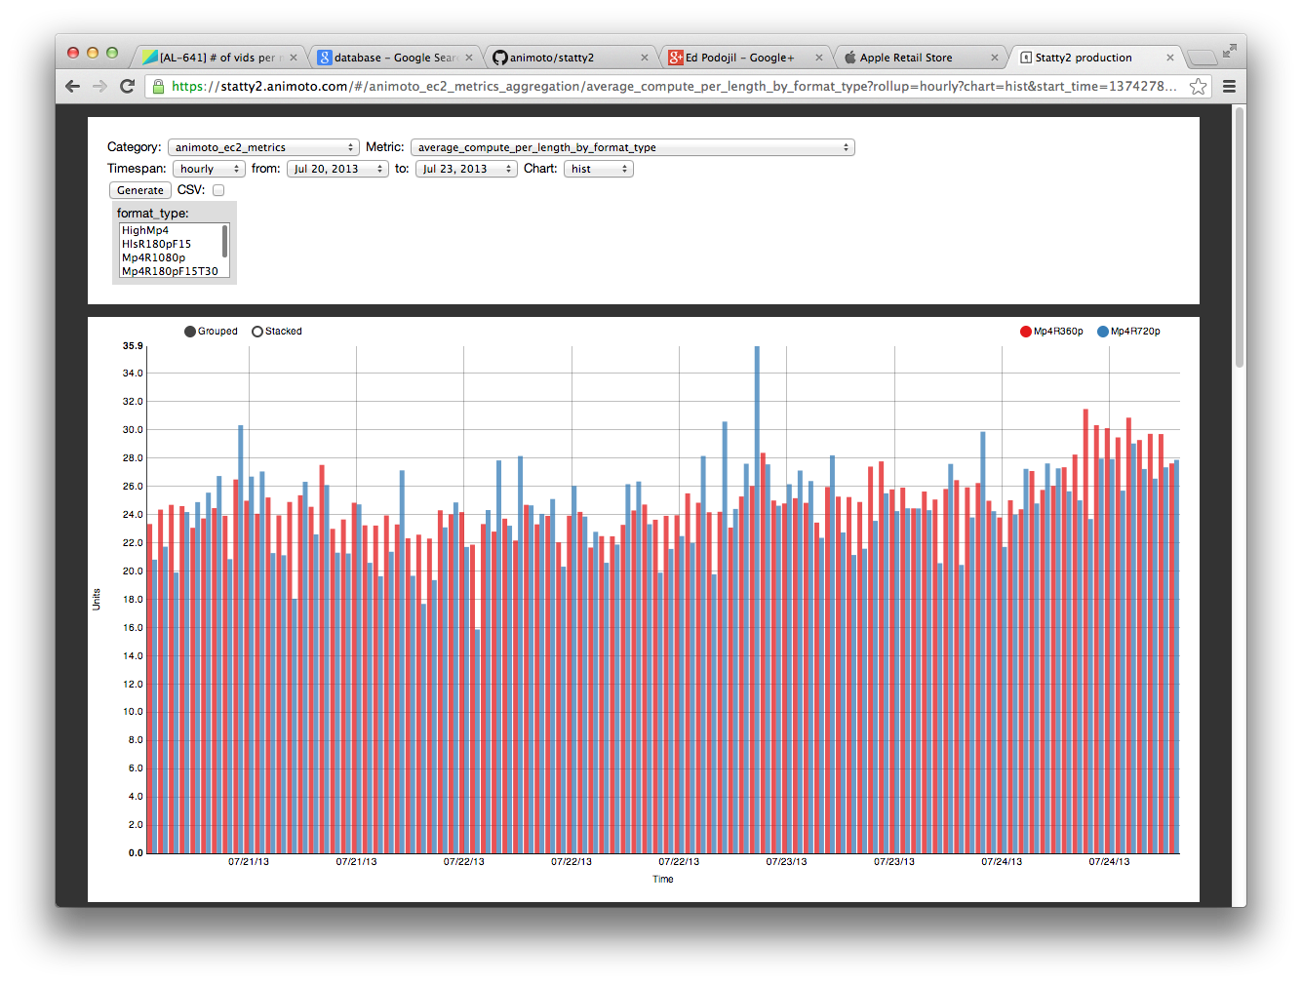
A New Report In Statty2
Compute Time Per Video Length and Total Time Spent Rendering Are Now Available on Demand in Statty2
Notes:
----- Meeting Notes (7/29/13 15:51) -----
Part of It–new report in statty2
displays two new metrics (compute time per video length, and total render time)
displays it for chosen time periods, can be broken down by any combination of style, format, subscription type, or nothing

Slide 21
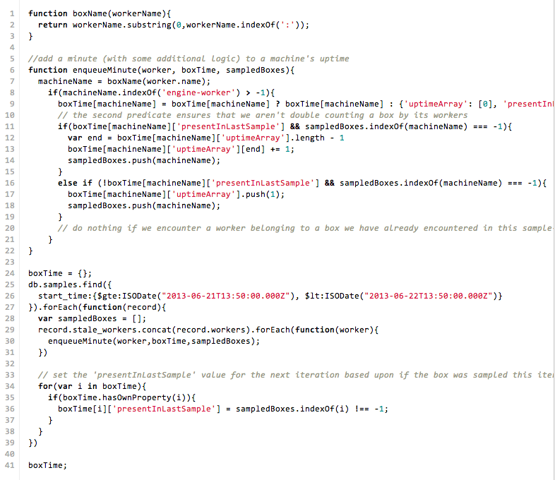
Autolaunch Usage Data From Mongo
Now we can keep track of how long we keep instances in Amazon Web Services Running
Notes:
----- Meeting Notes (7/29/13 15:51) -----
Also analyzed record samples from autolaunch mongo database
Developed a map-reduce mongo query that boiled samples down into summaries of how long we had each instance on
These two things should be helpful in the ongoing analysis over our EC2 usage and efficiency questions

Slide 22

That’s It!
Questions?
Notes:
----- Meeting Notes (7/29/13 15:51) -----
That brings me to the conclusion of my presentation. Does anyone have questions?

