Slide 1
IDT Content Rate Extract
Architecture OVERVIEW JAN 2019

Slide 2
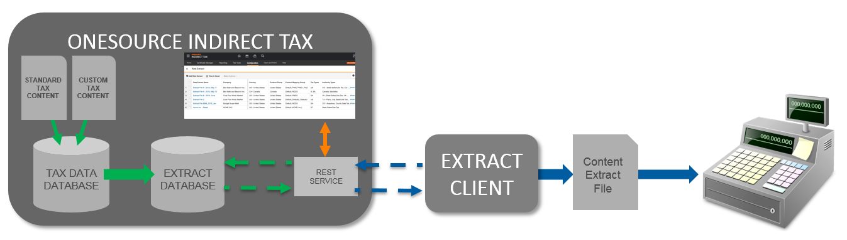
Content Extract - DATAFLOW

Slide 3
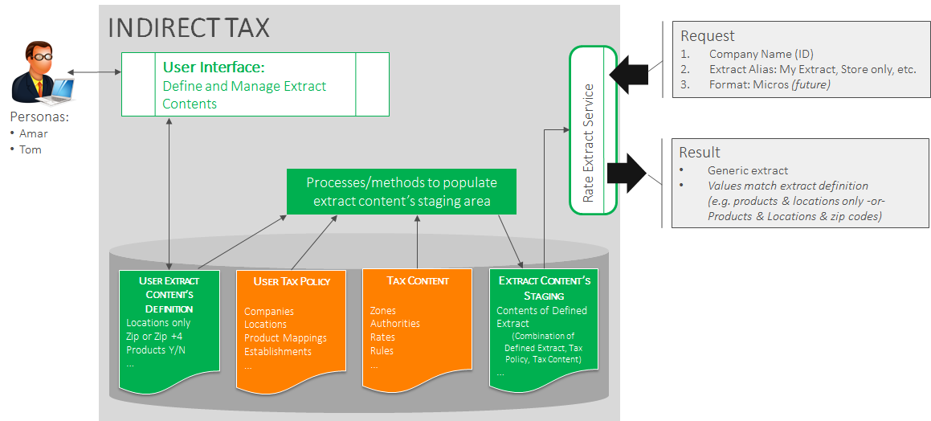
Business Example

Slide 4
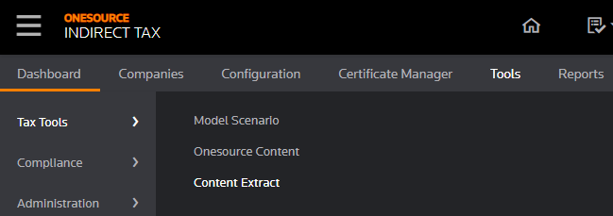
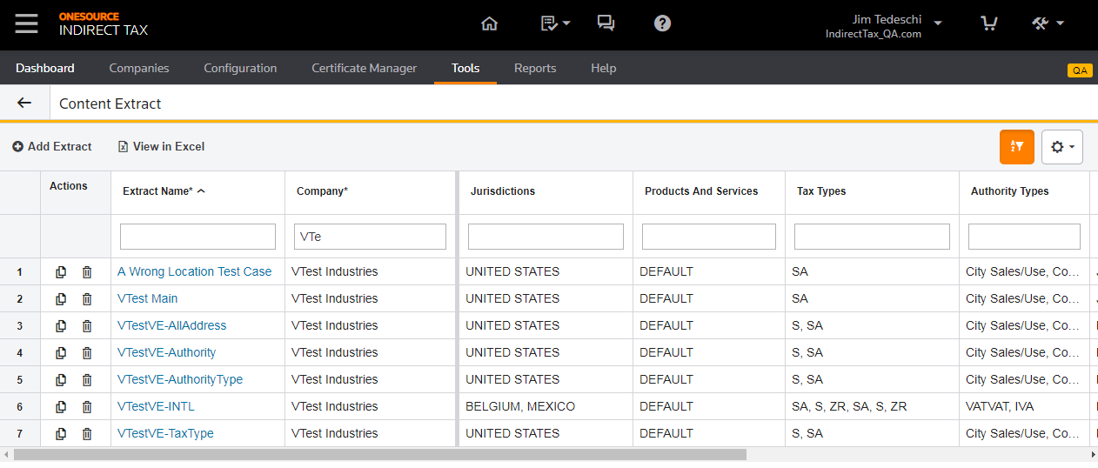
Cloud UI

Slide 5
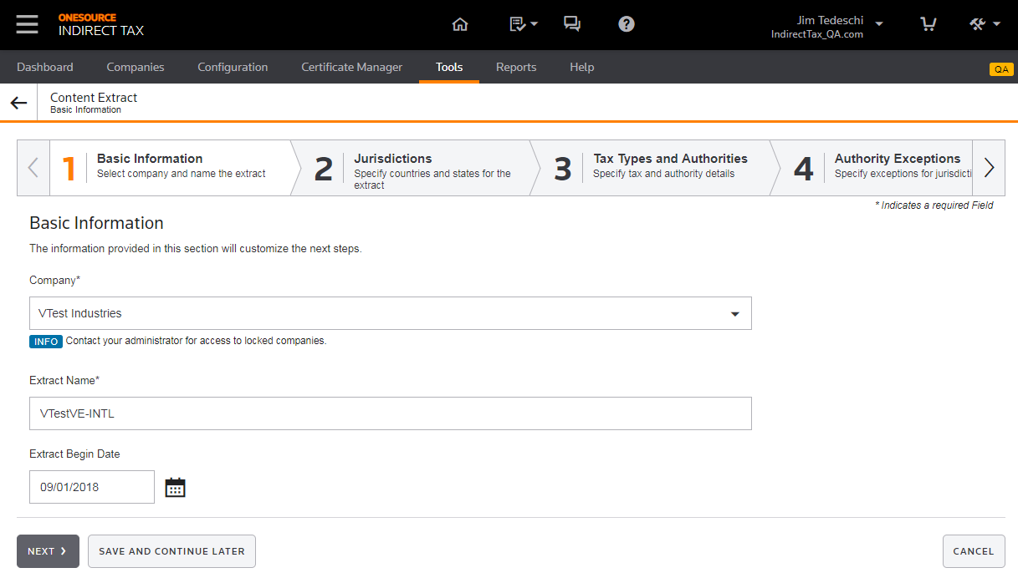
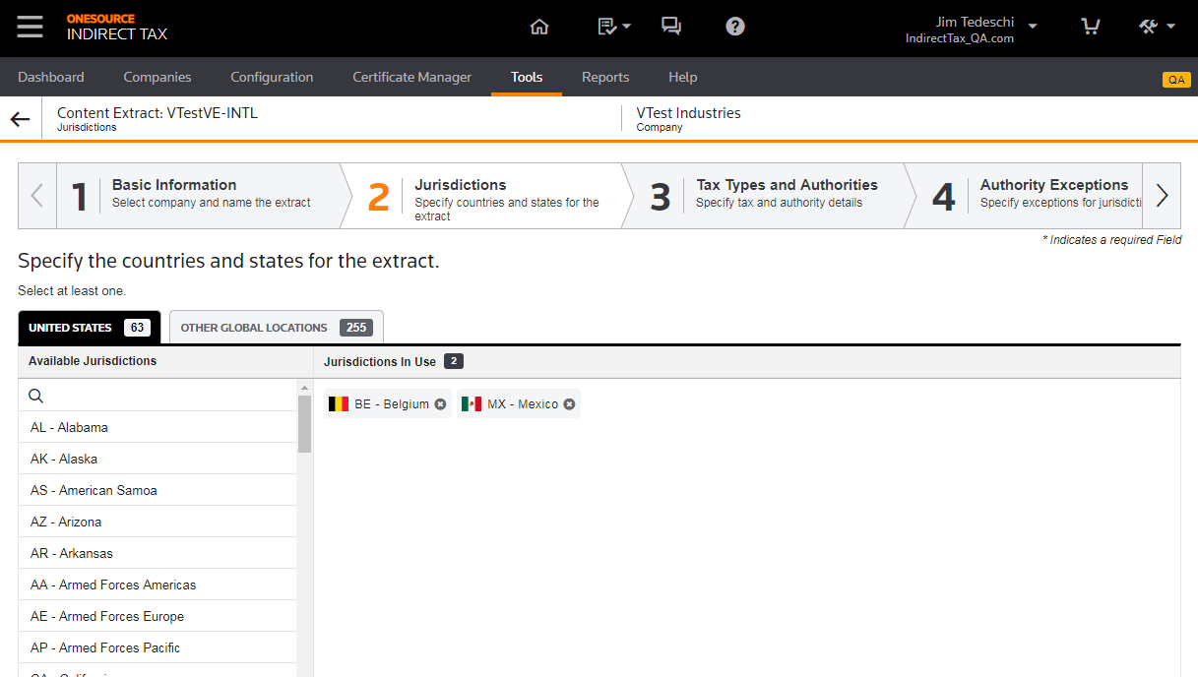
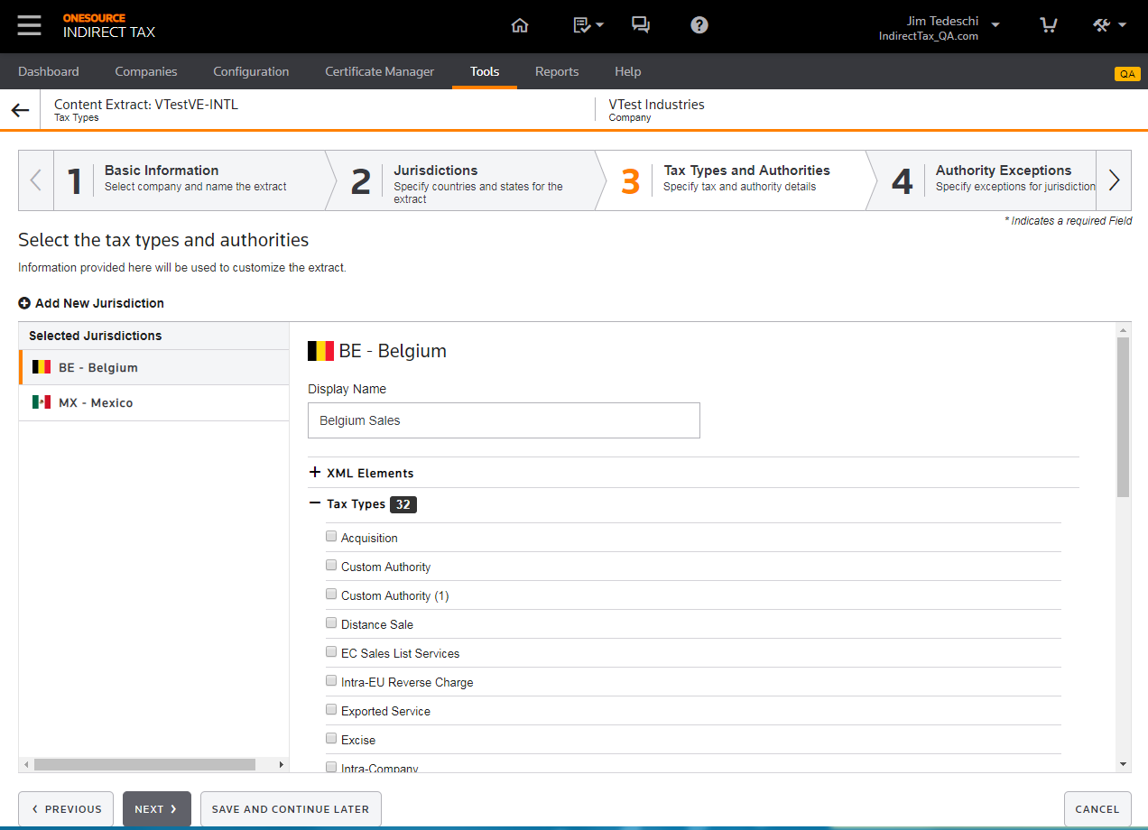
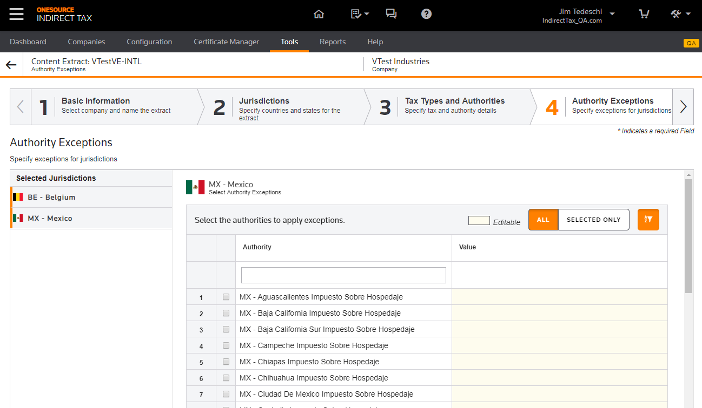
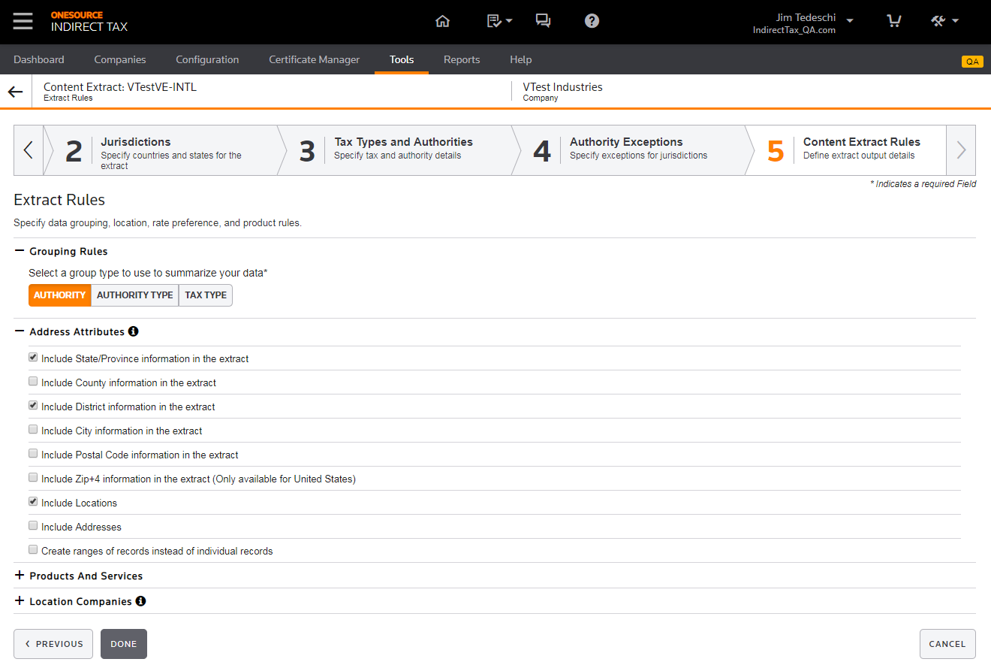
Configuration Wizard

Slide 6
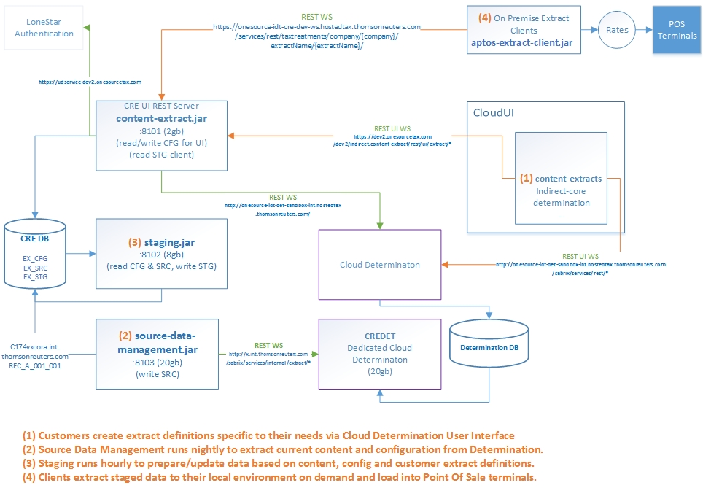
Spring Boot Components

Slide 7
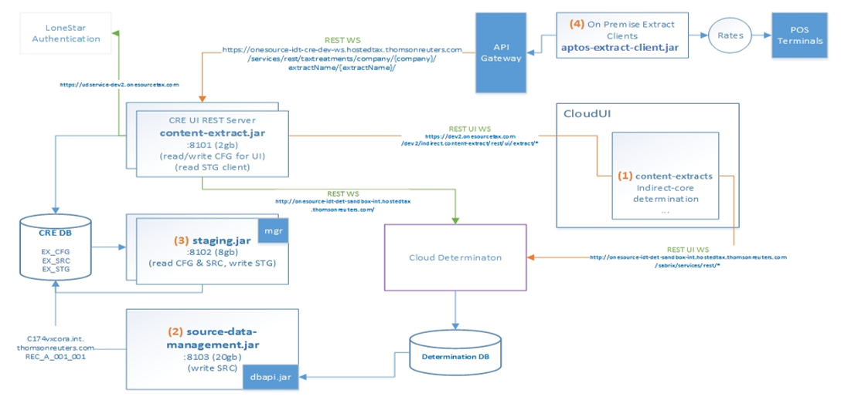
Cloud Considerations
Eliminate need for dedicated Determination node (currently in test)
Horizontally scalable Staging process (needs sequences and mgr)

Slide 8
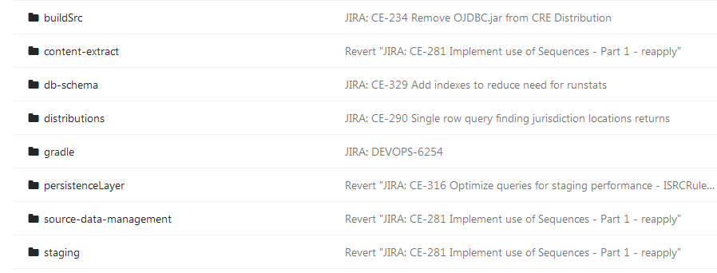
Code Base
https://git.sami.int.thomsonreuters.com/trta-idpt/cloud-rate-extract
Common persistence layer, content-extract (UI back end), Staging and SDM
https://git.sami.int.thomsonreuters.com/trta-idpt/cloud-ui/tree/develop/content-extracts
https://git.sami.int.thomsonreuters.com/trta-idpt/aptos-extract-client
https://git.sami.int.thomsonreuters.com/trta-idpt/cloud-rate-extract-client-xstore

Slide 9

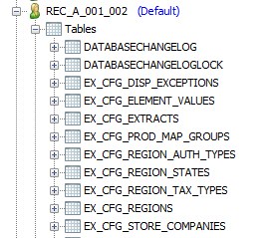
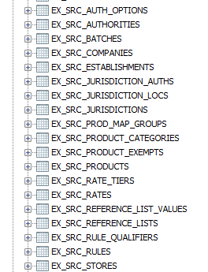
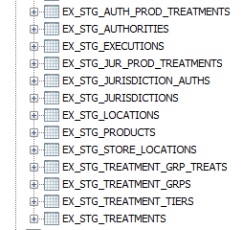
Database
EX_CFG contains user extract definitions entered via UI
EX_SRC contains all Content and Company Configurations from Determination. Refreshed every 12 hours. System deletes old batches every time a new batch is created.
EX_STG is the processed intersection of extract configuration and content. This is the data that gets pulled by the POS client.

Slide 10
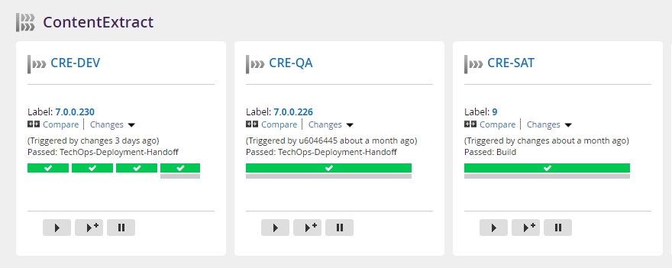
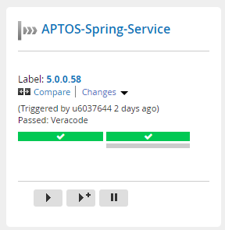
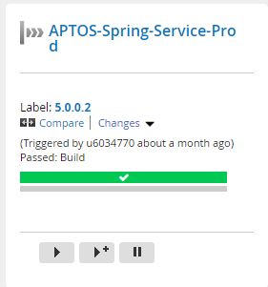
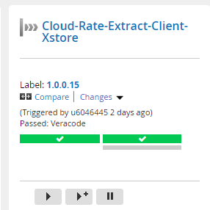
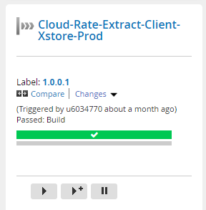
Continuous Delivery
http://go.corp.ositax.com:8153/go/pipelines

Slide 11
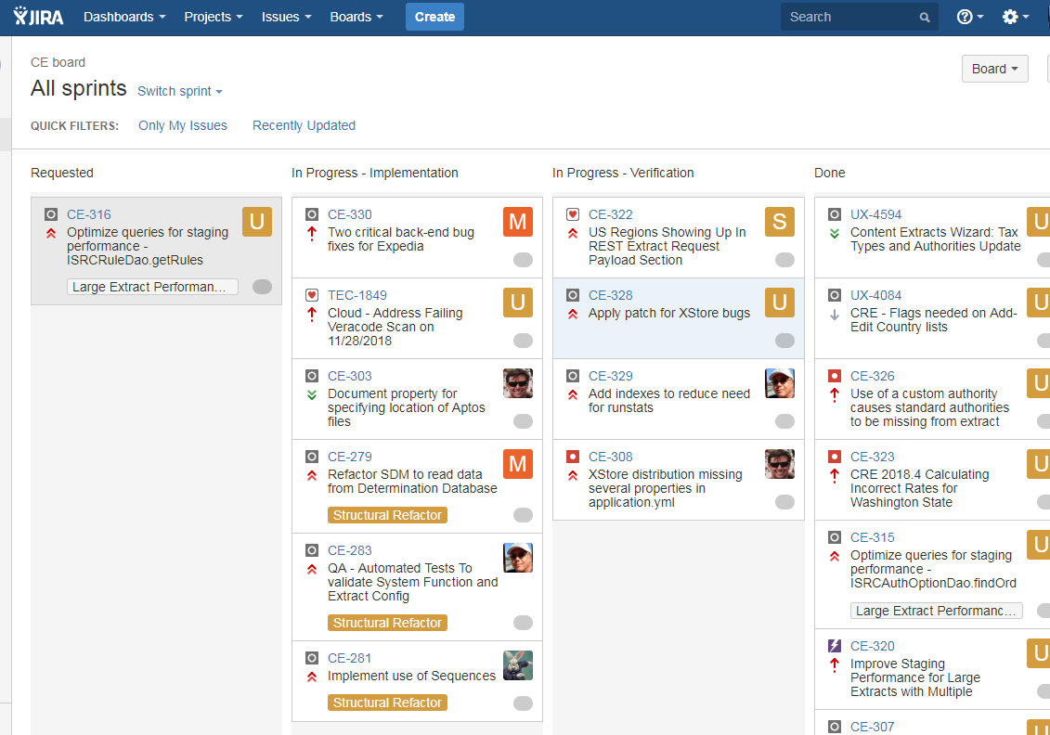
Kanban
http://jira.corp.ositax.com:9090/secure/RapidBoard.jspa?rapidView=97

Slide 12
Current Status
Kanban team with PM, 1 backend developer, 2 part-time QA meeting regularly with planned monthly release schedule.
Able to monitor application health in all environments
User interface completely developed
Developed automation of rate validation, to be turned over to QA at some point.
Currently able to handle volume but refactoring is in progress to support future increases in Content and omit need for a dedicated Determination node.
Original design document (who, what why…) https://thehub.thomsonreuters.com/docs/DOC-2383264
Dev Hub Page https://thehub.thomsonreuters.com/docs/DOC-2536668
Design Hub Page https://thehub.thomsonreuters.com/groups/indirect-tax-development/projects/pos-extract/content

Slide 13
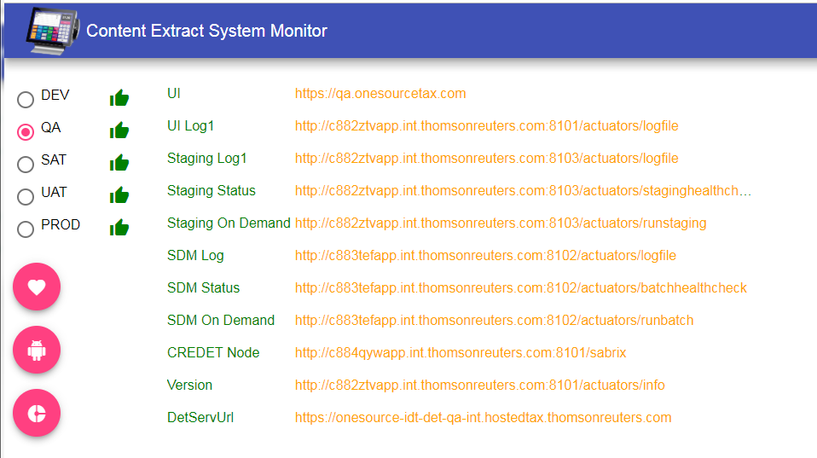
Tools to aid monitoring and testing
Angular 6 / NodeJS Internal Application
https://trta-idt-techops-int-smoke-uat.hostedtax.thomsonreuters.com/

Slide 14
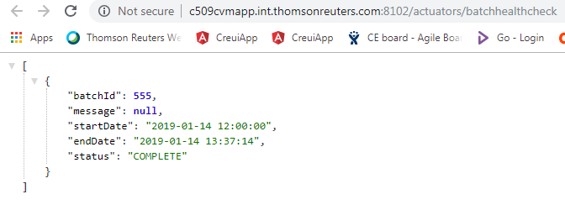
SDM Health Check
Accessible within TR Network
Should show one complete batch and possibly one pending. More than two complete batches indicates Staging is not cleaning up and will trigger an operations notification.

Slide 15
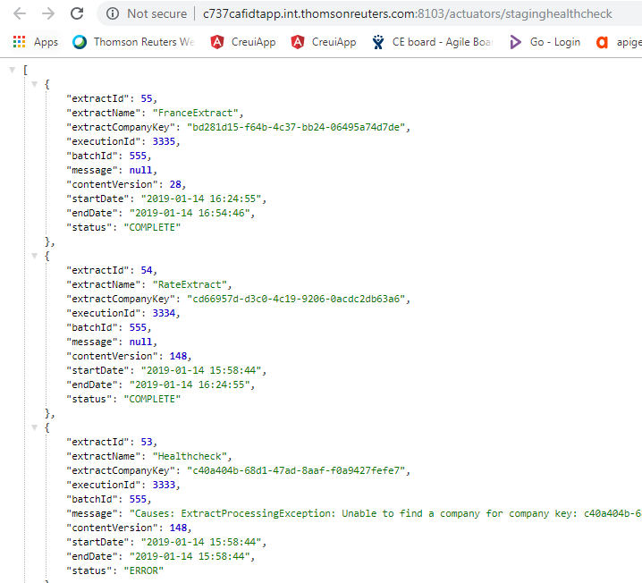
Staging Health Check
Accessible within TR Network
Shows the status of every customer’s extract

Slide 16
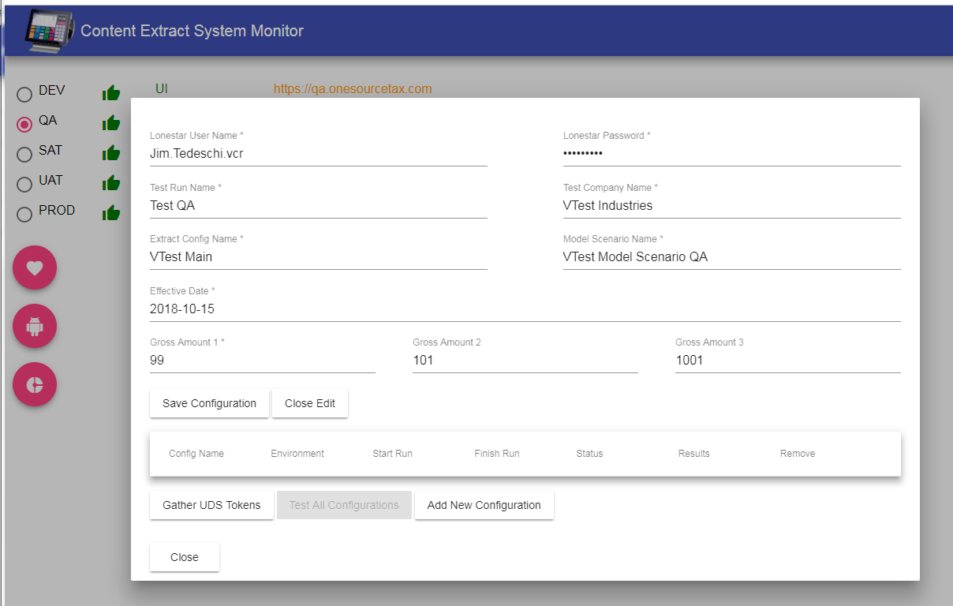
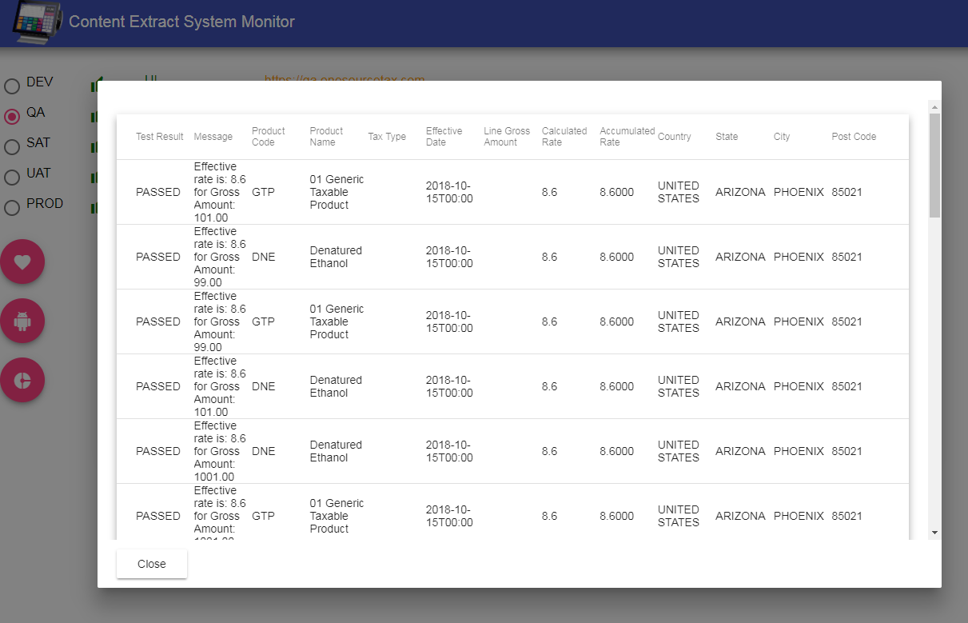
Rates Verification Setup and Results
System calls Determination Model Scenarios and compares rates with extract output. Determination uses dynamic calculation whereas Content Extract rates are denormalized.

Slide 17
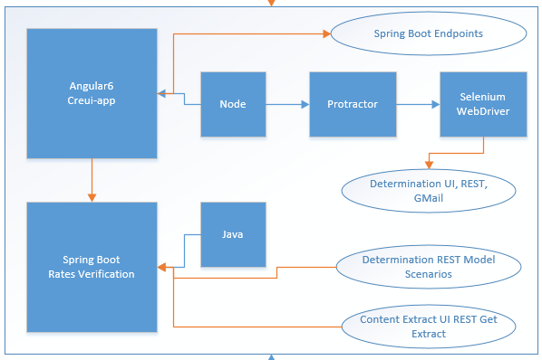
QA Server
Windows VM: c167zhaapp.intqa.thomsonreuters.com
Hosts Monitor/Test tool UI https://git.sami.int.thomsonreuters.com/Jim.Tedeschi/creui-app
Hosts Spring Boot Rate Verification application https://git.sami.int.thomsonreuters.com/trta-idpt/extract-validator

Slide 18
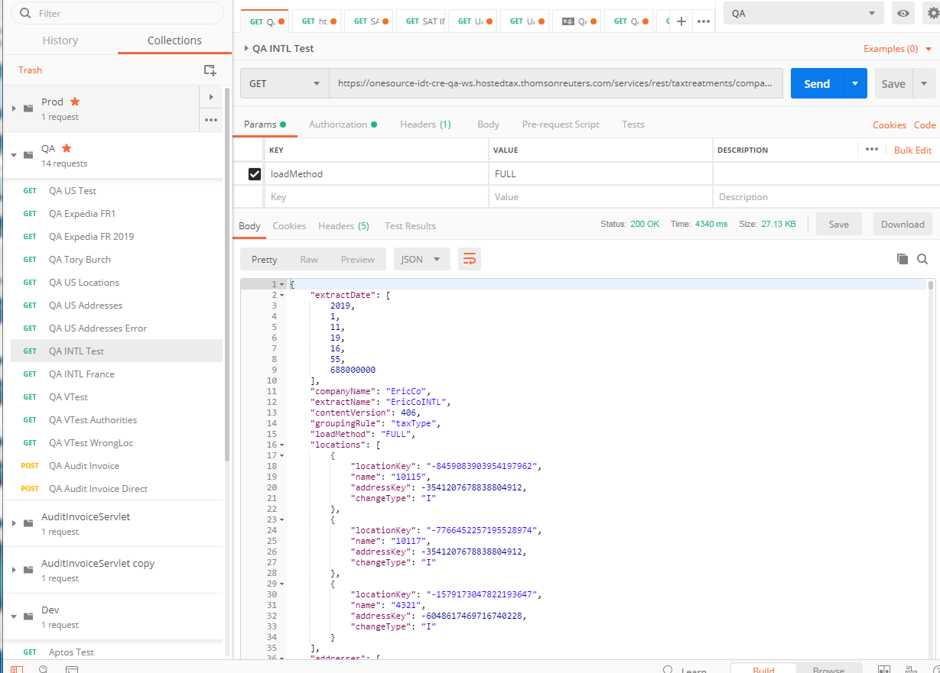
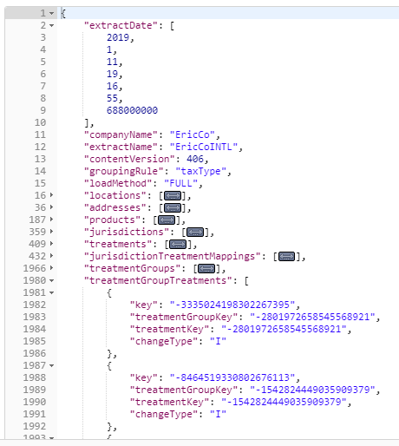
Testing Client Extract with Postman

Slide 19
Q & A
What company configuration is most relevant for POS?
Jurisdictions, Product Mappings and Locations.
Are there restrictions with configuration depending on target POS?
Yes. For APTOS client all Determination location codes and product mapping codes must be numeric up to 4 digits.

