Slide 1

Beyond the Boundary: What Actually Drives
a Billion-Dollar IPL Valuation?
Course: BM5104H Business Statistics and Data Analysis for Management
DATA TANK GROUP ASSIGNMENT
TEAM SHARK 9
# | Name | Roll Number
1 | Pranav C Satheesh | 264024021
2 | Kunwar Atul Ang | 252241017
3 | Parth Arvind Deshmukh | 264024020

Slide 2

The Business Question
For a corporate entity looking to invest in or sponsor an IPL franchise, what is the most cost-effective driver of franchise valuation?
On-Field Performance
Geographic Market Size
Off-Field Digital Engagement
Wins and titles. The intuitive answer.
Home-city GDP and population. The economist's answer.
Social media following. The modern answer.
Dependent variable (Y): 2025 Franchise Brand Value (US$M) · Independent variables (X): Titles · All-Time Win% · Playoff Appearances · Home City GDP · Population · Social Media Followers · Auction Spend
The IPL's total business value hit US$18.5 billion in 2025. The decision this pitch informs: where should a franchise board send its next marginal million dollars?

Slide 3
Data & Methodology
Domain | Source | Coverage
Brand valuation | Houlihan Lokey IPL Brand Valuation Studies | 2024, 2025, 2026
On-field performance | IPL official season points tables | 2008–2023, 136 team-seasons
Titles & playoffs | IPL official results | Through 2026
Market size | Census of India 2011; metro GDP estimates | 2011 / 2022-23
Digital engagement | Instagram + X follower counts | 2025-26 snapshot
Auction spend | IPL auction purse utilisation reports | 2022-2026
Statistical toolkit: Descriptive statistics → Pearson & Spearman correlation → Partial correlation → Conditional probability → Normality testing (Shapiro-Wilk) → Confidence interval estimation → Hypothesis testing (two-sample t-test, one-proportion z-test, one-way ANOVA) → Simple, multiple, and hierarchical regression.
Implementation: Every statistic is a live Excel formula referencing a single source-of-truth data sheet. Supporting deliverable:

Slide 4
Sources Cited
Valuation
Sponsorship
Houlihan Lokey, IPL Brand Valuation Study 2024. https://www.hl.com
Houlihan Lokey, IPL Brand Valuation Study 2025 (8 July 2025). https://www.hl.com
Houlihan Lokey, IPL Brand Valuation Study 2026. https://www.hl.com
Ramesh, A., Tata Group to continue as IPL title sponsor until 2028, India Today (20 Jan 2024). https://www.indiatoday.in
TATA Group retains IPL title sponsorship rights for 2024–28 cycle, Siasat (20 Jan 2024). https://www.siasat.com
Forbes India, Through the IPL, brands have started to speak to the many Indias (12 Apr 2024). https://www.forbesindia.com
Performance & League Data
Indian Premier League, Official Season Points Tables 2008–2023. https://www.iplt20.com
ESPNcricinfo Statsguru, IPL Team Records and Statistics. https://stats.espncricinfo.com
Wikipedia, List of Indian Premier League Records and Statistics. https://en.wikipedia.org
Market Size & Digital
Government of India, Census of India 2011 — Urban Agglomeration Population. https://censusindia.gov.in
Metropolitan GDP estimates 2022–23 (institutional approximations; no official Indian city-level GDP series exists).
Instagram official franchise accounts, follower counts 2025–26. https://www.instagram.com
X (formerly Twitter) official franchise accounts, follower counts 2025–26. https://x.com
Auction
Indian Premier League, IPL 2025 Mega Auction — Team-wise Purse Utilisation. https://www.iplt20.com
Wisden Cricket, IPL Purse Remaining for Each Team After Auction. https://wisden.com
Hindustan Times, IPL Auction — Final Updated Squads of All 10 Franchises. https://www.hindustantimes.com

Slide 5
The Master Dataset
All 10 franchises, all variables
Team | 2025 BV ($M) | 2026 BV ($M) | Titles | Playoffs | Win% (08–23) | GDP ($B) | Social (M) | Auction (₹Cr)
Royal Challengers Bengaluru | 269 | 312 | 2 | 11 | 48.25 | 112.42 | 31.8 | 119.70
Mumbai Indians | 242 | 264 | 5 | 11 | 55.70 | 162.44 | 28.2 | 119.80
Chennai Super Kings | 235 | 244 | 5 | 12 | 57.00 | 91.53 | 34.3 | 119.95
Kolkata Knight Riders | 227 | 245 | 3 | 8 | 49.12 | 75.21 | 13.2 | 119.95
Sunrisers Hyderabad | 154 | 168 | 1 | 8 | 47.44 | 80.06 | 9.1 | 119.85
Delhi Capitals | 152 | 156 | 0 | 6 | 46.49 | 186.14 | 7.3 | 119.80
Rajasthan Royals | 146 | 161 | 1 | 7 | 49.50 | 18.13 | 9.4 | 119.90
Gujarat Titans | 142 | 157 | 1 | 4 | 71.43 | 67.28 | 5.7 | 119.85
Punjab Kings | 141 | 158 | 0 | 3 | 46.49 | 11.70 | 8.3 | 119.50
Lucknow Super Giants | 122 | 122 | 0 | 2 | 60.71 | 10.92 | 4.4 | 119.90
Source: Houlihan Lokey IPL Brand Valuation Studies 2025 & 2026 (hl.com); IPL official season results 2008–2026 (iplt20.com); Census of India 2011 (censusindia.gov.in); Instagram/X franchise accounts 2025–26; IPL auction purse reports 2025.

Slide 6
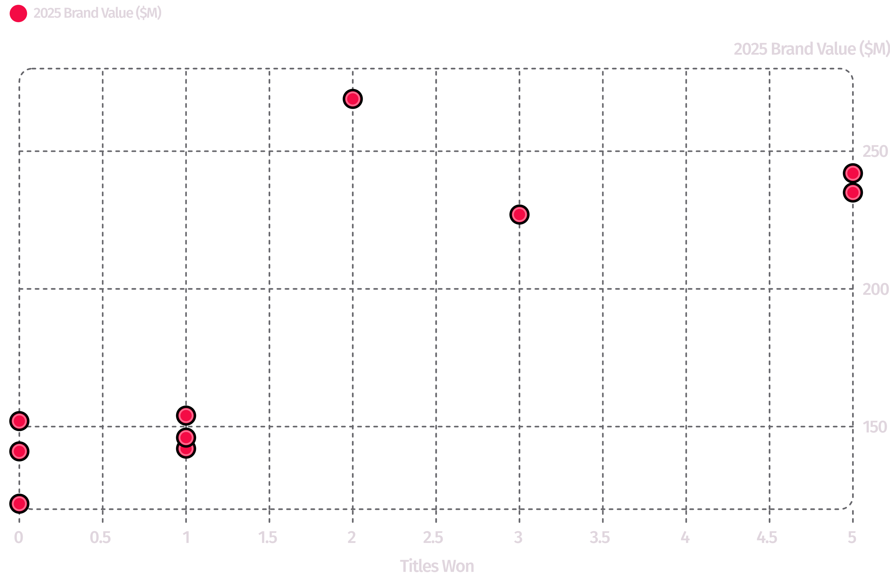
The Hook: Brand Value vs. Titles Won
The Pattern
More titles, more value. r = 0.81.
The Anomaly
RCB is the single most valuable brand at $269M - with only 2 titles. CSK and MI, with 5 titles each, sit below it.
If trophies alone explained valuation, RCB should not be there. Something else is doing the work.
Source: Houlihan Lokey IPL Brand Valuation Study 2025; IPL official results through 2026.

Slide 7

Descriptive Statistics: 2025 Franchise Brand Value (US$M)
Measure | Value
Mean | $183.00M
Median | $153.00M
Standard Deviation (sample) | $53.60M
Variance (sample) | 2,872.67
Minimum | $122M : Lucknow Super Giants
Maximum | $269M : Royal Challengers Bengaluru
N | 10
Read the Gap
Mean ($183M) sits well above median ($153M) the distribution is right-skewed. Four premium brands (RCB, MI, CSK, KKR all above $225M) pull the average up; the remaining six sit between $122M and $154M.
Investor implication: The IPL is not ten comparable assets. It is a two-tier market, separated by roughly $70M.
Source: Houlihan Lokey 2025.

Slide 8
Myth 1: "Money Buys Wins"
Two independent tests. Same verdict.
Test A Pearson Correlation: Auction Spend vs. All-Time Win%
Test B Conditional Probability: P(Above-median Playoffs | Top-50% Spend)
Statistic | Value
Pearson r | 0.3512
t-statistic (df = 8) | 1.0608
p-value | 0.3197 - NOT SIGNIFICANT
Top-50% Spend? | Below-median Playoffs | Above-median Playoffs | Total
No | 2 | 2 | 4
Yes | 3 | 3 | 6
P(Playoffs | Top-50% Spend) = 3/6 = 0.50 — a coin flip
The salary cap compresses spend into ₹119.50–120.00 Cr. Nine of ten franchises spend within ₹0.50 Cr of each other. Under a hard cap, out-spending rivals is structurally impossible.
Source: IPL 2025 mega-auction purse reports (iplt20.com); IPL points tables 2008–2023.

Slide 9
Correlation Matrix: Pearson Correlations Across All Variables
 | 2025 BV | Titles | Win% | GDP | Social | Auction | Population
2025 Brand Value | 1.00 | 0.81 | −0.17 | 0.50 | 0.91 | 0.08 | 0.28
Titles | 0.81 | 1.00 | 0.13 | 0.40 | 0.83 | 0.36 | 0.16
Win% (08–23) | −0.17 | 0.13 | 1.00 | −0.15 | −0.08 | 0.35 | −0.16
City GDP | 0.50 | 0.40 | −0.15 | 1.00 | 0.43 | 0.95 | 0.95
Social Followers | 0.91 | 0.83 | −0.08 | 0.43 | 1.00 | 0.04 | 0.21
Auction Spend | 0.08 | 0.36 | 0.35 | 0.06 | 0.04 | 1.00 | 0.02
Population | 0.28 | 0.16 | −0.16 | 0.95 | 0.21 | 0.02 | 1.00
r = 0.91
r = −0.17
r = 0.08
Social followers - strongest correlate of brand value
Win% correlates negatively with brand value
Auction spend correlates with essentially nothing

Slide 10
Rank & Partial Correlation: Two Robustness Checks
Spearman Rank Correlation - Win% Rank vs. Brand Value Rank
Partial Correlation — Titles ↔ Brand Value, Controlling for City GDP
Statistic | Value
Spearman ρ | −0.1094
t-statistic | −0.3114
p-value | 0.7635 - NOT SIGNIFICANT
Component | Value
r(XY) - Titles Brand Value | 0.8068
r(XZ) - Titles GDP | 0.3983
r(YZ) - Brand Value GDP | 0.5038
Partial r (Titles BV | GDP) | 0.7650
A franchise's rank by win percentage tells you nothing about its rank by brand value.
Titles survive the market-size control (0.807 → 0.765). The market rewards trophies - visible, celebrated moments - not the grinding consistency of a high win rate.

Slide 11
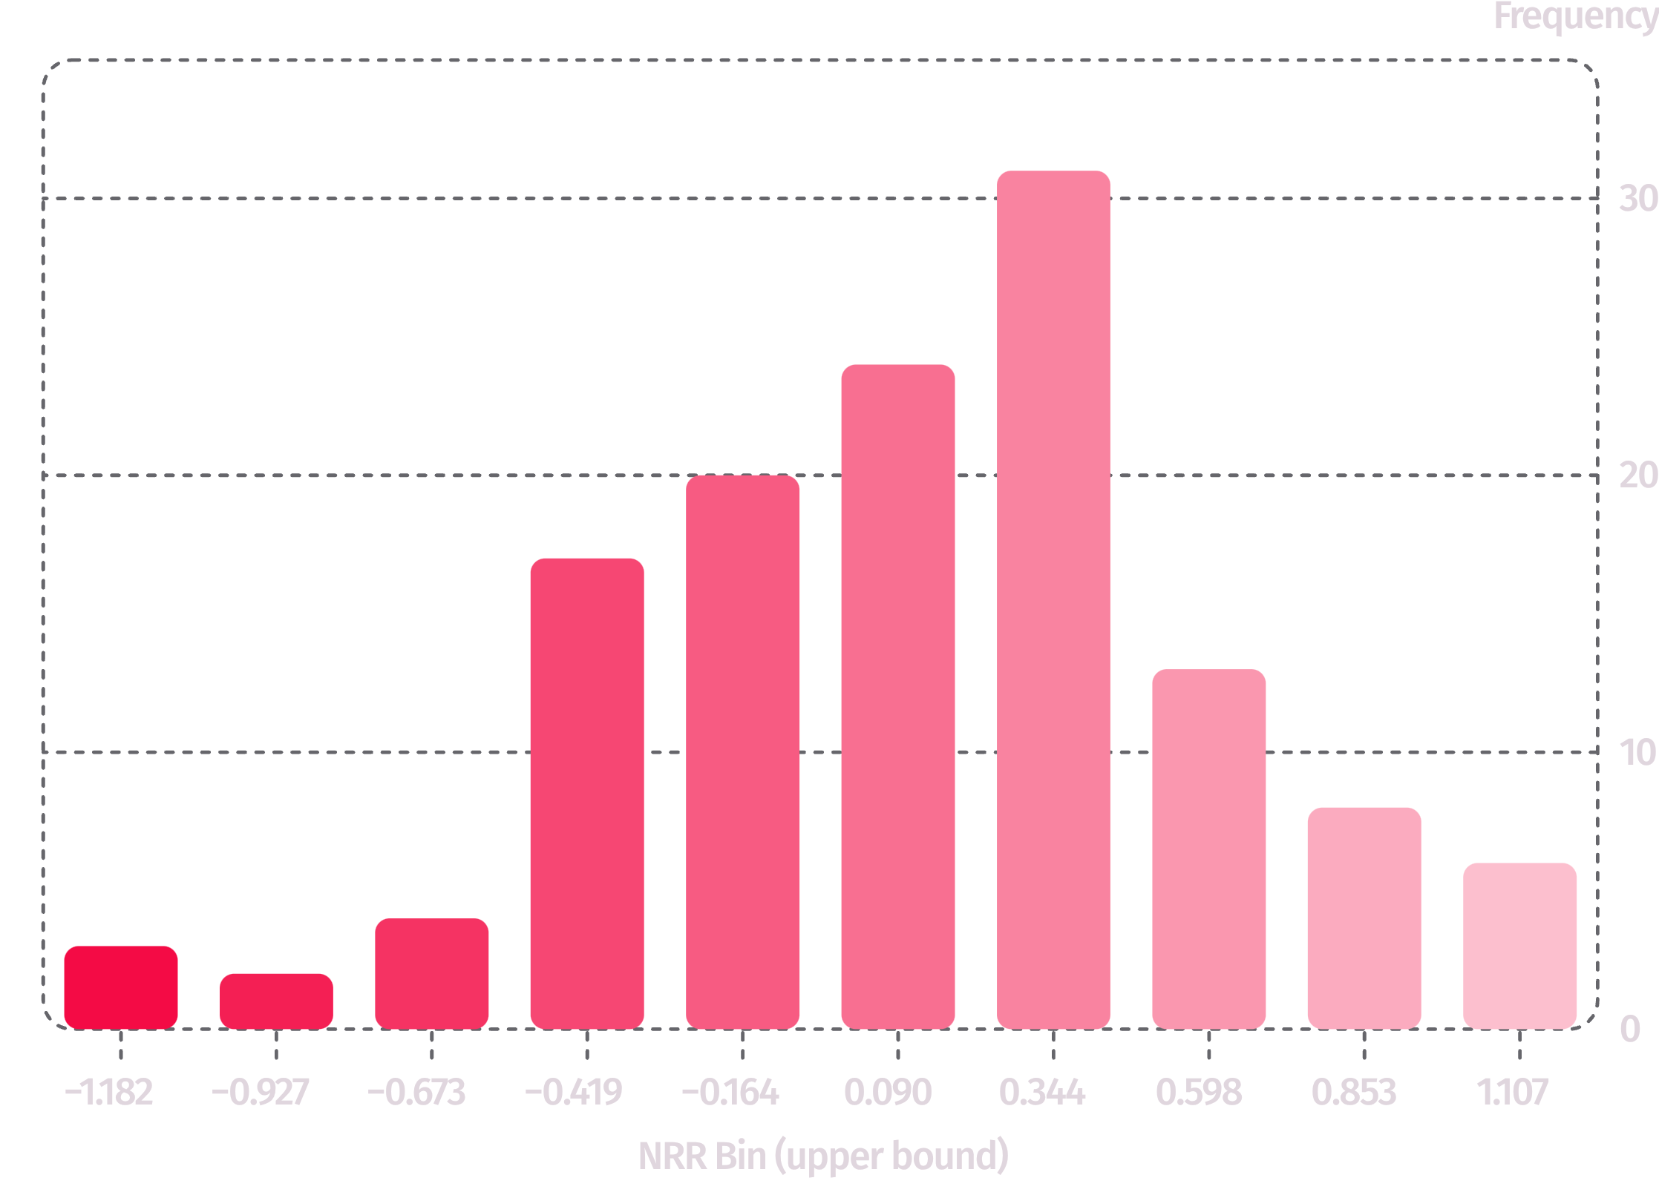
Is the League Competitively Balanced?
Distribution of Net Run Rate, 128 team-seasons (2009–2023)
Statistic | Value
Mean NRR | −0.0002
Standard Deviation | 0.4908
Skewness | −0.1975
Excess Kurtosis | 0.2432
Shapiro-Wilk W | 0.9908
p-value | 0.5152 - FAIL TO REJECT H₀
NRR is consistent with a normal distribution. The IPL is a genuinely balanced competition, no structural dynasty effect. If on-field outcomes are near-random, commercial differentiation must come from off-field activity.

Slide 12
Confidence Interval Estimation
95% CI for Mean Franchise Brand Value
Component | Value
Sample size (n) | 10
Sample mean | $183.00M
Sample standard deviation | $53.60M
Standard error of the mean | $16.95M
Margin of error @ 95% (t, df = 9) | $38.34M
95% CI lower bound | $144.66M
95% CI upper bound | $221.34M
"If a new franchise is introduced in 2027, we can state with 95% confidence that its baseline brand value will fall between $145 Million and $221 Million, setting the floor for the BCCI's auction reserve price."
Honest caveat: This interval describes ten established franchises with existing fanbases and title histories. A 2027 entrant's realistic starting value sits near the low end of this range or below.
Source: Houlihan Lokey 2025. Calculated

Slide 13
Hypothesis Test 1: Two-Sample t-Test
Legacy vs. Expansion Franchises - H₀: No difference in brand value based on franchise age
Group | n | Mean Brand Value
Legacy (founded 2008) | 8 | $195.75M
Expansion (GT, LSG - 2022) | 2 | $132.00M
Conclusion
Legacy franchises command a statistically significant premium of roughly $64M.
Brand equity is time-accumulated. A franchise cannot buy eighteen years of fan memory. Expansion teams are not underpriced legacy teams - they are a different asset class on a different maturity curve.
Test | Value
Welch's two-sample t-test, two-tailed, unequal variance | —
p-value | 0.0181
Decision at α = 0.05 | REJECT H₀
Caveat: Only n = 2 expansion franchises. Treat the magnitude cautiously even though the test clears significance.
Source: Houlihan Lokey 2025; IPL franchise founding records. Computed .

Slide 14
Hypothesis Test 2: One-Proportion z-Test
Is RCB Actually an Underachiever? - H₀: RCB's all-time win percentage equals 50%
Component | Value
RCB win rate (2008–2023) | 48.25%
Matches played (n) | 228
Hypothesised proportion (p₀) | 0.50
Standard error | 0.0331
z-statistic | − 0.5285
p-value (two-tailed) | 0.5972 - FAIL TO REJECT H₀
The Commercial Punchline
RCB is the most valuable brand in the league ($269M → $312M in 2026) while being a statistically average team with just 2 titles - and it holds the largest social following at 31.8M.
Perception and engagement, not the win column, are carrying that valuation.
RCB's long-run win rate is statistically indistinguishable from a coin flip. Across 228 matches, the "RCB always chokes" narrative is not supported by evidence.

Slide 15
Hypothesis Test 3: One-Way ANOVA
Does Auction Spend Differ Across Title Tiers? — H₀: Mean 2025 auction spend is equal across Zero / Single / Multiple-title franchises
Tier | n | Mean Spend (₹Cr)
Zero titles | 3 | 119.73
Single title | 3 | 119.87
Multiple titles | 4 | 119.85
Verdict
Title-winners do not out-spend anyone. All three tiers cluster within ₹0.14 Cr of each other.
The salary cap has produced near-perfect spending parity, and parity in spending means spending cannot explain differences in outcomes.
Method note: Built transparently from component sums of squares using AVERAGEIF and SUMPRODUCT, p-value via F.DIST.RT. Source: IPL 2025 mega-auction purse utilisation reports (iplt20.com).
ANOVA Table
Source | SS | df | MS
Between groups | 0.0327 | 2 | 0.0163
Within groups | 0.1333 | 7 | 0.0190
F-statistic | 0.8575
p-value | -0.4644 - FAIL TO REJECT H₀

Slide 16
Regression: Simple & Multiple Models
Model 1 : Brand Value = β₀ + β₁ (Titles)
Terme | Coefficient | Std. Error | t-stat | p-value
Intercept (β₀) | 142.714 | 14.885 | 9.588 | < 0.001
Titles (β₁) | 22.381 | 5.794 | 3.863 | 0.0048
R² = 0.6510 · Adjusted R² = 0.6074 · F = 14.92 · df = 8 - Each IPL title is worth +$22.38M in brand value. Titles alone explain 65% of variance. A zero-title franchise still carries a $143M baseline - the value of simply holding an IPL slot.
Model 2 — Brand Value = β₀ + β₁ (Win%) + β₂ (Social) + β₃( Population)
Term | Coefficient | Std. Error | p-value | Significant?
Intercept | 146.347 | 62.418 | 0.0575 | -
Win % | −0.593 | 1.083 | 0.6037 | No
Social Followers (M) | 4.117 | 0.765 | 0.0017 | Yes ✓
Population | 0.00000088 | 0.0000019 | 0.6613 | No
R² = 0.8446 · Adjusted R² = 0.7669 · F = 10.87 - With all three competing, only social media is significant. Each additional million followers is associated with +$4.12M in brand value.

Slide 17
Hierarchical Regression: Building the Model in Three Blocks
Block | Variables Entered | R² | ΔR² | What It Tells Us
Block 1 | City GDP | 0.2538 | - | Market size alone explains 25%
Block 2 | + Win %, Titles | 0.7477 | +0.4939 | On-field adds 49 points
Block 3 | + Social Followers | 0.8660 | +0.1183 | Digital adds 12 more
Final Block 3 Coefficients
Term | Coefficient | Std. Error | p-value
Intercept | 164.148 | 68.097 | 0.0608
City GDP | 0.094 | 0.164 | 0.5901
Win % | −0.884 | 1.180 | 0.4875
Titles | 6.444 | 8.780 | 0.4959
Social Followers | 3.069 | 1.461 | 0.0896
Final model: R² = 0.8660 · Adjusted R² = 0.7588 · F = 8.08 -Social media adds ΔR² = 0.118 even after market size and on-field performance are already in the model. Digital engagement explains brand value independently.

Slide 18
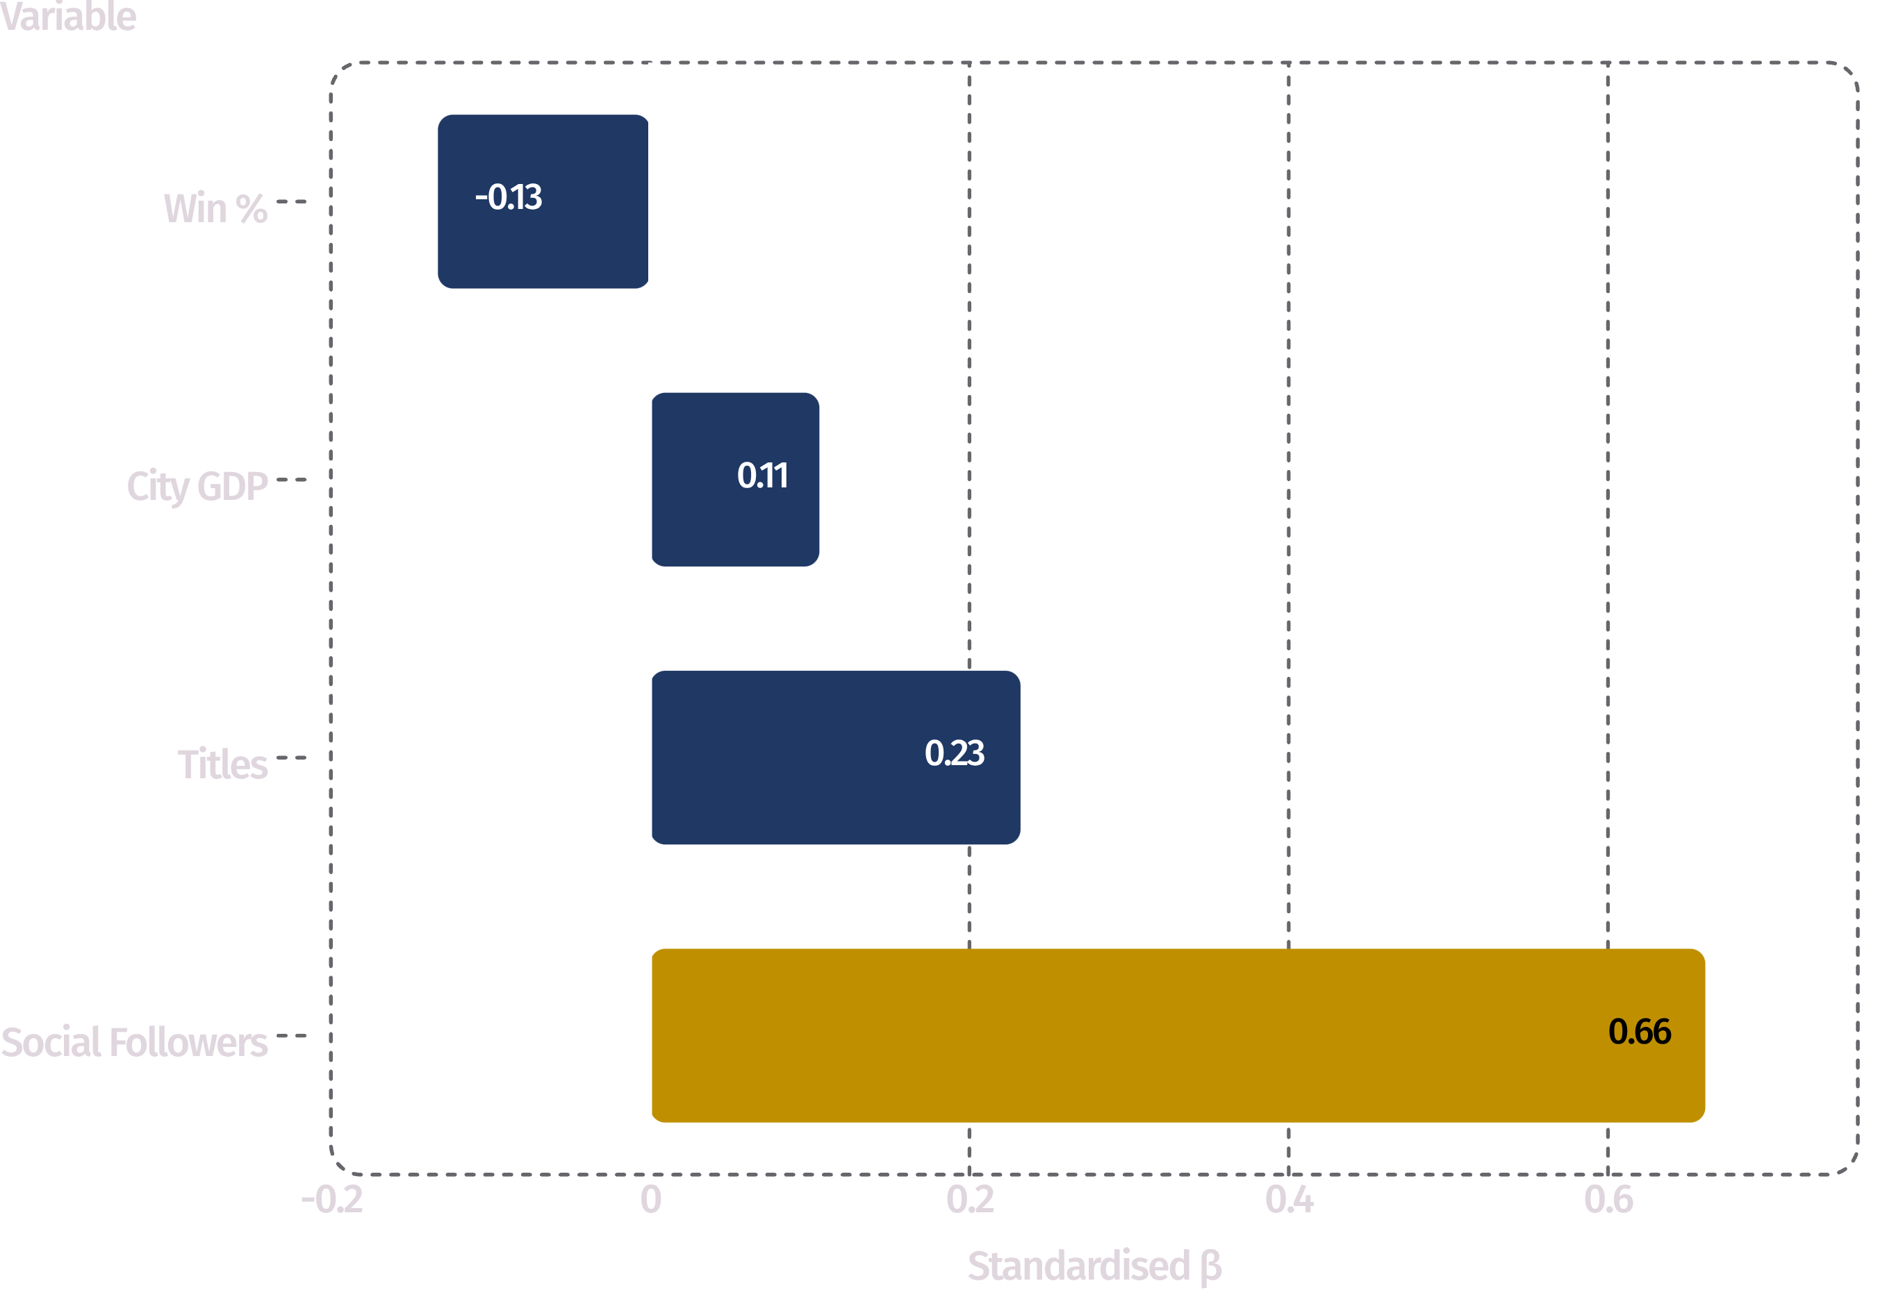
Which Lever Carries the Weight?
Standardised Beta Coefficients - Final Hierarchical Model
Variable | Standardised β | Rank
Social Followers | 0.661 | 1
Titles | 0.232 | 2
Win % | - 0.133 | 3
City GDP | 0.106 | 4
Social media followers carries nearly 3× the weight of titles and roughly 6× the weight of market size. Win percentage is not merely weak - it is negative.

Slide 19
Five Statistically-Backed Findings
1
Money does not buy wins.
Auction spend vs. win %: r = 0.35, p = 0.32 (n.s.). P(playoffs | top-50% spend) = 0.50. The salary cap has eliminated spending as a lever.
2
Winning does not build brand value -trophies do.
Win % correlates negatively (r = −0.17); Spearman ρ = −0.11 (p = 0.76). But titles: r = 0.81, worth +$22.4M each (p = 0.0048), surviving market-size control (partial r = 0.765).
3
Digital engagement is the dominant driver.
r = 0.91 · only significant predictor in multiple regression (p = 0.0017) · ΔR² = 0.118 after performance and market size · largest standardised β = 0.661.
4
Franchise age carries a real premium.
Legacy $195.75M vs. expansion $132.00M (t-test p = 0.0181). Brand equity accumulates with time and cannot be purchased.
5
The league is competitively balanced.
NRR across 128 team-seasons is normally distributed (W = 0.99, p = 0.515) - no dynasty effect. Differentiation must come from off-field activity.

Slide 20

Business Recommendation
→ Off-Field Digital Content and Fan Engagement
The Evidence Chain
Why Not the Alternatives?
Lever | Verdict | Evidence
Auction spend | Capped out | p = 0.32; P = 0.50; 9 of 10 teams within ₹0.50 Cr
Market expansion | Fixed & weakest | β = 0.106, p = 0.59 franchise cannot relocate
On-field performance | Largely stochastic | NRR normally distributed; win % loads negatively (β = −0.133)
β = 0.661
p = 0.0017
Highest standardised beta - nearly 3× titles
Only significant predictor in multiple regression
ΔR² = 0.118
+$4.12M
Contributes after performance and market size are controlled
Brand value per additional million followers
The RCB proof case: The league's most valuable brand ($269M → $312M) is a statistically average team (48.25% win rate, p = 0.60) with only 2 titles - but the largest social following at 31.8M. Titles remain the second-strongest driver (β = 0.232) and should not be abandoned. The claim is one of marginal efficiency.

Slide 21
Limitations & Future Scope
Limitations
Future Scope
Only one League :(n = 10)
Extend to a 2020–2026 panel for fixed-effects estimation and causal inference
All results are directional, not high-powered inference. With 5 predictors against 10 observations, Block 3 coefficients are individually insignificant despite strong overall fit.
Add engagement quality metrics -impressions, watch-time, engagement rate - beyond raw follower counts
Correlation ≠ causation
Incorporate merchandise revenue, gate receipts, and jersey-sponsorship values as additional dependent variables
The arrow between following and value may run both ways - well-run franchises likely invest more in content, so engagement may be partly downstream of success.
Instrumental-variable approach to isolate the causal effect of digital investment on valuation
Cross-sectional design
2025 brand value against all-time performance; a panel would separate long-run equity from current form. Win% excludes 2024–2026 - recent-form effects not captured.
Third-party valuations
Houlihan Lokey figures are institutional estimates, not audited financials. City GDP is an approximation - India publishes no official city-level series.

Slide 22
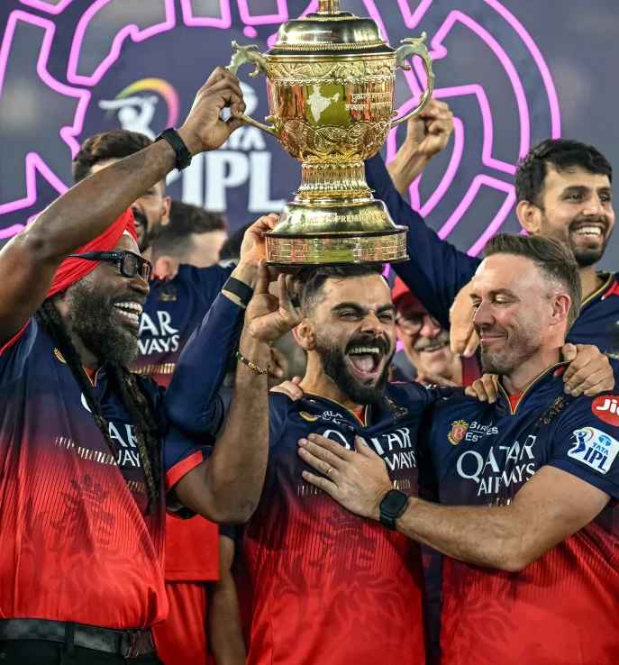
The RCB Paradox:
A Case Study in Attention Economics
$269M
2025 Brand Value
#1 in the league - despite only 2 titles
31.8M
Social Followers
Largest following of any IPL franchise
48.25%
All-Time Win Rate
Statistically indistinguishable from a coin flip (p = 0.5972)
$312M
2026 Brand Value
Growing - without a third title
RCB is the empirical proof that attention is the asset. A statistically average team with 2 trophies commands the league's highest valuation by monetising engagement, not silverware.

Slide 23
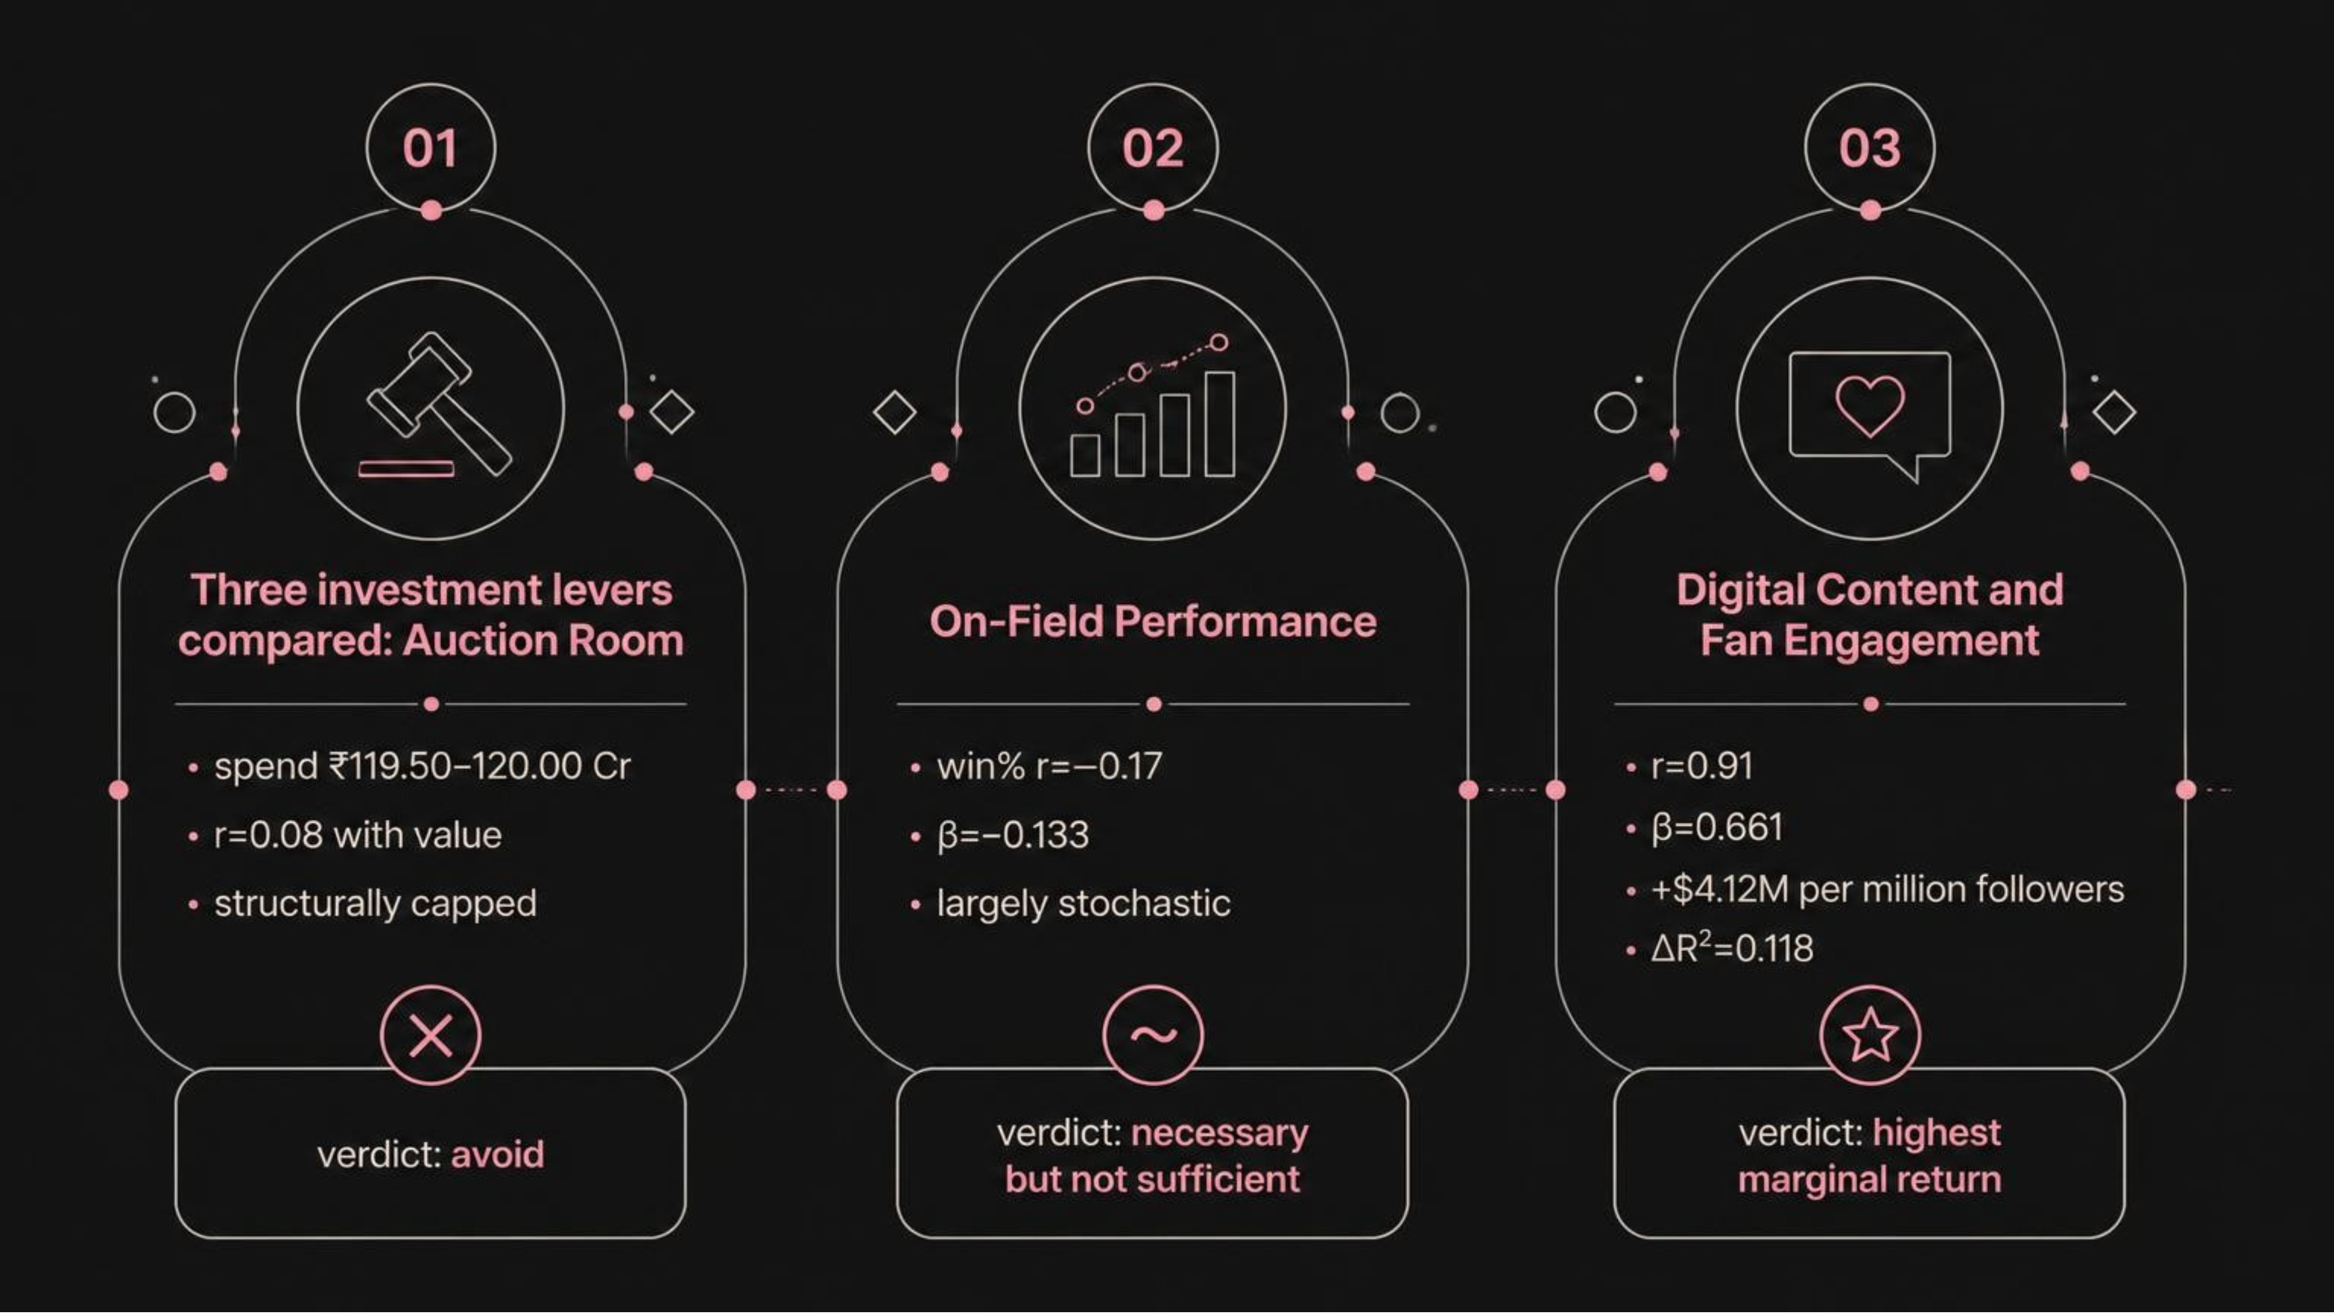

The Capital Allocation Decision
The next marginal million dollars buys more brand value in content and community than in the auction room. Titles remain important (β = 0.232) - but the marginal return on digital investment is nearly 3× greater.

Slide 24
TEAM SHARK 9
Pranav C Satheesh (264024021) · Kunwar Atul Ang (252241017) · Parth Aravind Deshmukh (264024020)
BM5104H -Business Statistics and Data Analysis for Management
The Finding
The Proof
The Recommendation
Digital engagement (β = 0.661) is the dominant driver of IPL franchise brand value - outweighing titles, market size, and spending combined.
RCB: $269M → $312M, 2 titles, 48.25% win rate, 31.8M followers. Attention is the asset.
Send the next marginal million dollars into off-field digital content and fan engagement. +$4.12M per million followers.
Questions?

