Slide 1
Gotta Model ’Em All! A Pokémon ABM
Ali Turfah
CMPLXSYS 530
04/05/18

Slide 2
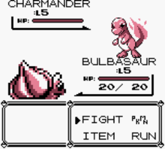

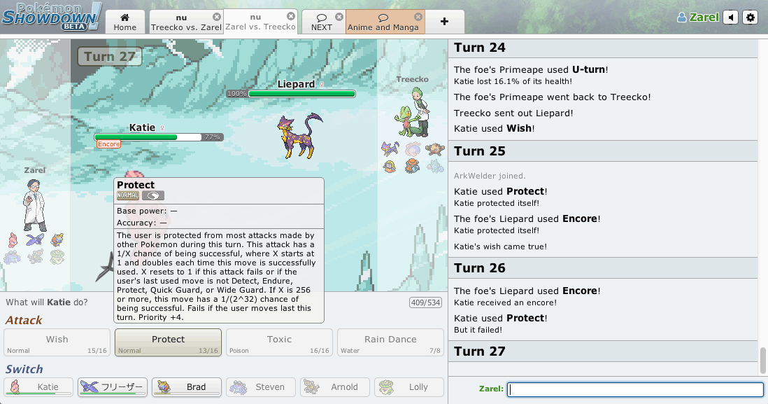
Introduction - System of Interest
Pokémon is a children’s video/card game and tv show
Some people take it seriously and play Pokémon competitively
Some other people developed a website so people could play Pokémon competitively online (Pokémon Showdown)
This online simulator’s metagame is the system of interest

Slide 3
Introduction – System of Interest pt. 2
Interested in modelling actual battles themselves
Different playstyles match up differently
Operating under incomplete information -> Risk Management
A LOT of random chance -> Probability Management

Slide 4
Introduction – System of Interest
Rules of Pokémon are somewhat intricate
Different types of moves
Move effects
Items
Abilities
Etc…
Simplified games were modelled
Rock/Paper/Scissors (RPS)
Pokémon with only attacking moves

Slide 5
Modelling approach
Agents
Players in game
Action defined by make_move()
Keep track of their own and opponent’s game states
Engine
Implements rules of the game
Ingests player’s moves and updates game state
Informs agents of the game state
Ladder
Decides who plays whom
Randomly or by Elo ranking

Slide 6
Modelling approach – Agents
 | Rock Paper Scissors | Pokemon
Random | Play R/P/S randomly by defined strategy vector | Either Switch or Attack on any given turn
Strategic | Counter opponent’s last move | Calculate “expected outcome” and choose move to maximize it

Slide 7
Modelling approach – Engine
Player 1
Player 2
Game Engine

Slide 8
Modelling approach – Engine
Player 1
Player 2
Game Engine

Slide 9
Modelling approach – Engine
Player 1
Player 2
make_move()
make_move()
Game Engine

Slide 10
Modelling approach – Engine
Player 1
Player 2
Game Engine

Slide 11
Modelling approach – Engine
Player 1
Player 2
update_gamestate()
update_gamestate()
Game Engine

Slide 12
Modelling approach – Ladder
Each agent has an Elo ranking
Higher Elo ranking ≈ Better player
High ranked player beats low ranked player -> minor Elo change
Low ranked player beats high ranked player -> drastic Elo change
Combines Elo ranking and “waiting time” to decide who plays

Slide 13
Results – RPS #1
Best of 5 Rock/Paper/Scissors Tournament
50,000 games
36 Players
12 Rock
12 Paper
12 Scissors
Parameter of interest: Unweighted vs Weighted Ladder

Slide 14
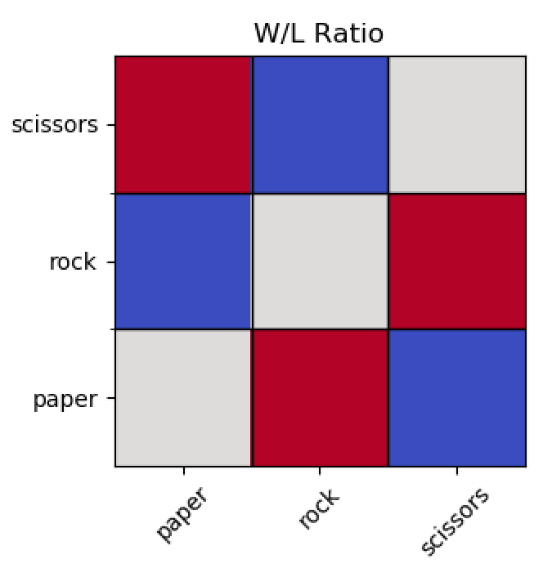
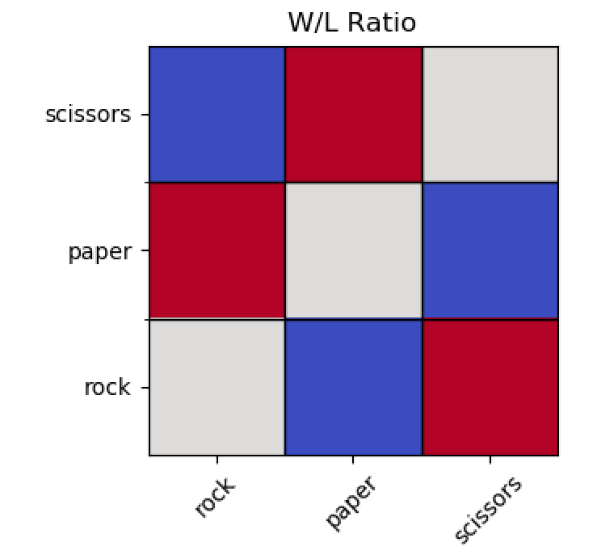
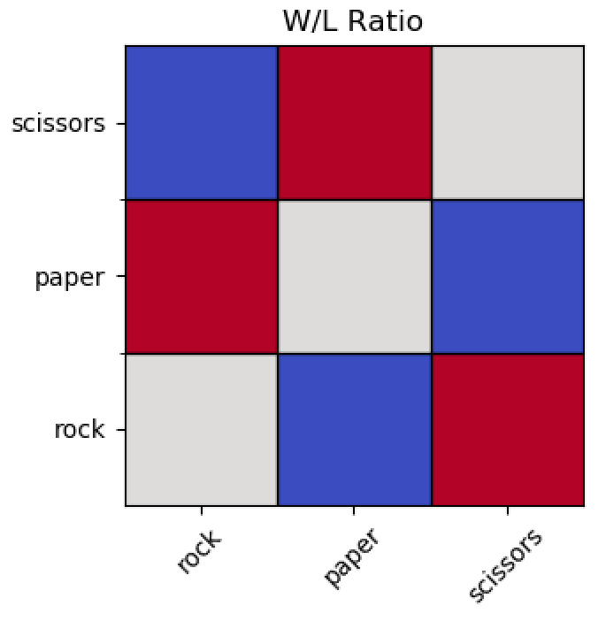

Results – RPS (Random)

Slide 15
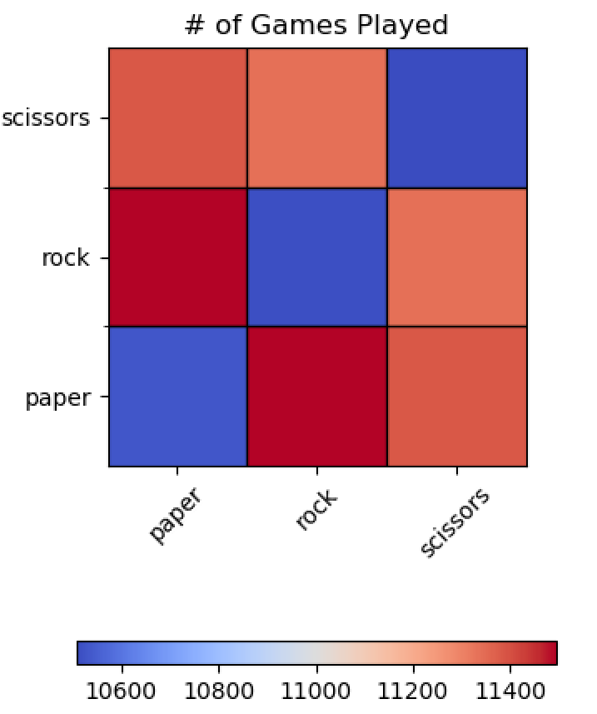
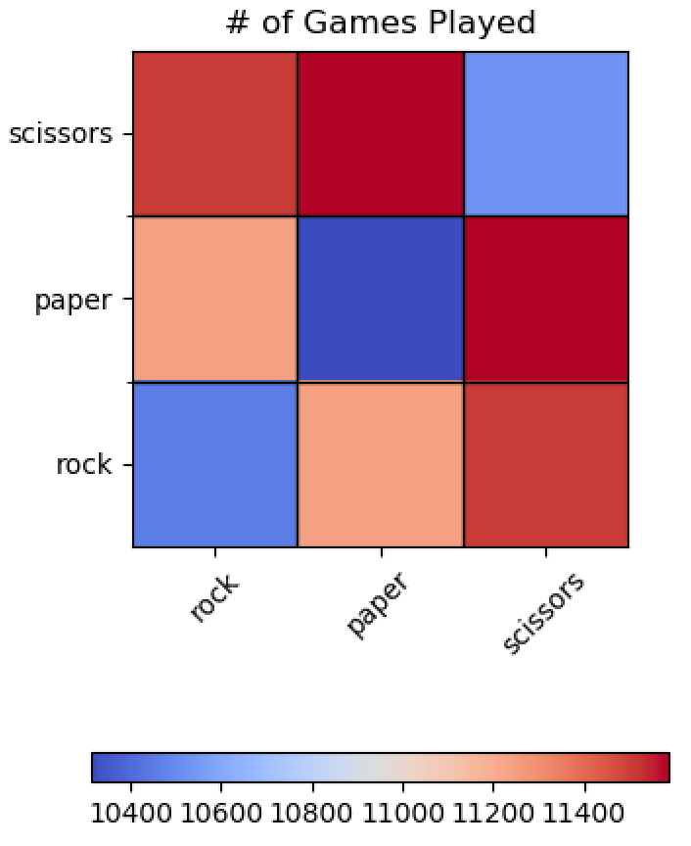
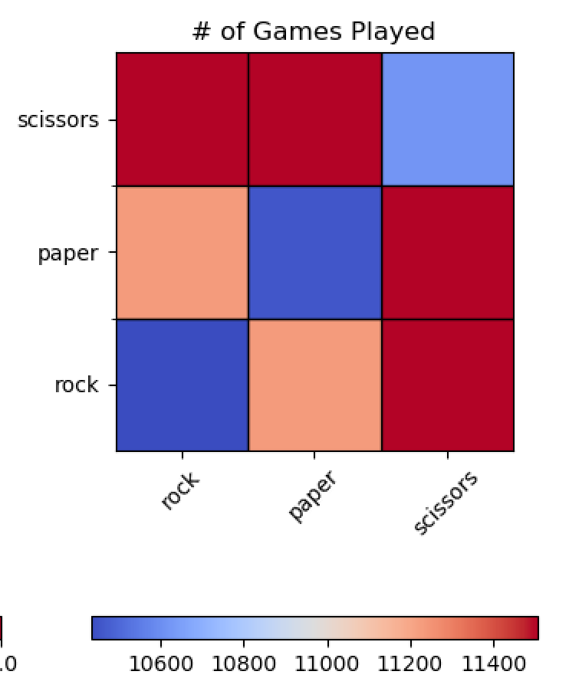
Results – RPS (Random)

Slide 16
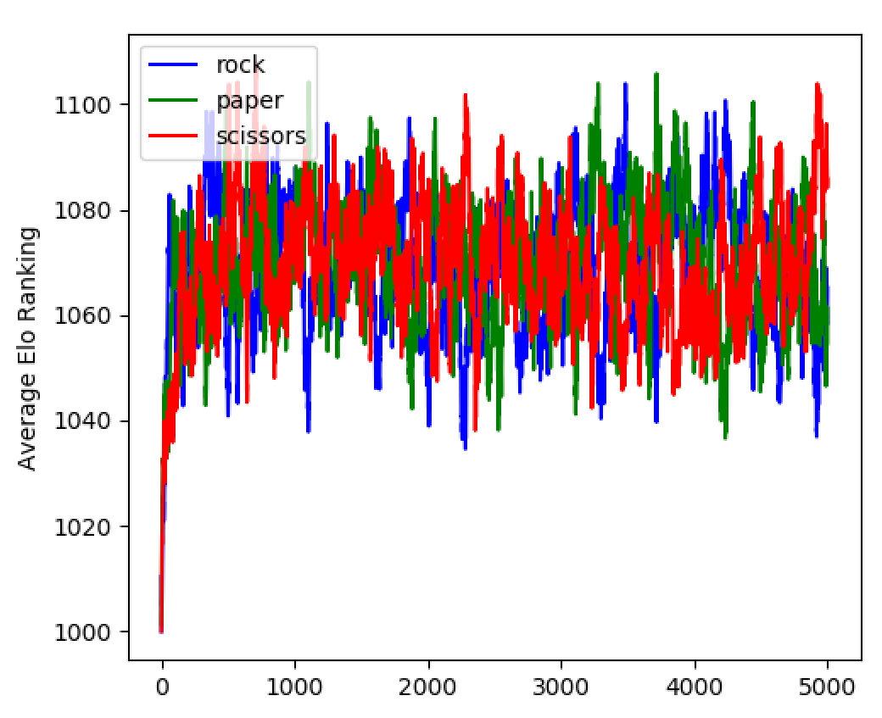
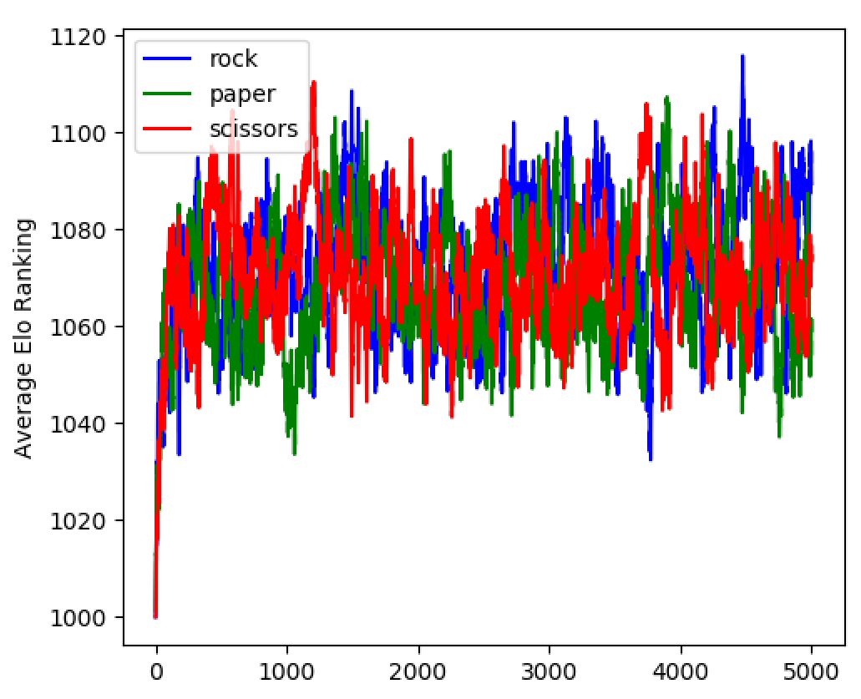
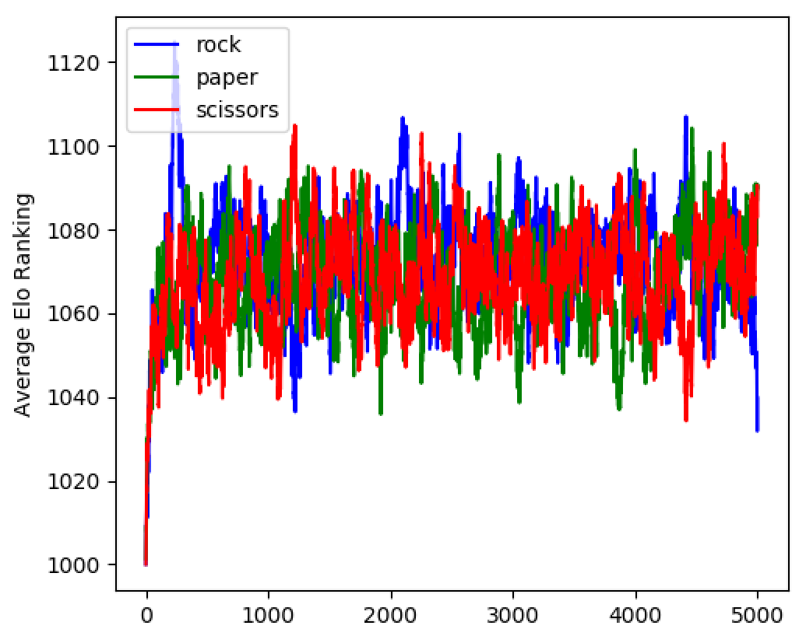
Results – RPS (Random)

Slide 17
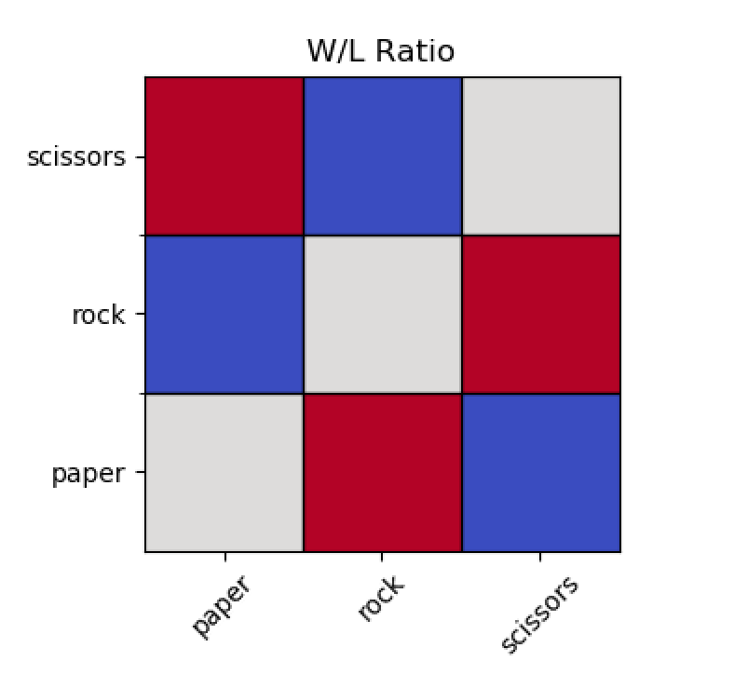
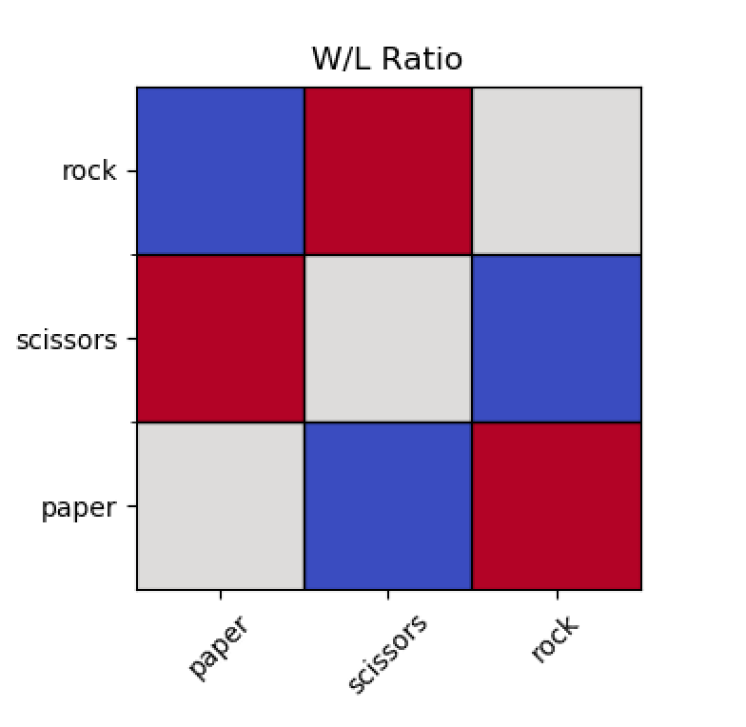
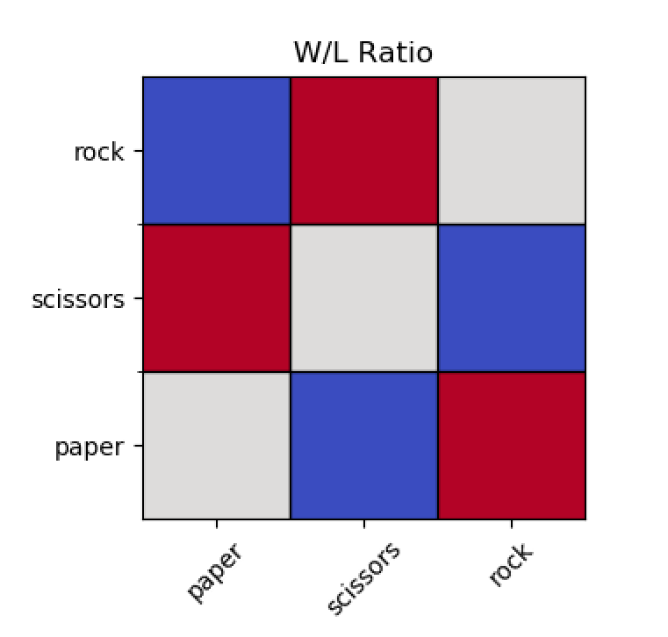
Results – RPS (Weighted)

Slide 18
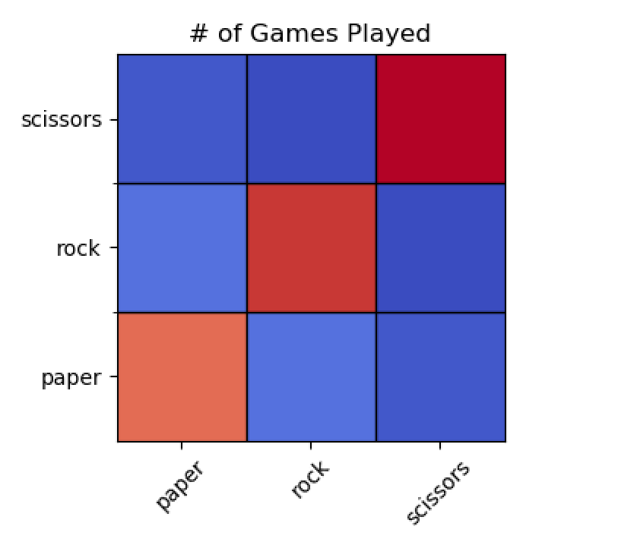
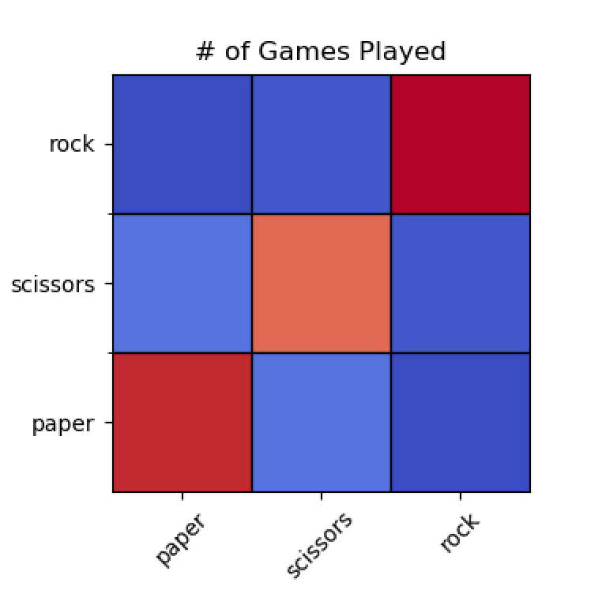
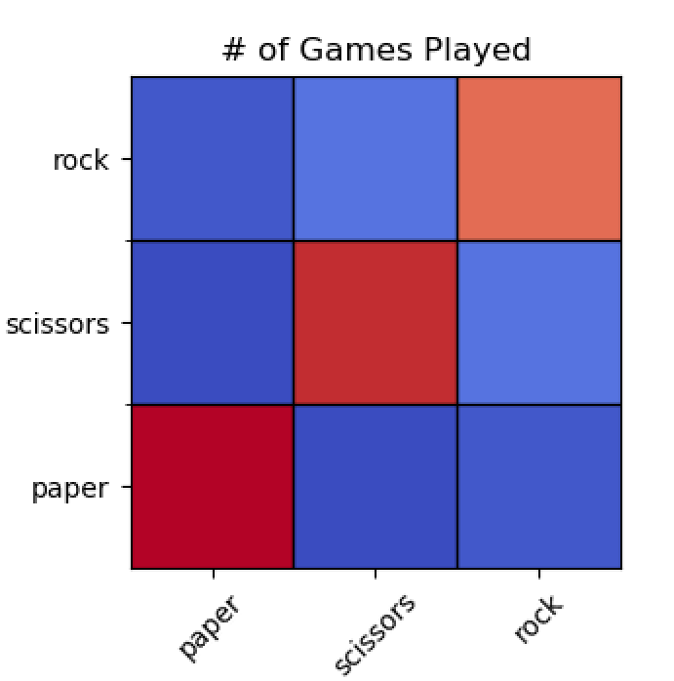

Results – RPS (Weighted)

Slide 19
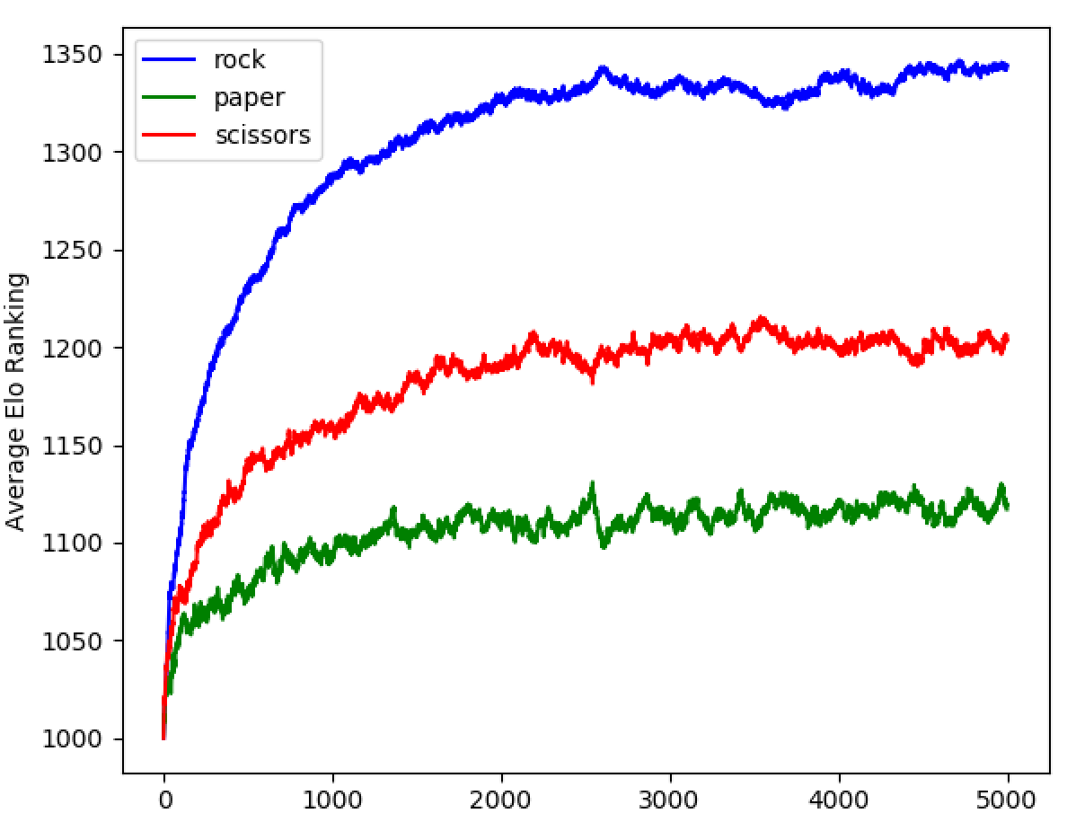
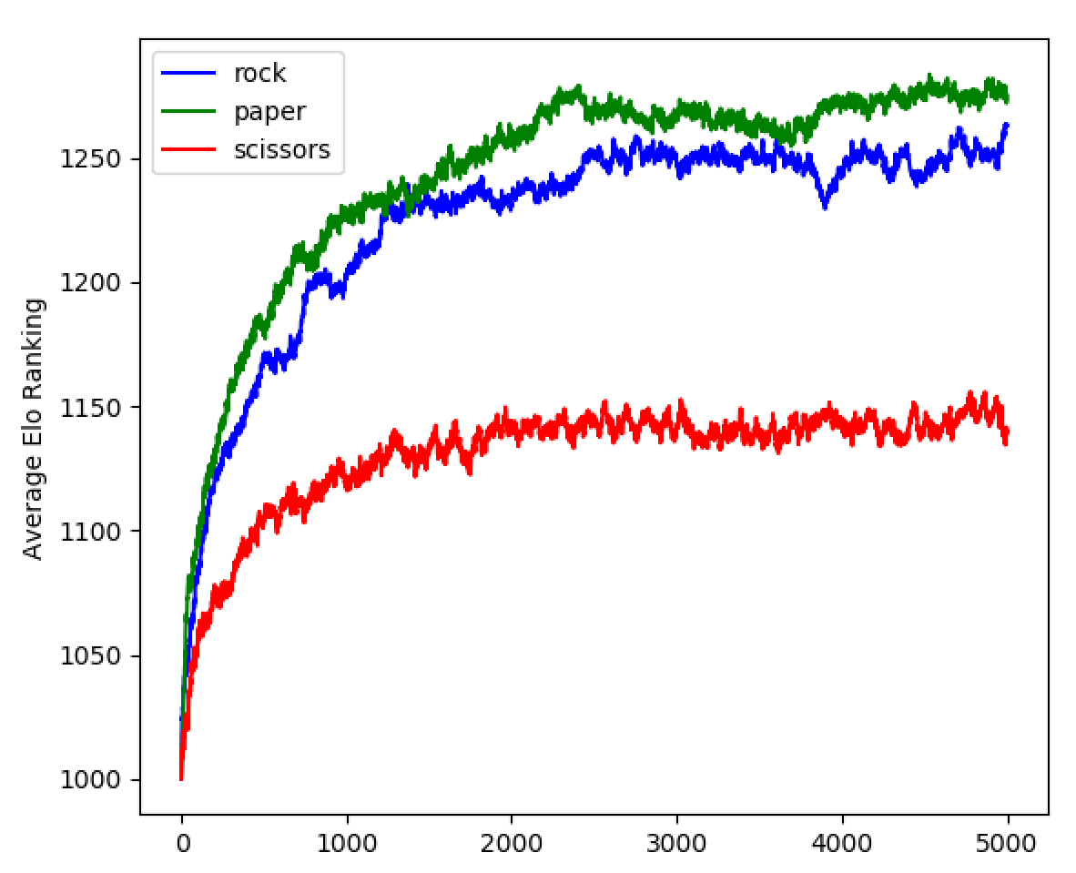
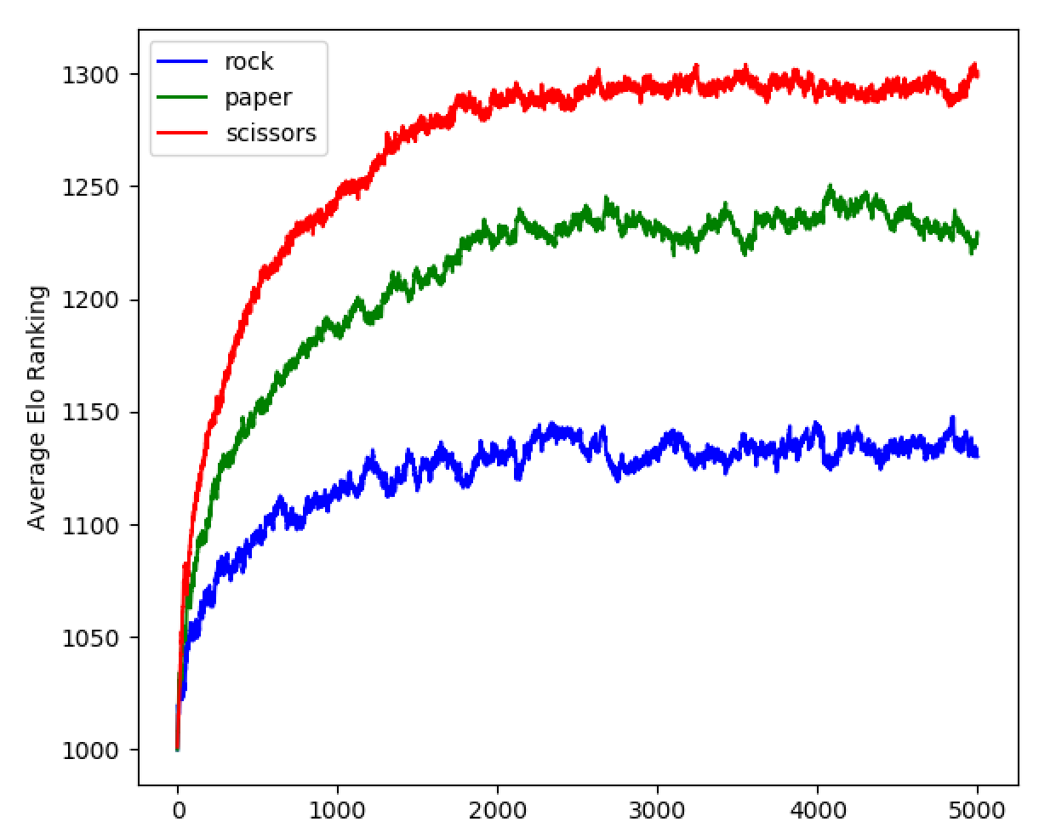
Results – RPS (Weighted)

Slide 20
Results – RPS #2
Best of 5 Rock/Paper/Scissors Tournament
50,000 games
38 Players
12 Rock
12 Paper
12 Scissors
2 Counter
Weighted Ladder

Slide 21
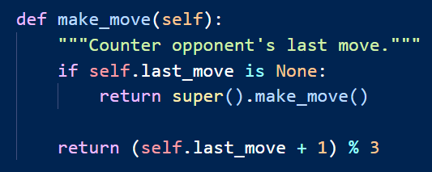
Results – RPS (Counter)
Turn 1
Play randomly
Turn 2
VS Rock -> Play Paper
VS Paper -> Play Scissors
VS Scissors -> Play Rock
VS Counter -> Play ???

Slide 22
Results – RPS (Counter)
Turn 1
Play randomly
Turn 2
VS Rock -> Play Paper
VS Paper -> Play Scissors
VS Scissors -> Play Rock
VS Counter -> Play randomly
P(Play R) = P(Play R| Opp plays S)*P(Opp plays S)
+ P(Play R| Opp plays R)*P(Opp plays R) + …
P(Play R) = 1*P(Opp plays S) + 0 + 0
P(Play R) = P(Play P) = P(Play S) = 1/3

Slide 23
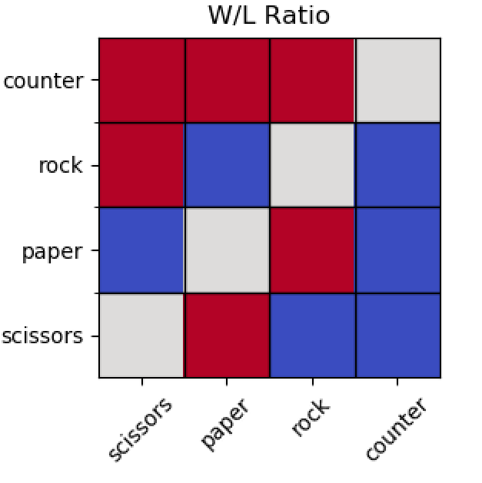
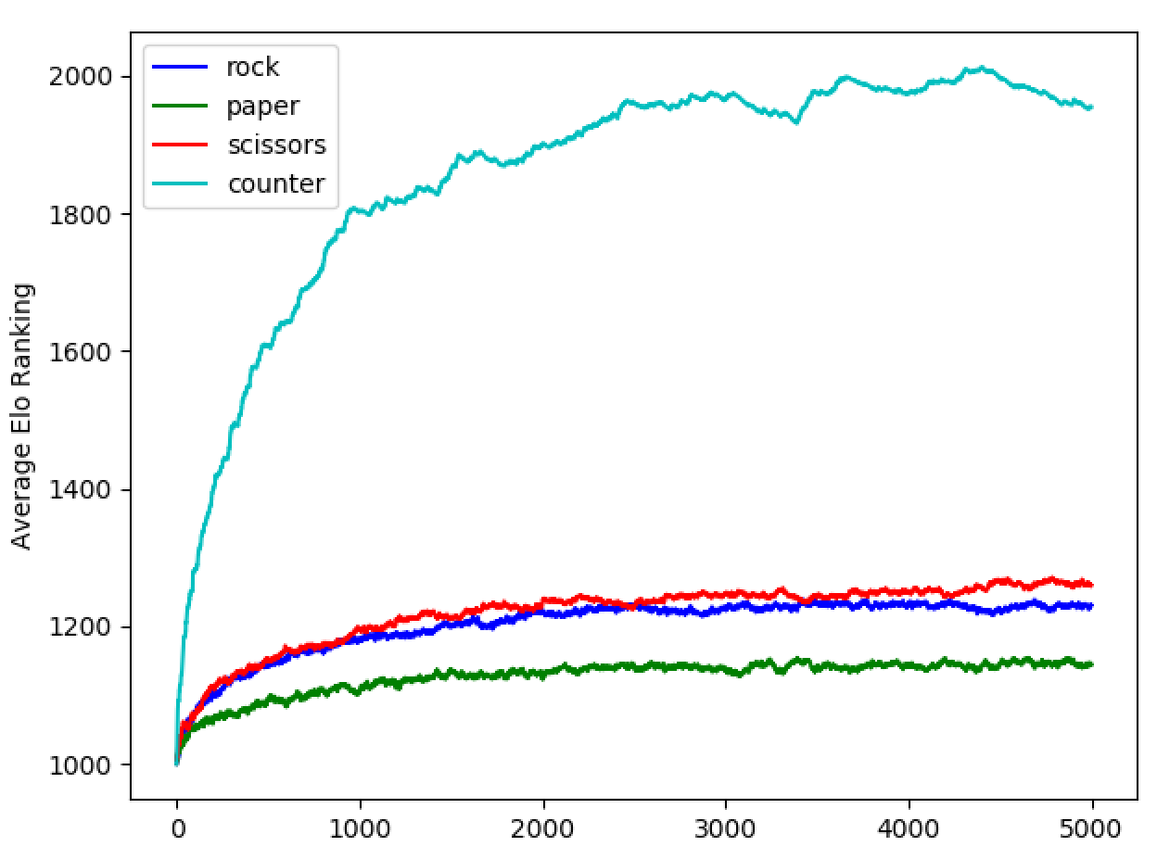
Results – RPS (Counter)

Slide 24
Results – Pokémon
3 possible pokemon
Floatzel, Ivysaur, Spinda
Matchups: Floatzel > Ivysaur ≈ Spinda
2 possible players
Random or Planning
Random and Weighted Ladder
50,000 Games
60 players; 10 of each type
Parameter of interest: Can a player “outplay” the matchup?

Slide 25
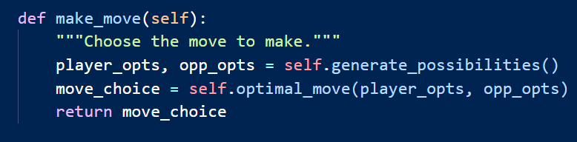
Results – Pokemon
Calculate all possible moves
Choose player move that maximizes expected battle position
Battle position =
<% Player HP> / <% Opponent HP>

Slide 26
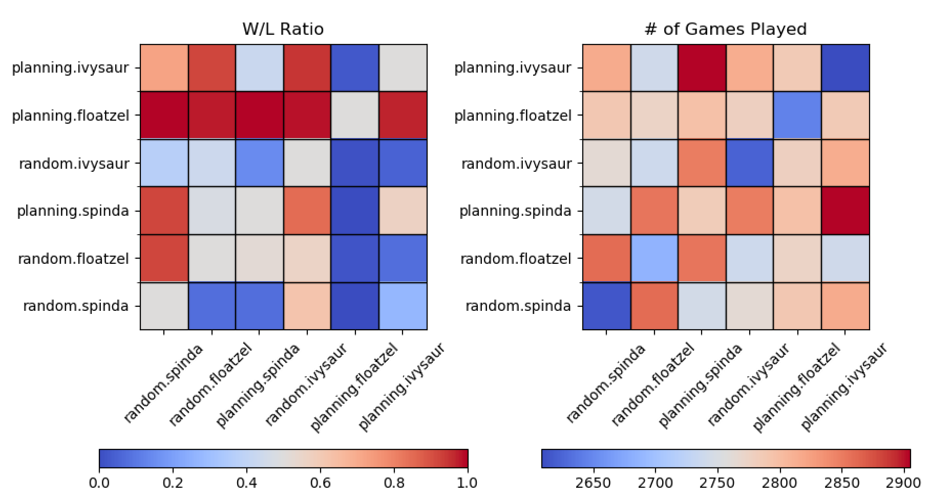
Results – Pokémon (Random)

Slide 27
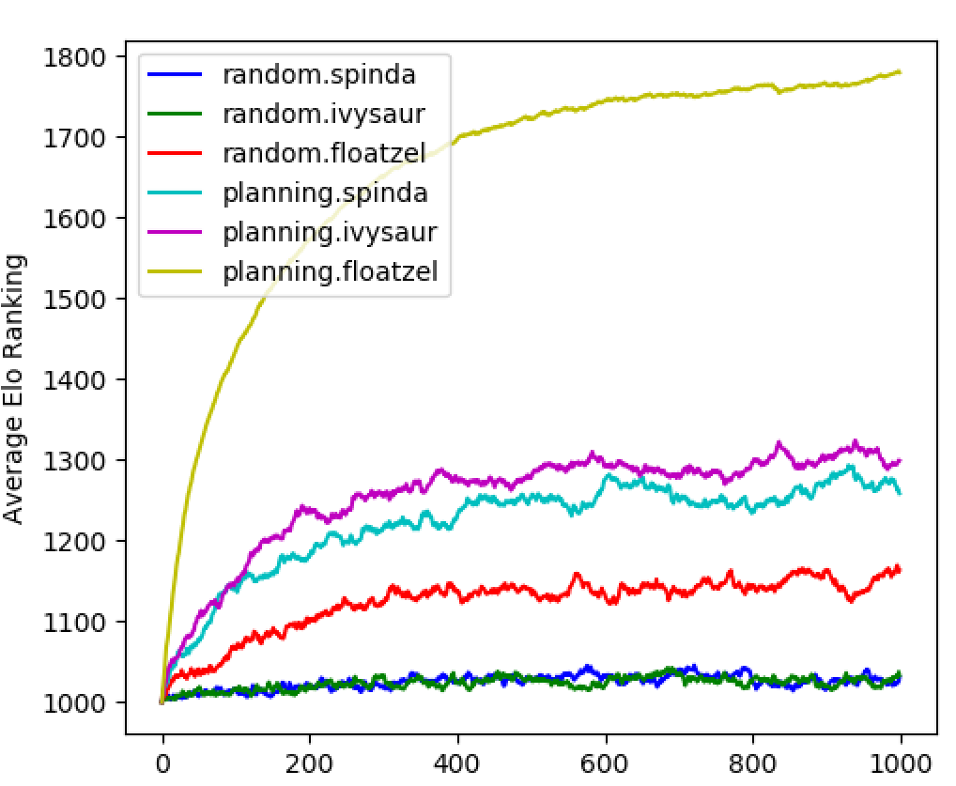
Results – Pokémon (Random)

Slide 28
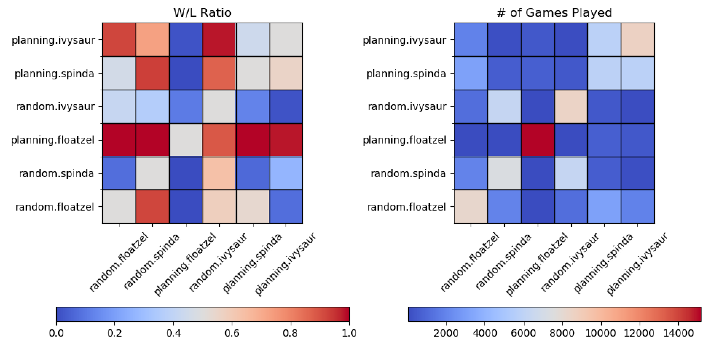
Results – Pokémon (Weighted)

Slide 29
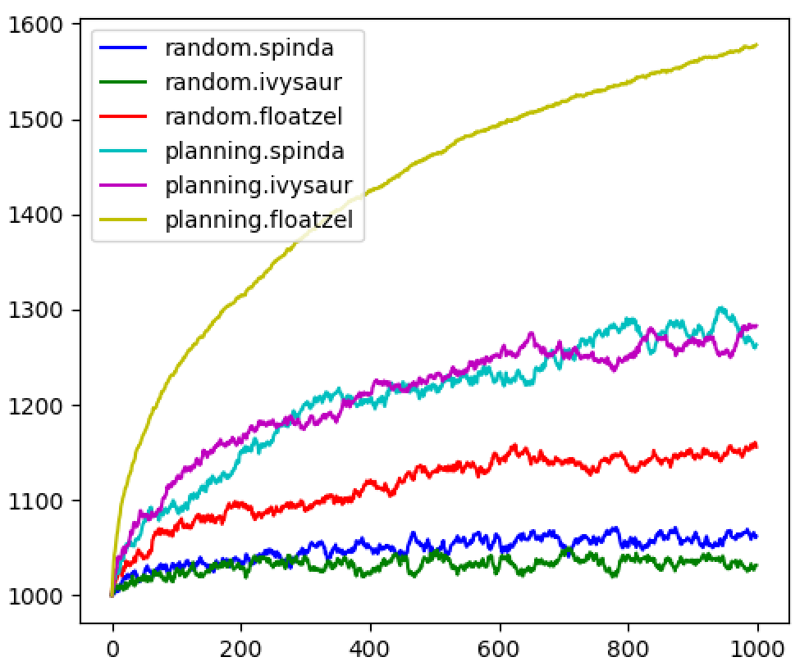
Results – Pokémon (Weighted)

Slide 30
Future Directions
More accurate model of Pokémon battle engine
Add more strategies
Log the player-player interactions
Improve code efficiency
Find a journal to publish

Slide 31
Thank you!

Slide 32
Extra Slides
Pokémon Terminology
Basic Agent Code
Strategic Agent Code

Slide 33
Pokémon Terminology
“Team” of 6 Pokémon
One is active at any time
Takes one turn to switch out
Statistic Values (stats)
Attack, Defense, Hit points, Speed values
Used to calculate turn order, and damage
Moves
Attack choices
Pokémon have up to 4 moves
Types
Determine weaknesses, and move effectiveness
Pokémon and moves each have types

Slide 34
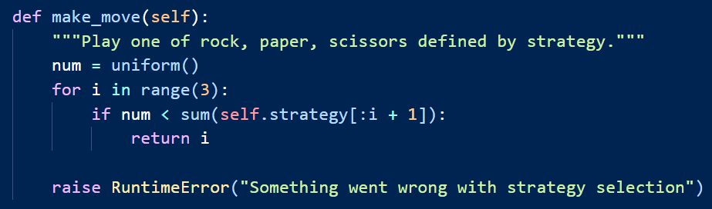
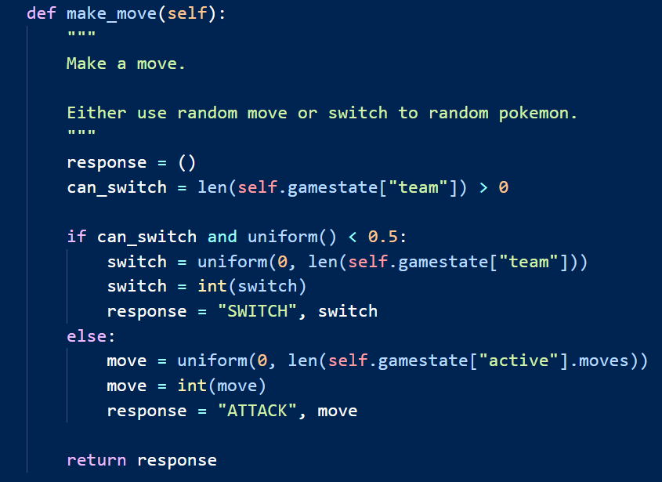
Modelling approach – Agents (Basic)

Slide 35
Modelling approach – Agents (Strategy)

