Slide 1
Building HPC Carpentry
Applying the Software and Data Carpentry model to training needs in large scale research computing

Slide 2
Lessons & Structure

Slide 3
Workshop & Lessons
Workshops range from ½ day – 2 days in length
Lesson modules range from 20 – 60 minutes
Learning objectives are clearly defined and used to build the lesson
Every 10 – 15 min, a formative assessment is done
Cumulative assessment at the end of each module
Modules may be trimmed or swapped in/out

Slide 4
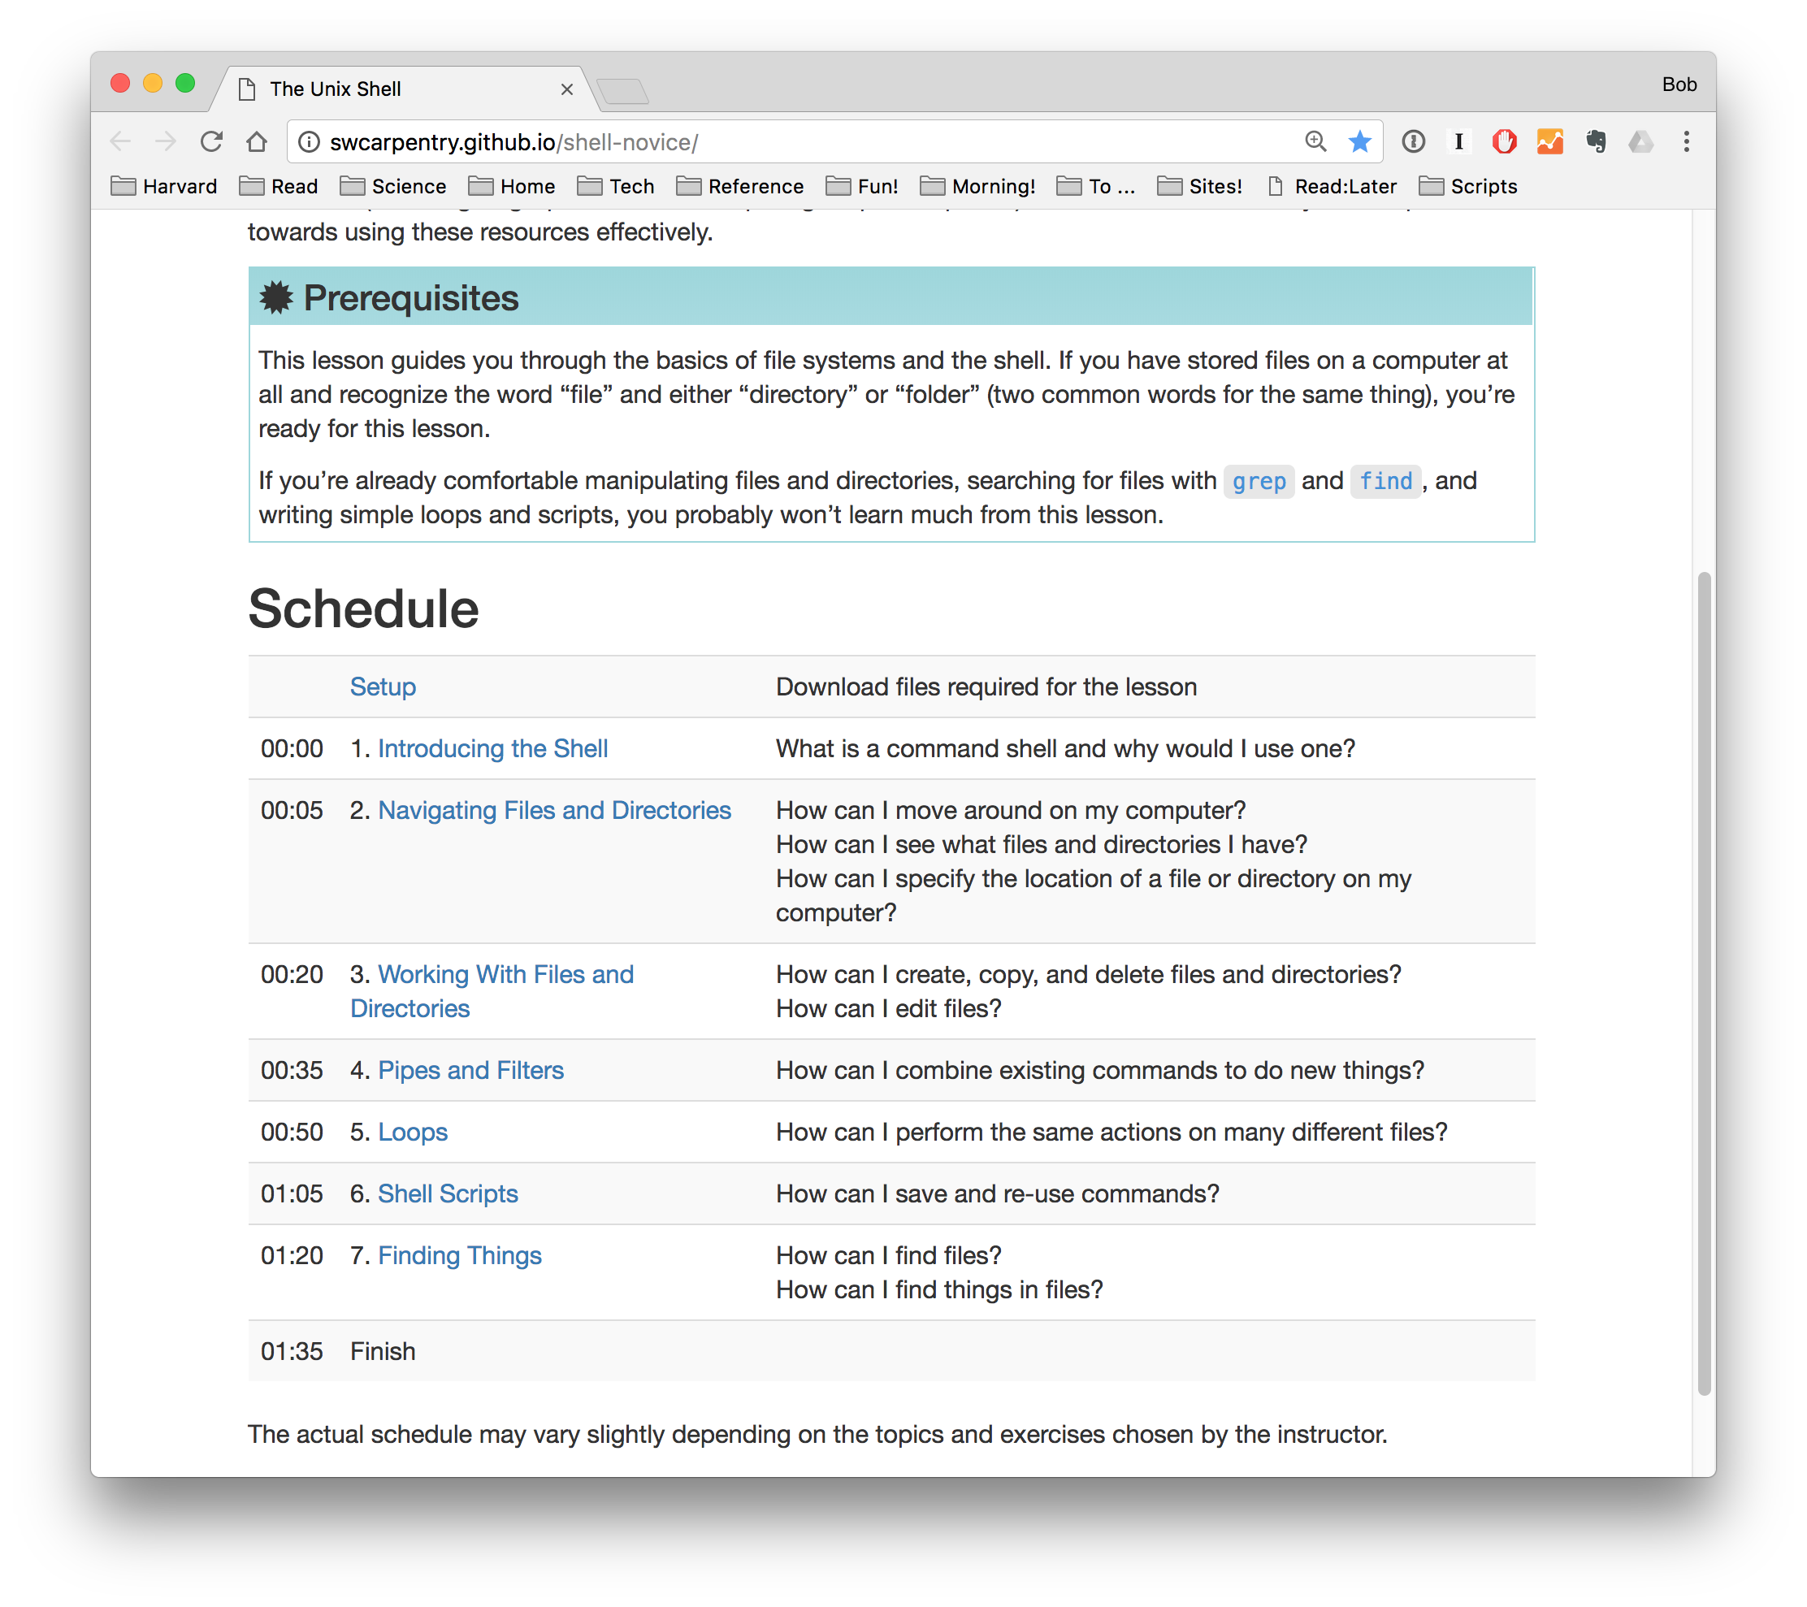

Slide 5
Activity
On your own, brainstorm the 5 – 10 skills you would like the provided user profile to have by the end of the workshop.
Translate these skills into specific learning objectives.
Group these learning objectives into specific lesson topics

Slide 6
In your group
An example workshop outline with lesson modules is provided. Assuming a 1 day workshop:
Verify lesson modules
What lessons are missing?
What should be dropped or combined?
If a longer workshop were given, what could be in Day 2?
List lesson objectives
Pick a specific lesson module. Please list 2 – 3 learning objectives that embody the skills you desire

