Slide 1
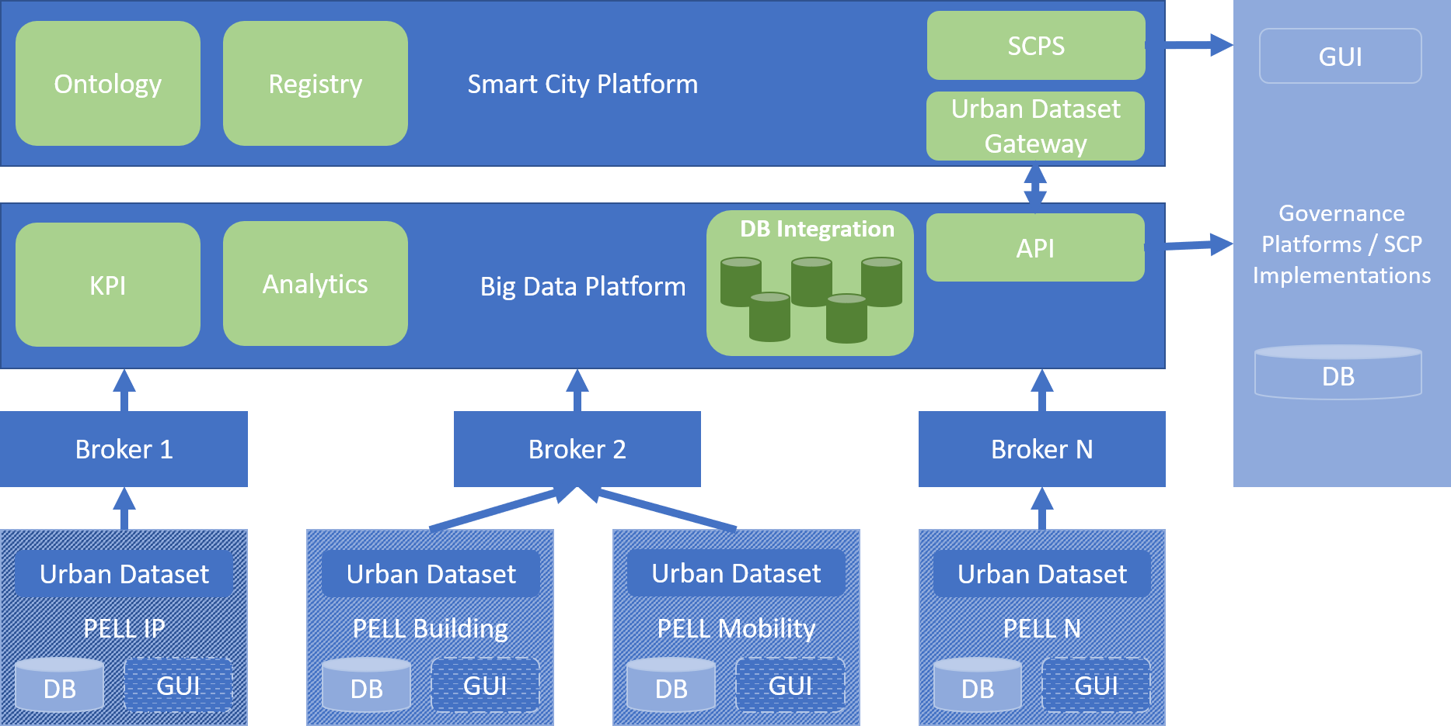
Architettura dati - Interoperabilità SCP-PELL

Slide 2


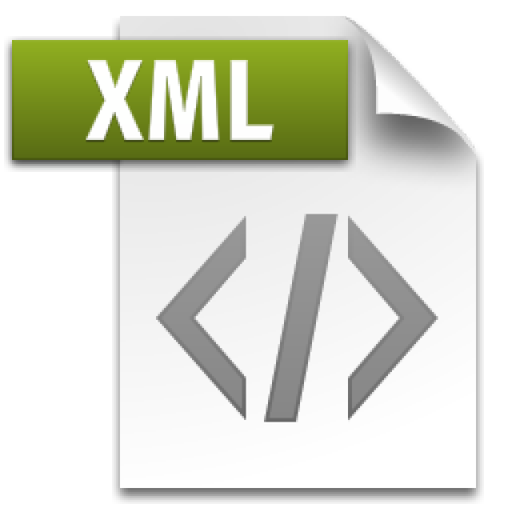





Municipality
Citizen
Administration
Enterprises
GUI Frontend (Rapido Theme)
PELL Gateway
Utility
Business Logic
SAVE tool
Oxytech tool
KPI
Analytics & Diagnostics
Data Integration
Middleware
Middleware
PELL Broker
Static Data
Dynamic Data

