Slide 1
SUDOS
Smart Urban Delivery Optimization System
Design and Analysis of Algorithms | Course Project | April 2026
Submitted by:
ROHAN KUMAR – 24BDS0463
ATVIK SHARMA – 24BCT0025
MD RAKSHSHAN SAIF – 24BKT0164
Dijkstra
Floyd-Warshall
DP TSP
Max-Flow
Greedy
Inspired by Amazon • Swiggy • Blinkit

Slide 2
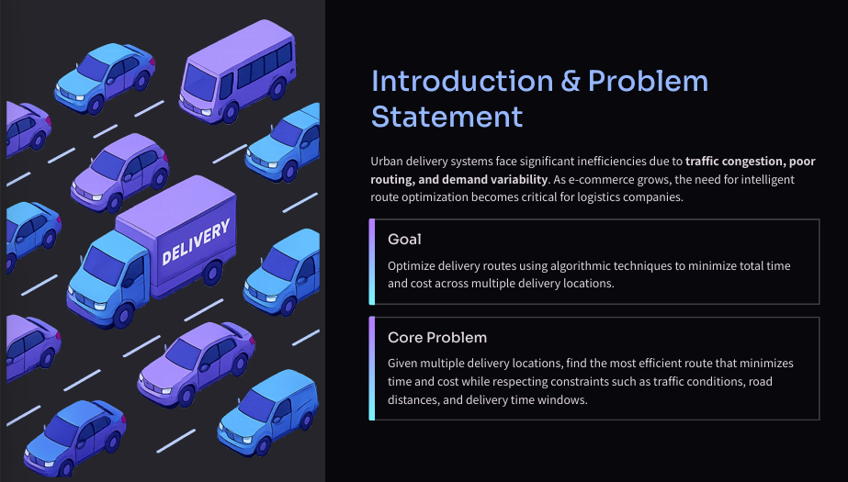

Slide 3
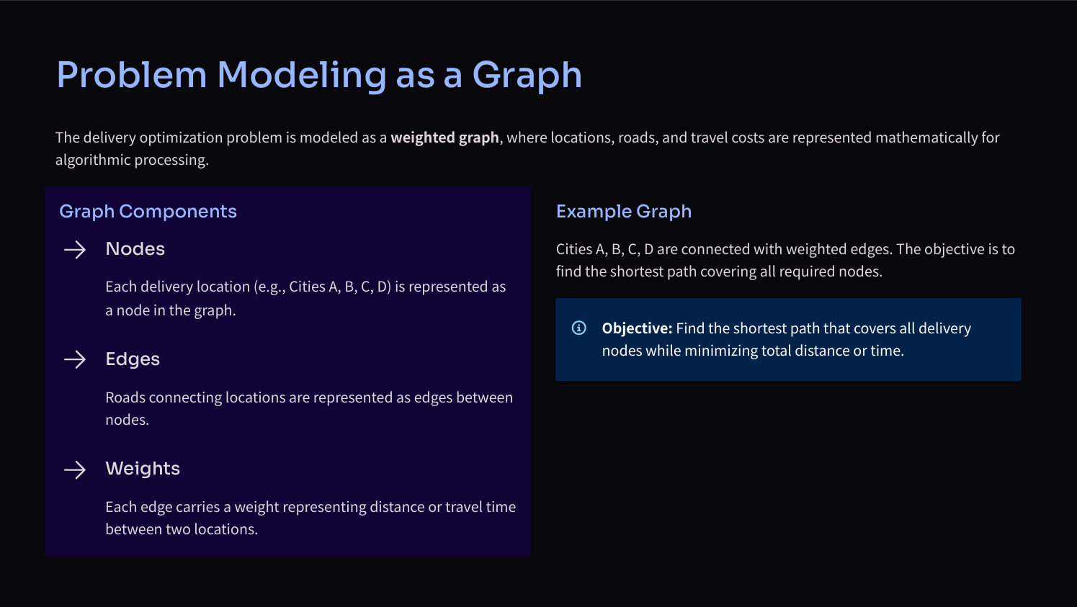

Slide 4
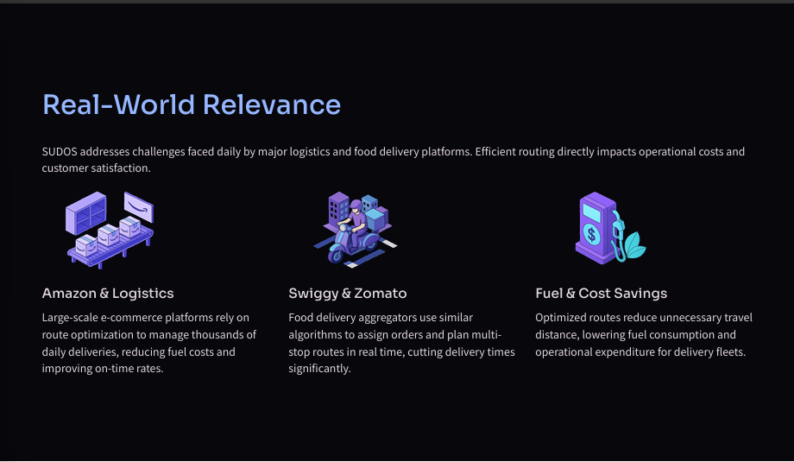

Slide 5
PROBLEM
The Delivery Challenge
🗺
👤
⚡
Route Optimization
Agent Assignment
Speed vs Optimality
Find the shortest path visiting all delivery points — a variant of the NP-Hard Traveling Salesman Problem.
Fairly distribute delivery zones across multiple agents without overloading any individual agent.
Exact algorithms guarantee best routes but are slow. Heuristics are fast but approximate. We need both.
Goal: Model a city as a graph → assign deliveries to agents → compute optimal/near-optimal routes

Slide 6
ARCHITECTURE
System Pipeline
1
2
3
4
5
City Graph
APSP Pre-compute
Agent Assignment
Route Planning
Compare & Report
▶
▶
▶
▶
Adj List + Matrix
12 nodes, 19 edges
Floyd-Warshall
O(V³) once
Max-Flow
Ford-Fulkerson
Greedy / DP / Insertion
Per agent
Cost, Time, Quality
Benchmark
Core Modules
▸ sudos.py → All algorithms (Dijkstra, FW, TSP, Flow)
▸ visualize.py → Matplotlib charts and route maps
▸ tests/test_sudos.py → Unit tests for every function

Slide 7
ALGORITHMS
5 Algorithmic Paradigms
Paradigm
Algorithm
Complexity
Use in SUDOS
Graph
Dijkstra's SSSP
O((V+E) log V)
Depot → delivery shortest path
Graph
Floyd-Warshall
O(V³)
All-pairs precomputation
Greedy
Nearest Neighbor TSP
O(N²)
Fast route approximation
DP
Bitmask TSP (Held-Karp)
O(2ᴺ · N²)
Exact optimal tour (N ≤ 20)
Approx
Nearest Insertion
O(N²)
Better heuristic, 2× bound
Flow
Ford-Fulkerson Max-Flow
O(V · E)
Fair agent assignment

Slide 8
GRAPH ALGORITHMS
Shortest Path Algorithms
Dijkstra's Algorithm
Floyd-Warshall
• Single-source shortest paths
• All-pairs shortest paths
• Uses a min-heap (priority queue)
• Triple nested loop over nodes
• Relaxes edges greedily
• dp[i][j] = min(dp[i][j],
• Requires non-negative weights ✓
dp[i][k]+dp[k][j])
Result on sample city:
Key advantage in SUDOS:
0 → 5 : dist=18 path=[0,1,5]
Run ONCE → O(1) lookup for
0 → 9 : dist=25 path=[0,1,5,9]
any pair during TSP routing
0 → 11: dist=37 path=[0,1,5,10,11]
dist[0][11] = 37
Both algorithms pre-compute distances once — all TSP algorithms use these results in O(1)

Slide 9
TSP ALGORITHMS
Solving the Traveling Salesman Problem
Greedy Nearest Neighbor
DP Bitmask TSP
Nearest Insertion
O(N²) Heuristic
O(2ᴺ·N²) Exact
O(N²) Approx ≤2×
1. Start at depot
1. dp[mask][i] = min cost
1. Start with 2-node tour
2. Move to nearest unvisited node
2. Visit subset 'mask', end at i
2. Find nearest unvisited node
3. Repeat until all visited
3. State transition over all edges
3. Insert at cheapest position
4. Return to depot
4. Reconstruct path via parent[]
4. Repeat until complete
Cost = 83 | Time = 0.013 ms
Cost = 83 | Time = 0.195 ms
Cost = 83 | Time = 0.024 ms
Fast, no optimality guarantee
Optimal! Confirms heuristic quality
Best of both worlds

Slide 10
NETWORK FLOW
Agent Assignment via Max-Flow
Zone 1
Agent 1
cap=3
Results
Zone 2
Max Flow = 5/5
SOURCE
cap=1
each
cap=1
each
SINK
All zones covered!
Zone 3
Agent 1:
Agent 2
cap=3
Nodes [3, 5, 7]
Zone 4
Agent 2:
Nodes [9, 11]
Zone 5
No zone assigned
to 2 agents ✓
Ford-Fulkerson guarantees every delivery zone is assigned exactly once, respecting agent capacity constraints

Slide 11
RESULTS
Algorithm Comparison & Benchmarks
Algorithm | Tour Cost | Time (ms) | Optimal? | Scalable?
Greedy Nearest Neighbor | 83 | 0.013 | No | ✅ O(N²)
Nearest Insertion | 83 | 0.024 | No | ✅ O(N²)
DP Bitmask (Exact) | 83 | 0.195 | ✅ Yes | ⚠️ N≤20 only
Floyd-Warshall (APSP) | — | < 1 | ✅ Yes | ⚠️ V≤500
Dijkstra (SSSP) | — | 0.01 | ✅ Yes | ✅ Large graphs
Ford-Fulkerson (assign) | — | 0.05 | ✅ Max-flow | ✅ O(VE)
🎯 DP confirms: Heuristics found the EXACT optimal tour on this instance!
⚡ Greedy is 15× faster than DP — critical for real-time delivery apps

Slide 12
DEMO
Multi-Agent Routing in Action
City: 12 nodes | Depot: Node 0 | Deliveries: [3, 5, 7, 9, 11] | Agents: 2 | Algorithm: Greedy + Max-Flow
🚚 Agent 1
🚚 Agent 2
Assigned Zones:
Assigned Zones:
[3, 5, 7]
[9, 11]
Route:
Route:
0 → 3 → 5 → 7 → 0
0 → 9 → 11 → 0
0→3: 20 km
0→9: 25 km
3→5: 21 km
9→11: 14 km
5→7: 29 km
11→0: 37 km
7→0: 11 km
Total Cost: 81 km
Total Cost: 76 km
Combined fleet cost: 157 km vs 83 km single agent → Each customer served ~2× faster!

Slide 13
Conclusions & Takeaways
✅
Modeled city as a graph — applied 5 DAA paradigms to one real-world system
⚡
Greedy NN: 0.013 ms | DP TSP (exact): 0.195 ms — DP is 15× slower, confirms heuristic was optimal
🔀
Max-Flow cleanly separates assignment from routing — each zone covered exactly once
📈
Floyd-Warshall precomputation saves repeated Dijkstra calls during TSP — amortized efficiency
🏆
Nearest Insertion achieves a proven 2× approximation bound — best heuristic for large N
SUDOS | GitHub: https://github.com/atviksharma/SUDOS-Smart-Urban-Delivery-Optimization-System.git| All code open-source | April 2026

