Slide 1

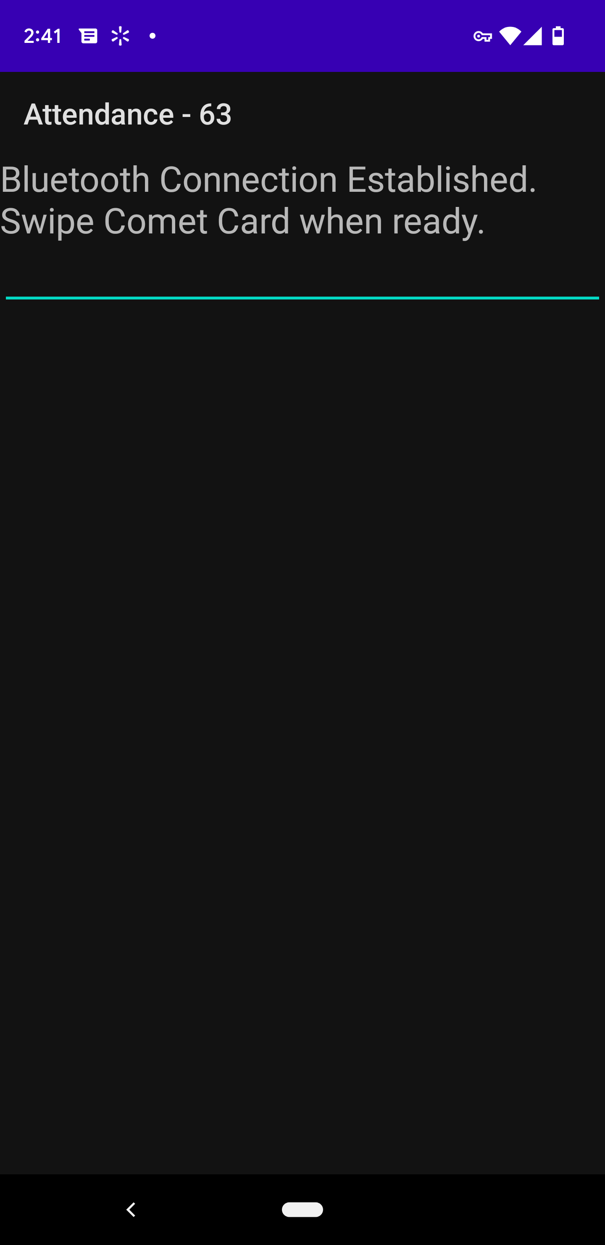

Mobile Attendance App – Streamlining the Process
Brandon Atwal | Owais Ashraf | Anthony J Chen | Jacob C Danel
Goal: Create an accompanying mobile android application to work alongside Dr. John Cole’s existing desktop attendance app to help streamline the process by allowing students to sign in for attendance by swiping their UTD student card through a card reader
Approach:
Bluetooth connection via paired devices
Multithreaded connection to reduce connection slowdowns
File processing to interface with card reader
Simple and seamless UI
Quick and easy to use
Works for most versions of the Android OS (Android 8 and up)
Features:
Automatic Bluetooth connection
Auto-submit inputs
Text field refocusing – No need to refocus manually
Message tones and toast messages to notify users of valid/invalid card swipe

