Slide 1
BIG BIO DATA LAST YEAR’S PAPER
https://docs.google.com/document/d/1nR0EaKFF796alwT9eS0wem6TGB6PozS8yRth5qNbG-U/edit?usp=sharing

Slide 2


Slide 3
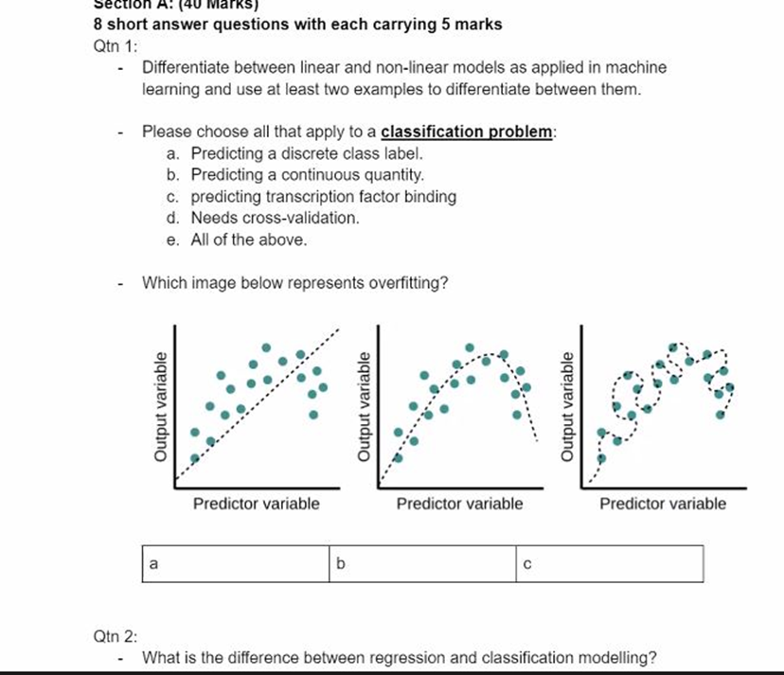
SECTION A

Slide 4
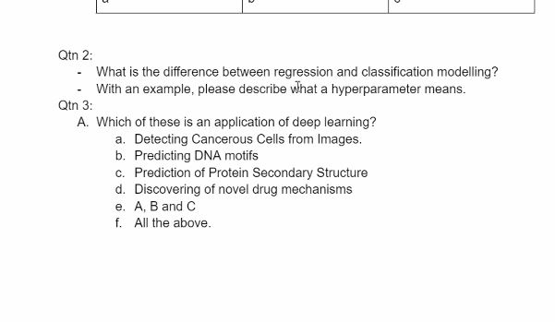
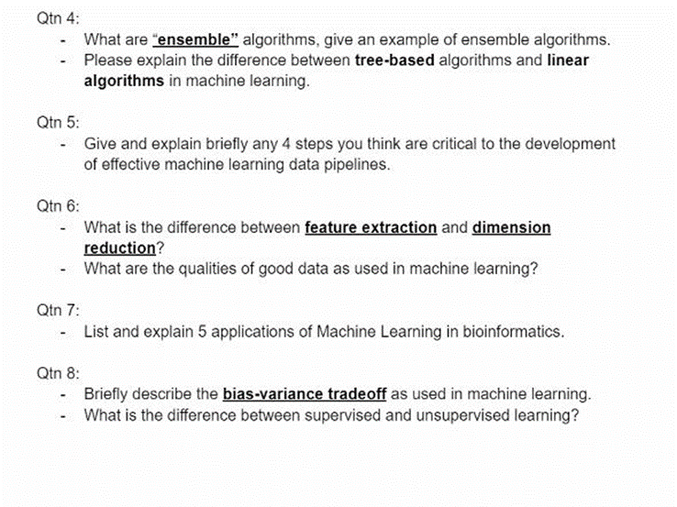
SECTION A

Slide 5
QN 4
Ensemble algorithms are algorithms that combine multiple algorithms to improve performance and accuracy of the model.
They are divided into Bagging and Boosting
Bagging(pykaret)-Involves training each model independently and then compare them after.(it reduces bias)eg RandomForest
Boosting involves combined training of models sequentially and obtaining an optimal prediction.(Adaboost, GradientBoosting)
Tree based algorithms have a tree like structure and assume non-linear relationship eg RF, Decision Trees, GradientBoosting.
Linear algorithms assume a linear relationship(input and output are continuous).

Slide 6
QN 5
Critical steps to the development of effective pipeline ML
1. Data collection and cleaning
2.Data Preprocessing(Min/Max scaling,Encoding)
3.Model training and validation
4.Deploy

Slide 7
6b
Feature extraction involves transforming raw input data into a set of meaningful and relevant features.
Dimension reduction involves reducing number of input variables while maintaining the most relevant.
Qualities of good data as used in ML
-it should be relevant to the problem
-it should be accurate and free of errors
-it should be complete (no missing values)
It should be consistent
It should be timely

Slide 8
No 7
Applications of ML
-Disease diagnosis(detecting cancer using cancer images)
-Drug discovery
-Predicting resistance to drugs
-Prediction of mutations
-Prediction of protein structure
Gene sequencing eg Nanopore technology
Evolutionary distance detection
Determining sequence relationship

Slide 9
Bias-variance tradeoff in ML describes the relationship between model’s ability to fit training data and its ability to generalize to new unseen data.(difference between actual and predicted values)
High bias shows that the model is too simple (under fitting)
High variance shows the model is complex and over fitting
The goal is to strike a balance between bias variance.

Slide 10
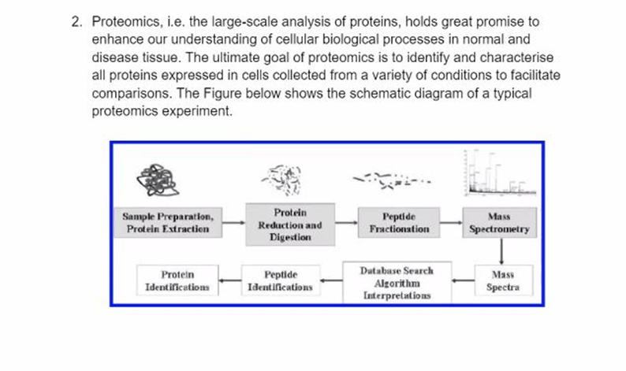
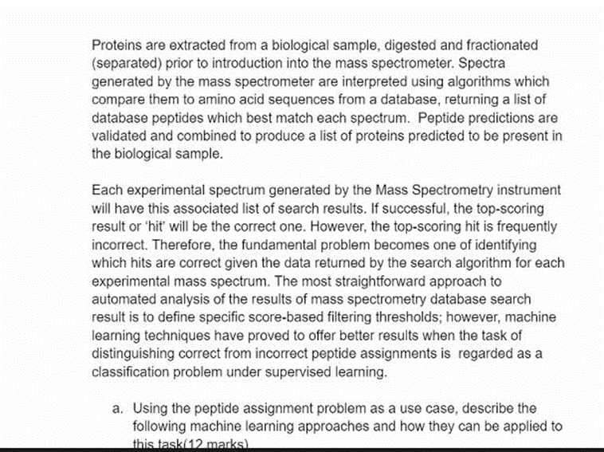
NUMBER TWO

Slide 11
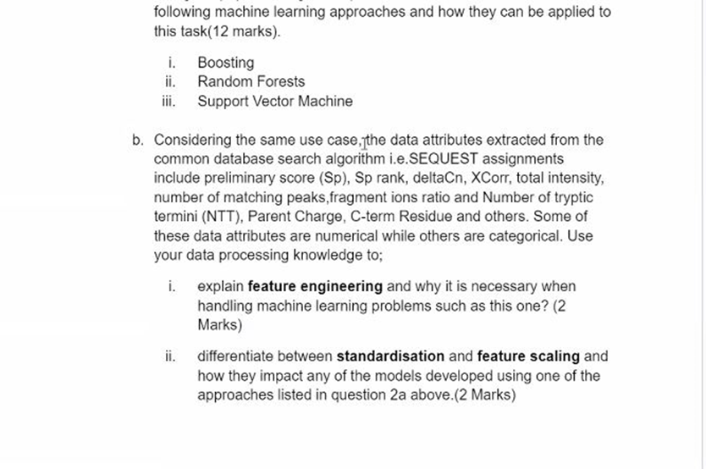

Slide 12
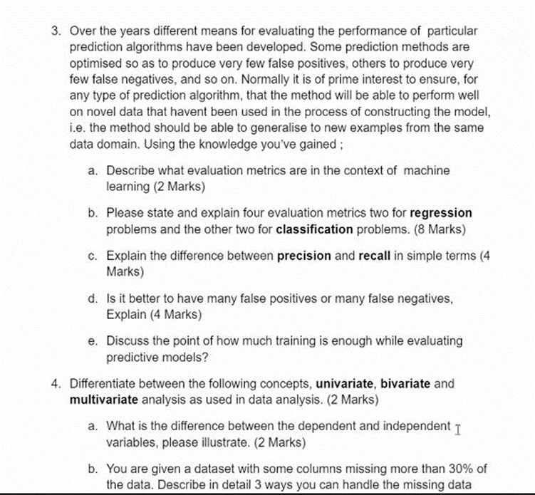
NUMBER THREE

Slide 13
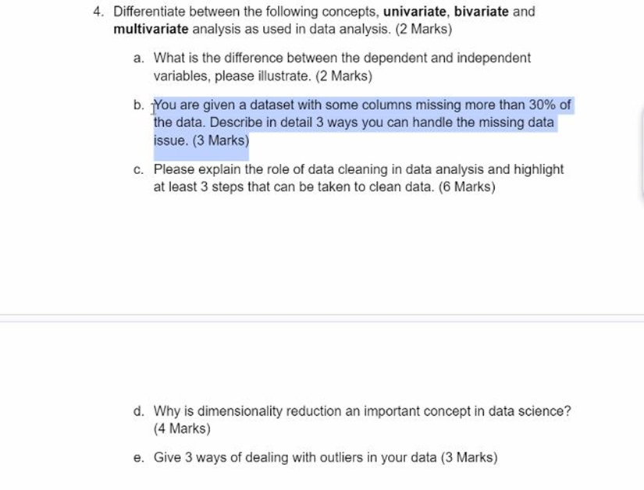
NUMBER FOUR

Slide 14
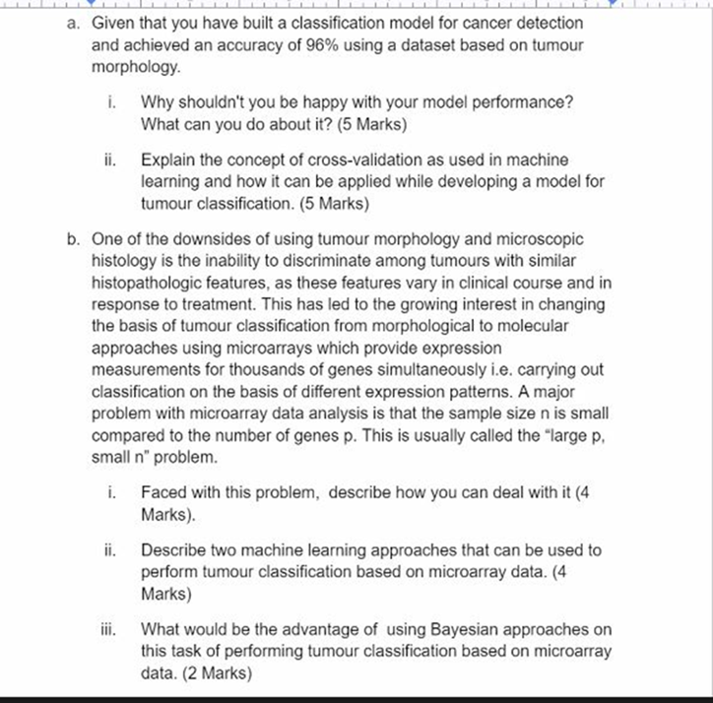
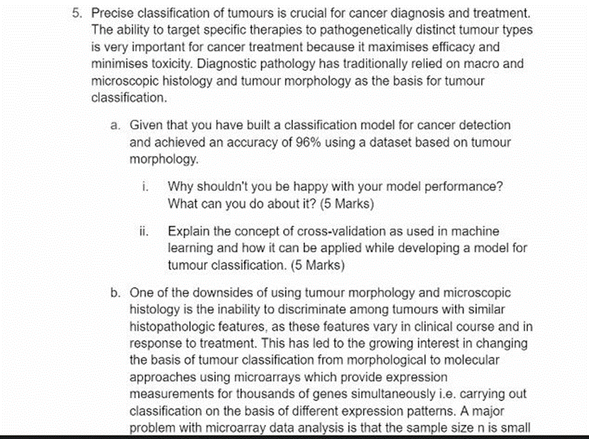
NUMBER FIVE

