Slide 1
Web Crawl Style Creator
Matt Canute, Donggu Lee, Adriena Wong, Young-Min Kim

Slide 2
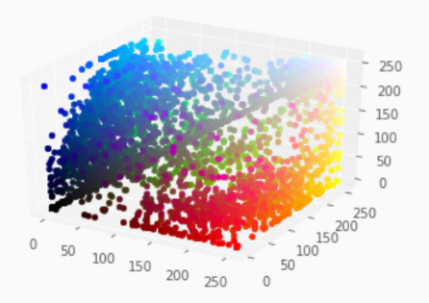
What is the project about?
Colours and fonts have a huge impact on how visitors view your online content, whether it's a company website or a personal blog.
With so many possible colours and fonts, it's difficult to choose the perfect combination for your site.
Get the best colours and fonts for your website/blog with the Web Crawl Style Creator.
It compares your website/blog's typical text content with other similar websites/blogs in order to recommend you the perfect style!
We are a team of four SFU Big Data students who are on a mission to help you make your online content more beautiful <3

Slide 3
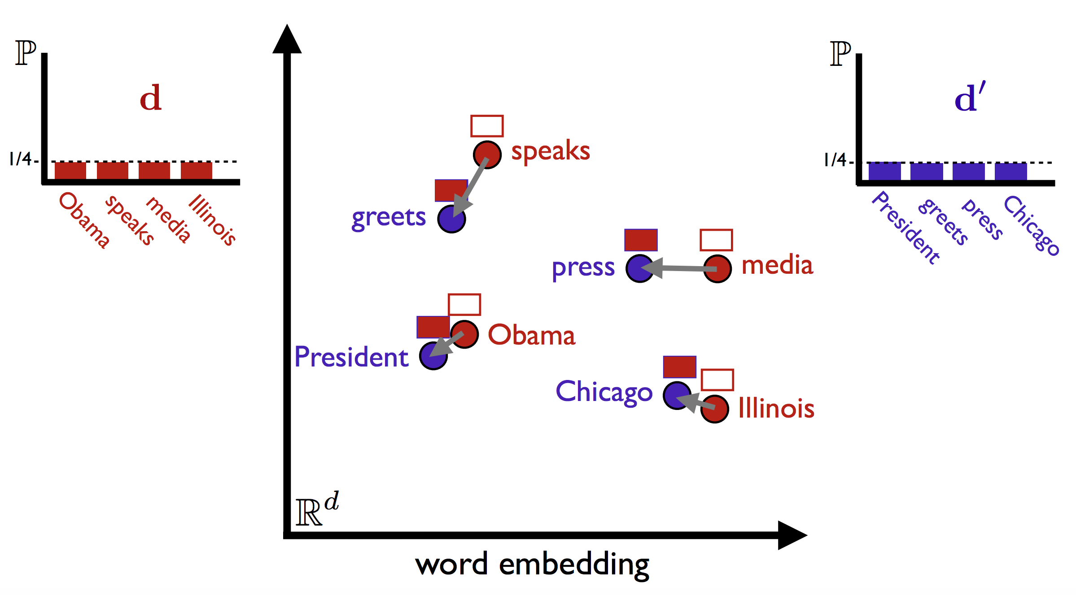
How did we do this?
Technologies used:
Cassandra
Flask
Spark
Pandas
Gensim
BeautifulSoup4
NLTK
Word2Vec

Slide 4
Process
Websites
Blogs
Pulled a dataset of 100k websites from the Alexa Top Websites Dataset.
Ran BeautifulSoup4 in parallel to grab website colour schemes, font-families, and text.
Ran Tumblr API to recursively compile a list of Tumblr blogs.
Ran Tumblr API again to pull info from that list of Tumblr.
Inserted both datasets into a Cassandra database.
Formatted website and blog text into word embedding space to
calculate semantic similarity for suggested similar colour schemes to
be used.
Created Flask application for user input to interact with our style
suggestions.

Slide 5
How else can we use this?
Monthly snapshots of the entire internet will allow us to quantitatively measure changes in style preferences over time.
This could allow us to determine trends and what might have made websites more popular than others.
Association rules will allow us to determine popular colour/font pairings.
Analyze colour preferences by different types of websites.

Slide 6
Thank You!

