Slide 1

Aircraft Fault Detection through ML-based classification
Team Members :
Bhautik (Brian) Amin, Mevlut Bayram, Ben Campos, Richard Hong

Slide 2

Introduction
Aircraft have actuators (Rudder, Elevator, Aileron)
Actuators play an important role for flight control
Actuator failures may cause fatal crashes
Nominal flight controllers might not locate the failures and failure detection is needed.
Early and correct detection may save the aircraft for a potential crash

Slide 3
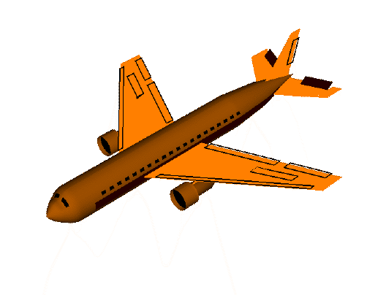
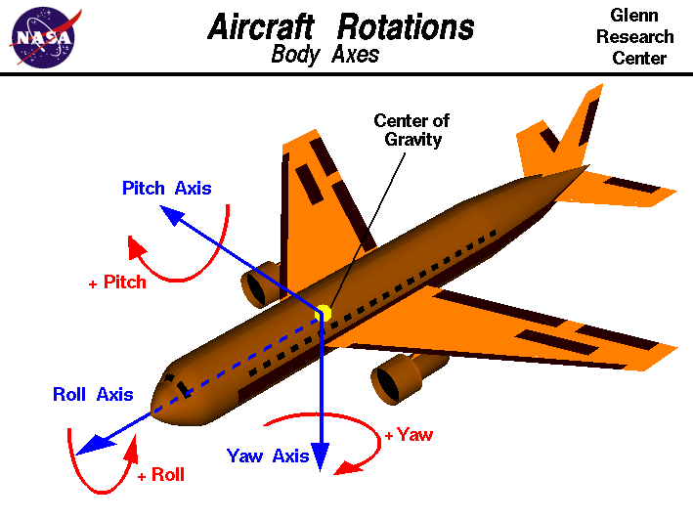
Problem Statement
Elevator is placed horizontally on tail which is a vital actuator that allows pitch up and down
Comparing other actuators, elevators failures are very complicated
Elevator jam may result with a fatal accident [4,5]
If stuck is detected, a switching control system (controller) might save the aircraft [2,3]
Pictures from Nasa website nasa.gov

Slide 4
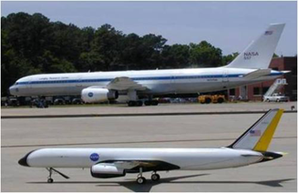
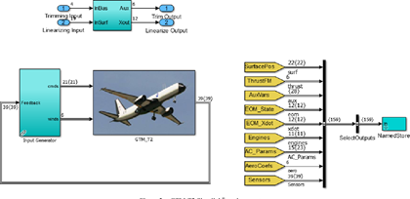
Data Collection
A dynamically scaled Generic Transport Model (GTM) simulation designed by NASA to investigate the loss of control problems [1] is used for data collection.
46 different stuck and non-stuck cases are collected.
Ascending/Descending scenario added for non-stuck cases to make the problem more challenging
Elevator Jam occurred various time and angles.
Fig 2: GTM and Actual Model
Fig 3: GTM Simulink Simulation

Slide 5
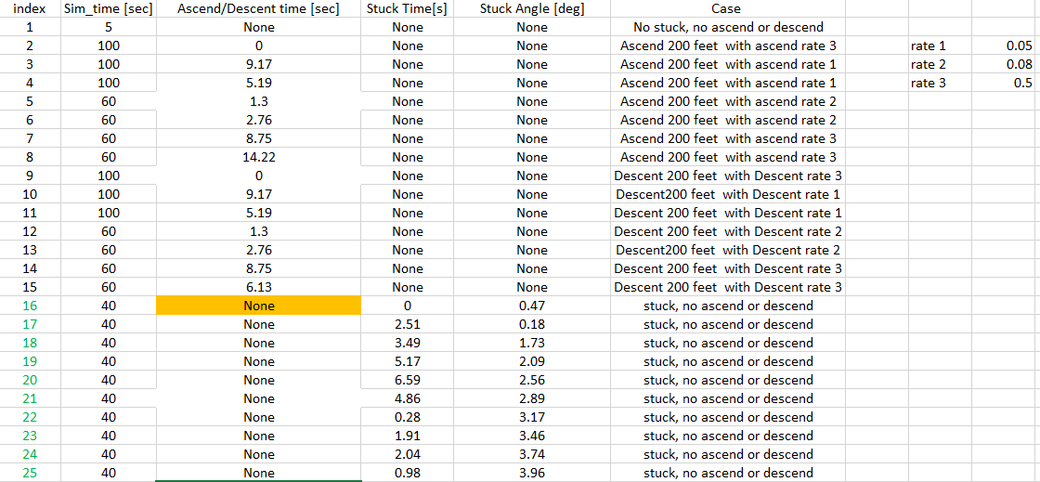
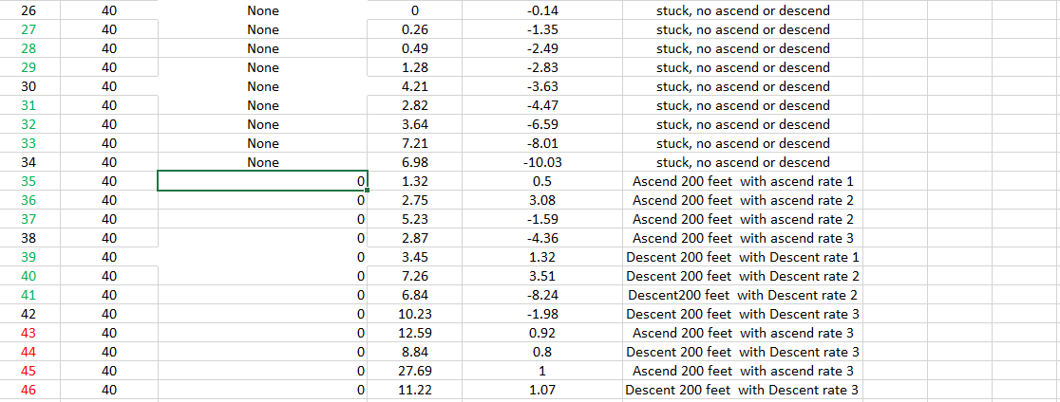
Data Collection
Non-Stuck Cases:
No ascend/descend, no stuck. Literally no changes in state
Ascend and descend 200 feet with various climb rate and with various time
Stuck Cases:
No ascend/descend, but jam.
Ascend and descend 200 feet with various climb rate and elevator jammed an angle with a time.
Fig 4: All stuck and non-stuck calses

Slide 6
Flight Dynamics
Aircraft have complex and coupled dynamics
For the sake of simplicity, dynamics will be separated as Longitudinal and Lateral dynamics
For the elevator detection problem, only the longitudinal dynamics will be considered
  The effect of elevator on other states (lateral dynamics ) are very small.
  Longitudinal Features that will be considered:
    Speed (TAS), Angle of Attack (Alpha), Pitch Angle (Theta), Pitch Rate (q)
Notes:
P
Q
R
Elevation
Ail
Rudder
Throttle
Akt
stuck

Slide 7
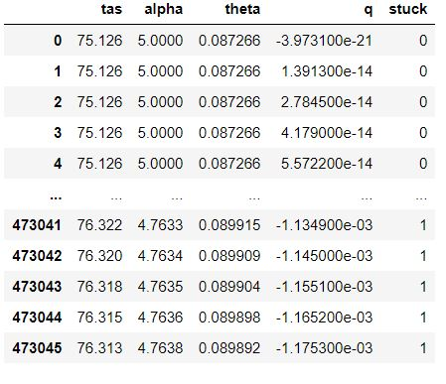
Preprocessing
The data was created using Matlab Simulink.
Trim sates:
[V, alpha, theta, q]= [75.13 kt, 5°, 5°, 0 °]
Trimmed elevator, "δ" _e= 0.97°
Total 46 simulations that contain either stuck or not stuck cases and then all simulations are combined.
Due to aircraft dynamics , ony 4 states are used: Speed (tas), angle of attack (alpha), pitch angle (theta) and pitch rate(q).
Elevator most affect the 4 states above.
Label is binary: stuck (1) or no stuck (0)
Fig 5: Longitudinal states and label
Notes:
P
Q
R
Elevation
Ail
Rudder
Throttle
Akt
stuck

Slide 8
Basic Approach
Supervised Learning Approach
Perform binary classification on the data set (Stuck or Not Stuck)
  Two Main Approaches:
    Frequency Domain Approach (Using the Fast Fourier Transform)
    Time Domain Approach (Using the raw time-series data)
  Collect performance metrics using the following classifiers:
    Random Forest
    Decision Tree
    Neural Network
    Logistic Regression
Notes:
P
Q
R
Elevation
Ail
Rudder
Throttle
Akt
stuck

Slide 9
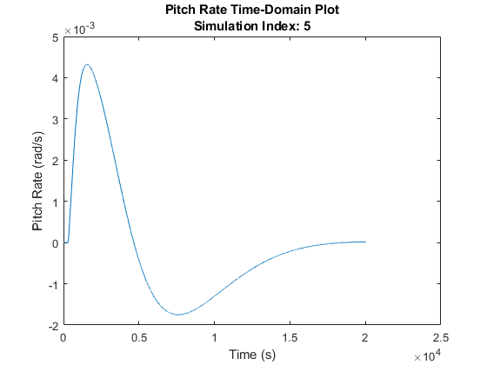
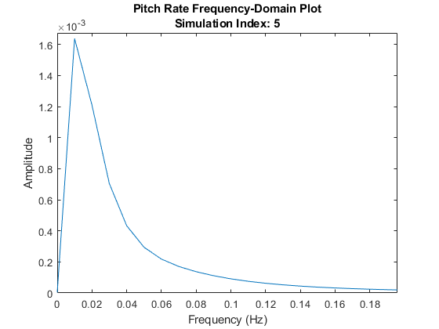
Supervised Learning: Frequency-Domain
Data is converted into the frequency domain using the Fast Fourier Transform (FFT) algorithm

Slide 10
Supervised Learning: Frequency-Domain
Frequency-Domain can reveal patterns (Repeated sequences) within data
  Such patterns can relate to the aircraft performing a maneuver (Climbing, Descending, Stuck, Not Stuck)
By looking at the highest peaks in the data, and observing the associated frequency of the peak, a new feature set can be constructed

Slide 11
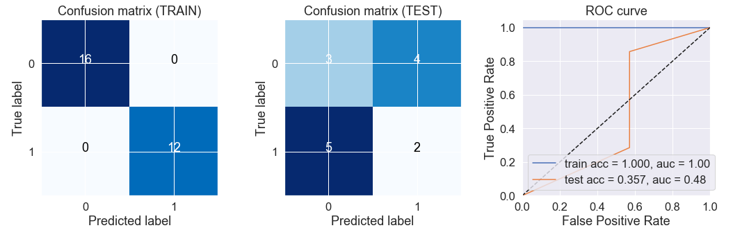
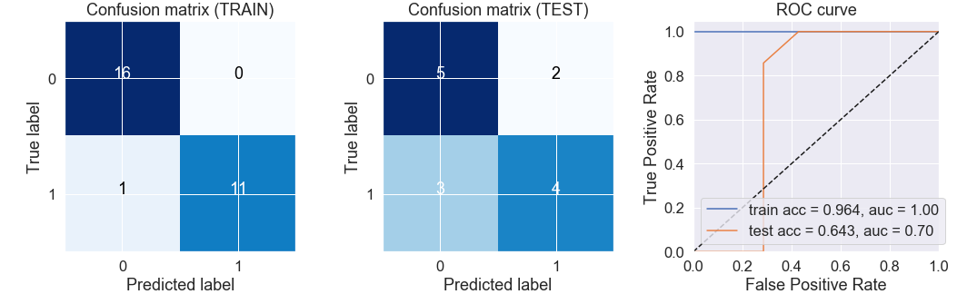
Supervised Learning: Frequency-Domain
Results:
Training accuracy is near perfect
  May indicate possible overfitting
  More data for training needed​
Logistic regression: Accuracy on Test Data: 0.35
Random Forest: Accuracy on Test Data: 0.64

Slide 12
Supervised Learning: Time-Domain Data
Each row in data (Fig.5) shows every 0.005 second from simulation
Though the data looks like time series, our work shows that the data is not time dependent
Each state assumed is a feature and label is binary (4 features , 1 label)
The data is standardized and separated as train and test data
Train model created for multiple ML algorithm such as logistic regression, decision tree etc.

Slide 13
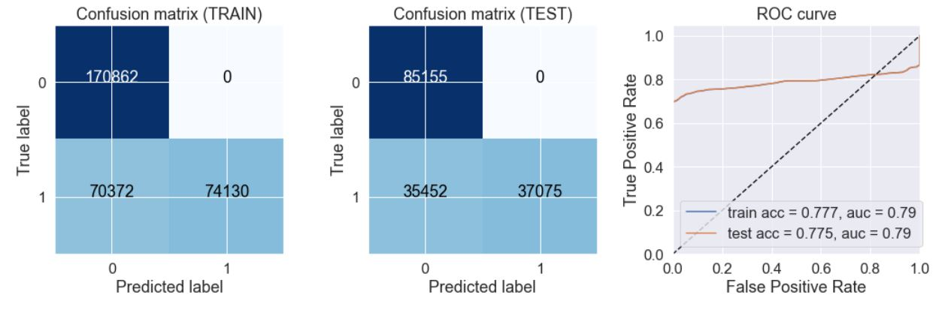
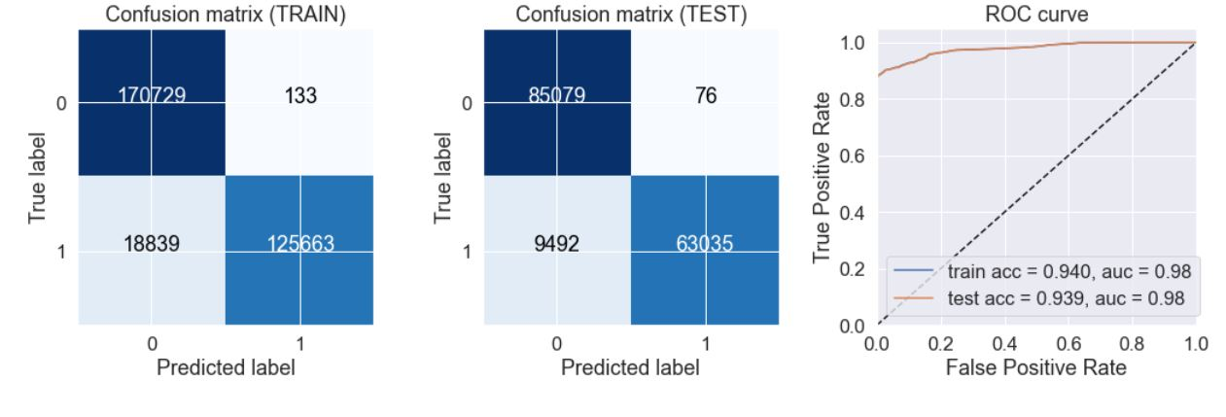
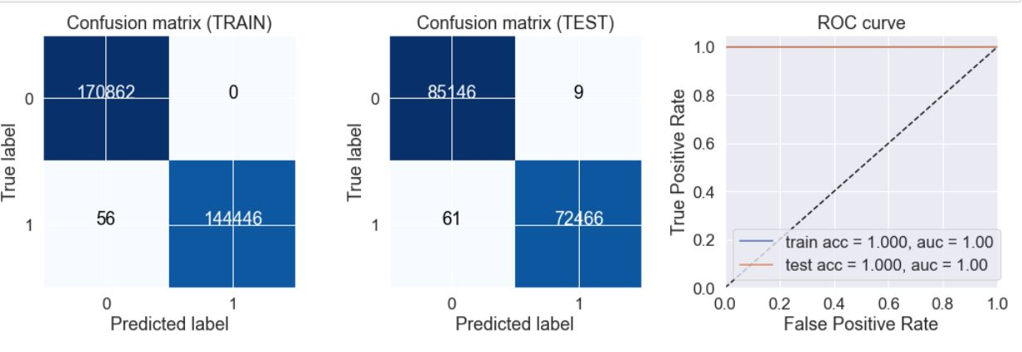
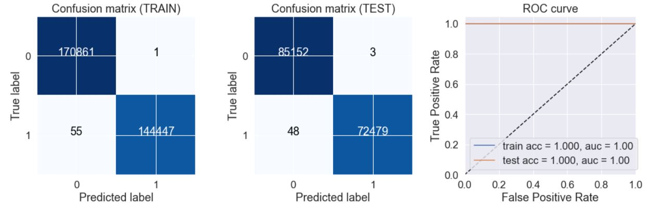
Supervised Learning: Time-Domain Data
Logistic regression accuracy on Test Data: 0.78
Naïve Bayes accuracy on Test Data: 0.94
Decision Tree accuracy on Test Data : ~1
Random Forest accuracy on Test Data : ~1

Slide 14
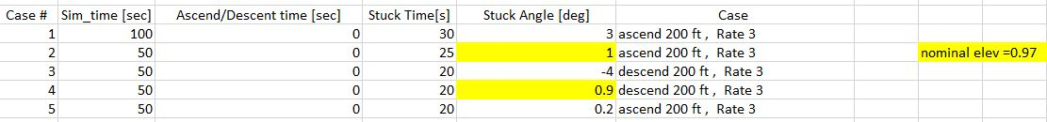
New Data on Trained Model
Purpose of this project was to get a trained model and predict if the elevator is jammed or not.
We have trained model which successfully work on test data.
Now we get new 5 cases as seen below
Case 2 and Case 4 are challenging because elevator jam occurred near the nominal elevator "δ" _e= 0.97°
Fig 6: Five different new cased crated to be tested on trained models

Slide 15
New Data on Trained Model
Each row in data represent state conditions sampled at 0.005 seconds intervals
In real life, it might be impractical to predict if the elevator is stuck in 0.005 second intervals
New data is formed to reflect this, with 0.05 second intervals of simulation
Decision tree was found to be the best and fastest algorithm in this project
In all 5 different new cases, elevator stuck is detected accurately within 0.3 seconds
However, accuracy in case#2 and case#4 are lower comparing other cases.
In other case, the accuracy is almost 1.

Slide 16
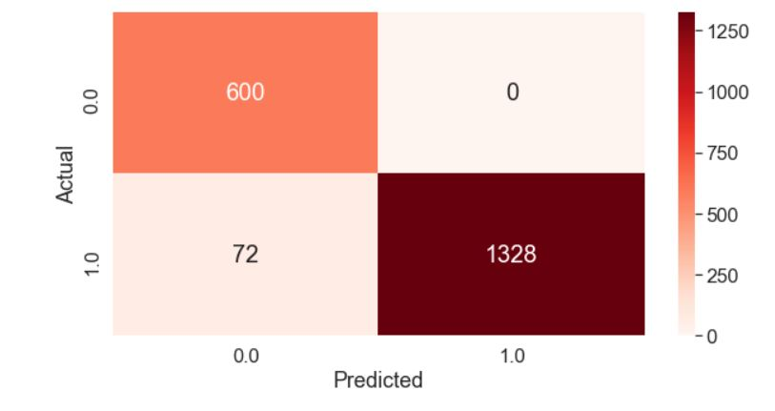
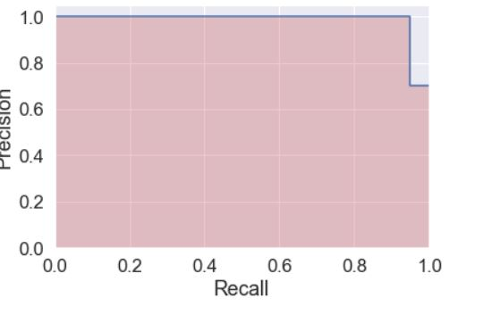
New Data on Trained Model
Result for Case 1:
  Elevator jammed at 3 degree (nominal was 0.97 degree)
  Model: Decision Tree
Metrics:
Accuracy: 0.964
Precision: 1.0
Recall: 0.948
f-measure: 0.9736
Fig 7a : Confusion Matrix
Fig 7b:PR graph

Slide 17
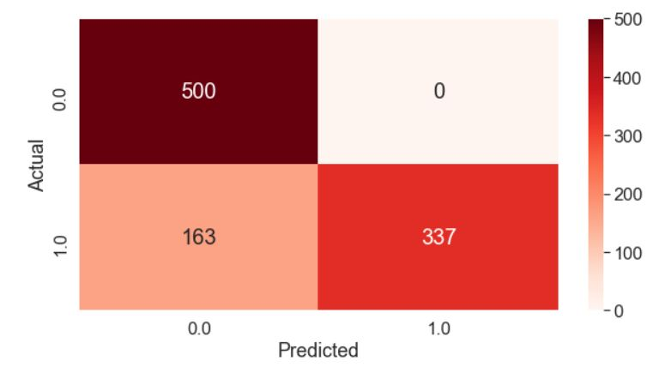
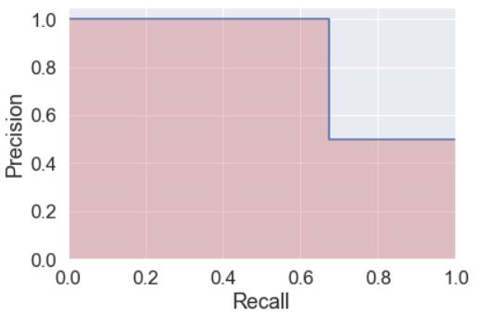
New Data on Trained Model
Result for Case 2:
  Elevator jammed at 1 degree (nominal was 0.97 degree)
  Model: Decision Tree
Metrics:
Accuracy: 0.837
Precision: 1.0
Recall: 0.674
f-measure: 0.805
Fig 8a : Confusion Matrix
Fig 8b:PR graph

Slide 18
New Data on Trained Model
Other methods have been tested using other cases but are not shown here:
Accuracy for case #2 and #4 are low comparing with cases 1, 3, and 5
  This was found to be because the stuck condition is very close to the nominal value for the elevator – so the behavior of the features look as if they were nominal as well
  The control system may have easily compensated for the small stuck case and recovered the aircraft for a short period of time.
    In this period, the aircraft behavior may look normal – even though the label is stuck!

Slide 19
Conclusion
Frequency-Domain technique was not as adequate as working with the time-domain data directly
  Data is not necessarily time-dependent
Many known supervised ML algorithms have performed well using the time-domain data
Decision Tree is fastest and most accurate method found in this project
In all 5 possible new test cases, the stuck class was detected in less than 0.3 second of the actuator failure incidence
For small (stuck distance from nominal) stuck angles, the accuracy drops however
The methods explored in this project might be useful for actuator detection in real-time applications

Slide 20
Future Work
Simulations were running for level flight only. Coordinated turns and some other maneuvers might be considered
Other actuator failures could be investigated
More than 1 actuator failure at the same time could be investigated though such a case is rare to see in real life

Slide 21
References
[1] https://github.com/nasa/GTM_DesignSim
[2] B. Chang, M. Bayram, H. Kwatny and C. M. Belcastro, "Flight path and altitude tracking control of an impaired nonlinear generic transport model (GTM) aircraft with elevator jam failures," 2016 IEEE Conference on Control Applications (CCA), Buenos Aires, 2016, pp. 15-20.
[3] Chan, P. C., Chang, B. C., Bayram, M., Kwatny, H., & Belcastro, C. M. (2019). Robust tracking control of an aircraft with critical actuator jam failures. Asian Journal of Control.
[4] https://www.ntsb.gov/investigations/data/Pages/aviation_stats.aspx
[5] https://www.ntsb.gov/investigations/AccidentReports/Reports/AAR0201.pdf
[6].https://www.emerald.com/insight/content/doi/10.1108/00022660510585992/full/pdf?title=sensor-and-control-surfaceactuator-failure-detection-and-isolation-applied-to-f16-flight-dynamic
[7]. https://www.ncbi.nlm.nih.gov/pmc/articles/PMC4098612/
[8]. https://www-clinicalkey-com.ezproxy2.library.drexel.edu/#!/content/journal/1-s2.0-S0730725X08000775
[9]. http://ataspinar.com/2018/04/04/machine-learning-with-signal-processing-techniques/

