Slide 1

Artificial Intelligence
for developers
8 weekend per diventare Machine Learning Specialist

Slide 2


Natural Language Processing
Maurizio Atzori
Università degli Studi di Cagliari
atzori@unica.it
February 9-10 , 2024

Slide 3
Outline of the course
Intro on AI, ML and NLP
Text Processing
Words and Corpora
Lexical similarity
Language Modeling
Text Classification
Semantic similarity
Knowledge Graphs
Intro to Large Language Models

Slide 4
Minimum Edit Distance
Lexical Similarity

Slide 5
How similar are two strings?
Spell correction
The user typed “graffe”
Which is closest?
graf
graft
grail
giraffe
Computational Biology
Align two sequences of nucleotides
Resulting alignment:
AGGCTATCACCTGACCTCCAGGCCGATGCCC
TAGCTATCACGACCGCGGTCGATTTGCCCGAC
-AGGCTATCACCTGACCTCCAGGCCGA--TGCCC---
TAG-CTATCAC--GACCGC--GGTCGATTTGCCCGAC
Also for Machine Translation, Information Extraction, Speech Recognition

Slide 6
Edit Distance
The minimum edit distance between two strings
Is the minimum number of editing operations
Insertion
Deletion
Substitution
Needed to transform one into the other

Slide 7

Minimum Edit Distance
Two strings and their alignment:

Slide 8
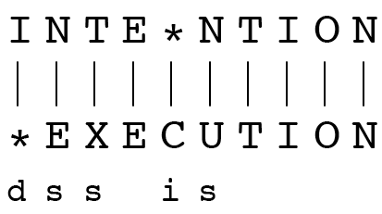
Minimum Edit Distance
If each operation has cost of 1
Distance between these is 5
If substitutions cost 2 (Levenshtein)
Distance between them is 8

Slide 9
Alignment in Computational Biology
Given a sequence of bases
An alignment:
Given two sequences, align each letter to a letter or gap
AGGCTATCACCTGACCTCCAGGCCGATGCCC
TAGCTATCACGACCGCGGTCGATTTGCCCGAC
-AGGCTATCACCTGACCTCCAGGCCGA--TGCCC---
TAG-CTATCAC--GACCGC--GGTCGATTTGCCCGAC

Slide 10
Other uses of Edit Distance in NLP
Evaluating Machine Translation and speech recognition
R Spokesman confirms senior government adviser was appointed
H Spokesman said the senior adviser was appointed
S I D I
Named Entity Extraction and Entity Coreference
IBM Inc. announced today
IBM profits
Stanford Professor Jennifer Eberhardt announced yesterday
for Professor Eberhardt…

Slide 11
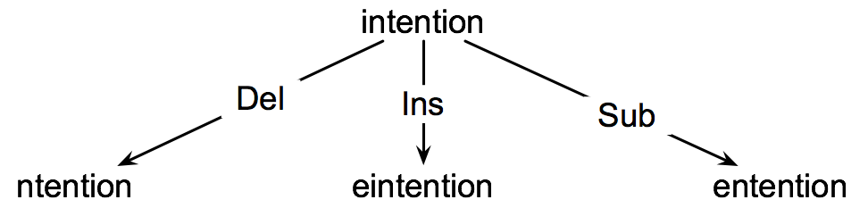
How to find the Min Edit Distance?
Searching for a path (sequence of edits) from the start string to the final string:
Initial state: the word we’re transforming
Operators: insert, delete, substitute
Goal state: the word we’re trying to get to
Path cost: what we want to minimize: the number of edits

Slide 12
Minimum Edit as Search
But the space of all edit sequences is huge!
We can’t afford to navigate naïvely
Lots of distinct paths wind up at the same state.
We don’t have to keep track of all of them
Just the shortest path to each of those revisted states.

Slide 13
Defining Min Edit Distance
For two strings
X of length n
Y of length m
We define D(i,j)
the edit distance between X[1..i] and Y[1..j]
i.e., the first i characters of X and the first j characters of Y
The edit distance between X and Y is thus D(n,m)

Slide 14
Minimum Edit Distance
Lexical Similarity

Slide 15
Computing the Minimum Edit Distance
Lexical Similarity

Slide 16
Dynamic Programming for Minimum Edit Distance
Dynamic programming: A tabular computation of D(n,m)
Solving problems by combining solutions to subproblems.
Bottom-up
We compute D(i,j) for small i,j
And compute larger D(i,j) based on previously computed smaller values
i.e., compute D(i,j) for all i (0 < i < n) and j (0 < j < m)

Slide 17
Defining Min Edit Distance (Levenshtein)
Initialization
D(i,0) = i
D(0,j) = j
Recurrence Relation:
For each i = 1…M
For each j = 1…N
D(i-1,j) + 1
D(i,j)= min D(i,j-1) + 1
D(i-1,j-1) + 2; if X(i) ≠ Y(j)
0; if X(i) = Y(j)
Termination:
D(N,M) is distance

Slide 18
Rì0/1
Minimum Edit Distance
Lexical Similarity

Slide 19
The Edit Distance Table
N | 9
O | 8
I | 7
T | 6
N | 5
E | 4
T | 3
N | 2
I | 1
# | 0 | 1 | 2 | 3 | 4 | 5 | 6 | 7 | 8 | 9
 | # | E | X | E | C | U | T | I | O | N

Slide 20
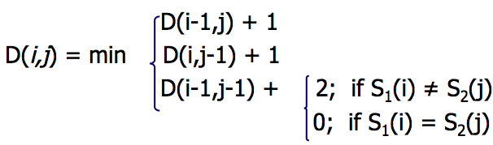
The Edit Distance Table
N | 9
O | 8
I | 7
T | 6
N | 5
E | 4
T | 3
N | 2
I | 1
# | 0 | 1 | 2 | 3 | 4 | 5 | 6 | 7 | 8 | 9
 | # | E | X | E | C | U | T | I | O | N

Slide 21
Edit Distance
N | 9
O | 8
I | 7
T | 6
N | 5
E | 4
T | 3
N | 2
I | 1
# | 0 | 1 | 2 | 3 | 4 | 5 | 6 | 7 | 8 | 9
 | # | E | X | E | C | U | T | I | O | N

Slide 22
The Edit Distance Table
N | 9 | 8 | 9 | 10 | 11 | 12 | 11 | 10 | 9 | 8
O | 8 | 7 | 8 | 9 | 10 | 11 | 10 | 9 | 8 | 9
I | 7 | 6 | 7 | 8 | 9 | 10 | 9 | 8 | 9 | 10
T | 6 | 5 | 6 | 7 | 8 | 9 | 8 | 9 | 10 | 11
N | 5 | 4 | 5 | 6 | 7 | 8 | 9 | 10 | 11 | 10
E | 4 | 3 | 4 | 5 | 6 | 7 | 8 | 9 | 10 | 9
T | 3 | 4 | 5 | 6 | 7 | 8 | 7 | 8 | 9 | 8
N | 2 | 3 | 4 | 5 | 6 | 7 | 8 | 7 | 8 | 7
I | 1 | 2 | 3 | 4 | 5 | 6 | 7 | 6 | 7 | 8
# | 0 | 1 | 2 | 3 | 4 | 5 | 6 | 7 | 8 | 9
 | # | E | X | E | C | U | T | I | O | N

Slide 23
Computing the Minimum Edit Distance
Lexical Similarity

Slide 24
Backtrace for Computing Alignment
Lexical Similarity

Slide 25
Computing alignments
Edit distance isn’t sufficient
We often need to align each character of the two strings to each other
We do this by keeping a “backtrace”
Every time we enter a cell, remember where we came from
When we reach the end,
Trace back the path from the upper right corner to read off the alignment

Slide 26
Edit Distance
N | 9
O | 8
I | 7
T | 6
N | 5
E | 4
T | 3
N | 2
I | 1
# | 0 | 1 | 2 | 3 | 4 | 5 | 6 | 7 | 8 | 9
 | # | E | X | E | C | U | T | I | O | N

Slide 27
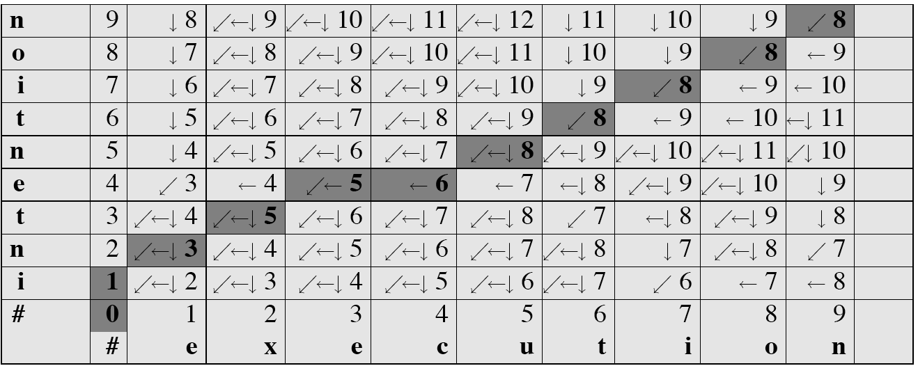
MinEdit with Backtrace

Slide 28
Adding Backtrace to Minimum Edit Distance
Base conditions: Termination:
D(i,0) = i D(0,j) = j D(N,M) is distance
Recurrence Relation:
For each i = 1…M
For each j = 1…N
D(i-1,j) + 1
D(i,j)= min D(i,j-1) + 1
D(i-1,j-1) + 2; if X(i) ≠ Y(j)
0; if X(i) = Y(j)
LEFT
ptr(i,j)= DOWN
DIAG
deletion
insertion
substitution
insertion
deletion
substitution

Slide 29
The Distance Matrix
Every non-decreasing path
from (0,0) to (M, N)
corresponds to
an alignment
of the two sequences
x₀ …………………… x_{N}
An optimal alignment is composed of optimal subalignments
y₀ ……………………………… y_{M}

Slide 30
Result of Backtrace
Two strings and their alignment:

Slide 31
Performance
Time:
O(nm)
Space:
O(nm)
Backtrace
O(n+m)

Slide 32
Backtrace for Computing Alignment
Lexical Similarity

Slide 33
Weighted Minimum Edit Distance
Lexical Similarity

Slide 34
Weighted Edit Distance
Why would we add weights to the computation?
Spell Correction: some letters are more likely to be mistyped than others
Biology: certain kinds of deletions or insertions are more likely than others

Slide 35
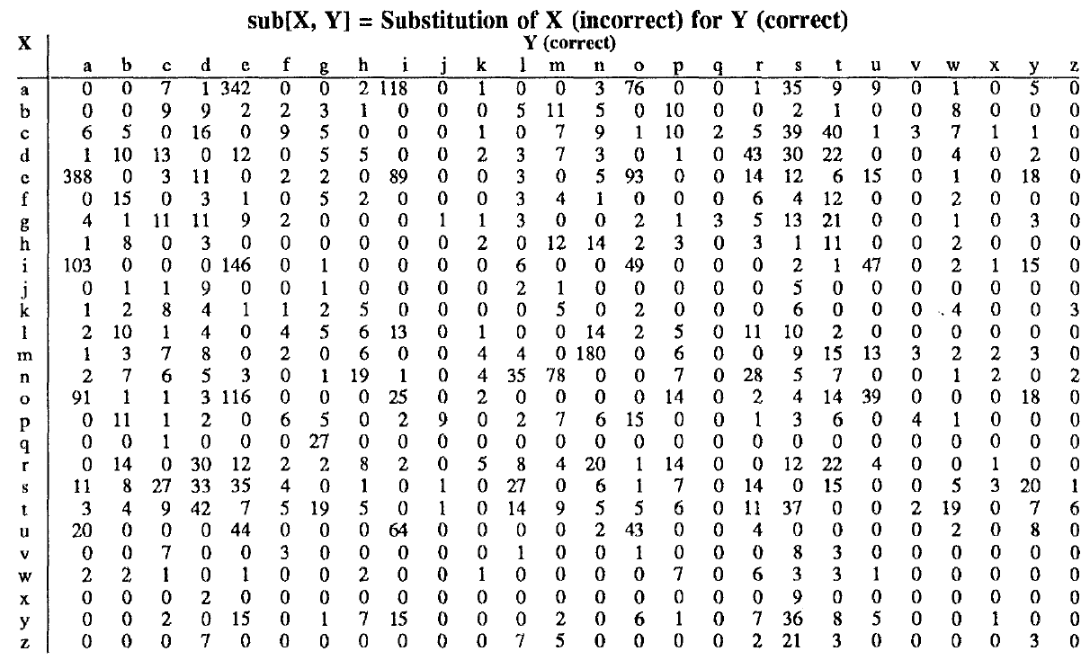
Confusion matrix for spelling errors

Slide 36
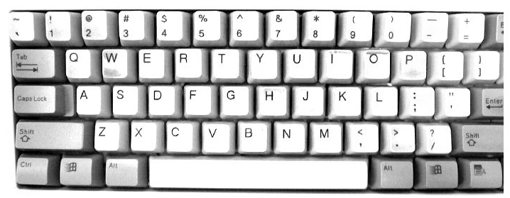

Slide 37
Weighted Min Edit Distance
Initialization:
D(0,0) = 0
D(i,0) = D(i-1,0) + del[x(i)]; 1 < i ≤ N
D(0,j) = D(0,j-1) + ins[y(j)]; 1 < j ≤ M
Recurrence Relation:
D(i-1,j) + del[x(i)]
D(i,j)= min D(i,j-1) + ins[y(j)]
D(i-1,j-1) + sub[x(i),y(j)]
Termination:
D(N,M) is distance

Slide 38
Where did the name, dynamic programming, come from?
…The 1950s were not good years for mathematical research. [the] Secretary of Defense …had a pathological fear and hatred of the word, research…
I decided therefore to use the word, “programming”.
I wanted to get across the idea that this was dynamic, this was multistage… I thought, let’s … take a word that has an absolutely precise meaning, namely dynamic… it’s impossible to use the word, dynamic, in a pejorative sense. Try thinking of some combination that will possibly give it a pejorative meaning. It’s impossible.
Thus, I thought dynamic programming was a good name. It was something not even a Congressman could object to.”
Richard Bellman, “Eye of the Hurricane: an autobiography” 1984.

Slide 39
Weighted Minimum Edit Distance
Lexical Similarity

Slide 40
Applications to Computational Biology
Lexical Similarity

Slide 41
Sequence Alignment
AGGCTATCACCTGACCTCCAGGCCGATGCCC
TAGCTATCACGACCGCGGTCGATTTGCCCGAC
-AGGCTATCACCTGACCTCCAGGCCGA--TGCCC---
TAG-CTATCAC--GACCGC--GGTCGATTTGCCCGAC

Slide 42
Why sequence alignment?
Comparing genes or regions from different species
to find important regions
determine function
uncover evolutionary forces
Assembling fragments to sequence DNA
Compare individuals to looking for mutations

Slide 43
Alignments in two fields
In Natural Language Processing
We generally talk about distance (minimized)
And weights
In Computational Biology
We generally talk about similarity (maximized)
And scores

Slide 44
The Needleman-Wunsch Matrix
x₁ ……………………………… x_{M}
(Note that the origin is at the upper left.)
y₁ …………………… y_{N}

Slide 45
A variant of the basic algorithm:
Maybe it is OK to have an unlimited # of gaps in the beginning and end:
----------CTATCACCTGACCTCCAGGCCGATGCCCCTTCCGGC
GCGAGTTCATCTATCAC--GACCGC--GGTCG--------------
If so, we don’t want to penalize gaps at the ends

Slide 46
Different types of overlaps
Example:
2 overlapping“reads” from a
sequencing project
Example:
Search for a mouse gene
within a human chromosome

Slide 47
Applications to Computational Biology
Lexical Similarity

