Slide 1

Artificial Intelligence
for developers
8 weekend per diventare Machine Learning Specialist

Slide 2


Natural Language Processing
Maurizio Atzori
Università degli Studi di Cagliari
atzori@unica.it
February 9-10 , 2024

Slide 3
Outline of the course
Intro on AI, ML and NLP
Text Processing
Words and Corpora
Lexical similarity
Language Modeling
Text Classification
Semantic similarity
Knowledge Graphs
Intro to Large Language Models

Slide 4
Intro to N-grams
Language Modeling

Slide 5
Probabilistic Language Models
Today’s goal: assign a probability to a sentence
Machine Translation:
P(high winds tonite) > P(large winds tonite)
Spell Correction
The office is about fifteen minuets from my house
P(about fifteen minutes from) > P(about fifteen minuets from)
Speech Recognition
P(I saw a van) >> P(eyes awe of an)
+ Summarization, question-answering, etc., etc.!!
Why?

Slide 6
Probabilistic Language Modeling
Goal: compute the probability of a sentence or sequence of words:
P(W) = P(w₁,w₂,w₃,w₄,w₅…w_{n})
Related task: probability of an upcoming word:
P(w₅|w₁,w₂,w₃,w₄)
A model that computes either of these:
P(W) or P(w_{n}|w₁,w₂…w_{n-1}) is called a language model.
Better: the grammar But language model or LM is standard

Slide 7
How to compute P(W)
How to compute this joint probability:
P(its, water, is, so, transparent, that)
Intuition: let’s rely on the Chain Rule of Probability

Slide 8
Reminder: The Chain Rule
Recall the definition of conditional probabilities
p(B|A) = P(A,B)/P(A) Rewriting: P(A,B) = P(A)P(B|A)
More variables:
P(A,B,C,D) = P(A)P(B|A)P(C|A,B)P(D|A,B,C)
The Chain Rule in General
P(x₁,x₂,x₃,…,x_{n}) = P(x₁)P(x₂|x₁)P(x₃|x₁,x₂)…P(x_{n}|x₁,…,x_{n-1})

Slide 9
The Chain Rule applied to compute joint probability of words in sentence
P(“its water is so transparent”) =
P(its) × P(water|its) × P(is|its water)
× P(so|its water is) × P(transparent|its water is so)

Slide 10
How to estimate these probabilities
Could we just count and divide?
No! Too many possible sentences!
We’ll never see enough data for estimating these

Slide 11
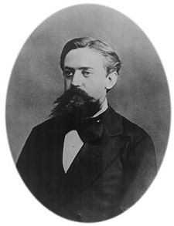
Markov Assumption
Simplifying assumption:
Or maybe
Andrei Markov

Slide 12
Markov Assumption
In other words, we approximate each component in the product

Slide 13
Simplest case: Unigram model
Some automatically generated sentences from a unigram model
fifth, an, of, futures, the, an, incorporated, a, a, the, inflation, most, dollars, quarter, in, is, mass
thrift, did, eighty, said, hard, 'm, july, bullish
that, or, limited, the

Slide 14
Bigram model
Condition on the previous word:
texaco, rose, one, in, this, issue, is, pursuing, growth, in, a, boiler, house, said, mr., gurria, mexico, 's, motion, control, proposal, without, permission, from, five, hundred, fifty, five, yen
outside, new, car, parking, lot, of, the, agreement, reached
this, would, be, a, record, november

Slide 15
N-gram models
We can extend to trigrams, 4-grams, 5-grams
In general this is an insufficient model of language
because language has long-distance dependencies:
“The computer which I had just put into the machine room on the fifth floor crashed.”
But we can often get away with N-gram models

Slide 16
Intro to N-grams
Language Modeling

Slide 17
Estimating N-gram probabilities
Language Modeling

Slide 18
Estimating bigram probabilities
The Maximum Likelihood Estimate

Slide 19

An example
<s> I am Sam </s>
<s> Sam I am </s>
<s> I do not like green eggs and ham </s>

Slide 20
More examples: Berkeley Restaurant Project sentences
can you tell me about any good cantonese restaurants close by
mid priced thai food is what i’m looking for
tell me about chez panisse
can you give me a listing of the kinds of food that are available
i’m looking for a good place to eat breakfast
when is caffe venezia open during the day

Slide 21
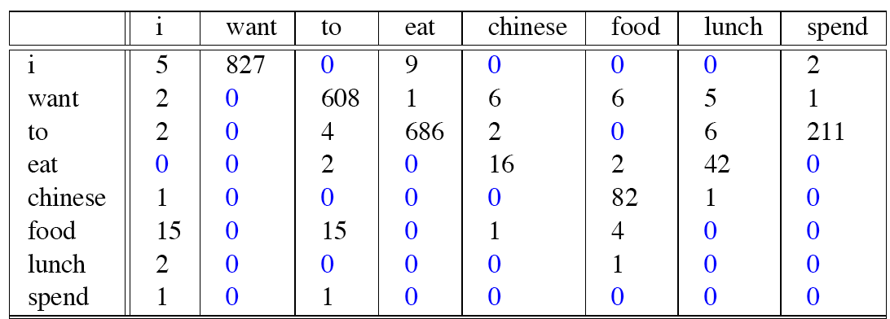
Raw bigram counts
Out of 9222 sentences

Slide 22
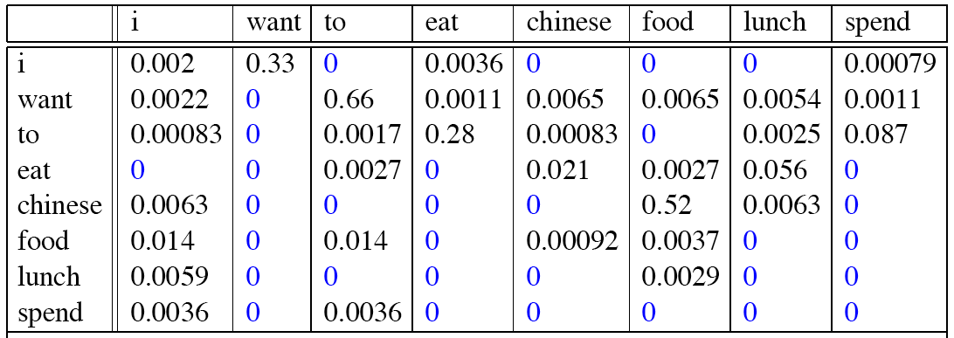
Raw bigram probabilities
Normalize by unigrams:
Result:

Slide 23
Bigram estimates of sentence probabilities
P(<s> I want english food </s>) =
P(I|<s>)
× P(want|I)
× P(english|want)
× P(food|english)
× P(</s>|food)
= .000031

Slide 24
What kinds of knowledge?
P(english|want) = .0011
P(chinese|want) = .0065
P(to|want) = .66
P(eat | to) = .28
P(food | to) = 0
P(want | spend) = 0
P (i | <s>) = .25

Slide 25
Practical Issues
We do everything in log space
Avoid underflow
(also adding is faster than multiplying)

Slide 26
Language Modeling Toolkits
SRILM
http://www.speech.sri.com/projects/srilm/
KenLM
https://kheafield.com/code/kenlm/

Slide 27
Google N-Gram Release, August 2006
…

Slide 28
Google N-Gram Release
serve as the incoming 92
serve as the incubator 99
serve as the independent 794
serve as the index 223
serve as the indication 72
serve as the indicator 120
serve as the indicators 45
serve as the indispensable 111
serve as the indispensible 40
serve as the individual 234
http://googleresearch.blogspot.com/2006/08/all-our-n-gram-are-belong-to-you.html

Slide 29
Google Book N-grams
http://ngrams.googlelabs.com/

Slide 30
Evaluation: How good is our model?
Does our language model prefer good sentences to bad ones?
Assign higher probability to “real” or “frequently observed” sentences
Than “ungrammatical” or “rarely observed” sentences?
We train parameters of our model on a training set.
We test the model’s performance on data we haven’t seen.
A test set is an unseen dataset that is different from our training set, totally unused.
An evaluation metric tells us how well our model does on the test set.

Slide 31
Estimating N-gram probabilities
Language Modeling

Slide 32
Generalization and zeros
Language Modeling

Slide 33
The Shannon Visualization Method
Choose a random bigram
(<s>, w) according to its probability
Now choose a random bigram (w, x) according to its probability
And so on until we choose </s>
Then string the words together
<s> I
I want
want to
to eat
eat Chinese
Chinese food
food </s>
I want to eat Chinese food

Slide 34
Approximating Shakespeare

Slide 35
Shakespeare as corpus
N=884,647 tokens, V=29,066
Shakespeare produced 300,000 bigram types out of V²= 844 million possible bigrams.
So 99.96% of the possible bigrams were never seen (have zero entries in the table)
Quadrigrams worse: What's coming out looks like Shakespeare because it is Shakespeare

Slide 36
The Wall Street Journal is not Shakespeare (no offense)

Slide 37
Can you guess the training set author of the LM that generated these random 3-gram sentences?
They also point to ninety nine point six billion dollars from two hundred four oh six three percent of the rates of interest stores as Mexico and gram Brazil on market conditions
This shall forbid it should be branded, if renown made it empty.
“You are uniformly charming!” cried he, with a smile of associating and now and then I bowed and they perceived a chaise and four to wish for.

Slide 38
The perils of overfitting
N-grams only work well for word prediction if the test corpus looks like the training corpus
In real life, it often doesn’t
We need to train robust models that generalize!
One kind of generalization: Zeros!
Things that don’t ever occur in the training set
But occur in the test set

Slide 39
Zeros
Training set:
… denied the allegations
… denied the reports
… denied the claims
… denied the request
P(“offer” | denied the) = 0
Test set
… denied the offer
… denied the loan

Slide 40
Zero probability bigrams
Bigrams with zero probability
mean that we will assign 0 probability to the test set!
And hence we cannot compute perplexity (can’t divide by 0)!

Slide 41
Generalization and zeros
Language Modeling

Slide 42
Smoothing: add-one (laplace) smoothing
Language Modeling

Slide 43
The intuition of smoothing (from Dan Klein)
When we have sparse statistics:
Steal probability mass to generalize better
P(w | denied the)
3 allegations
2 reports
1 claims
1 request
7 total
allegations
attack
man
reports
outcome
…
claims
request
P(w | denied the)
2.5 allegations
1.5 reports
0.5 claims
0.5 request
2 other
7 total
allegations
allegations
attack
man
outcome
reports
…
claims
request

Slide 44
Add-one estimation
Also called Laplace smoothing
Pretend we saw each word one more time than we did
Just add one to all the counts!
MLE estimate:
Add-1 estimate:

Slide 45
Maximum Likelihood Estimates
The maximum likelihood estimate
of some parameter of a model M from a training set T
maximizes the likelihood of the training set T given the model M
Suppose the word “bagel” occurs 400 times in a corpus of a million words
What is the probability that a random word from some other text will be “bagel”?
MLE estimate is 400/1,000,000 = .0004
This may be a bad estimate for some other corpus
But it is the estimate that makes it most likely that “bagel” will occur 400 times in a million word corpus.

Slide 46
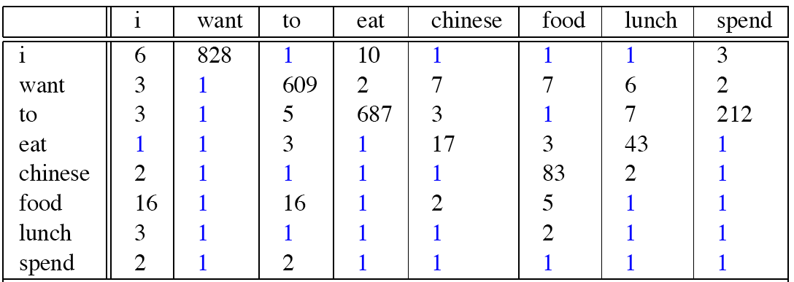
Berkeley Restaurant Corpus: Laplace smoothed bigram counts

Slide 47

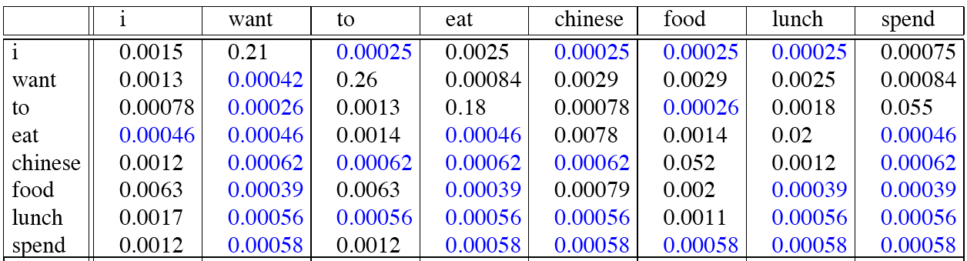
Laplace-smoothed bigrams

Slide 48
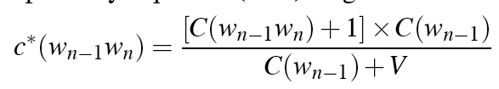
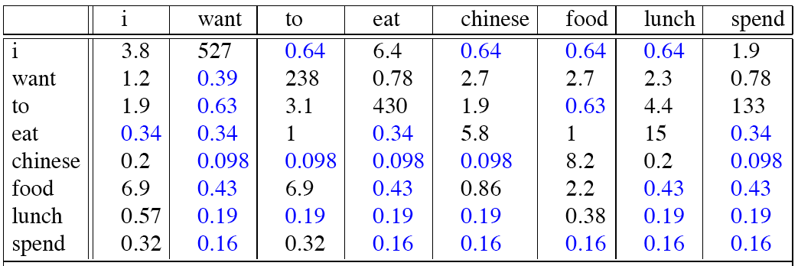
Reconstituted counts

Slide 49
Compare with raw bigram counts
Notes:
C(want to) went from 608 to 238, P(to|want) from .66 to .26!
Discount d= c*/c
d for “chinese food” =.10!!! A 10x reduction

Slide 50
Add-1 estimation is a blunt instrument
So add-1 isn’t used for N-grams:
We’ll see better methods
But add-1 is used to smooth other NLP models
For text classification
In domains where the number of zeros isn’t so huge.

Slide 51
Smoothing: add-one (laplace) smoothing
Language Modeling

