Slide 1
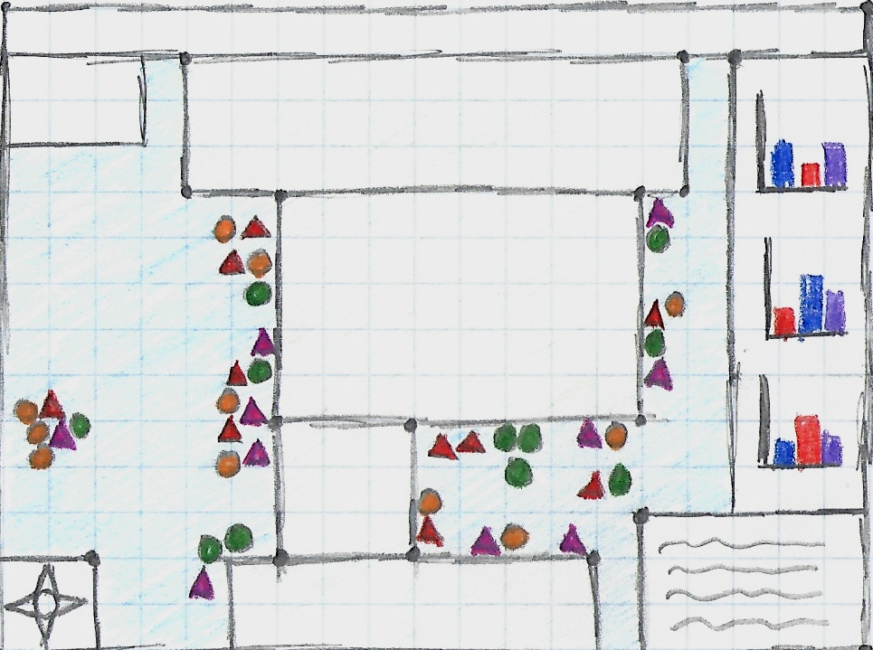
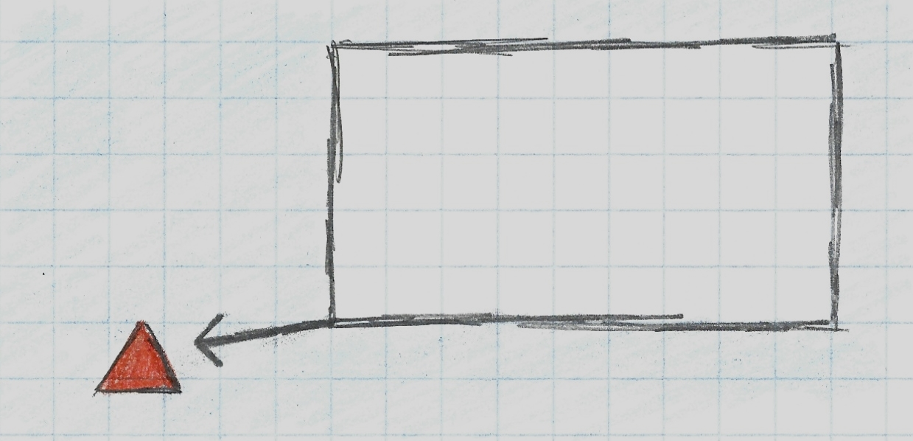
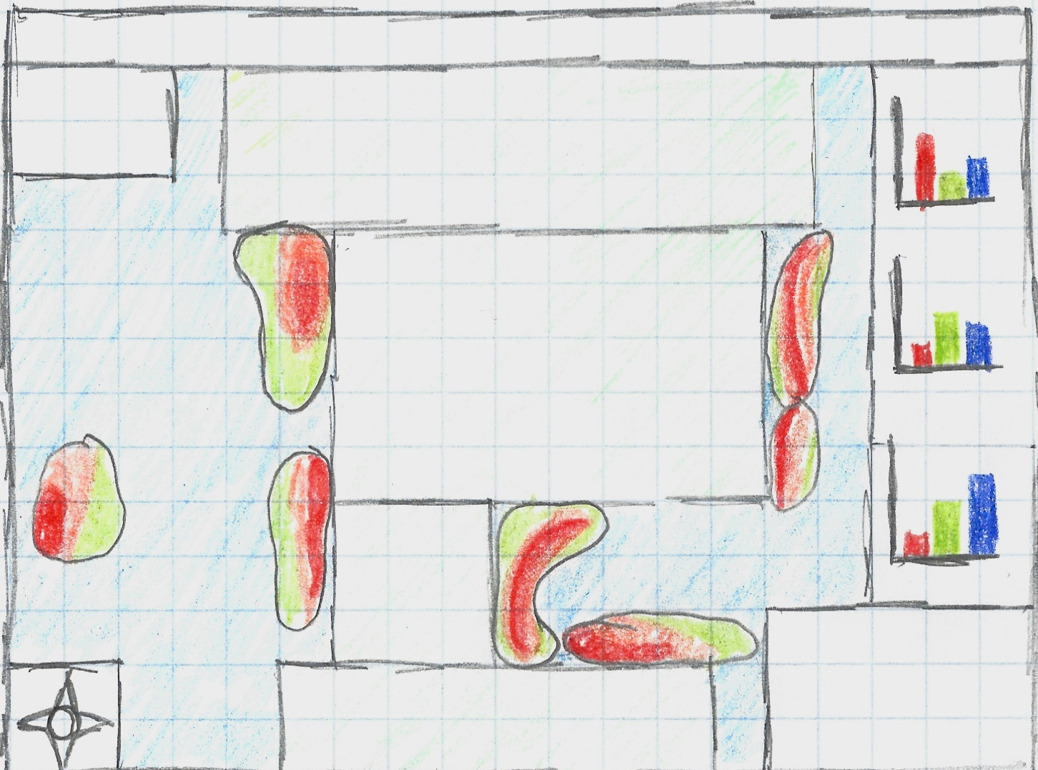
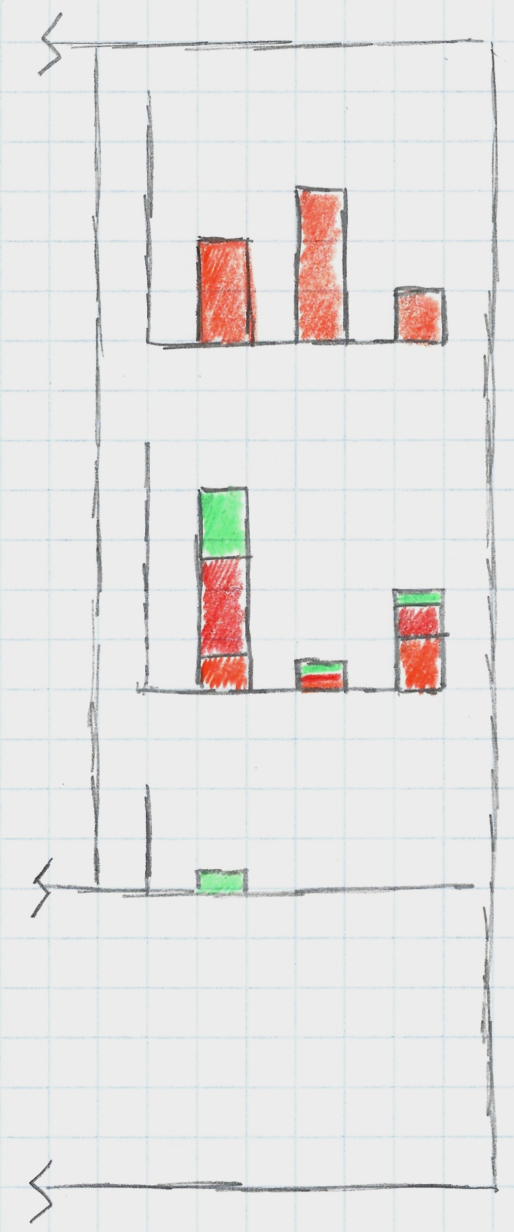
Deep-Sea Interactive Visualization Experience
A Coral and Sponge Narrative
James Deromedi
jd1504a@american.edu
Main Screen
Title Bar
Pan & Zoom
Filtering/Legend/Widgets floating
Shape = Specimen Type
Color = Species
Filter
Species
Locality
Depth
Software/Libraries
D3.js (Main Workhorse)
Simpleheat.js (Heatmaps)
Anychart.js (Bar graphs)
Filtering Menu
Canada
Milestones | Dates
Spatial Map w/ Nodes | 3/22
Heat Map | 4/5
Bar Graph Creator | 4/12
Connect each section together | 4/19
Create Flair! | Turn-in
USA
Compass
South America
Heatmap Screen
Information
Title Bar
Widgets that break down data further
Selecting items on the map, updates the widgets
Click on a widgets brings it up as a popup
Filtering Menu
Canada
Selecting a node on the main screen brings up a popup with all that’s items attributes
Provides a link to the dataset and future information for research
USA
Compass
South America
Legend

