Slide 1
Exploration of Global CO2 Emissions
A brief analysis of developed, underdeveloped and developing countries

Slide 4

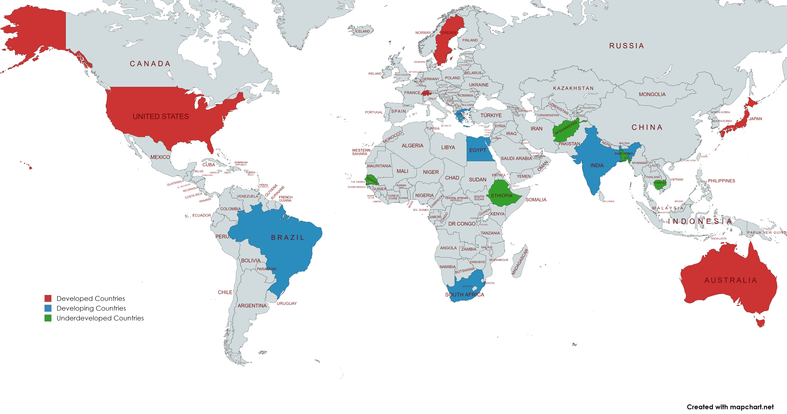
Developed | Developing | Underdeveloped
Australia | Brazil | Ethiopia
Sweden | India | Senegal
Japan | Egypt | Cambodia
Switzerland | Greece | Bangladesh
USA | South Africa | Afghanistan
Country Classifications

