Slide 1
Exploration of Global CO2 Emissions
A brief analysis of developed, underdeveloped and developing countries

Slide 2
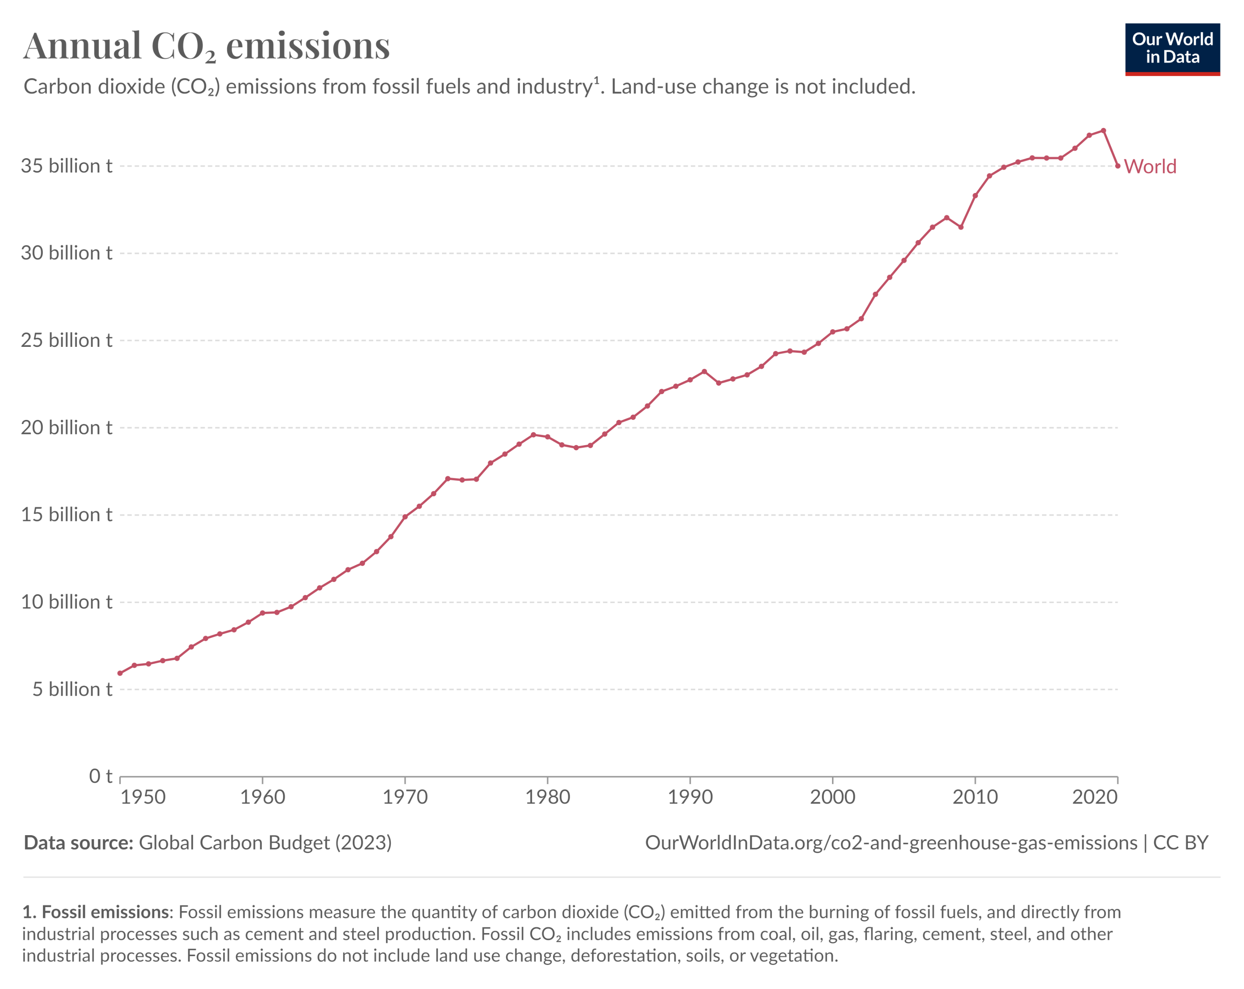
Cause & Effect
CO2 emissions growth
1950’s – 42.15% | 1960’s – 16.33% | 1970’s – 8.28% | 1980’s – 4.39%
1990’s – 4.95% | 2000’s - 5.26% | 2010’s - 2.92%
Emission Causes
Generating Power | Manufacturing Goods
Using Transportation | Powering Buildings
Producing Food | Consumption

Slide 3
Countries classified into three categories:
Economic & Emission Markers:
Annual GDP ($USD)
Population Size
Average Daily Income ($USD)
Total CO2 Emissions (millions of tonnes)
Annual CO2 Emissions Per Capita (tonnes)
Developed | Developing | Underdeveloped
Australia | India | Bangladesh
Sweden | Greece | Afghanistan
Japan | Egypt | Senegal
Switzerland | Brazil | Ethiopia
USA | South Africa | Cambodia

Slide 4

Investigate Trends In Emission Data
Examples of Trends
Major Contributors?
Population vs Total emissions
GDP vs Total emissions
GDP vs Total Emissions ratio
Emissions Per Person vs Daily Income
Change over time?
Economic conditions
Average income
GDP vs Population
Country categorisation
Does the overall development classification of the country impact it’s CO2 emissions?

