Slide 1
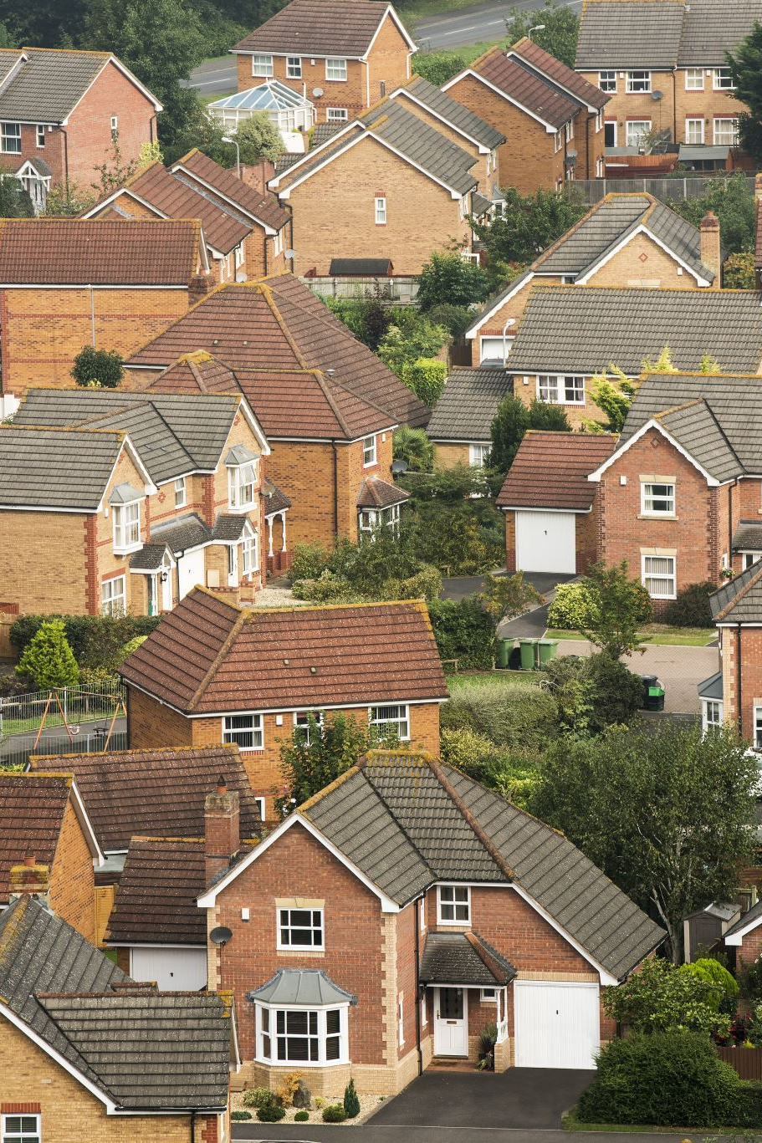
Where to live in Melbourne?

Slide 2



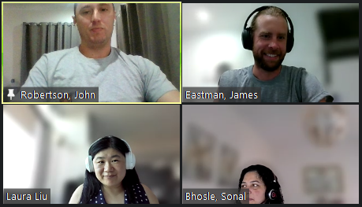
Our Journey – Our Storye Challenges
Ideas
Data Source
Code/Debug
Tools used
Analysis
Our Team
Trend Analysis
Conclusions
Recommendations
Lessons Learnt
Q & A
Outline specific steps, owners, timelines, and resources required to execute the solutions and track the metrics.
List the major challenges facing urban greening efforts in Victoria such as climate change, population growth, and lack of funding.
Propose potential solutions to address each challenge such as developing climate-resilient plant species, securing government funding, and engaging community volunteers.
Determine the most critical actions that need to be taken in the near-term to drive progress on urban greening in Victoria.
Identify key performance indicators to measure progress over time such as number of new trees planted annually or increase in urban canopy cover.

Slide 3
Benefits of Green Spaces
Improves Mental Health
Supports Physical Health
Cleaner Air
Green spaces reduce stress, depression and anxiety, and improve mood and self-esteem.
Green spaces encourage physical activity and reduce rates of obesity, heart disease, diabetes and other chronic illnesses.
Trees and plants absorb air pollutants like carbon dioxide, sulfur dioxide and nitrogen dioxide.
Mitigates Urban Heat
Reduces Noise
Promotes Biodiversity
Shaded green spaces cool the air through evapotranspiration and reduce urban heat island effects.
Trees, shrubs and other vegetation absorb and block sound.
Green spaces provide habitat for diverse plants, insects, birds and other wildlife.

Slide 4
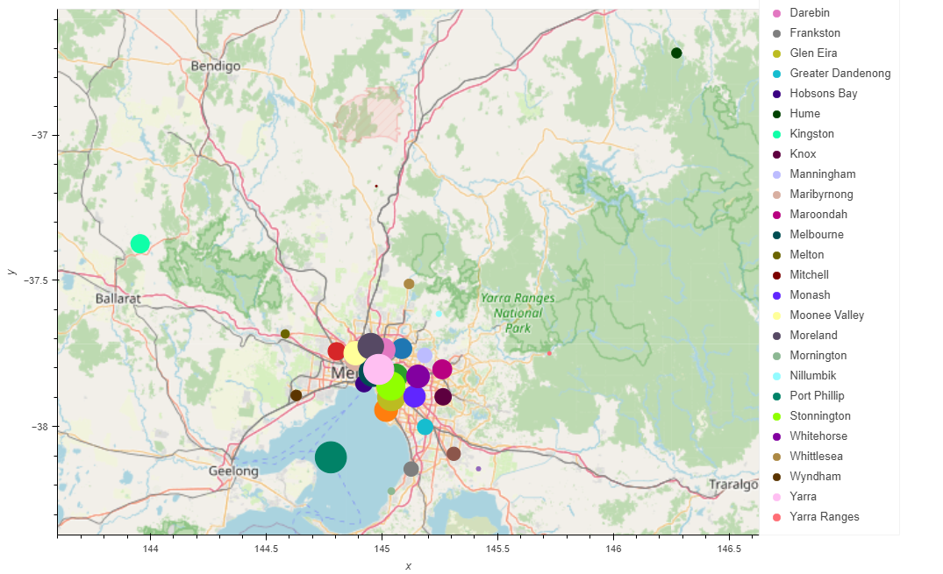
Area of Interest
Notes:
Mitchell, Kingston and Yarra Ranges located well outside the Melbourne Metro LGA area. Would not be considered suitable for a family or person moving there who’s after a good balance between availability of inner-city services and public spaces.
Last slide – Jimmy – Over to Sonal

Slide 5
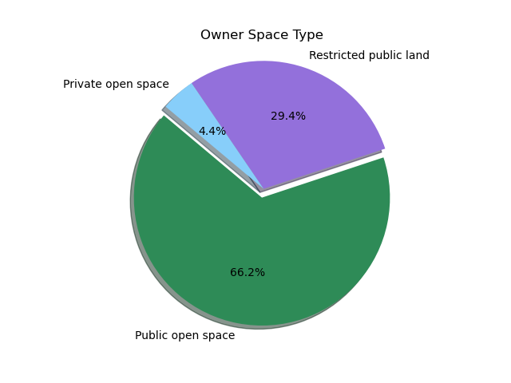
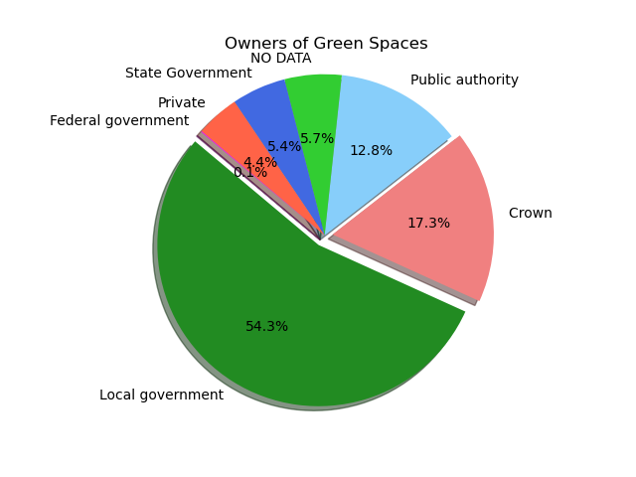
Breakdown of public spaces

Slide 6
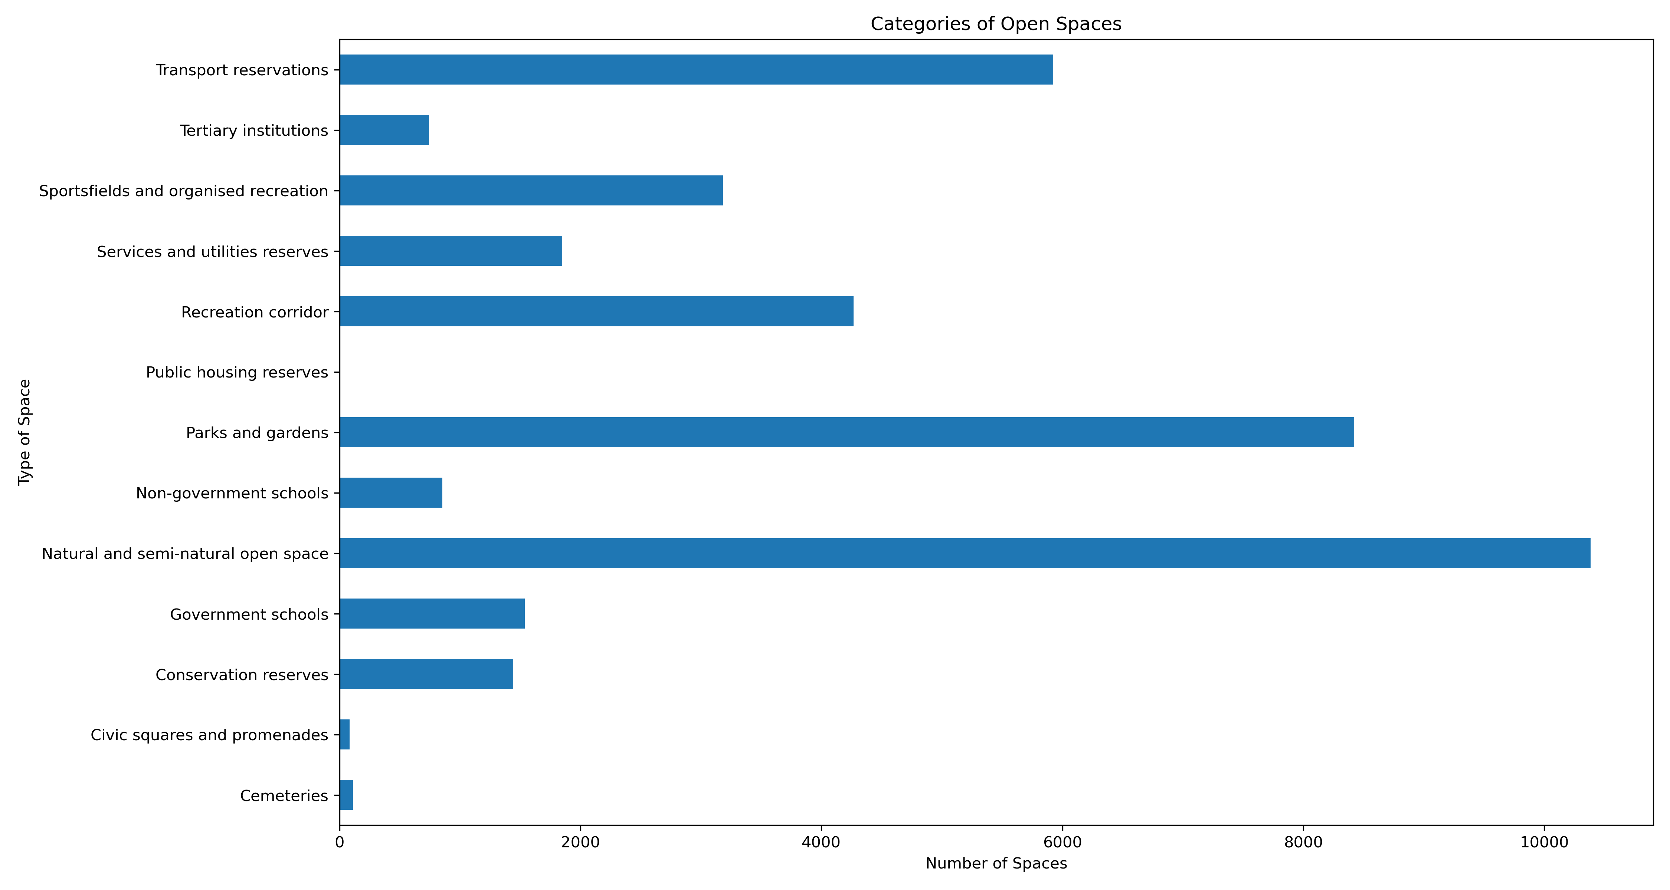

Slide 7
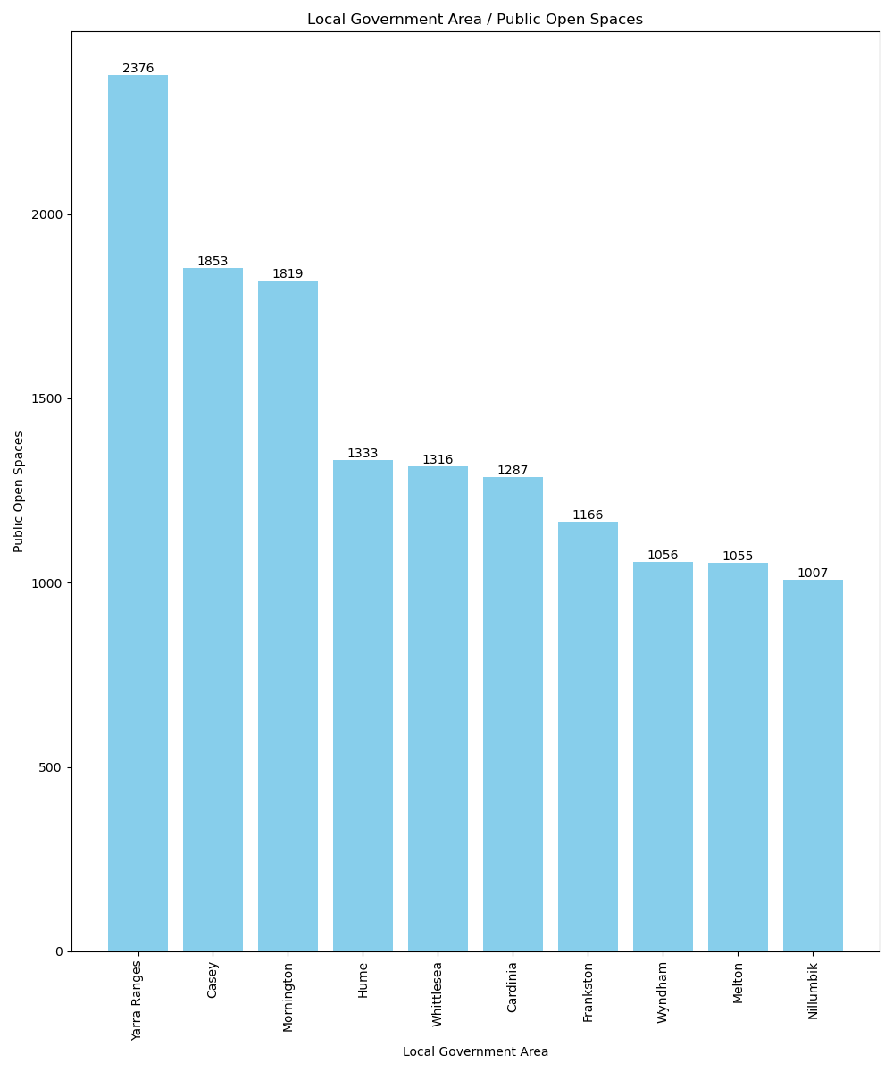
Compare LGA and Public Open Spaces
Top 5:
Yarra Ranges
Casey
Mornington
Hume
Whittlesea
Bottom 5:
Mitchell
Bayside
Glen Eira
Stonnington
Yarra
Notes:
The above bar graph shows there are 32 LGAs and the number of parks per LGA.
Highest number of parks are in Yarra Ranges and Mitchell has the lowest number of parks.
For new homeowners, factors of a good location like neighbourhood, proximity to amenities will increase the value of their property as per Investopedia.

Slide 8
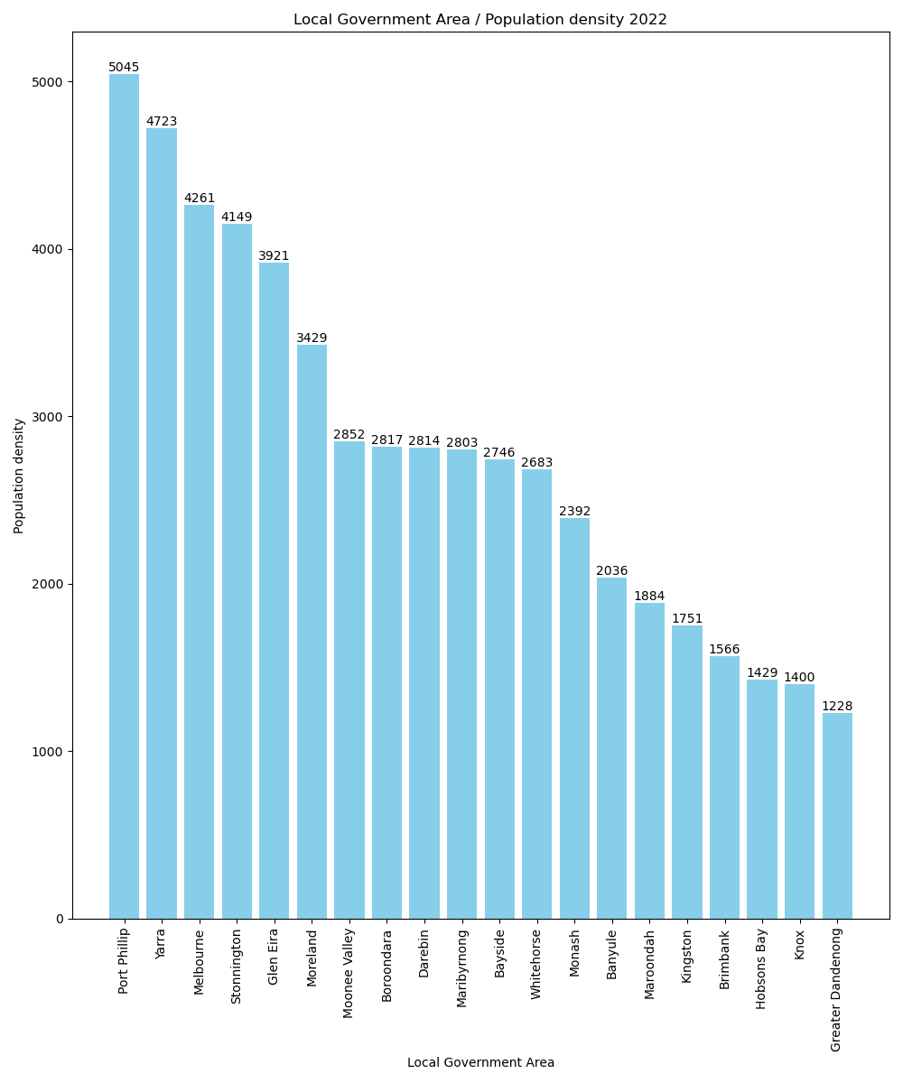
LGAs and their Population Density
Top 5: Port Phillip Yarra Melbourne Stonnington Glen Eira Bottom 5: Mitchell Yarra Ranges Cardinia Nillumbik Mornington
Notes:
Last slide – Sonal – Over to Laura

Slide 9
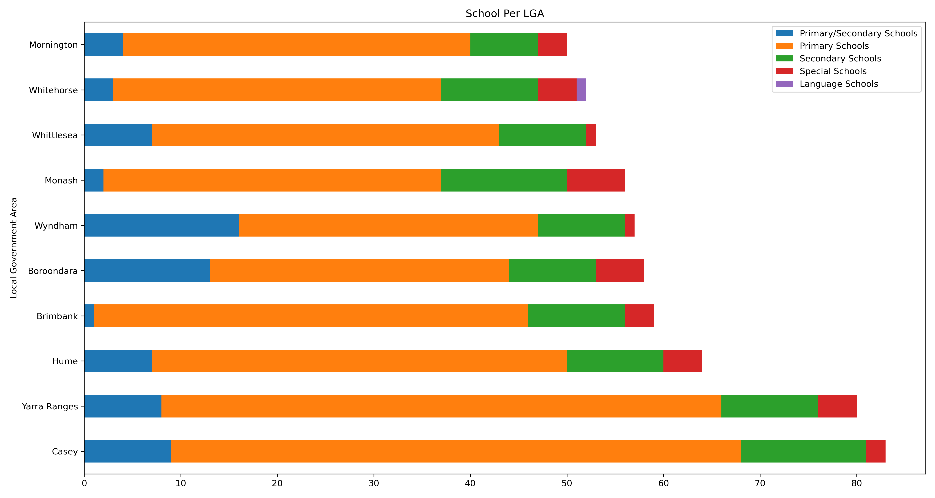
Compare LGA and types of schools
Notes:
The above bar graph shows the different types of schools per LGA.
Families with kids would prefer buying a property which is near schools due to
-improved investment returns
-easy accessibility to schools
-Safer neighbourhood
-Sense of community
Cons
-Noisy
-Traffic
-Parking

Slide 10
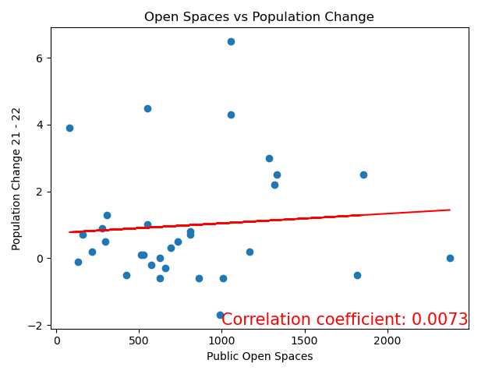
Trend Analysis:

Slide 11
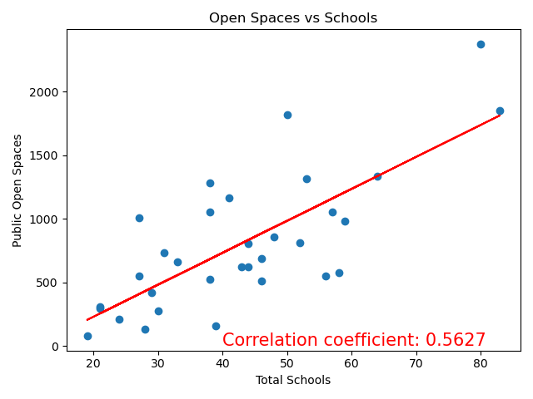
Trend Analysis:

Slide 12
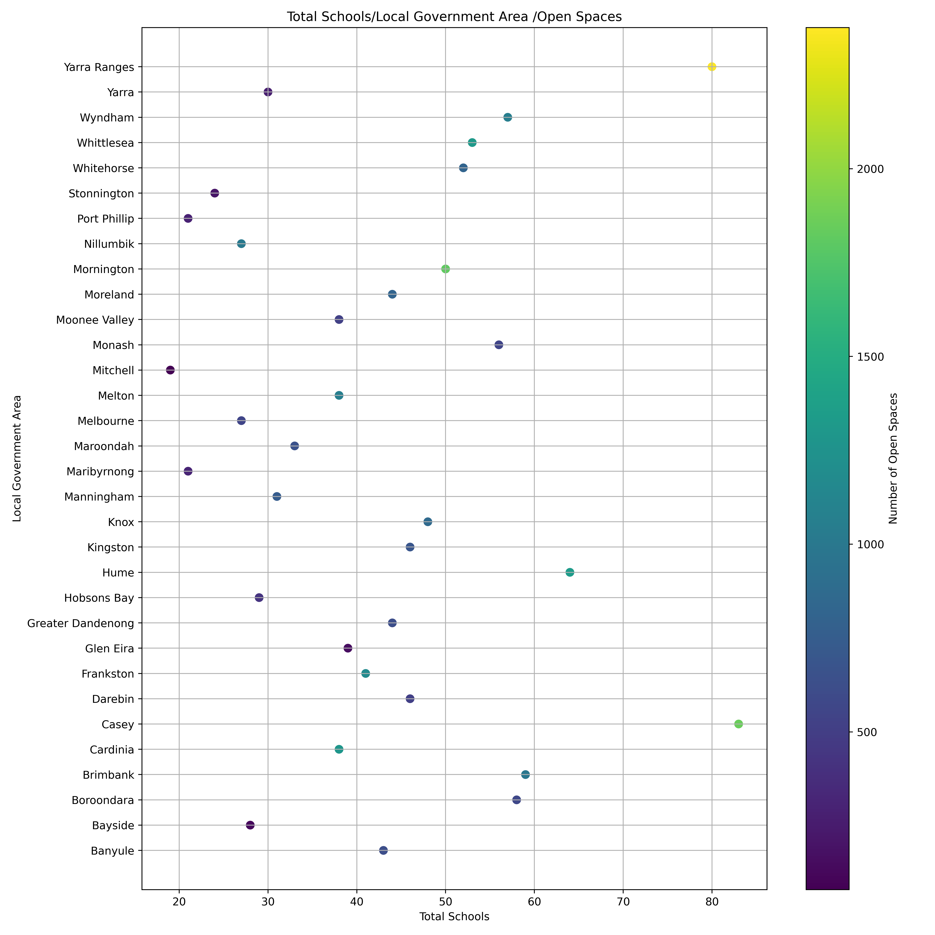
Compare schools to LGA and open spaces
Notes:
It is evident with the above graph that Casey has the greatest number of open spaces and schools.
Last slide – Laura – Over to John

Slide 13
Conclusions and Recommendations
3-Candidate Analysis
City/Suburban | Suburban/Rural | Rural/Remote
Casey | Hume | Yarra Ranges
Open Space Rank: | Open Space Rank: | Open Space Rank:
2nd | 4th | 1st
School Count: | School Count: | School Count:
1st | 3rd | 2nd
Population Change: | Population Change: | Population Change:
+2.5% | +2.5% | 0%
Low population density | Low population density | Low population density
School to Open Space Ratio: | School to Open Space Ratio: | School to Open Space Ratio:
High | High | Very High
Ideal for: | Ideal for: | Ideal for:
Small/moderate size families | Moderate size families/Multi-generation houses | Large families/Multi-generation houses
Notes:
CASEY
1800 Open spaces
83 Schools
+9273 Population
925 persons/km2
Above 60th percentile pop. density
YARRA RANGES
2300 Open Spaces
80 Schools
-33 Population
63 persons/km2
99th percentile pop. density
HUME
1300 Open Spaces
64 Schools
+6067 Population
503 persons/km2
Above 60th percentile pop. density

Slide 14
Lessons Learnt
Data Retrieval | Data Analysis
Inspect the raw data: Headers. Data labels. Zero or n/a values. Diverse Data | Data lengths: Complete information. Correct labels. Visualisations: Visualisation type & format. Identify trends.
Collaboration | Knowledge Sharing
Direction. Strengths & weaknesses. Code. Criticism. | Share your information and data sources. Report difficulties early on.

Slide 15
Q & A

Slide 16
Thank You

