Slide 1
Intelligent Post-Operation Pain Management
Akshay Uppal Richie Gowtham Shubhaw Kumar

Slide 2
Agenda
Project Overview
Model Architecture
Implementation
Future Improvements

Slide 3
Project Overview
“The UN body quantified the number of surgeries taking place every year globally —234 million.”
Even the bravest patient cringes at the mention of a surgical procedure. Surgery inevitably brings discomfort, and oftentimes involves significant post-surgical pain. Currently, patient pain is frequently managed through the use of narcotics that bring a bevy of unwanted side effects. How about an intelligent solution that changes the medical field and help India become narcotics free.

Slide 4
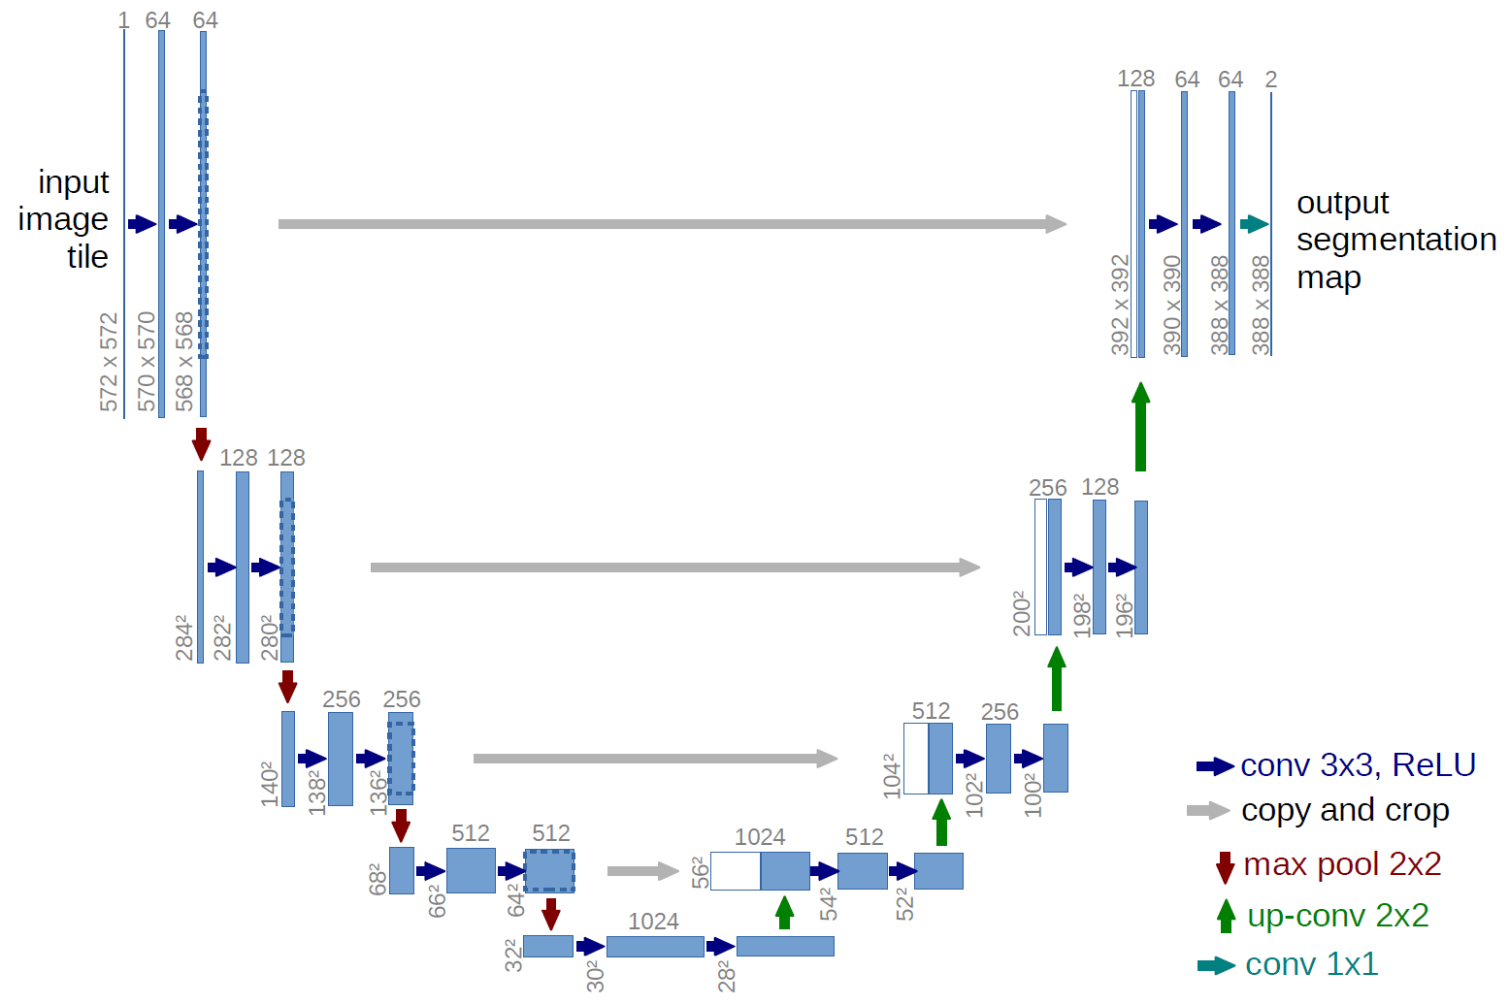
Model Architecture

Slide 5
Implementation
U-Net Deep convolution neural network has been implemented using Keras with Tensorflow as its backend.
Dice Coefficients are used as an evaluation metrics for the CNN.
For now only Neck ultrasound images were used to train the CNN.
5635 Train Images were split into 80-20 for training and validation sets. 5508 Test images were used for prediction.

Slide 6
Future Improvements
We can train the same CNN for different parts of the body and store weights accordingly, hence making the solution accurate for the entire body.
A Proper GUI which is easy and intuitive for the hospital staff to use.
Hyperparameter Tuning to further increase the efficiency of the CNN, the [resent efficiency is about 60% without any sort of parametric optimization.

Slide 7
Q n A

Slide 8
Thank You!

