Slide 1
Predicting House Prices using Machine Learning
INNOVATION

Slide 2
Abstract
The system is intended to forecast the price of a home grounded on its various features such as location, square footage, number of bedrooms and bathrooms, and other related factors. The system uses a variety of machine learning algorithms, including linear regression, decision tree regression, random forest regression, and artificial neural networks to make accurate predictions. Algorithms are trained on a large dataset of house prices and their associated characteristics to learn the relationships between these factors and the corresponding prices. The system is measured against various performance metrics, such as: B. root-mean-square and r-squared score, to measure its accuracy and effectiveness. The results show that the system can predict house prices with great accuracy, making it a valuable tool for real estate agents, home buyers and sellers.

Slide 3

Smart Data Acquisition and augmentation
Implement an automated data gathering system that leverages web scraping, APIs, and real-time data feeds from various sources to ensure the dataset is always up-to-date and diverse.
Utilize data augmentation techniques, including generative adversarial networks (GANs) or data synthesis, to create additional training examples and enrich the dataset.

Slide 4
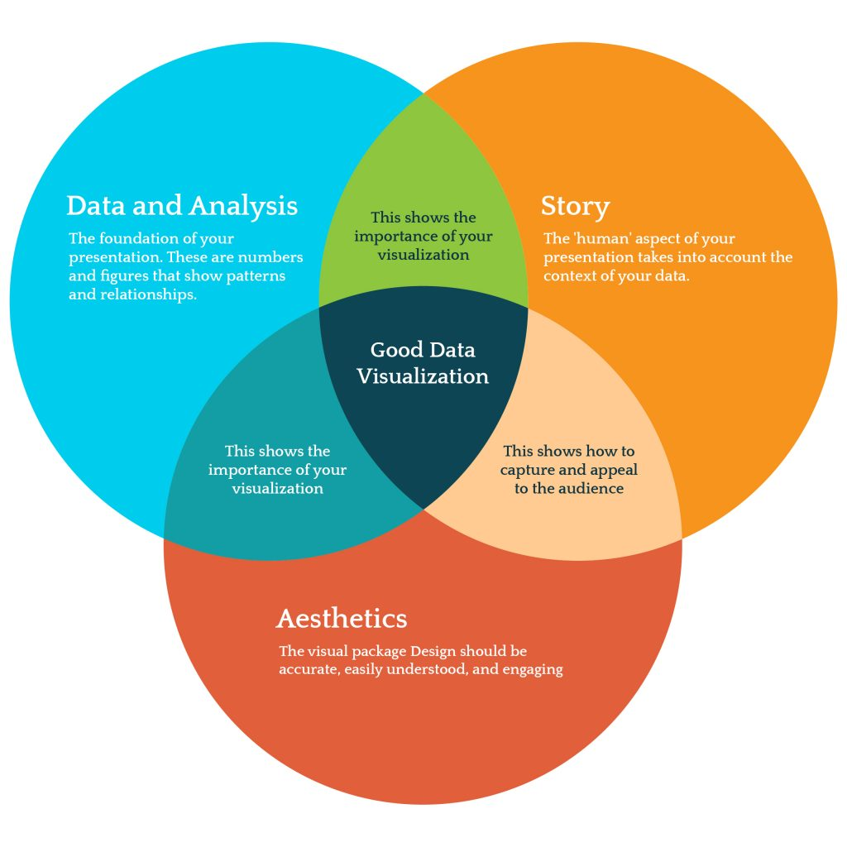
Interactive Data Visualization and Exploration
Develop an interactive and immersive 3D visualization tool that allows users to explore properties virtually, providing a more engaging and realistic experience for potential buyers.
Implement augmented reality (AR) features to overlay house details, prices, and other relevant information when viewing a property through a mobile device.

Slide 5
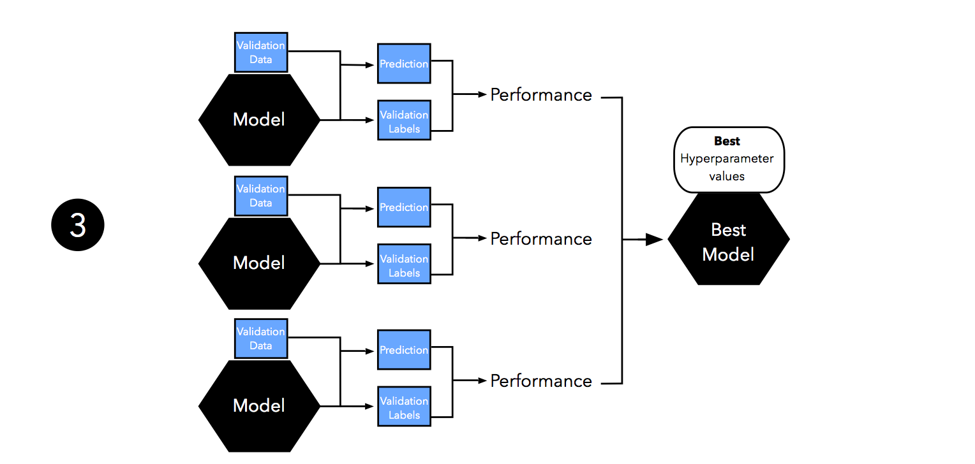
AI-Powered Model Selection and Hyperparameter Optimization
Incorporate an AI-driven assistant that recommends the best model and hyperparameters based on the dataset characteristics, thus automating the model selection and hyperparameter tuning process.
Utilize reinforcement learning or evolutionary algorithms to optimize the model's architecture and hyperparameters dynamically during training.

Slide 6
ADVANCED REGESSION TECHNIQUES
Linear Regression with Regularization:
Ridge Regression (L2 regularization): Adds a penalty term based on the square of the weights to the linear regression objective function, preventing overfitting and improving generalization.
Lasso Regression (L1 regularization): Similar to Ridge but uses the absolute values of the weights, encouraging sparsity and feature selection by setting some weights to zero.
Neural Networks (Deep Learning):
Feedforward Neural Network: A multi-layered network where information flows in one direction, often used for regression tasks.
Deep Neural Networks (DNNs): Neural networks with multiple hidden layers, capable of capturing complex relationships in the data.

Slide 7
Gradient boosting
Gradient Boosting is a powerful ensemble learning technique that helps improve the predictive performance of models in the context of predicting house prices. Here's how Gradient Boosting helps enhance the model:
Combining Weak Learners into a Strong Model
Reducing Overfitting
Improving Predictive Accuracy
Handling Non-linearity and Interactions
Robustness to Outliers and Noisy Data
Hyperparameter Tuning for Improved Performance
Flexibility and Adaptability

Slide 8
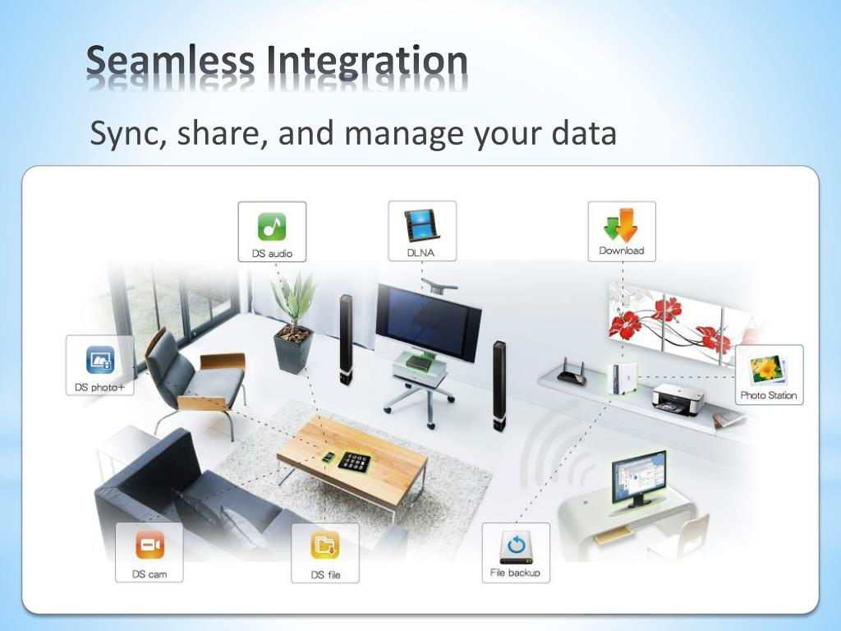
Seamless integration and user centric interface
Develop a user-centric mobile application with an intuitive interface, leveraging advanced UX/UI design principles to make the prediction process simple and engaging for users.
Enable integration with smart home devices, allowing users to explore properties virtually and experience smart home features directly through the application.

Slide 9
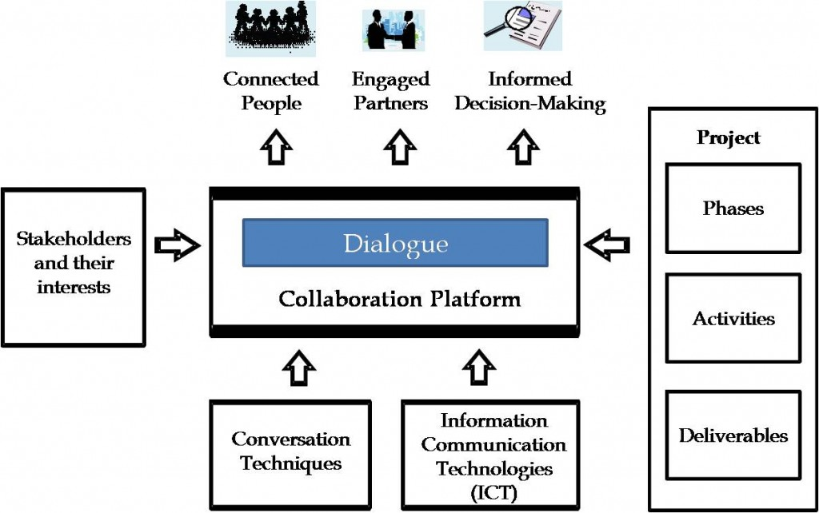
Community-driven and Collaborative Platform
Create a collaborative platform where users can share their property insights, ratings, and experiences, creating a community-driven knowledge base that augments the model's predictions.
Implement a reward system to incentivize users for contributing valuable data and feedback, encouraging active participation and fostering a sense of community.

Slide 10
Conclusion
By incorporating these innovative approaches, the house price prediction system becomes a cutting-edge, interactive, and adaptable solution that not only provides accurate predictions but also enhances user engagement and trust in the platform.
Each of these techniques has its own strengths and weaknesses, and the choice of which one(s) to use depends on the specific characteristics of the dataset, the desired level of interpretability, the need for speed, and the overall model performance.

