Slide 1


Slide 2
IBM PROJECT
Phase 3: Development part 1
Topic : AI based Diabetes prediction System

Slide 3
Group 3
Members
1.Priyadharshini.V
2.Sakthi.M
3.Loshini.R
4.Mariyammal.S
5.Pavithra.R
6.Nithya.R

Slide 4
AI Based Diabetes Prediction System
Introduction
Diabetes is a chronic disease that directly affects the pancreas, and the body is incapable of producing insulin . Insulin is mainly responsible for maintaining the blood glucose level. Many factors, such as excessive body weight, physical inactivity, high blood pressure, and abnormal cholesterol level, can cause a person get affected by diabetes.
researchers have successfully combined multiple machine learning algorithms with diverse data preprocessing approaches for automatic diabetes detection.

Slide 5
Loading and preprocessing dataset
Loading dataset:
The Pima Indian dataset is an open‐source dataset [6] that is publicly available for machine learning classification, which has been used in this work along with a private dataset. It contains 768 patients’ data, and 268 of them have developed diabetes.
Figure shows the ratio of people having diabetes in the Pima Indian dataset. Table demonstrates the eight features of the open‐source Piman Indian dataset.

Slide 6
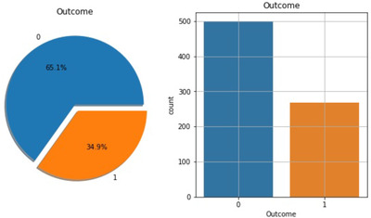
Pima Indian dataset
Table:
Pregnancies | Skin thickness | Diabetes pedigree function
Glucose | Insulin | Age
Blood pressure | BMI

Slide 7
RTML private dataset : A significant contribution of this work is to present a private dataset from rownak Textile Mills Ltd, Dhaka, Bangladesh, referred to as RTML, to the scientific community. Following a brief explanation of the study to the female volunteers, they voluntarily agreed to participate in the study. This dataset comprises six features, that is, pregnancy, glucose, blood pressure, skin thickness, BMI, age, and outcome of diabetes from 203 female individuals aged between 18 and 77. In this work, blood glucose was measured by the Enhance blood sugar meter. The blood pressure and skin thickness of the participants were obtained by OMRON HEM‐7156T and digital LCD body fat caliper machines, respectively. Table illustrates distinct features of the private RTML dataset with their minimum, maximum, and average values.

Slide 8
Table
Features | Minimum | Maximum | Average
Pregnancies | 0 | 8 | 1.61
Glucose (mg/dL) | 52.2 | 274 | 109.39
Blood pressure (mm Hg) | 5.9 | 115 | 71.09
Skin thickness (mm) | 2.9 | 23.3 | 10.78
BMI (kg/m²) | 2.61 | 41.62 | 22.69
Age (years) | 17 | 77 | 27.02

Slide 9
Preprocessing dataset
In the merged dataset, we discovered a few exceptional zero values. For example, skin thickness and Body Mass Index (BMI) cannot be zero. The zero value has been replaced by its corresponding mean value. The training and test dataset has been separated using the holdout validation technique, where 80% is the training data and 20% is the test data.
Mutual Information: Mutual information attempts to measure the interdependence of variables. It produces information gain, and its higher values indicate greater dependency .
Figure shows the mutual information of various features, that is, the importance of each attribute of this dataset. For example, according to this figure, the diabetes pedigree function seems less important according to this mutual information technique.

Slide 10
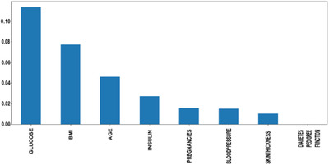
Features important hierarchy

Slide 11
Semi supervised learning: A combined dataset has been used in this work by incorporating the open‐source Pima Indian and private RTML datasets. According to Table, the RTML dataset does not contain the insulin feature, which is predicted using a semi‐supervised approach. Before merging the collected dataset with the Pima Indian dataset, a model was created using the extreme gradient boosting technique (XGB regressor). Various regression and ensemble learning techniques have been successfully used in many works to predict missing value. [ An extensive investigation has been performed while choosing the best‐performed regressor technique to predict the insulin feature of the RTML dataset from the Pima Indian dataset. As the actual value of the insulin was not available in the RTML dataset, the Pima Indian dataset was initially used to select the best regression model. First, the Pima Indian dataset was divided into an 8:2 ratio and three supervised regression models, extreme gradient boosting technique (XGB), support vector regression (SVR), and Gaussian process regression (GPR), have been employed to predict the selected outcome, that is, insulin of the validation samples of the Pima Indian dataset. Next, we computed the root mean square error (RMSE) of various regression frameworks as
RMSE=√∑Ni=1(Predicted I – actual I)^2/N

Slide 12
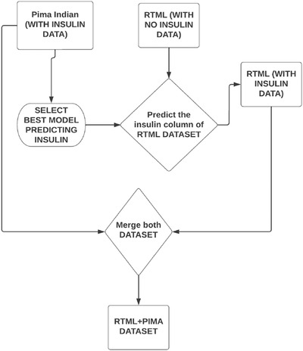
Working steps of predicting Insulin in RTML dataset

Slide 13
Merged dataset: The semi‐supervised approach, we predicted the insulin feature and merged the RTML dataset with the Pima Indian dataset. The merged dataset contained 877 data with all the features, excluding the diabetes pedigree.
Min–Max normalization: In this research, we used the min–max normalization technique. The data has been scaled to the same range using the following equation:
X scaled =X− X min/X max – X min
where X _{max} and X _{min} denote maximum and minimum values in the individual feature column, respectively.

Slide 14
Algorithm 1
Feature Importance Determination.
Input: data: nonzero entries of the original PIMA Indian diabetes dataset
Output: sorted feature: list of features sorted in the order of importance
based on the probability value
Initialization p = ← [] // p-value list for all features
Initialization label ← [] // feature labels list
t = r× f √
1−r2 // t-statistics
p = tdi st(t, f, k) // probability values
where r is the correlation coefficient, n is the sample size, and p is the
associated p-value given t-statistics with degrees of freedom, f, and a
number of tails, which is usually 2.
for i, j in data do check
set k to the index of the response variable
set the significance threshold, T
scale j[k]
if scaled j[k] ≤ T then
add j[k] to p
add i to label

Slide 15
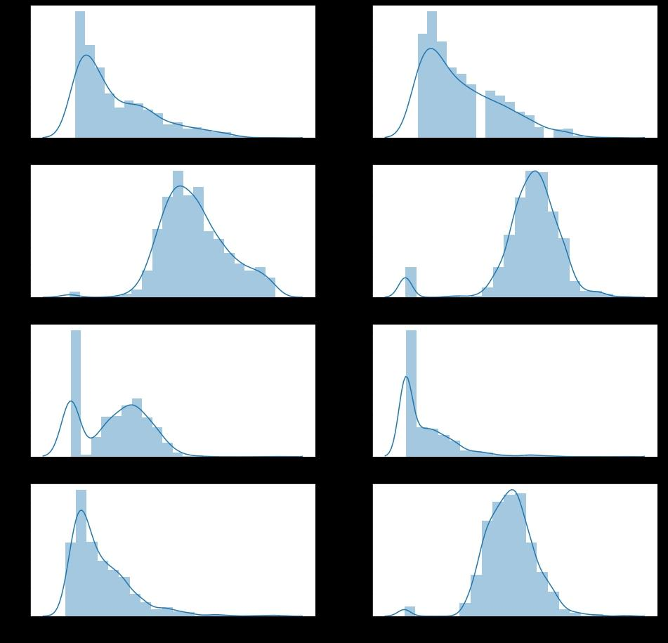

Slide 16
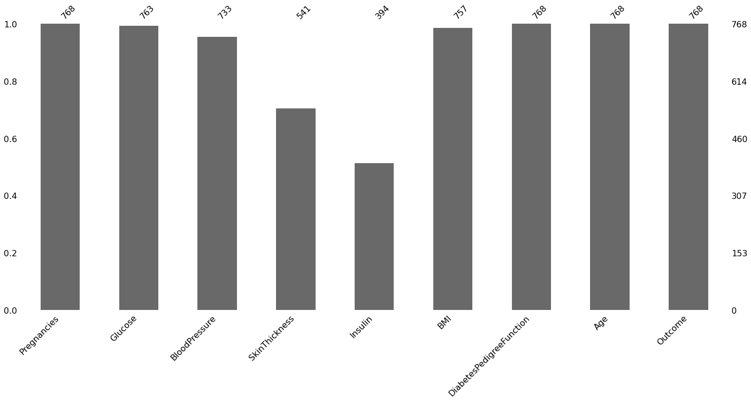

Slide 17
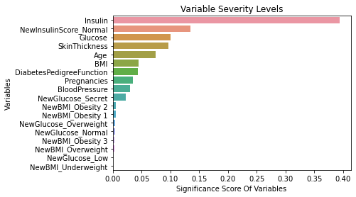

Slide 18


