Slide 1
IndentationError 縮進錯誤
SyntaxError 語法錯誤

Slide 2
a = int(input(": "))
b = int(input(": "))
c = int(input(": "))
list1 = [a, b, c]
print(f"串列 = {list1}")
list2 = []
for x in list1:
if x % 2 == 0:
list2.append(x)
if list2:
print("偶數 = ", end = "")
print(*list2, sep = " , ")
a = int(input(": "))
b = int(input(": "))
c = int(input(": "))
list1 = [a, b, c]
print(f"串列 = {list1}")
list2 = []
for x in list1:
if x % 2 == 0:
list2.append(x)
if list2:
a = str(list2)[1:-1]
print(a)
a = int(input(": "))
b = int(input(": "))
c = int(input(": "))
list1 = [a, b, c]
print(f"串列 = {list1}")
list2 = []
for x in list1:
if x % 2 == 0:
list2.append(x)
print("偶數 = " + " , ".join(map(str, list2)))

Slide 3
import
import random(亂數選取)
# # 產生0到1的隨機浮點數。
random.random()
# 產生特定範圍的int
random.randint(1, 100) #1到100
# 產生特定範圍的float
random.uniform()
# 產生特定範圍的int+步數
random.randrange(1, 100, 2)
# 從指定串列中抽出元素
random.choice(["吃飯", "睡覺", "看小說"])
# 從指定串列中抽出複數元素
a =['吃飯', '睡覺', '看小說']
random.choices(a,k=2)
#weights(指定取出的機率)
a =['吃飯', '睡覺', '看小說']
random.choices(a,weights=[80, 20, 0])
# 從指定字串中取出特定數量的值，並以串列形式回傳(不可重複)
random.sample('abcdef',3)
#打亂元素順序
import random
x=["a","b","c"]
random.shuffle(x)
print(x)

Slide 4
function
#enumerate() 常用在for loop
seasons = ['Spring', 'Summer', 'Fall', 'Winter']
list(enumerate(seasons))
[(0, 'Spring'), (1, 'Summer'), (2, 'Fall'), (3, 'Winter')]
list(enumerate(seasons, start=1))
[(1, 'Spring'), (2, 'Summer'), (3, 'Fall'), (4, 'Winter')]
#sum(iterable[, start])
# iterable--列表、元祖、集合
# start--指定相加的參數，默認為0
a = [1, 2, 3, 4]
a_sum = sum(a)
print(a_sum)

Slide 5
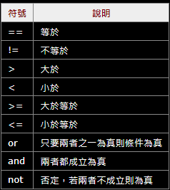

Slide 6
Comments註解
# or " " " 字串" " "
x = 5 查資料型態
print(type(x))
Variable變量
變量名必須以字母或下劃線字符開頭
變量名不能以數字開頭
變量名區分大小寫
文字類型： str(字串)
數字類型： int(整數), float(小數點), complex(複數)
序列類型： list(列表)是[], tuple(元祖)是(), range
映射類型： dict
套裝類型： set,frozenset
布爾類型： bool
二進制類型： bytes, bytearray, memoryview
無 類型： NoneType
x = "Orange "
y = " Banana "
Z = "Cherry"
x, y, z = "Orange", "Banana", "Cherry"
在函數內部創建變量時，該變量是局部變量，並且只能在該函數內部使用
#要在函數中創建全局變量，使用 global
#元祖tuple，無法新增、修改、刪除。防止資料修改

Slide 7
Strings
字串用單引號或雙引號括起來

Slide 8
strings
b = "Hello, World!"
#獲取位置 2 到位置 5 的字符（不包括5）
print(b[2:5])
llo
#刪除開頭和結尾空格
print(b.strip())
#查位置是甚麼字
print(b[1])
e
#替換字
print(b.replace('H', 'A'))
Aello, World
#獲取從開始到位置 5 的字符（不包括5)
print(b[:5])
Hello
#分隔字串
str = "Line1-abcdef Line2-abc Line4-abcd"
print(str.split(' ',2)) 以空格(' ')為分隔符號，分隔2次
['Line1-abcdef', 'Line2-abc', 'Line4-abcd']
#從位置 2 獲取字符，一直到最後
print(b[2:])
llo, World
#從倒數第5到倒數第2(不包括2)
print(b[-5:-2])
ore
#至中
a = "banana"
c = a.center(20, "@")
print(c)
@@@@@@@banana@@@@@@@
#判斷是不是大寫或小寫
Print(b.isupper())
print(b.islower())
#字大寫
print(b.upper())
print(a.casefold()) 更積極
#換行
print("你媽\n死了")
#字符串的長度
print(len(b))
13
#字小寫
print(b.lower())

Slide 9

#查單字在字串出現次數
txt = "I love apples, apple are my favorite fruit"
print(txt.count("apple"))
2
#將數字插入字符串#format用法
print("i am {} years old".format(87))
I am 87 years old
#雙引號中用雙引號
print("sadasfasd\"asdasd\"")
#查字是否在字串中
a = '''有一天牙籤A跟牙籤B在
馬路上相遇，突然一隻刺蝟快速
的經過，牙籤A就對牙籤B說 :乾
，我的公車過了..'''
print('乾' in a)
有乾 true 沒乾 False
#雙引號中用雙引號
#找第一個字出現的位置
print(txt.index(“o"))
3
import random
print(random.randrange(1, 3))
1~3隨機出現
encode()?

Slide 10
#字串前加r就不會轉譯
print(r"c:\\sdsad")
#end = ""
print("a", end = "和")
print("b")

Slide 11
bool
布林值表示以下兩個值之一： True或False。

Slide 12
#大部分boll()都是True
#自己定義
def 我有三隻手() : #定義 我有三隻手時
return False #回傳False
print(我有三隻手())
False
#小部分boll()是False
print(bool(False))
print(bool(None))
print(bool(0))
print(bool(""))
print(bool(()))
print(bool([]))
print(bool({}))
print(bool())
print(bool( ))
#查是否屬於某種數據類型
a = 200
print(isinstance(a, str))
False
#根據條件判斷
a = 100
b = 99
if b > a:
print("b大於a")
else:
print("a大於b")
a大於b
#查該項目是否在
a = ("apple", "mango", "papaya", "pineapple", "cherry")
print("apple" in a)

Slide 13
Operators
用於對變量和值執行操作

Slide 14
算數
Arithmetic Operators
Assignment Operators
x = 2
y = 4
print(y + x)
print(y - x)
print(y * x)
print(y / x)
print(y % x) #餘數
print(y ** x) #次方
print(y // x) #除完後的整數
x = 5
x += 3 x = x + 3
x -= 3 x = x - 3
x *= 3 x = x * 3
x /= 3 x = x / 3
x %= 3 x = x % 3
x **= 3 x = x ** 3
x //= 3 x = x // 3
x &= 3 x = x & 3
x |= 3 x = x | 3
x ^= 3 x = x ^ 3
x >>= 3 x = x >> 3
x <<= 3 x = x << 3
邏輯
Logical Operators
x = 5
print(not(x > 3 and x < 10))
False
Is、is not和 == 、!=差別?

Slide 15
?
Python 位運算符
位運算符用於比較（二進制）數字：
Operator | Name | Description
& | AND | Sets each bit to 1 if both bits are 1
| | OR | Sets each bit to 1 if one of two bits is 1
^ | XOR | Sets each bit to 1 if only one of two bits is 1
~ | NOT | Inverts all the bits
<< | Zero fill left shift | Shift left by pushing zeros in from the right and let the leftmost bits fall off
>> | Signed right shift | Shift right by pushing copies of the leftmost bit in from the left, and let the rightmost bits fall off

Slide 16
lists
將多個項目存儲在單個變量中
存儲數據集合的 4 種內置數據類型之一
列表項是有序的、可更改的，並且允許重複值

Slide 17
scores = [10,56,92,32,40,87]
thislist = ["apple", "banana", "cherry"]
#改值
scores[0] = 50
print(scores)
[50, 56, 92, 32, 40, 87]
#插入列表到尾端(也可添加tuple, set, dict……)
thislist.extend(scores)
print(thislist)
['apple', 'banana', 'cherry', 10, 56, 92, 32, 40, 87]
#更改值
scores[0:1] = [87, 88]
print(scores)
[87, 88, 56, 92, 32, 40, 87]
#刪除
scores.remove(87)
print(scores)
[10, 56, 92, 32, 40]
scores[:4] = [87, 88]
print(scores)
[87, 88, 40, 87]
scores.pop(0) #沒指定位置則刪除最後一位
print(scores)
[10, 56, 92, 32, 40]
#插入值
scores.insert(0, 78)
print(scores)
[78, 10, 56, 92, 32, 40, 87]
del scores[5] #沒指定則刪整個list
print(scores)
#清空值但list還在
scores.clear()
print(scores)
[]
#找值的位置
print(scores.index(87))
5
#數值有幾個
print(scores.count(87))
1
#插入值到尾端
scores.append(78)
print(scores)
[10, 56, 92, 32, 40, 87, 78]

Slide 18
scores = [10,56,92,32,40,87]
thislist = ["banana", "Orange", "Kiwi", "cherry"]
#排序(升)
#大寫會在最前面
scores.sort()
print(scores)
[10, 32, 40, 56, 87, 92]
# 不區分大小寫的升序
thislist.sort(key = str.lower)
print(thislist)
#排序(降)
scores.sort(reverse = True)
print(scores)
def thisthing(a):
return a["year"]
cars = [
{'car': 'Ford', 'year': 2005},
{'car': 'Mitsubishi', 'year': 2000},
{'car': 'BMW', 'year': 2019},
{'car': 'VW', 'year': 2011}
]
cars.sort(key=thisthing)
print(cars)
#顛倒排序
scores.reverse()
print(scores)
#自定義排序
def myfunc(n):
return abs(n - 50)
thislist = [100, 50, 65, 82, 23]
thislist.sort(key = myfunc)
print(thislist)

Slide 19
#將 list1 複製到 list2
list1 = ["apple", "banana", "cherry"]
list2 = list1.copy()
print(list2)
#list(str)轉str
A = ["a", "b", "c"]
StrA = "".join(A)
print(StrA)
list1 = ["apple", "banana", "cherry"]
list2 = list(list1)
print(list2)
#list(int)轉str
a = [1,2,3]
print(" , ".join(map(str, a)))
#將list1和list2連接，生成list3
list1 = ["apple", "banana", "cherry"]
list2 = [87, 69, 78]
list3 = list1 + list2
print(list3)
#將list2的值逐個加到list1
list1 = ["apple", "banana", "cherry"]
list2 = [87, 69, 78]
for x in list2:
list1.append(x)
print(list1)
#在list14的尾端加入list2
list1.extend(list2)
print(list1)

Slide 20
List Comprehension(列表理解)
#直接print列表中所有項目
fruits = ["apple", "banana", "cherry", "kiwi", "mango"]
newlist = []
for x in range(10):
newlist.append(x)
print(newlist)
thislist = ["apple", "banana", "cherry"]
[print(x) for x in thislist]
newlist = []
for x in fruits:
if "a" in x:
newlist.append(x)
print(newlist)
newlist = [x for x in range(10)]
print(newlist)
newlist = []
for x in range(10):
if x < 5:
newlist.append(x)
print(newlist)
newlist = []
for x in fruits:
if x != "apple":
newlist.append(x)
print(newlist)
newlist = [x for x in fruits if "a" in x]
print(newlist)
newlist = [x for x in range(10) if x < 5 ]
print(newlist)
newlist = [x for x in fruits if x != "apple"]
print(newlist)

Slide 21
#newlist = [expression for item in iterable if condition == True]
fruits = ["apple", "banana", "cherry", "kiwi", "mango"]
#變大寫
newlist = [x.upper() for x in fruits]
print(newlist)
#讓列表中所有值設為hello
newlist = ["hello" for x in fruits]
print(newlist)
#if後一定要有else?
newlist = []
for x in fruits:
if x != 'banana':
newlist.append(x)
else:
newlist.append('orange')
print(newlist)
newlist = [x if x != "banana" else "orange"
for x in fruits]
print(newlist)

Slide 22
tuple
在單個變量中存儲多個項目
有序的、不可更改的，並且允許重複值
#元祖tuple，無法新增、修改、刪除。防止資料修改
一個元祖可以包含不同的數據類型

Slide 23
fruits = ("apple", "mango", "papaya", "pineapple", "cherry")
#如果只有一項，在後加,才能算tuple
tuple1 = ("apple",)
元組開苞
更改元組值
# 用*將剩餘的都分配掉
#將元組轉換為列表、更改列表並將列表轉換回元組
(green, *tropic, red) = fruits
print(green)
print(tropic)
print(red)
apple
['mango', 'papaya', 'pineapple']
cherry
y = list(fruits)
y[0] = "orange"
Fruits = tuple(y)
print(fruits)
#創一個新的tuple並加進去
x = ("apple", "banana", "cherry")
y = ("orange",)
x += y
print(x)

Slide 24
set
將多個項目存儲在單個變量中
無序的、不可更改的，並且不允許重複值
重複的值將被忽略
一個集合可以包含不同的數據類型

Slide 25
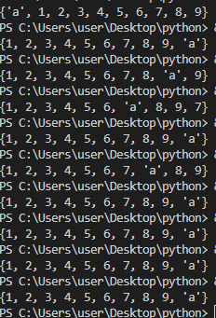
fruits = {"apple", "mango", "papaya", "pineapple", "cherry“}
nm = {87, 78, 69}
#新增值
fruits.add("a")
print(fruits)
#清空集合
nm.clear()
print(nm)
#改任何一個變數的值另一個也會更改
fruits1 = fruits
#刪除集合
del nm
#加入另一個集的值
#也可以是任何iterable object
fruits.update(nm)
print(fruits)
#建新的集並包含所有集
set1 = {1, 2, 3}
set2 = {4, 5, 6}
set3 = {7, 8, 9}
set4 = {"a"}
setall = set1.union(set4, set2, set3)
print(setall)
#刪除
fruits.remove("apple")
print(fruits)
#當項目不存在時不會error
fruits.discard("apple")
print(fruits)
#刪除最後一項，因set是無序的，所以是隨機刪除一項
fruits.pop()
print(fruits)
#將set1插入set2
set2.update(set1)
print(set2)

Slide 26
#只保留重複項目
x = {"apple", "banana", "cherry"}
y = {"google", "microsoft", "apple"}
x.intersection_update(y)
print(x)
#只保留不重複項目
x = {"apple", "banana", "cherry"}
y = {"google", "microsoft", "apple"}
x.symmetric_difference_update(y)
print(x)

Slide 27
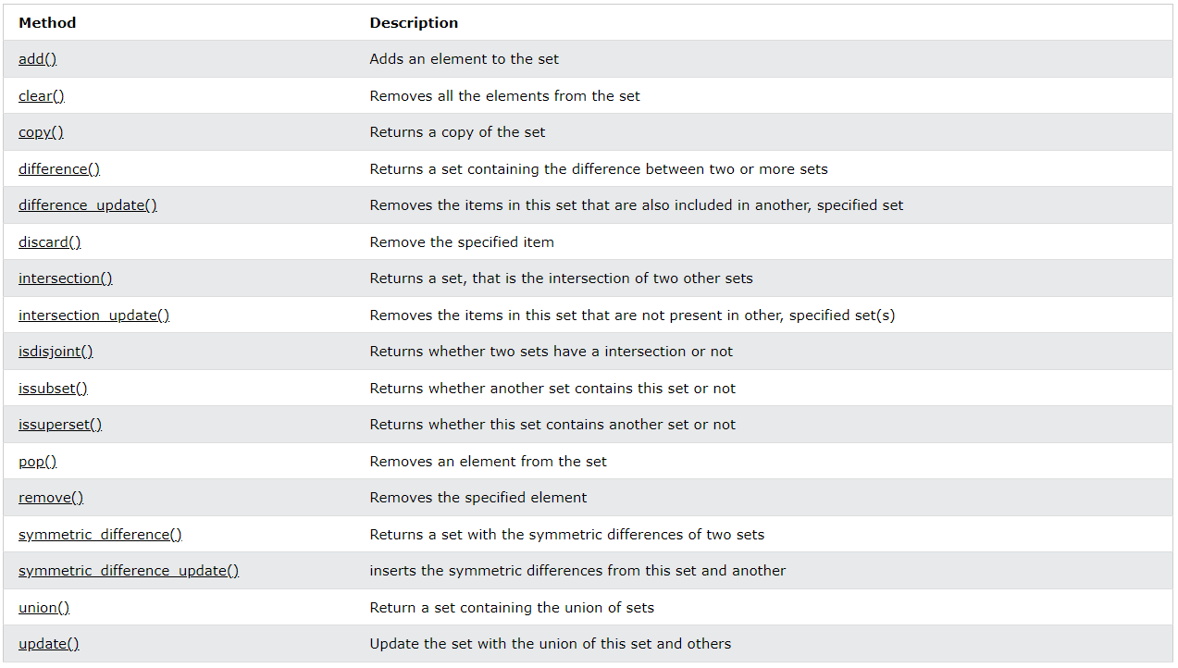

Slide 28
dictionaries
有序、可更改、不允許重複的集合

Slide 29
#刪除
thisdict.pop("model")
dict
#字典 dictionary
#key鑑(單字)
#value值(注釋)
# key value
a={"蘋果":"apple", "香蕉":"banana", "貓":"cat", "狗":"dog"}
print(a["香蕉"])
#刪除最後插入
thisdict.popitem()
thisdict = {
"brand": "Ford",
"model": "Mustang",
"year": 1964,
"year": 2020
}
#獲取鍵列表
print(thisdict.keys())
dict_keys(['brand', 'model', 'year'])
#獲取values
print(thisdict.values())
#重複值將覆蓋現有值
#獲取每個項目
print(thisdict.items())
print(thisdict)
{'brand': 'Ford', 'model': 'Mustang', 'year': 2020}
#添加新項目與更改
thisdict["color"] = "white"
#獲取值
print(thisdict.get("year"))
#更新
thisdict.update({"year": 2021})

Slide 30
thisdict = {
"brand": "Ford",
"model": "Mustang",
"year": 1964,
"year": 2020
}
for x in thisdict:
print(x)
brand
model
year
for x in thisdict.keys():
print(x)
brand
model
year
for x in thisdict:
print(thisdict[x])
Ford
Mustang
2020
for x, y in thisdict.items():
print(x, y)
brand Ford
model Mustang
year 2020
for x in thisdict.values():
print(x)
Ford
Mustang
2020

Slide 31
#字典中包含字典
myfamily = {
"dad" : {
"name" : "andy",
"age" : 53
},
"mom" : {
"name" : "sharon",
"age" : 52
},
"me" : {
"name" : "kevin",
"age" : 24
}
}
#字典加入字典中
dad = {
"name" : "andy",
"age" : 53
},
mom = {
"name" : "sharon",
"age" : 52
},
me = {
"name" : "kevin",
"age" : 24
}
myfamily = {
"張曉熙" : dad,
"蔡雪貞" : mom,
"張智凱" : me
}
thisdict = {
"brand": "Ford",
"model": "Mustang",
"year": 1964,
"year": 2020
}
#改任何一個變數另一個也會更改
thisdict1 = thisdict
#複製
thisdict1 = thisdict.copy()
thisdict1 = dict(thisdict)

Slide 32
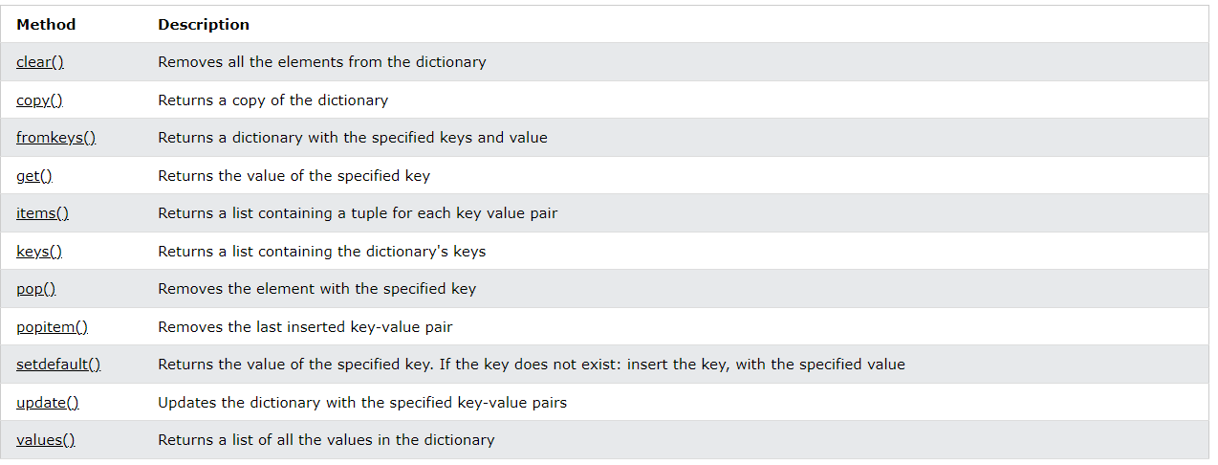

Slide 33
在python 用import或者from...import來導入相應的模塊。
將整個模塊(somemodule)導入，格式為：import somemodule
從某個模塊中導入某個函數,格式為：from somemodule import somefunction
從某個模塊中導入多個函數,格式為：from somemodule import firstfunc, secondfunc, thirdfunc
將某個模塊中的全部函數導入，格式為：from somemodule import *

Slide 34
Conditions and If statements
等於：a == b
不等於：a != b
小於：a < b
小於或等於：a <= b
大於：a > b
大於或等於：a >= b
elif:
如果前面條件不成立，就運行這句
包含前面沒有的條件
else:
包含前面沒有的條件
and、or

Slide 35
a = 33
b = 33
x = 100
y = 1
#Short Hand If
if x > y: print("A")
#Short Hand If ... Else
print("A") if x < y else print("B")
if b > a:
print("1")
elif a == b:
print("2")
2
print("A") if a > b else print("=") if a < b else print("B")
=
if b > a:
print(1)
elif a < b:
print(2)
else:
print(3)
3
if a > b:
print("A")
else:
print("=")
if a < b:
print("B")
else:
print("==")
=
==
# if statements 不能為空
if a == b:
pass

Slide 36
for x in range(4):
a = int(input(": "))
if a%2 ==0:
print("偶數")
else:
print("基數")
for x in range(4):
a = int(input(": "))
print("偶數") if a%2 ==0 else print("基數")
for x in range(4):
a = int(input(": "))
if a > 0:
print("+")
elif a < 0:
print("-")
else:
print("0")
for x in range(4):
a = int(input(": "))
print("+") if a > 0 else print("-") if a < 0 else print("=")

Slide 37
For Loops
每個項目執行一次
不需要預先設置索引變量

Slide 38
fruits = ["apple", "banana", "cherry"]
for x in fruits:
print(x)
apple
banana
cherry
thislist = ["apple", "banana", "cherry"]
for x in range(len(thislist)):
print(thislist[2])
Cherry
Cherry
cherry
for x in "banana":
print(x)
b a
n
a
n
a

Slide 39
a = [1, 2, 3, 4, 5]
遇到 continue 就停住，不執行其後的程式碼。
跳回到迴圈的開頭，再繼續執行程式碼。
#休息聲明 break
for x in a:
print(x)
if x == 3:
break
1
2
3
#休息聲明continue
for x in a:
if x == 3:
continue
print(x)
1
2
4
5
#range()默認從 0 開始，遞增 1
#range(開始, 結束(不包含), )
for x in range(5):
print(x)
0
1
2
3
4
for x in range(0, 5):
print(x)
0
1
2
3
4
for x in range(0, 5, 2):
print(x)
0
2
4
for x in a:
if x == 3:
break
print(x)
1
2
#continue
a = [1, 2, 3, 4, 5]
for x in a:
print(x)
if x == 3:
continue
1
2
3
4
5

Slide 40
#else: for結束後要執行的code
for x in range(5):
print(x)
else:
print("---終止線---")
0
1
2
3
4
---終止線---
#Nested Loops "內循環"將在"外循環"的每次迭代中執行一次
adj = ["red", "big", "tasty"]
food = ["apple", "banana", "cherry"]
for x in adj:
for y in food:
print(x, y)
red apple
red banana
red cherry
big apple
big banana
big cherry
tasty apple
tasty banana
tasty cherry
for x in range(8, 10):
for y in range(1, 5):
print(str(x) + "*" + str(y) + "=" + str(x * y))
8*1=8
8*2=16
8*3=24
8*4=32
9*1=9
9*2=18
9*3=27
9*4=36
#else會被break打斷
for x in range(5):
if x == 3:
break
print(x)
else:
print("---終止線---")
0
1
2
#pass可用在沒有值得for loop
for x in range(9):
pass

Slide 41
#1加到100
sum = 0
for x in range(101):
sum += x
print(sum)
#1到1002的偶數和
sum = 0
for x in range(2, 101, 2):
sum += x
print(sum)

Slide 42
While Loops

Slide 43
i = 1
while i < 6:
print(i)
i +=1
1
2
3
4
5
i = 1
while i < 6:
i += 1
print(i)
2
3
4
5
6
i = 1
while i < 6:
i += 1
if i == 5:
continue
print(i)
2
4
5
6
i = 1
while i < 6:
print(i)
i += 1
else:
print("超過了")
1
2
3
4
5
超過了
#從上到下+1完
後才print(i)
#當while不再為True
時運行else
i = 1
while i < 6:
print(i)
if (i == 3):
break
i += 1
1
2
3
i = 1
while i < 6:
print(i)
if i == 3:
continue
i += 1
1
2
3
3
3
3
3
thislist = ["apple", "banana", "cherry"]
i = 0
while i < len(thislist):
print(thislist[i])
i = i + 1
#當i=3 時停止，然後跳
回 while i < 6然後不
斷print(i)，因為到不
了i+=1，所以一直重複3

Slide 44
str1 = 'str1:'
s = input("使用者輸入:")
while s!='a':
str1 = str1 + s
s = input("1")
print(str1)

Slide 45
def
void Foo(int i, float f)
{
}
void Bar()
{
int num = 1;
Foo(anInt, 2.0);
}
Parameter
參數Arguments 通常縮寫為args
Argument
Keyword Arguments通常縮寫為 kwargs

Slide 46
# **kwargs
def my_function(**kid):
print("His last name is " + kid["lname"])
my_function(fname = "Tobias", lname = "Refsnes")
def 某個函數():
print("這是定義")
某個函數()
這是定義
def 某個函數(參數):
print(“這是定義 ” + 參數)
某個函數("one")
某個函數("two")
這是定義 one
這是定義 two
#默認參數值
def my_function(country = "Norway"):
print("I am from " + country)
my_function("Sweden")
my_function()
#function不能為空值
def myfunction():
pass
#參數未知的話，在參數前放*(*args)
def my_function(*kids):
print("The youngest child is " + kids[2])
my_function("Emil", "Tobias", "Linus")
#return
def my_function(x):
return 5 * x
print(my_function(3))
# kwargs
def my_function(child3, child2, child1):
print("The youngest child is " + child3)
my_function(child1 = "Emil", child2 = "Tobias", child3 = "Linus")

Slide 47
#Recursion
def tri_recursion(k):
if(k > 0):
result = k + tri_recursion(k - 1)
print(result)
else:
result = 0
return result
tri_recursion(6)

Slide 48
lambda function
可以接受任意數量的參數，但只能有一個表達式

Slide 49
x = lambda a, b, c : a + b + c
print(x(5, 6, 2))
13
def myfunc(n):
return lambda a : a * n
mydoubler = myfunc(2)
print(mydoubler(11))
22
def myfunc(n):
return lambda a : a * n
mydoubler = myfunc(2)
mytripler = myfunc(3)
print(mydoubler(11))
print(mytripler(11))

Slide 50
Classes and Objects
所有類都有一個名為 __init__() 的函數
#創一個class
class nm1:
a = 1
print(nm1)
#創建一個名為 p1 的objects，並print a 的值
class nm1:
a = 1
p1 = nm1()
print(p1.a)

Slide 51
__init__() Function
__str__() Function
__init__()每次使用該類創建新對象時都會自動調用該函數

Slide 52
# 創建一個名為 Person 的class，使用 __init__() function為 name 和 age 賦值：
class person:
def __init__(me, name, age):
me.name = name
me.age = age
def __str__(me):
return "名子: %s \n年齡: %d" %(me.name, me.age)
a1 = person("張智凱", 24)
print(a1.name)
print(a1)
張智凱
名子: 張智凱
年齡: 24
class person:
def __init__(me, name, age):
me.name = name
me.age = age
a1 = person("張智凱", 24)
print(a1.name)
print(a1)
張智凱
<__main__.person object at 0x000001B8E86A7C40>

Slide 53
class person:
def __init__(me, name, age):
me.name = name
me.age = age
def myself(isme):
print("我叫%s\n今年%d歲" %(isme.name, isme.age))
a1 = person("張智凱", 24)
a1.myself()
我叫張智凱
今年24歲
# 修改
a1.age = 87
# 刪除
del a1.age
del a1
# 不能為空值
class Person:
pass

Slide 54
Inheritance
Parent class是被繼承的類
任何類都可以是父類，因此語法與創建任何其他類相同
Child class是繼承自另一個類的類
子類的函數會覆蓋父類

Slide 55
#Create a Parent Class
class person:
def __init__(myname, fname, lname):
myname.firstname = fname
myname.lastname = lname
def printname(name):
print("我的名子是%s%s" %(name.firstname, name.lastname))
x = person("張", "智凱")
x.printname()
# Create a Child Class
class person:
def __init__(myname, fname, lname):
myname.firstname = fname
myname.lastname = lname
def printname(name):
print("我的名子是%s%s" %(name.firstname, name.lastname))
class student(person):
pass
x = student("0", "07")
x.printname()
# 讓子類繼承父類的所有方法和屬性
def __init__(myname, fname, lname):
person.__init__(myname, fname, lname)
def __init__(myname, fname, lname):
super().__init__(fname, lname)

Slide 56
# 添加屬性
class person:
def __init__(myname, fname, lname):
myname.firstname = fname
myname.lastname = lname
def printname(name):
print("我的名子是%s%s" %(name.firstname, name.lastname))
class student(person):
def __init__(myname, fname, lname, year):
person.__init__(myname, fname, lname)
myname.nm = year
x = student("0", "07", 87)
print(x.nm)

Slide 57
Iterator
Iteration
走訪/迭代/遍歷一個 object 裡面被要求的所有元素之「過程」或「機制」。是一個概念性的詞
iterate迭代
Iterable
可執行 Iteration 的 objects 都稱為 Iterable
可以被 for loop 遍歷的 objects
只要具有__iter__ or __getitem__ 的 objects 就是 Iterable
Iterator
只要具有__iter__和__next__的 objects 就是 Iterable
Iterator是Iterable的subset

Slide 58
mytuple = ("apple", "banana", "cherry")
mytp = iter(mytuple)
print(next(mytp))
print(next(mytp))
print(next(mytp))
apple
banana
cherry
問
class nm:
def __init__(self) -> None:
pass
def __iter__(self):
self.a = 1
return self
def __next__(self):
y = self.a
self.a += 1
return y
myclass = nm()
myiter = iter(myclass)
print(next(myiter))
print(next(myiter))
print(next(myiter))
print(next(myiter))
print(next(myiter))
class nm:
def __init__(self):
pass
def __iter__(self):
self.a = 0
return self
def __next__(self):
if self.a < 10:
self.a += 1
return self.a
else:
raise StopIteration
my_class = nm()
my_iter = iter(my_class)
for x in my_iter:
print(x)

Slide 61
數據分析
NumPy

